Slide 1




CI to support ecological forecasting challenges
Input from
Carl Boettiger
UC-Berkeley

Slide 2
Workshop overview
Objectives:
Introduce NEON and the Forecasting Challenge
Provide tools and resources to contribute to the Challenge
Introduce the Challenge cyberinfrastructure
Explore the existing forecast catalogue and scores

Slide 3
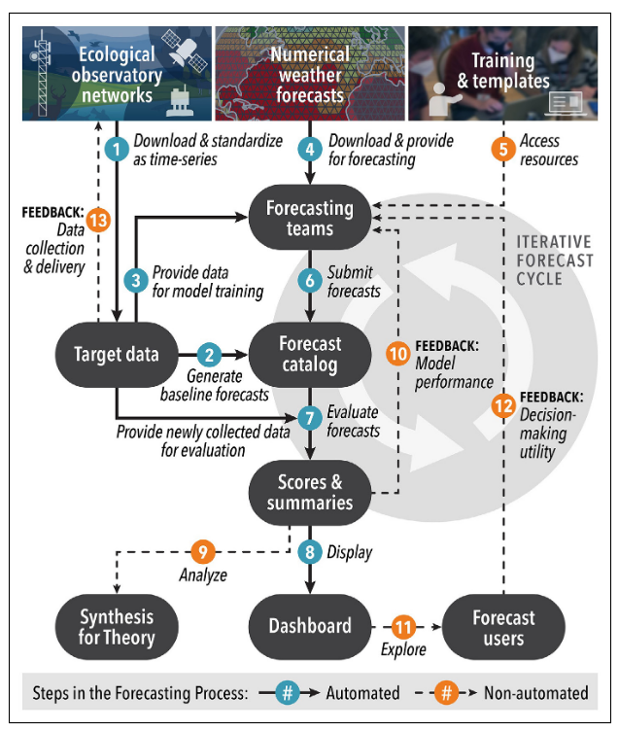
https://doi.org/10.1002/fee.2616

Slide 4
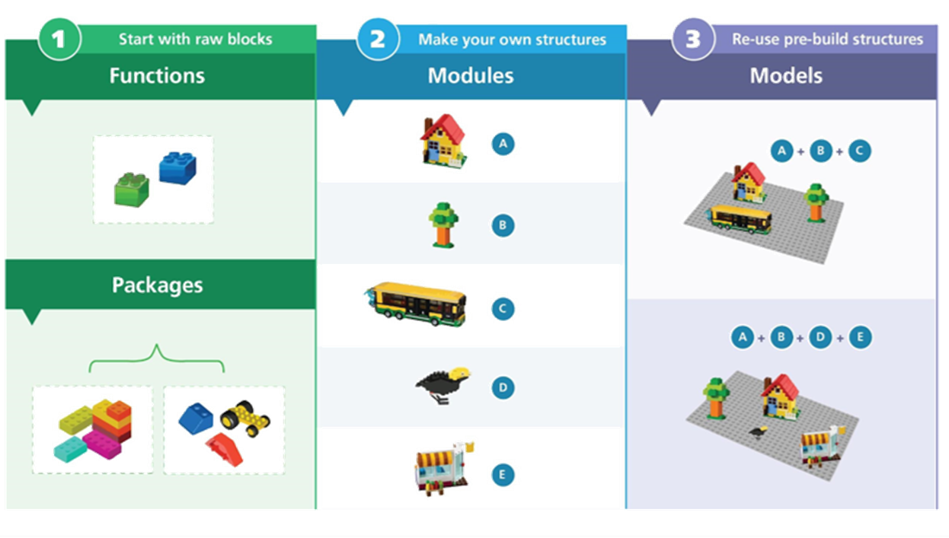
We need better bricks (and less glue)
McIntire (2022) ELE

Slide 5
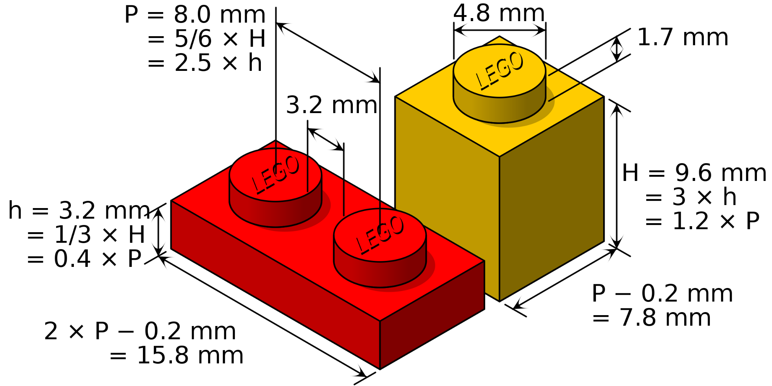
Standards

Slide 6
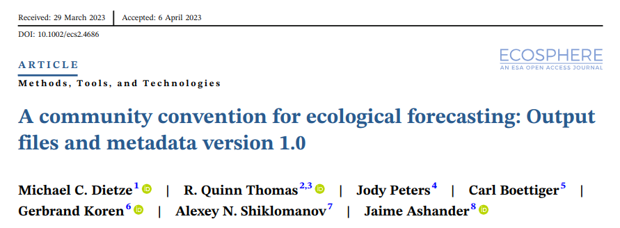
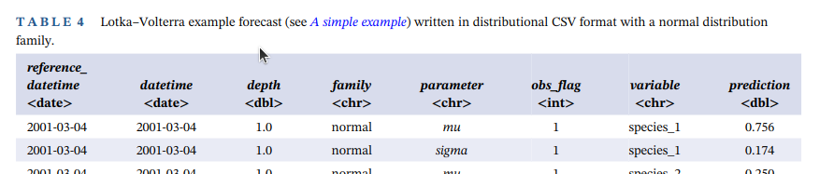
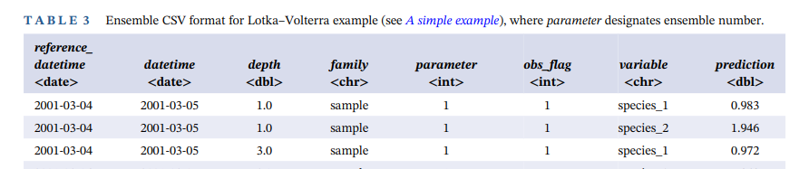
Standards
Dietze, M., R.Q. Thomas, J. Peters, C. Boettiger, A. Shiklomanov, and J. Ashander. 2023. A community convention for ecological forecasting: output files and metadata v1.0. Ecosphere 14: e4686 https://doi.org/10.1002/ecs2.4686

Slide 7














Standards
compute environment
s3 object store
range requests
docs + metadata
HTTP 1.1: rfc7233

Slide 8

Cloud-based automated workflow
Observation
system
Targets
S3 cloud
storage
Weather
Forecast
Forecast
Carl Boettiger
UC-Berkeley
Evaluation
Dashboard
Catalog

Slide 9
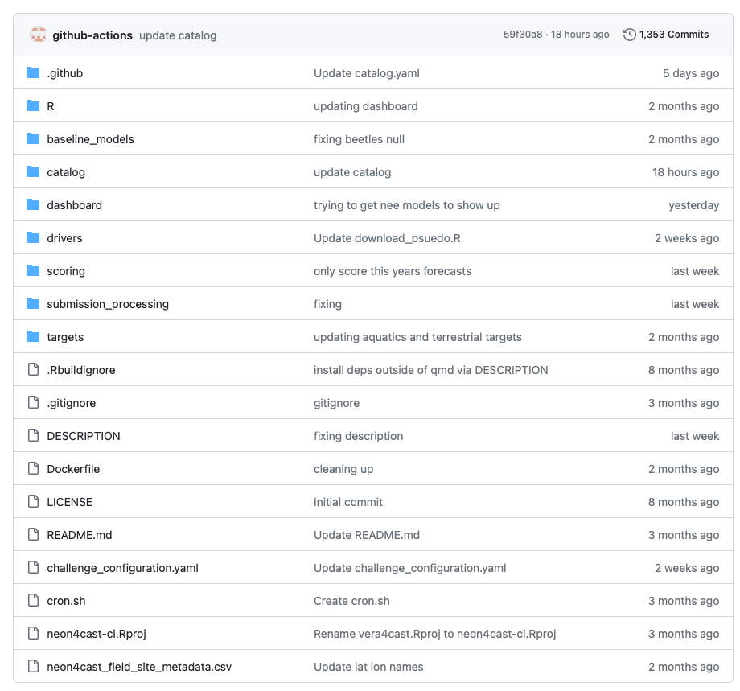
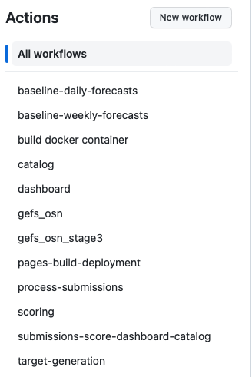
https://github.com/eco4cast/neon4cast-ci

Slide 10
”Verse” of R package
Scoring: github.com/eco4cast/score4cast
Submitting: github.com/eco4cast/neon4cast
Downloading NOAA Weather Forecasts: github.com/eco4cast/gefs4cast
Cataloging: github.com/eco4cast/stac4cast

Slide 11
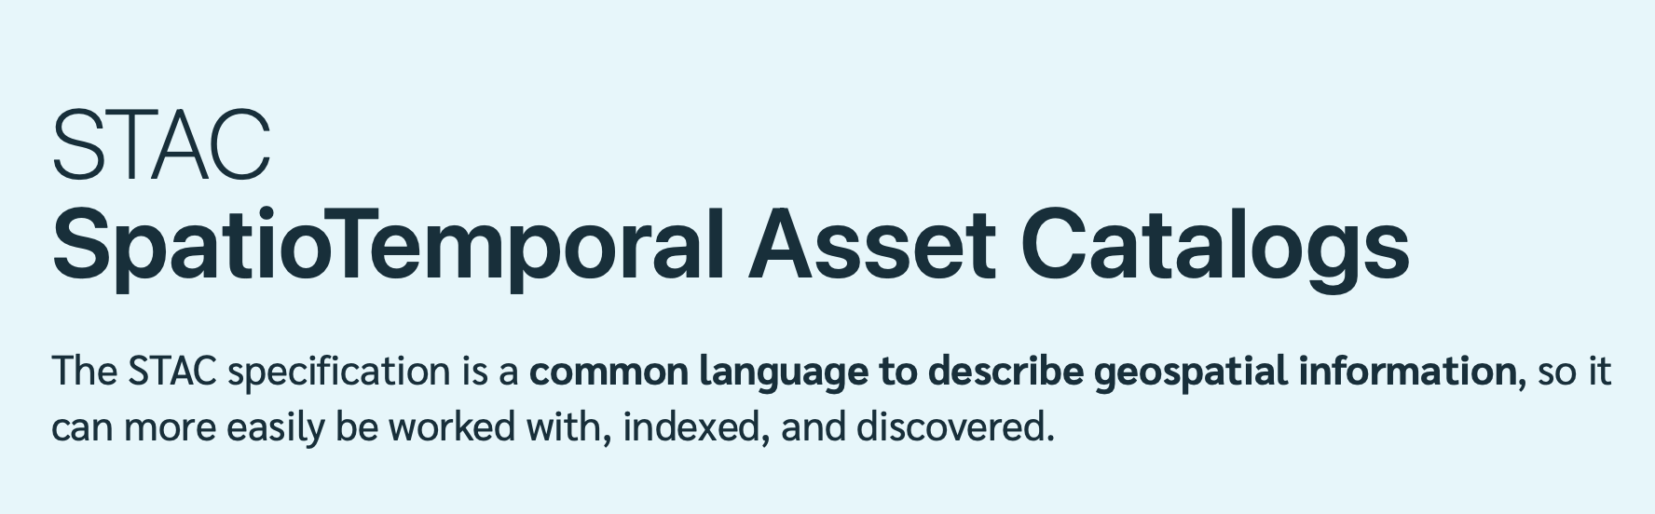
3. Workflow tasks: catalog forecasts
https://stacspec.org/en
Set of JSON files in GitHub repo
(https://github.com/eco4cast/neon4cast-catalog/tree/main/stac)
+
STAC Browser (https://radiantearth.github.io/stac-browser/#/)
=
Forecast catalog (https://tinyurl.com/3ms4tbpk)

Slide 12
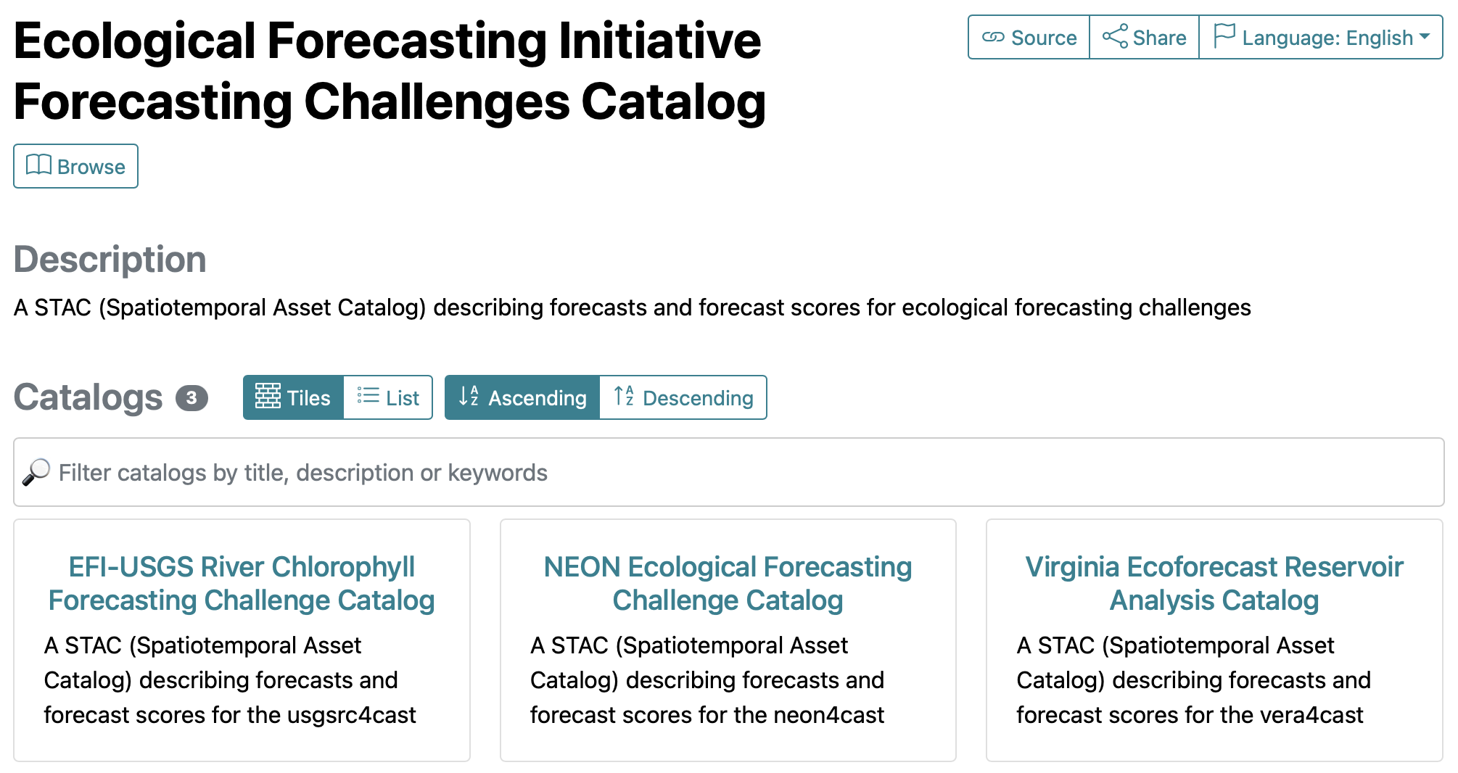
https://github.com/eco4cast/challenge-catalogs

