Slide 1


The penguins are in trouble. They face danger from all sides: their ice sheet is melting, their resources are dwindling, and they are under constant threat of attack from the ice sheets resident giant yellow cat, which has a somewhat uncontrollable swinging tail. The penguins have one option: escape the planet by building a tower to the moon, made of fish.
Your task: harvest enough fish to build your tower to the moon.
Guide your penguins to start harvesting the Salmon. Salmon tiles are salmon colored. Use the arrow keys to navigate the world. Use E & D to tilt the camera. Use O to center the camera on the igloos. Use P to find penguins that are not gathering resources.
Penguin Economy
This penguin is harvesting salmon.
Cost | Item | Action
50 fish | 1% upgrade to tower | Press Q
40 fish | Add an Igloo to add space for 3 more penguins | Press I
70 fish | Upgrade Febreeze tower so it will de-stink more quickly | Press F
BEWARE THE GIANT CAT – he will come out if the stinkiness reaches 100 percent, and who knows what mayhem will ensue?
Press M at any time to see a top view of the Penguin world.

Slide 2
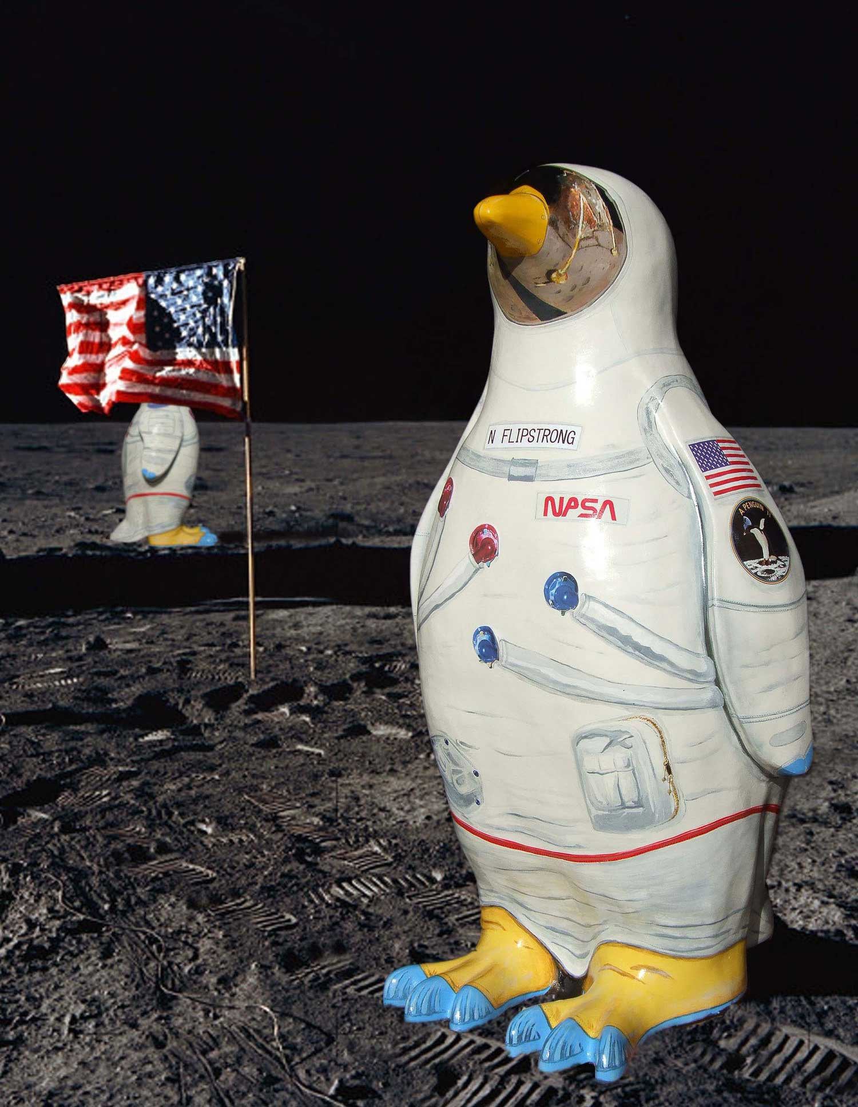
Congratulations. The penguins have reached a new era!

