Slide 1
DLA Internet Bid Board System (DIBBS) Quoting
FOR OFFICIAL USE ONLY

Slide 2
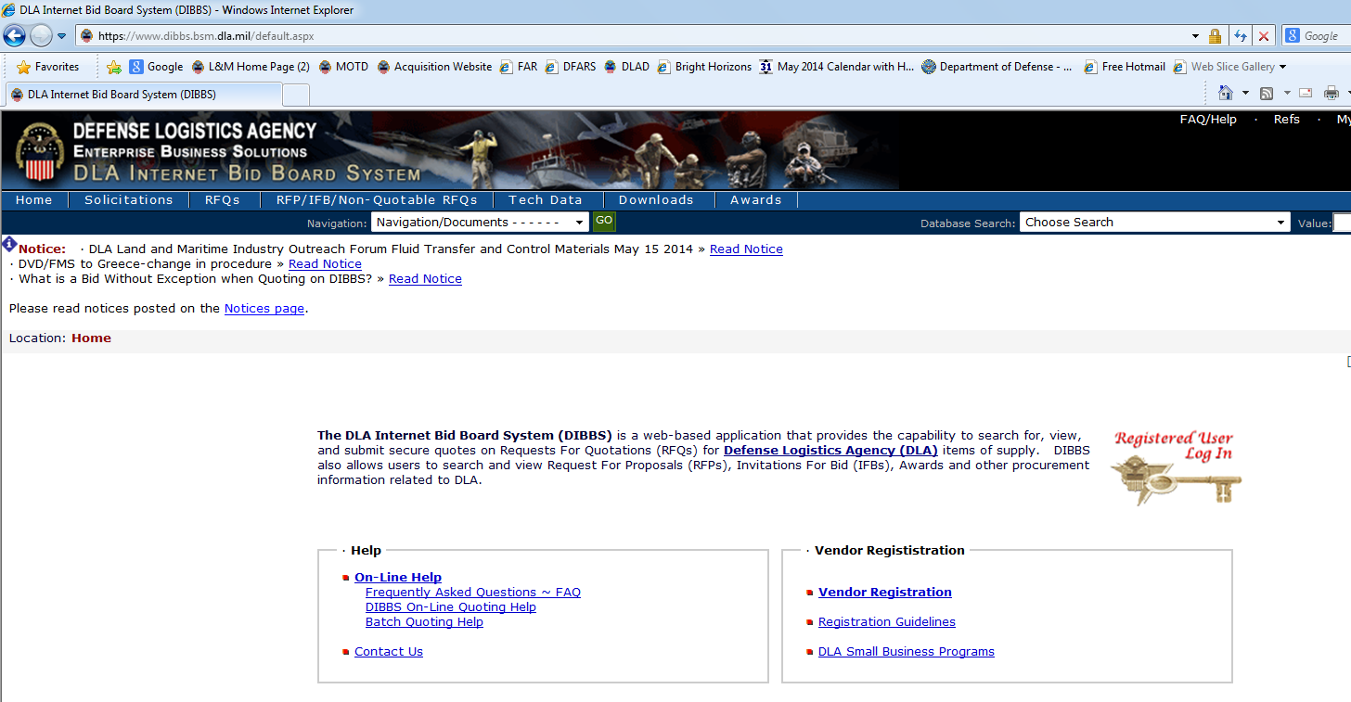
DIBBS Homepage https://www.dibbs.bsm.dla.mil/
If having trouble accessing DIBBS e-mail https://www.dibbs.bsm.dla.mil/
Notes:
**CLICK**
To submit a quote through DIBBS, users will need to log into DIBBS. If contractors have trouble accessing DIBBS, the contractor call the Customer Interaction Center (CIC) for support at 877-352-2255.
FLOOR WALKERS: VENDORS For this exercise, please go ahead and log into DIBBS.
**CLICK**

Slide 3
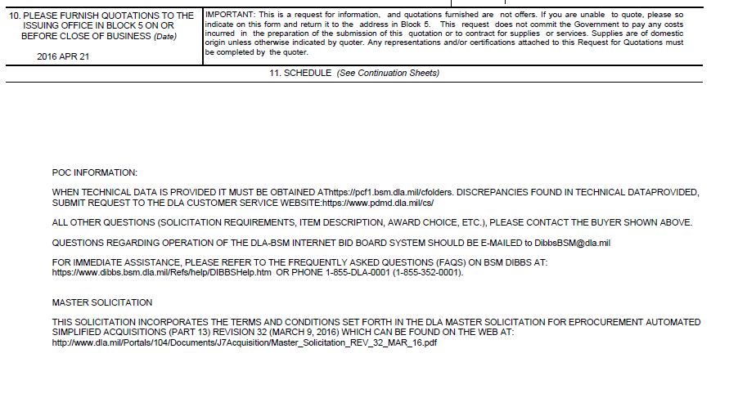
T-Solicitation
Master Solicitation Reference
Master Solicitation Location:
http://www.dla.mil/Portals/104/Documents/J7Acquisition/Master_Solicitation_REV_32_MAR_16.pdf
Notes:
As a reminder, all automated solicitations incorporate the terms and conditions within the DLA Master Solicitation for eProcurement Automated Simplified acquisitions.
The website is provided.
**CLICK**

Slide 4
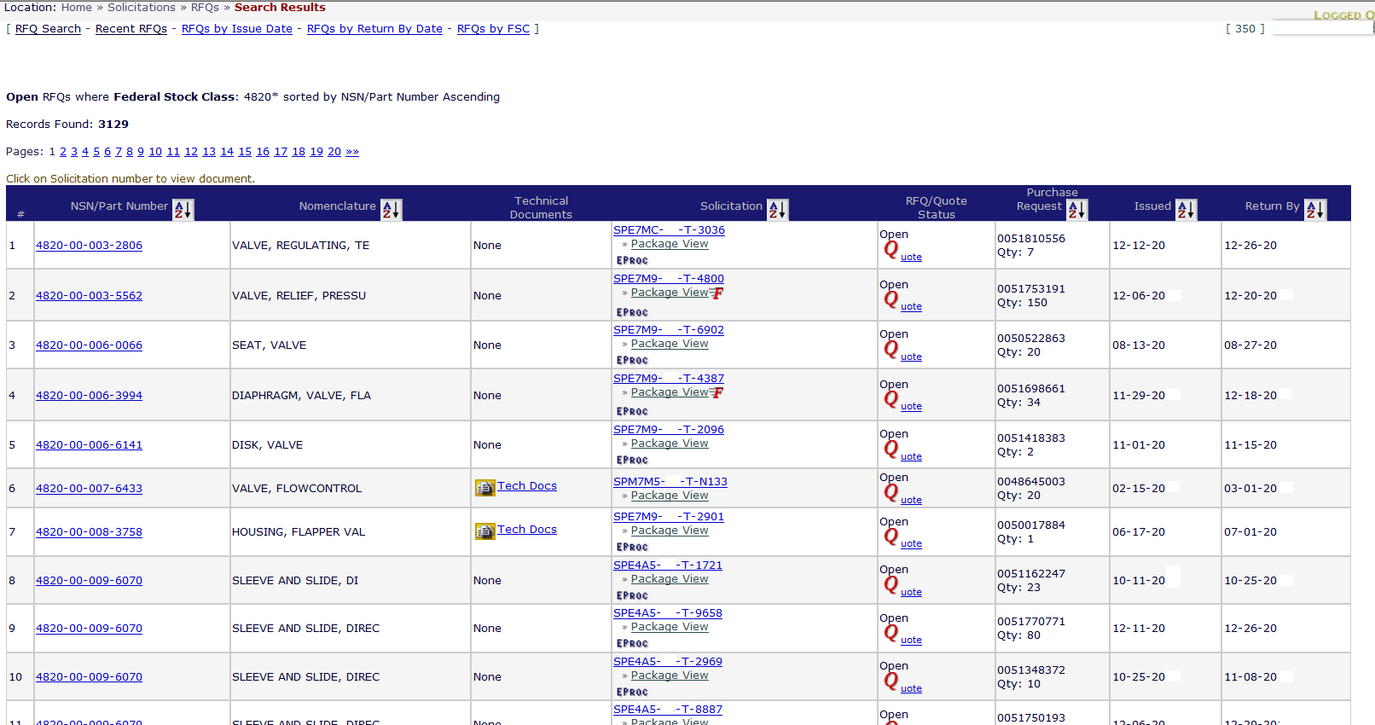
Notes:
Back to the RFQ search result page, when you are ready to quote, just click on the letter “Q” (quote image) next to the solicitation number you wish to quote on within the search results.
This will take you to the DIBBS Quote Input Form.
**CLICK**

Slide 5
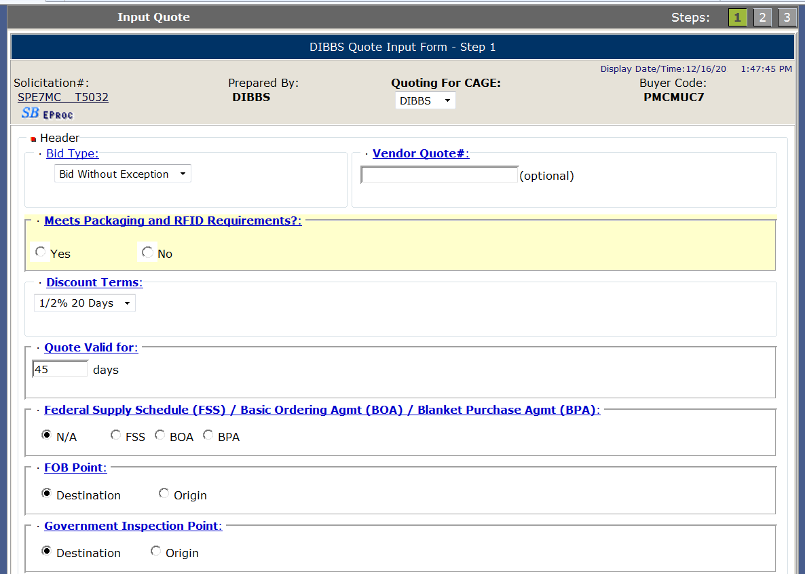
DIBBS Quote Input Form Step 1
Choose 1 from multiple CAGEs you are preauthorized to quote on behalf of.
xxxxxxxxxxxx
Some data will pre-fill from your registration data
Notes:
This is the DIBBS Quote Input Form.
Some of the questions are already pre-filled for you based on your DIBBS registration. However, you can change any field based on the solicitation requirement and your quote.
**CLICK**
VENDORS: Those who have a DIBBS registration can now follow along.
Your first vendor input will be Quoting for Cage. From the dropdown menu chose the cage code you are preauthorized to quote on behalf of.
FLOOR WALKERS Make sure vendors are filling in quote form as presentation goes on.
**CLICK**

Slide 6
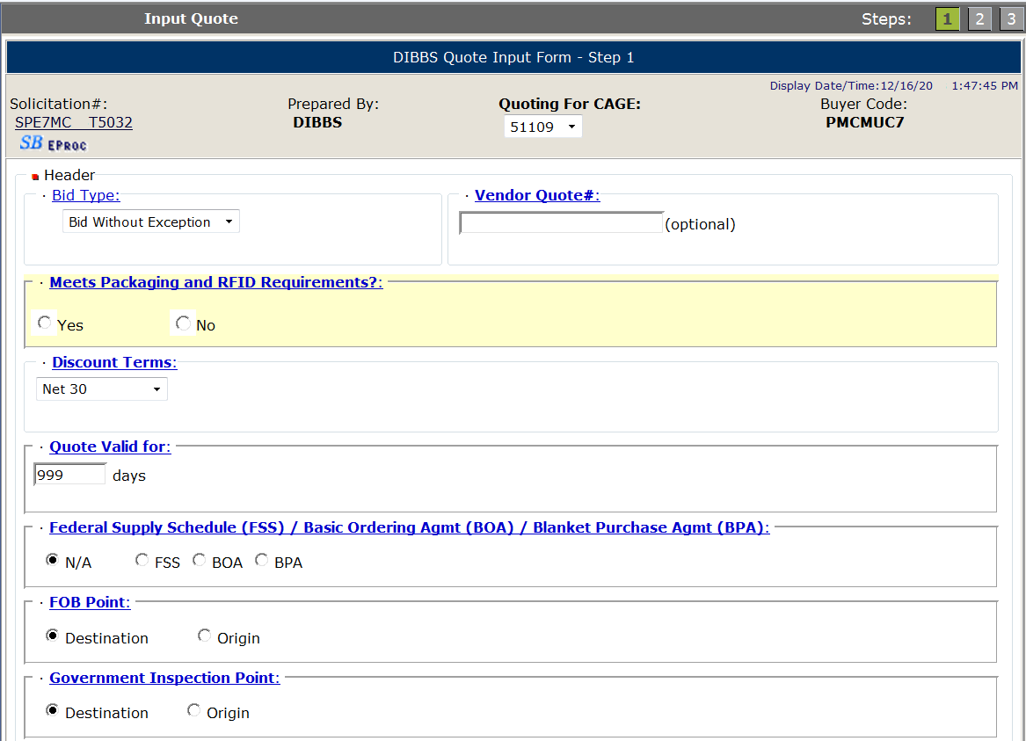
Bid Types - Bid Without Exception
Bid Without Exception: (Found in Master Solicitation)
Used to indicate quote is in exact compliance with the solicitation requirements.
The following conditions ARE NOT considered exceptions:
Quoting a different delivery than the required delivery.
Quoting origin inspection on solicitations requiring destination inspection.
Quoting a superseding or previously approved part or correction to a CAGE/part number cited in the AID on an item described by manufacturers CAGE and part number.
4. Quoting a used, reconditioned, remanufactured, new/unused Govt. surplus, foreign, or hazardous end item.
5. Quoting different “quote valid for” days than registration
Bid Type dropdown
xxxxxxxxxx
Notes:
Bid Type --- From the dropdown box vendors need to select 1 of 4 choices based on their quote. The information provided in this field is used by the auto evaluation system to evaluate automated solicitations which contain a “T” or “U” in the ninth position of the solicitation number.
**CLICK**

Slide 7
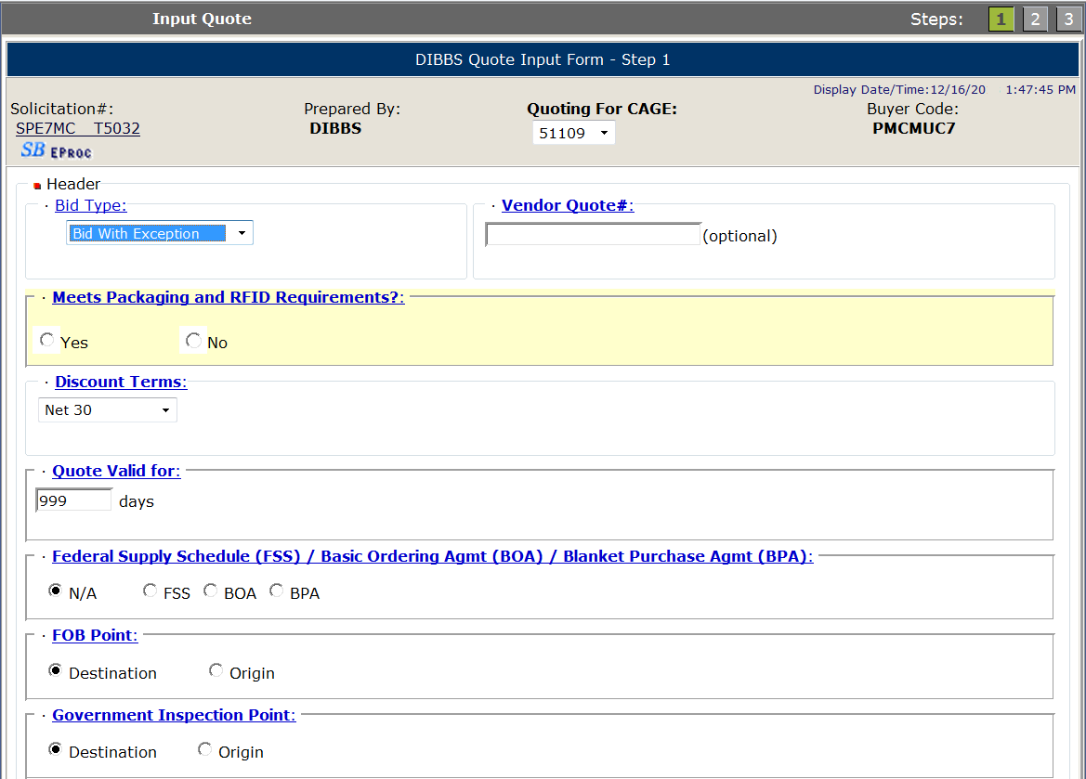
Bid Types - Bid With Exception
Bid With Exception: (Found in Master Solicitation)
The following ARE considered exceptions to the solicitation:
Taking exception to the item description
Exceptions to packaging requirements
Exceptions to FOB point
Quoting destination inspection on a solicitation requiring origin inspection
Exceptions to required quantity
6. Quoting a quantity variance outside the range specified on automated solicitations.
NOTE: Quoting Bid With Exception WILL preclude you from receiving an automated award.
Bid Type dropdown
xxxxxxxxxx
Notes:
Second bid type is Bid With Exception: This indicates that the quote is NOT in exact compliance with the solicitation. The following conditions are considered an exception to the solicitation.
Taking an exception to the solicitation item description, packaging requirements, FOB point or required solicitation quantity.
Quoting destination inspection when the solicitation requires origin inspection.
Quoting a quantity variance which is outside the range specified on automated solicitations. An automated solicitation will contain a “T” or “U” in the 9th position of a solicitation number. Manual solicitations have a “Q” in the 9th position.
Quoting an exception will preclude you from receiving an automated award.
**CLICK**

Slide 8
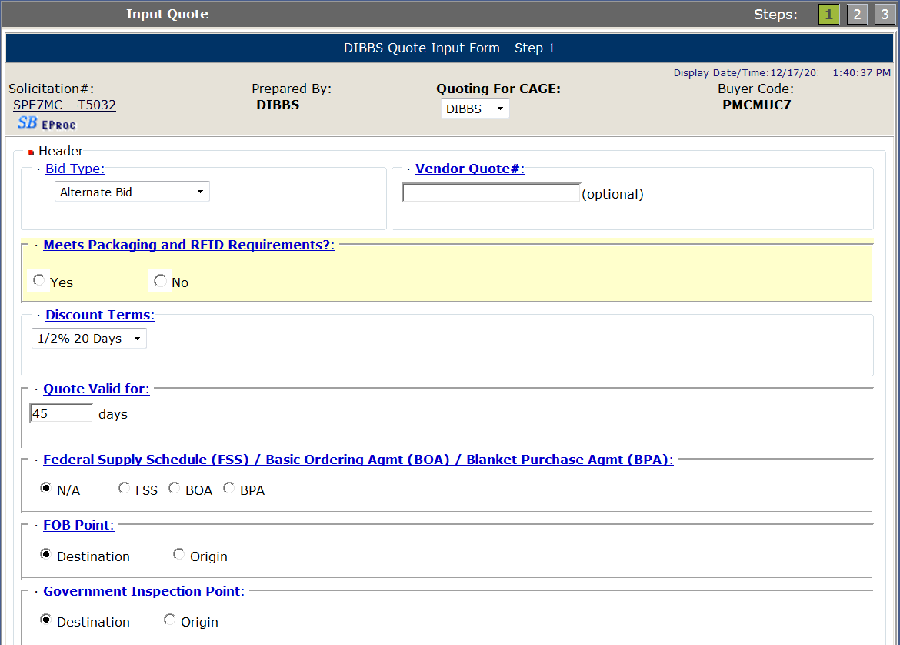
Bid Types – Alternate Bid
Bid Type dropdown
Alternate Bid:
If you wish to supply other than the approved part, you will have to submit your bid as an Alternate Bid.
For automated solicitations ("T" or "U“ in 9th position of solicitation number), the following applies to your alternate offer:
Offers of alternate products will not be evaluated for the current procurement, ONLY for FUTURE procurements.
You may submit a request to the Supply Center for evaluation for future procurements of the same item.
xxxxxxxxxxx
Notes:
Third bid type is Alternate Bid: This indicates the vendor wishes to supply other than the approved part which is listed in the solicitation. Alternate offers are not evaluated on automated solicitations.
If vendors wish to have their alternate item evaluated for future requirements, they would need to submit a technical data package to the supply center which will be discussed tomorrow.
**CLICK**

Slide 9
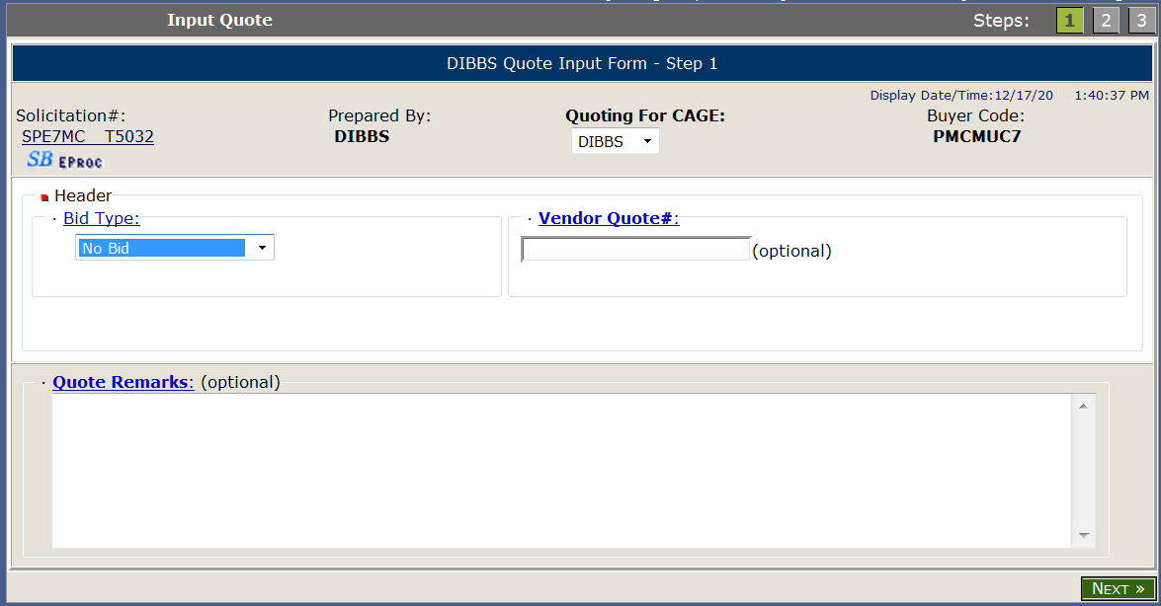
Bid Types – No Bid
No Bid:
Declining to submit a quote on this solicitation.
Quoting zero quantity for all line items will force a bid type of "No Bid.”
A “No Bid” will also delete a previously submitted bid.
Note: “No Bidding” is the ONLY way to delete a previously submitted bid.
Bid Type dropdown
Notes:
Last bid type is No Bid. Most vendors do not submit No Bids; however, it is beneficial to do so if the part number listed in the solicitation is obsolete. Vendors can add a quote remark to inform the supply center of a possible obsolete item.
Also submitting a “No Bid” is the only way to delete a previously submitted bid prior to a solicitation award.
**CLICK**

Slide 10
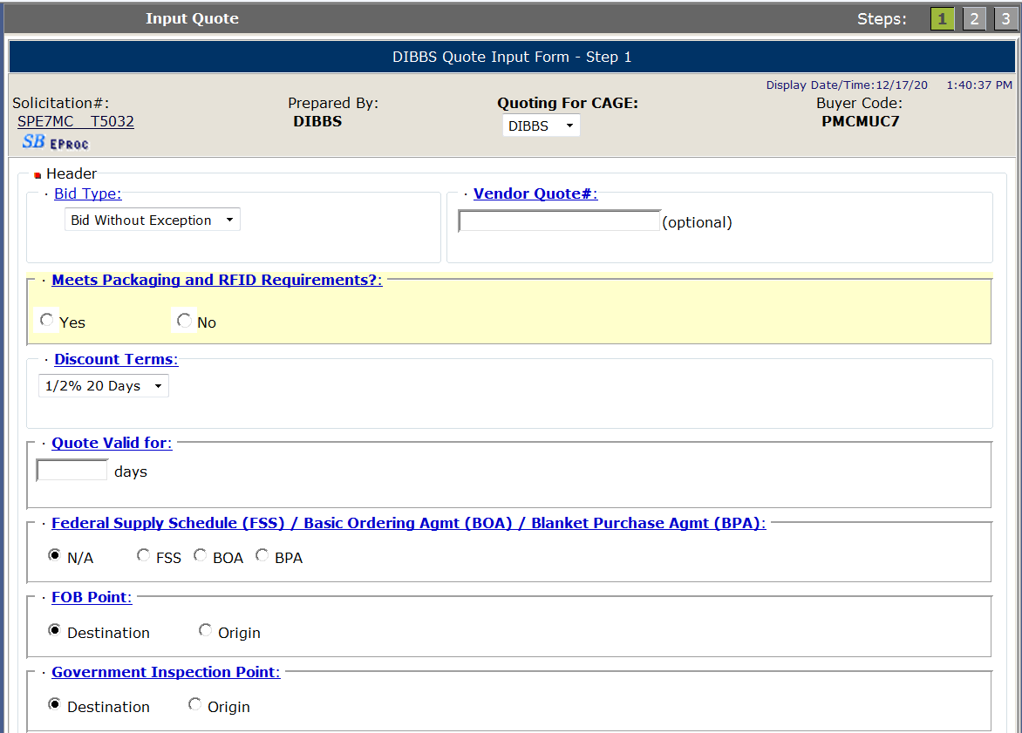
Vendor Quote #
Optional fill-in for a vendor reference number.
Notes:
Many vendors may use an internal reference number when creating and locating a quote in their system.
In the Vendor Quote # field, which is optional, vendors can enter their internal reference number for this quote. So when a buyer calls them with a question, the buyer can provide the internal reference number instead of a PR number or NSN.
**CLICK**

Slide 11
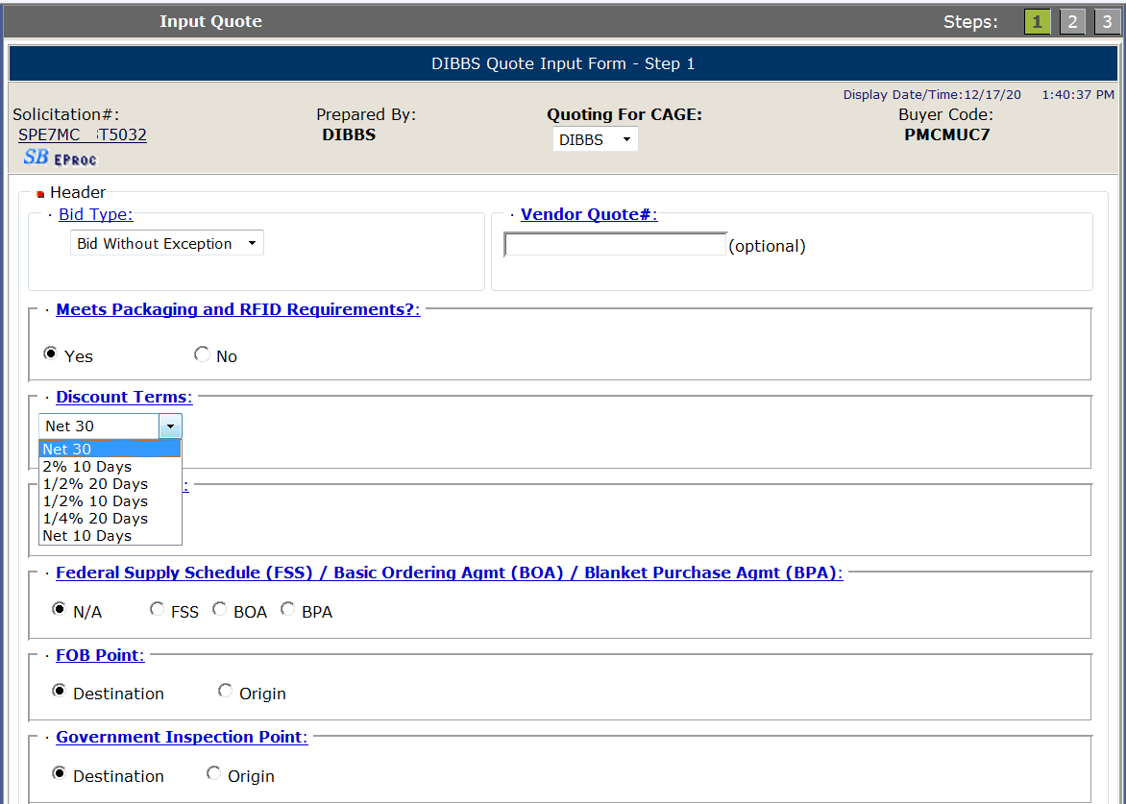
Discount Terms
Select dropdown to select from a list of six most common discount terms. This field will default from vendor DIBBS registration.
Notes:
Discount terms can be quoted when the vendor allows a price discount if the Government pays the invoice within a certain number of days.
Select the dropdown box for a list of the six most common discount terms. This field will default from the vendors DIBBS registration; however, vendors are able to change this field for any quote.
“Net 30” is most commonly used.
**CLICK**

Slide 12
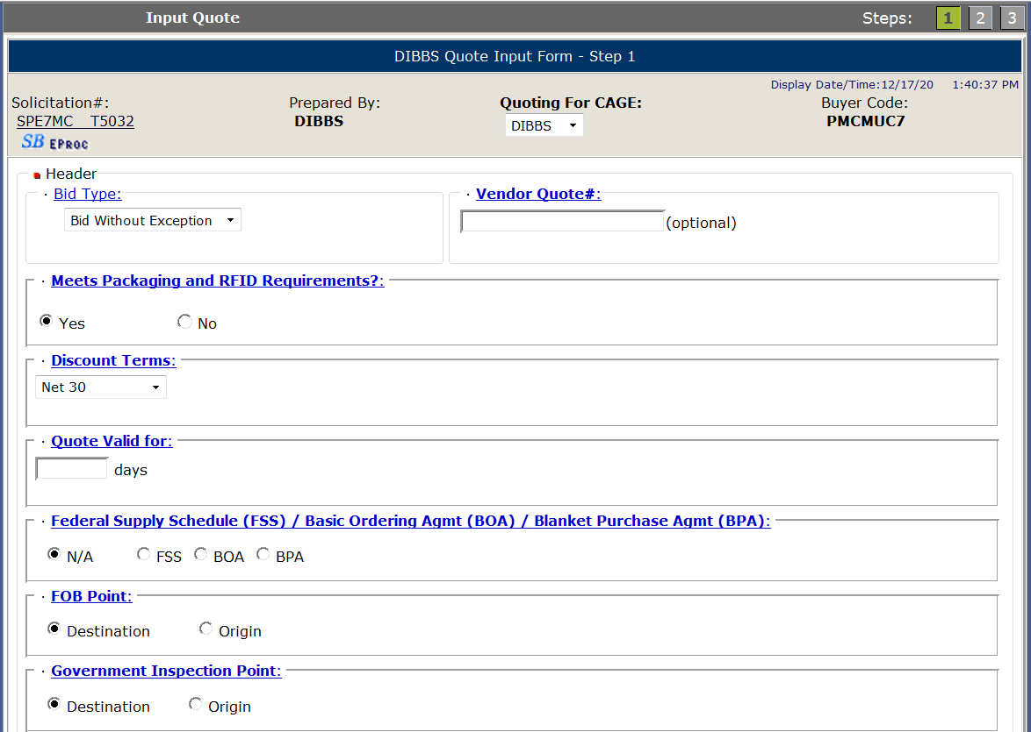
Quote Valid For
Enter number of days your quote is valid. Validation forces a numeric response from 1-999.
This field will default from vendor DIBBS registration.
Notes:
Quote Valid For is where the vendor will input the number of days the quote is valid for. Typically the Government requests 90 days.
If you quote less than 90 days, most likely the buyer will be coming back to you to ask you to extend the quote or submit a new quote.
**CLICK**

Slide 13
FSS / BOA / BPA
Defaults to N/A
Select "FSS/BOA/BPA" ONLY if applicable and include Contract # and expiration date, otherwise leave N/A.
Notes:
Vendors will select this next area only if they have an existing Federal Supply Schedule (FSS) , Basic Ordering Agreement (BOA) , or Blanket Purchase Agreement (BPA) that they wish for this requisition to be ordered against.
This field defaults to N/A.
**CLICK**

Slide 14
FOB (Free on Board) Point
Defaults to Solicitation requirement.
Select Destination or Origin for FOB point. FOB Origin will require City, State and Country.
If quoting other than what is required, bid type must be Bid with Exception.
Notes:
Free on Board or FOB point. This field will default to the solicitation requirement.
If vendor quotes FOB Destination, then all shipping costs must be included into the unit price of the item.
If vendor quotes FOB Origin, shipping costs are NOT included in the unit price. Vendors will invoice for the cost of supplies.
First Destination Transportation (FDT) RFQs must be quoted FOB origin as solicited. If you quote FOB Destination on an FDT eligible solicitation, the quote will be considered a “bid with exception” and the quote will not be considered for an automated award.
FLOOR WALKERS: make sure vendors are following along.
**CLICK**

Slide 15
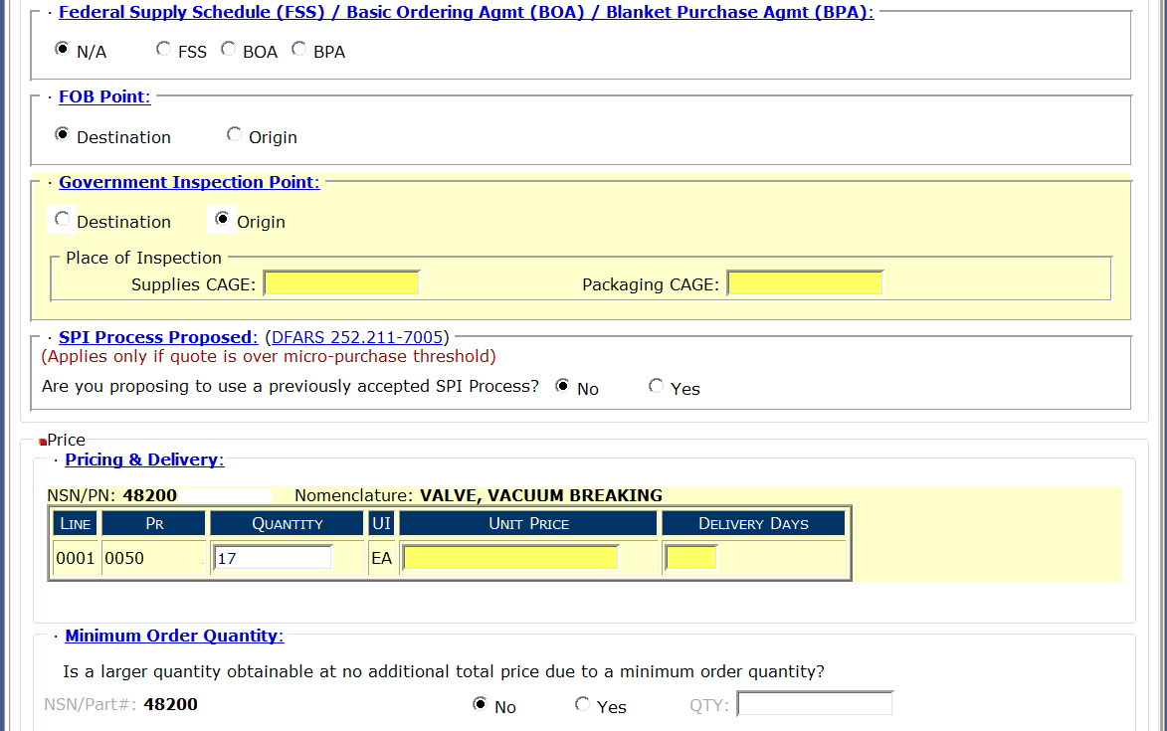
Government Inspection Point
Defaults to Solicitation requirement.
Select Destination or Origin for Inspection point.
Inspection at Origin will require the CAGE code where the supplies and packaging may be inspected.
If solicitation requirement is Origin Inspection and vendor quotes Destination Inspection, bid type must be Bid with Exception.
Notes:
Next section is Government Inspection Point.
This field will default to the solicitation requirement.
Inspection at destination means that the supplies/packaging will be inspected at the shipping destination on the order.
Inspection at origin means that the supplies/packaging will be inspected at the CAGE code provided for supplies and packaging per the quote, prior to shipping.
**CLICK**

Slide 16
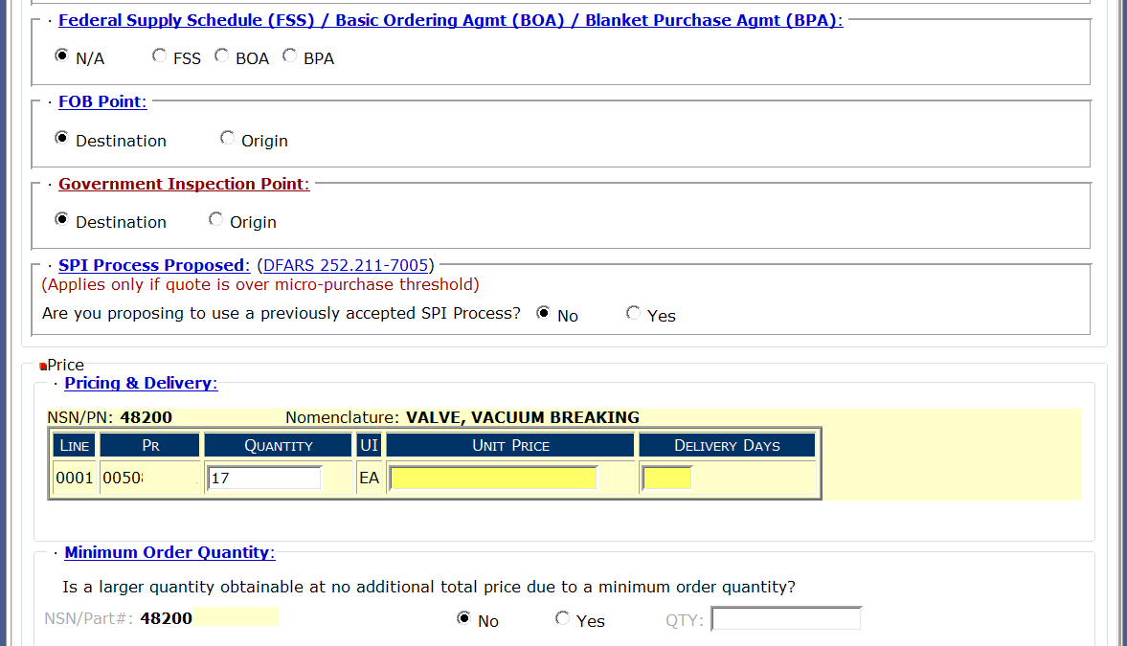
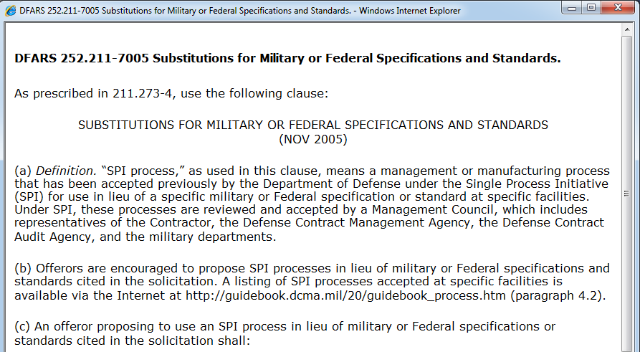
SPI Process Proposed
Applies only over micro-purchase threshold
Management or Manufacturing process that has been previously accepted by DoD under the Single Process Initiative (SPI) for use in lieu of specific military or Federal specs or standards at specific facilities.
Notes:
The next field for Single Process Initiative (aka SPI) which is not common.
Single Process Initiative only applies over the micro-purchase threshold.
**CLICK**
See how DFARS 252.211-7005 is underlined…you can click on this number and the DFARS text will show in a new window.
Most of the time the answer for this field will be “No”.
**CLICK**

Slide 17
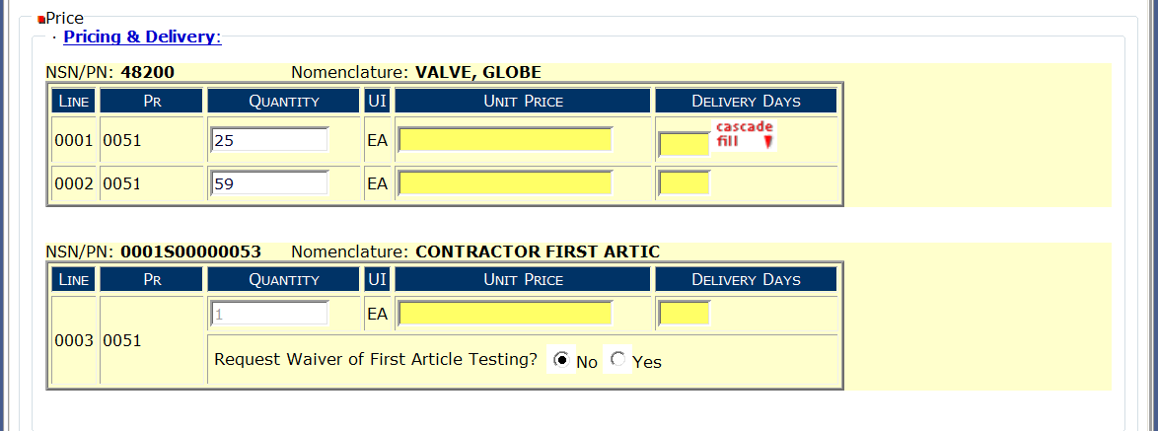
Pricing & Delivery
First Article price/delivery and Waiver Request
Enter price and delivery by line item.
If price or delivery do not vary per line, enter info into first line and click on “cascade fill” for all other line items.
If quantity quoted is not in accordance with RFQ, bid type must be Bid with Exception.
Notes:
When you go into submitting a unit price, there maybe different quantities per Line. If the quantities do not require different unit prices or delivery, you can input the unit price and delivery in Line 1 and click on “Cascade Fill”.
**CLICK**
This will repeat the unit price and delivery for the remaining quantity lines on the solicitation.
However, if you can provide a lower unit price/delivery for 59 compared to 25, please provide the different unit prices and/or delivery days. Also, since the total quantity will be on one purchase order, give us the unit price for a total quantity of 84 compared to the unit price for 25 and a unit price for 59. During evaluation, you may lose out on an award because you were unable to give us a better price for a higher quantity.
**CLICK**
Now, if the solicitation requires a first article test, you are able to quote a unit price and delivery only for the first article test. Make sure this is the unit price and delivery for the first article test. Its okay if the first article unit price & delivery is different from the Line quantities requested on the solicitation.
If there was a first article test before and it passed, vendors can ask for a waiver of the first article testing.
**CLICK**

Slide 18
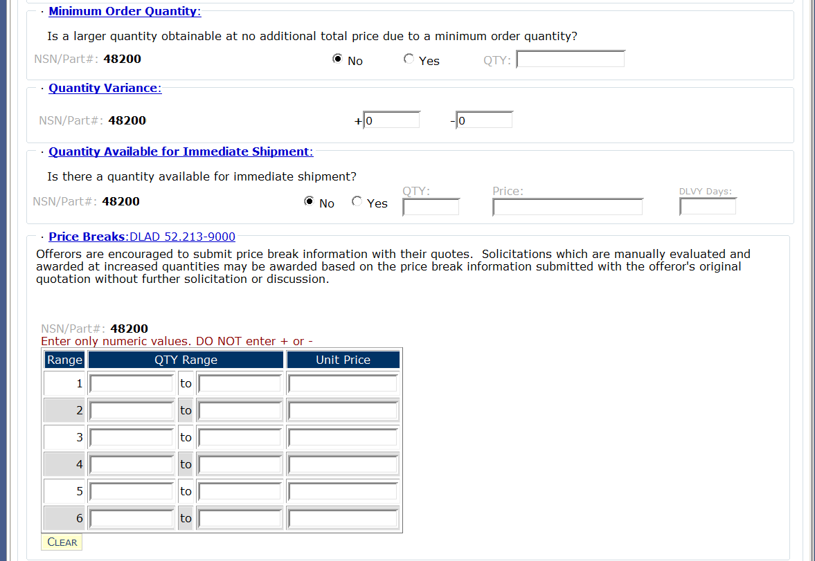
Min Order, Qty Variance Immediate Shipment
Select appropriate response to question.
Qty % Government will accept under or over required quantity.
Select appropriate response to question.
Notes:
Minimum Order Quantity: Vendor will select the appropriate response to the question…Can the Government obtain a larger quantity at no additional price due to a minimum order quantity? Selecting “Yes” requires an entry for the quantity that is available at no additional cost.
**CLICK**
Quantity Variance: This value represents the quantity the Government will accept under or over the required solicitation quantity. The default is +0, -0 which is the norm in most cases. But for example, if the unit of issue is feet, you may see a quantity variance of +10, -10. This means that the Government will accept 10% more or 10% less than the required solicitation quantity.
NOTE: On automated solicitations, if a quantity variance is quoted when not allowed or a quantity variance is quoted outside what is allowed in the solicitation, bid type must be Bid with Exception.
**CLICK**
Quantity Available for Immediate Shipment: Select the appropriate response to the question, Is there a quantity that can be shipped immediately? If yes, then what is the quantity, unit price and number of delivery days.
**CLICK**

Slide 19
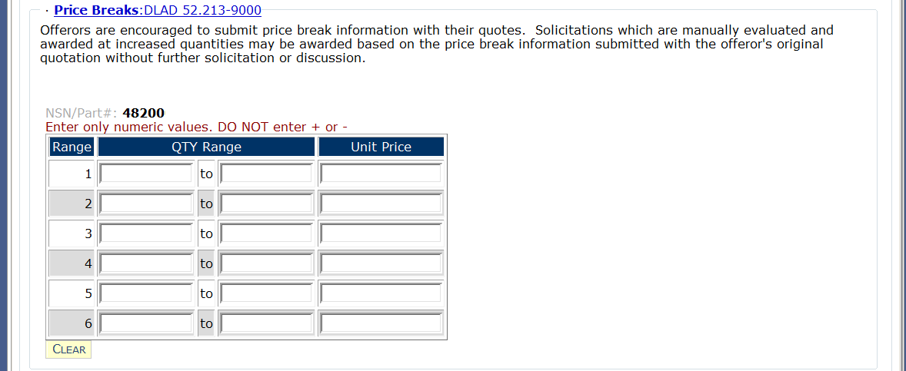
Price Breaks
Enter price break ranges and unit prices in the blocks provided.
If price breaks are solicited, default values will show. Ranges may be altered using the “CLEAR” button.
If price break ranges were not solicited, values will be blank. However, vendors can provide ranges and unit prices with quote.
1
5
10.00
6
10
7.00
Notes:
Price Breaks: If a larger quantity is obtainable at a lower unit price, then enter the lowest to highest quantity that can be provided for a given unit price.
**CLICK**
For example: 1 – 5 at $10.00 each
6 – 10 at $7.00 each
11 – 15 at $5.00 each
The Government may elect to accept these alternate quantities and unit prices for quotes not exceeding $150,000 without further solicitation or discussion.
**CLICK**

Slide 20
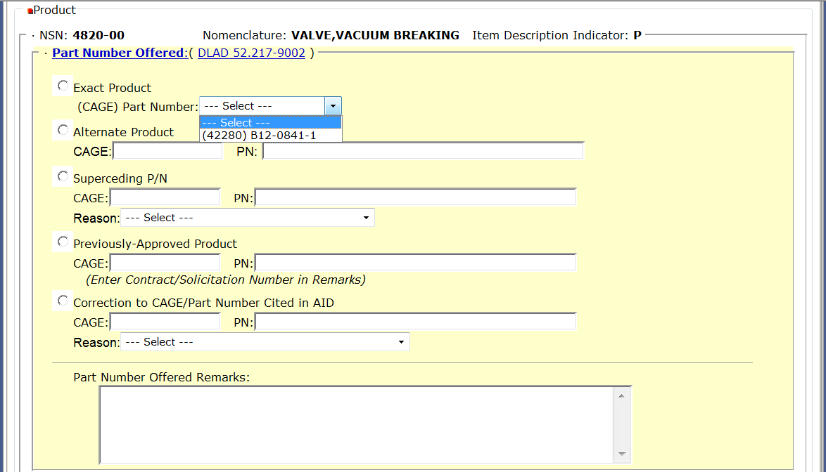
Part Number Offered Exact Product & Alternate Product
Exact Product = providing EXACT manufacturer CAGE code & part number as it appears in the solicitation. Bid type is “Bid without exception”.
Alternate Product = providing manufacturer CAGE code & part number that is NOT listed in solicitation. Bid type is “Alternate Bid”.
Notes:
In this next section, you are telling the Government what product are you providing. For product type definitions that are listed, click on the DLAD 52.217-9002 reference for exact definitions.
First, we’ll go over the difference between an exact product and alternate product.
**CLICK**
If you are providing the Government the exact manufacturer CAGE code and part number as it appears in the solicitation --- then click the radial button next to “Exact Product”. Select the dropdown arrow and from the list of manufacturer CAGE code(s) and part number(s) provided, select the exact manufacturer CAGE code and part number you are quoting to provide.
If you are providing a manufacturer CAGE code and part number that is NOT exactly listed in the solicitation – then click on the radial button next to “Alternate Product”. You will then type in the CAGE code of the manufacturer and the part number you are quoting to provide.
If you quote an alternate product, the bid type must be “Alternate Bid”.
FLOOR WALKERS: make sure vendors select drop down arrow to select correct part number.
**CLICK**

Slide 21
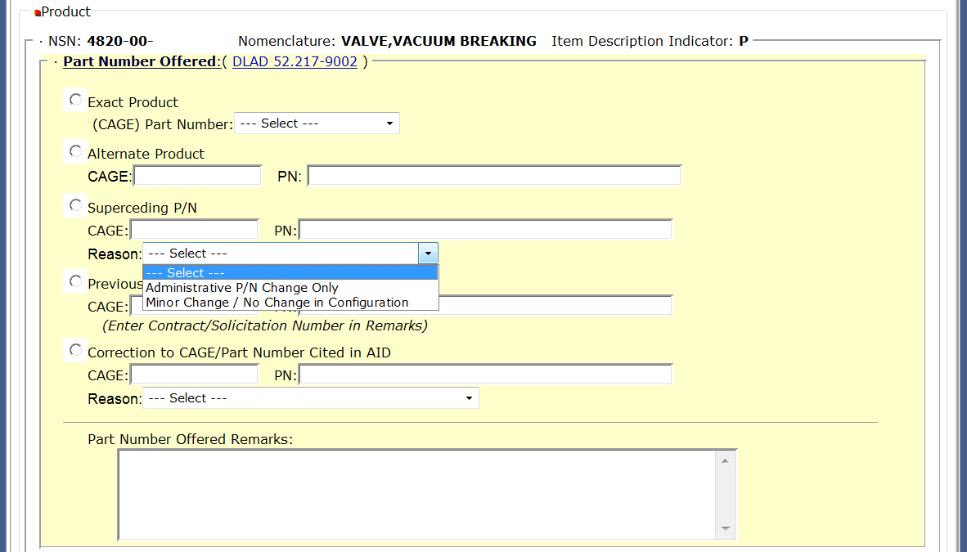
Part Number Offered Superseding P/N
Superseding P/N = providing exact product; however, there is a part number change. Bid type is “Bid without Exception”.
Notes:
A vendor would quote superseding part number if the offered item qualifies as an exact product; however, there is a part number change. With a superseding part number the change in question would not affect the form, fit or function of the exact product…again just a part number change.
If a vendor quotes a superseding part number, select the radial button next to Superseding P/N, type in the CAGE code and part number that you are quoting to provide and then from the dropdown arrow select either option provided.
A superseding quote is considered a Bid WITHOUT Exception.
**CLICK**

Slide 22
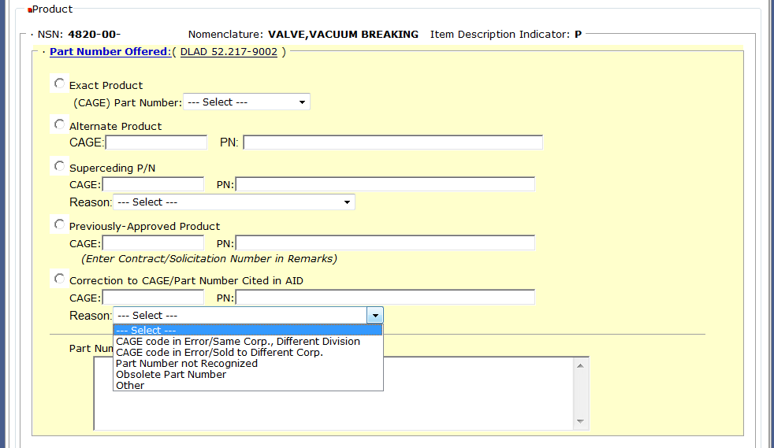
Part Number Offered Correction to CAGE/PN cited in AID
Correction to CAGE/PN Cited in Acquisition Item Description = used to notify the Gov’t if there is a CAGE code error, obsolete p/n etc. Bid type is “Bid without Exception”.
Notes:
Last option for a part number offer is Correction to CAGE/Part Number which is cited in the acquisition item description (AID). From the “reasons” dropdown list, select the correct reason why there needs to be a correction made to the CAGE code and Part number in the item description. Vendors will select correct reason and provide the corrected information in the fields for CAGE and PN.
If the selection is “Other”, vendor needs to provide additional information in the part numbered offered remarks section.
A correction to CAGE/PN cited in the AID is considered a Bid WITHOUT Exception.
**CLICK**

Slide 23
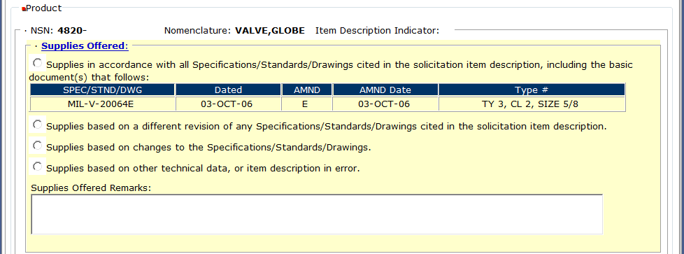
Drawing Item Offered Specifications/Standards/Drawings
For a DRAWING ITEM: Select the type of supplies being offered based on the 4 options provided. Bid type is not affected.
Notes:
VENDORS: THIS SAMPLE MUST VIEW POWERPOINT PRESENTATION. This is an example when the solicited item is described by a basic specification/standard/drawing, this is how you tell the Government what product are you providing. If you’re going to make an exception to the specs/standards or drawings listed, you must let us know so we can evaluate the change. For example, say the drawing calls for aluminum but you want to provide steel, you need to provide us that information for evaluation.
Vendors will select the type of supplies they are offering based on the 4 options provided:
**CLICK**
If supplies are in accordance with all specs/ standards/ drawings cited in the solicitation item description the first radial button should be selected. Supplies offered remarks are not allowed.
**CLICK**
2. If supplies are based on a different revision of any of the specs/standards/drawings cited in the solicitation, select the second radial button. Supplies offered remarks are available, but not required. Bid type is not affected.
**CLICK**
3. If supplies are based on changes to the specs/standards/drawings, select the third radial button. Supplies offered remarks are available, but not required. Bid type is not affected.
**CLICK**
4. Last selection is if the supplies are based on other technical data or there’s an error in the item description. Supplies offered remarks are available, but not required. And again, bid type is not affected.
**CLICK**

Slide 24
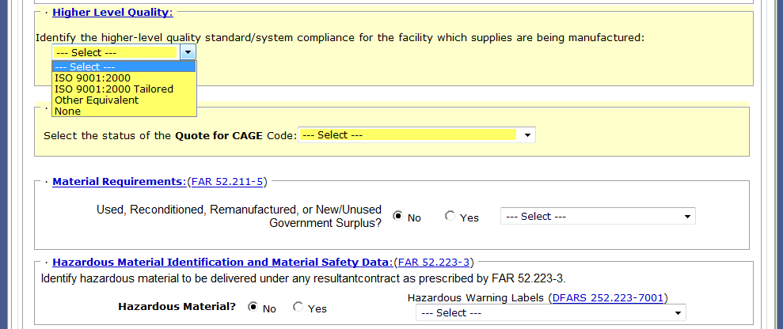
Higher Level Quality Requirements
Select appropriate higher level quality system that is currently in place at the manufacturing facility for the supplies.
Notes:
VENDORS: THIS SAMPLE MUST VIEW POWERPOINT PRESENTATION.
In this next section…based on the quality requirements of an item, vendors may need to identify the higher-level quality standard or system compliance that is in place at the manufacturing facility for the supplies.
The quality requirement of the item is stated in the item description as well as in the clauses portion of the solicitation. Vendors will need to select the quality standard or system that is in place at the manufacturing location for the supplies being offered.
If requirement is ISO 9001:2000 then the vendor must be certified.
If the requirement is ISO 9001:2000 TAILORED, the vendor just has to be in compliance with the requirement and NOT certified.
A selection of “NONE” will force a “Bid with Exception”.
**CLICK**

Slide 25
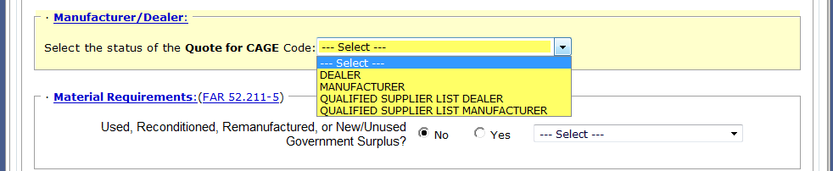
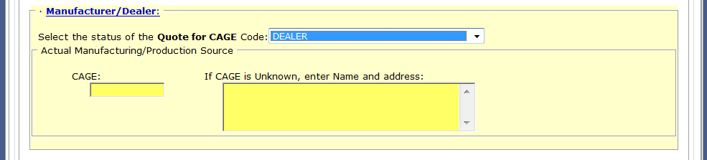
Product Offered Are you a Manufacturer or Dealer?
Select one
If quoting as dealer or QSL dealer – provide CAGE of mfg or if unknown, provide Name and address
Notes:
In this next section you are telling the Government whether you are a manufacturer providing this quote OR are you a dealer providing this quote?
**CLICK**
From the dropdown arrow – first select Dealer, Manufacturer, Qualified Supplier List (QSL) Dealer or Qualified Supplier List (QSL) Manufacturer.
**CLICK**
If you select dealer or QSL dealer – you will need to provide the CAGE code of the actual manufacturer under the CAGE field. If you don’t know the CAGE code, then in the CAGE unknown field, provide the manufacturers name and address.
If you are the manufacturer or QSL Manufacturer no additional information is required.
MAKE SURE VENDORS KNOW THE DIFFERENCE BETWEEN MFG AND DEALER.
**CLICK**

Slide 26
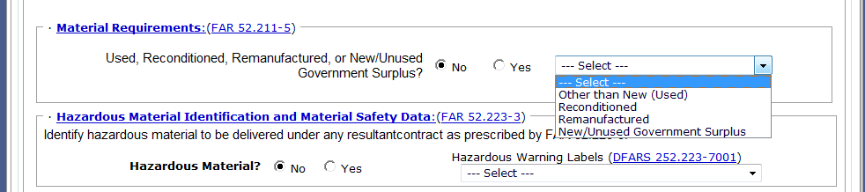
Material Requirements
Select one of the following, if your reply is “YES”
Notes:
Under Material Requirements, the system default is “NO”. With the reply of “NO” you are proposing to offer a NEW/UNUSED product from this quotation.
However, if you are going to provide a used, reconditioned, remanufacturer or new/unused Government Surplus then your selection must be “YES” and from the dropdown arrow identify what kind of product you are providing.
**CLICK**

Slide 27
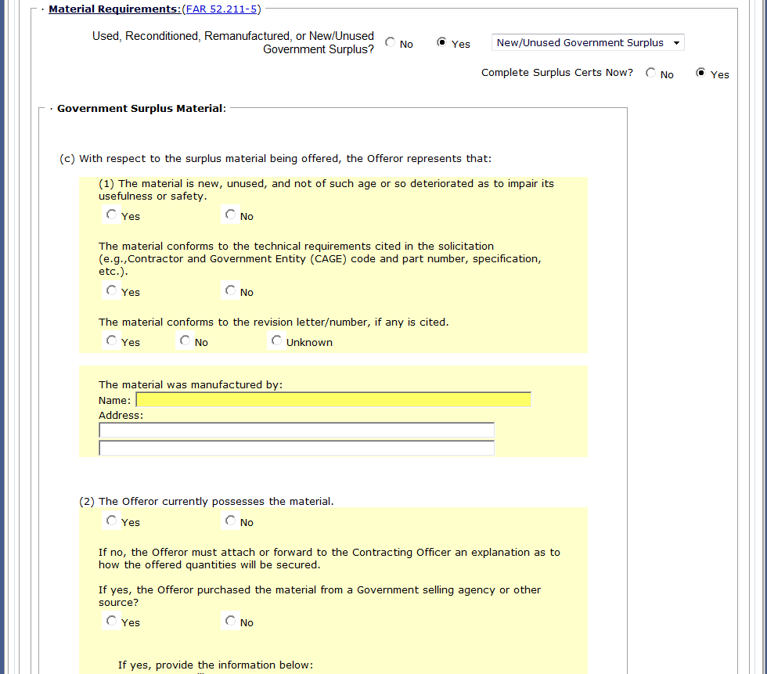
Material Requirements Surplus / On-line Certification
Fill-in completely
Government Surplus Material certification
Notes:
If supplying new/unused previously owned Government surplus, an on-line certification can be filled out at this point and submitted with your offer.
**CLICK**
To assist with the evaluation, it is recommended that you complete the surplus certification with your offer.
A reminder: Vendor surplus is NOT accepted. Only previously owned Government surplus will be evaluated.
FLOOR WALKERS: VENDORS select surplus “yes” so you can view surplus certification.
**CLICK**

Slide 28
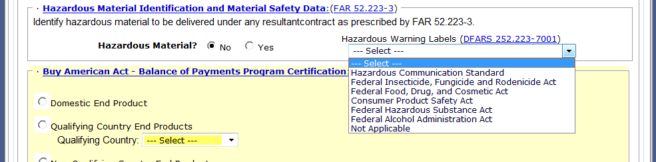
Hazardous Material Identification and Material Safety Data
Select one of the following, if your reply is “YES” to Hazardous Material
Notes:
For the Hazardous Material section, the system default is “NO”. With the reply of “NO” you are stating that “NO” hazardous material will be delivered on any resultant contract.
**CLICK** If yes, then review DFARS 252.223-7001 to determine which statute the hazardous warning label will conform to.
**CLICK** Remember you can view the DFARS reference by clicking on the underlined blue text.
**CLICK**

Slide 29
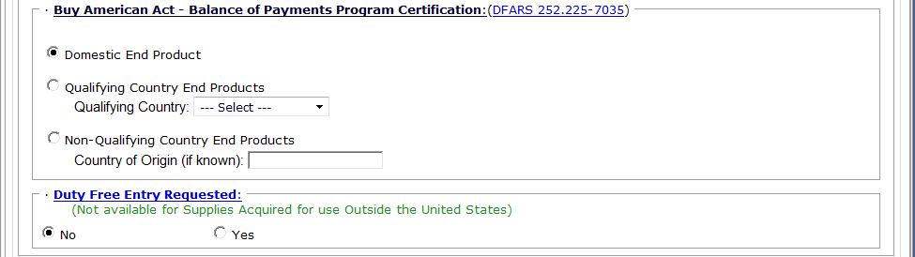
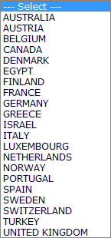
Buy American Act
Fill-in for information purposes only on Foreign Military Sales (FMS), overseas shipments, and all micro-purchases as the restrictions of the Buy American Act DO NOT apply.
Select one of the following:
Domestic
Qualifying Country
Non-Qualifying Country
Notes:
In the Buy American Act section you are informing the Government whether you are quoting a domestic end product, Qualifying Country End Product or a Non-Qualifying Country End Product.
**CLICK** If providing a Domestic End product click radial next to domestic.
**CLICK** If providing a Qualifying Country, then click radial next to qualifying country and select the applicable Country from the dropdown list.
**CLICK** If providing a Non-Qualifying Country, click radial next to Non-Qualifying Country and then also provide the Country of Origin, if known in the text field.
**CLICK** The Buy American Act does not apply to Foreign Military Sales (FMS), overseas shipments or micro-purchases, but is used for informational purposes, only.
**CLICK** Remember you can refer to DFARS 252.225-7035 by clicking on the underlined blue text.
**CLICK**

Slide 30
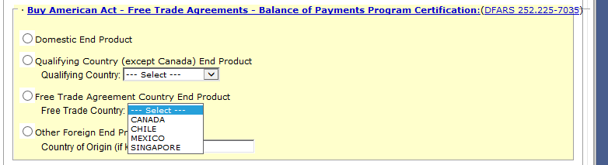
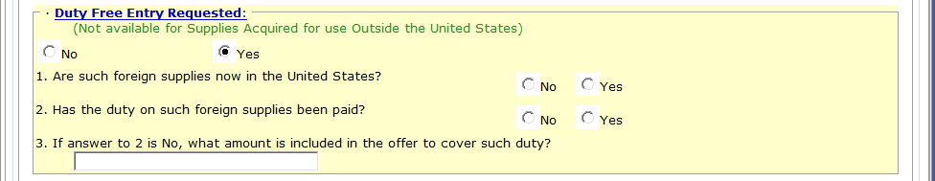
Default = NO
If requesting duty free, select yes and answer questions 1 – 3.
Notes:
Under Duty Free Entry, the system default is “NO”.
However, if the product is coming from overseas, you need to request duty free. So select “YES’ and then answer the 3 questions provided.
**CLICK**

Slide 31
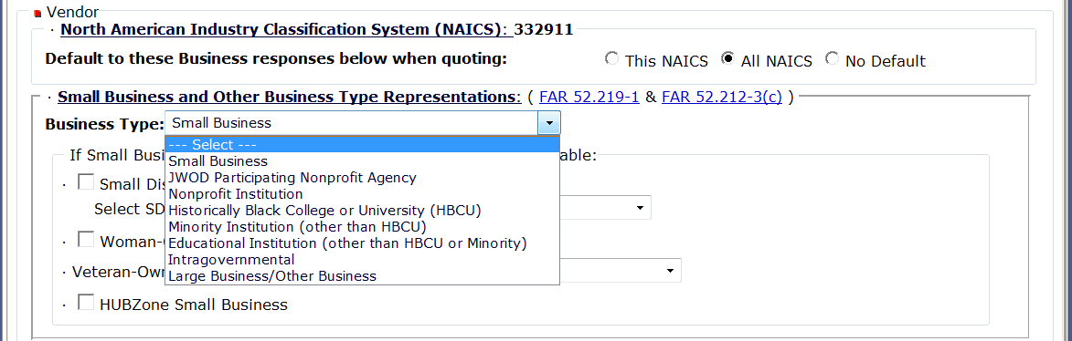
Business Size Representation
Select one based on vendors applicable business type for this solicitation
Notes:
Now we have moved onto the vendor section of the quote form.
The North American Industry Classification System (NAICS) code for the solicitation should be listed. The NAICS codes will determine based on size standards if your company can be classified as a small or large business. The information about business type is pre-filled from the vendors Representations and Certifications from www.SAM.gov (System for Award Management).
SAM is the official U.S. Government system that consolidated the capabilities of CCR, ORCA and EPLS. There is NO fee to register for this site. Users have advised us in the past that some replica SAM.gov websites are out there that require a fee to register…THESE ARE NOT THE OFFICIAL U.S. GOVERNMENT SYSTEM. Vendors should only register, for free, at www.SAM.gov.
This is also a great spot to remind vendors to keep their profiles up-to-date and have applicable NAICS codes entered in DIBBS, SAM and the Small Business Administration Dynamic Small Business Search.
**CLICK** From the dropdown arrow, vendors should select their applicable business type for this solicitation.
**CLICK** You can also reference FAR 52.219-1 & FAR 52.212-3(c) by clicking on the underlined blue text.
**CLICK**

Slide 32
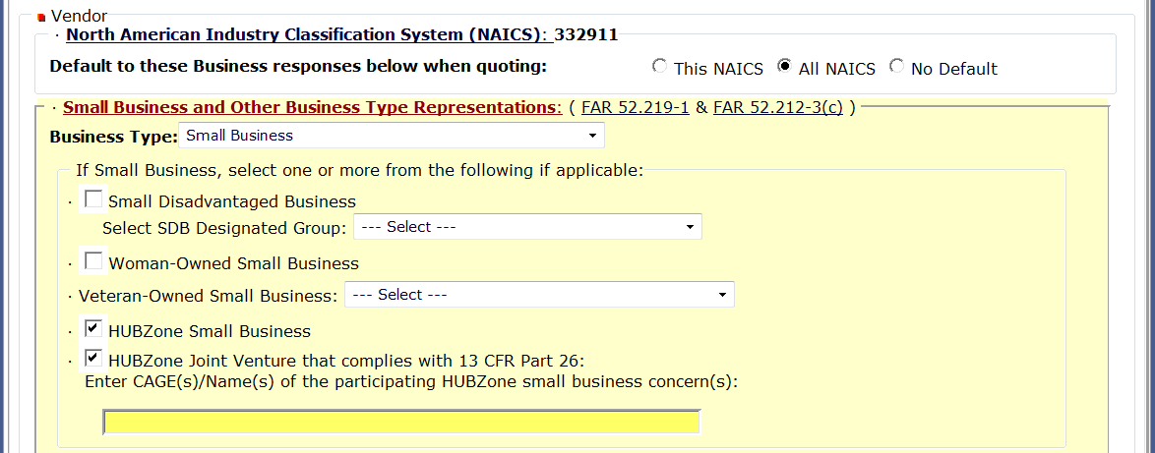
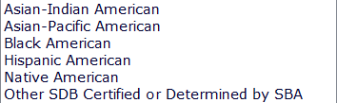
Small Business Size Representation
If a small business, select one or more of the socioeconomic categories listed.
HUBZone Joint Venture
SDB Designated Groups:
Veteran-Owned Small Business selections:
Notes:
If your business type is “Small Business”, select one or more of the following:
**CLICK**
Small Disadvantaged Business
Woman-Owned Small Business
Veteran-Owned Small Business
HUBZone Small Business
**CLICK** If you select Small Disadvantaged Business – from the dropdown list – select from the SDB designated groups.
**CLICK** If you are a veteran-owned small business select from Service Disabled Veteran-Owned Small Business OR Other Veteran-Owned Small Business
**CLICK** If you are a HUBZone, also check if you are a HUBZone Joint Venture. If in a HUBZone joint venture, provide the CAGE codes and names of the participating HUBZone small business concerns.
FLOOR WALKERS: Make sure vendors are selecting all applicable business size types.
**CLICK**

Slide 33
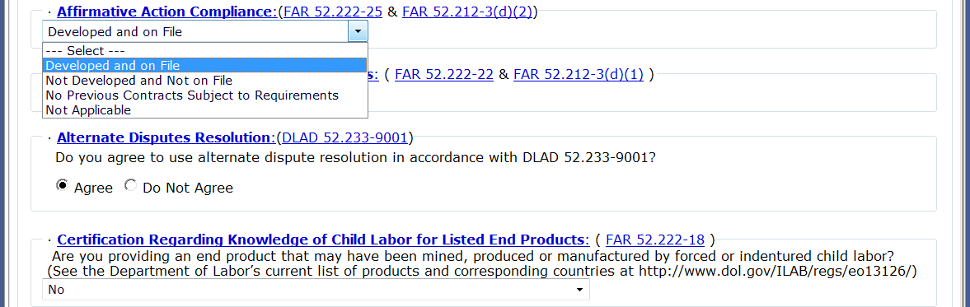
Affirmative Action Compliance
Affirmative Action Compliance applies to solicitations estimated to exceed $10,000.
Select one as applicable
Notes:
The next field – Affirmative Action Compliance applies to solicitations estimated to exceed $10,000.
**CLICK** Select as applicable from dropdown list.
**CLICK**

Slide 34
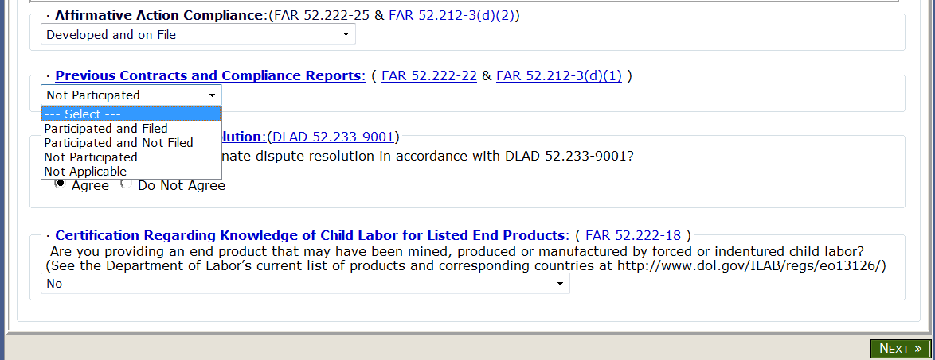
Previous Contracts and Compliance Reports
Previous Contracts and Compliance Reports applies to solicitations estimated to exceed $10,000.
Select one as applicable
Notes:
Next field – Previous Contracts and Compliance Reports applies to solicitations estimated to exceed $10,000.
**CLICK** Select as applicable from dropdown list.
**CLICK**

Slide 35
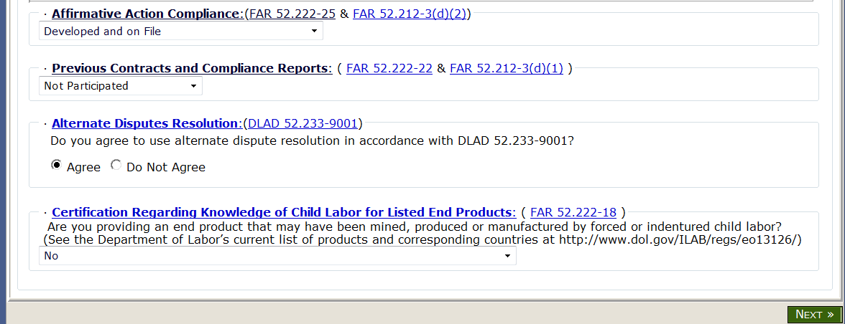
Alternate Disputes Resolution
Select as applicable
Notes:
Next field – Alternate Disputes Resolution, answer the question, Do you agree to use ADR in accordance with DLAD 52.233-9001?
You can select the blue underlined DLAD reference for the full text.
**CLICK** Select Agree or Do not Agree as applicable.
**CLICK**

Slide 36
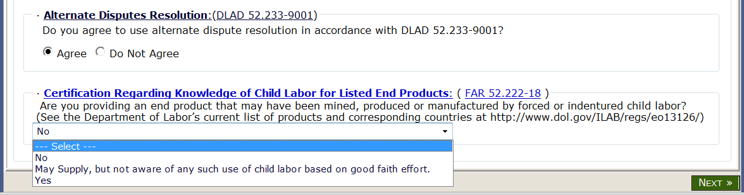
Certification Regarding Child Labor
Select as applicable
Make sure all information on your quote is complete and correct.
Click on NEXT.
Notes:
Last field is Certification Regarding Knowledge of Child Labor for Listed End Products.
Vendors to select response from dropdown box based on the question given: Are you providing an end product that may have been mined, produced or manufactured by forced or indentured child labor?
If “YES” then bid type must equal Bid with Exception or Alternate Bid.
**CLICK** Finally, scan through quote to make sure all information is completed and correct….and then click on NEXT.
**CLICK**

Slide 37
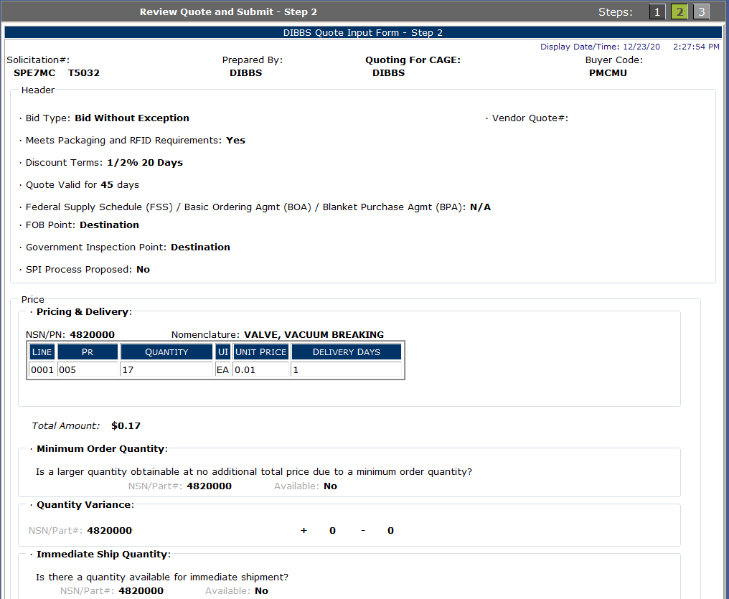
Review Quote
Validate Quote for Accuracy
Scroll down to bottom of webpage
Notes:
Step 2 is now review quote. This is your final chance to review your quote to make sure every field is completed and correct.
Remember you will have to scroll down the page to see the rest of your quote.
**CLICK**

Slide 38
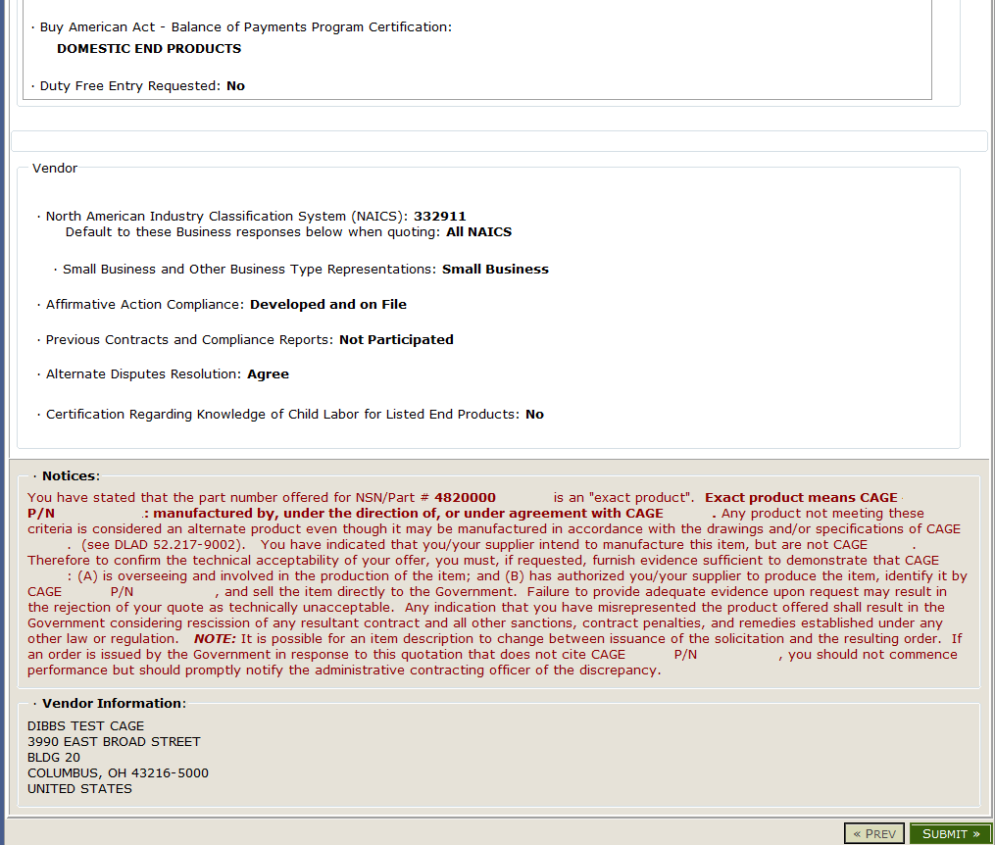
Legal Notice for Part Numbers and Submit
Notes:
IMPORTANT NOTICE: Make sure you read and understand the Notices portion of this quote prior to submitting a quote. This will explain to you based on your quote information, what we expect from you. Many vendors have went to court and lost because they did not abide by this NOTICE.
This is an example of a notice when offering an exact part number from an approved manufacturer. The next slide will demonstrate there is no notice presented when the quoting item is in accordance with a specification/standard/drawing.
**CLICK**
FLOOR WALKERS/PRESENTOR: VENDORS CAN CLICK ON SUBMIT DURING THIS EXERCISE.
Now on bottom right side of page, click on SUBMIT.
**CLICK**

Slide 39
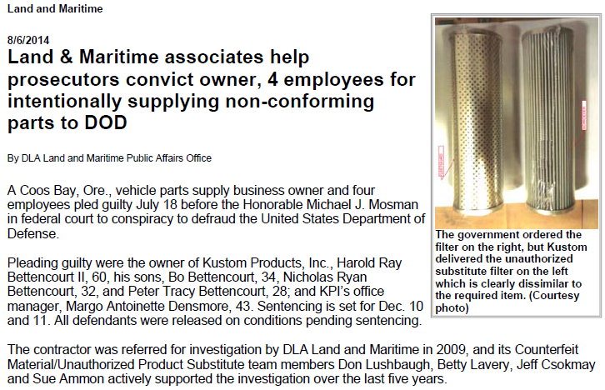
Example of Misinformation
KPI, acting through the individual defendants, lied in order to secure what the Government found to include 750 fraudulent contracts with a value in excess of $10 million.

Slide 40
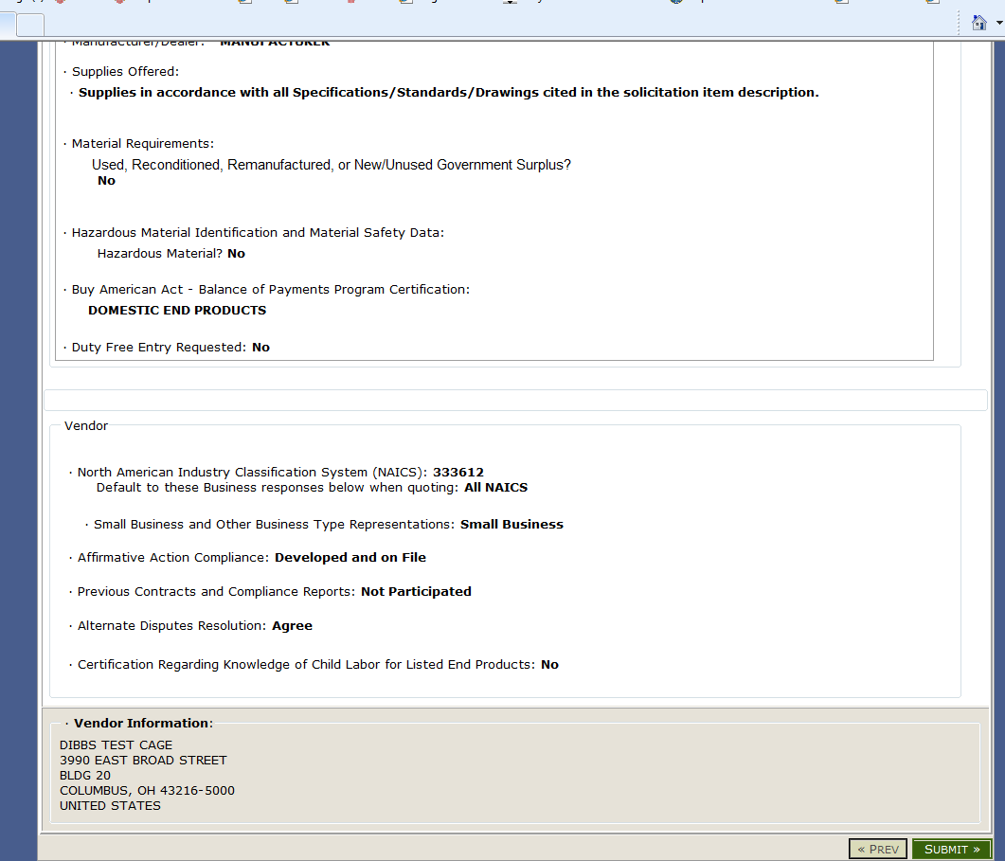
Vendor Statement Concerning the
Supply of Material IAW Spec/Std/Drawings and Submit
Notes:
Example where the legal notice is not shown when the quote is in accordance with a specification/standard/drawing.
**CLICK**
FLOOR WALKERS/PRESENTOR: VENDORS CAN CLICK ON SUBMIT DURING THIS EXERCISE.
Again, click on bottom right side of page to SUBMIT
**CLICK**

Slide 41
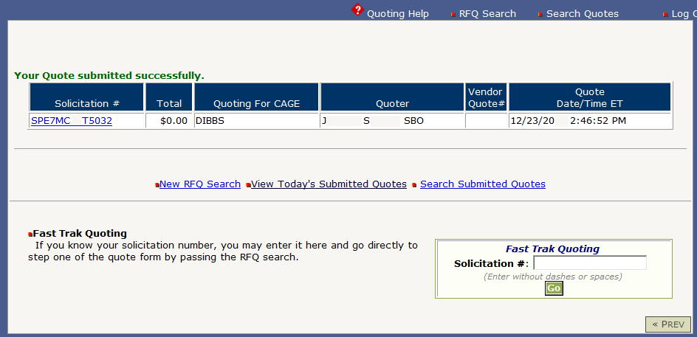
Quote Accepted
Notes:
FLOOR WALKERS: Make sure vendors are now following along online.
Once you click on SUBMIT, make sure you receive this next screen which states that your quote was submitted successfully.
If you do not receive this screen, then your quote did not submit and you’ll have to redo it.
**CLICK**

Slide 42
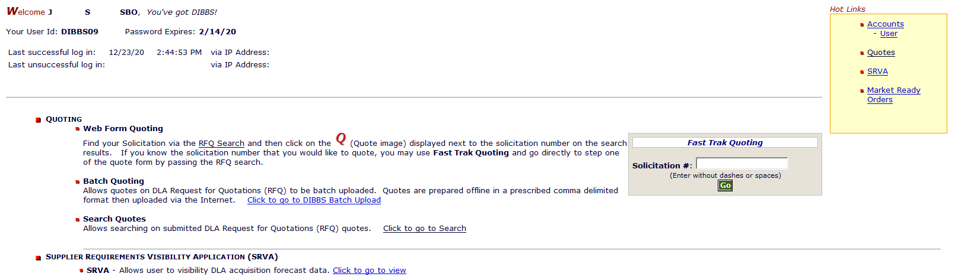
View Submitted Quotes
Notes:
To view submitted quotes, go back to the welcome screen of DIBBS and under HOT LINKS – click on QUOTES.
FLOOR WALKERS: Make sure vendors are now following along online.
**CLICK**

Slide 43
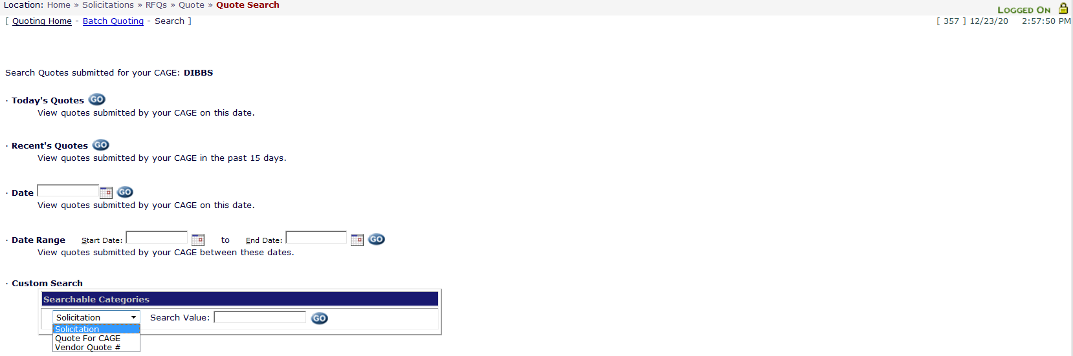
Quote Search
Notes:
On this quote search page you can search by:
Today’s Quotes
Recent Quotes
View quotes by date
View quotes by date range
Or
Custom search for solicitation number, quote for CAGE or Vendor Quote Number
VENDORS For this exercise: Click on Today’s Quotes.
**CLICK**
Just click on “GO” next to search criteria for results.
**CLICK**

Slide 44
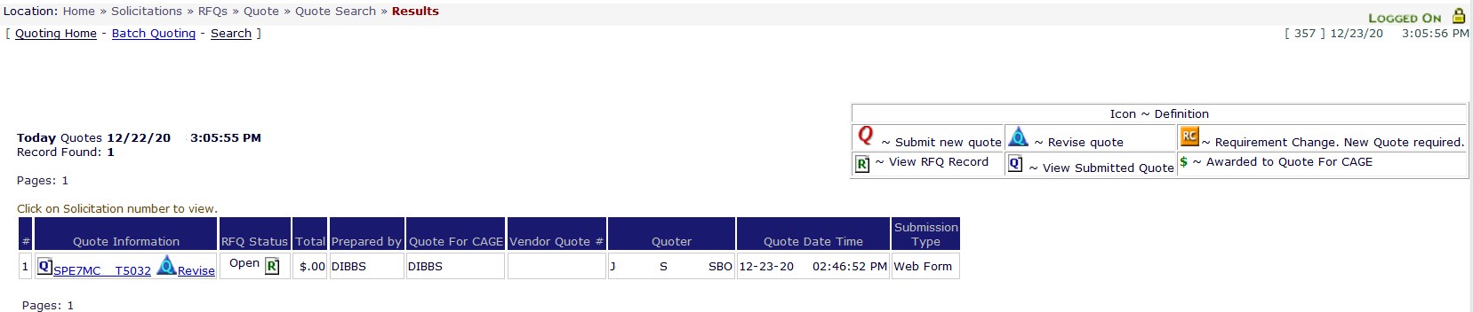
Quote Search Results
Notes:
Here is a sample of the quote search.
If you need to revise a quote that’s been previously submitted, you may do so here before the PR is awarded.
**CLICK**

Slide 45
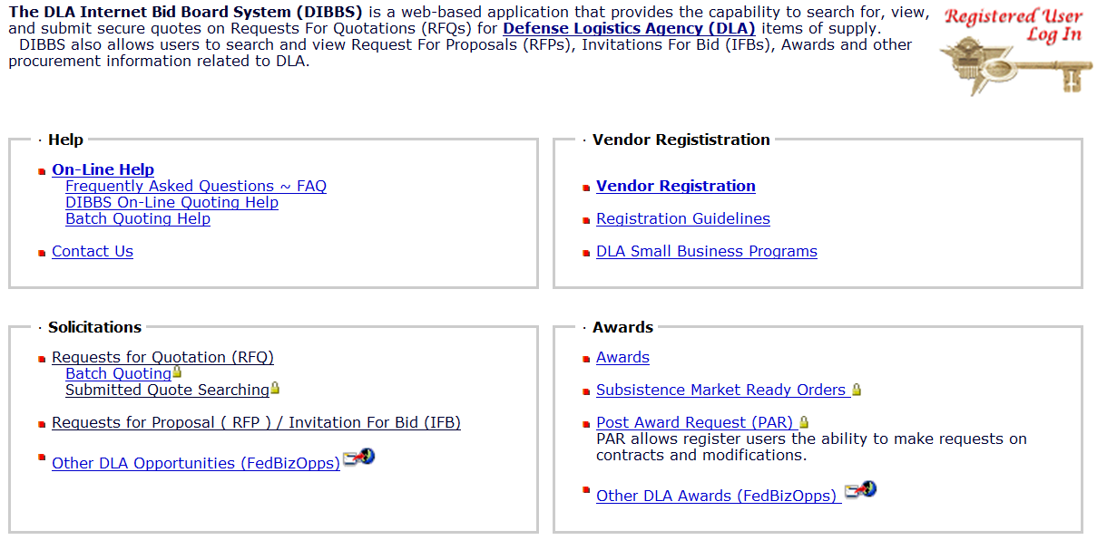
Award Search
Notes:
FLOOR WALKERS: VENDORS go back to DIBBS Homepage.
Now back to the DIBBS homepage, under the Awards section on the right hand side of the screen, you can also search for awards.
Click on underlined word “Awards”.
**CLICK**

Slide 46
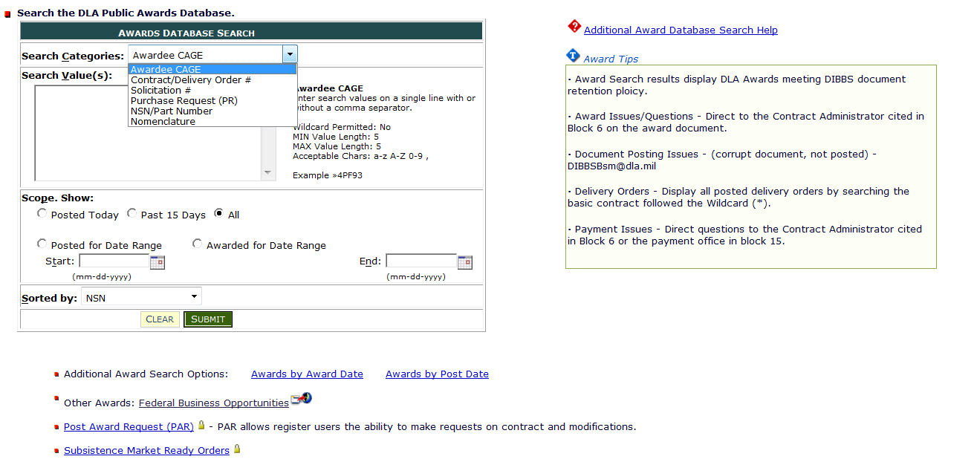
Award Search (cont’d)
Notes:
Click on the dropdown arrow to change the search category to any of the following listed:
Awardee Cage
Contract/Delivery Order #
Solicitation #
Purchase Request (PR)
NSN/Part Number
Or Nomenclature
**CLICK**

Slide 47
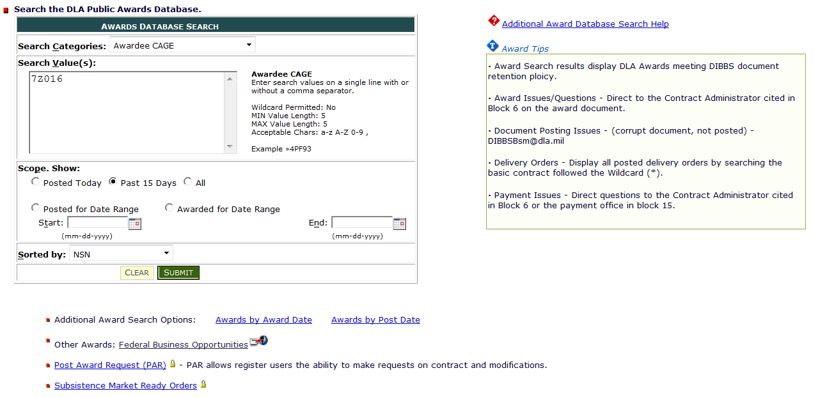
Award Search (cont’d)
Notes:
In this example the search category is Awardee Cage.
**CLICK**
Then in the Search Value field, type in the awardee cage you wish to search for.
VENDORS: TYPE IN SAMPLE CAGE CODE OF 7Z016
**CLICK**
Under scope – you can then view awards posted today, past 15 days, All or select a specific date range.
**CLICK**
When entering search criteria is complete, click on “Submit” for search results.
**CLICK**

Slide 48
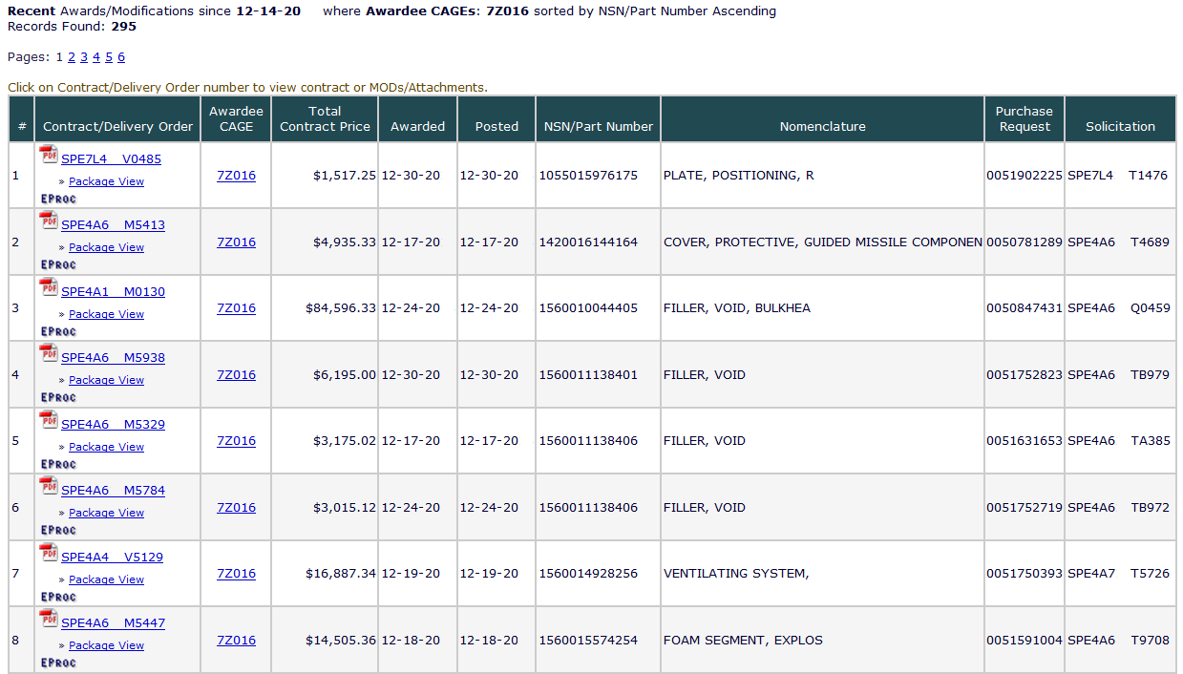
Award Search (cont’d)
Notes:
An award search will provide a copy of the award document, what was the awardees CAGE code, the total contract price, award date and date posted to DIBBS, the NSN, Nomenclature, PR number and finally Solicitation Number.
**CLICK**

Slide 49

Post Award Requests (PAR) in DIBBS
Enter DIBBS user ID and Password
Notes:
VENDORS: Now follow along with presentation and not online.
Post Award Requests (PAR) in DIBBS.
This is were registered DIBBS users will have the ability to make modification requests via DIBBS. Vendors should use PARS to send post-award requests for action/information to Award Administrators, replacing formerly-used methods such as phone calls, emails, letters, faxes etc.
**CLICK**
Vendors must have access and an account in DIBBS in order to submit PARs.
Vendors can only submit PARs for Purchase Orders/Contracts that have been awarded in SRM (awards would start with SPE)
**CLICK**

Slide 50

Post Award Requests (PAR) in DIBBS (cont’d)
Notes:
On the DIBBS homepage, vendors will look on the right hand side under Awards.
**CLICK**
To make a post award request (aka PAR) click on the underlined words.
**CLICK**

Slide 51

Post Award Requests (PAR) in DIBBS (cont’d)
Notes:
Vendors would then select either a New PAR or PAR Status links.
**CLICK**

Slide 52

Submit a New PAR
Submit a New PAR
Notes:
To submit a new PAR is a 3 step process.
Step 1 – Do you want to copy a previous PAR core data?
Verify that the NO radio button is selected.
**CLICK**
Click on Next
**CLICK**

Slide 53

Submit a New PAR (cont’d)
* Mandatory Entries
Note: When entering text within this field, do not use the “Enter” key at the end of each line. Allow the system to word wrap your sentences to the next line.
Notes:
Step 2 – Provide as much information as possible regarding your request for a modification.
**CLICK**
Note that Contract Number and PAR Reason must be selected in order to submit a request.
**CLICK**
You can also upload an attachment to the PAR by clicking on the “BROWSE” button. However, the ability to add an attachment is currently not working but will be fixed.
It is not necessary to attach a document in order to create a PAR.
**CLICK**

Slide 54

Submit a New PAR (cont’d)
Notes:
From the dropdown list is shown the complete list of PAR reasons. Vendors are to select the reason that best matches your request.
**CLICK**
Once all information is completed, click on “SUBMIT”
**CLICK**

Slide 55

Submit a New PAR (cont’d)
Notes:
Once you have successfully submitted the PAR, the PAR screen displays a confirmation.
**CLICK**

Slide 56

Submit a PAR Status Request
Notes:
You also have the ability to search for all PARs (open or closed) that you have submitted via the Contract Number, PAR Number or a Date Range.
Select the radial button next to your desired method of search and enter applicable number(s) in the Contract Number, PAR Number or Date Range Fields.
**CLICK**
Then click on search.
**CLICK**

Slide 57

Submit a PAR Status Request (cont’d)
Notes:
The search results will appear in a table at the bottom of the screen.
**CLICK**

Slide 58
DLA Land Depot Level Reparables (DLRs)
Find Contracting Opportunities at:
DLA Aberdeen https://acquisition.army.mil DoDAAC Search = SPRBL1
DLA Warren http://contracting.tacom.army.mil DoDAAC search = SPRDL1
Contact DLA Land and Maritime Small Business Specialist @ 800-262-3272 or DSCC.bcc@dla.mil
Notes:
Some additional information.
DLA Land Depot Level Reparable Procurements are located at DLA Aberdeen and DLA Warren.
Listed on this chart are the small business locations with their contact information.
**CLICK**

Slide 59
DLA Land Depot Level Reparables (DLRs) and Shipyard Detachments
Find Contracting Opportunities at:
https://www.fbo.gov
https://www.neco.navy.mil
DLR Site
DLA Mechanicsburg: DoDAAC = SPRMM1
DLA Warren: DoDAAC = SPRDL1
Shipyards
DLA Norfolk: DoDAAC = SPMYM1
DLA Puget Sound: DoDAAC = SPMYM2
DLA Portsmouth: DoDAAC = SPMYM3
DLA Pearl Harbor: DoDAAC = SPMY4
Contact DLA Land and Maritime Small Business Specialist @
800-262-3272 or DSCC.bcc@dla.mil
Notes:
DLA Maritime Depot Level Reparable Procurements are located at DLA Mechanicsburg.
DLA Land and Maritime also provides contracting oversight for the DLA shipyards listed.
**CLICK**

Slide 60

Conclusion

Slide 61

FOR OFFICIAL USE ONLY

