Slide 1
DLA Internet Bid Board System (DIBBS) Solicitations
FOR OFFICIAL USE ONLY

Slide 2
How DLA Buys
Approved CAGE Code & Part Number stated in solicitation under item description
Manufacturer(s) already approved
Approved source(s) for dealers and distributors
Qualified Products/Manufacturers Lists (QPLs/QMLs) –
Pre-qualified Large and/or Small Businesses
Source controlled via approved sources –
Restricted to pre-approved sources listed on drawing
Fully Competitive –
Government has available for use to any manufacturer to make items of supply
I/A/W Drawings Available (BidSets/Technical Data Packages)
Notes:
* Now, when considering DLA’s buying practices, if you think about DLA as a large quality control agency, they have ways in which they assure the quality of the items meet the needs of the military customer they’re buying for.
The first way is by the approved CAGE Code and Part Number. This means engineers or technical personnel identified a part that is made by a certain company who has a CAGE code, and they have approved that part number. So when they want to buy that item, they are asking you to provide that specific item. Now, quite often we will solicit for a CAGE Code and Part Number, but vendors will want to offer a substitute, that they are certain is just like the item shown on the solicitation. Be careful! We consider this an “Alternate Item.” Only the CAGE and part number shown on the solicitation can be called the “Exact Item.”
In other cases, there are qualified products and manufacturers on a list, called a Qualified Products List, QPL or Qualified Manufacturers List, QML. Technical staff has reviewed the characteristics of items, and the capabilities of manufacturers who provides them. It may be the original manufacturer, or someone else. The QPL or QML list determines what qualified products we will buy and what qualified manufacturers can supply them.
The third kind of item, would be source controlled via approved sources. In these cases, source control items are those that have been tested and approved by the OEMs (Original Equipment Manufacturers)
The greatest range of competition, especially for new or small businesses is in the case of fully competitive items. Here we reserve the right to test, but we don’t necessarily test before we buy. What happens then, as part of the DIBBS bidding process, we administer a set of drawings, or what’s called a technical data package, and the business determines whether or not they can make the item in conformance with those drawings. The businesses submit their offer based on what they feel it would take, in terms of time, cost, and profit, to provide that item.
So these are the primary ways in which a business would determine whether or not they can bid on an item. Either they are on a list, the item has been previously approved, or they can look at a set of drawings, a technical data package, and determine if they can make and quote for that item.
This is giving you a lot of Information, (ASK : DO YOU HAVE ANY QUESTIONS?)

Slide 3
Common Solicitation Types
Request for Quotations (RFQs)
- Under $250,000
- Most common type at DLA
- Average award is under $4,000
- Most quoted through DIBBS
Request For Proposals (RFPs)
- Over $250,000
- Proposals may be negotiated
- Solicitations must be filled out by hand and
returned to DSCC by a specific time and date
stated on solicitation
-Upload Proposal Capability
Notes:
* CLICK There are two common solicitation types. One is a Request for Quotation. This is for solicitations with an estimated value under $150,000, the most common type of solicitation at DLA. Believe it or not, the average award value at DLA is under $4,000. And when you consider the billions of dollars we spend, you recognize that we issue a lot of solicitations, and awards, every day and every year. But most interesting is the fact that 30 to 40 percent of those are awarded without human intervention.
So the requirements can be solicited and awarded by an automated system. Your quotes are evaluated by that system, and if all goes well, the announcement of the award is sent to you electronically. So if you are really focused on working on a system where you have a lot of human interaction, this may be a hard system for you to get used to initially, but we’ll talk about ways in which you can identify some support resources, both at DLA and in your local community, to help you to effectively participate in that system a bit later.
The other type of solicitation is a Request for Proposal. These are solicitations for awards over $150,000. Sometimes they are one-year contracts, sometimes multiyear contracts. The terms of these solicitations can be negotiated once the solicitation period has closed. For example, terms that can be negotiated may include price, delivery time, or delivery quantity. The initial announcement of the solicitation will be found on DIBBS, but the proposal and negotiation will be processed outside of DIBBS.

Slide 4
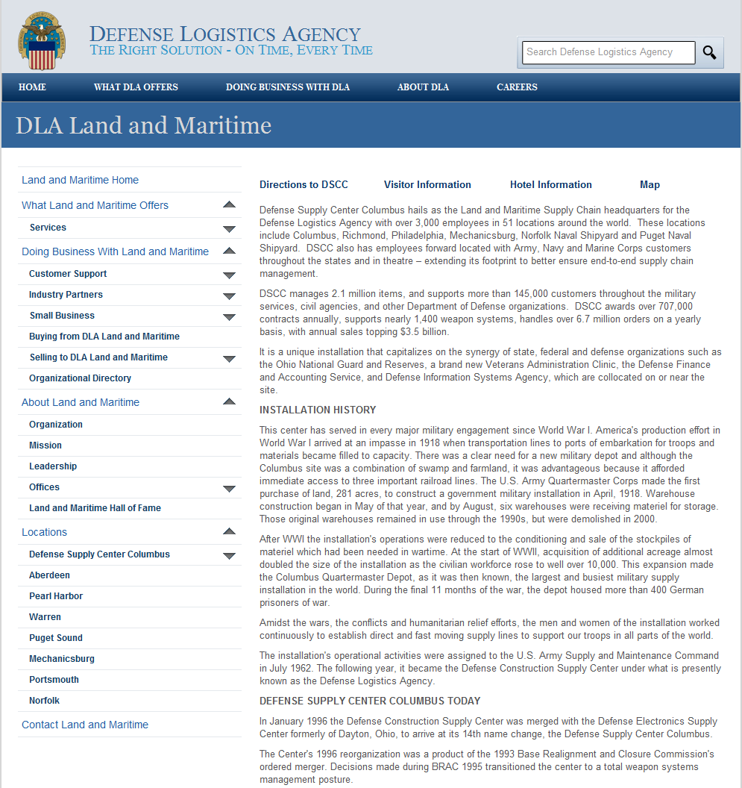
DLA Land and Maritime Homepage
Notes:
* CLICK If you are on the Land and Maritime site, you’ll see a link on the sidebar that says, “DLA Internet Bid Board System,” or, if you’re on the Small Business Web site, there will be a similar link that says “DLA Internet Bid Board System.”
* CLICK Both of these links will take you to the homepage. You can go almost anywhere in DIBBS from this homepage.
VENDORS: Open DIBBS home page and state what is on the site, what you can look for from here and that at least 85% of our Simplified Acquisition solicitations (under $150K) are AUTOMATED***

Slide 5
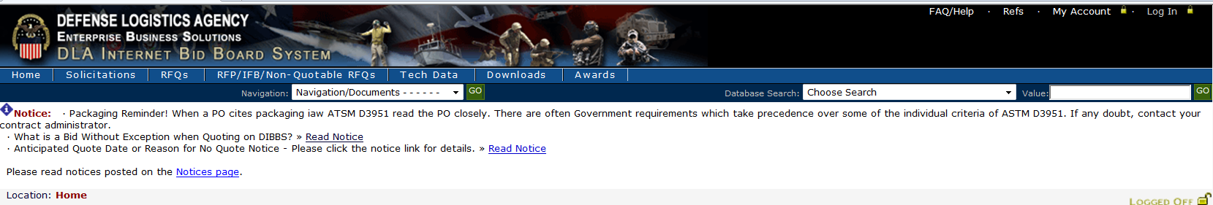
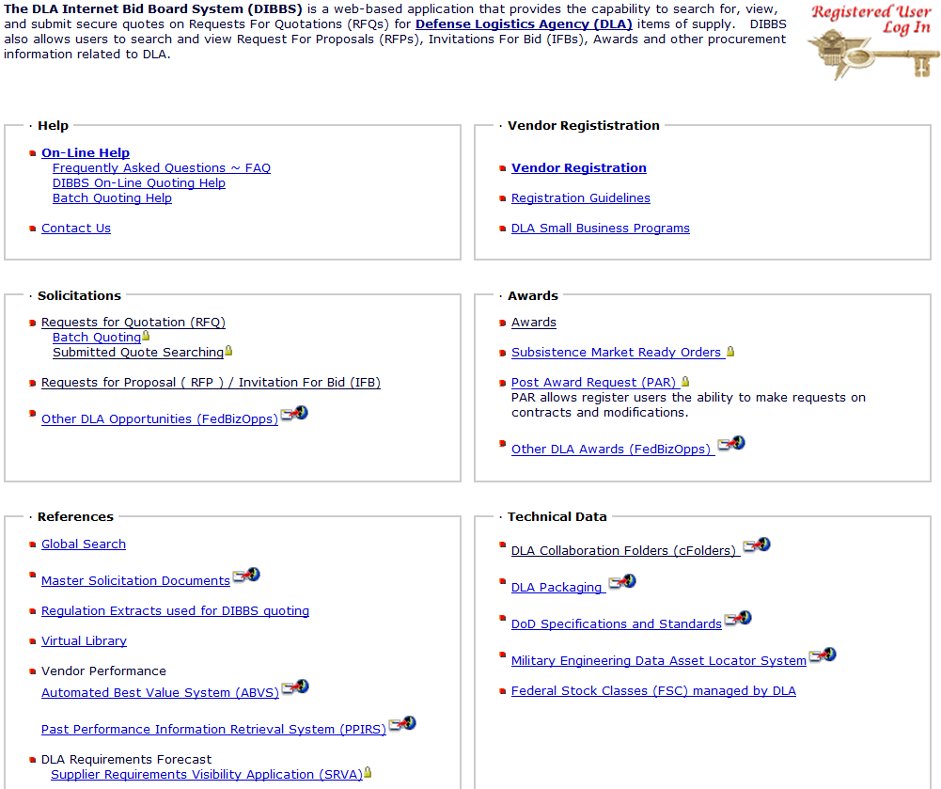
DIBBS Home Page (upper part) https://www.dibbs.bsm.dla.mil/
Check Banner - for New items to be found in the Notices section
For Vendor Registation - must have prior SAM Account.
Registration enables – submission of electronic quotes for RFQ’s. Also to receive solicitation and award notifications.
DIBBS Helpdesk – if you have DIBBS system questions/issues, or if you need clarification of FAQ’s – ie “Super User left company, we need account deleted” use Contact Us
Auto Solicitations have no Clauses listed, only referenced – see them here
FSC List
Notes:
Please note the DIBBS web address at the top of this slide and the banner that lists important notices.
I want to talk about the boxes that you see on the DIBBS homepage, and the kind of functionality that you can achieve by clicking on the links that show up in blue. So, in the upper left-hand corner is the Help box. * In our office, we receive a lot of requests for help, but I want to show some resources that have been placed in the DIBBS System to help you either get started, or navigate through an issue you might be having.
There is an online Frequently Asked Questions page that you can get to by clicking on the link under “Online Help.” There’s also batch quoting help for those of you who have had experience with DIBBS, and may be having issues with batch quoting.
I would also recommend that if you have questions, work with the closest Procurement Technical Assistance Center, who can provide free assistance on how to get established on DIBBS or navigate through DIBBS. Just use your Internet Search engine to find the PTAC home page. (SHANDA HARRIS WAVE YOUR HAND)
There are references down in the bottom left-hand corner, some of which are going to be critical to how you formulate or respond to a solicitation issued by DLA. One is the Master Solicitation. Solicitation documents won’t contain the full text of all of the applicable provisions and clauses. You must become familiar with the Master Solicitation to understand your rights and obligations in quoting and receiving awards from DLA.
*CLICK For all automated bids, the Master Solicitation Document contains all the provisions and clauses attached to each and every automated solicitation. You can look there to find out the nature of those requirements.
There are other links in that box that spell out the applicable regulations, whether they apply to quality, packaging, delivery, or types of processes used when making items. All those regulatory references can be accessed in this block, as well.
Now, back to the top right of the page. You will find Vendor Registration, which hopefully you have completed by working with your local Procurement Technical Assistance Center (PTAC). But in case you have not, this is where you register your company for DIBBS access. You may also set up your registration so that you receive automatic solicitation alerts for either Federal Supply Classes, or National Stock Numbers, that your company is capable of providing. Those automatic notices let you know when there is a solicitation on DIBBS, and the notice will come to the same e-mail address you used when you registered in the System for Award Management (SAM). We won’t send you the actual solicitation, but DIBBS will let you know that there’s a solicitation to review.
Next, in the bottom right-hand corner, is a Technical Data section. By viewing the list of DLA managed Federal Stock Classes (FSC), vendors can determine if the FSC is managed by DLA or General Services Administration (GSA).
VENDORS: SCROLL DOWN

Slide 6
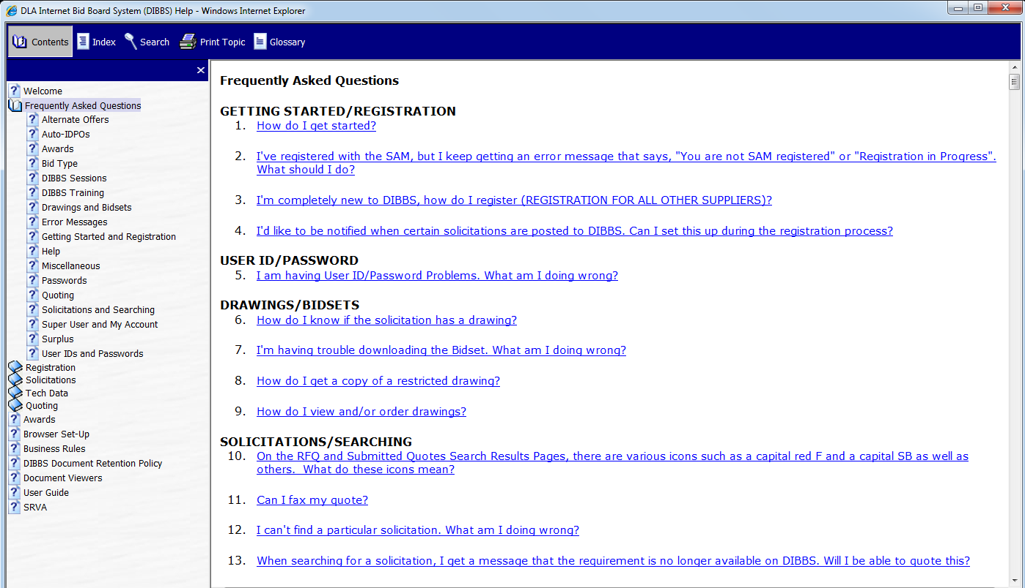
Help – FAQ Topics
Notes:
This is a view of the Frequently Asked Questions site.
There are 16 different topics and 43 common questions, in multiple parts.

Slide 7
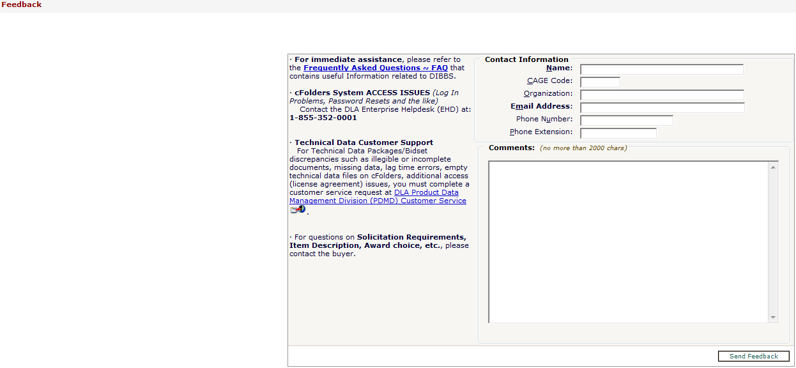
Help – Contact Us
Fill out as much of the contact information as possible
Describe your issue
– “System won’t let us change our email & address”
Notes:
In Help – you would click on Contact Us
This is a view of the Help Contact Us site.

Slide 8
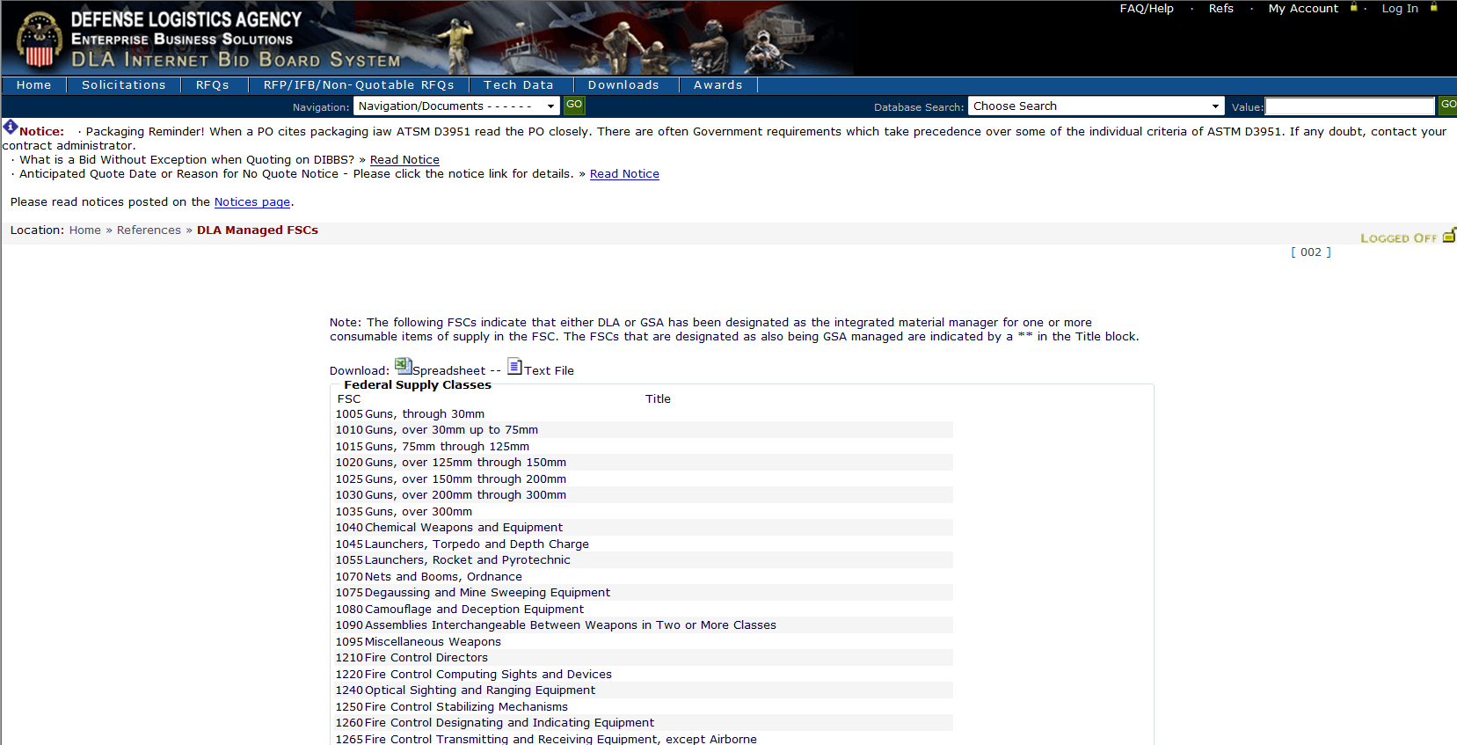
Identifying Federal Supply Classes
DLA’s FSC list with corresponding item description
3040 Miscellaneous Power Transmission Equipment
Think of an FSC as an “area code” of a phone number & each FSC having thousands of NSNs in it’s “area code”
Notes:
In the Technical Data Section – Federal Supply Classes shows those FSCs Managed by DLA
This is a view of the FSCs managed by DLA. You can see, that this list will provide the FSC and the corresponding description of the item
(think of FSC (first four numbers of National Stock Number [NSN]) as area code of your phone number)
NIIN – National Item Identification Number

Slide 9
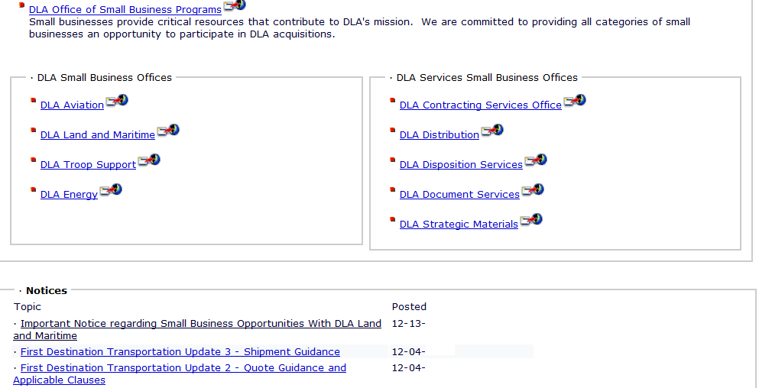
DIBBS Home Page (lower part)
IT Systems, Professional / Management Services; Enterprise-wide Requirements
Links go to each locations home page
DIBBS Notices such as System Updates and Other Opportunities – recommended check weekly if not daily
Notes:
* Moving down on the DIBBS Home Page, vendors also see a link for the DLA Office of Small Business Programs. This is a location to find DLA resources for small businesses.
Also within this same box are direct links to the major Supply Centers: Aviation, Land and Maritime, Troop Support and Energy.
At the very bottom is the DIBBS Notices area. This is something each business will want to look at when they first open DIBBS. These are important notices about upcoming policy changes, training activities and special events. Watch for notices about TKO training, our free webinars on doing business with DLA.

Slide 10
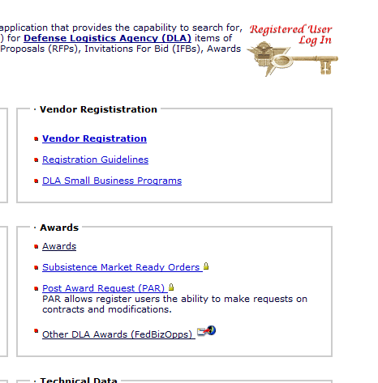
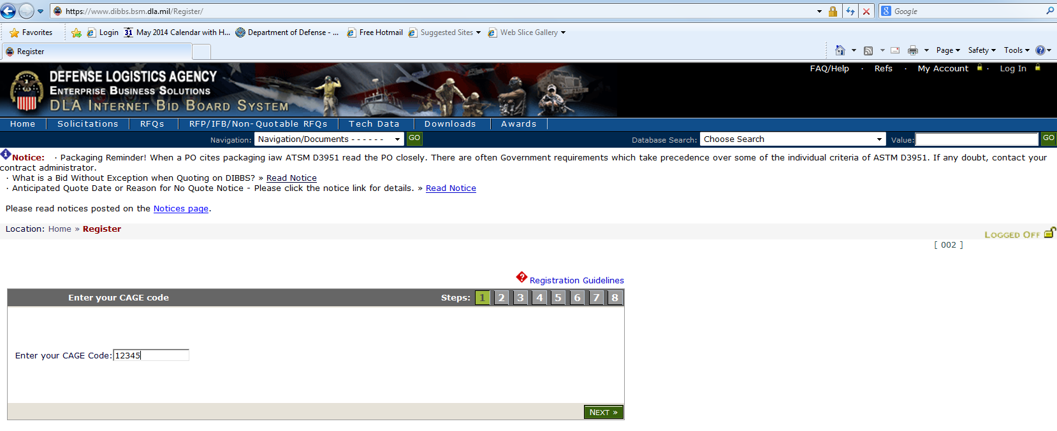
DIBBS Registration
Click here to Register
Enter your CAGE
Notes:
This next section is for demonstration purposes only *CLICK
For new Users / Vendors who need to Register go to Vendor Registration Section (upper right)
- Click Vendor Registration
To register provide your CAGE code.
TURN OVER-- Shanda

Slide 11
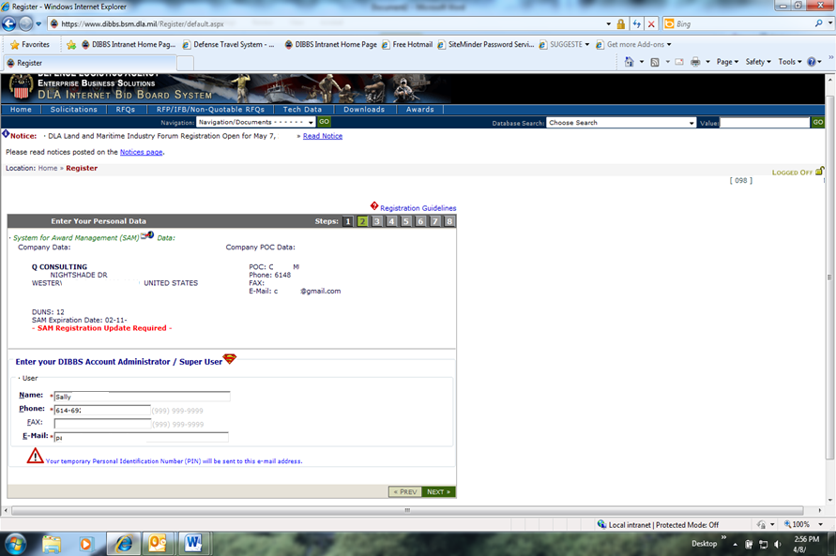
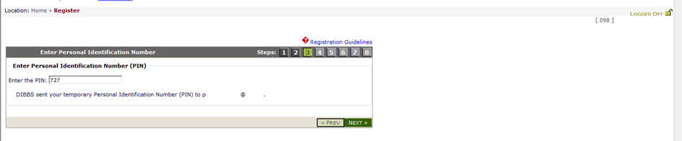
DIBBS Registration (cont’d)
Data pulled from SAM
Super User - enter name, phone number and email
Your Temporary PIN # will be sent here
After receiving Temp ID input number here
Notes:
You see the company data information in the center of the screen, which is pulled from SAM. *
* You will want to enter a name, phone number and email address for your company’s Super User DIBBS Account Administrator.
* When you click on “NEXT”, the system will send the Super User / Account Administrator a temporary ID and PIN # to the email address provided. If for some reason that PIN number fails, there is a Help link for you to e-mail the Help Desk. They will reset the PIN and send you a temporary password.

Slide 12
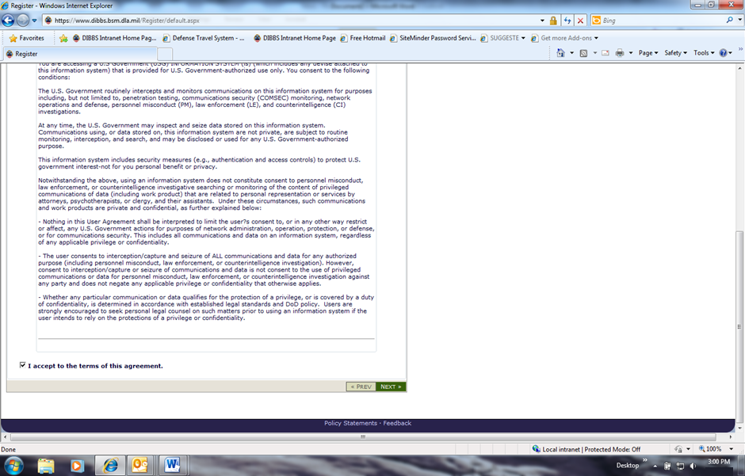
DIBBS Registration (cont’d)
Carefully read & understand agreement
Check “I accept terms box”
&
“NEXT”
Notes:
To continue the registration process, carefully read the terms of this agreement.
Make sure you accept the terms” and click “NEXT”.

Slide 13
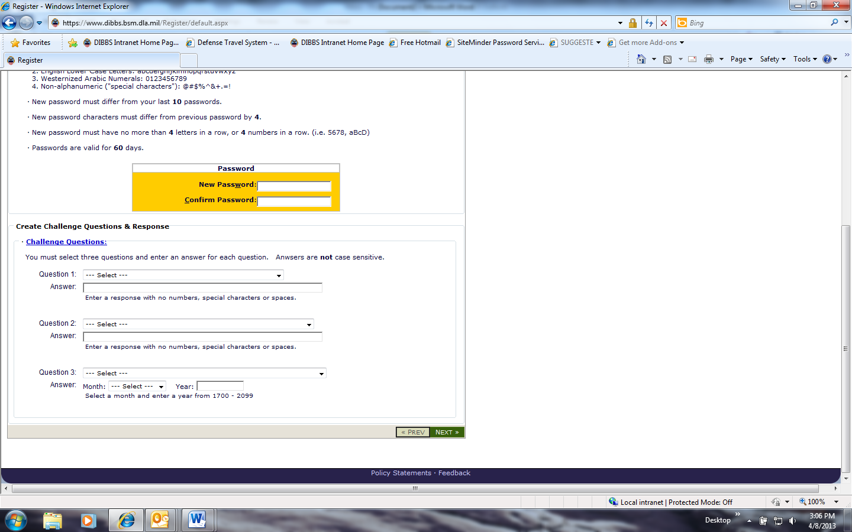
DIBBS Registration (cont’d)
Password Format · At a minimum your password must be at least 15 characters long. · Your password must contain at least 1 characters from each of the following 4 classes listed in the chart below: 1. English Upper Case Letters: ABCDEFGHIJKLMNOPQRSTUVWXYZ 2. English Lower Case Letters: abcdefghijklmnopqrstuvwxyz 3. Westernized Arabic Numerals: 0123456789 4. Non-alphanumeric ("special characters"): @#$%^&+.=! · New password must differ from your last 10 passwords. · New password characters must differ from previous password by 4. · New password must have no more than 4 letters in a row, or 4 numbers in a row. (i.e. 5678, aBcD) . · Passwords are valid for 60 days.
Passwords should be complex, but one you can easily remember. For example, Msi5%Y0ld%ni$8! (My Son is 5 years old and is great)
Passwords should not contain personal information such as names, telephone numbers, account names, birthdates, or dictionary words
Must select three challenge Questions and enter an answer for each;
“NEXT”
Notes:
You will be prompted to establish a password
- Upper Case
- Lower Case
- Number
- Special Character
15 characters long changed every 60 days
and select three challenge questions with answer’s
Then click “NEXT”.

Slide 14
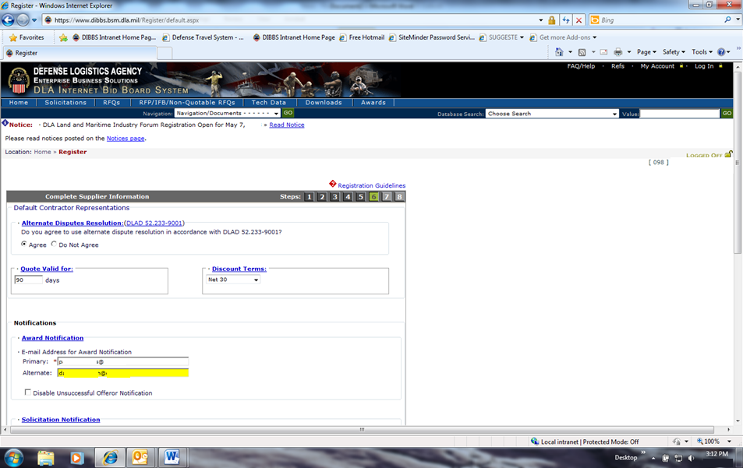
DIBBS Registration (cont’d)
NOTE: Contract Award, and Other Contract Actions i.e. Modifications will ONLY be sent via email to the Primary POC, so verify email address always current
**Also, think about making Primary email a Distribution List or box that multiple people check daily
Agree / Disagree to use Alternate Dispute Resolution
Days Quote Valid for – standard 90 days but can change
Discount terms – standard net 30 days but can change
Award & Solicitation Notifications – Primary and
Secondary (Alternate) POCs – Only ONE Primary & Alternate POC, no more can be added.
*Notifications are sent ONLY to Primary, unless get notification back (undeliverable only) that the e-mails did not go through then Notifications sent to Alternate POC
Notes:
*CLICK
The system will rely on this information when it completes your Request for Quotation.
Complete the alternate dispute resolution, quote valid for and discount terms which will auto fill into your quote. We will discuss these items in further detail in the next section – DIBBS Quoting.
Who will receive your notices?
Under the solicitation notification section --- make sure you include an email address for a primary and secondary points of contact. These email addresses will be used by DIBBS to send your notifications of new open solicitations.

Slide 15
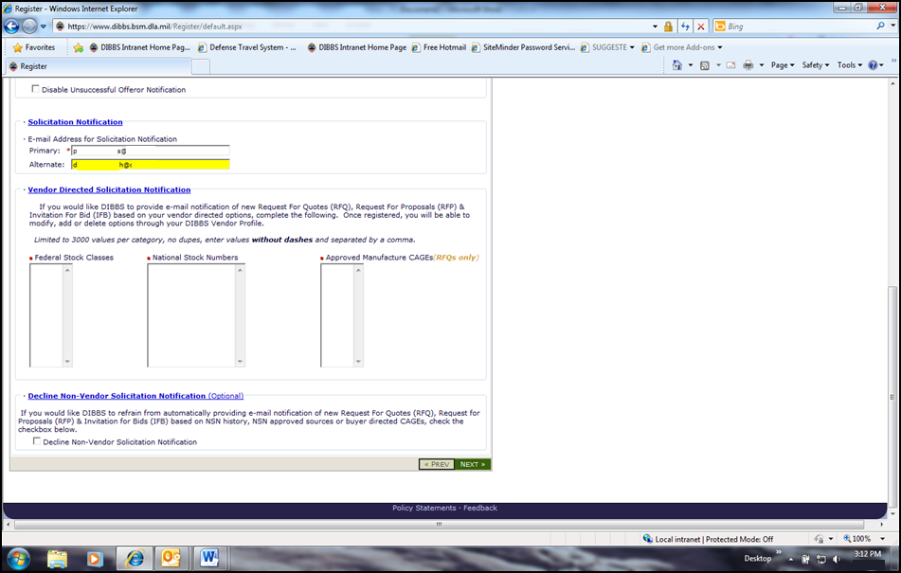
DIBBS Registration (cont’d)
Solicitation Notifications – Primary and Secondary (Alternate) POC w/ e-mail address for notification
Vendor Directed Solicitation Notification
Instructions:
This feature allows the Super User to direct email notification of new solicitations that match selections for FSC, NSN, and Approved Manufacturer CAGE in their profile.
Can enter up to 3000 values per category (FSCs, NSNs, and/or CAGE’s) separated by commas.
Specific NSNs
FSCs - will get every open solicitation in all the loaded FSCs (Email box overload)
Approved
Manufacturer / Cage
Codes - Distributers use this feature a lot
“NEXT”
Notes:
*CLICK
Next is the Vendor Directed Solicitation Notification section --- this section allows the super user to direct email notifications of new solicitation that match selections for Federal Supply Code (FSC), NSN and/or Approved Manufacturer Cages.
For example, if you choose to receive notices about all solicitations in a Federal Supply Class (or FSC), then you will receive a single email notice for every new solicitation for that FSC. This would result in hundreds or thousands of solicitations on that one email received each day, because there are millions of items that could be classified under any Federal Supply Class.
As well as entering an FSC, you can enter National Stock Numbers that your company is interested in.
Lastly, you can also load Approved Manufacturer CAGE codes -- let’s say, you’re a distributor or representative for many manufacturers – you could enter all the different approved manufacturers’ CAGE codes that you supply. Then, every time there is a solicitation that calls for an item made by that approved manufacturer cage code. You will receive a notice.

Slide 16
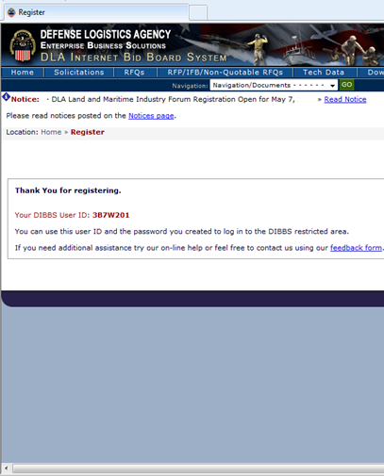
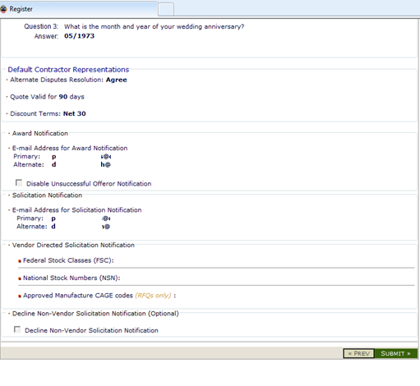
DIBBS Registration (cont’d)
Section 7 – Do a complete Review
If everything is correct > “Submit”
If not: “< Prev” - to go back and make corrections
Section 8 – Thank you for Registering
Shows your DIBBS Super User ID – always your CAGE CODE followed by 01
* Super User can create & assign accounts 02-99
Notes:
Once you review your registration information, click “SUBMIT”.
*CLICK
The right side of the screen is what you see after submitting your registration. The primary user will have an account number which will be their CAGE code followed by “01” and that’s referred to as a “Super User”. Sometimes people come and go, but you definitely want to keep your Super User ID current being that is the primary person contacted by the DIBBS System. Other users may also have account numbers with their CAGE code, followed by 02, 03 up to 99, but they won’t be the primary recipients of information from DIBBS.
If you do not receive the confirmation screen you will need to contact “Help Contact Us”.
Please note that there are slides on the TKO website that address managing and updating your profile and account.

Slide 17
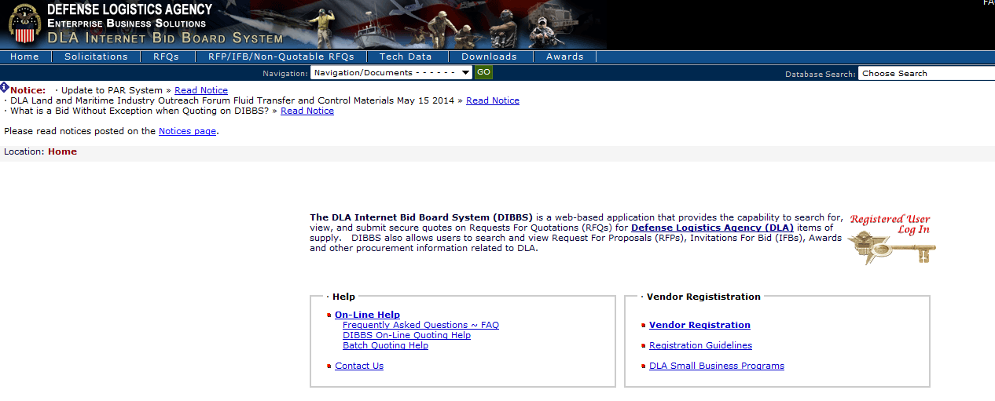
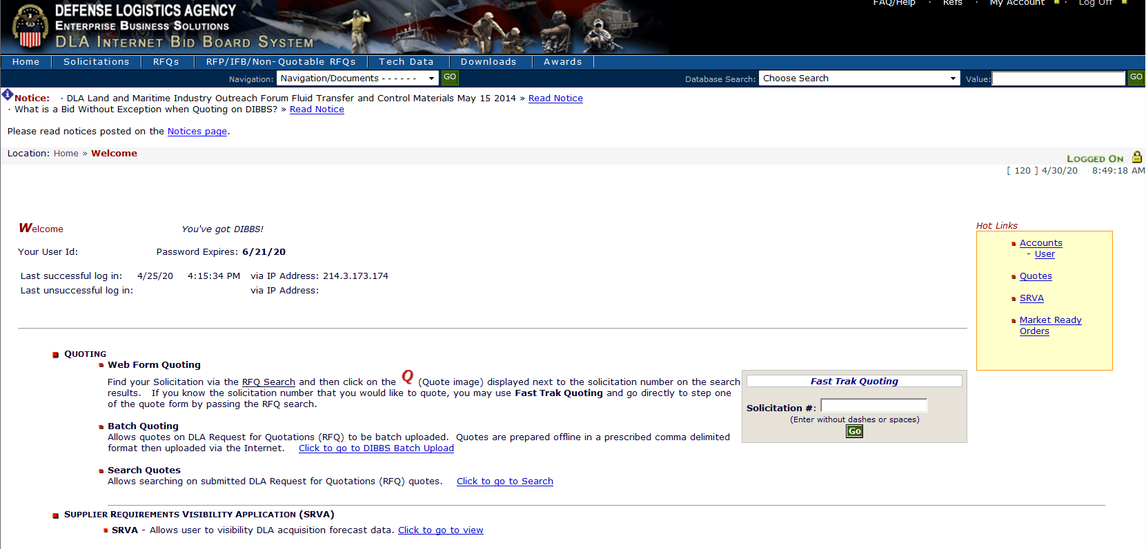
DIBBS
Login for previously registered users
Hot Links to:
Manage your Accounts – User & Vendor, Your Submitted Quotes, SRVA, Market Ready Orders
Home Page:
– Date password expires
– Shows if SAM needs updating and provides link to website (yearly update)
* System will let you quote but you can NOT receive an Award until SAM updated
Notes:
If you are currently registered in DIBBS then you would log in by clicking *CLICK on the key in the upper right hand corner of the DIBBS home page.
That will then bring you to the DIBBS welcome page. Please note that this page shows you when your DIBBS password is going to expire.
When your SAM.gov yearly registration is about to expire you will receive the red warning notice.
You should still should be on DIBBS Home Page

Slide 18
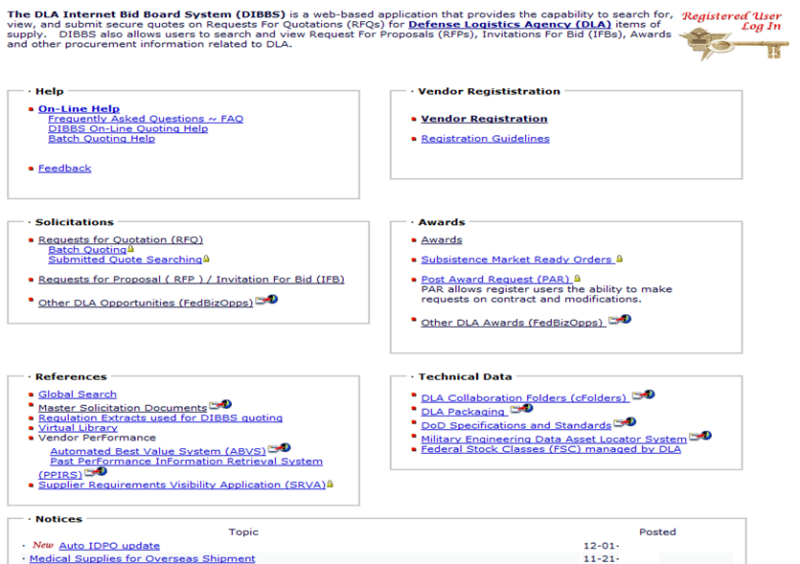
RFQ QUOTE SEARCH
Estimated value at or below $250,000
RFPs - estimated value above $250,000 & Offers/Sealed Bids shall be submitted in accordance with the instructions in Block 9 of the solicitation
Notes:
Now, let us move over to the solicitation area of DIBBS and review the use of the “Request for Quote” search. *CLICK
Remember that a Request for Quotation has an estimated value at or below $150,000.
Be sure to check Request for Proposal for opportunities estimated above $150,000.

Slide 19
SOLICITATION TYPES
RFQ
RFP
Cover Page:
Set aside Type
Issuing Activity / Contracting Officer
Master Solicitation Revision used
*(Q’s) Return by date & time
Section A:
General Contract Requirements
Quality Provisions / Testing
Any available Contract History
Section B:
Item description
Drawing / Specification List OR Code & Part Number List
Contract Delivery lines
Packaging / Shipping Data
Section D: (Q Solicitation)
Contains all required solicitation clauses
Contractor: Reviews & Fills-in applicable clauses
Section A: Cover Sheet
Return by date & time
Set-a-side Type
Issuing Activity / Contracting Officer
Cover Page:
Same as above
Table of Contents w/ # of pages
Part I: The Schedule
Section: A thru H
Part II: Contract Clauses
Section: I
Part III: - List of Documents, Exhibits & Other Attachments
Section: J
Part IV: - Representations & Instructions
Section: K thru M
Notes:
Shanda - PTAC Explanation
After she is finished say: Future Webinar offerings will include more detailed information on this topic

Slide 20
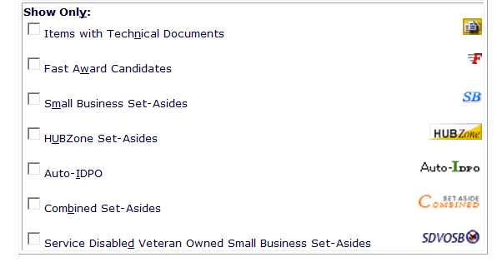
DIBBS ICONS
Micro Purchase (under $10,000) – evaluated by the computer every day & can be awarded after 1 day if offer deemed “fair & reasonable”
Ignore – Legacy icon only & will be going away, eventually
Notes:
Before we talk about how to search for solicitations. Here are some icons that appear inside the solicitation area of DIBBS. We will see these in action, but I just want to cover them briefly.
The Government buys a wide range of material from aardvarks to zithers (A to Z). While we may know the part numbers, occasionally will we have technical documents. If we do have the drawings, and can share them with you, you will see the Tech Docs Icon in your solicitation search results.
“Fast Award” indicates that we may award a purchase order as soon as we receive acceptable quotes, even before the official closing date. One day after the solicitation issue date the auto system will start to evaluate quotes. If the offer is determined fair and reasonable an award will be made, if not the automated system will re-evaluate every 24 hours after.
We Set-Aside many acquisitions for Small business and socio-economic set-asides. Participation on these solicitations is restricted. For questions on socio-economic certifications you can contact your local PTAC and/or SBA Office.
Auto-IDPO is an Indefinite Delivery Purchase Order, covering DLA requirements lasting for one year, with an estimated value under $150,000 being this is a part of the old system

Slide 21
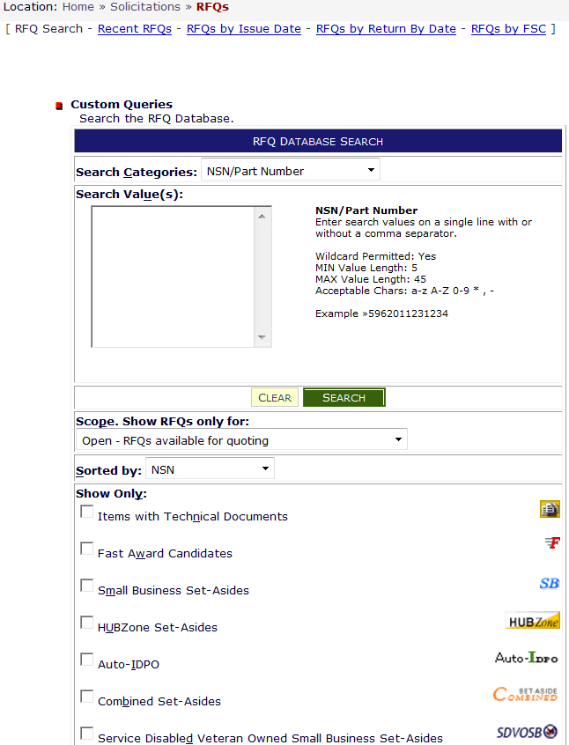
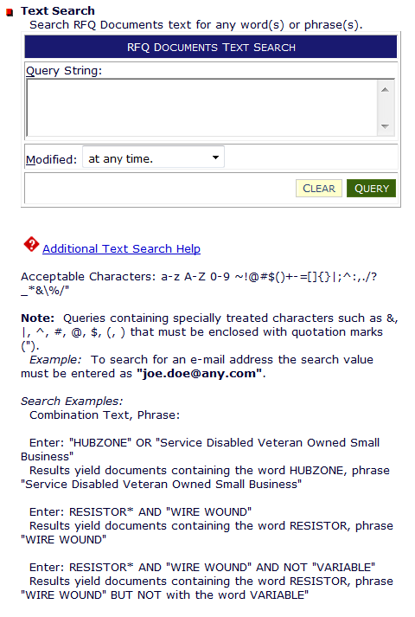
RFQ DATABASE SEARCH
Not available at this time
NATIONAL STOCK NUMBER (NSN)
• FEDERAL SUPPLY CLASS (FSC)
• SOLICITATION NUMBER (SPM)
• PURCHASE REQUEST (PR)
• NOMENCLATURE
• APPROVED PART NUMBER
• APPROVED OEM CAGE CODE
)
Wildcard (*) & Min search value rules change for each category
Notes:
NOTE: Queue floor walkers to assist attendees.
VENDORS: Go to Solicitation section, click on RFQ search.
We see a database search window that looks like the one on the screen. Now, you can search for “Requests for Quotations” by searching all the various search categories that are illustrated in the red box- *CLICK -National Stock Number, FSC, Solicitation Number etc.
A Purchase Request Number, is often referred to as a PR, and that is created from a request by a military customer. There may be multiple purchase requests on a single solicitation. If the requirement is not based upon a National Stock Number, look for an Approved Part Number and manufacturer’s CAGE code.
The wildcard character ( * ) may be used following a search value. The wildcard character ( * ) preceding search values is only permitted on the Nomenclature Search Category.

Slide 22
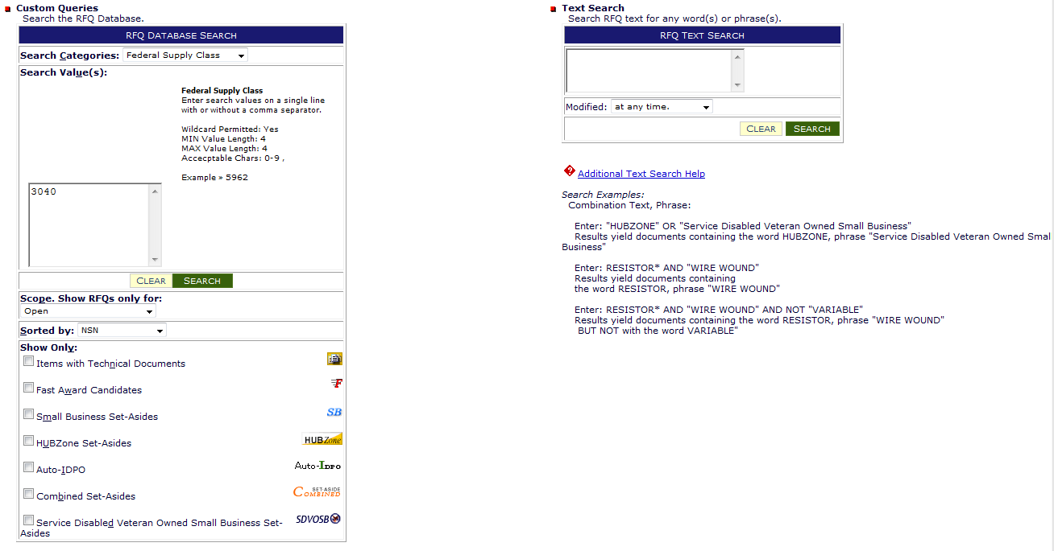
Solicitations - FSC 3040 Mechanical Power Transmission Equipment - Miscellaneous
Not available at this time
Notes:
Vendors follow along.
We will select “Federal Supply Class” from the search categories dropdown box, *CLICK and type in FSC “3040” then click “SEARCH”.
3040 is the FSC for “Miscellaneous Power Transmission Equipment”, a Federal Stock class managed by DLA.

Slide 23
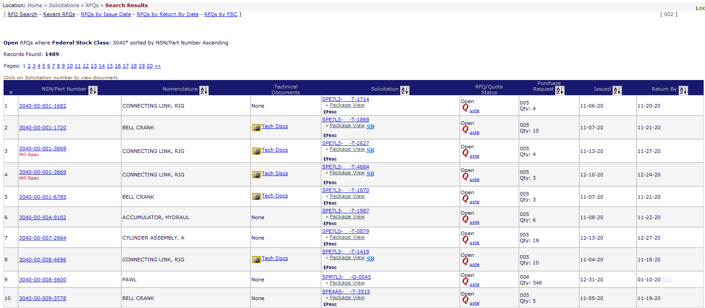
Solicitation Results - FSC 3040
Number of open solicitations
Note: T or U Solicitations –Automated by the System
CLICK: a “NSN” link for Code & Part Number example
Note: Q Solicitations –Generated by an Actual Buyer
Notes:
*CLICK DIBBS returns over 1,450 open solicitations for that FSC. That should give you a feeling for the scope and breadth of what DLA buys, and the potential sales opportunities open to you.
ASK VENDORS: how many results they found.
We could take a long time going through that number of solicitations. So you’ll want to narrow your search to a more manageable list. You might want to limit your search to Small business set-asides, opportunities with Technical documents, or sort the results by nomenclature.
VENDORS: Go ahead and click on the first NSN in column 2 that has the word“None” in the Technical Document field Column 4

Slide 24
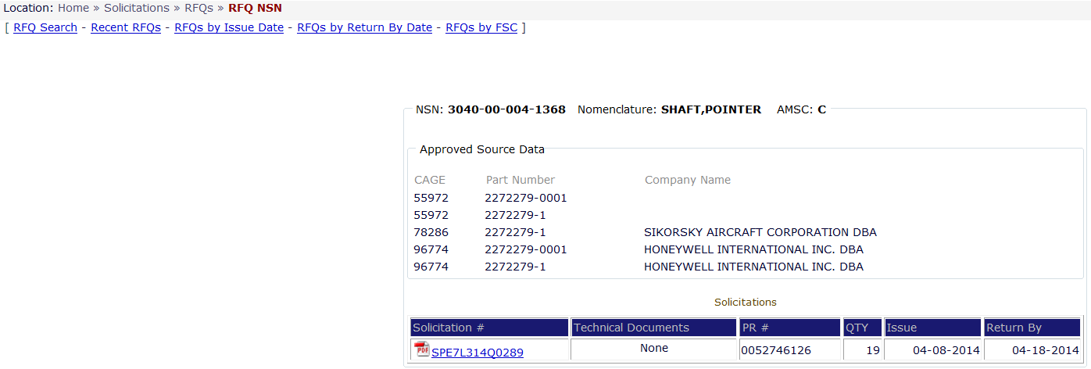
Solicitation – Code and Part Number
Common Code & Part Number AMSC:
(Acquisition Method Suffix Code- limited sources):
B: Source Control
C: Contracting from Approved Source
H: Inadequate Data
T: Qualified Products List (QPL)
Approved Cage Code
Company Name
Approved Part Number
Solicitation #
Notes:
Once you click on the NSN it will give you a synopsis of the NSN details. In this example under Approved Source Data there is a list of approved CAGE codes, manufacturers and their approved part numbers. It also provides a link to the open Solicitation.
The AMSC (Acquisition Method Suffix Code) that is assigned to the NSN is located in the upper right hand corner. Listed are four of most common AMSCS.
VENDORS: Click RFQ Search in upper left hand corner.

Slide 25
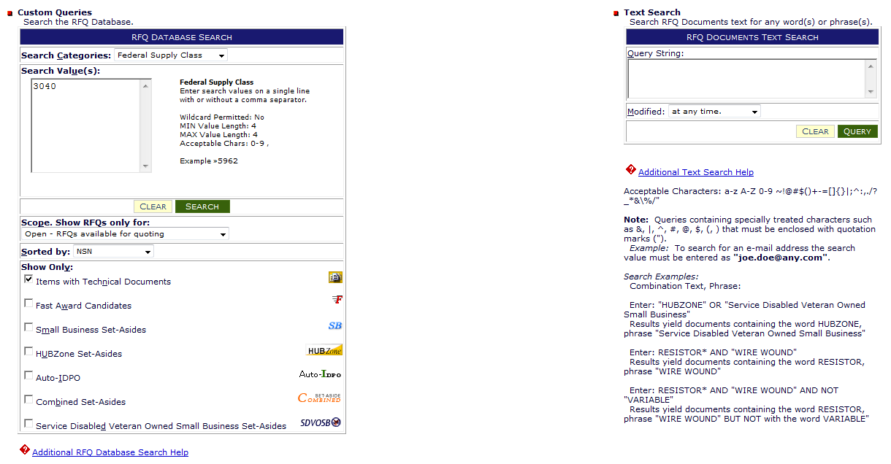
3040 Solicitations – Tech Docs only
Note: Checking “Items with Bidsets” reduced the search list by 64% the day this list was pulled
Check this box before submit
Notes:
Now, coming back to the database search window, we will have to re-select “Federal Supply Class” from the search categories dropdown box, and type in FSC “3040” -- but we can go below the search value box into the “Show Only” section and filter that category by clicking on “Items with Technical Documents”. If you could please click on it now.
And the reason this is important is if you are a manufacturer, chances are you will only want to bid on items that have technical documents.
If you are not a manufacturer, you will probably be more interested in items that are purchased by CAGE code and part number. But in either case, by checking one or several of the boxes in the bottom portion of your screen, you’ll be able to refine the search results.
VENDORS: Click Search.

Slide 26
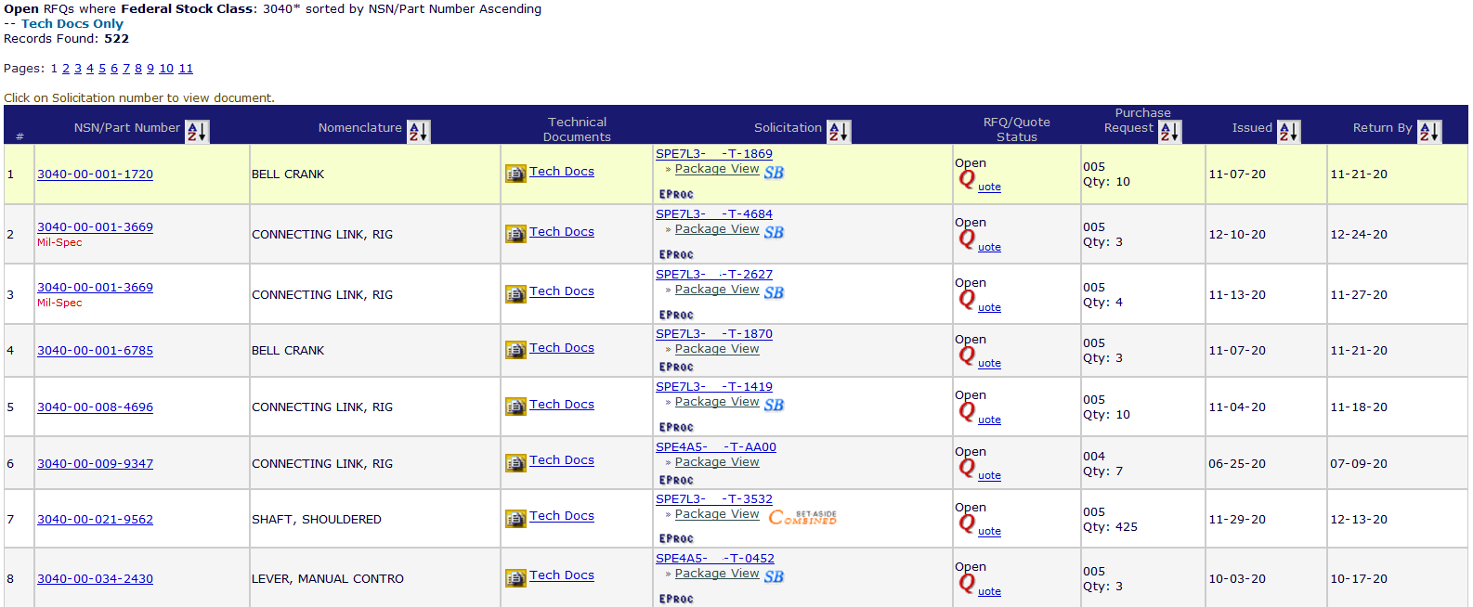
3040 Solicitations – Tech Docs only
Note: Checking “Items with Bidsets” reduced the search list by 64% the day this list was pulled
CLICK: a “NSN” link for the next screen
Notes:
In this case, we went from over 1,450 responses down to 522 * CLICK — a somewhat more manageable set of solicitations to review. As you can see this is a search for FSC 3040 solicitations that have technical documents available.
ASK VENDORS: HOW MANY RESULTS DO YOU HAVE NOW?
If you click on the solicitation number in the middle of the page, you can read the solicitation document, NOTE the other specialized Icons..
If you click on a NSN in column two, you can see the specifications and drawing numbers for that item. Let’s take a closer look….

Slide 27
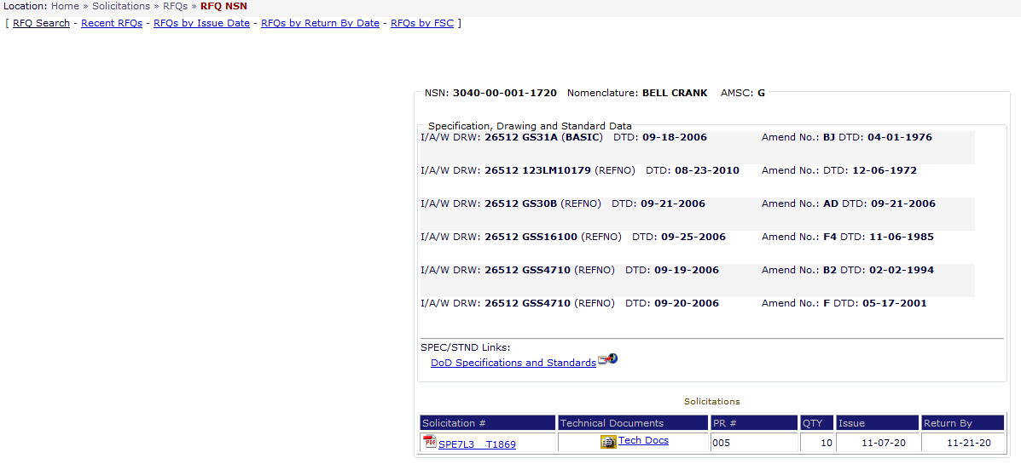
3040 Solicitations – AMSC code “G”
AMSC (Acquisition Method Suffix Code) “G” – indicates the adequacy of the available technical data
List of drawings w/ rev & date required to make item of supply
List of Gov’t & Industry Spec’s & Standards required to make item of supply
Icon to cFolders to down load Tech Docs
Notes:
In my example the AMSC Codeis “G” which indicates that DLA has the complete Technical Data Package for this item.
If you look down at the bottom of that screen, you’ll see a little icon for technical documents, and that verifies that we have the documents that you can download and determine whether or not you can make that particular item.
If you are a manufacturer and the AMSC is other than “G” Remember you want to access solicitations that have the complete technical documents. We recommend you to to the previous page and look for AMSCs of “G:go to the previous page and choose the next NSN.
As a reminder if you have questions in regards to accessing the Technical Data in cFolders you can go to the FAQ section on DIBBS home page.
SAY: Go back to top left or VENDORS CLICK ON RFQ SEARCH
VENDORS CLICK ON RFQ SEARCH.

Slide 28
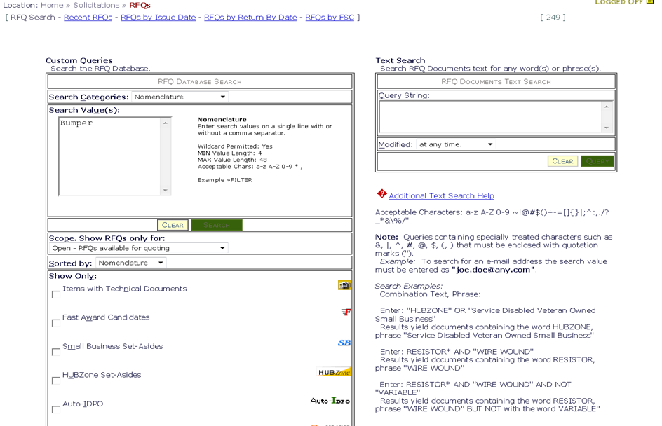
RFQ Nomenclature Search
Not available at this time
NATIONAL STOCK NUMBER (NSN)
• FEDERAL SUPPLY CLASS (FSC)
• SOLICITATION NUMBER (SPM)
• PURCHASE REQUEST (PR)
• NOMENCLATURE
• APPROVED PART NUMBER
• APPROVED OEM CAGE CODE
Only solicitations with the word “Bumper” in the Nomenclature are listed
Notes:
Now to show you how to do a nomenclature search.
VENDORS: (1) change the drop down to Nomenclature.
Enter the word “Bumper” into the Search Value field
You have the option to Click the item with technical documents
Only solicitations with the word “Bumper” in the nomenclature are listed in your results.
VENDORS CLICK RFQ SEARCH

Slide 29
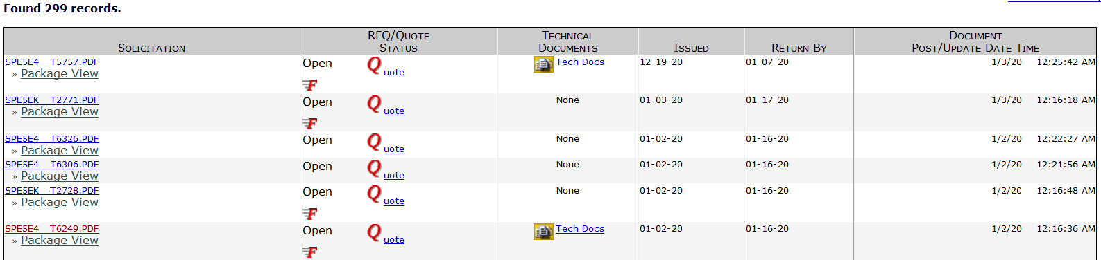
Text Search (cont’d)
The word “Bumper” appears in the item description, but may not be the actual nomenclature
Notes:
When you search by a word or phrase, the word or phrase may appear in the item description but may not be part of the item name or “nomenclature” for that NSN.
So searching for a “bumper” may yield a list of automotive bumpers, loading dock bumpers, or rubber baby buggy bumpers. The FSC, or first four digits of the National Stock number, may help us to zero in on a particular product category.
SAY: This is a quick view of the Solicitation Search. I will be available tomorrow afternoon if you need more support after the C-Folders Brief.

Slide 30

Conclusion

Slide 31

FOR OFFICIAL USE ONLY

