Slide 1


DEPOT-WIDE MINOR CONSTRUCTION MULTIPLE AWARD INDEFINITE DELIVERY INDEFINITE QUANTITY (IDIQ) MULTIPLE AWARD TASK ORDER CONTRACT (MATOC) TOBYHANNA ARMY DEPOT W25G1V21R0014
Proposal Kick-off
July 2, 2021
Proposal Coordinator: Kathylynn Barranco

Slide 2
ACTIVATION AGENDA
ii

Slide 3
Opportunity Overview
Name | Proposal Role/Section
Cecil Whitlock | BD Managing Director
Niki Bradshaw | BD Manager
Kathylynn Barranco | Proposal Coordinator
Kendra King Bowes | Administrative / Proposal Director
Harry Brown | General Manager, Wiipica
Daniela David | VP Finance
Eric Coffee | Excel POC / Consultant
Slide 1

Slide 4
Solicitation Details
Solicitation #: W25G1V21R0014
Solicitation Issued By: ACC-APG TOBYHANNA DIVISION
Multiple Award: Small Business set-aside IDIQ
Contract Value: $10M (Page 6)
Period of Performance: October 2021 – September 2026
Each Task Order will delineate its own individual performance options
Place of Performance: Exclusive use of Tobyhanna Army Depot (TYAD)
Competition Type: Small Business Contractors
Contract Type: IDIQ with FFP Task Orders
Customer POC:
jacgueline.d.ramsey.civ@mail.mil
Slide 2

Slide 5
Scope
XX
XX
XX
Slide 3

Slide 6
Customer Hot Buttons
XX
XX
XX
Slide 4

Slide 7
Competition / Discriminators
XX
XX
XX
Slide 5

Slide 8
Solicitation Milestone Dates
RFP released: June 22, 2021
Site Visit Registration: June 30, 2021
Site Visit: July 1, 2021
Questions Due: July 8, 2021
Rolling until 7 days prior to deadline
Send out PPQ’s: July 13, 2021
POC’s must deliver to Gov by Deadline
Draft Review: July 14, 2021
Final Review: July 19, 2021
Pens Down: July 21, 2021
Proposal Due: July 22, 2021
Slide 6

Slide 9
Calendar View
Sunday |  |  |  |  | Monday | Tuesday | Wednesday | Thursday | Friday | Saturday
 | 27 |  |  | 27 | 28 | 29 | 30 | 1 | 2 | 3
 |  |  |  |  |  | Site Visit Registration | Site Visit |  | Kickoff
 |  | 4 |  | 4 | 5 | 6 | 7 | 8 | 9 | 10
 |  |  |  |  | Independence Day Holiday
 |  |  |  |  |  | Team TAG 10am Review Writing Assignments | Team TAG 10am Past Performance PPQs to Customers | Submit Questions to Government | Team TAG 10am
 |  |  |  | 11 | 12 | 13 | 14 | 15 | 16 | 17
 |  |  |  |  |  |  | IPR/Pink Review
 |  |  |  |  |  | PPQ'S TO POC's Note: List of POC's to be sent to Contract Specialist before due date |  | Potential Additional Questions to Government |  | Red Recovery
 |  |  |  | 18 | 19 | 20 | 21 | 22 | 23 | 24
 |  |  |  |  | Red Review All Vols |  |  | Deadline: 22 July 2021 at 4:00PM EST
Red Recovery |  |  |  |  | Red Recovery | Red Recovery | Final Review/Edit and Compilation | PPQs are due from POCs
 |  |  | 25 | 25 | 26 | 27 | 28 | 29 | 30 | 31

Slide 10
Requirements Directed Outline – Volume I: Technical (Page Limit = 50 Total)
Potential Proposal Section # | Responsibility | Page Limit | Section L – Instructions (Proposal Outline)
Section 1 - Subfactor a |  |  | Bonding Capacity
Keypoint | Daniela |  | Offeror shall provide a signed letter from its chosen surety demonstrating that it can obtain at lease $5M of Performance and Payment Bonds or evidence that it currently has at least $5 of spare performance and payment capacity per year for this contract.
Section 2 -Subfactor b |  |  | Safety program
2.1 Keypoint #1 |  |  | Accident Prevention Plan (APP)
 |  |  | The Offeror is required to submit an Accident Prevention Plan (APP) for the Building 14 TO in accordance with the requirements of the Unified Facilities Guide Specifications (UFGS) 01 35 26 and compliant with United States Army Corp of Engineers Engineering Manual 385-1-1 (USACE EM385) Safety Standards and Controls requirements (see Attachment 3). This APP will be used in the Base MATOC Award and Building 14 seed project TO evaluation.
2.2 Keypoint#2 |  |  | Experience Modification Rate (EMR)
 |  |  | The Offeror shall provide the Experience Modification Rate (EMR) for itself and teaming partners for at a minimum the previous three (3) full year operating period from issue date of RFP. The required EMR information shall be provided in a letter format from the insurance companies of the Offeror. The Offeror shall also provide contact information for the insurance companies so that the Government can at its discretion verify the information provided.
2.3 Keypoint #3 |  |  | Occupational Safety and Health Administration (OSHA) recordable injuries report
 |  |  | The Offeror shall provide the Occupational Safety and Health Administration (OSHA) recordable injuries/illnesses reports and Days Away Restricted or Transferred (DART) rate for at a minimum the previous three (3) full year operating period from issue date of RFP.
Section 3 - Subfactor c |  |  | Quality Control
3.1 Keypoint |  |  | Offeror is required to submit a Quality Control Plan for the Building 14 TO in accordance with the requirements of the Unified Facilities Guide Specifications (UFGS) 01 35 26 and compliant with United States Army Corp of Engineers Engineering Manual 385-1-1 (USACE EM385) Safety Standards and Controls requirements (see Attachment 4). This QCP will be used in the Base MATOC Award and Building 14 sed project TO evaluation.

Slide 11
Requirements Directed Outline – Volume I: Technical
Potential Proposal Section # | Responsibility | Page Limit | Section L – Instructions (Proposal Outline)
Section 4 - Subfactor d |  |  | Contract Management Plan
 |  |  | This Sub-factor evaluates the Offerors’ Contract Management Plan (CMP): The Offeror shall provide information that demonstrates/substantiates the following:
4.1 |  |  | Describe the overall company structure, experience and capability related to fulfilling the potential requirements described in this MATOC for NAICS Code 236220.
4.2 |  |  | Provide general overview of planned contract execution.
4.3 |  |  | Organization: Organization and ability to manage multiple projects through adequate and qualified on-site staffing to support at least three (3) ongoing task orders.
4.4 |  |  | Scheduling methodology: Describe the scheduling techniques and project planning methodology. Describe the criteria for selecting and qualifying subcontractors.
4.5 |  |  | Include a plan for providing additional resources, manpower and technical expertise for support of the field office to cover peak workloads, special projects and urgently required projects. Response time shall be not more than one (1) hour from notification of emergency projects.
4.6 |  |  | Provide discussion and documentation/evidence of how the Offeror has the ability to provide a sufficient quantity of qualified personnel, i.e. U.S. Citizens, who can obtain mobility access
4.7 |  |  | Describe method of evaluating and selecting Architect/Engineering (A/E) firm on Design/Build Task Orders.

Slide 12
Requirements Directed Outline – Vol. II: Past Performance (15 pages total)
Potential Proposal Section # | Responsibility | Page Limit | Section L – Instructions (Proposal Outline)
Section 1 |  |  | Contract Descriptions
1.1 | Kathylynn/Niki |  | Format
a |  |  | Contractor/Subcontractor place of performance, CAGE Code and DUNS Number. If the work was performed as a subcontractor, also provide the name of the prime contractor and Point of Contact (POC) within the prime contractor organization (name, and current address, e-mail address, and telephone and fax numbers).
b |  |  | Government contracting activity, and current address, Procuring Contracting Officer's name, e-mail address, telephone and fax numbers.
c |  |  | Government's technical representative/Contracting Officer's Representative and current email address, telephone and fax numbers.
d |  |  | Government contract administration activity and the Administrative Contracting Officer's name, and current e-mail address, telephone and fax number.
e |  |  | Contract Number and, in the case of lndefinite Delivery type contracts, GSA contracts, and Blanket Purchase Agreements, include Delivery Order Numbers.
f |  |  | Contract Type (specific type such as Firm Fixed-Price (FFP), Cost Reimbursement (CR), Time & Material (T&M), etc.). In the case of Indefinite Delivery contracts, indicate specific type (Requirements, Definite Quantity, and Indefinite Quantity) and secondary contract type (FP, CR, T&M, etc.).
g |  |  | Awarded price/cost.
h |  |  | Final or projected final price/cost.
i |  |  | Final or projected final, delivery schedule, including dates ofstart and completion of work.
j |  |  | Original delivery schedule, including dates ofstart and completion or work

Slide 13
Requirements Directed Outline – Vol. II: Past Performance
Potential Proposal Section # | Responsibility | Page Limit | Section L – Instructions (Proposal Outline)
Section 2 |  |  | Performance
 |  |  | The Offeror shall provide a specific narrative explanation of each contract listed in Section 1, Contract Description, describing the objectives achieved and detailing how the effort is relevant to the requirement of this RFP.
2.1 |  |  | For any contracts that did not/do not meet original schedule or technical performance requirements, provide a briefexplanation ofthe reason(s) for the shortcomings and any corrective action(s) taken to avoid recurrence. The Offeror shall list each time the delivery schedule was revised and provide an explanation of why the revision was necessary. All Requests for Deviation and Requests for Waiver shall be addressed with respect to causes and corrective actions. The Offeror shall also provide copy of any Cure Notices or Show Cause Letters received on each contract listed and a description of any corrective action implemented by the Offeror or proposed subcontractor. The Offeror shall indicate if any of the contracts listed were terminated and the type and reasons for the termination.
2.2 |  |  | For all contracts, the Offeror shall provide data on all manufacturing warranty returns. Data shall delineate total number of warranty returns, number of Could Not Duplicate (CND), number of failures attributable to GFE component failures, and number and nature of failures attributable to the Offerors' delivered product.
Section3 |  |  | New Corporate Entities
3.0 |  |  | New corporate entities may submit data on prior contracts involving its offices and employees. However, in addition to the other requirements in this section, the Offeror shall discuss in detail the role performed by such persons in the prior contracts cited. Information should be included in the files described in the sections above. Letters of Commitment shall be included in the proposal for these employees in order to be considered.

Slide 14
Requirements Directed Outline – Vol. II: Past Performance
Potential Proposal Section # | Responsibility | Page Limit | Section L – Instructions (Proposal Outline)
Section4 | Niki |  | Past Performance Questionnaires (PPQ)
 |  |  | Attachment 5
4.0 |  |  | For all contracts identified in Section 1, Contract Descriptions, a PPQ shall be completed and submitted. The Offeror shall complete Part I ofthe Past Performance Questionnaire and e-mail the questionnaire to both the Government contracting activity and technical representative responsible for the past/current contract. The POCs shall be instructed to electronically complete Part II ofthe questionnaire, providing detailed description on all ratings other than Satisfactory Confidence; when detailed information is not provided, the rating will be considered Satisfactory Confidence for evaluation purposes.
 |  |  | The entire questionnaire shall be e-mailed to the Contract Specialist at jacgueline.d.ramsey.civ@mail.mil no later than the proposal due date.
 |  |  | The Offeror shall also e-mail to the Contract Specialist a list ofall the POCs who were sent a questionnaire. The Government must receive this list no later than the proposal due date. The POC List shall be submitted in Word for Windows Table Format to include the following fields: Solicitation Number; Company Name; Contract Number; Government Agency; POC Last Name, First Name; POC Title; POC Telephone Number; POC E-mail Address; and Date E-Mail to POC (month/day).
Section 5 |  |  | Submissions
Acknowledgement Statement | Kathylynn |  | The Offeror is discouraged from providing points ofcontact with another contractors' facility, i.e., in case the Offeror (or one ofhis/her team members) is in a subcontract with another contractor who has submitted a proposal on the same requirement. The Offeror shall provide and submit the prime contract number and all Governmental agency POCs in lieu ofsubcontract numbers or prime contract POCs in situations as described above.

Slide 15
Requirements Directed Outline – Volume III: Price
Potential Proposal Section # | Responsibility | Page Limit | Section L – Instructions (Proposal Outline)
Volume III |  | No Limit | Price
1.0 | Daniela |  | (1) The Offeror shall complete the pricing page ofthe Exhibit A(l), Building 14 Renovation TO RFP, and not on the SF1442. Fill-in an amount for each Contract Line Item Number (CLIN) including Options. Offeror shall provide a complete breakdown ofCLIN pricing with the offer including labor categories, hourly labor rates, number oflabor hours, materials, supplies, equipment, other direct costs (quantity and unit price), profit, and indirect costs in sufficient detail to provide thorough evaluation per Federal Acquisition Regulation (FAR) 52.215-20 Alt I in electronic Excel spreadsheet format. When subcontractors are used, provide evidence ofcompetitive award; if subcontract is not competitively awarded provide subcontractor's detailed pricing as previously described.
2.0 | Kathylynn |  | (2) Compliance. Include Acknowledgement Statement: Failure to comply with the RFP requirements for cost information may result in an adverse assessment ofthe Offeror's proposal and remove the proposal from evaluation due to being non-responsive. The Offeror shall ensure that the information presented in this volume is consistent and correlates with the information contained in the other proposal volumes. Also, the Offeror shall ensure that the information submitted in this volume is consistent with and fully supports the amounts set forth in the Exhibit A(l) Bldg 14 Renovation TO RFP.
3.0 | Kathylynn |  | (3) General Instructions. Acknowledgement Statement: In accordance with Federal Acquisition Regulation (FAR) 15.402 and 15.403-1, certified cost or pricing data are not required based on the fact that adequate competition is expected for this procurement. Information other than certified cost or pricing data shall be provided in accordance with FAR 52.215- 20 Alt I. Additionally, in the event that adequate competition is not obtained, the Contracting Officer may request a Certificate ofCurrent Cost or Pricing Data. There are no page limitations for this volume. Proposal information included in this volume which is not directly related to Cost will be disregarded.

Slide 16
Requirements Directed Outline – Volume III: Price
Potential Proposal Section # | Responsibility | Page Limit | Section L – Instructions (Proposal Outline)
Volume IV |  | No Limit | Solicitation, Offer and Award Documents and Certifications/Representations and Submittals
1.0 | Kathylynn |  | (1) Section A- Standard Form 1442 (SF 1442), Solicitation, Offer and Award - An authorized official of the firm shall sign the SF 1442 and all certifications requiring original signature. An Acrobat PDF file shall be created to capture the signatures for submission. All Amendments must be acknowledged on SF 1442.
2.0 | Kathylynn |  | (2) Section K- Certifications and Representations- Each Offeror shall complete (fill-in and signatures) the solicitation sections indicated below using the file (without modification to the file) provided with the MATOC RFP.
3.0 | Harry |  | (3) Joint Venture (JV) Offerors: The Offerors shall provide a copy ofthe signed joint venture agreement with the proposal.
4.0 | Daniela/Harry |  | (4) Exhibit A- Building 14 Renovation TO Bid Guarantee for Building 14 TO must be included with proposal.

Slide 17
Basis of Award (Section M)
Awards will be made based on the best overall (i.e. best value) proposals that are determined to be the most beneficial to the Government, with appropriate consideration given to the following three evaluation factors: Technical, Past Performance, and Price
Factor 1. Technical Factor
Subfactor a – Bonding Capacity
Subfactor b – Safety Program
Subfactor c - Quality Control Approach
Subfactor d – Contract Management Plan
Factor 2. Past Performance
Each Offerors' past performance will be reviewed to determine relevancy and confidence assessment.
Factor 3. Price

Slide 18
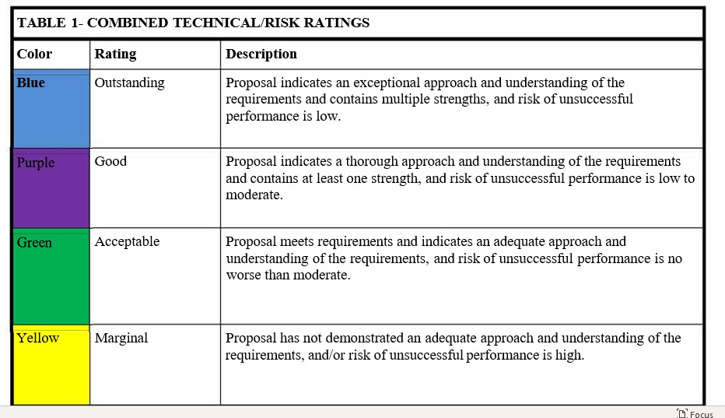
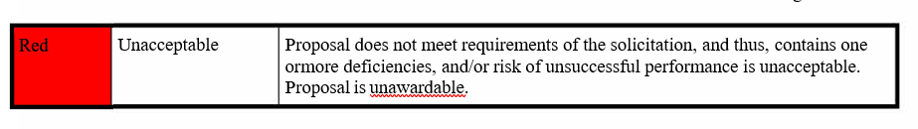
Evaluation Criteria –Factor 1: Technical

Slide 19
Evaluation Criteria – Factor 1: Technical
Subfactor a: Bonding Capacity -
Evaluates the Offerors' proposed Bonding Capacity for the base contract. An adjectival rating will be given for this subfactor.
The Offeror will provide information to substantiate the following: The Government will evaluate the Offerors' ability to provide documentation from a certified and approved Surety demonstrating that it currently has or can obtain $5M ofpayment and performance bonds per year specifically for this contract.
NOTE: Surety companies utilized for the proposal and contract must be listed on the U.S. Department of the Treasury website.
Reference https://www.fiscal.treasuzy.gov/surety-bonds/list-certified- companies.html
Subfactor b: Safety Program -
This rating will consist of the rating for Key Point #1 and depend on the Offeror receiving Acceptable ratings for both Key Point #2 and #3. An unacceptable rating in either may result in an unsatisfactory rating for this subfactor. Evaluators will rate:
KEY POINT #1: The Government will evaluate the Offerors' Accident Prevention Plan (APP) written for the Building 14Renovation TO, using the Statement of Work (SOW) in Exhibit A(2). The APP will be evaluated using a two-step approach.
Government will evaluate the numerical headings listed in Attachment 3 to ensure they are addressed and written to provide the Government confidence the Offeror has a clear understanding of the mandatory requirements stated in the UFGS and USACE EM385 Standards. If information is missing, the proposal may be removed from further evaluation.
Step two, the Government will credit the Offeror for details provided using the alphabetical sub criteria listed in the attachment. This detail will be evaluated for added strength in the APP based on the information provided and the confidence the Government has that the Offeror has a clear understanding ofthe requirement.

Slide 20
Evaluation Criteria – Factor 1: Technical
Subfactor b: Safety Program (cont’d)
KEY POINT #2: The Government will evaluate the Offerors' Experience Modification Rate (EMR) for the previous three (3) full year operating period from issue date of RFP. This key point will be evaluated acceptable/unacceptable based on meeting minimum requirements.
NOTE: An EMR of greater than 1.0 during any portion of the previous three (3) full year operating period from issue date of the RFP will be considered unacceptable.
• KEY POINT #3: The Government will evaluate the DART rate for the previous three (3) full year operating period from issue date of RFP. Evaluation will be of the Offerors' record of safe and regulatory compliant operations based on its OSHA recordable injuries/illnesses reports and its DART rate.
The Offerors' OSHA DART rate shall be at or below 1.4- 2017; 1.4- 2018 and 1.1 - 2019 for each of the previous three (3) full year operating periods from issue date of RFP.
This key point will be evaluated acceptable/unacceptable based on meeting minimum requirements. A DART rate below the rates stated above for any one (1) year will be rated unacceptable.
Subfactor c: Quality Control Plan.
KEY POINT - The Government will evaluate the Offeror Quality Control Plan (QCP) for the Building 14 Renovation TO, using the SOW in Exhibit A(2), in accordance with UFGS and US Army Corp of Engineer - Construction Quality Control Management (USACE-CQCM) Standards.
The QCP will be evaluated using a two-step approach. Step one, the Government will evaluate the numerical headings listed in Attachment 4 to ensure they are addressed and written to provide the Government confidence the Offeror has a clear understanding of the mandatory requirements stated in the UFGS and USACE-CQCM Standards. If information is missing or unclear, the proposal may be removed from further evaluation. Step two, the Government will credit the Offeror for details provided using the alphabetical sub criteria listed in the attachment.
This detail will be evaluated for added strength in the QCP based on the information provided and the confidence the Government has that the Offeror has a clear understanding of the requirement.

Slide 21
Evaluation Criteria – Factor 1: Technical
Subfactor d: This sub-factor evaluates the Offerors' Contract Management Plan (CMP).
KEY POINT - The Government will evaluate the Offerors' ability to perform based on its submitted information in the CMP for the following items:
Did the Offeror describe the overall company structure, experience and capability related to the requirements described for NAICS Code 236220?
Did the Offeror provide general overview of planned contract execution?
Did the Offeror provide scheduling methodology and criteria for selecting and qualifying subcontractors?
Organization: Did the Offeror describe their Organization and Method for managing 3 ongoing task orders and multiple projects simultaneously?
Did the Offeror include a plan for providing additional resources, manpower and technical expertise for support ofthe field office to cover peak workloads, special projects and urgently required projects? Does the Offeror acknowledge a response time shall be not more than one hour from notification of emergency projects?
Does the Offeror provide documentation and discussion of how the Offeror has the ability to or plans to provide a sufficient quantity of qualified personnel, i.e. U.S. Citizens, who can obtain mobility access badges for the security areas of Tobyhanna Anny Depot?
Did the Offeror describe method of evaluating and selecting A/E firm on Design/Build Task Orders?
In accordance with the Anny Source Selection Supplement (AS3), Section 3.1, the Anny methodology for evaluating Technical Approach and Related Risk is the Combined Technical/Risk Rating, (see Table 1 below). This methodology considers risk, in conjunction with the strengths, weaknesses, and deficiencies in determining technical ratings. The adjectival ratings for the subfactors will rolled up into a single Technical rating as long as there were no unacceptable ratings in any ofthe technical subfactors.

Slide 22
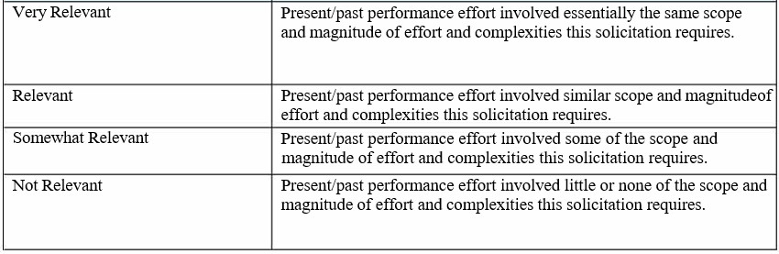
Evaluation Criteria – Factor 2: Past Performance (Section M)
Recency & Relevancy
RECENCY: The first aspect is to evaluate the recency of the Offerors' past performance. Recency is generally expressed as a time period during which past performance references are considered relevant and is critical to establishing the relevancy of past performance information.
RELEVANCY: The second aspect is to determine how relevant a recent effort accomplished by the Offeror is to the effort to be acquired through the source selection. Relevancy is not separately rated; however, the following criteria (see Table 2) will be used to establish what is relevant which shall include similarity of service/support, complexity, dollar value, contract type, and degree of subcontract/teaming.

Slide 23
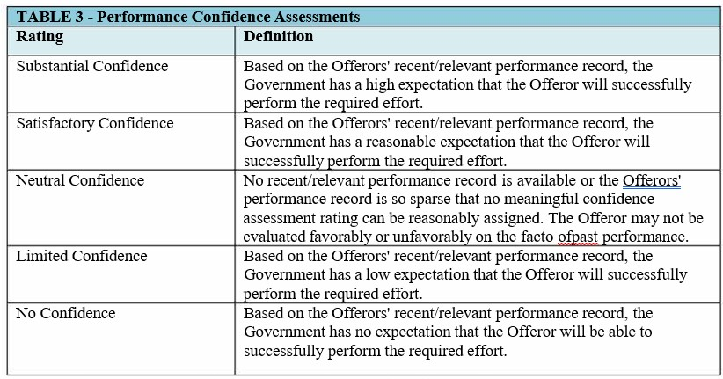
Evaluation Criteria – Factor 2: Past Performance (Section M)
Performance Confidence Assessment

Slide 24
Evaluation Criteria – Factor 3: Price (Section M)
Adjectival ratings shall not be used for Offerors' Price proposals.
The Government will fully evaluate and negotiate all priced Contract Line Item Numbers (CLINs) for award. For award purposes, the total proposed price for all CLINs will be added together into a total sum (contract value). The Offerors' Price proposal will be evaluated as follows.
FFP Evaluation. For a price to be fair and reasonable, it must represent a price to the Government that a prudent person would pay in the conduct of competitive business. The Offerors' proposed firm-fixed­ price CLINs may be evaluated, using one or more of the techniques described in FAR 15.404-1 in order to determine if they are fair and reasonable. Detailed, other than cost and pricing data must be provided for evaluation to begin, only providing lump sum pricing may result in the total proposal being non-responsive.
Overall Cost/Price Proposal Evaluation: The overall Price proposal will evaluated for the following:
Compliance: The Cost/Price proposal submitted by the Offeror will be evaluated for compliance based upon the submission requirements contained in the Section L Price instructions to include other than cost and pricing data as described in FAR 52.215-20 Alt I, using an Excel spreadsheet. When subcontractors are used, provide evidence of competitive award; if subcontract is not competitively awarded provide subcontractor's detailed pricing as previously described.
Unbalanced Pricing: The Offerors' overall Price proposal will be evaluated for unbalanced pricing as defined in FAR 15.404-1(g). An offer may be rejected if the contracting officer determines that the lack of balance poses an unacceptable risk to the Government (see FAR 15.404-1(g)(l) through FAR 15.404-1(g)(3)).
Pricing Notes:
The Offerors' Price proposal will be reviewed for errors. The Offeror may be given an opportunity to clarify
certain aspects of their proposal at the sole discretion of the Contracting Officer.
Total Evaluated Price: The Total Evaluated Price consists of summing the Offerors' proposed firm-fixed-price CLIN prices as indicated in Exhibit A(l) - Bldg. 14 TO RFP Pricing Sheet.

Slide 25
Additional Requirements to keep in Mind
Bond verifications to be eligible for award = $5M
Section K Reps and Certs are required
All Amendments must be acknowledged
Acknowledge acceptance of all Clauses and Conditions (RFP Section C-J)

Slide 26

Questions

