Slide 1


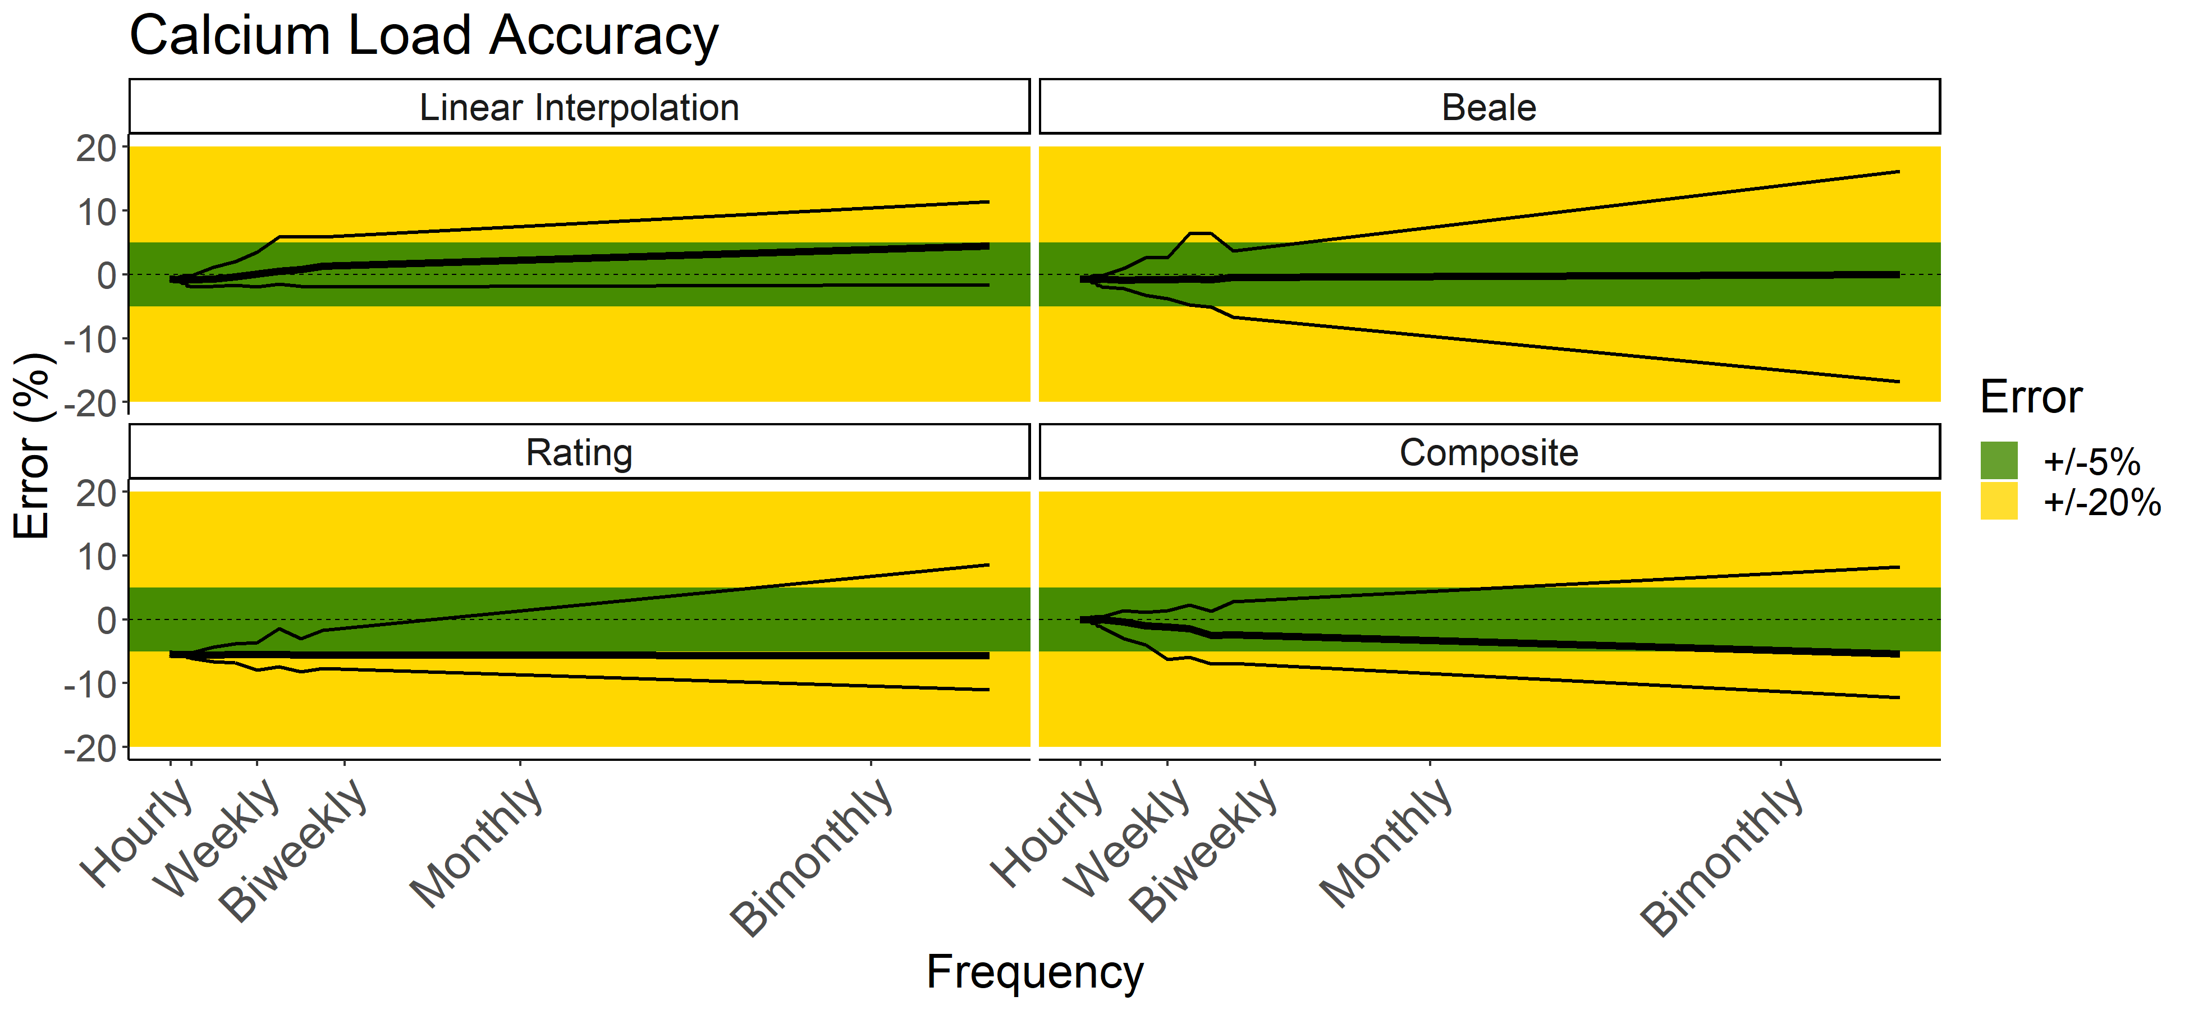
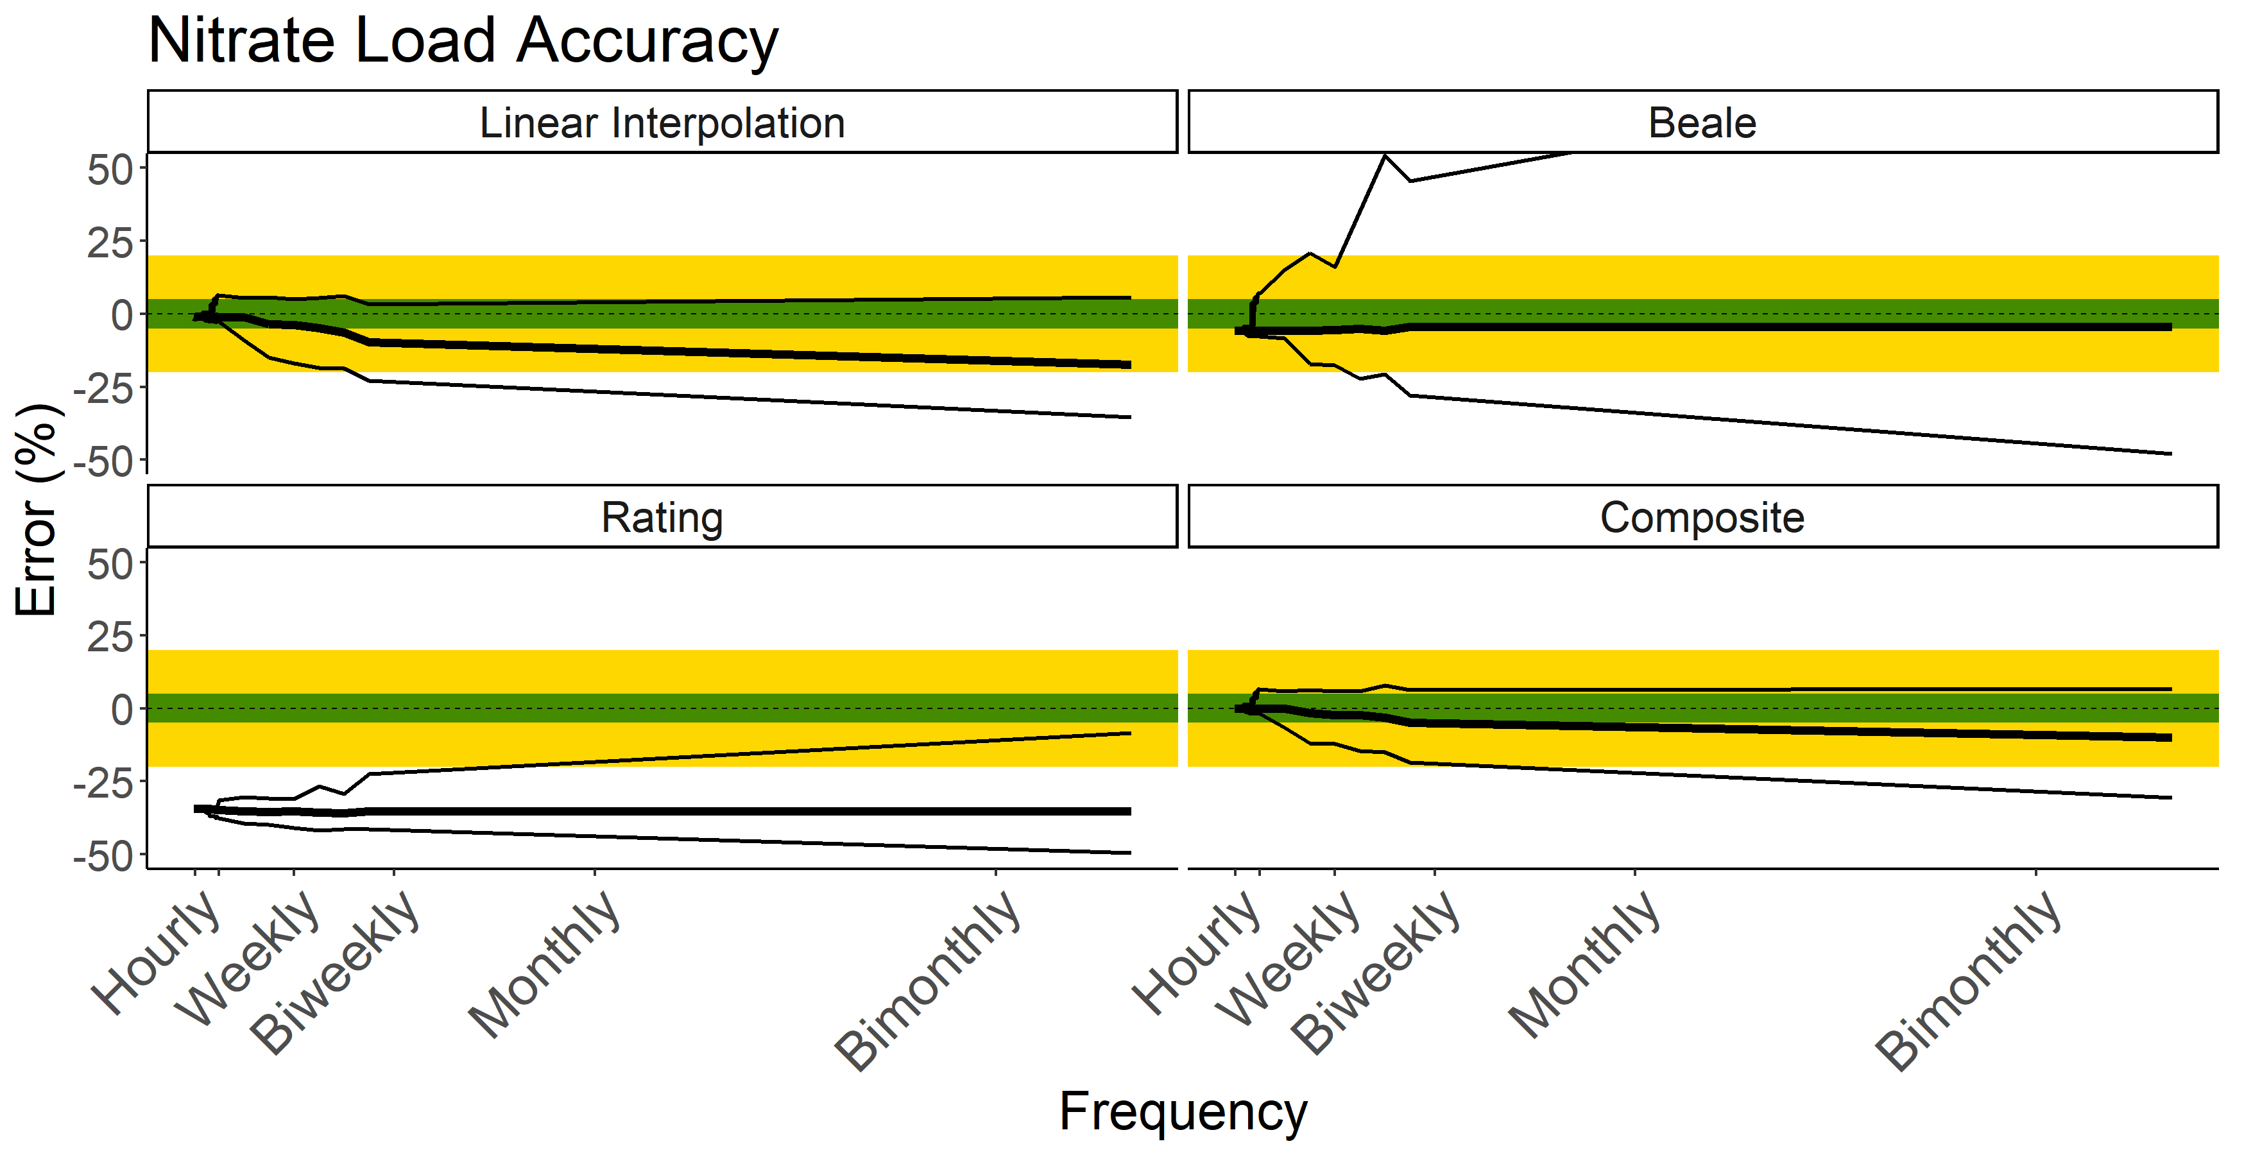
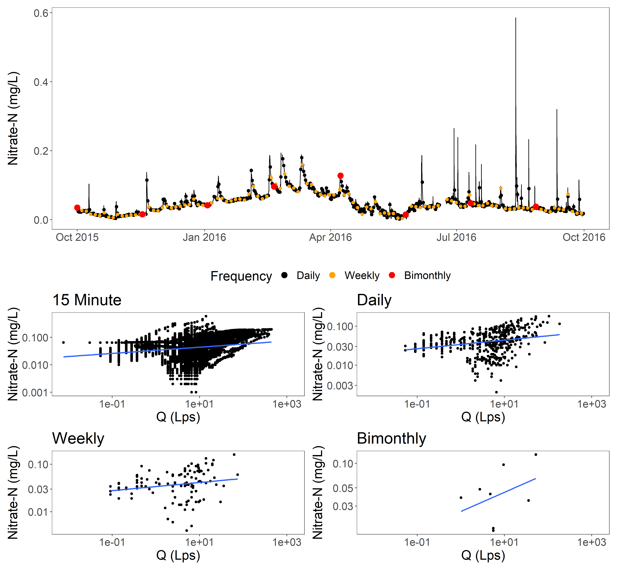
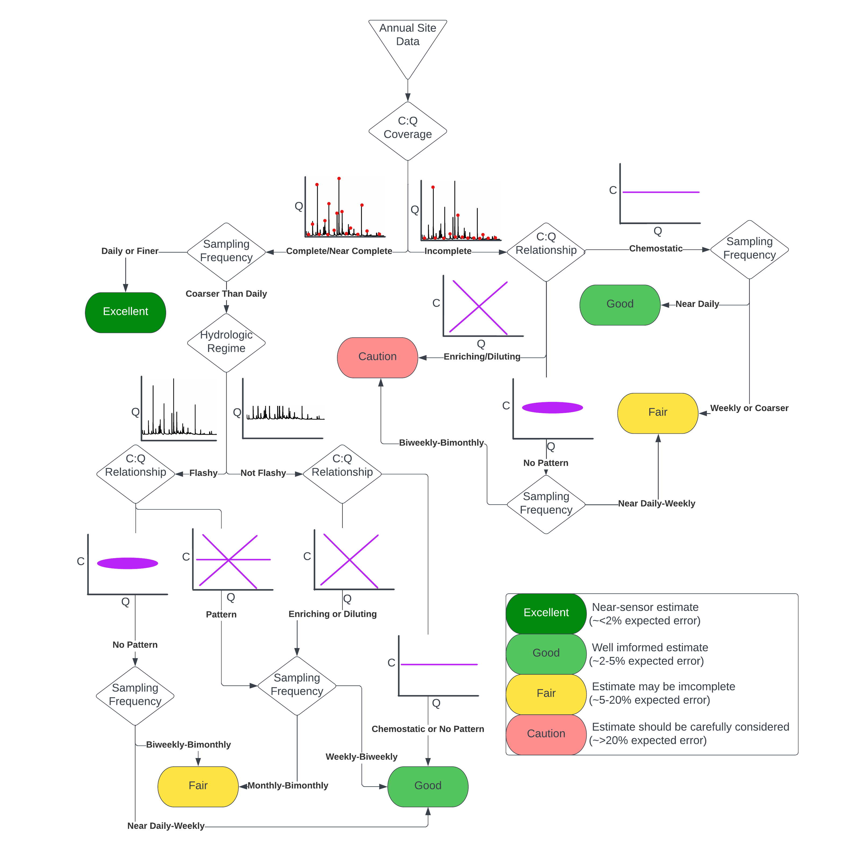
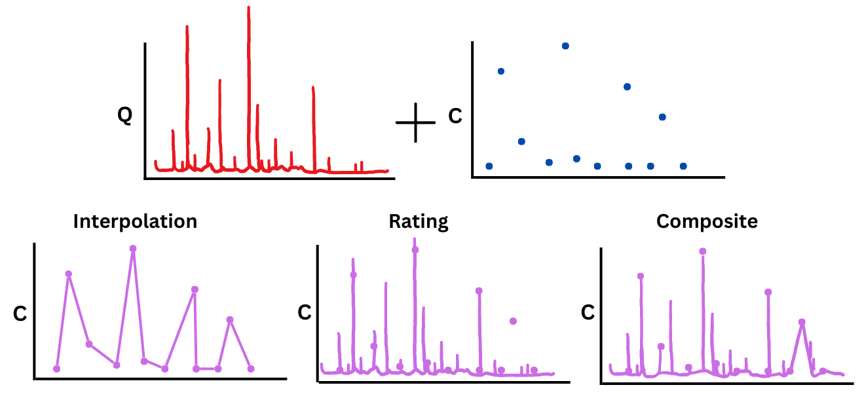
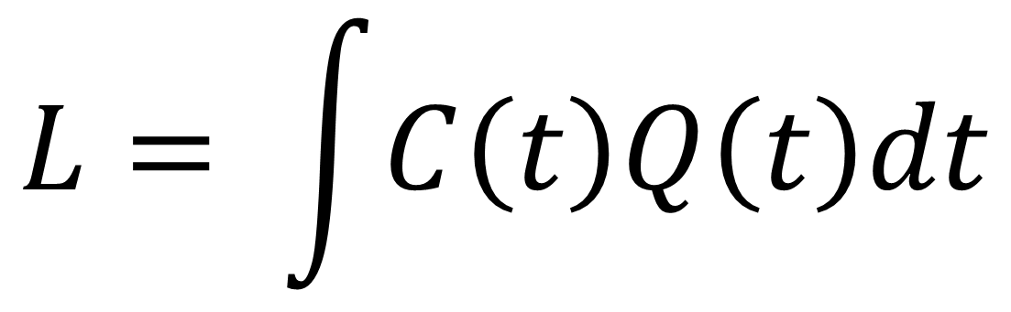
An Assessment of Annual Load Estimation Methods in Small Watersheds for Cross Site Comparisons Nicholas J Gubbins¹, Weston M Slaughter², Michael J. Vlah², Spencer Rhea², Emily S Bernhardt², Matthew RV Ross¹ ¹Colorado State University, Fort Collins, Colorado; ²Duke University, Durham, North Carolina
Load (L) is the mass of some solute of interest that moves past a point in a stream. It is calculated from discharge (Q) and solute concentration (C) data.
Solutes are sampled at varying intervals, both within sites as technology advances and between sites as research questions and funding differ. How frequently we sample informs our C:Q knowledge for the solute at the site.
To estimate annual load, researchers must fill in gaps using one of a variety of methods. All methods introduce error to load estimation. Selecting the most appropriate method is mostly dependent on the sampling frequency, C:Q relationship of the solute and the autocorrelation of samples through time.
Load estimates are greatly improved with high frequency sampling, complete C:Q knowledge, and proper method selection. Solutes with low variability can estimated accurately with sparse data, but dynamic solutes require more frequent monitoring or effective modeling to accurately estimate.
$$L= \int{C\left(t\right)Q\left(t\right)dt}$$
Strong C:Q Solute (Calcium from Specific Conductance)
Weak/Complex C:Q Solute (Nitrate as N)
To assess a load estimate’s quality, we need to assess:
Sampling frequency of underlying data
Hydrologic regime
C:Q relationship
Completeness and stability of C:Q relationship
Funding and Acknowledgments
This work was funded by NSF Grant #1926420. Thanks to Hubbard Brook Experimental Forest for sensor data.
Works Cited
Appling et al, 2015, “Reducing bias and quantifying uncertainty in watershed flux estimates: The R package loadflex”
Aulenbach et al, 2016, ‘’Approaches to stream solute load estimation for solutes with varying dynamics from five diverse small watersheds”.
Nava et al, 2019, “An R package for estimating river compound load using different methods”

