Slide 1


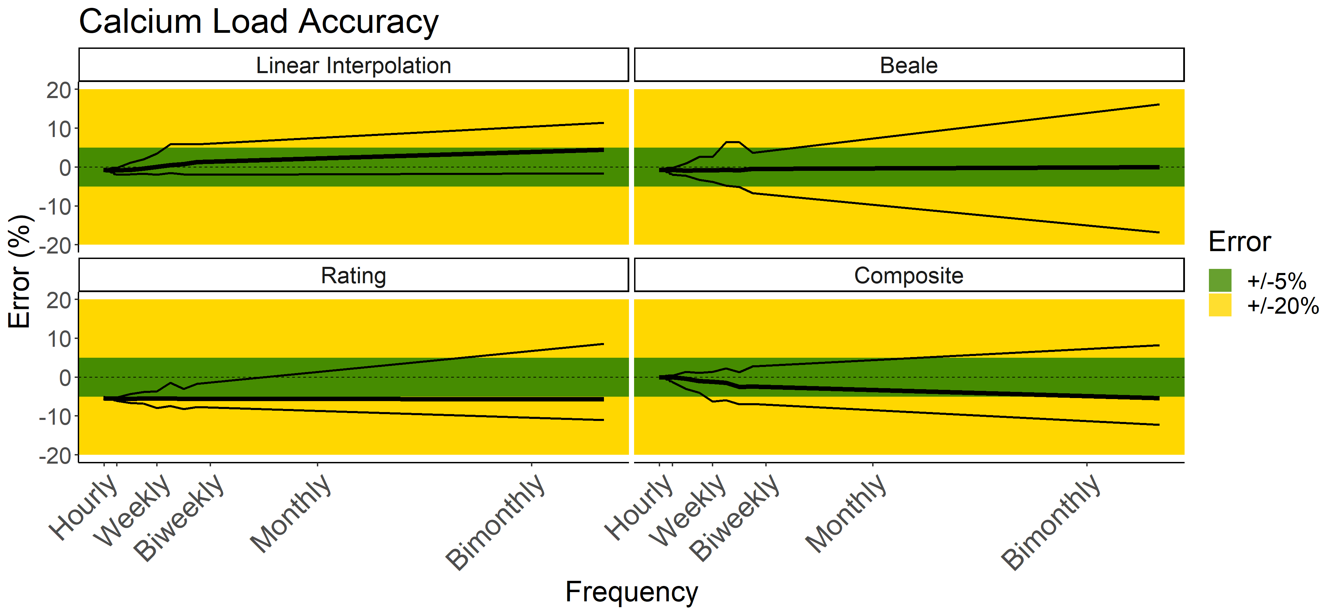
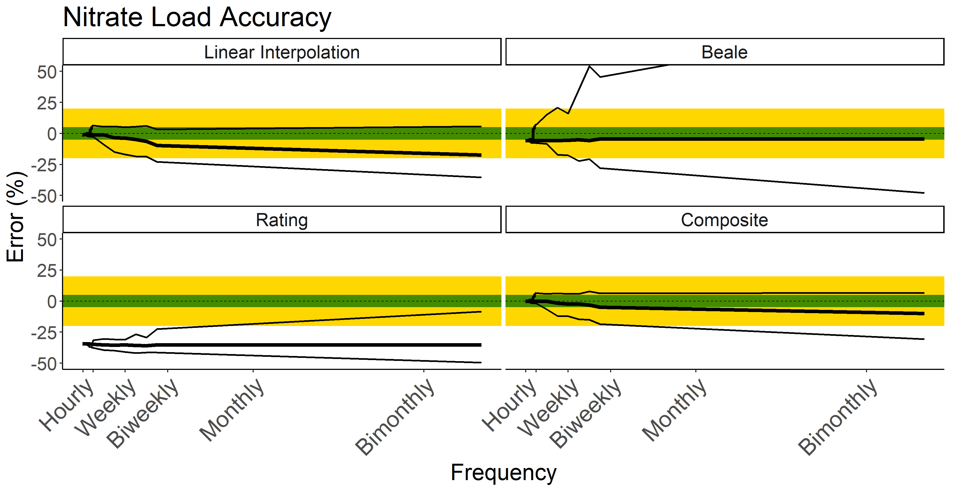
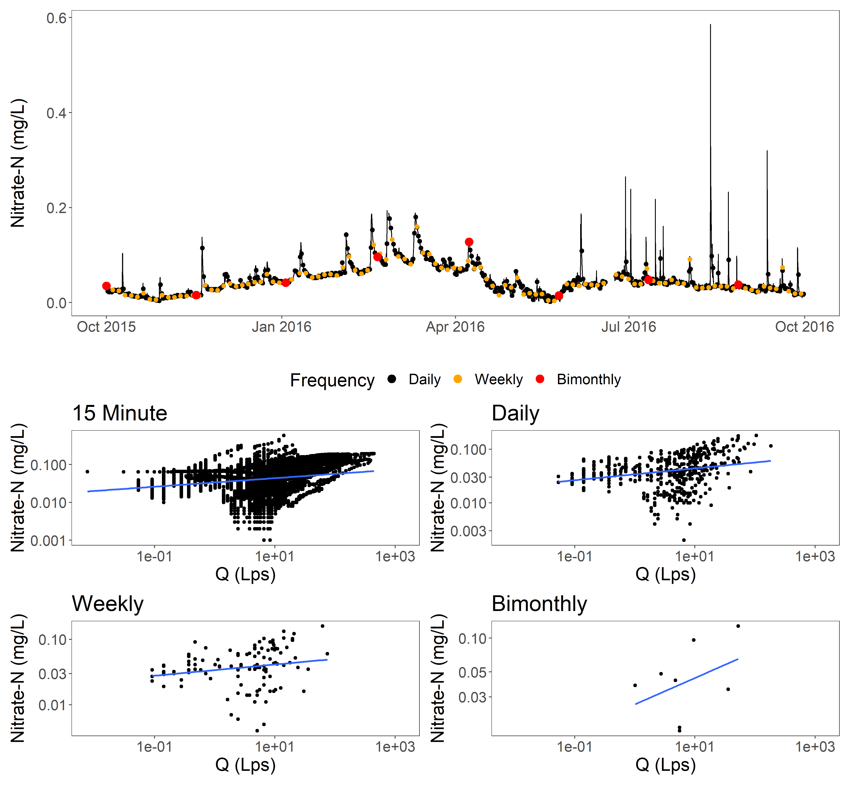
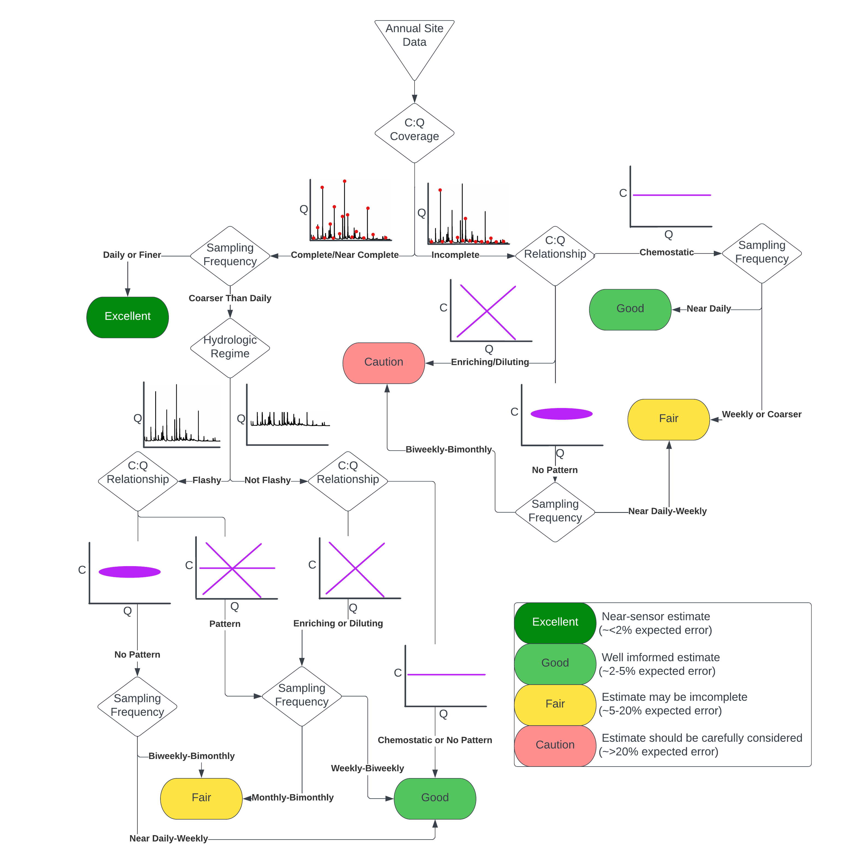
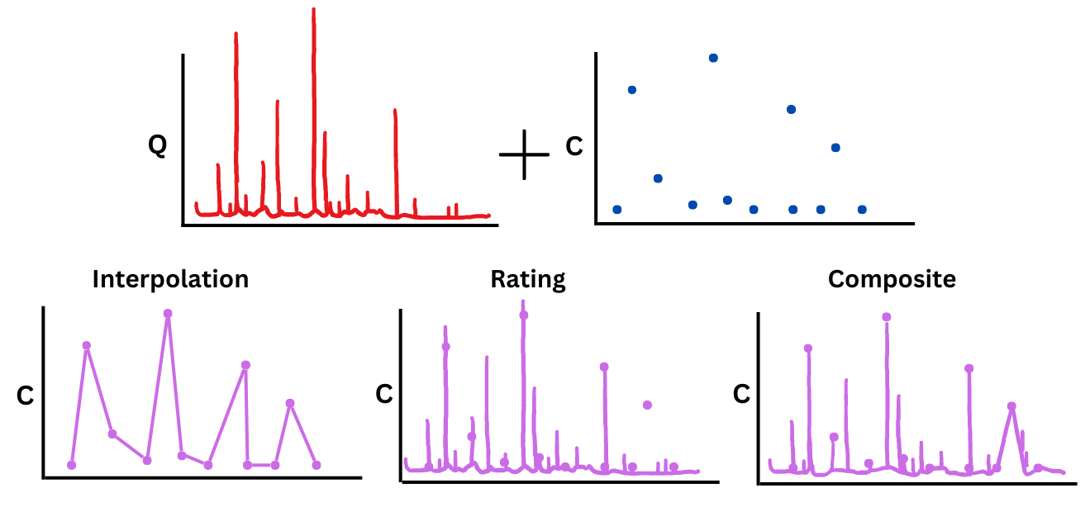
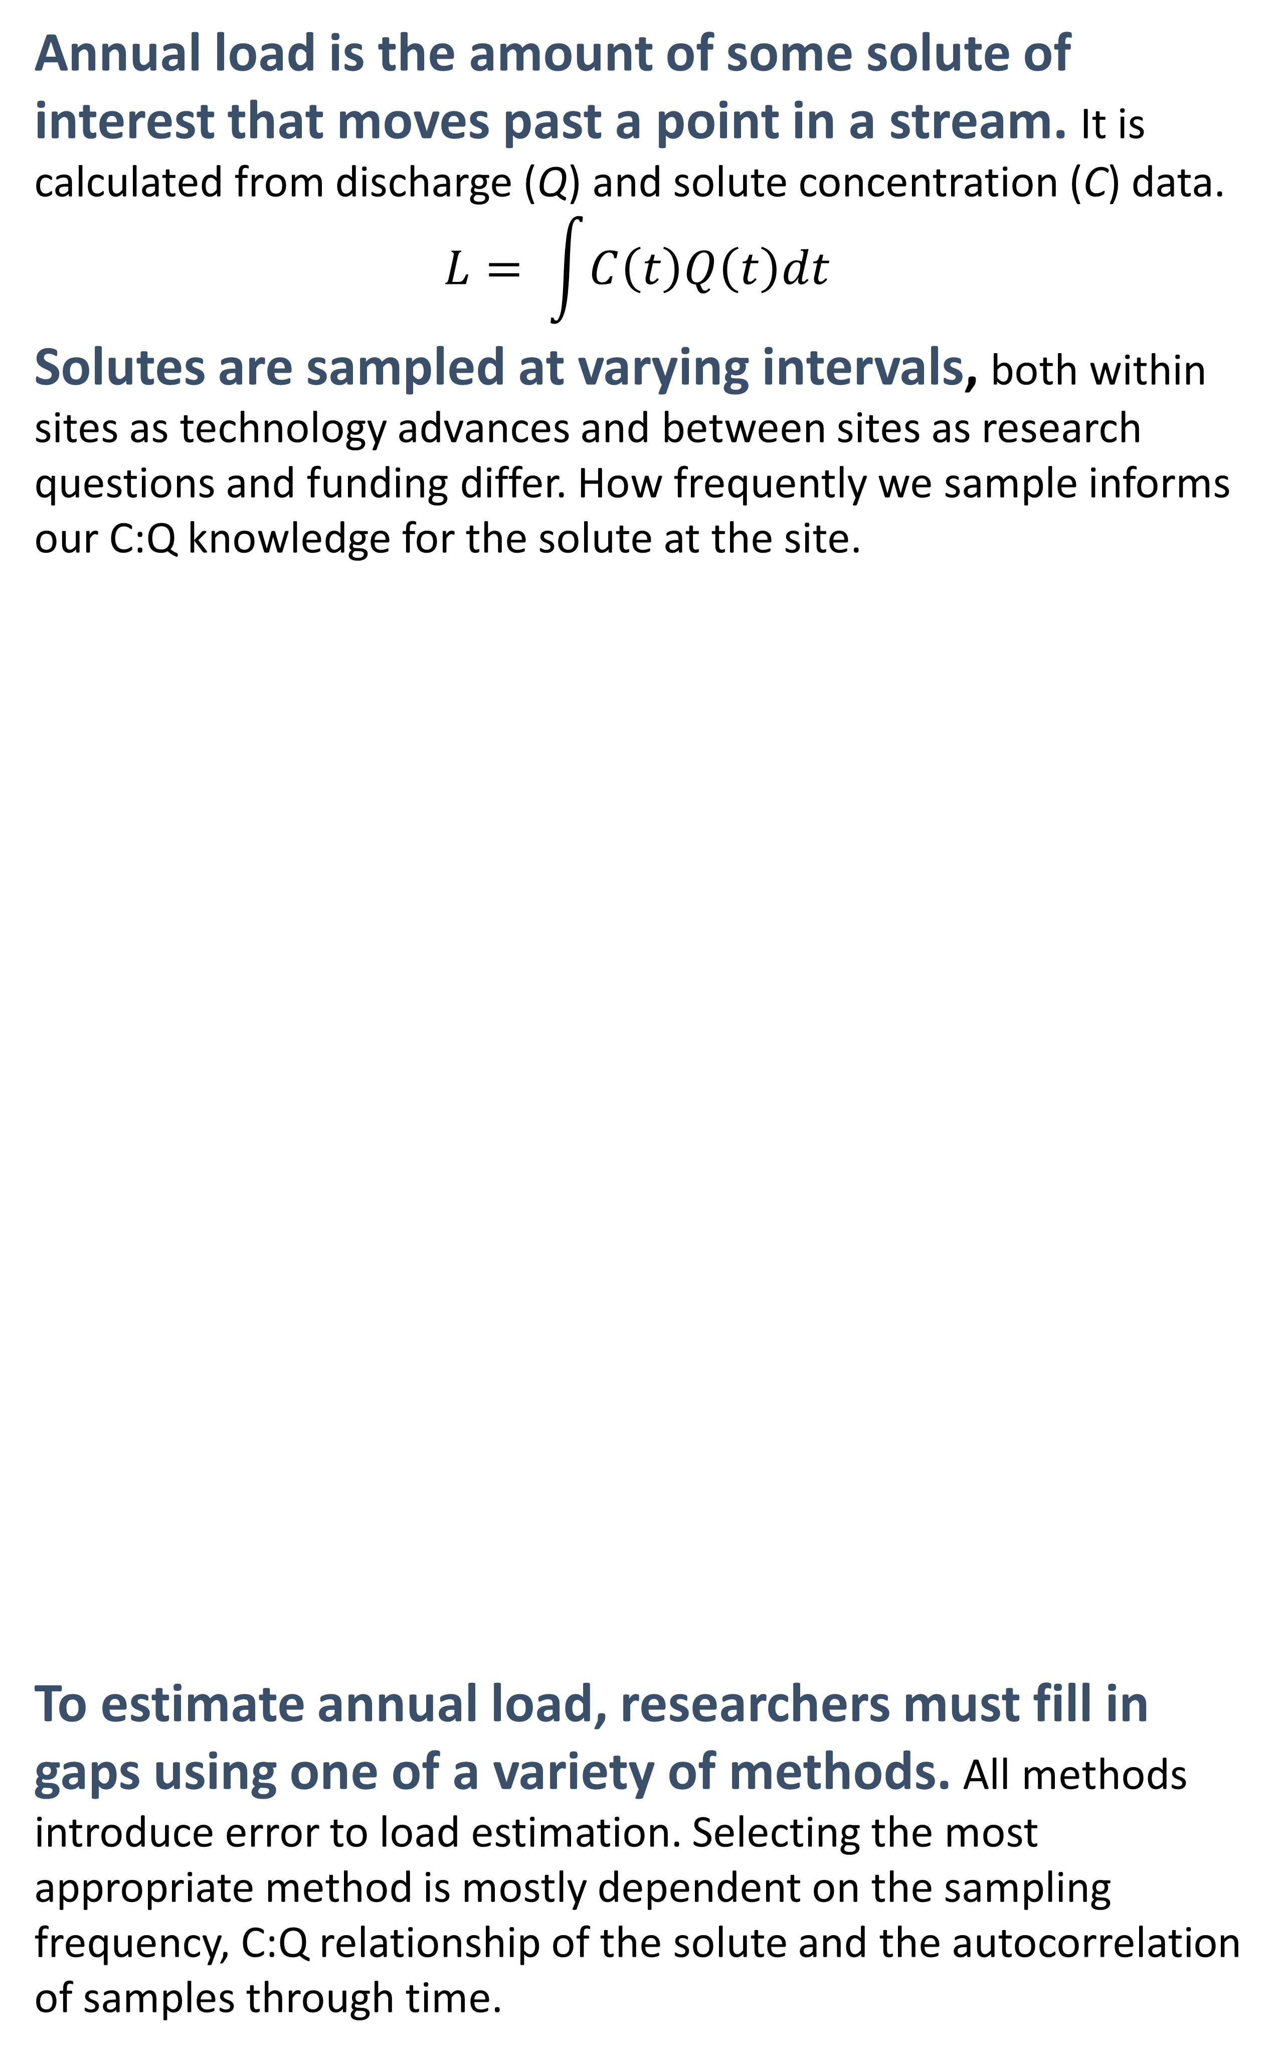
An Assessment of Annual Load Estimation Methods in Small Watersheds for Cross Site Comparisons Nicholas J Gubbins¹, Weston M Slaughter², Michael J. Vlah², Spencer Rhea², Emily S Bernhardt², Matthew RV Ross¹ ¹Colorado State University, Fort Collins, CO; ²Duke University, Durham, North Carolina
Annual load is the amount of some solute of interest that moves past a point in a stream. It is calculated from discharge (Q) and solute concentration (C) data.
$$L= \int{C\left(t\right)Q\left(t\right)dt}$$
Solutes are sampled at varying intervals, both within sites as technology advances and between sites as research questions and funding differ. How frequently we sample informs our C:Q knowledge for the solute at the site.
To estimate annual load, researchers must fill in gaps using one of a variety of methods. All methods introduce error to load estimation. Selecting the most appropriate method is mostly dependent on the sampling frequency, C:Q relationship of the solute and the autocorrelation of samples through time.
Load estimates are greatly improved with high frequency sampling, complete C:Q knowledge, and proper method selection. Solutes with low variability can estimated accurately with sparse data, but dynamic solutes require more frequent monitoring or effective modeling to accurately estimate.
Strong C:Q Solute (Calcium)
Weak/Complex C:Q Solute (Nitrate as N)
To assess a load estimate’s quality, we need to assess:
Sampling frequency of underlying data
Hydrologic regime
C:Q relationship
Completeness and stability of C:Q relationship
Funding and Acknowledgments
This work was funded by NSF Grant #1926420. Thanks to Hubbard Brook Experimental Forest for sensor data.
Works Cited
Appling et al, 2015, “Reducing bias and quantifying uncertainty in watershed flux estimates: The R package loadflex”
Aulenbach et al, 2016, ‘’Approaches to stream solute load estimation for solutes with varying dynamics from five diverse small watersheds”.
Nava et al, 2019, “An R package for estimating river compound load using different methods”

