Slide 1
Data Visualization & Exploratory Data Analysis
Transforming Data into Actionable Insights

Slide 2

Learning Objectives
By the end of this session, participants will be able to:
• Create effective visualizations using Matplotlib and Seaborn • Conduct exploratory data analysis (EDA) to understand datasets • Summarize data using descriptive statistics and distributions • Identify patterns, correlations, and outliers in data • Communicate insights clearly through charts, graphs, and plots • Apply EDA techniques to real-world datasets such as market or public health data

Slide 3
Data Cleaning - Quick Review
Common Challenges:
1. Missing Values • Handle with fillna(), dropna(), or interpolation • Choose strategy based on context and impact on analysis
2. Data Types • Convert with astype() while managing errors • Ensure consistency for calculations and visualizations
3. Duplicates • Remove using drop_duplicates() • Optionally specify subset of columns to focus on relevant duplicates
4. Outliers • Detect with Z-score or IQR methods • Decide whether to remove, cap, or analyze separately
5. Formatting Issues • Standardize strings using string methods or regex patterns • Maintain uniform formats for easier analysis

Slide 4
Why Data Visualization Matters
• Communicates insights clearly: Transforms complex data into understandable visuals • Reveals patterns and trends: Identifies relationships, anomalies, and correlations quickly • Supports decision-making: Visual evidence strengthens arguments and strategy • Highlights outliers and errors: Helps detect issues that may be hidden in raw data • Engages stakeholders: Well-crafted visuals are easier to interpret than tables of numbers

Slide 5
Real-World Impact
Business
Healthcare
Spot sales trends instantly
Track disease outbreaks
Identify customer patterns
Monitor treatment effectiveness
Research
Policy
Find complex correlations
Data-driven decisions
• In Public Health: Track disease outbreaks, vaccination coverage, and health trends • In Finance: Spot market patterns, detect anomalies, and manage risk effectively • In Education: Analyze student performance, engagement, and resource allocation

Slide 6

Introduction to Matplotlib
The Foundation of Python Visualization
Matplotlib is one of the most widely used data visualization libraries in Python. It was created by John Hunter, who was a neurobiologist and was working on analyzing Electrocorticography signals. His team had access to a licensed version of proprietary software for the analysis and was able to use it in turns only. To avoid this limitation, John developed a MATLAB based version which in the later stages was equipped with a scripting interface for quick and easy generation of graphics, currently known as matplotlib.
Matplotlib operates on a three-layer architecture system, The Backend Layer, Artist Layer & Scripting Layer.

Slide 7
Key Features of Matplotlib
• Create static, interactive, and animated visualizations • Fine-grained control over plot elements: figures, axes, and components • Supports a wide range of plot types: line, bar, scatter, histogram, and more • Fully customizable: titles, labels, legends, colors, and layout adjustments • Foundation for other libraries like Seaborn, enabling advanced statistical plots • Essential for exploratory data analysis and presentation-ready graphics

Slide 8
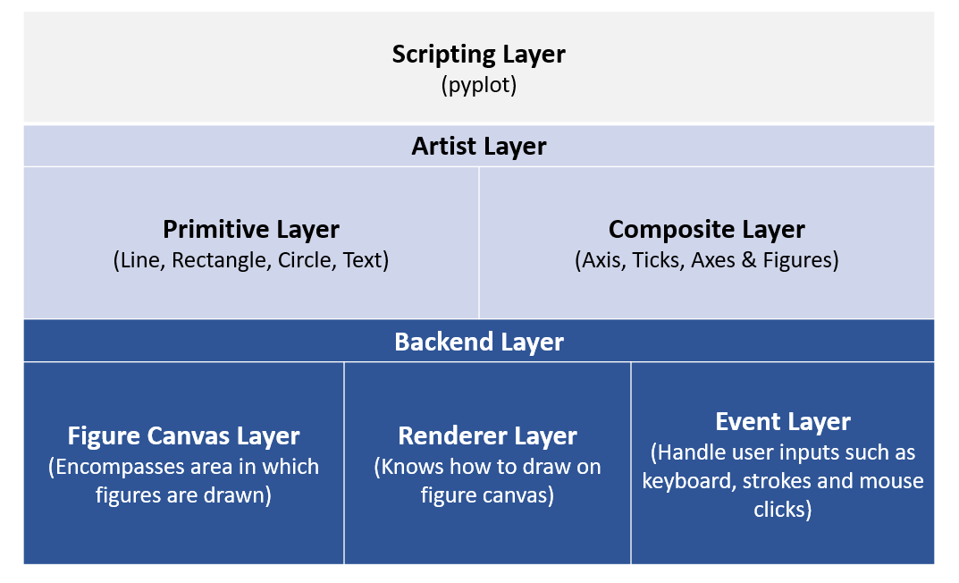
Matplotlib Architecture
• Backend Layer – Handles rendering and output of plots to the screen or files; manages different output formats (e.g., PNG, PDF, interactive GUI) • Artist Layer – Contains all visual elements (lines, text, shapes); everything you see on a plot is an “artist” • Scripting Layer – User-facing layer; provides the API to create plots, add labels, and control visual elements easily

Slide 9
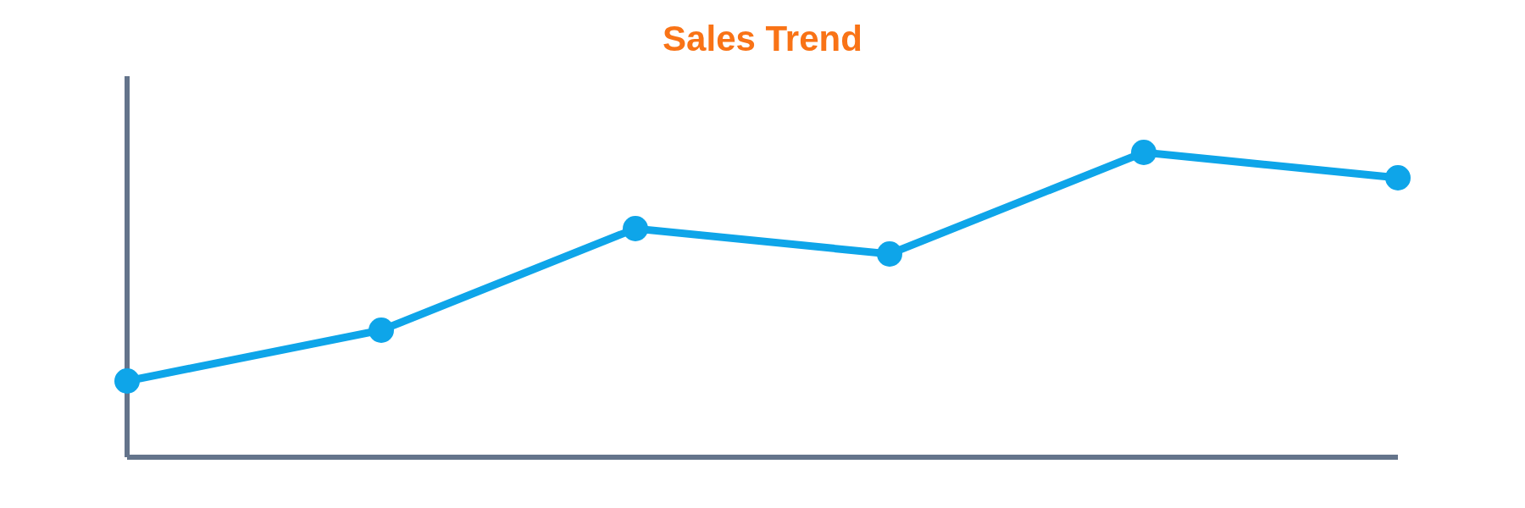
Line Plots - Trends Over Time
Line plots connect data points with lines to show trends over time, making them ideal for time series or sequential data. They typically include an x-axis, y-axis, labels, and legends, and can display multiple series for comparison. Line style, color, and markers can be customized to improve clarity.

Slide 10
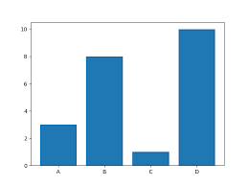
Bar Charts - Category Comparison
• Use rectangular bars to represent values for each category • Ideal for comparing groups or categories visually • Bars can be vertical or horizontal • Multiple series can be shown side by side for comparison • Customizable with colors, labels, and legends for clarity
Types: Vertical, Horizontal, Grouped, Stacked

Slide 11
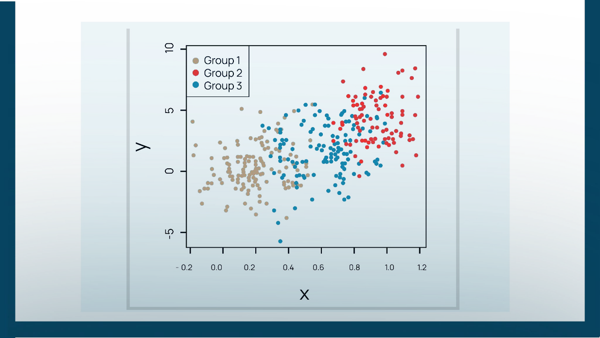
Scatter Plots - Relationships
• Show relationships between variables • Example: Scatter plot of CPU load vs response time with regression line • Useful for detecting linear/non-linear trends • Can help identify clusters or patterns within the data • Helps detect outliers or anomalies that may affect analysis

Slide 12
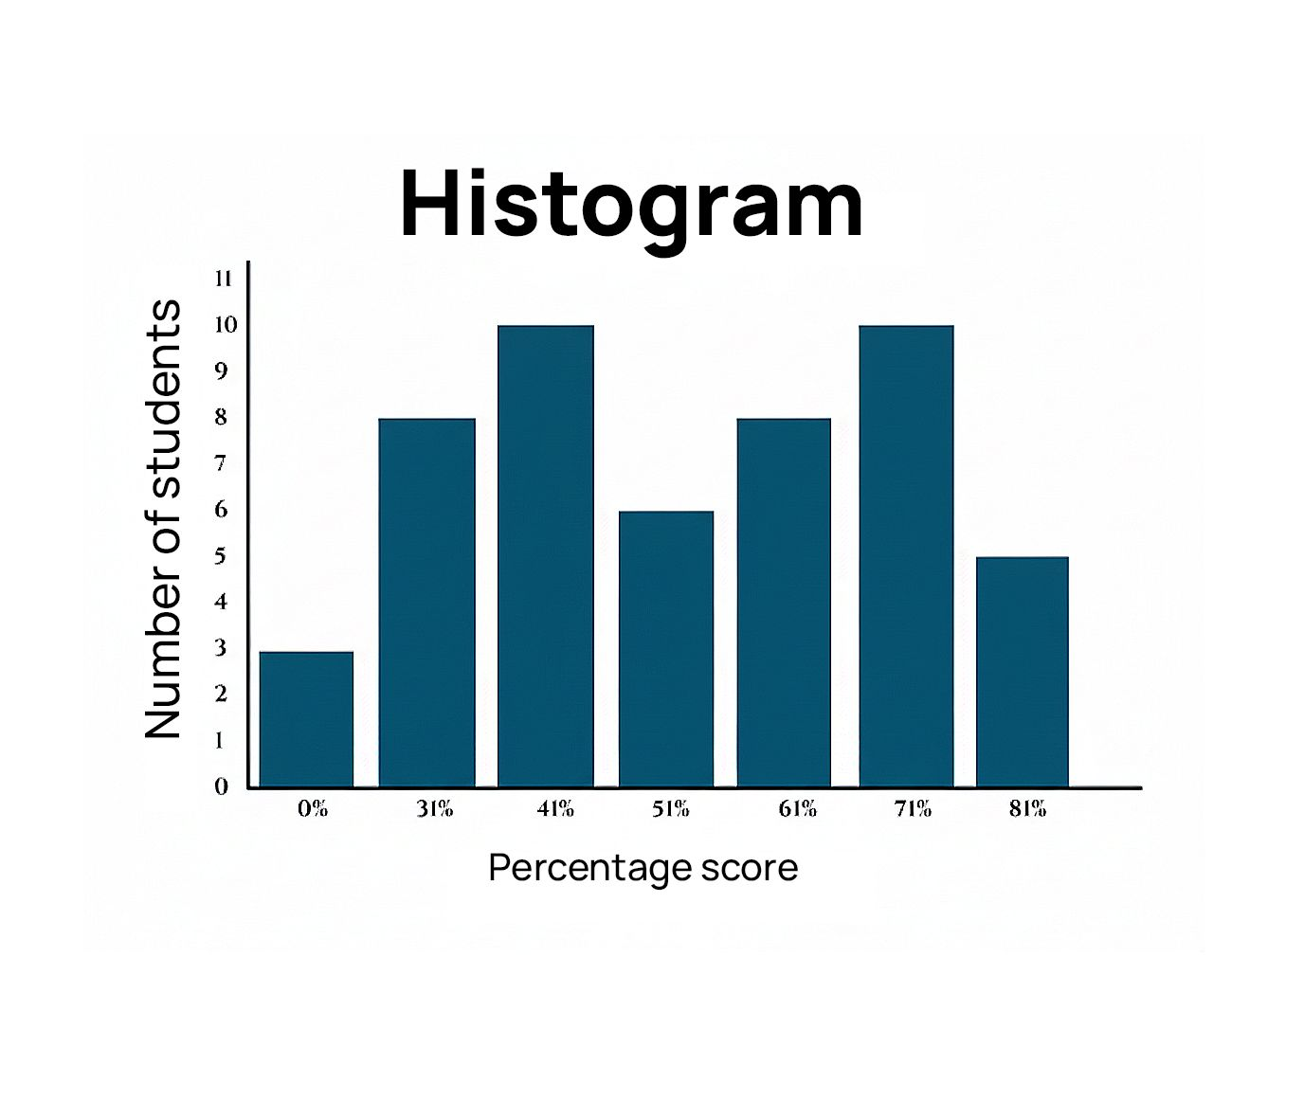
Histograms - Distributions
• Show distribution of data • Example: Histogram of login times for an authentication system • Helps identify normality, skewness, or unusual peaks • Useful for detecting outliers or extreme values • Can guide bin selection and data preprocessing for analysis

Slide 13
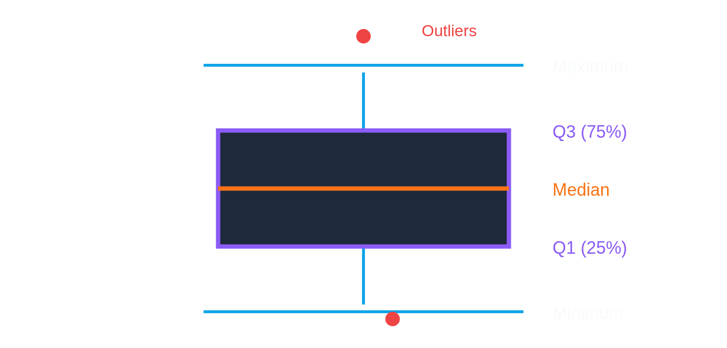
Box Plots - Statistical Summary
• Summarise data distribution: median, quartiles, outliers • Example: Visualising variance in daily bandwidth usage • Helps detect anomalies quickly • Useful for comparing distributions across multiple groups • Highlights skewness and spread of the data

Slide 14
Plot Customization Essentials
Titles: Clear, descriptive, actionable
Axis Labels: Include units of measurement
Legends: Strategic position, don't obstruct
Colors: Colorblind-friendly palettes
Grid Lines: Aid reading without distraction
Font Sizes: Large enough for presentations

Slide 15
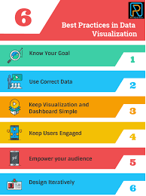
Best Practices in Visualisation
• Clarity: Avoid clutter • Accuracy: Represent data honestly (no misleading scales) • Relevance: Choose a chart type that matches the analysis goal • Accessibility: Ensure colour schemes are clear to all users • Consistency: Use uniform styles, colors, and fonts across plots • Context: Provide labels, captions, or notes so viewers understand the story

Slide 16
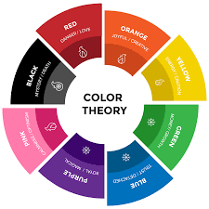
Color Psychology
• Colors influence perception and interpretation of data • Red: Often signals danger, alert, or important points • Green: Suggests growth, success, or positive outcomes • Blue: Conveys trust, stability, and calm • Orange/Yellow: Draw attention, highlight warnings or trends • Use color consistently to represent categories or ranges • Ensure accessibility: choose color schemes friendly to color-blind users

Slide 17
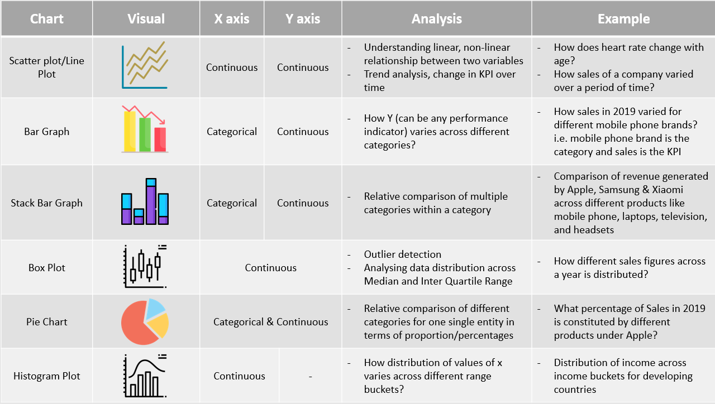
The chart selection framework

Slide 18
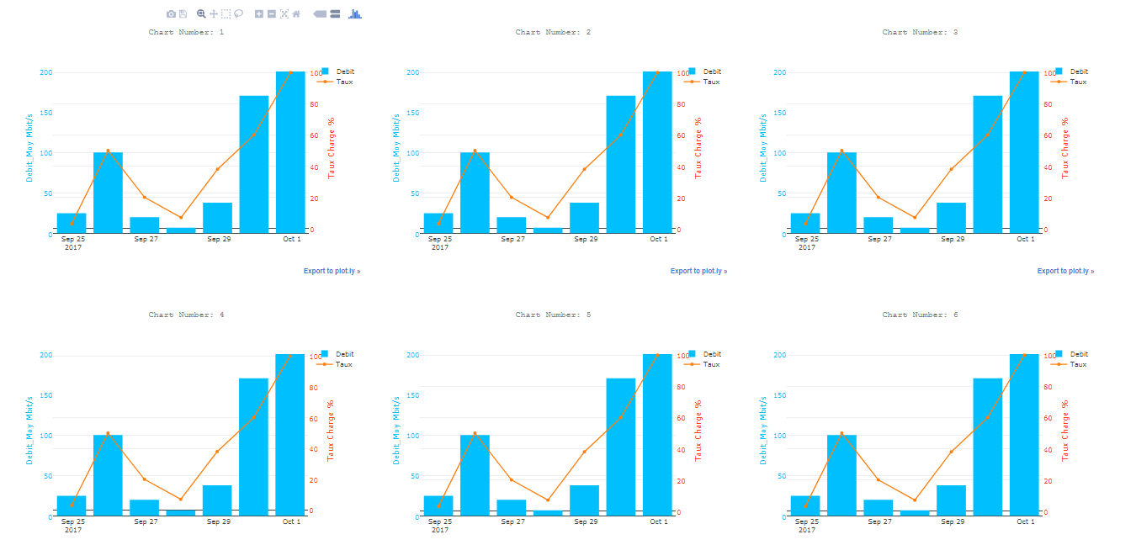
Subplots - Multiple Views
• Allow multiple plots in a single figure for easy comparison • Each subplot can have its own axes, labels, and scales • Useful for analyzing different aspects of the same dataset simultaneously • Helps in spotting patterns, trends, and anomalies across variables • Supports shared axes or independent axes depending on analysis needs • Improves presentation clarity by consolidating related visualizations

Slide 19
Introduction to Seaborn
Seaborn is a Python library built on Matplotlib for statistical data visualization • Simplifies creation of complex plots like violin plots, boxplots, and heatmaps • Provides high-level interface for drawing attractive and informative graphics • Integrates well with Pandas DataFrames for easy plotting of datasets • Supports color palettes, themes, and automatic aggregation for better visual appeal • Ideal for exploratory data analysis (EDA) and uncovering patterns in data

Slide 20
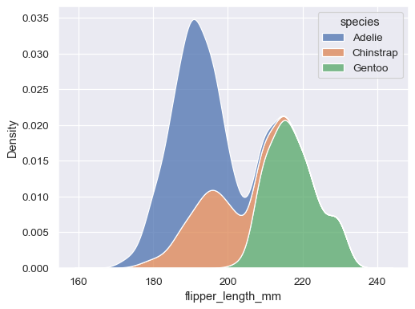
Seaborn - Distribution Plots
• Used to visualize the distribution of a single variable • Common plot types: histogram, KDE (Kernel Density Estimate), and rug plots • Helps identify skewness, modality, and outliers in data • Can combine multiple plots to compare distributions across groups • Customizable with colors, bins, and kernel settings for clarity • Supports integration with Pandas DataFrames for streamlined plotting

Slide 21
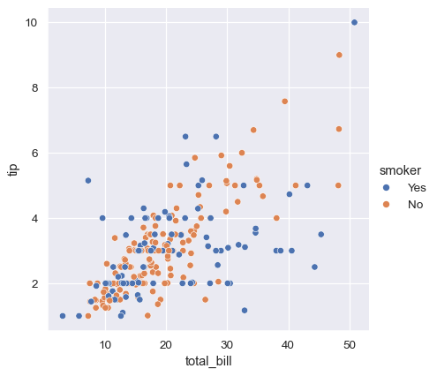
Seaborn - Relationship Plots
• Visualize relationships between two or more variables • Common plot types: scatter plots, line plots, and pair plots • Can include regression lines to show trends • Useful for detecting correlations, clusters, and patterns • Supports categorical separation using hue, style, or size • Integrates seamlessly with Pandas DataFrames for easy plotting

Slide 22
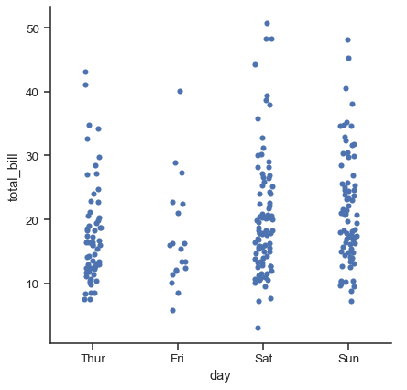
Seaborn - Categorical Plots
• Used to visualize relationships between categorical and numerical variables • Common plot types: bar plot, box plot, violin plot, and count plot • Helps identify distributions, trends, and variations across categories • Supports grouping and comparison using hue, style, or order • Customizable with colors, labels, and orientations for clarity • Ideal for summarizing and comparing category-level insights
barplot(): Bars with confidence intervals
boxplot(): Enhanced box plots
swarmplot(): Show all data points
catplot(): Categorical plot interface

Slide 23
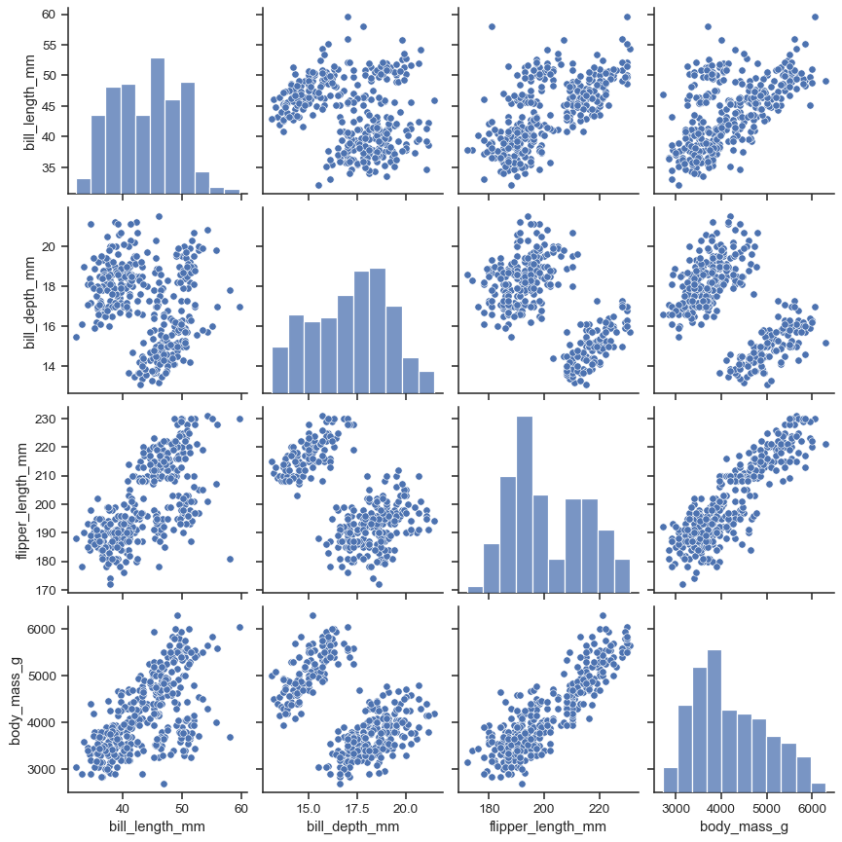
Seaborn Pair Plots
• Visualize pairwise relationships between multiple numerical variables in a dataset • Creates a matrix of scatter plots for each variable combination • Includes histograms or KDE plots along the diagonal for individual variable distributions • Useful for detecting correlations, trends, and clusters • Can differentiate groups using hue for categorical separation • Ideal for exploratory data analysis to quickly understand variable interactions

Slide 24
Exploratory Data Analysis
Systematic Discovery of Data Insights

Slide 25
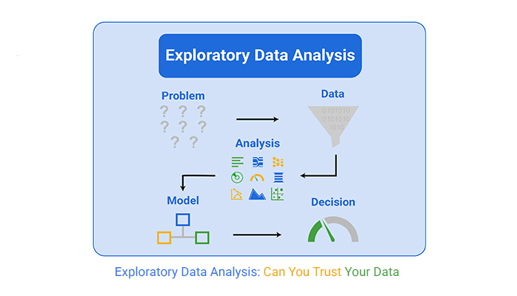
What is Exploratory Data Analysis?
Exploratory Data Analysis (EDA) is the process of examining and understanding a dataset before applying models. It involves summarizing data using statistics, visualizing distributions, and identifying patterns, trends, or anomalies. EDA helps detect missing values, outliers, and correlations, providing insights that guide feature selection, data cleaning, and modeling decisions.

Slide 26
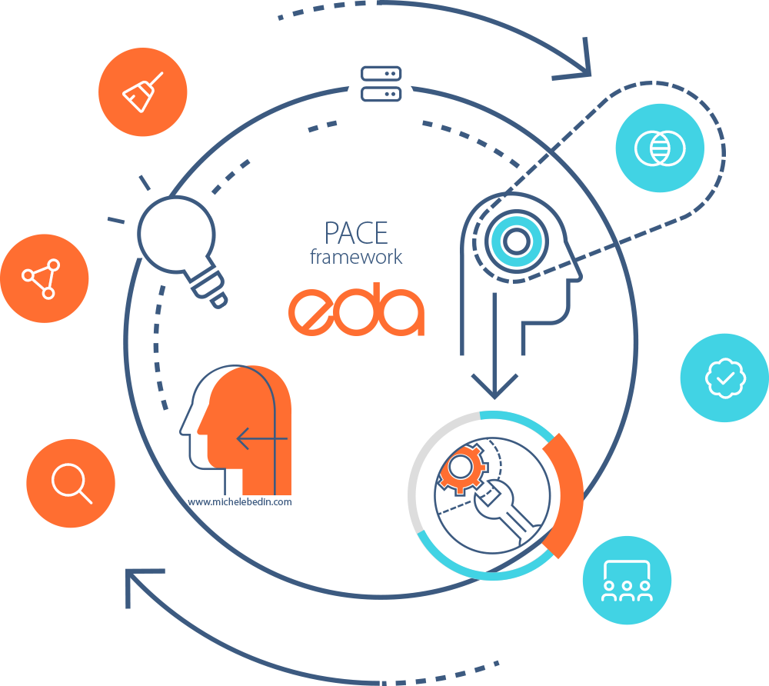
The EDA Mindset
Key Questions to Ask:
What does my data actually contain?
What are the data types and ranges?
Are there missing values or errors?
What patterns and relationships exist?
What outliers or anomalies are present?
What story does this data tell?

Slide 27
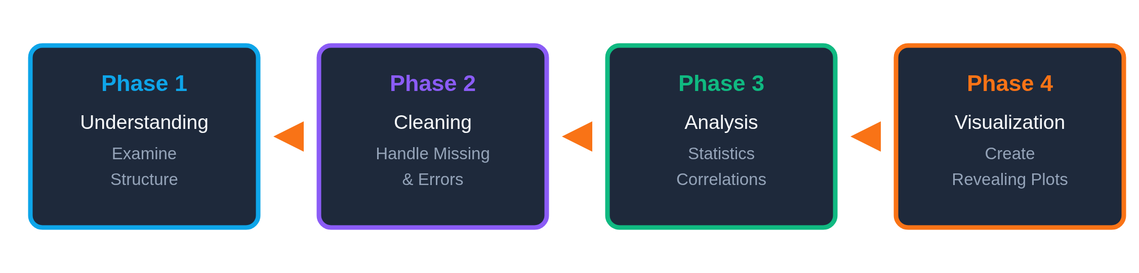
EDA Methodology - 4 Phases
1. Understanding • Inspect dataset structure, size, and variables • Review data types and basic summary information
2. Cleaning • Handle missing values and duplicates • Correct data types and formatting issues • Identify and treat outliers
3. Analysis • Generate summary statistics • Explore distributions and variable relationships • Identify trends and correlations
4. Visualization • Use plots to communicate patterns and insights • Validate findings through visual exploration • Support interpretation and decision-making
Iterative process - cycle as needed

Slide 28

Summary Statistics Deep Dive
• Describe the central tendency of data: mean, median, mode • Measure variability and spread: range, variance, standard deviation, IQR • Identify distribution shape: skewness and symmetry • Provide a quick overview of data behavior and scale • Support early detection of outliers and data quality issues • Guide feature selection and further analysis decisions

Slide 29
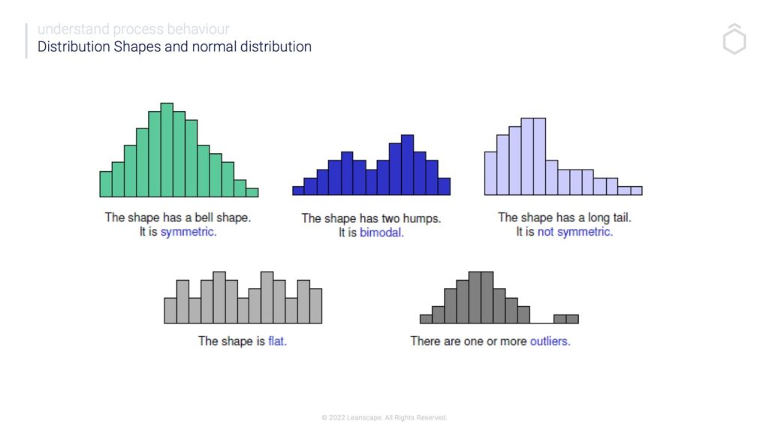
Distribution Analysis
• Examine how values are spread across a variable • Identify distribution shape: normal, skewed, or multimodal • Detect outliers and unusual patterns • Use visual tools such as histograms, KDE plots, and box plots • Compare distributions across groups or categories • Inform data transformations and modeling choices

Slide 30
Correlation Analysis

Slide 31
Introduction to Correlation Analysis
Correlation quantifies the strength and direction of a
relationship between two variables. Things to note
about correlation:
●
Range: -1 ≤ r ≤ 1
●
Positive (r > 0): Variables increase together.
●
Negative (r < 0): One increases, the other
decreases.
●
Zero (r ≈ 0): No linear relationship

Slide 32
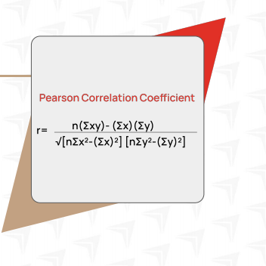
Pearson’s Correlation Coefficient
Pearson’s correlation coefficient (r), or the Pearson
R test, is a statistical measure that quantifies the
strength and direction of a linear relationship
between two continuous variables.
Example: Server uptime vs customer satisfaction →
r = 0.82 (strong positive correlation).

Slide 33
Correlation Causation
Correlation ≠ Causation.
Example: Cloud usage and company revenue
correlate, but growth may be driven by external
factors (market demand).
Always check context and other influencing
variables

Slide 34
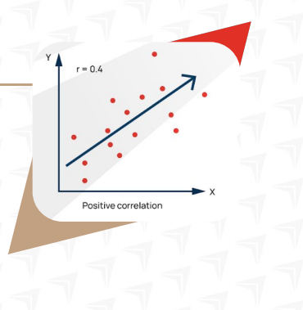
Limitations of Correlation
Only captures linear relationships.
Influenced by outliers.
Cannot prove cause and effect
May detect spurious relationship

Slide 35
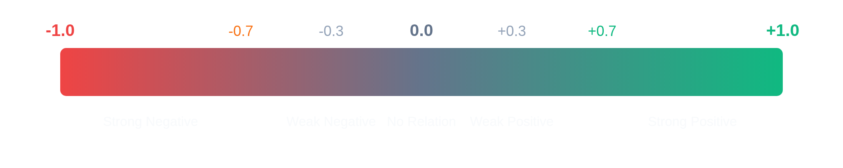
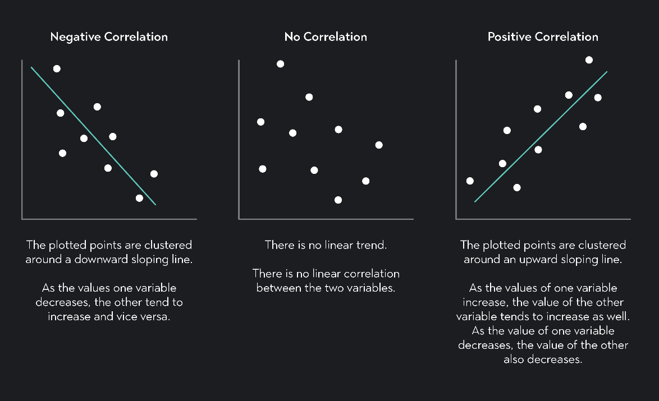
Interpreting Correlation
• Correlation measures the strength and direction of a relationship between variables • Values range from -1 to +1, indicating negative, no, or positive correlation • Positive correlation means variables increase together • Negative correlation means one variable decreases as the other increases • Correlation does not imply causation • Strong correlations can guide feature selection and further analysis

Slide 36
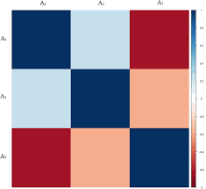
Correlation Heatmaps
• Visual representation of correlation matrices using color intensity • Makes it easy to spot strong positive and negative relationships • Useful for analyzing many variables at once • Color gradients help compare correlation strength quickly • Commonly created using Seaborn heatmap • Supports feature selection and multicollinearity checks

Slide 37
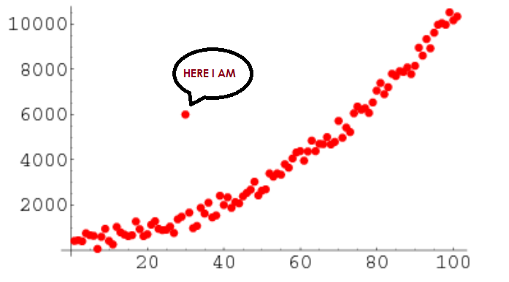
Identifying Outliers
• Outliers are data points that differ significantly from the rest of the data • May indicate data errors, rare events, or important signals • Common detection methods: IQR, Z-score, box plots, and scatter plots • Visual tools help reveal unusual patterns or extreme values • Outliers can distort statistics and models if not handled properly • Decisions include removal, transformation, or separate analysis

Slide 38
Pattern Recognition in Data
Pattern recognition involves identifying recurring trends, structures, or behaviors within a dataset. These patterns may appear as trends over time, clusters of similar observations, or associations between variables. Visual exploration plays a key role in revealing patterns that may not be obvious from summary statistics alone. Interpreting patterns in context helps distinguish meaningful signals from random noise and supports better analytical and decision-making outcomes.

Slide 39
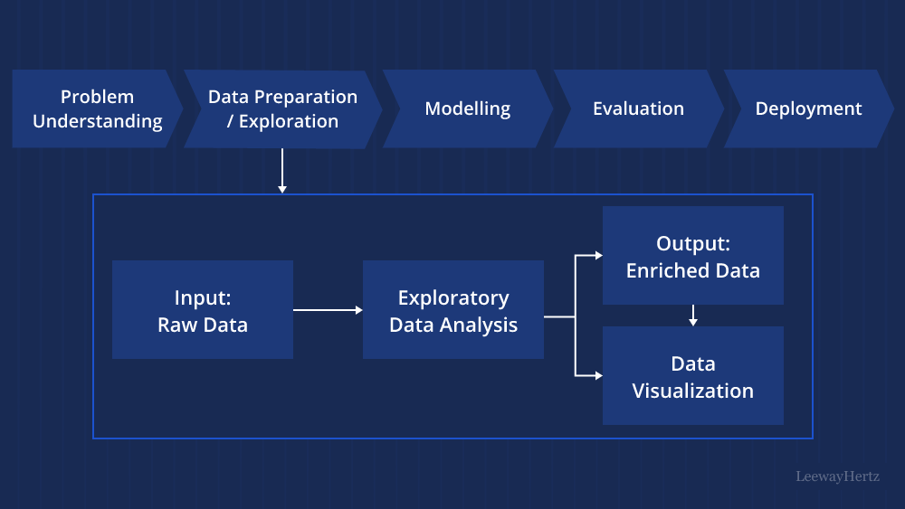
EDA Best Practices
• Understand the dataset structure and context before analysis • Explore data iteratively using both statistics and visualizations • Question unusual patterns, anomalies, or outliers • Validate findings across multiple perspectives or subsets • Document insights clearly for communication and reproducibility • Use EDA to guide data cleaning, feature selection, and modeling decisions

Slide 40
Common EDA Mistakes
• Jumping to modeling without understanding the data • Ignoring missing values or duplicates • Failing to visualize distributions or relationships • Overlooking outliers or anomalies • Relying solely on summary statistics without context • Documenting insights incompletely or inconsistently

Slide 41
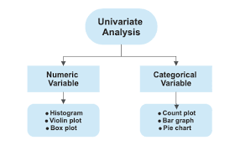
Univariate Analysis
Univariate analysis focuses on examining one variable at a time to understand its distribution, central tendency, and variability. Common techniques include histograms, box plots, and summary statistics such as mean, median, mode, and standard deviation. This analysis helps identify patterns, outliers, and potential data quality issues, providing a foundation for deeper multivariate exploration.

Slide 42
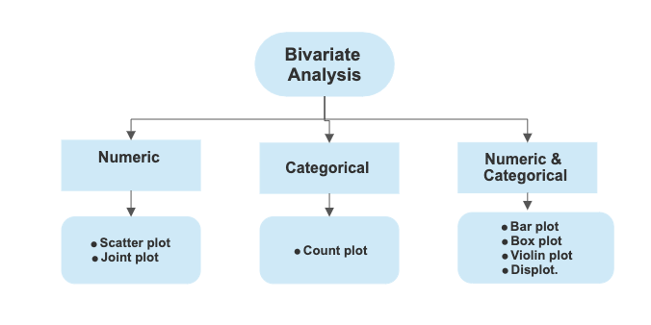
Bivariate Analysis
Bivariate analysis examines the relationship between two variables to understand how one may influence or relate to the other. Common methods include scatter plots, correlation coefficients, and cross-tabulations. This type of analysis helps identify trends, associations, and potential causal patterns, and informs decisions about feature selection, modeling, and further investigation.

Slide 43
Multivariate Analysis
Multivariate analysis examines three or more variables simultaneously to understand complex relationships and interactions within the data. Techniques such as pair plots, correlation matrices, PCA (Principal Component Analysis), and regression models are commonly used. This analysis helps identify patterns, clusters, and dependencies that are not apparent in univariate or bivariate analysis, providing deeper insights for decision-making and predictive modeling.

Slide 44
Your EDA Toolkit
Core Libraries
Advanced Tools
Pandas
NumPy
Matplotlib
Seaborn
Pandas Profiling
Sweetviz
Missingno
Plotly

Slide 45
Assignment - EDA Report
Requirements:
Jupyter Notebook format
Data cleaning documentation
5+ meaningful visualizations
Statistical analysis (correlations, outliers)
3-5 key insights (300-500 words)

Slide 46
Summary
Data visualization and exploratory data analysis (EDA) are essential steps in understanding and interpreting data. The process begins with data cleaning, handling missing values, duplicates, outliers, and formatting issues. Visualizations using Matplotlib and Seaborn—including line plots, bar plots, scatter plots, histograms, box plots, distribution plots, and heatmaps—help uncover trends, patterns, and relationships.
EDA involves univariate, bivariate, and multivariate analyses to summarize distributions, explore correlations, and recognize patterns across multiple variables. Best practices, such as clarity, accuracy, relevance, and accessibility, guide effective visualization, while awareness of common mistakes ensures insights are reliable. Pattern recognition, correlation analysis, and documentation of findings make the insights actionable, supporting informed decision-making and predictive modeling.

