Slide 1
Exposing soil data with SensorThingsAPI
113th OGC Technical Committee
Toulouse, France
Mickael Beaufils (BRGM)
19 November 2019

Slide 2
The data to expose: Soil pollution analysis
0
MAT#645
ANA#18101
LAYER#42
MAT#646
ANA#30637
ECH#2911
…
1,50
ANA#30706
MAT#647
SAMPLES
LAYER#43
ANALYSIS
2,50
MATERIALS
LAYER#44
3,80
BOREHOLE#591

Slide 3
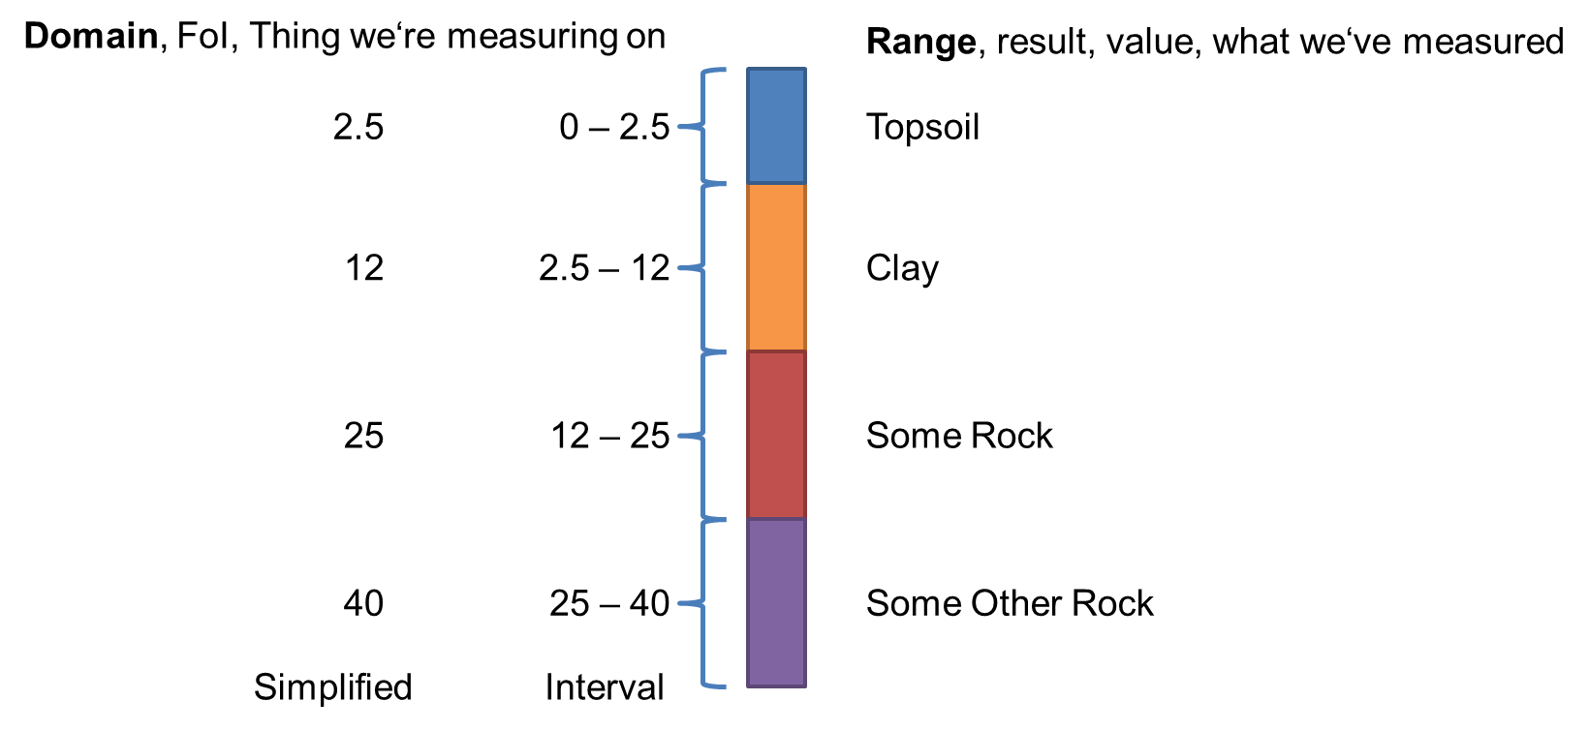
The native database structure
Site
BD SOLU (30/07/2019)
1
n
Borehole
Lien base ext
Site utilisation
1
n
BoreholeLayer
1
n
Material
1
n
Sample
1
n
Analysis

Slide 4
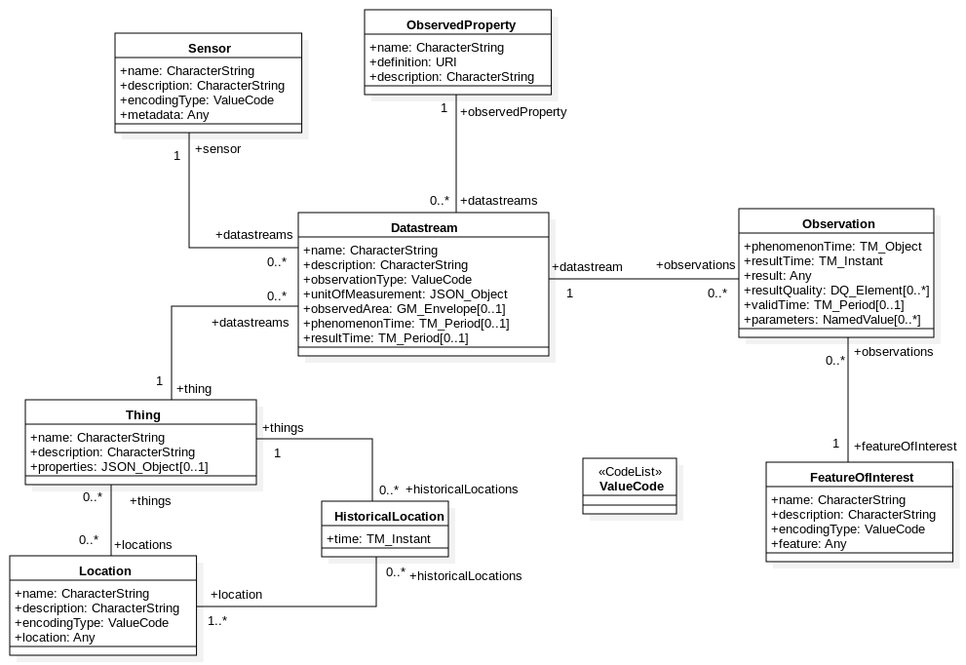
Defining the good mapping 1

Slide 5
Site
Defining the good mapping 2
Properties:relatedFeature
Borehole (SON)
STA4SOIL on 06/08/2019
Properties:relatedFeature
Layer Nature
Layer (NIV)
Material type
Granulometry
Properties:relatedFeature
Material proportion
Material (MAT)
Location
Properties:relatedFeature
Sample color
Thing
Sample smell
Sample (ECH)
Feature
Sample texture
Observation
Analysis

Slide 6
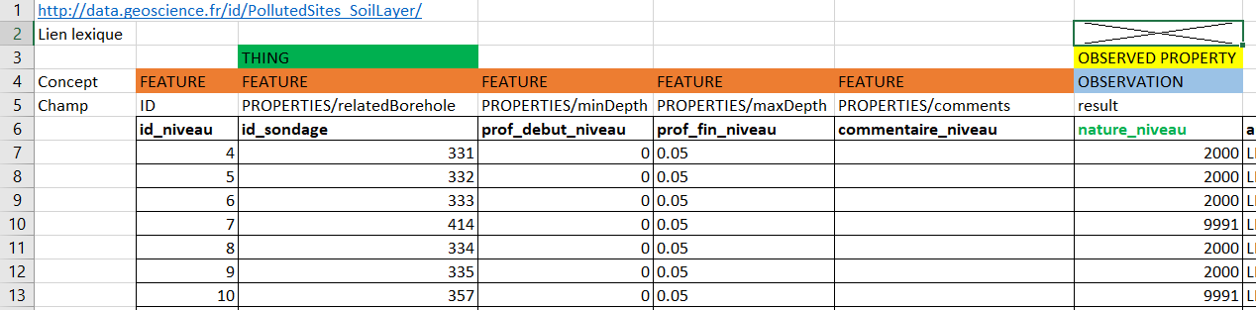
Defining the good mapping 3
Define where the initial data should go in the new data model

Slide 7
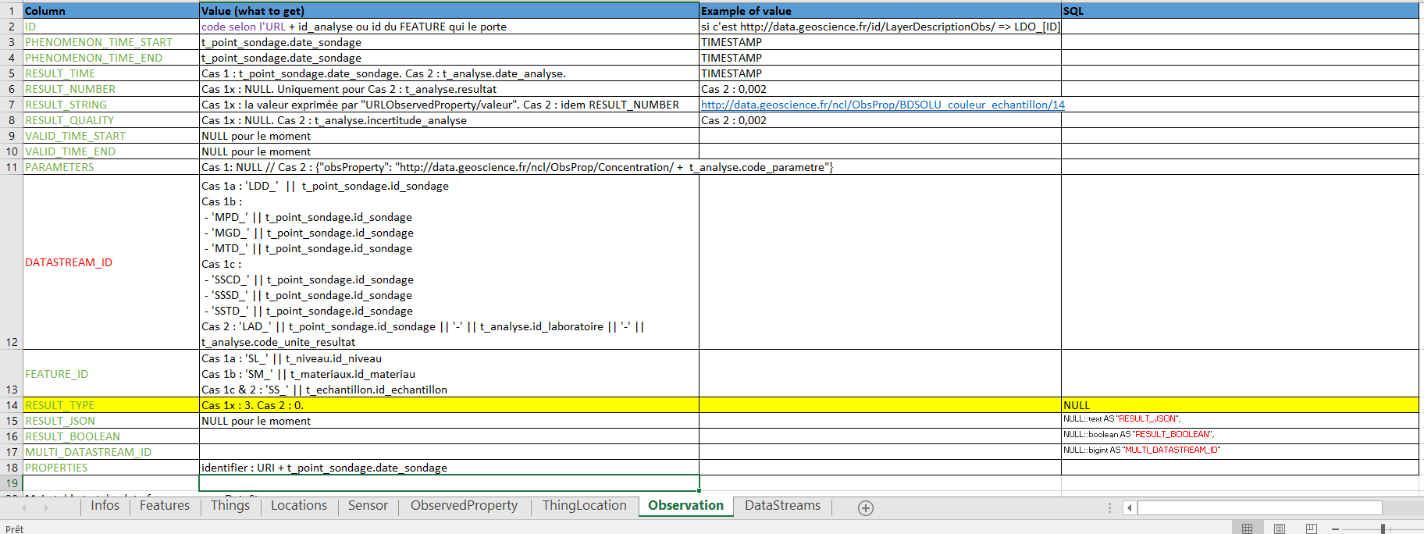
Defining the good mapping 4
How to (define how to) populate the SensorThingsAPI table

Slide 8
It works!
https://sta4soil.brgm-rec.fr/FROST-Server/

Slide 9
Feedback to SensorThingsAPI SWG
Implementation performed with the Frost Server
Third SensorThings API instance at BRGM
Groundwater measures
Surface water quality
Soil
Connection between FeaturesOfInterest not in the OGC:SensorThingsAPI standard
Yet we needed it
Counter-measure was to use the Properties:jsonObject that is offered in every class of the SensorThingsAPI Frost Implementation
Proposal 1: Have « Properties:jsonObject » officially in every class from SensorThingsAPI
Proposal 2: Enable a « RelatedFeature attribute » in the Features class

Slide 10
Thanks for your attention
m.beaufils@brgm.fr

