Slide 1
Effects of Tornadoes
Deborah Aina, Eric Colburn, Mario Cosby, and Jimmy White

Slide 2
Summary
Explore the effects of tornadoes across the countries using Census data.
See where tornadoes most commonly occur
Does this have an effect on prices of homes in these areas?
Does this have an effect on where people decide to live?
Find relationships between weather data and how strong the storm was.
Can the weather in a city that gets hit by a tornado predict how strong the tornado was?
Is there any relationship between tornado damage to how strong the storm was?
Use Twitter data to see how much coverage a tornado gets.
Do some tornadoes get more coverage than others?

Slide 3
Questions and Data
Tornado Data from 1950 to 2015
Is there a relationship between where tornadoes occur and real estate prices?
Census Data
Where do tornadoes most commonly occur?
Google Maps API
Is there a way to predict how strong a tornado will be based off of expected weather conditions in the affected areas?
World Weather Online API
Do the effects of a tornado (i.e. number of injuries) have any relationship to how strong the tornado was?
Tornado Data
Do all tornadoes get the same new coverage? Does it matter where the tornado is supposed to hit or the magnitude of the tornado?
Twitter API
Notes:
On this slide, talk about how we cleaned up the data and explored it.

Slide 4
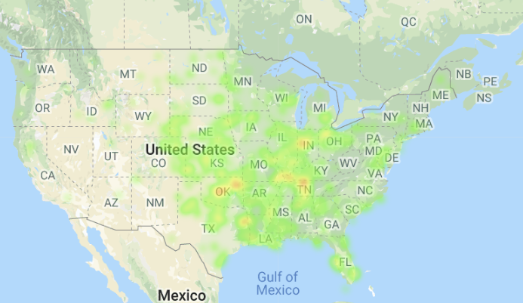
Top 5 Tornado Active States (2013)
Texas (84)
Oklahoma (82)
Kansas (55)
Illinois (52)
Nebraska (50)
Top 5 Property Loss(2013)
Oklahoma ($2 billion)
Illinois ($1.07 billion)
Texas ($270 million)
Georgia ($77 million)
Missouri ($68 million)
Jimmy Data
Texas (313)
Kansas (230)
Illinois (141)
Missouri (138)
Alabama (109)
Jimmy Data
Texas (313)
Kansas (230)
Illinois (141)
Missouri (138)
Alabama (109)

Slide 5
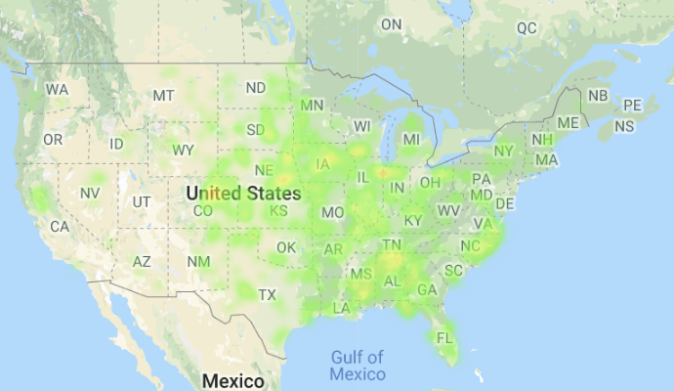
Top 5 Tornado Active States (2014)
Nebraska (62)
Iowa (55)
Alabama (52)
Colorado (49)
Illinois (48)
Top 5 Property Loss States (2014)
Arkansas ($226 million)
Mississippi ($196 million)
Nebraska ($52 million)
Wisconsin ($29 million)
North Carolina ($22 million)
Jimmy Data
Texas (313)
Kansas (230)
Illinois (141)
Missouri (138)
Alabama (109)
Jimmy Data
Texas (313)
Kansas (230)
Illinois (141)
Missouri (138)
Alabama (109)

Slide 6
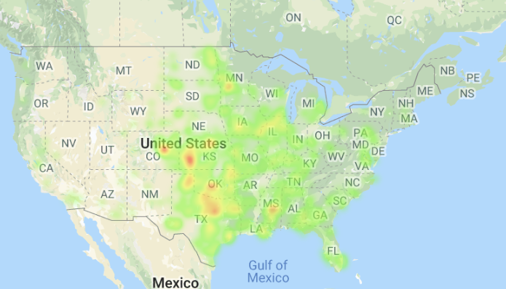
Top 5 Tornado Active States (2015)
Texas (241)
Kansas (126)
Oklahoma (108)
Illinois (67)
Iowa (59)
Top 5 Property Loss States (2015)
Texas ($114 million)
Oklahoma ($59 million)
Illinois ($50 million)
California ($20 million)
Mississippi ($15 million)
Jimmy Data
Texas (313)
Kansas (230)
Illinois (141)
Missouri (138)
Alabama (109)
Jimmy Data
Texas (313)
Kansas (230)
Illinois (141)
Missouri (138)
Alabama (109)

Slide 7
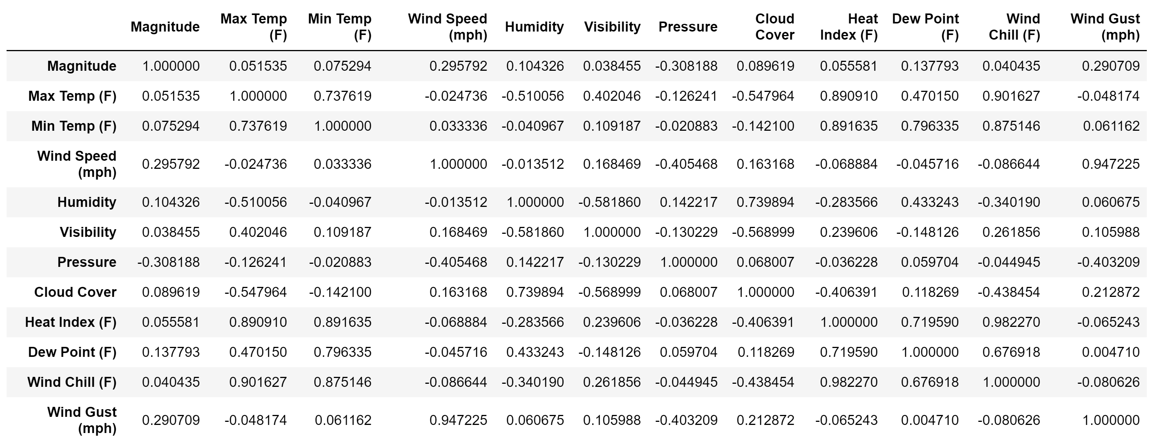
Weather Correlations

Slide 8
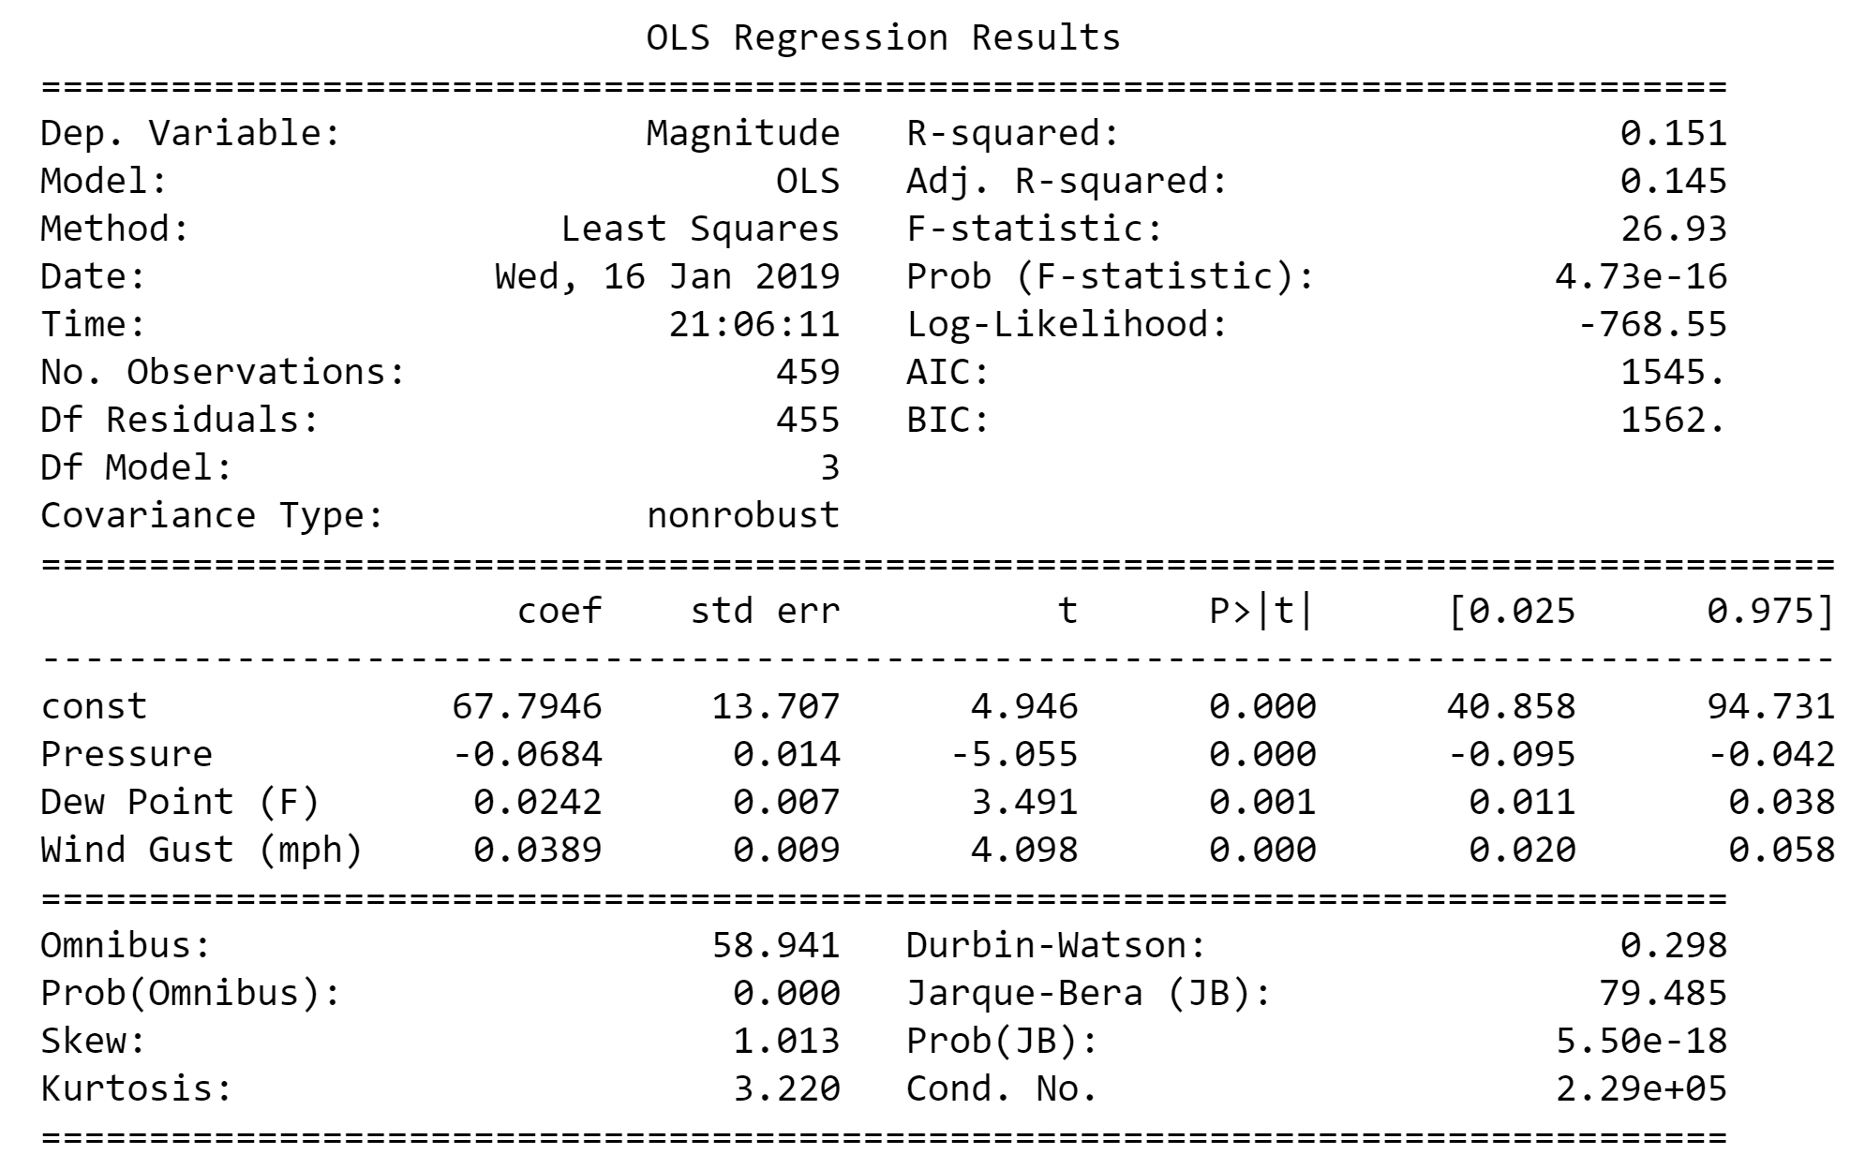
Regression Analysis

Slide 9
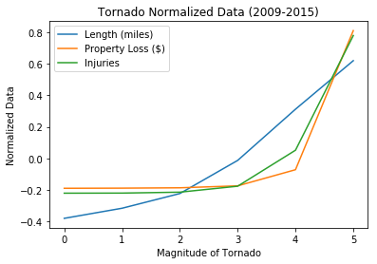
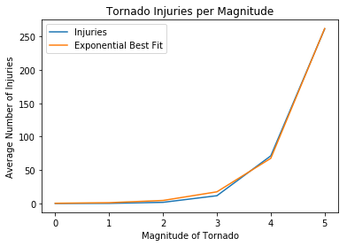
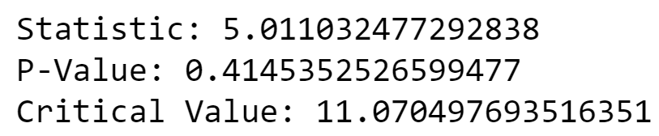
Goodness of Fit Tests

Slide 10
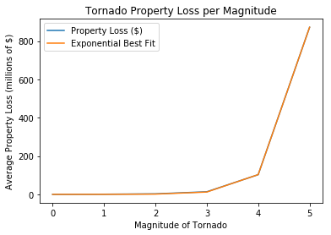
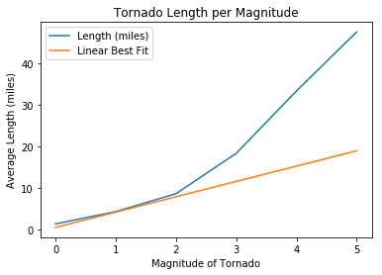
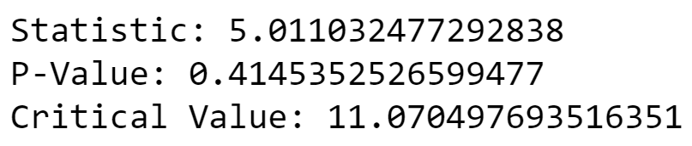
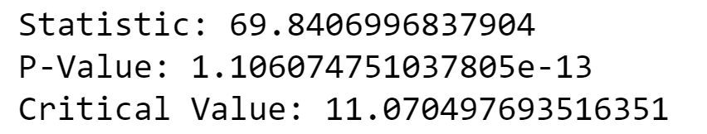
Goodness of Fit Tests

Slide 11
Do all tornadoes get the same new coverage? Twitter API
Does it matter where the tornado is supposed to hit or the magnitude of the tornado and how often are twitter users talking about it.
Free historical twitter data is not available. There is a free tier to pull tweets for 30days. Anytime longer than that has to be done using either the Premium full archive search or the enterprise paid tier.
With this access one can collect, analyze, trace the origin of tweets, how many tweets are sent per day, what people are tweeting about what news outlets are tweeting, how often are they tweeting and user id etc. There are several parameters to apply to return tweets, this includes but not limited to from: @user_name, has:media, place, has:video, keyword, url,#...etc. All these parameters are embedded in the query string.
Using the searchtweets library, we imported collect_results, gen_rule_payload and load_credentials.

Slide 12
Snippets of tweets collected from @breakingweather, keyword is tornado
2811 tornado warnings were issued by local forecast offices in 2017. #weatherOf2017
Learn more about tornadoes: https://t.co/N0C7rm48ne https://t.co/G28DBrQ9e2
2811 tornado warnings were issued by local forecast offices in 2017. #weatherOf2017
Learn more about tornadoes: https://t.co/N0C7rm48ne https://t.co/G28DBrQ9e2
2811 tornado warnings were issued by local forecast offices in 2017. #weatherOf2017
Learn more about tornadoes: https://t.co/N0C7rm48ne https://t.co/G28DBrQ9e2
Water spout looks like 'snow tornado' over Grand Traverse Bay https://t.co/YbhW0ylFPK
#Water spout looks like 'snow tornado' over Grand Traverse Bay: MLive https://t.co/vfZBQSMWJL
Notes:
Using the collect results function in the searchtweets library we are able to collect tweets . Using the function rule one can put together 1,2,3 or even more parameters to return tweets based on one’s preference, including but not limited to the parameters ; from, keyword, has:media, has:geo, has:video…etc

Slide 13
Tweets Count per Month and Day
COUNT | MONTH | DAY
65 | 11 | 30
241 | 12 | 1
87 | 12 | 2
34 | 12 | 3
18 | 12 | 4
9 | 12 | 5

Slide 14
Tweet Generator
twitterfeed
TweetDeck
Twitter for iPhone
wicked wx bot
TweetDeck
Twitter Web Client
Echofon
Twitter for Websites
UberSocial for BlackBerry
TweetDeck
wicked wx bot
twitterfeed
Cloudhopper
wicked wx bot
Twitter for iPhone
Twitterrific for iOS
twitterfeed
Twitter for Websites
Twitter for Mac

Slide 15
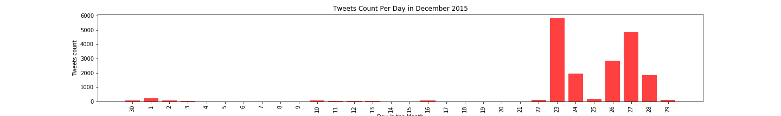
Count of tweet per day in December 2015 on the hashtag or keyword tornado
Notes:
This bar graph shows the number of tweets related to tornado watch or weather each day in November 2015. Starting at 0 up to 6000 tweets per day

Slide 16
What can we use historical tweets data for?
We can track or trace users interest and engagement on certain topics, product, business, organization, government.
This tracks the individual tweets, retweets, hashtags, counts of tweet, minutes, hour, day, month and year on which tweets were created.
The number of times users tweeted or retweeted on the topic tornado watch or tornado shows the level of interest or whether it not it poses a threat to people.
What are twitter users saying, how often are they talking about a topic, where they are tweeting from are all questions that helps make good marketing, business, governmental and/or organizational decisions.

Slide 17
Discussion
There is an exponential growth relationship with the average number of injuries vs. the strength of a tornado.
There is an exponential growth relationship with the average property loss vs the strength of a tornado.
There is no relationship between the weather in the location of a tornado and the strength of a tornado.
The Twitter API is a very powerful API when using to track or trace what people have been saying about a particular product or company. It helps citizens, marketers, politician and business people make informed decisions.
Notes:
Discuss your findings. Did you find what you expected to find? If not, why not? What inferences or general conclusions can you draw from your analysis?

Slide 18
Difficulties and Additional Questions
Weather data for actual tornadoes were not available, so we did not have accurate data to predict future tornadoes.
With more time and access to weather data on tornadoes (and not just where they occur), we would expect to find a predictive formula on how strong a tornado would be.
Historical Twitter data is not free
There were challenges encountered when applying the parameter language to return tweets in English. Tweets returned on the keyword tornado came in different languages.
There are many projects available on GitHub on how to use twitters full archive or enterprise tier API.
Tornado Data went back to 1950, but other data we used only went back a few years.
Historical Weather Data – 2009
Census Data – 2014
Twitter Data – more data/popular each year (2006)
Notes:
Discuss any difficulties that arose, and how you dealt with them
Discuss any additional questions that came up, but which you didn't have time to answer: What would you research next, if you had one more week?

Slide 19
Questions?

