Slide 1
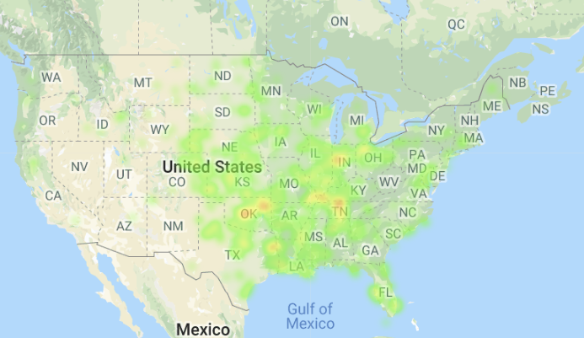
Top 5 Tornado Active States (2013)
Texas (84)
Oklahoma (82)
Kansas (55)
Illinois (52)
Nebraska (50)
Top 5 Property Loss(2013)
Oklahoma ($2 billion)
Illinois ($1.07 billion)
Texas ($270 million)
Georgia ($77 million)
Missouri ($68 million)
Jimmy Data
Texas (313)
Kansas (230)
Illinois (141)
Missouri (138)
Alabama (109)
Jimmy Data
Texas (313)
Kansas (230)
Illinois (141)
Missouri (138)
Alabama (109)

Slide 2
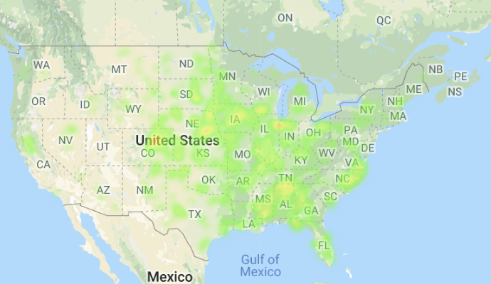
Top 5 Tornado Active States (2014)
Nebraska (62)
Iowa (55)
Alabama (52)
Colorado (49)
Illinois (48)
Top 5 Property Loss States (2014)
Arkansas ($226 million)
Mississippi ($196 million)
Nebraska ($52 million)
Wisconsin ($29 million)
North Carolina ($22 million)
Jimmy Data
Texas (313)
Kansas (230)
Illinois (141)
Missouri (138)
Alabama (109)
Jimmy Data
Texas (313)
Kansas (230)
Illinois (141)
Missouri (138)
Alabama (109)

Slide 3
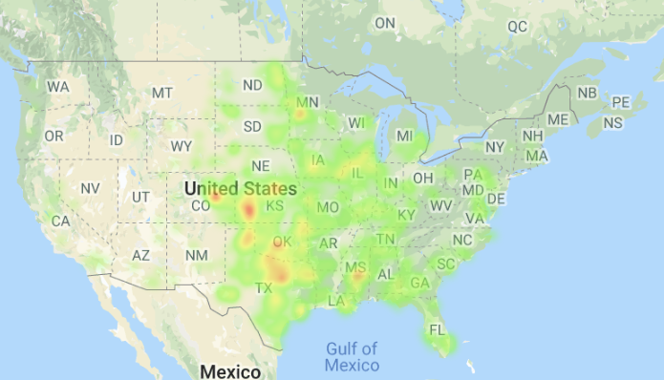
Top 5 Tornado Active States (2015)
Texas (241)
Kansas (126)
Oklahoma (108)
Illinois (67)
Iowa (59)
Top 5 Property Loss States (2015)
Texas ($114 million)
Oklahoma ($59 million)
Illinois ($50 million)
California ($20 million)
Mississippi ($15 million)
Jimmy Data
Texas (313)
Kansas (230)
Illinois (141)
Missouri (138)
Alabama (109)
Jimmy Data
Texas (313)
Kansas (230)
Illinois (141)
Missouri (138)
Alabama (109)

