Slide 1
Effects of Tornadoes
Deborah Aina, Eric Colburn, Mario Cosby, and Jimmy White

Slide 2
Summary
Notes:
Define the core message or hypothesis of your project.
Describe the questions you asked, and why you asked them
Describe whether you were able to answer these questions to your satisfaction, and briefly summarize your findings

Slide 3
Questions and Data
Tornado Data from 1950 to 2015
Is there a relationship between where tornadoes occur and real estate prices?
Census Data
Where do tornadoes most commonly occur?
Google Maps API
Is there a way to predict how strong a tornado will be based off of expected weather conditions in the affected areas?
World Weather Online API
Do the effects of a tornado (i.e. number of injuries) have any relationship to how strong the tornado was?
Tornado Data
Do all tornadoes get the same new coverage? Does it matter where the tornado is supposed to hit or the magnitude of the tornado?
Twitter API

Slide 4
Data Cleanup & Exploration
Notes:
Describe the exploration and cleanup process
Discuss insights you had while exploring the data that you didn't anticipate
Discuss any problems that arose after exploring the data, and how you resolved them

Slide 5
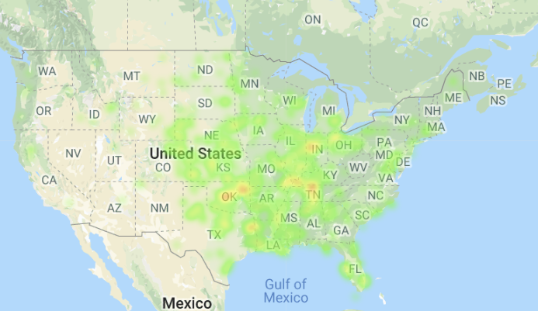
Top 5 Tornado Active States (2013)
Texas (84)
Oklahoma (82)
Kansas (55)
Illinois (52)
Nebraska (50)
Top 5 Property Loss(2013)
Oklahoma ($2 billion)
Illinois ($1.07 billion)
Texas ($270 million)
Georgia ($77 million)
Missouri ($68 million)
Jimmy Data
Texas (313)
Kansas (230)
Illinois (141)
Missouri (138)
Alabama (109)
Jimmy Data
Texas (313)
Kansas (230)
Illinois (141)
Missouri (138)
Alabama (109)

Slide 6
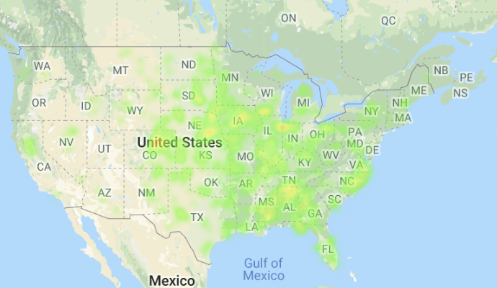
Top 5 Tornado Active States (2014)
Nebraska (62)
Iowa (55)
Alabama (52)
Colorado (49)
Illinois (48)
Top 5 Property Loss States (2014)
Arkansas ($226 million)
Mississippi ($196 million)
Nebraska ($52 million)
Wisconsin ($29 million)
North Carolina ($22 million)
Jimmy Data
Texas (313)
Kansas (230)
Illinois (141)
Missouri (138)
Alabama (109)
Jimmy Data
Texas (313)
Kansas (230)
Illinois (141)
Missouri (138)
Alabama (109)

Slide 7
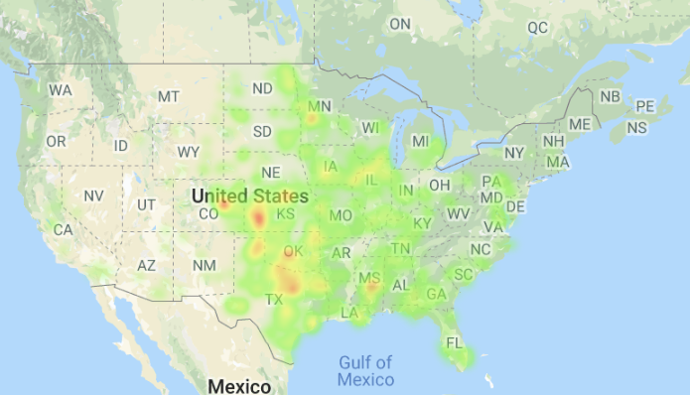
Top 5 Tornado Active States (2015)
Texas (241)
Kansas (126)
Oklahoma (108)
Illinois (67)
Iowa (59)
Top 5 Property Loss States (2015)
Texas ($114 million)
Oklahoma ($59 million)
Illinois ($50 million)
California ($20 million)
Mississippi ($15 million)
Jimmy Data
Texas (313)
Kansas (230)
Illinois (141)
Missouri (138)
Alabama (109)
Jimmy Data
Texas (313)
Kansas (230)
Illinois (141)
Missouri (138)
Alabama (109)

Slide 8
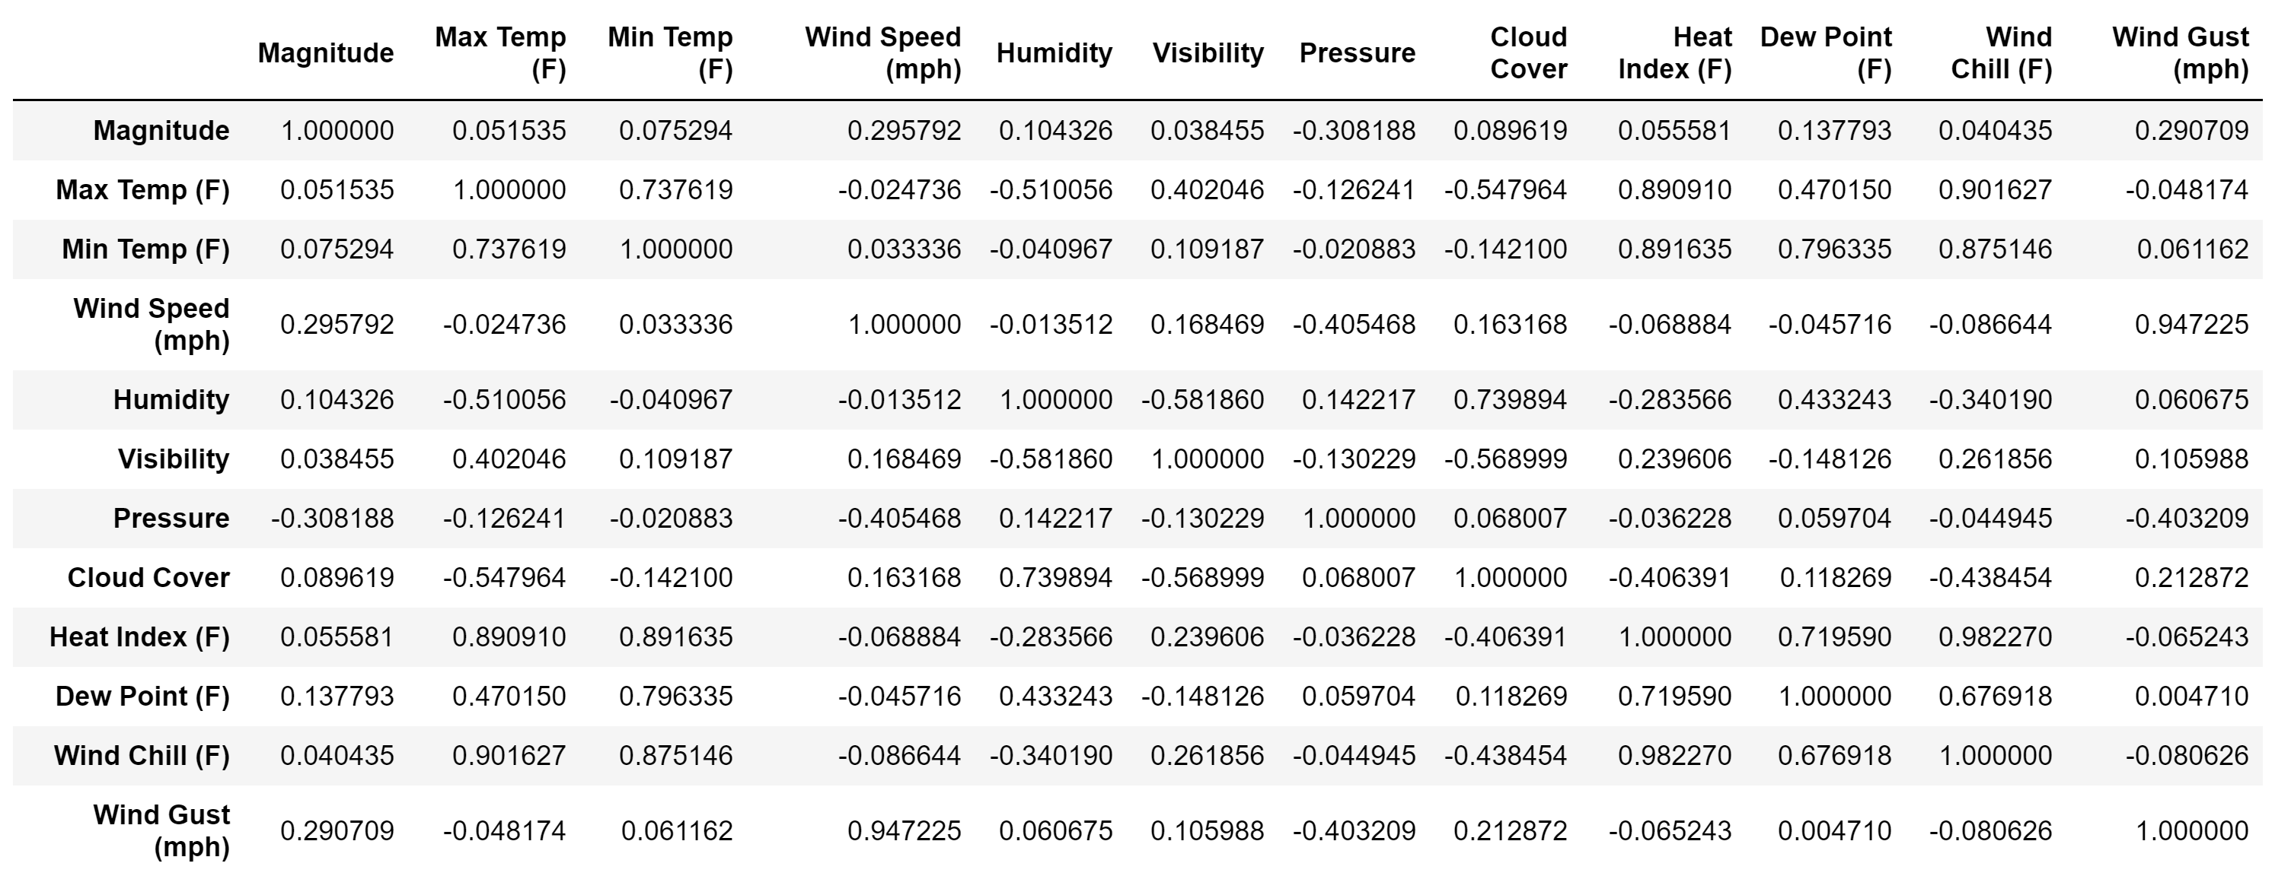
Weather Correlations

Slide 9
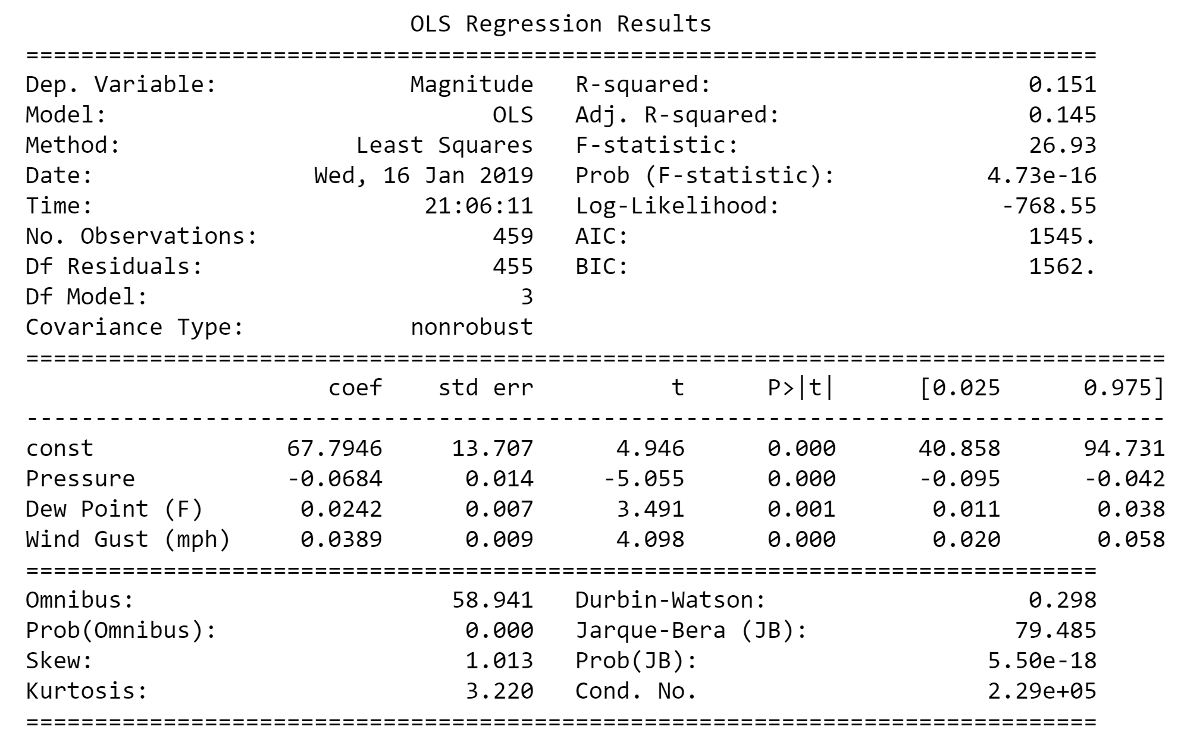
Regression Analysis

Slide 10
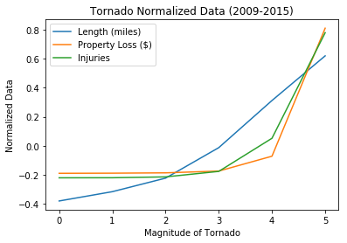
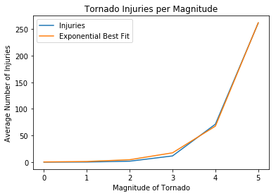
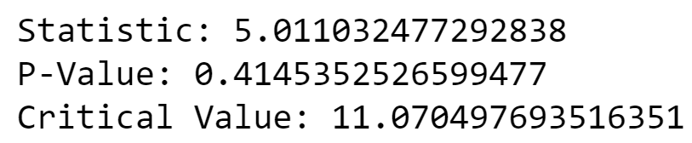
Goodness of Fit Tests

Slide 11
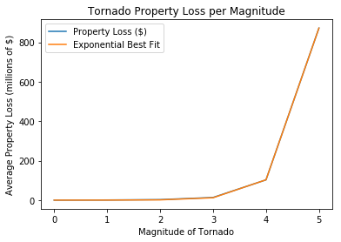
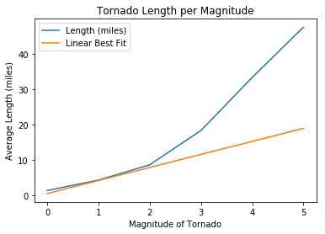
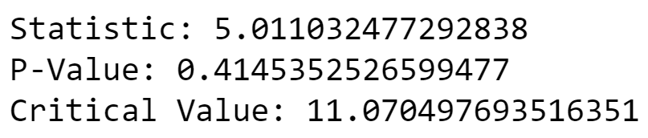
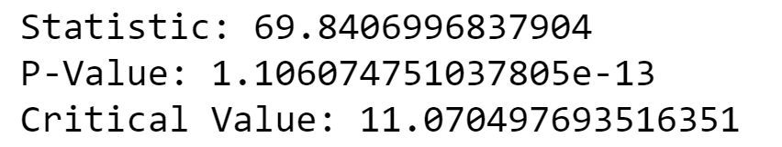
Goodness of Fit Tests

Slide 12
Discussion
There is an exponential growth relationship with the average number of injuries vs. the strength of a tornado.
There is an exponential growth relationship with the average property loss vs the strength of a tornado.
There is no relationship between the weather in the location of a tornado and the strength of a tornado.
Notes:
Discuss your findings. Did you find what you expected to find? If not, why not? What inferences or general conclusions can you draw from your analysis?

Slide 13
Difficulties and Additional Questions
Weather data for actual tornadoes were not available, so we did not have accurate data to predict future tornadoes.
With more time and access to weather data on tornadoes (and not just where they occur), we would expect to find a predictive formula on how strong a tornado would be.
Notes:
Discuss any difficulties that arose, and how you dealt with them
Discuss any additional questions that came up, but which you didn't have time to answer: What would you research next, if you had one more week?

Slide 14
Questions?

