Slide 1
Course Topics In Statistics Master’s Degree Programs
Josh Sidney, Ed Coleman, Thomas Reaves, Qiansheng Liang

Slide 2
Objective
Understand the prevalence of specific topics in required coursework
Topics considered: Sampling Methods, Bayesian Methods and Experimental Design
Goal is to estimate the proportion of programs that require exposure to these topics

Slide 3
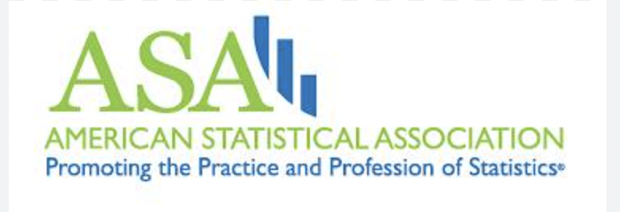
Frame
We used datasets from the American Statistical Association to construct our frame.
Datasets listed the institutions granting master’s degrees in statistics and biostatistics

Slide 4
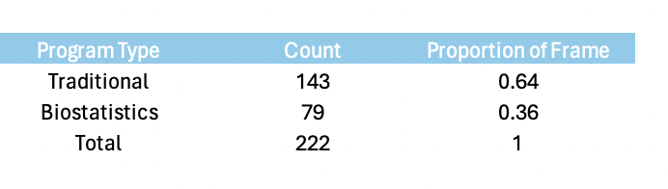
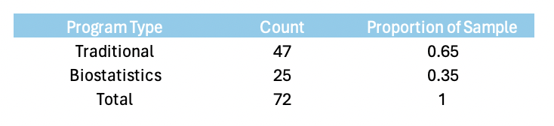

Sampling
Stratified on the ASA’s classification of a program
Simple random samples were taken within each strata.
Strata sample sizes were proportional to their size in the population
Frame
Sample

Slide 5
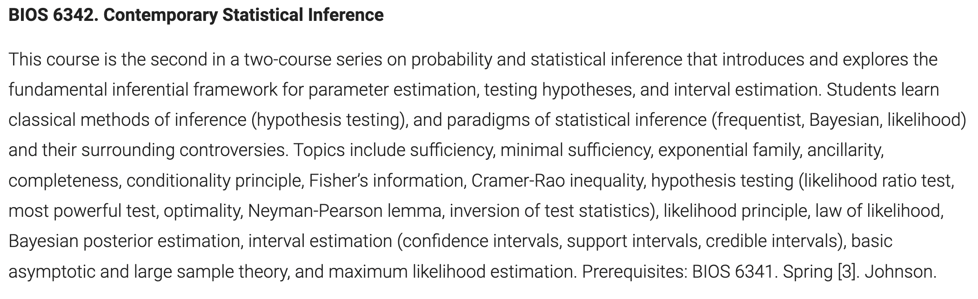
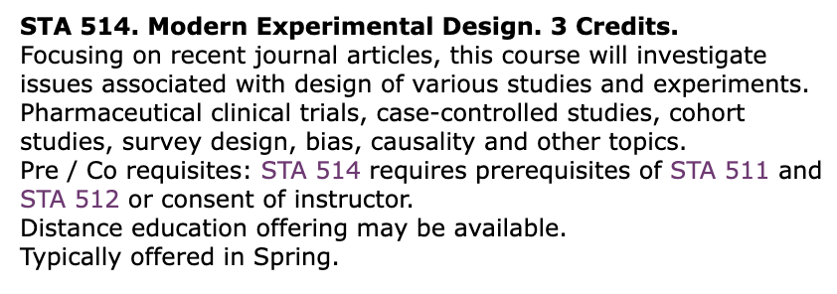
Measurement
Examined course descriptions from course catalogues and program handbooks
Subjective!

Slide 6
Statistical Methods
Exact confidence intervals using the hypergeometric distribution.
Agresti and Coull 1998
Brown, Cai and DasGupta 2001
Wang 2015
Sprop function in R

Slide 7
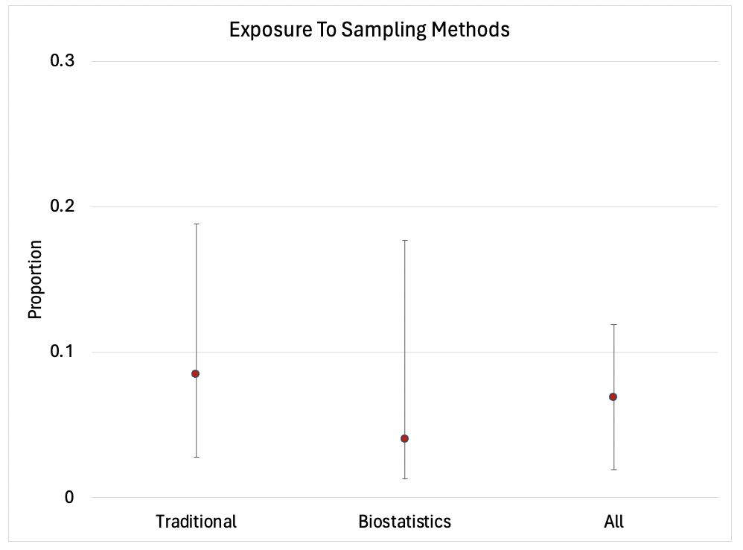
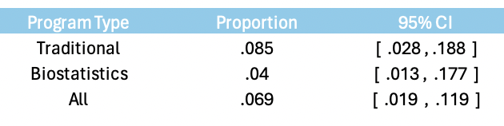
Results: Sampling Methods

Slide 8
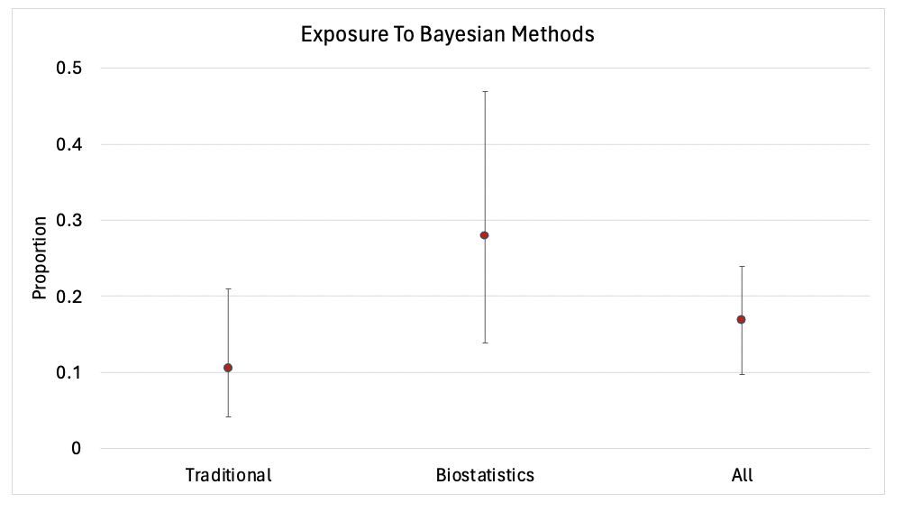
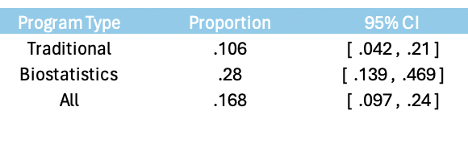
Results: Bayesian Methods

Slide 9
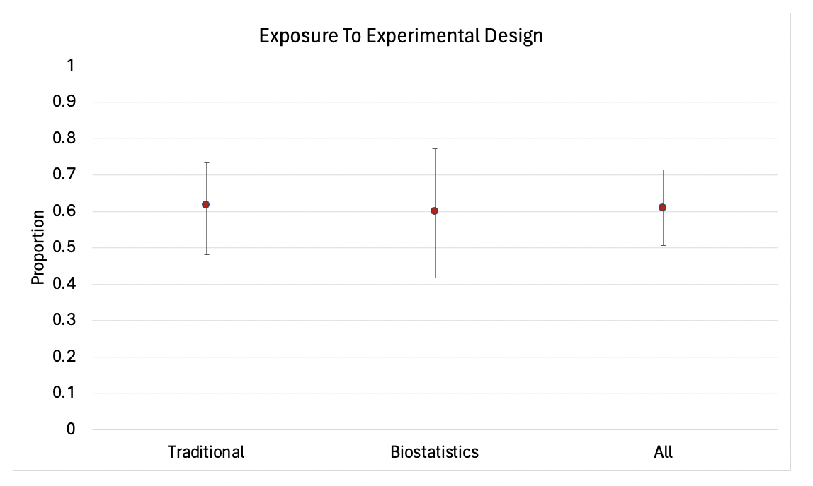
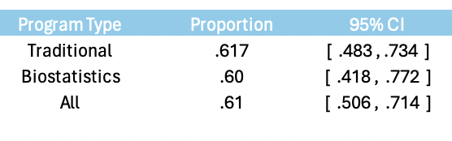
Results: Experimental Design

Slide 10
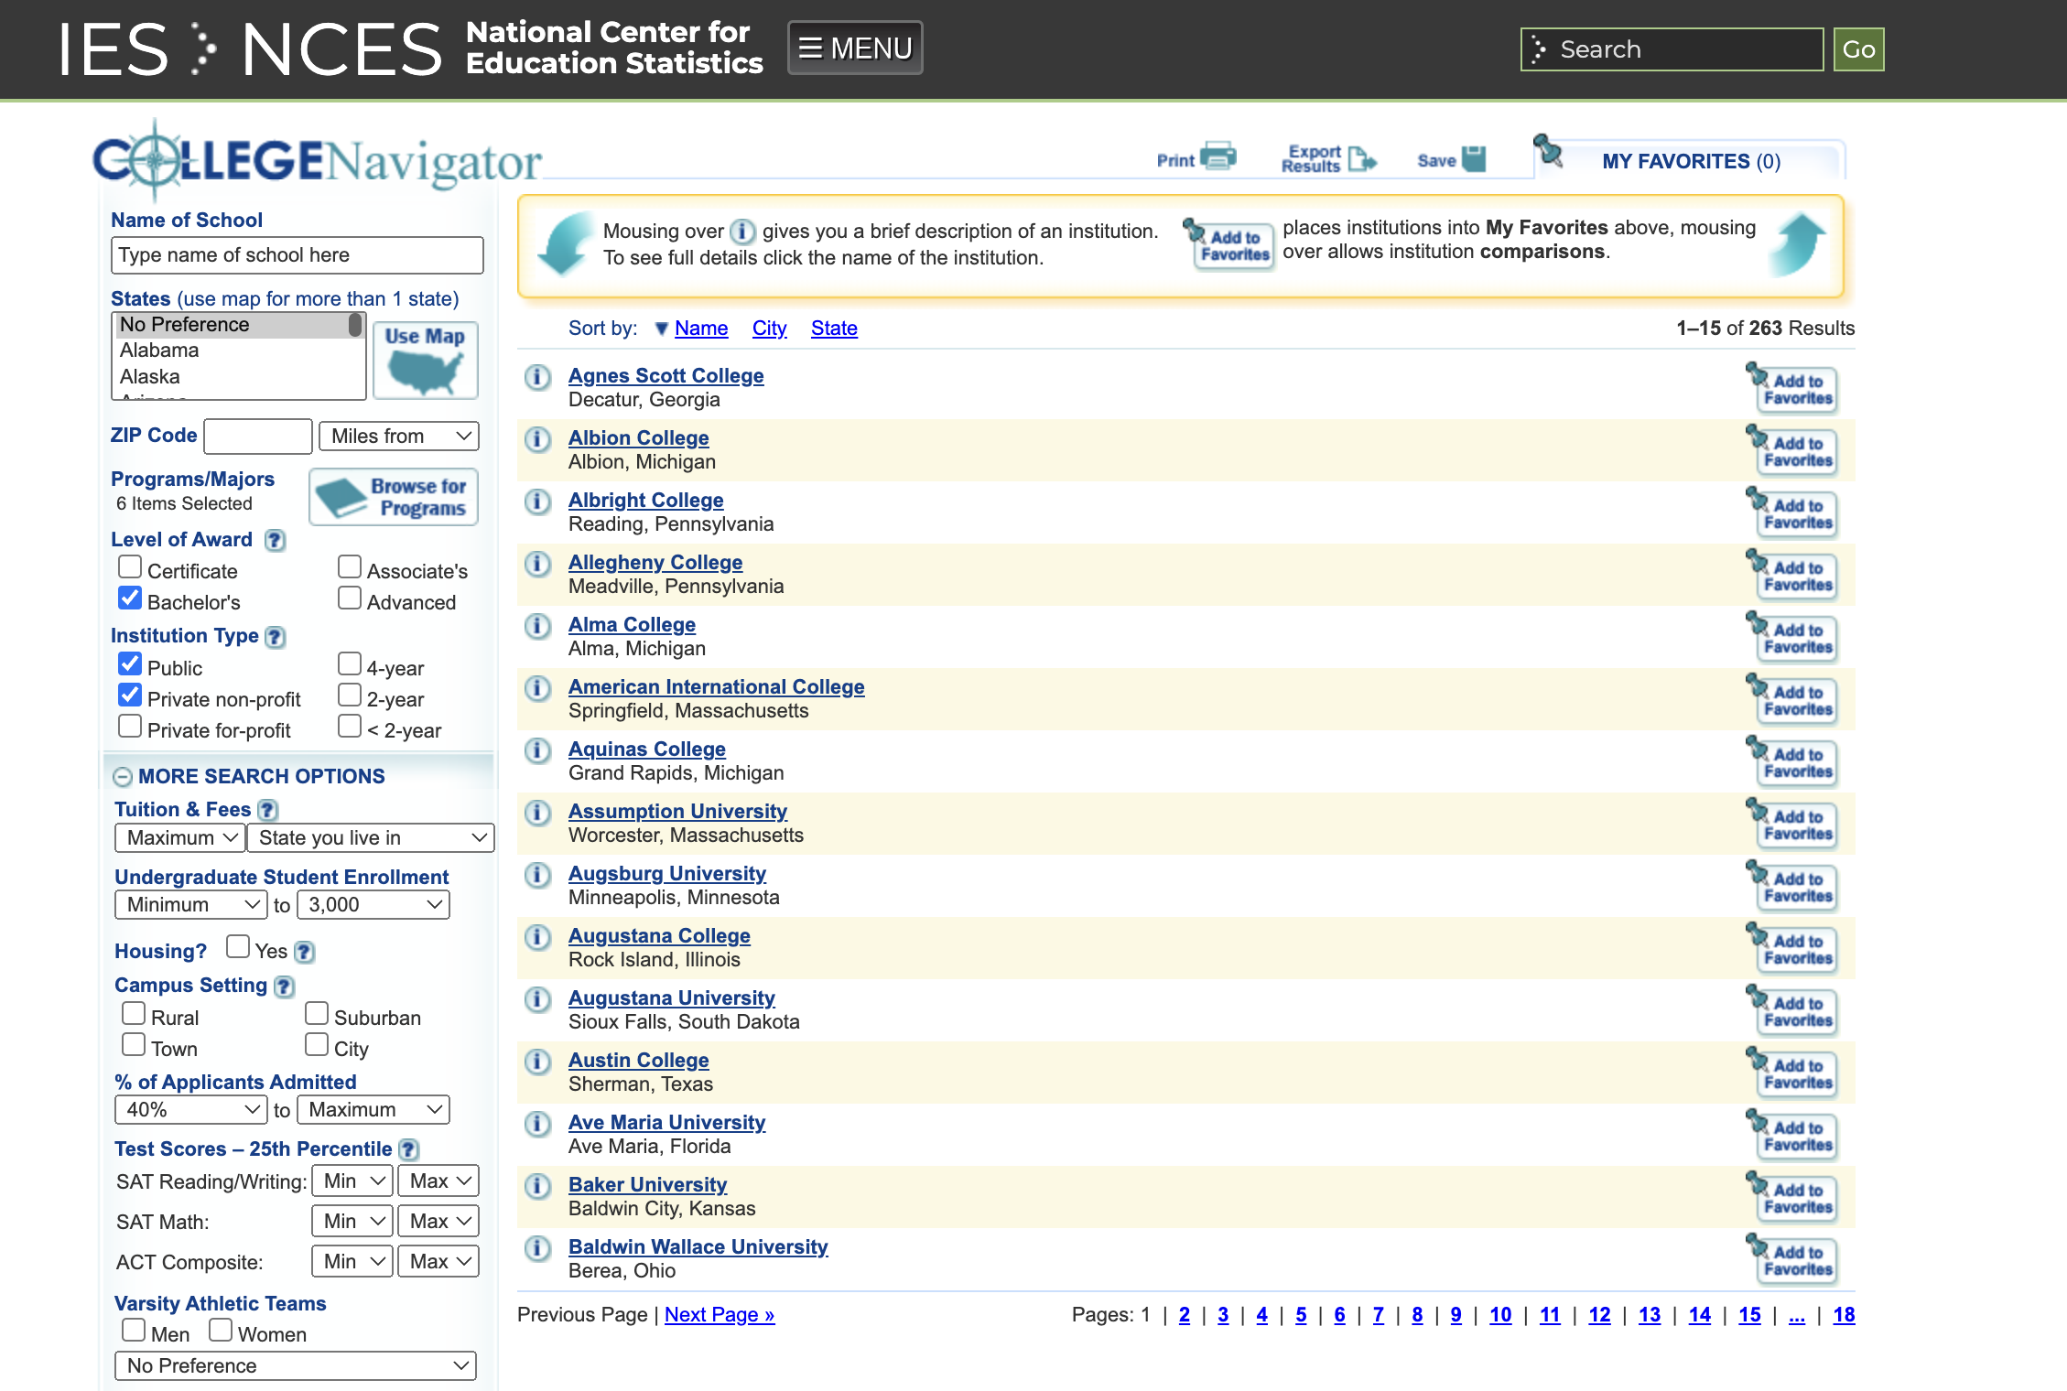
Discussion
Evaluation can be difficult and some cases can go either way
Overcoverage and undercoverage
Statistics Master’s consulting requirement
Undergraduate degree calculus requirements
Application to major

Slide 11
References
Agresti, Alan, and Brent A. Coull. "Approximate is better than “exact” for interval estimation of binomial proportions." The American Statistician 52, no. 2 (1998): 119-126.
Brown, Lawrence D., T. Tony Cai, and Anirban DasGupta. "Interval estimation for a binomial proportion." Statistical science 16, no. 2 (2001): 101-133.
Wang, Weizhen. "Exact optimal confidence intervals for hypergeometric parameters." Journal of the American Statistical Association 110, no. 512 (2015): 1491-149
J. Manitz, M. Hempelmann, G. Kauermann, et al. samplingbook: survey Sampling Procedures. R package

