Slide 1
Project_2 Environmental index
Yunke
Kaci Bourgua
Adel Chahed
30/01/2023

Slide 2
Table of content
Introduction
Database
Project Goals
Methodology
Results
Conclusion
Demo

Slide 3
Database building

Slide 4
Project Description
This project focuses on the theme of the environment and aims to compare countries with an environmental index that includes several elements.
The data for these 4 dimension come from the OECD and the World Bank:
Air pollution
Biodiversity
Environmental policy
Renewable energies
The data is analyzed from 2005 to 2015 on 10 G20 countries : Australia, Canada, France, Germany, Italy, Japan, Mexico, Korea, UK, USA

Slide 5
Table 1: Air pollution
The air pollution table examines the mortality from exposure to air pollution.
Measure: premature deaths linked to air pollution (per million inhabitants)
Air pollution is considered one of the most pressing environmental and health issues across OECD countries and beyond. According to the World Health Organisation (WHO), exposure to fine particulate matter (PM2.5) and ground-level ozone (O3) have potentially the most significant adverse effects on health compared to other pollutants.
source : OECD

Slide 6
Table 2: Biodiversity
The biodiversity table examines protected areas in the world.
Measure: Protected Areas (% of terrestrial protected areas out of total land area).
This dataset answers the questions: how extensively are geographic areas protected and what management objectives are pursued via protected area designation?
source : OECD

Slide 7
Table 3: Environmental Policy
The environmental policy table examines patents on environment technologie
Measure : Patents on environment technologies (% on total patents)
Encouraging collaboration on technology development is particularly pertinent when addressing global climate change or regional pollution.Inventors seek protection for their inventions in countries where they expect to invest, export or otherwise market their products. Often they do so in multiple jurisdictions (geographic markets). Patent data present a number of attractive properties compared to other alternative metrics of innovation. They are widely available, quantitative, comparable and outputoriented.
source : OECD

Slide 8
Table 4: Renewable Energy
The renewable energy table examines the share of renewable energy in the energy mix.
Measure : the renewable electricity output (as a % of total electricity output)
source : World Bank (API wrapper WBGAPI )

Slide 9
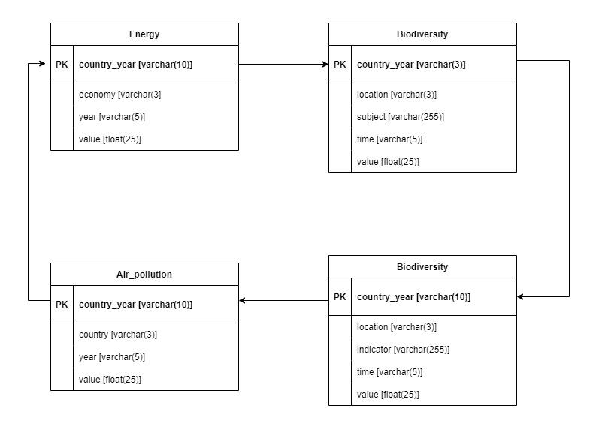
Database : entity relationship diagram

Slide 10
Project Goals
To analyze and understand the impact of CO2 emissions on mortality and welfare costs from exposure to air pollution
To examine the changes in land cover and the impact on biodiversity
To study the patents on environment technologies and their relationship to environmental performance
To analyze the share of renewable energy in the energy mix
To identify trends and patterns in the data and draw conclusions about the environmental performance of various countries

Slide 11


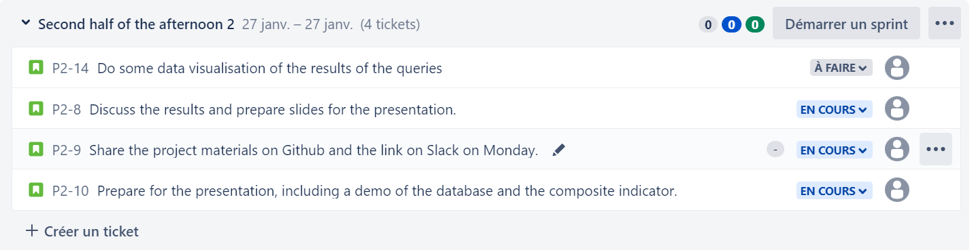
Methodology : organisation

Slide 12
Methodology : database creation
Cleaning data files
Change country names to their code names in 1 file
Import them in mySQL and normalizing their naming
Choose the years
Unpivot 2 tables so that their structure matches the others (dates as values instead of dates as columns)

Slide 13
Methodology : composite indicator
Composite indicator :
Premature deaths linked to air pollution, per million inhabitants (-20%)
Percentage of terrestrial protected areas (% of total land area) (20%)
Percentage of environment technologies patents (on total patents) (20%)
Renewable electricity output (% of total electricity output) (40%)

Slide 14
Methodology : queries
use CTE to build up final table step by step
combine all the tables with left join
get the min and max of values of each criteria
calculate indicators in final table

Slide 15
Challenges
Broad topic but hard to find reliable and relevant metrics
For the renewable energy, the data from OECD was unusable. So we had to find it in the world bank but the data was not updated.
Some datasets include the full name of the country and not its 3-character code, so we had to change some of them
The structure of some datasets was different from others, so we had to transpose columns into to rows for some tables

Slide 16
Main findings
Charts

Slide 17
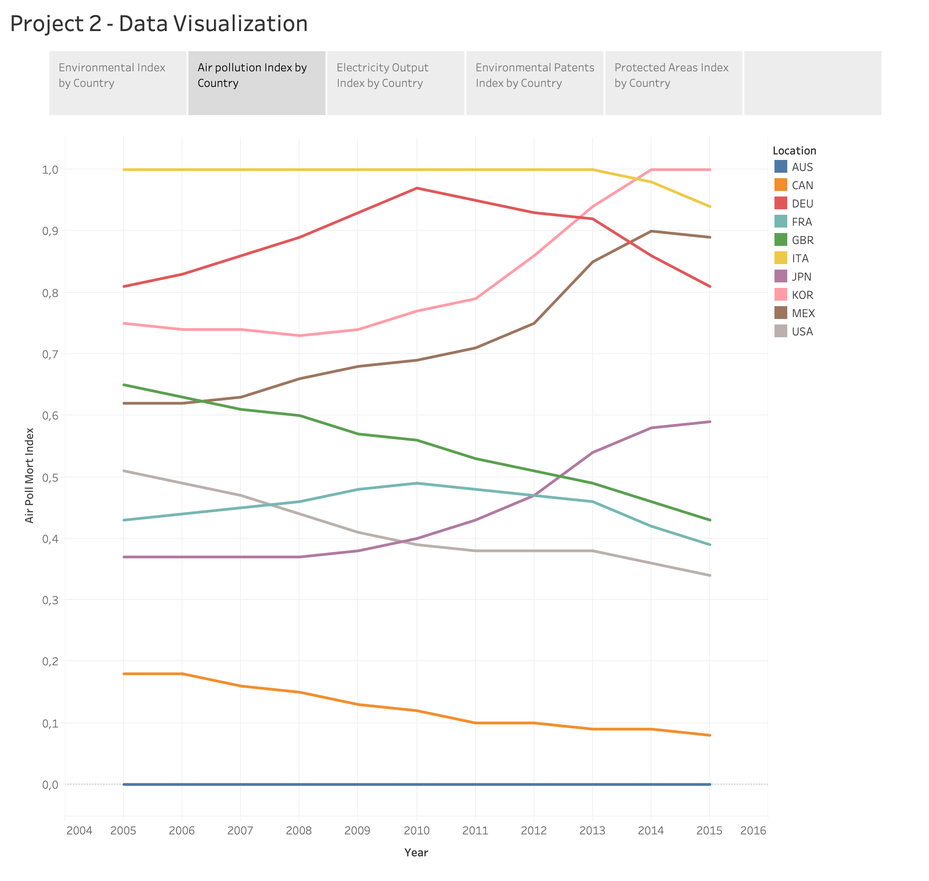
The data represents air pollution-related mortality indices in the years 2005-2015. The values range from 0 to 1, with higher values indicating a higher death rate due to air pollution.
Some of the countries with higher indices in the given time frame include Italy, Germany, and South Korea, while countries with lower indices include Australia and Canada.

Slide 18
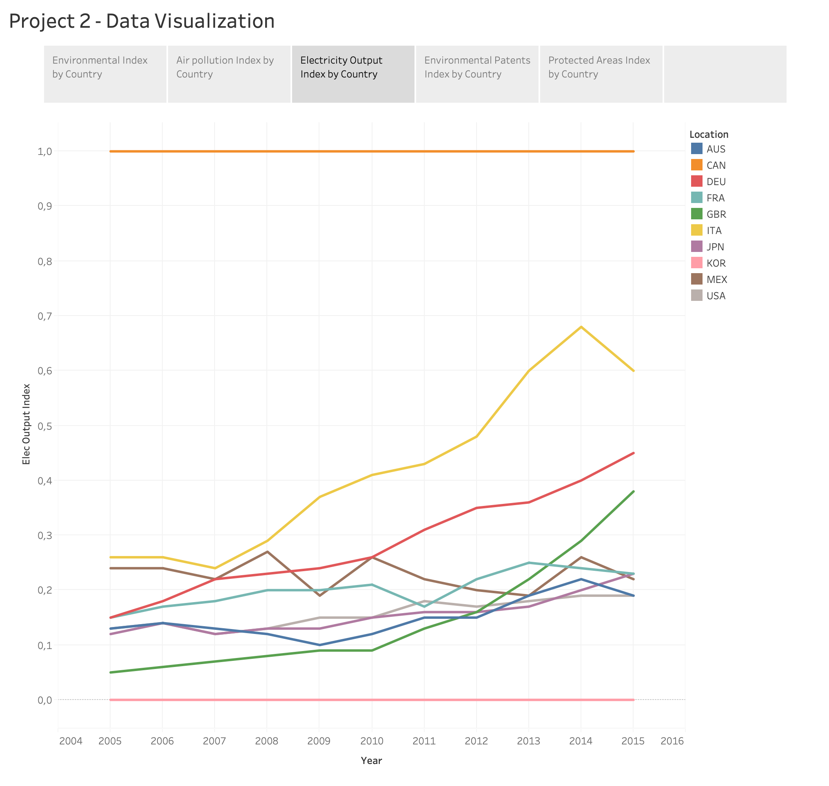
The data represents the index of the output of renewable energy for 10 different countries over the years (2005-2015).
The index of the output of renewable energy remained at a constant level of 1 for the entire 11 year period for Canada. On the other hand, other countries like Italy, Germany, and France saw a steady increase in their index values over the years, indicating a growth in their output of renewable energy.
However, countries like Australia, Japan, and the United States showed a more fluctuating pattern in their index values, with some ups and downs over the years. Korea recorded a constant 0 value throughout the 11 year period.
There is a diverse trend in the growth of renewable energy output among different countries, and more efforts need to be made to increase the output of renewable energy in countries where it has not yet grown significantly.

Slide 19
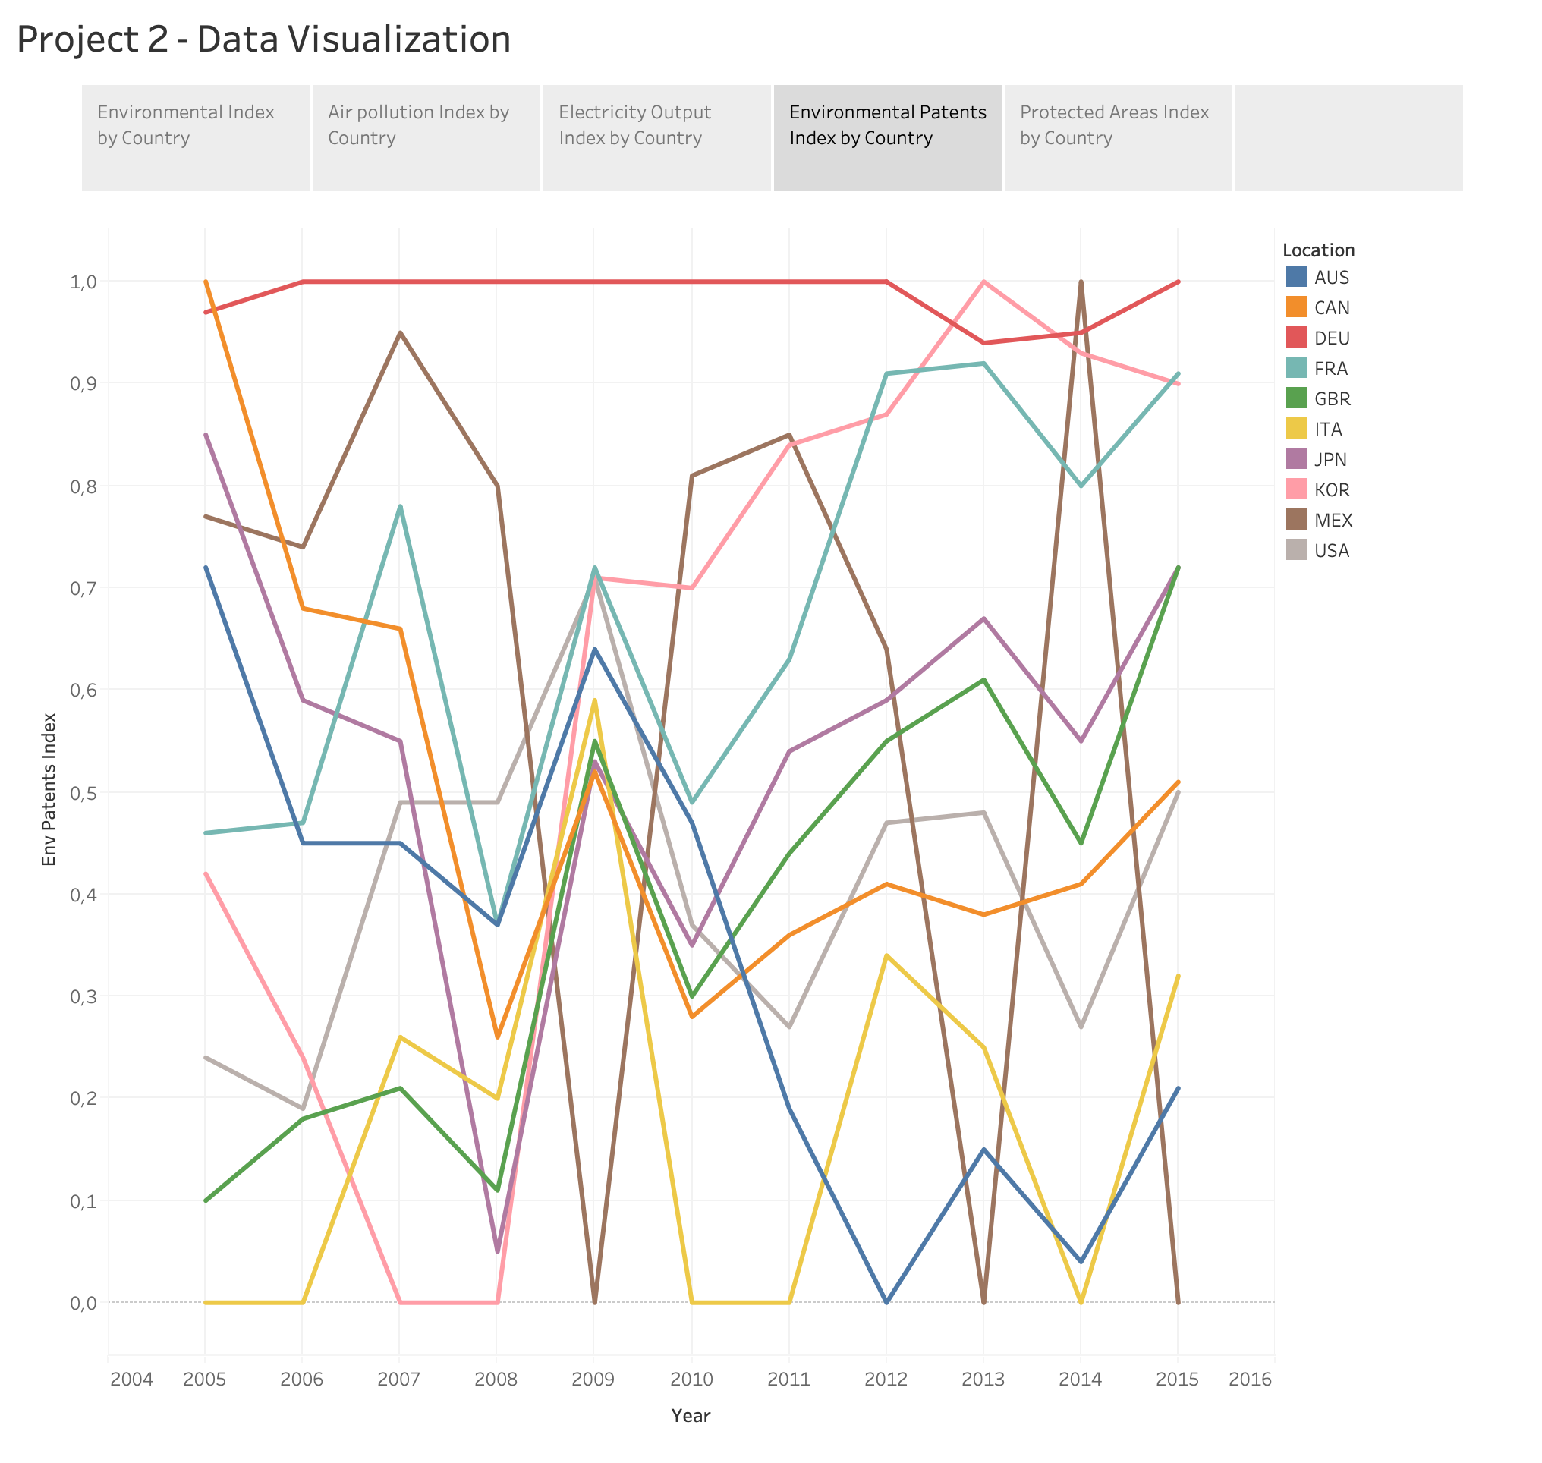
This data shows the index of patents on environmental technologies in various countries from 2005 to 2015. Germany had a high index value of patents in this area, consistently scoring over 0.9 throughout the years. On the other hand, countries such as Italy and Mexico had a low index value of patents in this area, with scores close to zero.

Slide 20
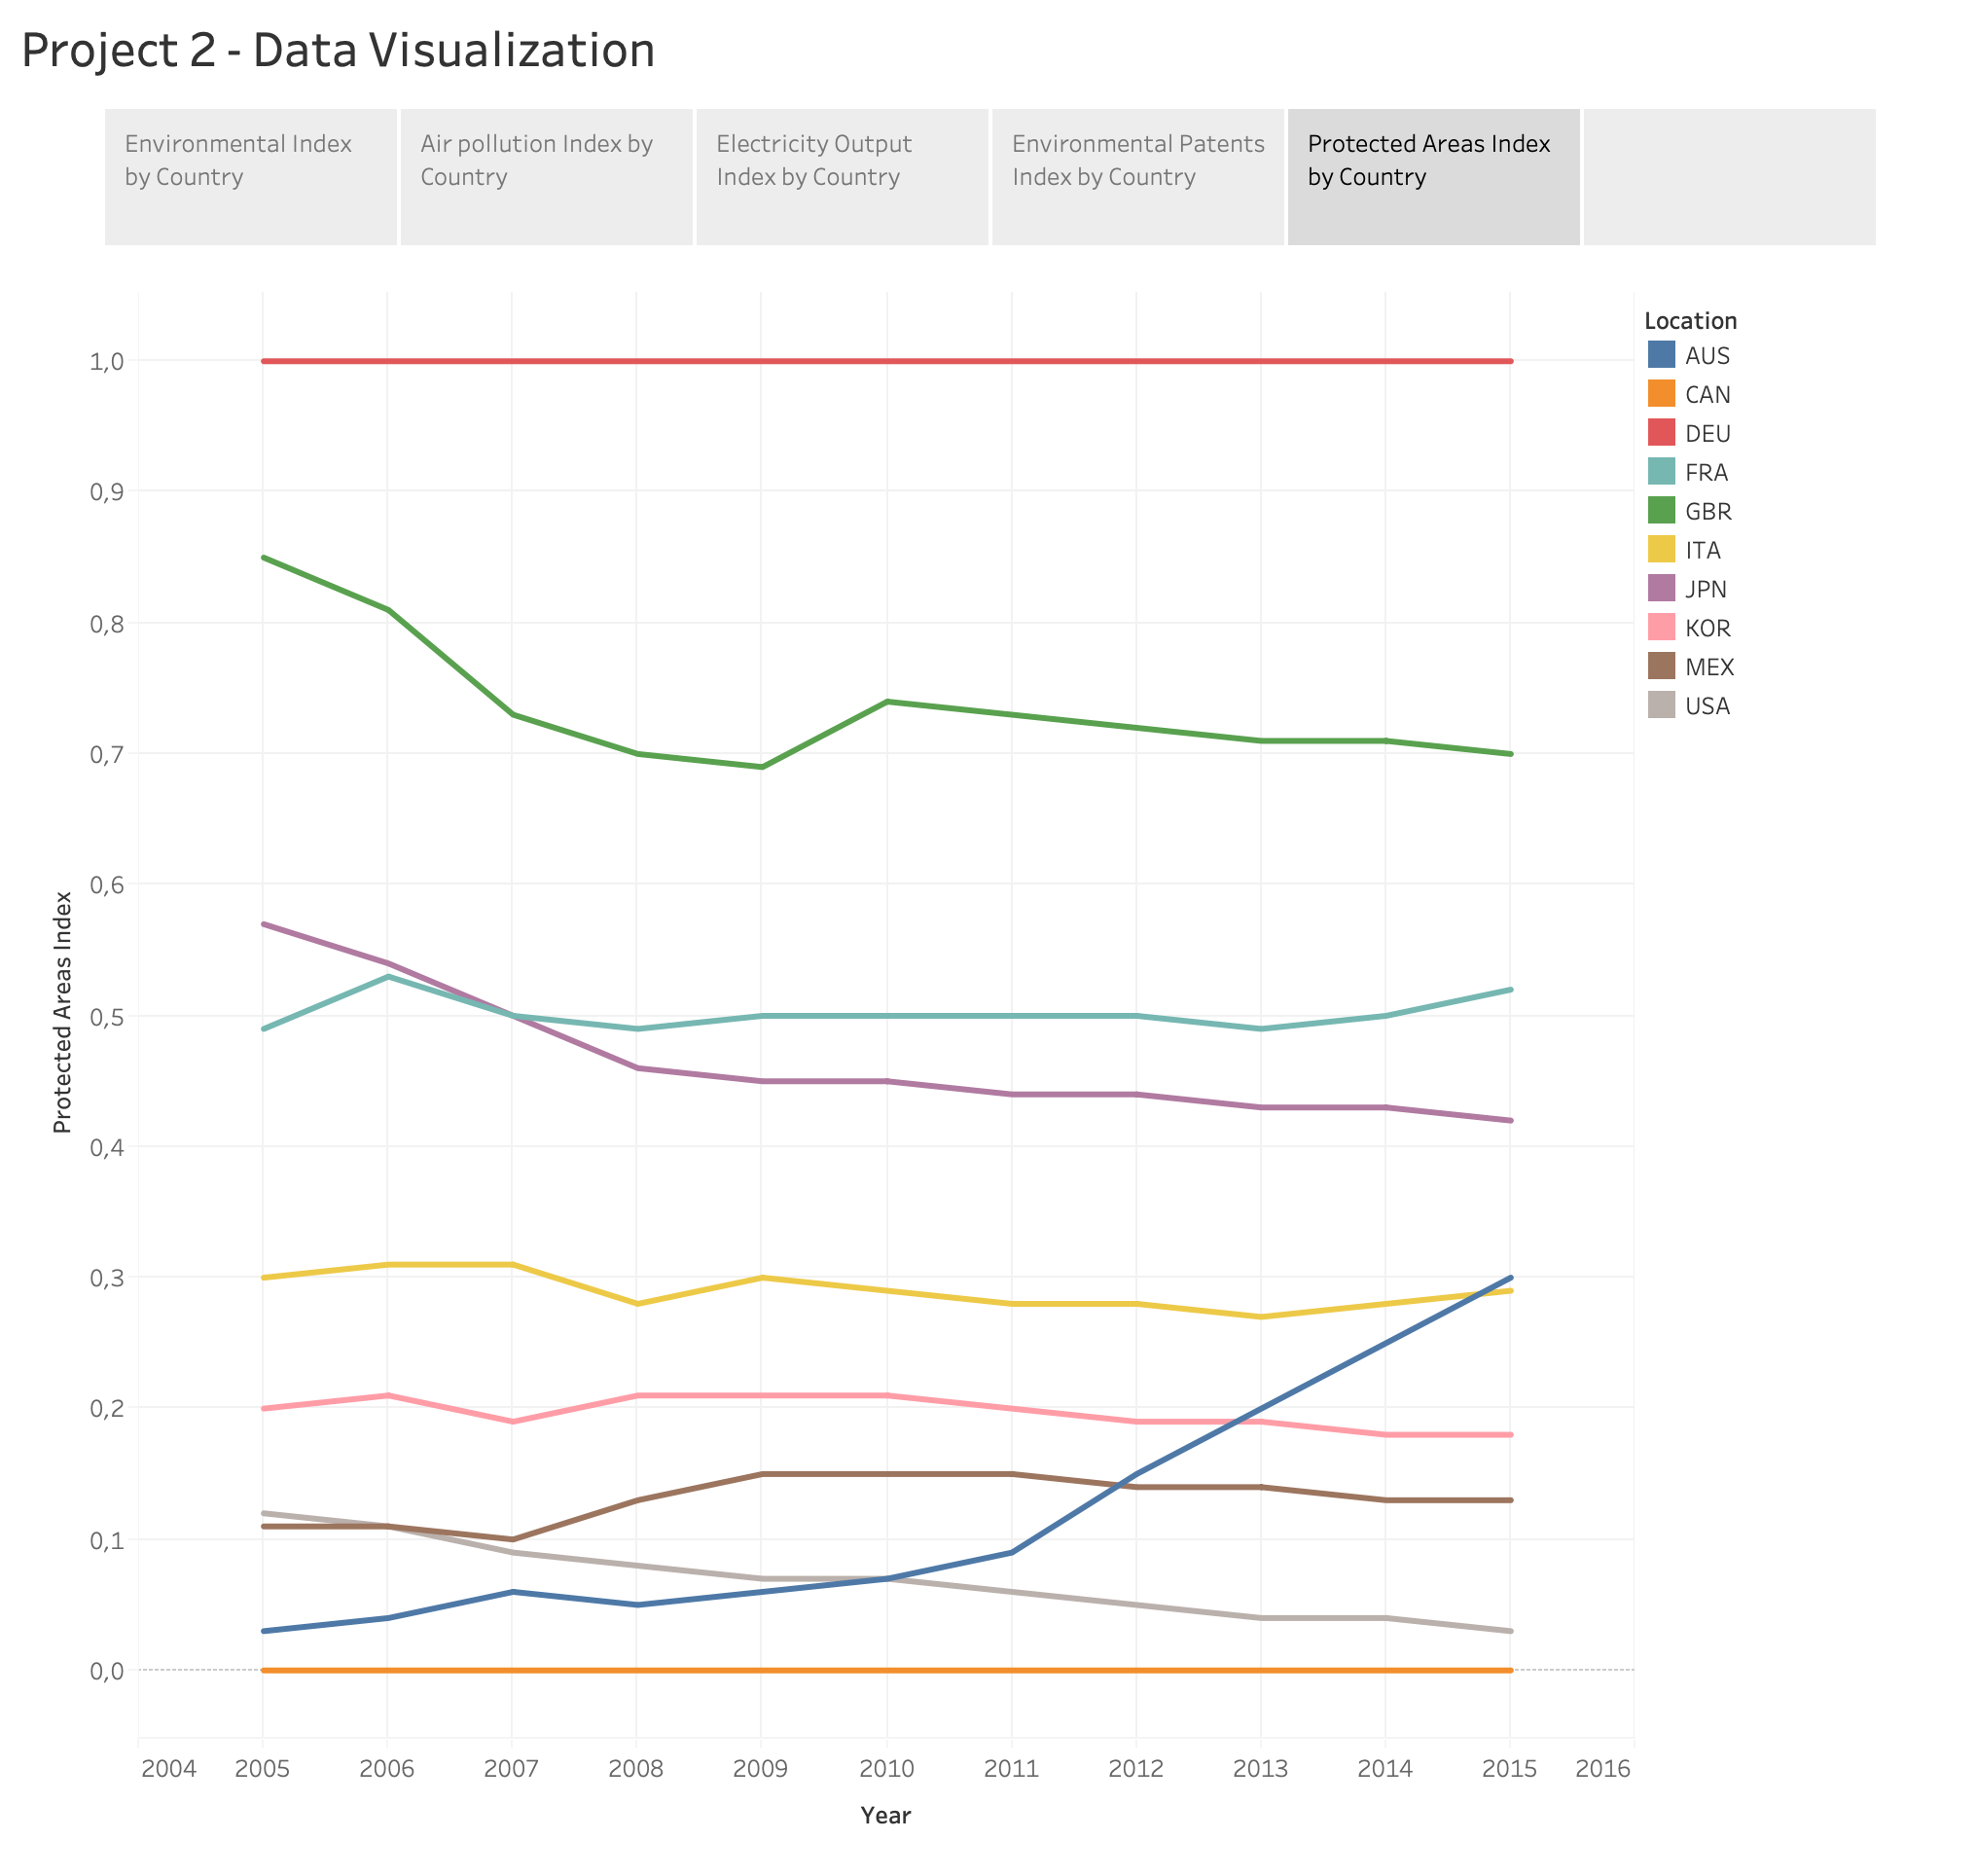
Protected Areas Index
Provides insight on the extent of geographic area protection and management objectives pursued through protected area designation
Covers the years 2005 to 2015
Index values of protected areas vary across the countries and years, with some countries having consistently high levels of protection, such as Germany, while others have low to moderate protection, such as Australia and Mexico.
Over the years, some countries showed increases in protected areas index, such as France and Australia, while others showed decreases, such as the United Kingdom.
Canada did not have any protected areas during the study period.

Slide 21
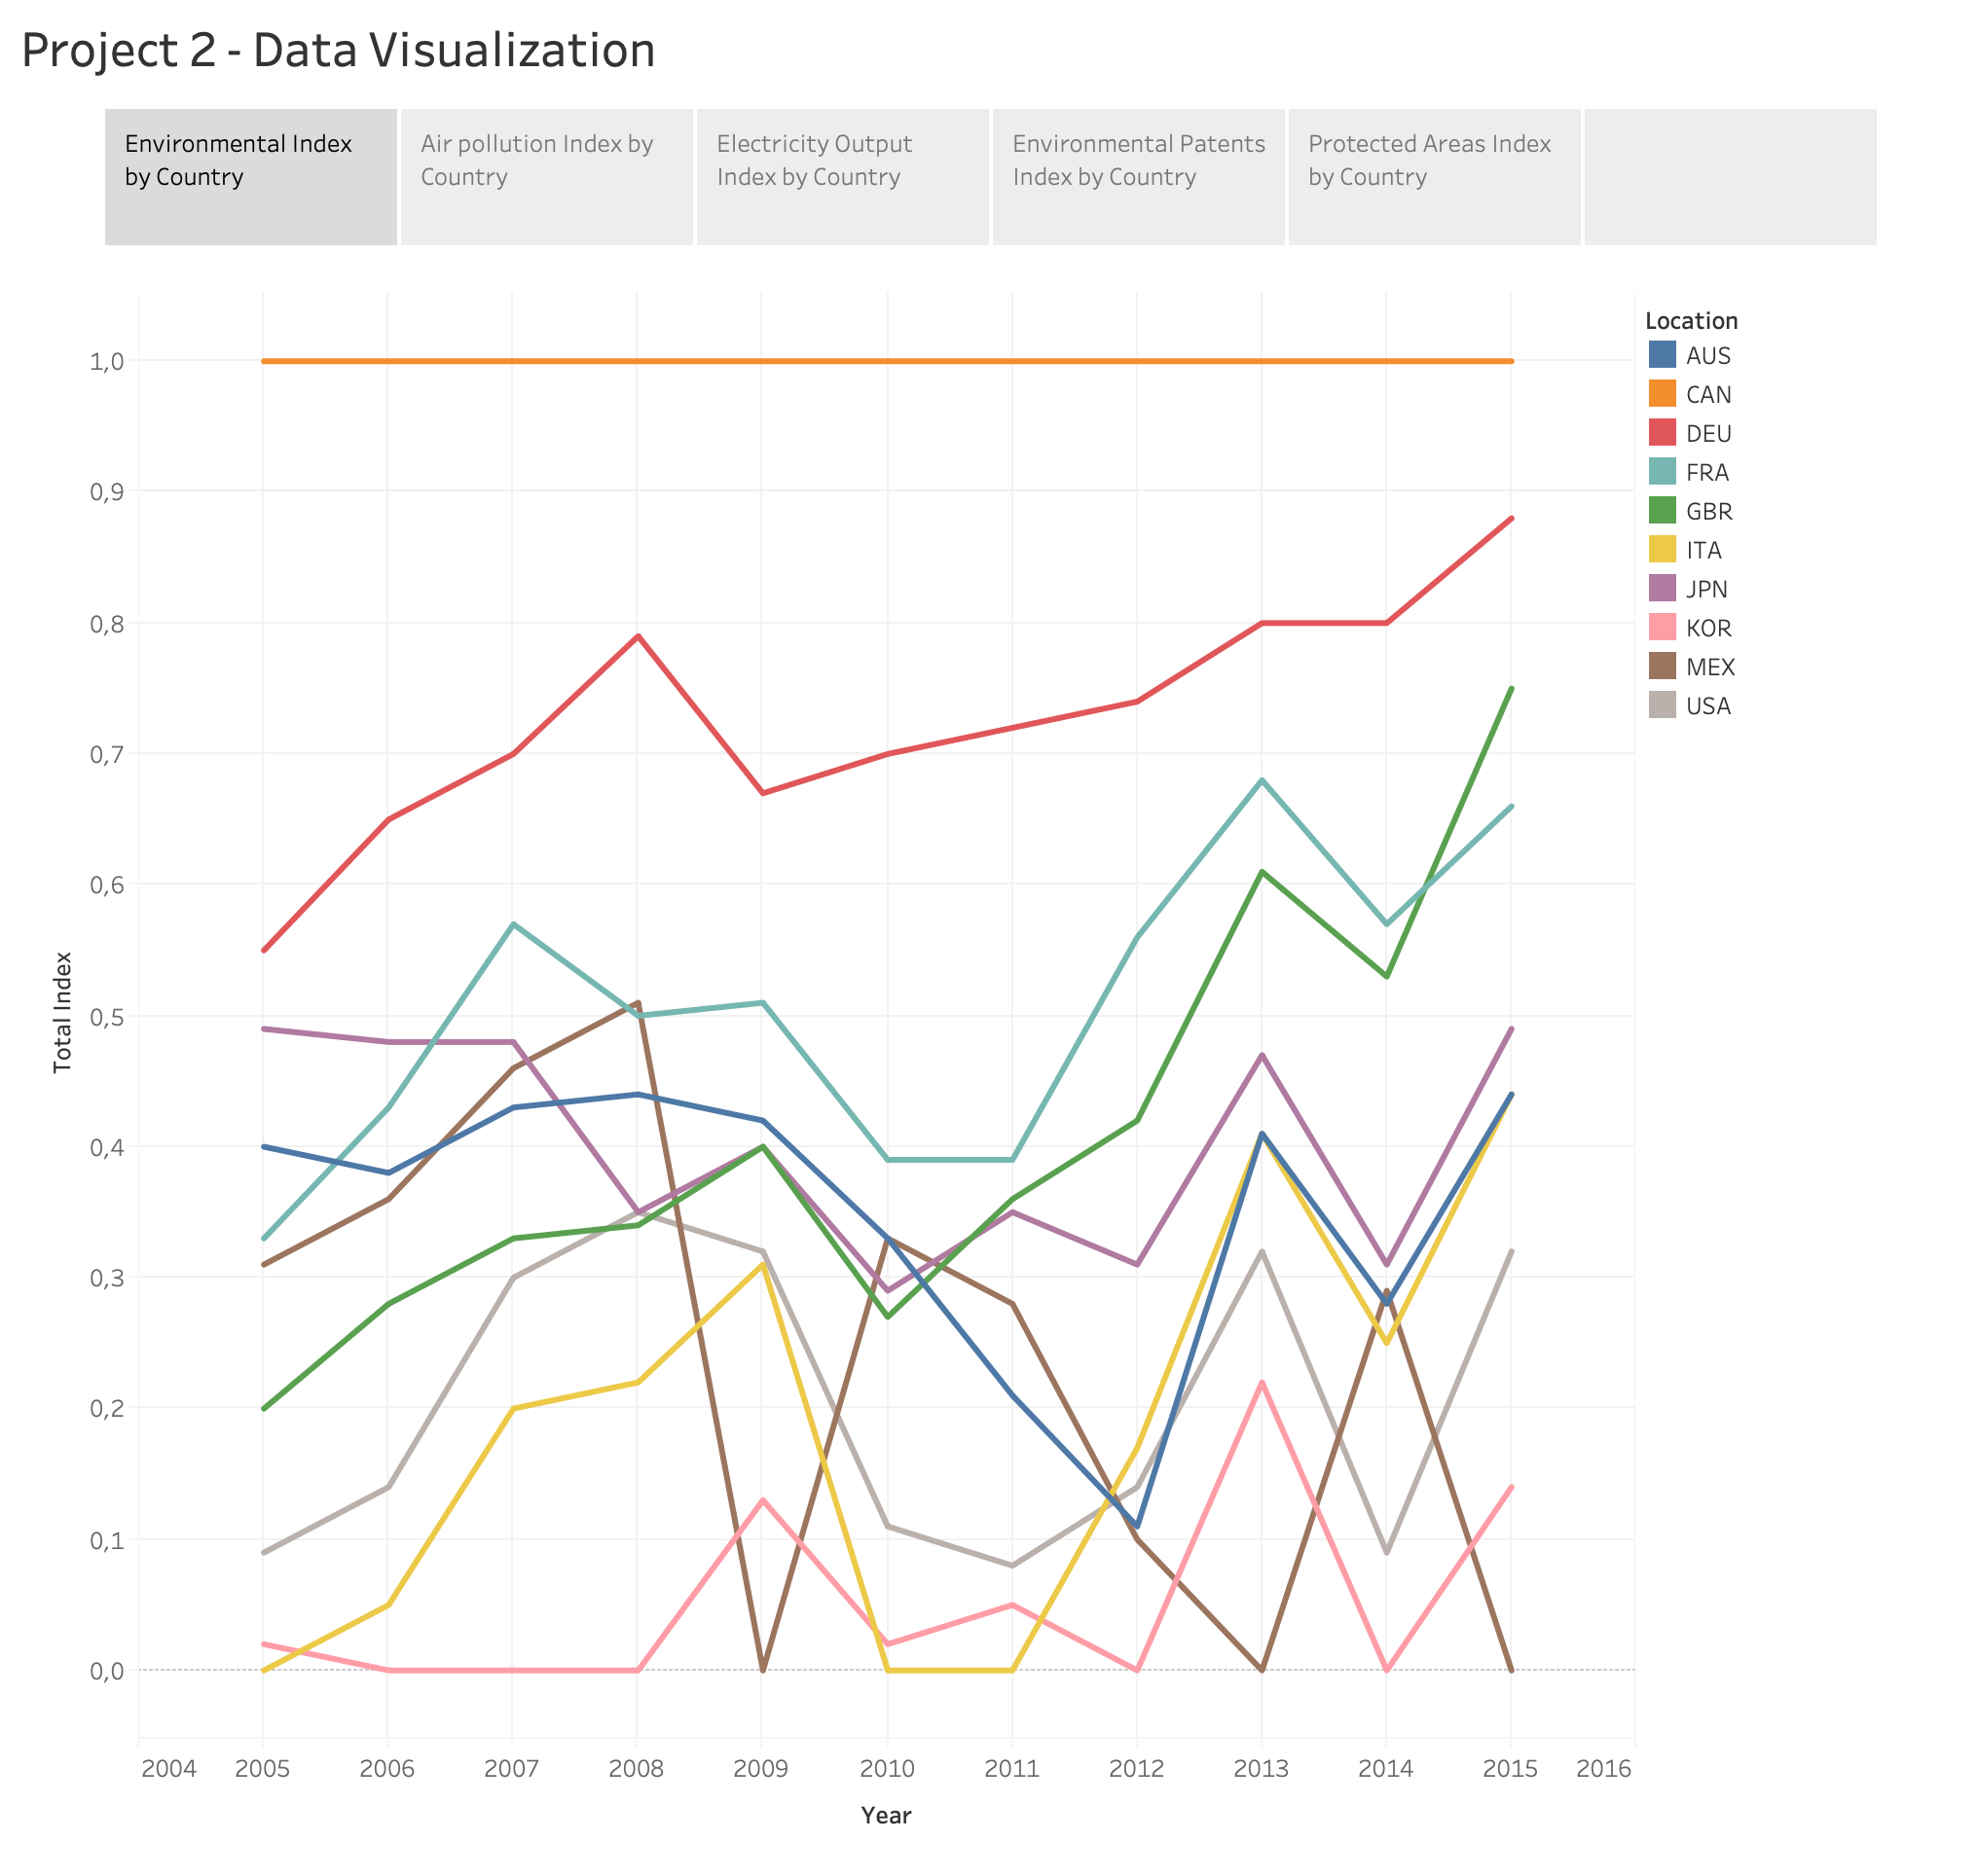
The data shows the environmental index for each country in each year (2005-2015). The index values range from 0 to 1.
Canada has the highest index value of 1 in every year. It indicates that Canada consistently performs better compared to other countries in this index.
Germany has improved index value over the years, with the highest value of 0.88 in 2015.
Some countries have fluctuations in their index value. For example, the United States has a value of 0.09 in 2005, 0.32 in 2015, with ups and downs in between.
Australia and France have shown improvement in index value from 2005 to 2015, with Australia having a value of 0.44 in 2015 and France having a value of 0.66 in 2015.
Japan and the United Kingdom have relatively stable values over the years, with Japan having a value of 0.49 in 2015 and the UK having a value of 0.75 in 2015.

Slide 22
Thank you !

Slide 23
environnement Topic :
- Air pollution (-) : CO2 emissions
o Mortality and welfare cost from exposure to air pollution
o https://www.oecd-ilibrary.org/environment/data/air-quality-and-health/mortality-and-welfare-cost-from-exposure-to-air-pollution_c14fb169-en
- Biodiversity (+)
o Land cover change
o https://stats.oecd.org/index.aspx?lang=en
- Environmental policy (+)
o Patents on environment technologies
o https://data.oecd.org/envpolicy/patents-on-environment-technologies.htm
- Renewable energy (+)
o Share of renewable energy in the energy mix
o https://data.oecd.org/energy/renewable-energy.htm
o The data from OECD didn’t really make sense so we looked for data in the WB
o o Renewable electricity output (% of total electricity output)
o Api
o https://data.worldbank.org/indicator/EG.ELC.RNEW.ZS?end=2019&start=1990&view=map
Source of DATA : OECD and World bank

