Slide 1
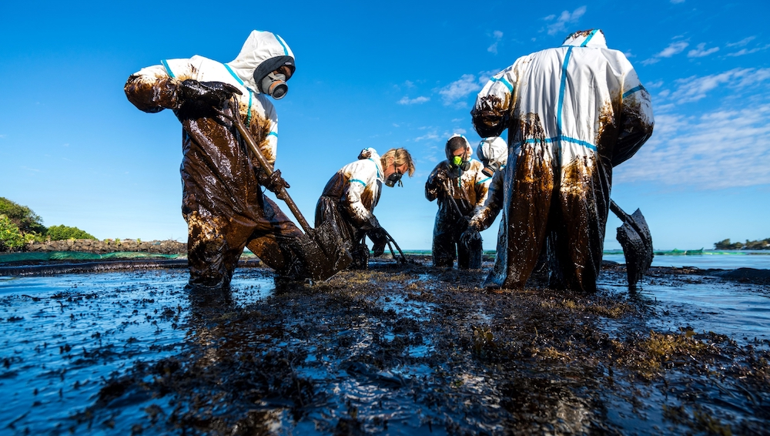

Data Cleaning – Sea pollution in Queensland “Data Preparation” February 7th, 2023 By Yunke & Bulduk IronHack Paris
Daaaaaamn those data look dirty af
I’ve never seen data so dirty before

Slide 2
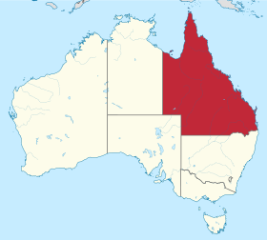
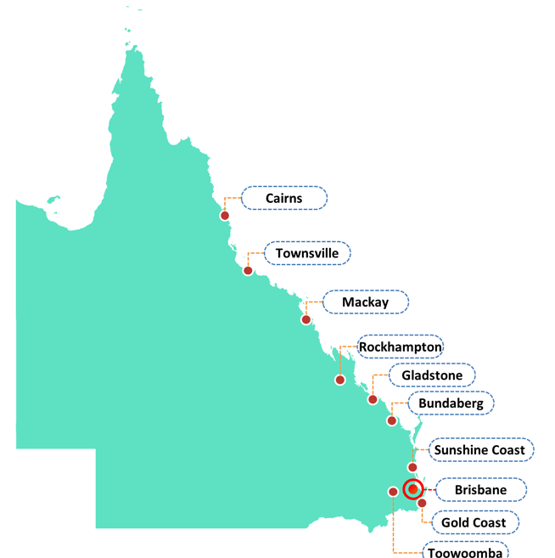
Dataset & Variables
5 tables from 2002 to 2020 describing all marine pollutions in Queensland, Australia
1098 entries, 8 variables:
Date of pollution
Place of pollution (5 subregions of Queensland)
Source of pollution (ship, land or unknown)
Ship type (if applicable: commercial, recreational, unknown)
Location: a more precise description of the location
Area: in ports or coastal waters
Pollutant: type of pollutant
Estimated litres of pollutant discharged
+ 1 official documentation
Data Cleaning – “Data Preparation” – February 2023
Notes:
Bulduk

Slide 3
Various challenges: The main challenges
Place of pollution, Source of pollution, Ship Type, Area:
Those variables should have only 2 to 5 possible values, but add many more => need for recode, but need for extra documentation from the official website also (and Google Maps)
Pollutant:
Around 100 different pollutants, need to restraint the number of pollutant with most “common” pollutant, that represents 95% of pollution and leave the others as “others“
Estimated litres of pollutant discharged:
Multiple format entered since 2018, “2l”, “2 litres”, “2 m2”, “2m x 40m”, “2000ml”, etc. More than 20 formats identified before we stopped counting
Data Cleaning – “Data Preparation” – February 2023
Notes:
Bulduk

Slide 4
Process
Making sure columns are the same across the 5 tables, concatenate the tables
Plan the coding by investigating all columns, value counts, types of data
Execute the plan step by step:
Transform all date to datetime and correcting typos
Recode unlisted subregions, thanks to documentation and Google Maps
Recode Sources to either “Ship”, “Land” or “Unknown”, Ship type as “Commercial”, “Recreational” or “NaN”, Area as “Port” or “Coastal Waters”. For the latest, some description were uncleared, and Google Maps was used thanks to the value in Location
For pollutant, after removing trailing spaces, regrouping some similar values
Estimated litres: a long and not at all fun removing. Formats were so various, uncleaned and time consuming that we eventually had to drop those entries from 2018, because of lack of time
Check for possible duplicate : none found !
Check for consistency: one value entered restrict other columns
Data Cleaning – “Data Preparation” – February 2023
Notes:
Bulduk

Slide 5
Comparison of the initial and final datasets
Value count | Before cleaning | After cleaning
Region | 14 | 5
Source | 11 | 3
Ship Type | 24 | 3
Area | 13 | 2
Pollutant | 107 | 16
… Ready for analysis !
Data Cleaning – “Data Preparation” – February 2023
Notes:
Bulduk

Slide 6
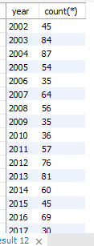
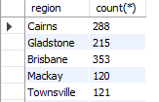
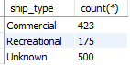
Quick analyzes…
Number of pollution per year
Number of pollution per type of ships
Number of pollution per region
Possible improvement:
To put this data in perspective of total population of those subregions
Data Cleaning – “Data Preparation” – February 2023
Notes:
Bulduk

Slide 7
The biggest issues we had with the “Estimated litres” variable
Estimated litres: Took more almost half the day to try to clean them… We were testing all the possible option with regex, etc.
Issues also with transforming the surface into litres, as thickness can be very different depending on oils spilled
Eventually had to drop those rows from 2018, as we were running out of times.
12% of data dropped because of this issue
Data Cleaning – “Data Preparation” – February 2023
Notes:
Bulduk

Slide 8
Learnings
Improvements
Better to make sure that the format are fixed and restricted before allowing any entry. Especially when already restricted by official documentation. Can save times and sweats for cleaning, and can avoid mistakes
Data cleaning takes time
With more time…
We could have clean the data of Estimated litres variable for 2018 to 2020.
Data Cleaning – “Data Preparation” – February 2023
Notes:
Bulduk

Slide 9
Thank you !

