Slide 1
Visualization seminar
02.05.2023, recording.

Slide 2
Contents
[50] Part 1: Introduction to visualization dashboards with Dash
How the Web works: frontend and backend development
Dash: gallery, core components, bootstrap components, plotly and callbacks
Maps in Dash by Marco
[10] === break ===
[60] Part 2: Hands on visualization example with Dash
Visualization example: basic app and how to run it.
Things to consider and Tools
Exercises

Slide 3
Part 1
Introduction to visualization dashboards with Dash
Goal: give you a high level overview so that you know what to google.

Slide 4

How the Web works
https://www.youtube.com/watch?v=hJHvdBlSxug&ab_channel=Academind
Frontend development:
How the website looks and feels
User
Browser
Website
expects to see
enters a URL
request
https://ethz.ch/
big dictionary that maps domain name to IP address of the correct web server
Domain is the name of a website, eg ethz.ch
URL (Universal Resource Locator) is how to find a website, eg https://ethz.ch
Website is what people see and interact with
Browser is a web application that can interpret the website source code, eg Google Chrome
DNS server
Backend development:
how the website works
returns website
Web server
response

Slide 5
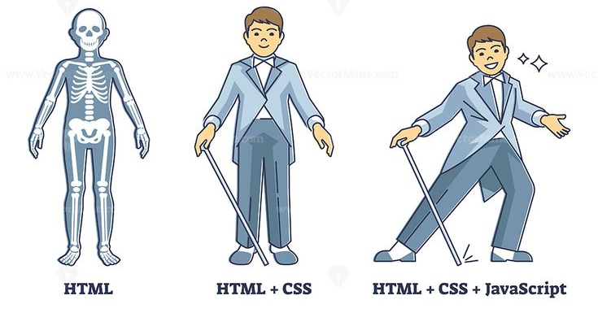
Frontend development
Responsible for how the website looks and feels.
Tools:
HTML
HyperText Markup Language
Structure / layout of the website
Where do we place headers, tabs, buttons
CSS
Cascading Style Sheets
Styling your website
Fonts, colors, thickness of lines, shadows, etc
Javascript
Programming language for the web
Can update and change both HTML and CSS, adds logic to a website
What happens when we open a dropdown list?
HTML, CSS, Javascript implement website design.

Slide 6
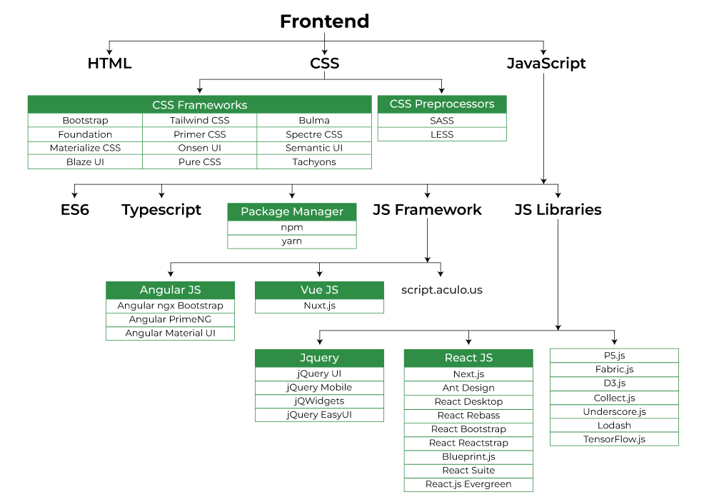

Slide 7
Web components
Components are sets of specifications that add functionalities and features to web pages and applications.
Examples are buttons, dropdown menus, navigation bars, etc.
Many modern apps are built using components.
Enable building functions that can be reused.
Allow more consistent user experience.

Slide 8
Backend development
Responsible for:
Interactions with a database
User authentification
Server and network configurations
Website responsiveness and speed
Tools: PHP, Node.js, Python, Ruby, Java, SQL, …

Slide 9
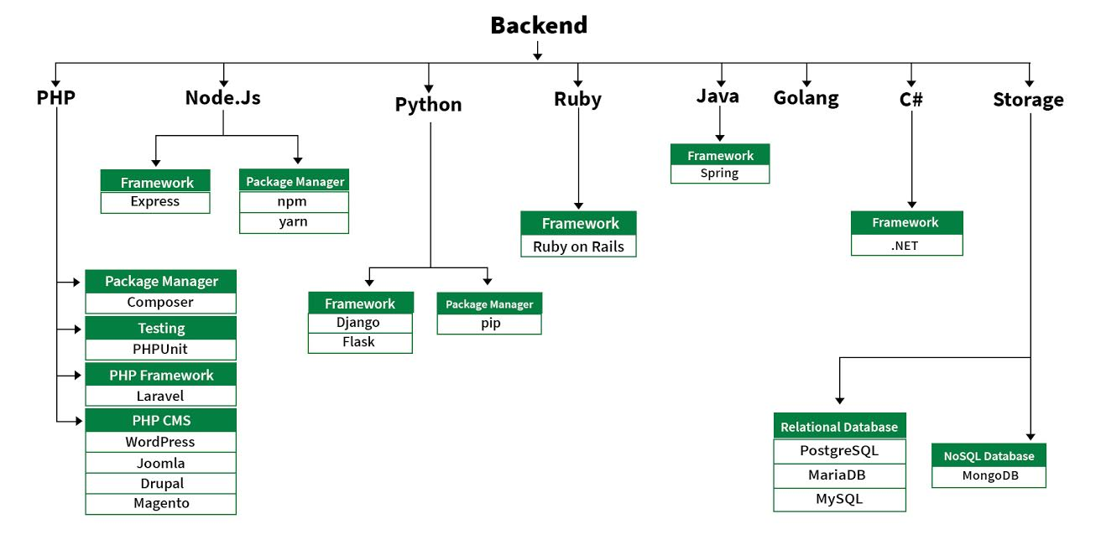

Slide 10
Frontend developers
Full stack developers
Backend developers
ESD members
Website designers

Slide 11
Dash
Most downloaded, trusted Python framework for building ML & data science web apps.
https://dash.plotly.com/

Slide 12
About Dash
Framework to build visualization interfaces.
Was released in 2017 as a Python library, now includes implementations for R, Julia and F#.
3 technologies constitute the core of Dash:
Flask for web server functionality
React.Js renders user interface of the web page
Plotly.Js generates charts and plots
Contains many web components.
Has open source and enterprise versions. For us, open source is enough.
R has smth similar: https://shiny.rstudio.com/

Slide 13
Layout and static components, eg headers, paragraphs
styling
Website components, such as buttons, dropdowns, tabs, navigation bars, etc
Interactive plots in python
plotly.js
Dash is built on top of React, we won’t use it directly

Slide 14
Dash is a Python library, and we also use Python for content creation
Conda is also managing packages
Dash is built on top of Flask
Should include, but we don’t consider databases in this seminar

Slide 15
Steps for website creation
Create website content
You are doing it on a daily basis!
Design and build your website
For example, using Dash.
Publish your website
Register domain name.
Choose web hosting provider. The web host provides server space for the website’s files. Can also be own server.
Disclaimer: it is possible to publish with Github for free!

Slide 16
Dash Gallery
https://dash.gallery/Portal/

Slide 17
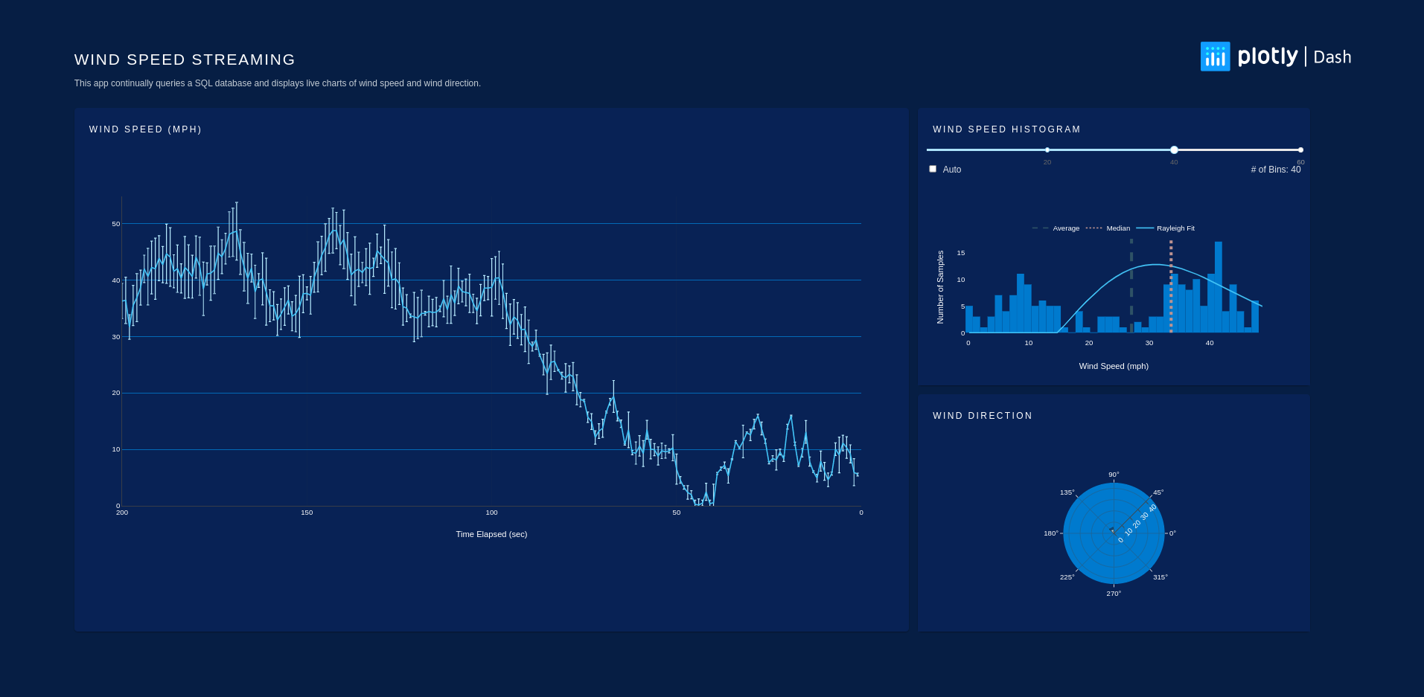
Streaming real-time data
https://dash.gallery/dash-wind-streaming/

Slide 18
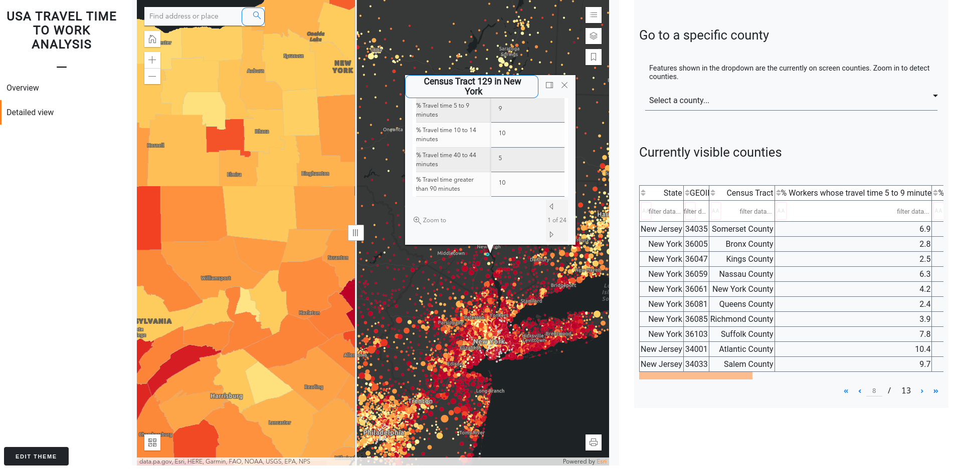
Maps
https://dash.gallery/american-commute/

Slide 19
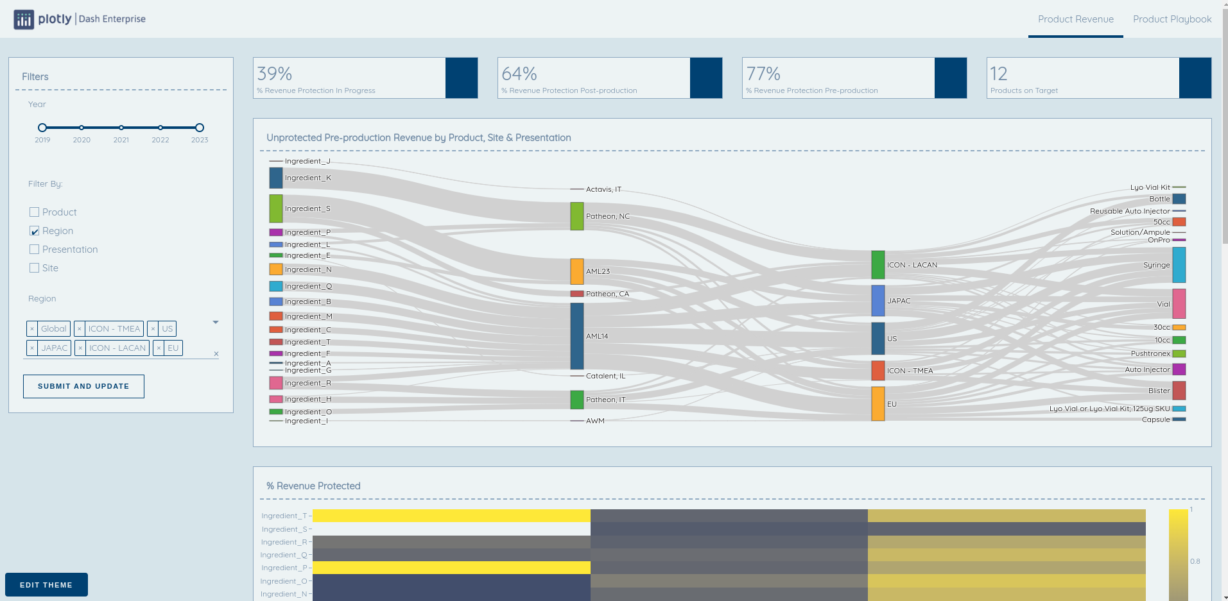
Sankey diagrams
https://dash.gallery/product-playbook/

Slide 20
Check out existing examples to see what is definitely possible with dash.
Sometimes their code is open source.

Slide 21
Dash Core Components
https://dash.plotly.com/dash-core-components

Slide 22
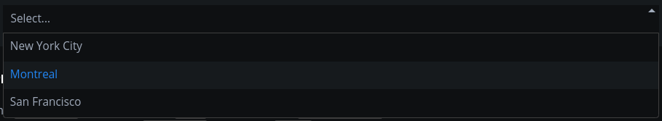

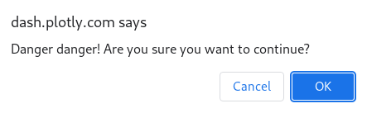
All core components
Dropdown
Checklist
Clipboard
ConfirmDialog
ConfirmDialogProvider
DatePickerRange
DatePickerSingle
Download
Dropdown
Graph
Geolocation
Input
Interval
Link
Loading
Location
LogoutButton
Markdown
RadioItems
RangeSlider
Slider
Store
Tab
Tabs
Textarea
Tooltip
Upload
Upload
Checklist
Confirm Dialog
Range Slider

Slide 23
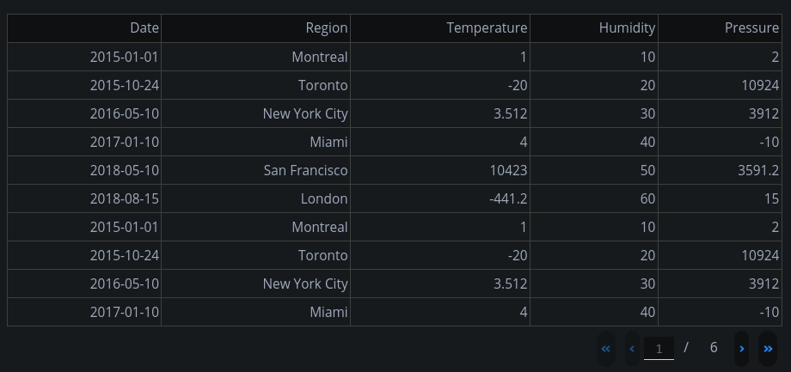
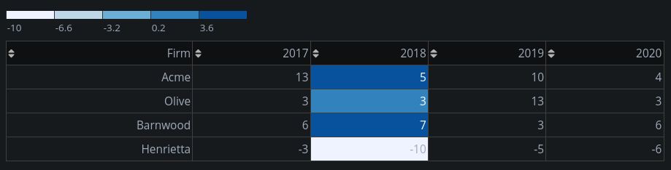
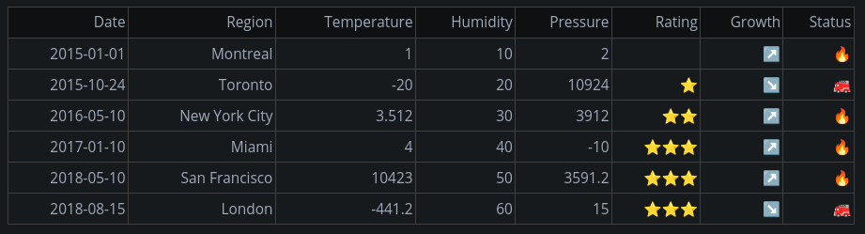
Dash datatables
Work with pandas dataframes
Interactive
Multiple pages
Adjust heights
Style cells separately and link cell colors to a legend
Export tables as excel / csv
Filter and sort data

Slide 24
Bootstrap Components
https://dash-bootstrap-components.opensource.faculty.ai/docs/components/

Slide 25

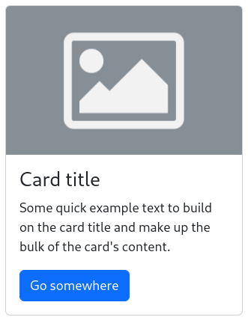

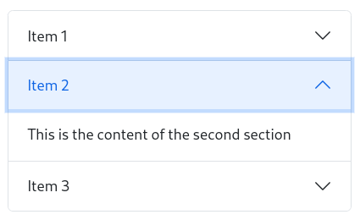
All bootstrap
components
Buttons
Spinners
Card
Accordion
Alert
Badge
Breadcrumb
Button
ButtonGroup
Card
Carousel
Collapse
DropdownMenu
Fade
Form
Input
InputGroup
Jumbotron
Layout
ListGroup
Modal
Nav
Navbar
Offcanvas
Pagination
Placeholder
Popover
Progress
Spinner
Table
Tabs
Toast
Tooltip
Accordion
Progress

Slide 26
Exploring bootstrap themes
https://dash-bootstrap-components.opensource.faculty.ai/docs/themes/explorer/
Can take certain theme as a base, and tweak style of some components.
Switching between themes is very very easy.
Switching between core and bootstrap components is also easy, but not instantaneous.

Slide 27
Dash and Plotly graphs
https://plotly.com/python/

Slide 28
What is so special about Plotly?
Unlike matplotlib, it has logic :)
So once you know it, it is easier to make plots, in my opinion.
It is interactive: can zoom in, rotate 3D plots, see values of data points.
You can save plots as interactive html files and share them.
Integrating plotly charts into Dash is very easy.
However, it does take time to learn plotly.

Slide 29
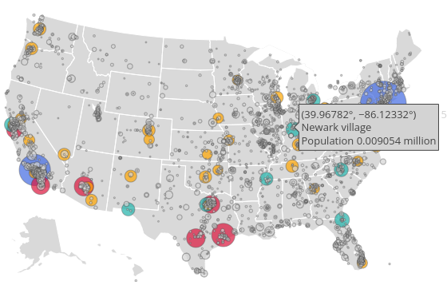
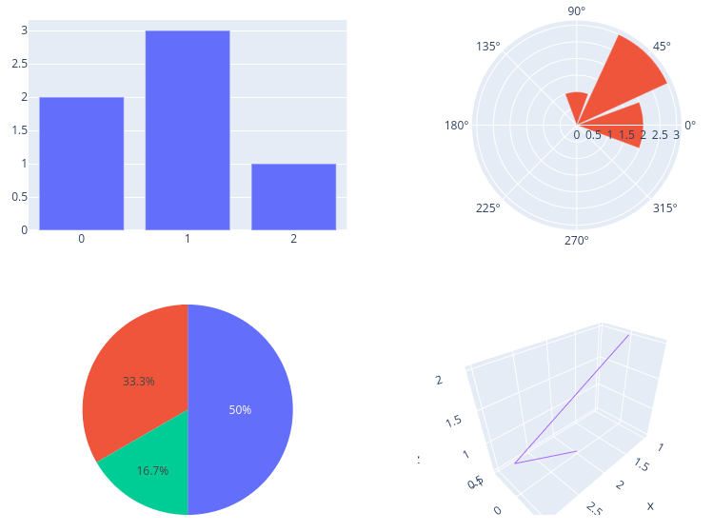
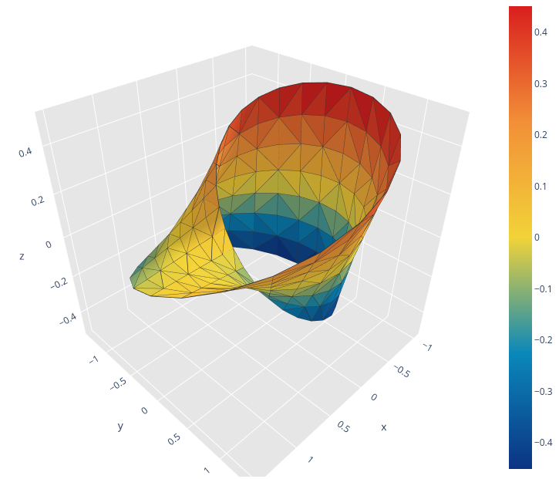
All plotly charts
Basic charts
Scatter plots
Line charts
Bar charts
Pie charts
Bubble charts
Statistical charts
Error bars
Boxplots
Histograms
Distributions
Maps
Scientific charts
Contour plots
Heatmaps
Log plots
Imshow (imaginary axis)
AI and ML
Classification
PCA
3D charts
Subplots
Animations

Slide 30
Dash Callbacks
https://dash.plotly.com/basic-callbacks

Slide 31
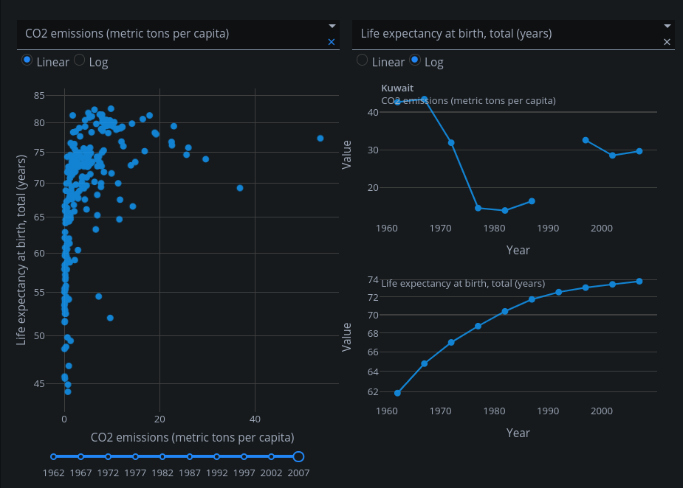
Callback functions
inputs
outputs
Functions that are automatically called by Dash whenever an input component's property changes, in order to update some property in another component (the output).
Needed to connect control components to eg charts.

Slide 32
Visualizing maps
https://plotly.com/python/maps/

Slide 33
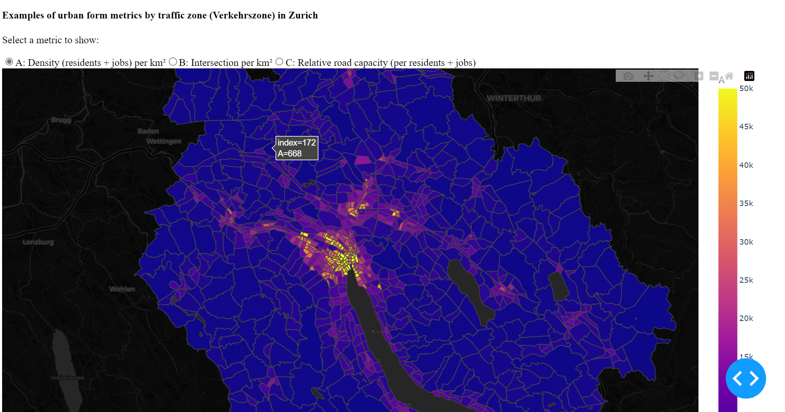
Dash + Plotly + Geospatial information
Making an interactive map in 1 hour!

Slide 34
High level vs. low level for maps
High level
Dash
Low level
Javascript
CSS
HTML

Slide 35
High level vs. low level for maps
High level
Dash
Plotly
Flask
React
d3.js
Low level
Javascript
CSS
HTML

Slide 36
High level vs. low level for maps
High level
Dash
Alternative
Plotly
Flask
React
Leaflet
Vue.js
d3.js
Openlayers
Low level
Javascript
CSS
HTML

Slide 37
High level vs. low level for maps
Time to get things done
High level
+
+
Low level
-
-

Slide 38
High level vs. low level for maps
Time to get things done
Debugging and “safety”
Speed
Customization potential
High level
+
+
+
-
~
Low level
+
+
+
-
-
-

Slide 39
The benefits and caveats of interactive visualizations
+
Engaging: visitors/users might take away more from it than a from a static plot
Multifaceted: can present a lot more information at once
Good for validation: allow to scan data for consistency more effectively
Inherently mutable: not ideal (often not allowed) for “final” research output
Misuable: especially if users are allowed to change input parameters
→ Can make it more likely that messages not consistent with research findings are attributed to authors/institution e.g. for political reasons
+
+
-
-

Slide 40
The benefits and caveats of interactive visualizations
+
Engaging: visitors/users might take away more from it than a from a static plot
Multifaceted: can present a lot more information at once
Good for validation: allow to scan data for consistency more effectively
Inherently mutable: not ideal (often not allowed) for “final” research output
Misuable: especially if users are allowed to change input parameters
→ Can make it more likely that messages not consistent with research findings are attributed to authors/institution e.g. for political reasons
+
+
-
-

Slide 41
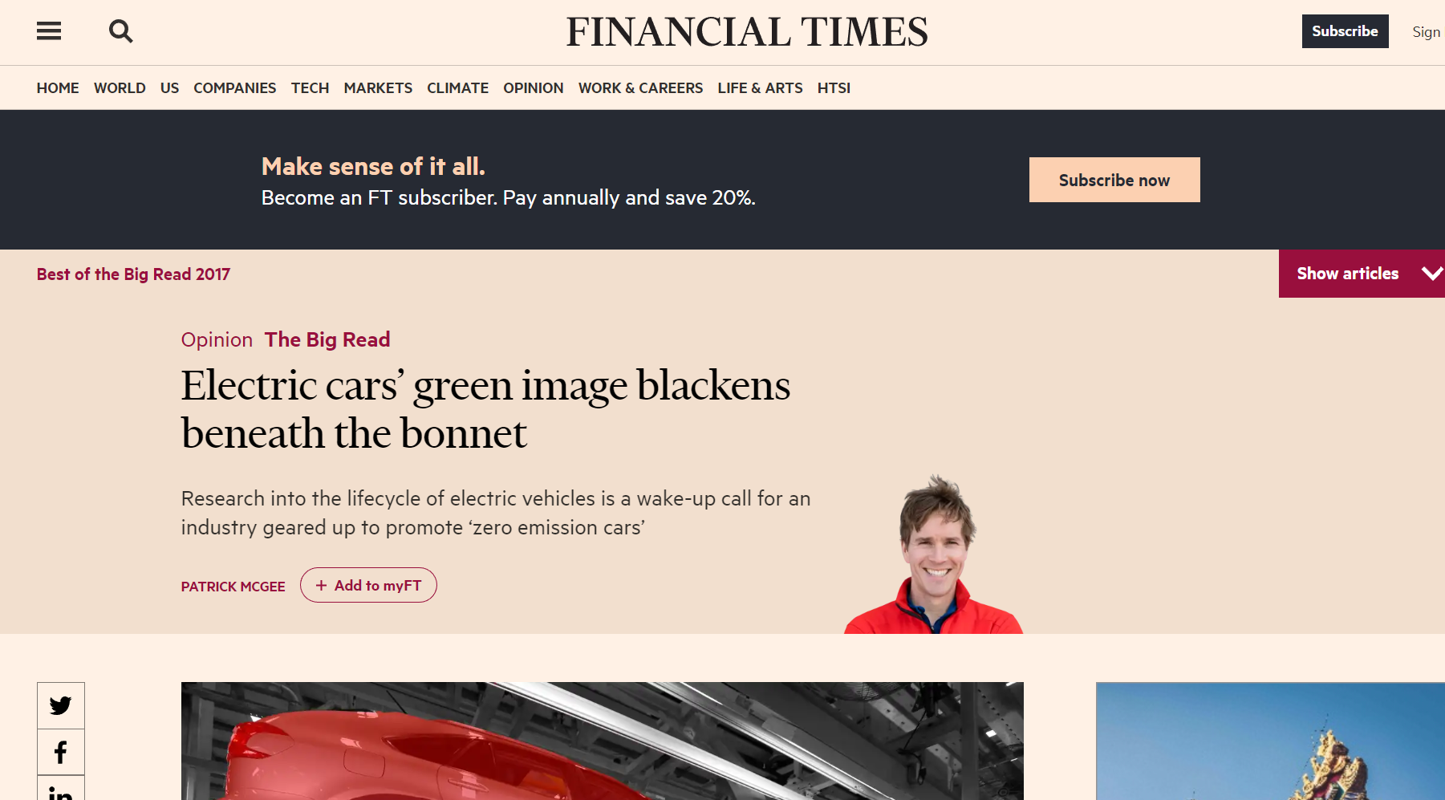

Slide 42
Please be back at 11:10

Slide 43
Part 2
Hands on visualization example with Dash
Goal: provide practical suggestions, and set up tools to get you started.

Slide 44
Visualization example explained

Slide 45
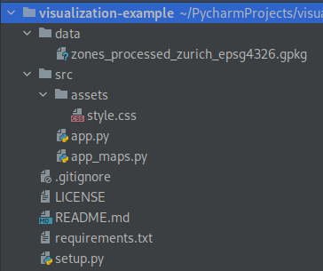
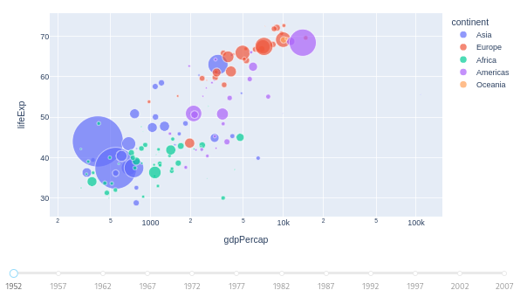
Visualization example
https://github.com/ecological-systems-design/visualization-example
data that we will plot
repo with the main code
CSS style files
main application
another application, typically one dashboard would only have one app.py file

Slide 46
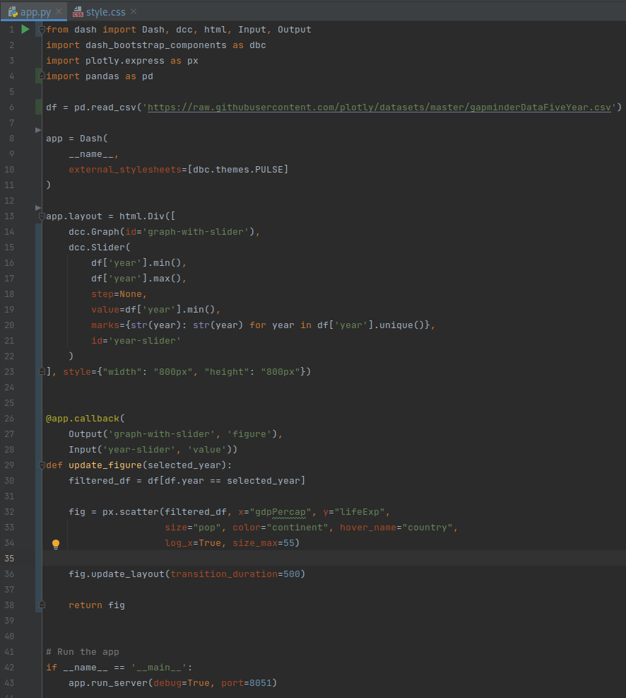
app.py
read the data
initialize the app
bootstrap theme
from dash import:
Dash - defines the application
dcc - contains dash core components
html - dash interface to html (static) components, such as headers
Input and Output - needed in callback functions
dash_bootstrap_components - contains bootstrap components
plotly.express - one of the modules to make plotly charts
pandas - library for working with tables
Debug mode: change the code while running the app, and your dashboard would be updated on the fly.
layout that consists of 2 components
common style of the 2 components
decorator (starts with @) for the callback function that has input and output
figure is updated based on the slider values
running the app in the debug mode

Slide 47
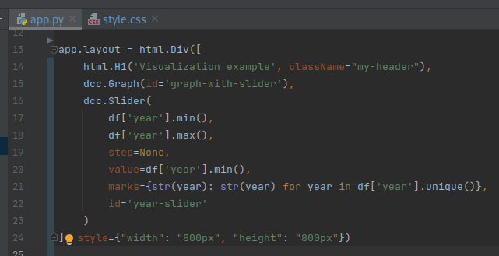
Keyword arguments
className - needed for modifying component’s style in the CSS file (see next slide)
style - accepts a dictionary with CSS properties to modify component’s style
id - you can define it for each component, useful in callback functions
There exist many other keyword arguments

Slide 48
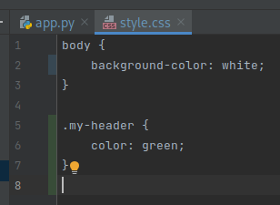
Updating style
Option 1
Option 2
Option 1 is the CSS way, and Option 2 is the Dash way. Probably Option 1 is more flexible than Option 2.

Slide 49
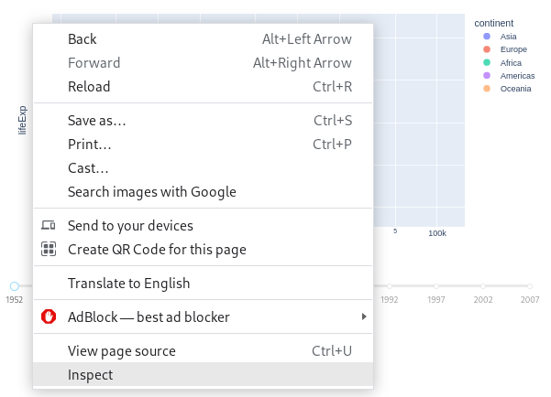
Webpage inspector
On any webpage, right click and choose Inspect.

Slide 50
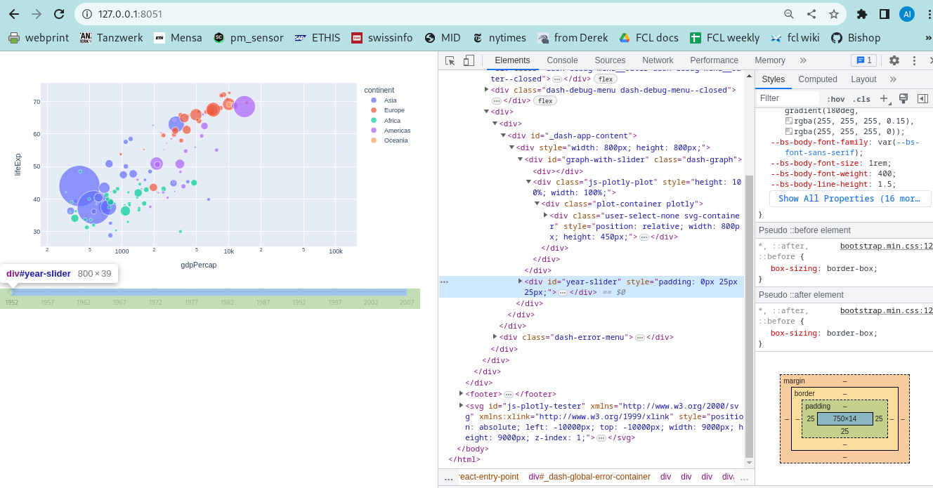
Tab Elements can help in understanding the layout of a page and CSS style of each component. Also of other websites if you want to understand how the design was implemented.

Slide 51
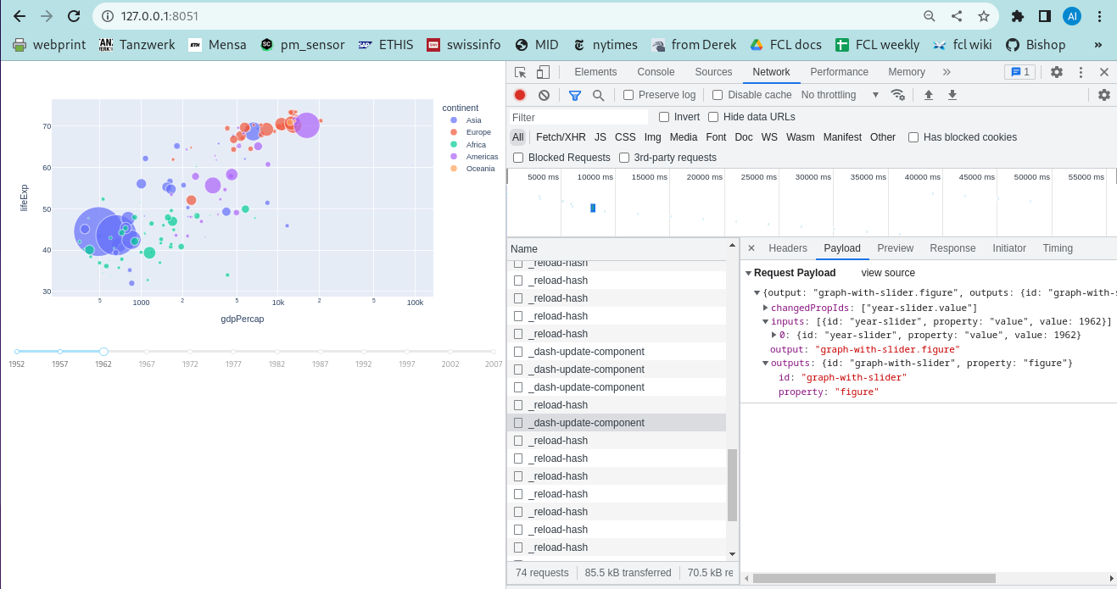
Tab Network tracks requests to the web server and responses from the web server. This is helpful if you need to understand callback functions.

Slide 52
Summary of the tools
Figma for design (allows export of CSS styles, and you can preview webpage design in real size with Figma’s presentation mode)
Conda for virtual environments
Pycharm (or any other IDE) for code development
Git for version control
Dash debug mode and website inspector for debugging

Slide 53
Things to consider
Is my app only for me or do I want to eventually publish it?
What is the underlying content data? How heavy is it? Do I need to set up a database? Precompute whatever you can.
Is Dash enough? Explore existing Dash gallery and core + bootstrap components documentation!
Layout - on which devices does it need to work? Check out flexboxes and dash bootstrap Layout component.
Develop modularly. Understand the interfaces between the different components, create placeholder functions, and gradually fill them.
Implement minimal version first that works from beginning till the end, then build on it. But keep the final goal in mind.

Slide 54
Getting started with your own dashboard
Setup up a conda environment
Setup Github repository
Read Dash and Plotly docs
Create the content you want to display
Think of a website design
Create layout and skeleton functions
Implement minimal version of your dashboard
Implement the complete design
Publish the website, at eg github.io

Slide 55
Exercises

Slide 56
Exercise: Visualization example
https://github.com/ecological-systems-design/visualization-example
Task: Follow the instructions on the repository website, and run the visualization example we provided.

Slide 57
Running other exercises
Either create new app_xxx.py files and run them.
Or replace the code in the existing app.py file and run it.
Browsers often cache elements of a webpage. If smth on the page that you are developing is not updating as per your expectations, use Hard Refresh (probably ctrl+shift+R but can be different for your laptop and browser configuration)

Slide 58
Exercise: Change dbc theme
https://dash-bootstrap-components.opensource.faculty.ai/docs/themes/explorer/
Task: Explore existing DBC themes and try changing it in your app.

Slide 59
Exercise: Layout and Styling
https://dash.plotly.com/layout
Task: Complete Part 1 to understand basics of layout and styling with Dash.

Slide 60
Exercise: Bootstrap component Layout
https://dash-bootstrap-components.opensource.faculty.ai/docs/components/layout/
Task: Try to add this component to understand how to implement flexible layouts.
Related material (optional):
Flexboxes for flexible layout but implemented completely in CSS https://css-tricks.com/snippets/css/a-guide-to-flexbox/

Slide 61
Exercise: Other Bootstrap components
https://dash-bootstrap-components.opensource.faculty.ai/docs/components/
Task: Explore other bootstrap components and try adding them to your dashboard.

Slide 62
Exercise: Callbacks
https://dash.plotly.com/basic-callbacks
Task: Complete Part 2 to understand callback functions.

Slide 63
Exercise (optional): Maps
https://plotly.com/python/maps/
Task: Try running app_maps.py from our visualization example, then try adding other plotly maps.

