Slide 1






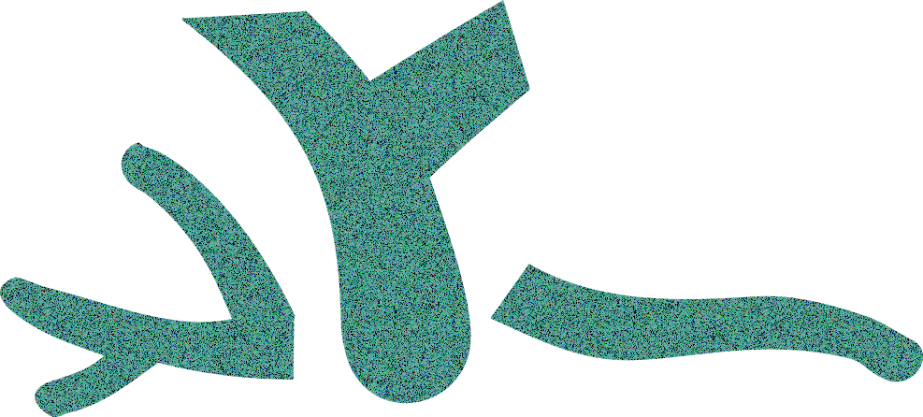
CORAL ADAPTATION TO CLIMATE CHANGE: META-ANALYSIS REVEALS HIGH HERITABILITY ACROSS MULTIPLE TRAITS
What is heritability or h² ?
The proportion of an offspring’s trait that is explained by additive genetics from parents
Why is h² important?
Higher heritability suggests populations may evolve rapidly in response to climate change
Heritability varies:
Across coral life stages
But not by temperature Nor across coral growth forms
By trait type
Temperature difference (relative to ambient) had little to no effect on h ²
Heritability, h² (log-scale)
0.75
0
0.1
0.2
0.5
1
e.g. growth
Gene expression
e.g., growth
Adult and larval growth and bleaching traits were 2–9 times more heritable than growth and bleaching in juveniles
Photochemistry
Growth
Nutrients
bleaching
Bleaching
bleaching
Symbionts
Corals may have a higher potential to adapt to climate change than previously assumed in recent models of coral evolution
Morphology
What does this mean for coral adaptation?
Immune
survival
survival
Survival
Graphical Abstract Text Description (max 100 words): Heritability is an important metric for understanding how animal populations may adapt given climate change. We examined how heritability changes across traits in reef-building corals and across different experimental temperatures. We found that heritability and thus the potential for adaptation is higher for traits related to coral survival and immune responses, but lower for traits related to gene expression as well as bleaching and growth in juvenile corals. Interestingly, temperature had only weak to negligible effect on heritability, suggesting that corals may continue to adapt in a somewhat consistent way given low to moderate climate change.

Slide 2
CORAL ADAPTATION TO CLIMATE CHANGE: META-ANALYSIS REVEALS HIGH HERITABILITY ACROSS MULTIPLE TRAITS
What is heritability or h² ?
The proportion of an offspring’s trait that is explained by additive genetics from parents
Why is h² important?
Higher heritability suggests populations may evolve rapidly in response to climate change
Heritability varies:
Across coral life stages
But not by temperature Nor across coral growth forms
By trait type
Temperature difference (relative to ambient) had little to no effect on h ²
Heritability, h² (log-scale)
0.75
0
0.1
0.2
0.5
1
e.g. growth
Gene expression
e.g., growth
Adult and larval growth and bleaching traits were 2–9 times more heritable than growth and bleaching in juveniles
Photochemistry
Growth
Nutrients
bleaching
Bleaching
bleaching
Symbionts
Corals may have a higher potential to adapt to climate change than previously assumed in recent models of coral evolution
Morphology
What does this mean for coral adaptation?
Immune
survival
survival
Survival

Slide 3


CORAL ADAPTATION TO CLIMATE CHANGE: META-ANALYSIS REVEALS HIGH HERITABILITY ACROSS MULTIPLE TRAITS
What is heritability or h² ?
The proportion of an offspring’s trait that is explained by additive genetics from parents
Why is h² important?
Higher heritability suggests populations may evolve rapidly in response to climate change
Heritability varies:
Across coral life stages
But not by temperature Nor across coral growth forms
By trait type
Temperature difference (relative to ambient) had little to no effect on h ²
Heritability, h² (log-scale)
0.75
0
0.1
0.2
0.5
1
e.g. growth
Gene expression
e.g., growth
Adult and larval growth and bleaching traits were 2–9 times more heritable than growth and bleaching in juveniles
Photochemistry
Growth
Nutrients
bleaching
Bleaching
bleaching
Symbionts
Corals may have a higher potential to adapt to climate change than previously assumed in recent models of coral evolution
Morphology
What does this mean for coral adaptation?
Immune
survival
survival
Survival
Graphical Abstract Text Description (max 100 words): Heritability is an important metric for understanding how animal populations may adapt given climate change. We examined how heritability changes across traits in reef-building corals and across different experimental temperatures. We found that heritability and thus the potential for adaptation is higher for traits related to coral survival and immune responses, but lower for traits related to gene expression as well as bleaching and growth in juvenile corals. Interestingly, temperature had only weak to negligible effect on heritability, suggesting that corals may continue to adapt in a somewhat consistent way given low to moderate climate change.

Slide 4


Coral adaptation to climate change: meta-analysis reveals high heritability across multiple traits
CORAL ADAPTATION TO CLIMATE CHANGE: META-ANALYSIS REVEALS HIGH HERITABILITY ACROSS MULTIPLE TRAITS
What is heritability or h² ?
The proportion of an offspring’s trait that is explained by additive genetics from parents
Why is h² important?
High trait heritability determines if populations can evolve rapidly in response to selection!
h² may vary across multiple factors:
Across coral life stages
By temperature
Experiment temperature relative to ambient temperature had little to no effect on heritability
By trait type
Heritability, h² (log-scale)
0.75
0
0.1
0.2
0.5
1
e.g., growth
Gene expression
adult and larval growth and bleaching traits had high h² relative to juveniles
Photochemistry
Growth
Nutrients
Across coral growth forms
bleaching
Bleaching
Symbionts
Morphology
Heritability, h² (log-scale)
Immune
no detectable differences across coral growth forms
0
0.1
0.2
0.5
0.75
1
survival
Survival
Sean- add STRI logo here?
0
1
2
3
4
5
6
10
Temperature difference (°C, square-root scale)
Factor of interest | Effect on h²? | Higher (↑), lower (↓), or intermediate (→) heritability
Trait type | ✓ | Survival (↑), immune response (↑), gene expression (↓), other traits (→)
Life stage | ✓ | Bleaching and growth in juveniles (↓), in larvae/adult (↑)
Growth form | X | Negligible effect
Heritability type | ✓ | Narrow-sense heritability (↓), broad-sense heritability (↑)
Temperature | x | Negligible effect
Graphical Abstract Text (max 100 words): Heritability is an important metric for understanding how animal populations may adapt given climate change. We examined how heritability changes across traits in reef-building corals and across different experimental temperatures. We found that heritability and thus the potential for adaptation is higher for traits related to coral survival and immune responses, but lower for traits related to gene expression as well as bleaching and growth in juvenile corals. Interestingly, temperature had only weak to negligible effect on heritability, suggesting that corals may continue to adapt in a somewhat consistent way given low to moderate climate change.

