Slide 2
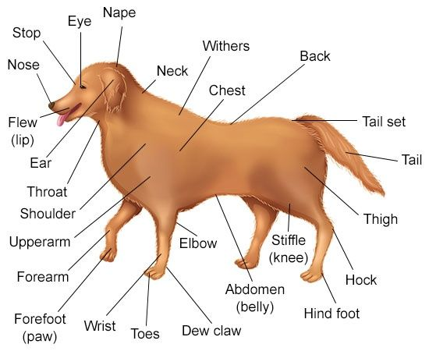
Dog anatomy

Slide 3
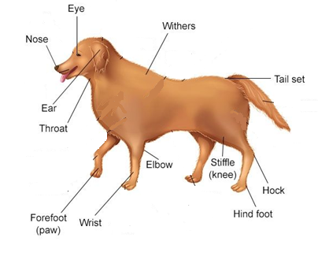
- Nose
- L_Eye
- R_Eye
- L_Ear
- R_Ear
- Throat
- Withers
- TailSet
- L_F_Paw
- R_F_Paw
- L_F_Wrist
- R_F_Wrist
- L_F_Elbow
- R_F_Elbow
- L_B_Paw
- R_B_Paw
- L_B_Hock
- R_B_Hock
- L_B_Stiffle
- R_B_Stiffle

Slide 4
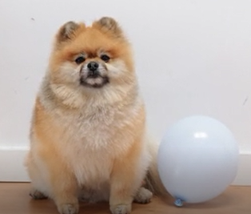
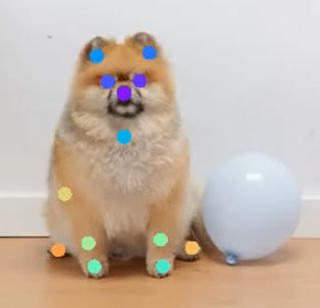

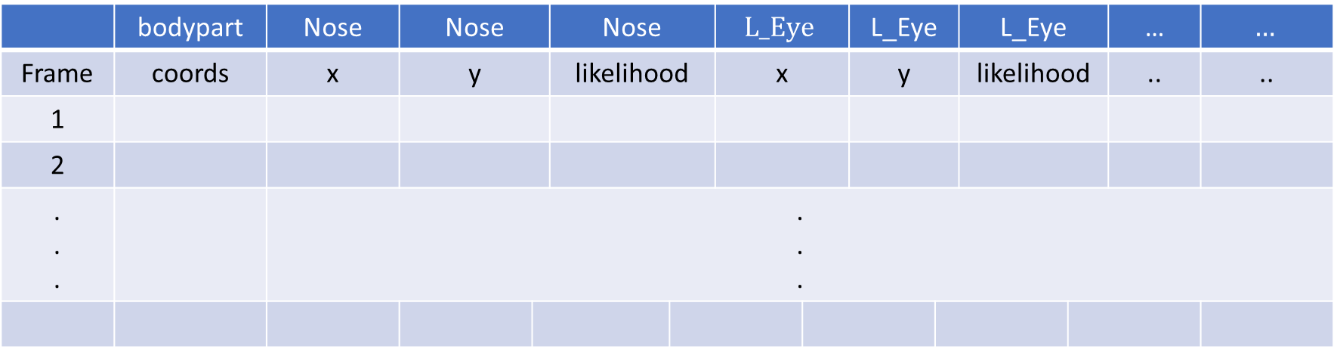
Keypoints on dog
DeepLabCut
$$(60,)$$
 | bodypart | Nose | Nose | Nose | Nose | $$L_Eye$$ | $$L_Eye$$ | L_Eye | L_Eye | L_Eye | L_Eye | … | … | $$…$$
Frame | coords | x | y | likelihood | likelihood | x | x | y | y | likelihood | likelihood | .. | .. | ..
1
2
. . . |  | . . .

Slide 5
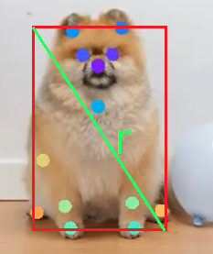

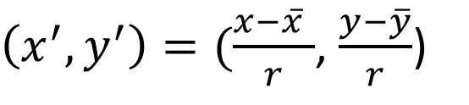
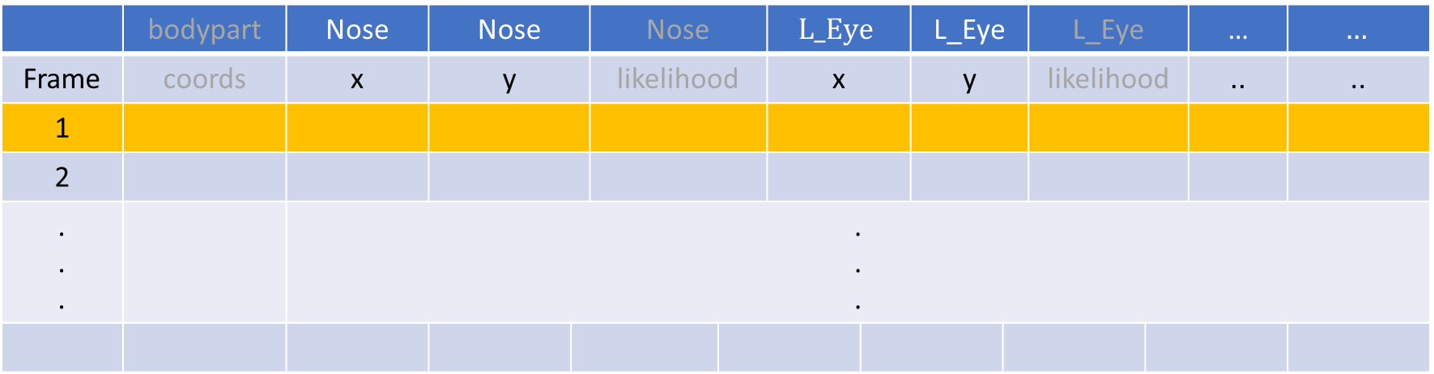
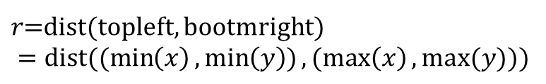
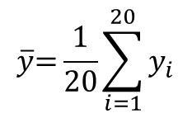
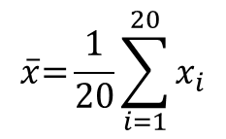
Normalized
 | bodypart | Nose | Nose | Nose | Nose | $$L_Eye$$ | $$L_Eye$$ | L_Eye | L_Eye | L_Eye | L_Eye | … | … | $$…$$
Frame | coords | x | y | likelihood | likelihood | x | x | y | y | likelihood | likelihood | .. | .. | ..
1
2
. . . |  | . . .
$\left(x^{′},y^{′}\right)=(\frac{x−\overline{x} }{r}$, $\frac{y−\overline{y}}{r}$)
$$\overline{x}\text{=}\frac{1}{20}\sum_{i=1}^{20}{x_{i}}$$
$$\overline{y}\text{=}\frac{1}{20}\sum_{i=1}^{20}{y_{i}}$$
$$\left(\overline{x},\overline{y}\right)$$
$r\text{=}$dist(topleft, bootmright) $$=dist((min\left(x\right),\min\left(y\right)),(max\left(x\right),max⁡(y)))$$

Slide 6

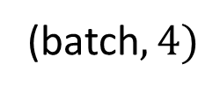

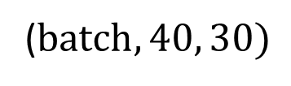




$$.$$
$$frame 30$$
$$.$$
$$.$$
$$frame 2$$
$$frame 1$$
LSTM
($batch,40, 30)$
(batch$,4)$
# 0:躺 1:坐 2:站 3:走

Slide 7
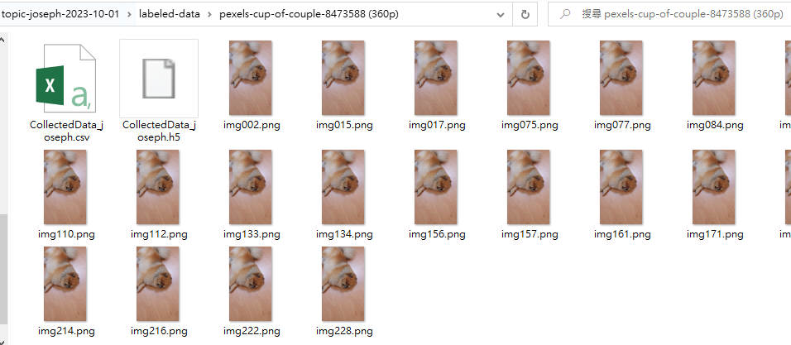
deeplabcut.extract_frame() ➔ labeled-data\pexels-cup-of-couple-8473588 (360p)
deeplabcut.label_frames(config_path) ➔ generate xxx.csv and xxx.h5
deeplabcut.check_labels(config_path, visualizeindividuals=True) labeled-data\pexels-cup-of-couple-8473588 (360p)_labeled

Slide 8
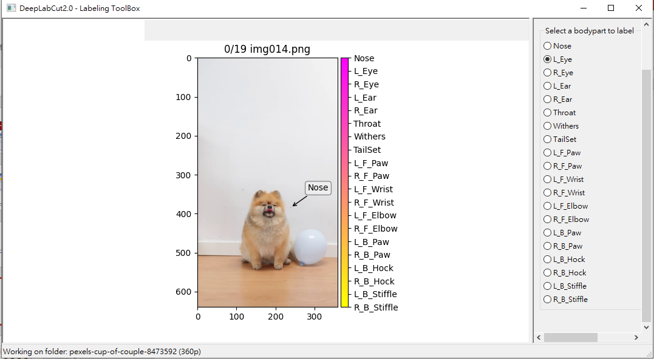

Slide 9
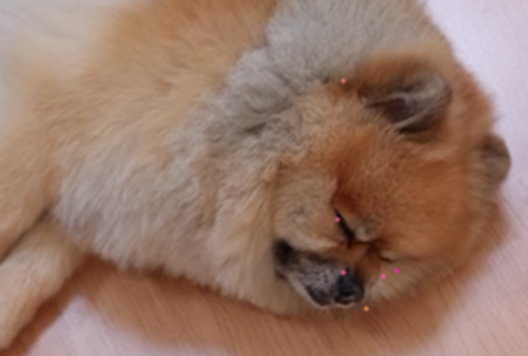

Slide 10
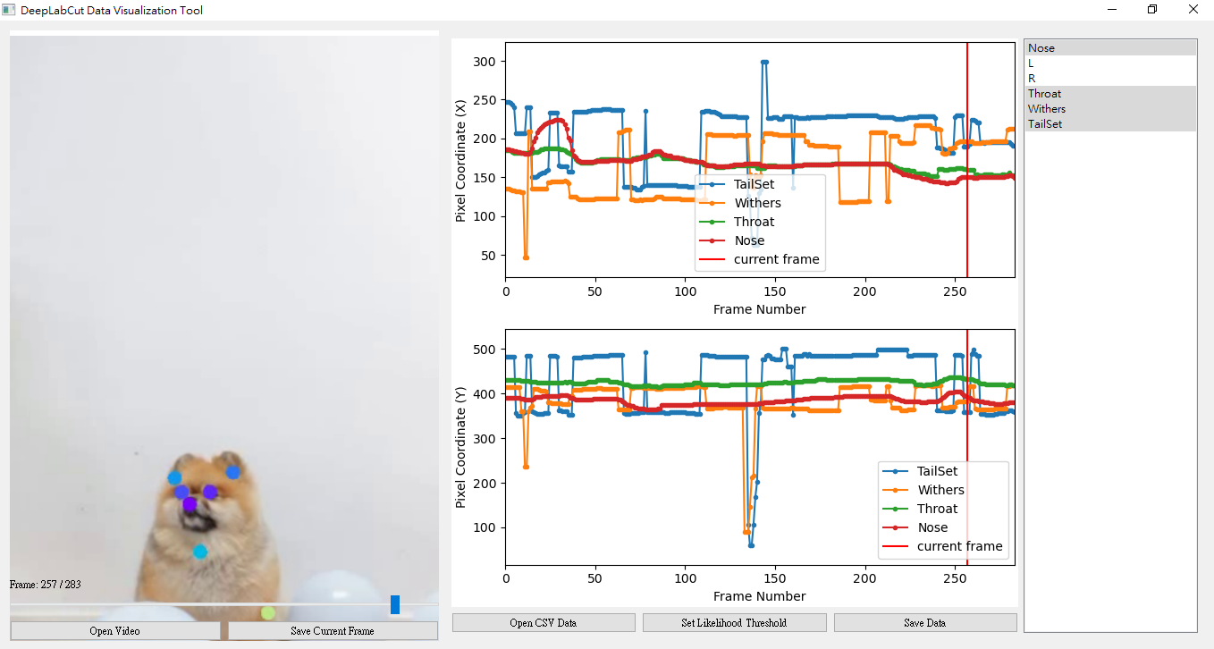

Slide 11
References
Predicting Dog Emotions Based on Posture Analysis Using DeepLabCut https://www.mdpi.com/1999-5903/14/4/97

