Slide 1
Introduce to Prestashop
eCommerce platforms for online stores

Slide 2
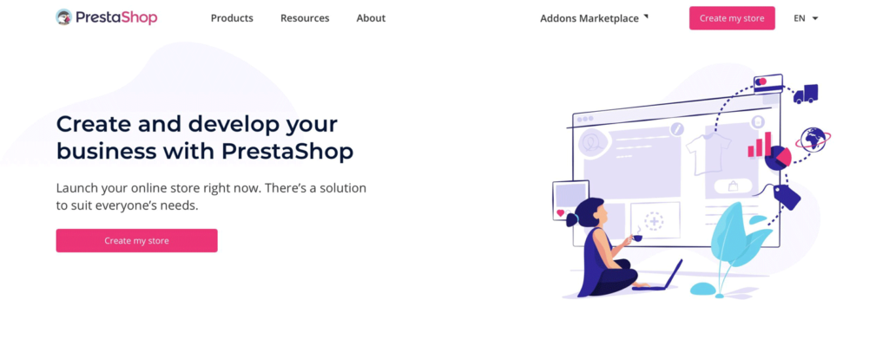
What Is PrestaShop?

Slide 3
PrestaShop Features
Amazing product management
Facilitates effective management of the store
Checkout functionality
Provides facility of multiple payment systems-
Supports marketing efforts and programs-

Slide 4
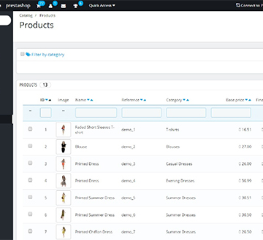
Amazing product management
Presence of unlimited categories, products and attributes.
Seamless comparison of the products.
Quantity/stock management for ensuring seamless product availability.
Supports cross- selling, product recommendations and customer reviews.
Consists of multiple images with lightbox and product image zoom feature.

Slide 5

Facilitates effective management of the store
Easy customization of the store design with PrestaShop themes.
Supports presence of multiple employees with restricted permissions.
Generation of the customized invoices for the customers.
Addition of the affiliate program to boost sales and site traffic.

Slide 6
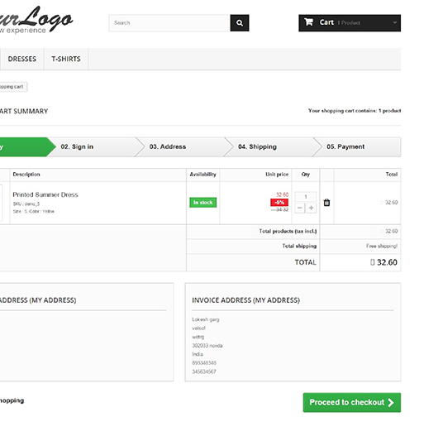
Checkout functionality
Availability of one page or multi- page checkout.
Facility of Guest checkout.
Presence of gift messages/wrapping option.
Functionality to save shopping carts.

Slide 7
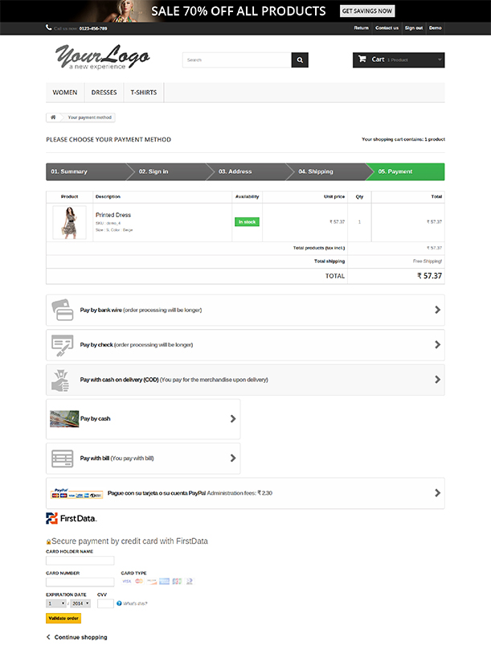
Provides facility of multiple payment systems
Easy integration with different payment systems through the help of various PrestaShop addons.
Allows viewing of the tax depending upon the country, states and counties.
Presence of a payment gateway as per the selected currency.

Slide 8
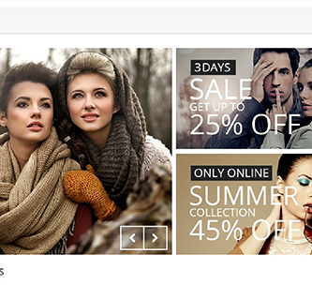
Supports marketing efforts and programs
Facility of sending automated follow- up emails.
Provides discount coupons and vouchers to customers.
Supports the loyalty programme for boosting the site traffic and customer engagement.
Consists of Refer- a- Friend program for increasing customer attention and product sales.

Slide 9

Question ? (in french plz ;))

