Slide 2
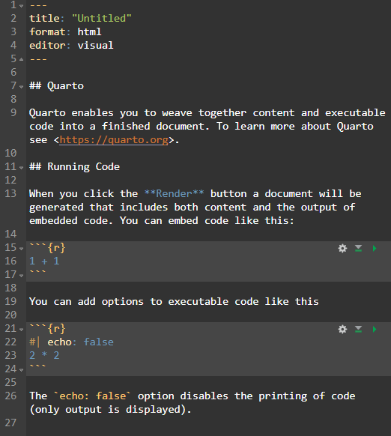
YAML
Text
Code chunk

Slide 3
