Slide 1


Slide 2





Structural Equation Modeling (SEM)using R

Slide 3










LAVAAN
SEM
SEMTools
psych
EFATools

Slide 4
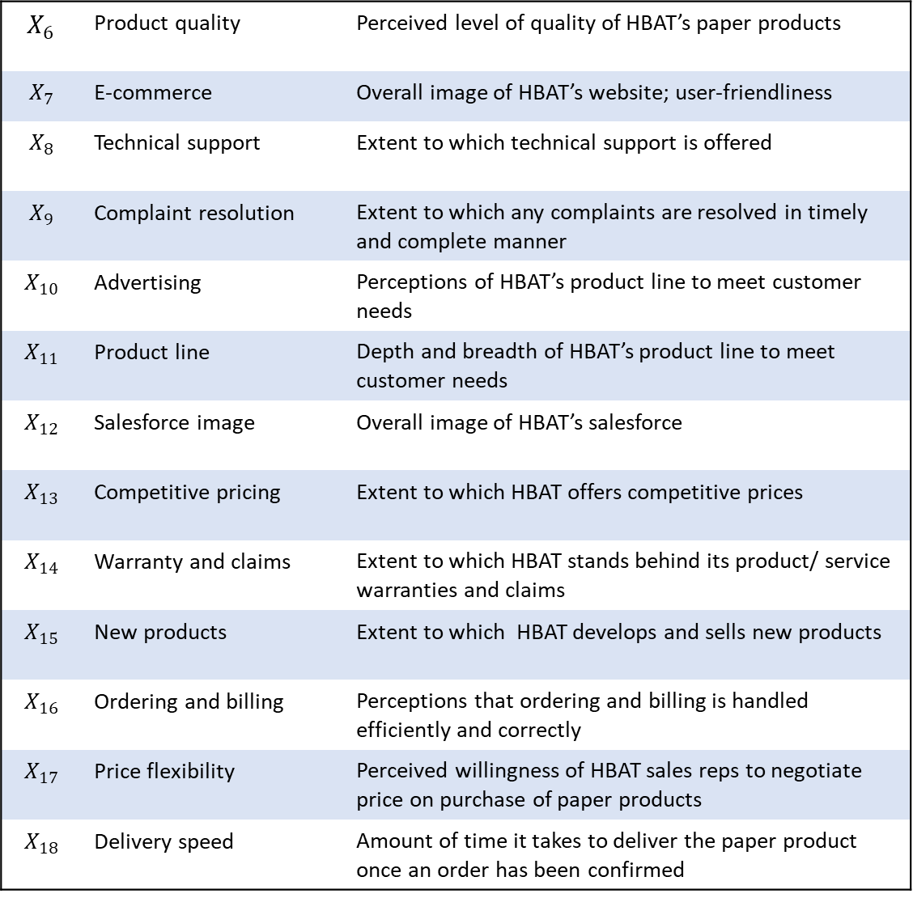
$$X_{6}$$ | Product quality | Perceived level of quality of HBAT’s paper products
$$X_{7}$$ | E-commerce | Overall image of HBAT’s website; user-friendliness
$$X_{8}$$ | Technical support | Extent to which technical support is offered
$$X_{9}$$ | Complaint resolution | Extent to which any complaints are resolved in timely and complete manner
$$X_{10}$$ | Advertising | Perceptions of HBAT’s product line to meet customer needs
$$X_{11}$$ | Product line | Depth and breadth of HBAT’s product line to meet customer needs
$$X_{12}$$ | Salesforce image | Overall image of HBAT’s salesforce
$$X_{13}$$ | Competitive pricing | Extent to which HBAT offers competitive prices
$$X_{14}$$ | Warranty and claims | Extent to which HBAT stands behind its product/ service warranties and claims
$$X_{15}$$ | New products | Extent to which HBAT develops and sells new products
$$X_{16}$$ | Ordering and billing | Perceptions that ordering and billing is handled efficiently and correctly
$$X_{17}$$ | Price flexibility | Perceived willingness of HBAT sales reps to negotiate price on purchase of paper products
$$X_{18}$$ | Delivery speed | Amount of time it takes to deliver the paper product once an order has been confirmed

Slide 5
Indicator variables
Conceptual hypothesized model
EFA
Exploratory factor analysis
Identify number of underlying latent factors.
CFA
Confirmatory factor analysis
Confirm hypothesized structure
Estimate causal relations and interrelations among latent factors.
SEM
Structural equation modelling
Calculate the model-fit indices
Validation of model fit

