Slide 1




Slide 2



Slide 5










LAVAAN
SEM
SEMTools
EFATools
psych

Slide 6

Workshop Training on the Basics of Structural Equation Modelling (SEM) using R

Slide 7
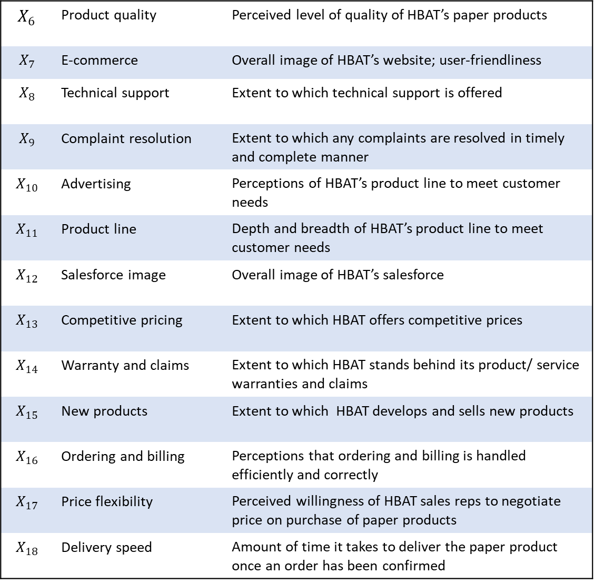
$$X_{6}$$ | Product quality | Perceived level of quality of HBAT’s paper products
$$X_{7}$$ | E-commerce | Overall image of HBAT’s website; user-friendliness
$$X_{8}$$ | Technical support | Extent to which technical support is offered
$$X_{9}$$ | Complaint resolution | Extent to which any complaints are resolved in timely and complete manner
$$X_{10}$$ | Advertising | Perceptions of HBAT’s product line to meet customer needs
$$X_{11}$$ | Product line | Depth and breadth of HBAT’s product line to meet customer needs
$$X_{12}$$ | Salesforce image | Overall image of HBAT’s salesforce
$$X_{13}$$ | Competitive pricing | Extent to which HBAT offers competitive prices
$$X_{14}$$ | Warranty and claims | Extent to which HBAT stands behind its product/ service warranties and claims
$$X_{15}$$ | New products | Extent to which HBAT develops and sells new products
$$X_{16}$$ | Ordering and billing | Perceptions that ordering and billing is handled efficiently and correctly
$$X_{17}$$ | Price flexibility | Perceived willingness of HBAT sales reps to negotiate price on purchase of paper products
$$X_{18}$$ | Delivery speed | Amount of time it takes to deliver the paper product once an order has been confirmed

Slide 8
Command | Operator | Illustration | Significance
Estimate covariance | ~~ | X ~~ Y | X is correlated with Y
Estimate regression | ~ | Y ~ X | Y is regressed on X
Define a reflective latent variable | = ~ | F =~ item_1 + item_2 + item_3 | The F factor is measured by indicators item 1, item 2, and item 3 over which it has effects
Label a parameter | * | F =~ b1*item_1 + b2*item2 + b3*item3 | Item 1-3 is named “b1”, “b2”, and “b3”, respectively.
Create a new parameter | := | B1b2 := b1*b2 | Define a parameter that is not in the model. For example: b1b2 = indirect effect of b1 and b2
Insert a comment in the syntax | # | #indirect effects B1b2 := b1*b2 | Explain to the reader the meaning of a command.

Slide 9

























$$e_{1}$$
$$e_{2}$$
$$e_{3}$$
$$e_{4}$$
F1
$$X_{1}$$
$$X_{2}$$
$$X_{3}$$
$$X_{4}$$
measured latent variable
$X_{1}$
observed / manifest variable
F1
F3
$$e_{1}$$
error variance / disturbance term
F2
Covariance / non-directional path
$$X_{5}$$
$$X_{6}$$
$$X_{7}$$
$$X_{8}$$
$$X_{9}$$
$$X_{10}$$
$$X_{11}$$
$$X_{12}$$
Regression / directional path
$$e_{5}$$
$$e_{6}$$
$$e_{7}$$
$$e_{8}$$
$$e_{9}$$
$$e_{10}$$
$$e_{11}$$
$$e_{12}$$

Slide 10






















$$e_{1}$$
$$e_{2}$$
$$e_{3}$$
$$e_{4}$$
$$X_{1}$$
$$X_{2}$$
$$X_{3}$$
$$X_{4}$$
Work environment
Job satisfaction
Coworker
$$X_{9}$$
$$X_{10}$$
$$X_{11}$$
$$X_{12}$$
$$X_{5}$$
$$X_{6}$$
$$X_{7}$$
$$X_{8}$$
$$e_{9}$$
$$e_{10}$$
$$e_{11}$$
$$e_{12}$$
$$e_{5}$$
$$e_{6}$$
$$e_{7}$$
$$e_{8}$$

Slide 11
















$$e_{1}$$
$$e_{2}$$
$$e_{3}$$
$$e_{4}$$
$$X_{1}$$
$$X_{2}$$
$$X_{3}$$
$$X_{4}$$
F1
F3
F2
$$X_{5}$$
$$X_{6}$$
$$X_{7}$$
$$X_{8}$$
$$X_{9}$$
$$X_{10}$$
$$X_{11}$$
$$X_{12}$$
$$e_{5}$$
$$e_{6}$$
$$e_{7}$$
$$e_{8}$$
$$e_{9}$$
$$e_{10}$$
$$e_{11}$$
$$e_{12}$$

Slide 12
$$e_{1}$$
$$e_{2}$$
$$e_{3}$$
$$e_{4}$$
$$X_{1}$$
$$X_{2}$$
$$X_{3}$$
$$X_{4}$$
Work environment
Job satisfaction
Coworker
$$X_{9}$$
$$X_{10}$$
$$X_{11}$$
$$X_{12}$$
$$X_{5}$$
$$X_{6}$$
$$X_{7}$$
$$X_{8}$$
$$e_{9}$$
$$e_{10}$$
$$e_{11}$$
$$e_{12}$$
$$e_{5}$$
$$e_{6}$$
$$e_{7}$$
$$e_{8}$$

Slide 13
$$e_{1}$$
$$e_{2}$$
$$e_{3}$$
$$e_{4}$$
$$X_{1}$$
$$X_{2}$$
$$X_{3}$$
$$X_{4}$$
F1
F3
F2
$$X_{5}$$
$$X_{6}$$
$$X_{7}$$
$$X_{8}$$
$$X_{9}$$
$$X_{10}$$
$$X_{11}$$
$$X_{12}$$
$$e_{5}$$
$$e_{6}$$
$$e_{7}$$
$$e_{8}$$
$$e_{9}$$
$$e_{10}$$
$$e_{11}$$
$$e_{12}$$

Slide 14
$$e_{1}$$
$$e_{2}$$
$$e_{3}$$
$$e_{4}$$
$$X_{1}$$
$$X_{2}$$
$$X_{3}$$
$$X_{4}$$
Work environment
Job satisfaction
Coworker
$$X_{9}$$
$$X_{10}$$
$$X_{11}$$
$$X_{12}$$
$$X_{5}$$
$$X_{6}$$
$$X_{7}$$
$$X_{8}$$
$$e_{9}$$
$$e_{10}$$
$$e_{11}$$
$$e_{12}$$
$$e_{5}$$
$$e_{6}$$
$$e_{7}$$
$$e_{8}$$

Slide 15
$$e_{1}$$
$$e_{2}$$
$$e_{3}$$
$$e_{4}$$
$$X_{1}$$
$$X_{2}$$
$$X_{3}$$
$$X_{4}$$
F1
F3
F2
$$X_{5}$$
$$X_{6}$$
$$X_{7}$$
$$X_{8}$$
$$X_{9}$$
$$X_{10}$$
$$X_{11}$$
$$X_{12}$$
$$e_{5}$$
$$e_{6}$$
$$e_{7}$$
$$e_{8}$$
$$e_{9}$$
$$e_{10}$$
$$e_{11}$$
$$e_{12}$$

Slide 16
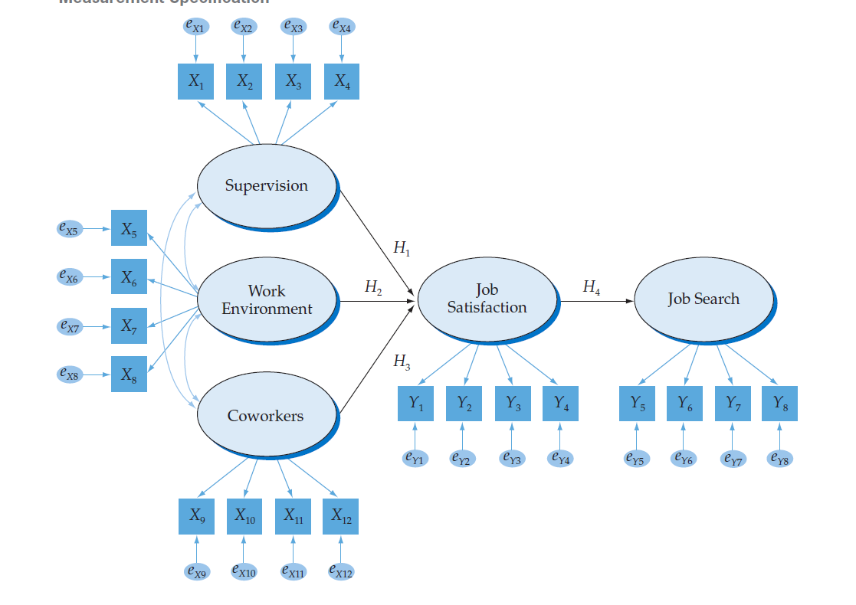
Work environment
Job satisfaction
Coworker

Slide 17
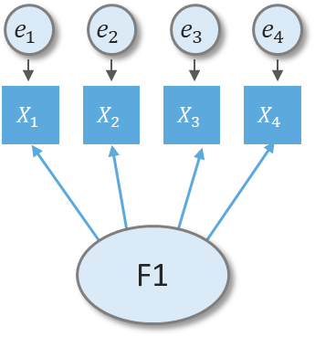





$$e_{1}$$
$$e_{2}$$
$$e_{3}$$
$$e_{4}$$
$$X_{1}$$
$$X_{2}$$
$$X_{3}$$
$$X_{4}$$
F1
$$e_{1}$$
$$e_{2}$$
$$e_{3}$$
$$X_{1}$$
$$X_{2}$$
$$X_{3}$$
F1

Slide 18





$$e_{1}$$
$$e_{2}$$
$$e_{3}$$
$$e_{4}$$
$$e_{5}$$
$$e_{6}$$
$$e_{7}$$
$$e_{8}$$
$$X_{1}$$
$$X_{2}$$
$$X_{3}$$
$$X_{4}$$
$$X_{5}$$
$$X_{6}$$
$$X_{7}$$
$$X_{8}$$
F1
F1

Slide 19














$$e_{1}$$
$$e_{2}$$
$$e_{3}$$
$$e_{4}$$
$$X_{1}$$
$$X_{2}$$
$$X_{3}$$
$$X_{4}$$
F1
F3
F2
$$X_{5}$$
$$X_{6}$$
$$X_{7}$$
$$X_{8}$$
$$X_{9}$$
$$X_{10}$$
$$X_{11}$$
$$X_{12}$$
$$e_{5}$$
$$e_{6}$$
$$e_{7}$$
$$e_{8}$$
$$e_{9}$$
$$e_{10}$$
$$e_{11}$$
$$e_{12}$$

Slide 20
$$e_{1}$$
$$e_{2}$$
$$e_{3}$$
$$e_{4}$$
$$X_{1}$$
$$X_{2}$$
$$X_{3}$$
$$X_{4}$$
F1
b1
F3
F2
b2
$$X_{5}$$
$$X_{6}$$
$$X_{7}$$
$$X_{8}$$
$$X_{9}$$
$$X_{10}$$
$$X_{11}$$
$$X_{12}$$
$$e_{5}$$
$$e_{6}$$
$$e_{7}$$
$$e_{8}$$
$$e_{9}$$
$$e_{10}$$
$$e_{11}$$
$$e_{12}$$

Slide 21
$$e_{1}$$
$$e_{2}$$
$$e_{3}$$
$$e_{4}$$
$$X_{1}$$
$$X_{2}$$
$$X_{3}$$
$$X_{4}$$
F1
b1
b3
F3
F2
b2
$$X_{5}$$
$$X_{6}$$
$$X_{7}$$
$$X_{8}$$
$$X_{9}$$
$$X_{10}$$
$$X_{11}$$
$$X_{12}$$
$$e_{5}$$
$$e_{6}$$
$$e_{7}$$
$$e_{8}$$
$$e_{9}$$
$$e_{10}$$
$$e_{11}$$
$$e_{12}$$

Slide 22
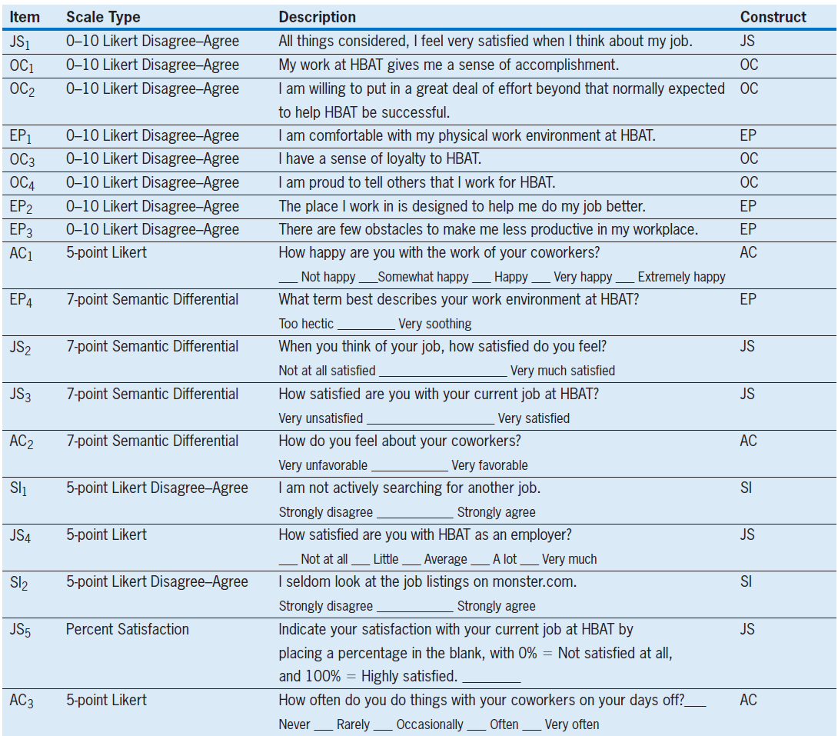
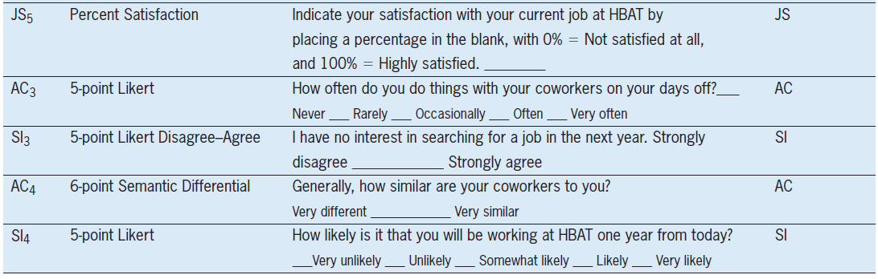

Slide 23
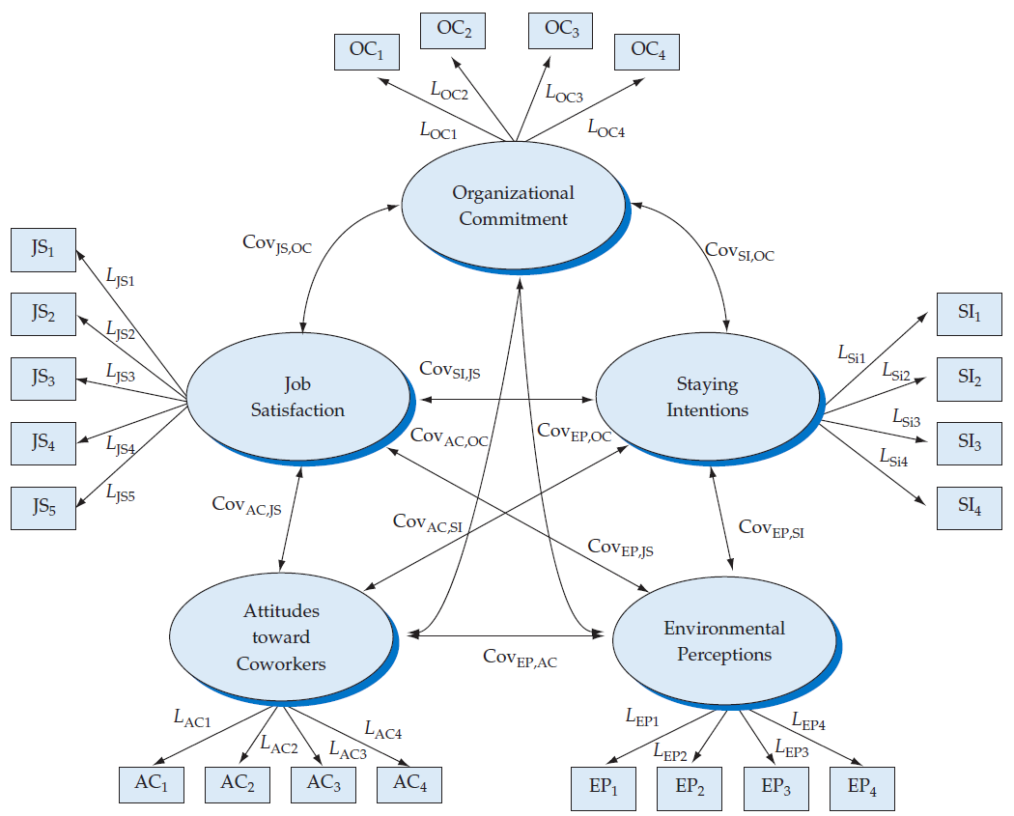

Slide 24
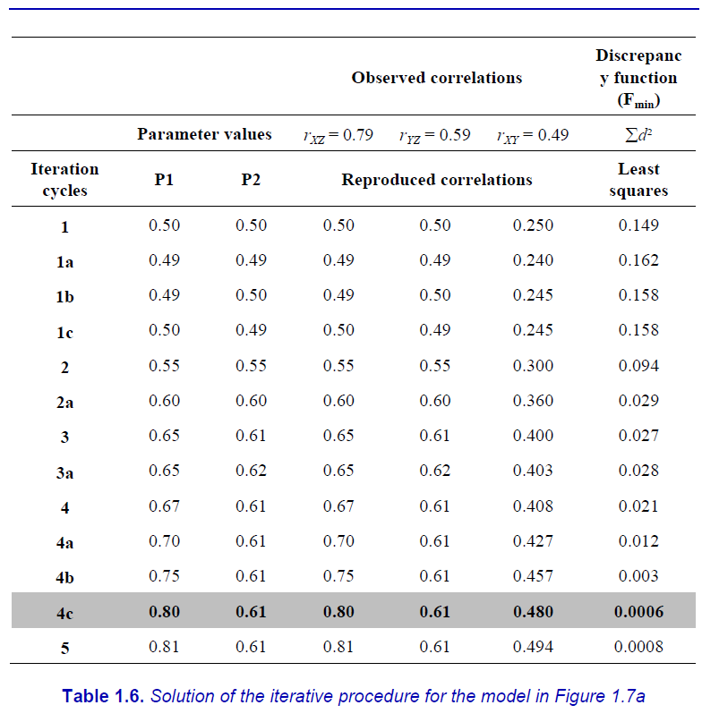
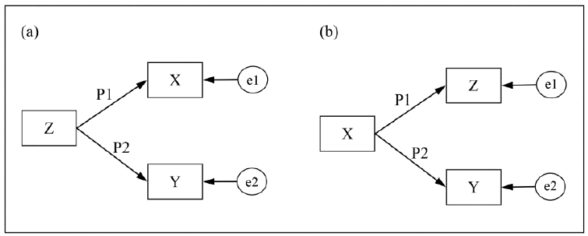

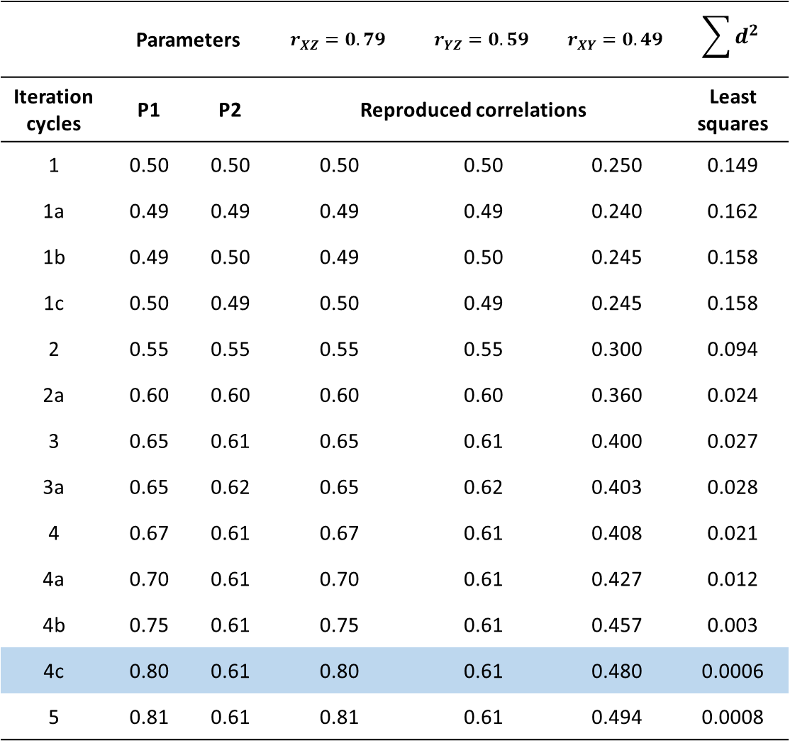






 | Parameters |  | $$r_{XZ}=0.79$$ | $$r_{YZ}=0.59$$ | $$r_{XY}=0.49$$ | $$\sum{d^{2}}$$
Iteration cycles | P1 | P2 | Reproduced correlations |  |  | Least squares
1 | 0.50 | 0.50 | 0.50 | 0.50 | 0.250 | 0.149
1a | 0.49 | 0.49 | 0.49 | 0.49 | 0.240 | 0.162
1b | 0.49 | 0.50 | 0.49 | 0.50 | 0.245 | 0.158
1c | 0.50 | 0.49 | 0.50 | 0.49 | 0.245 | 0.158
2 | 0.55 | 0.55 | 0.55 | 0.55 | 0.300 | 0.094
2a | 0.60 | 0.60 | 0.60 | 0.60 | 0.360 | 0.024
3 | 0.65 | 0.61 | 0.65 | 0.61 | 0.400 | 0.027
3a | 0.65 | 0.62 | 0.65 | 0.62 | 0.403 | 0.028
4 | 0.67 | 0.61 | 0.67 | 0.61 | 0.408 | 0.021
4a | 0.70 | 0.61 | 0.70 | 0.61 | 0.427 | 0.012
4b | 0.75 | 0.61 | 0.75 | 0.61 | 0.457 | 0.003
4c | 0.80 | 0.61 | 0.80 | 0.61 | 0.480 | 0.0006
5 | 0.81 | 0.61 | 0.81 | 0.61 | 0.494 | 0.0008
$$X$$
$$e_{1}$$
$$P1$$
$$Z$$
$$P2$$
$$Y$$
$$e_{2}$$

Slide 25
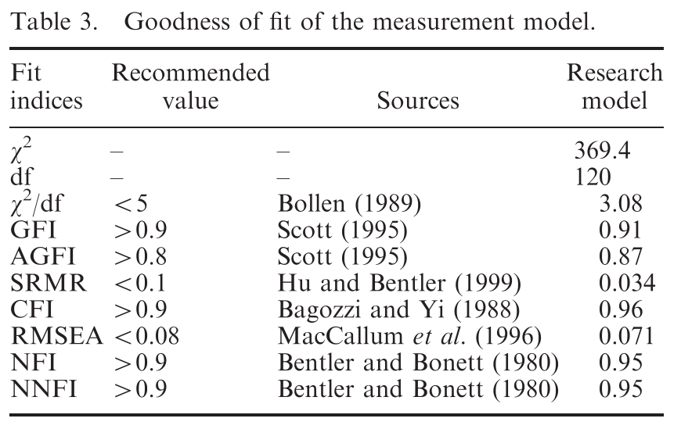

Slide 26
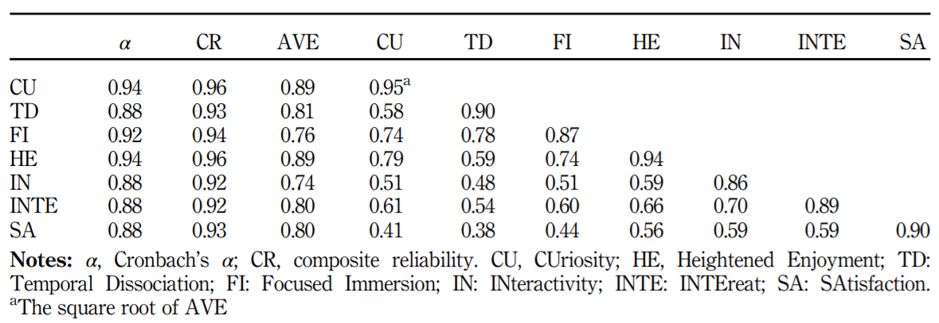

Slide 27
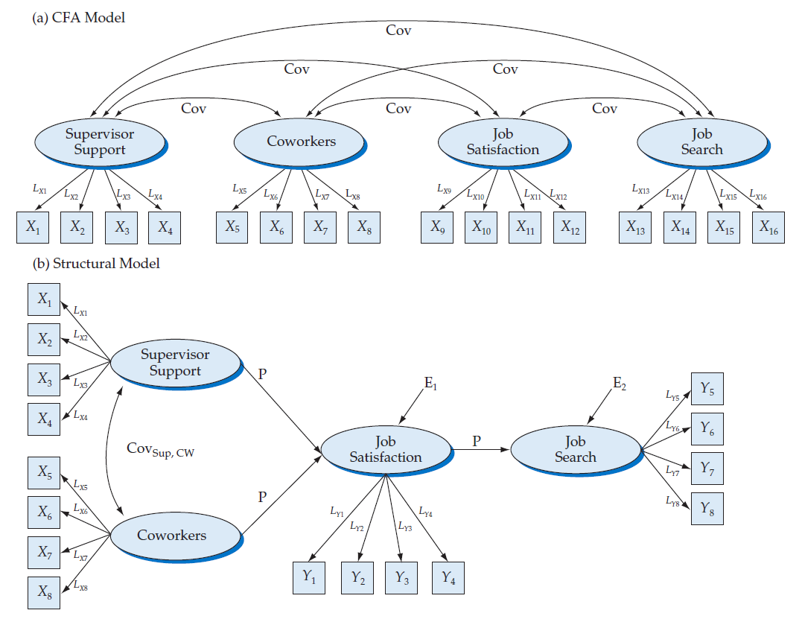

Slide 28
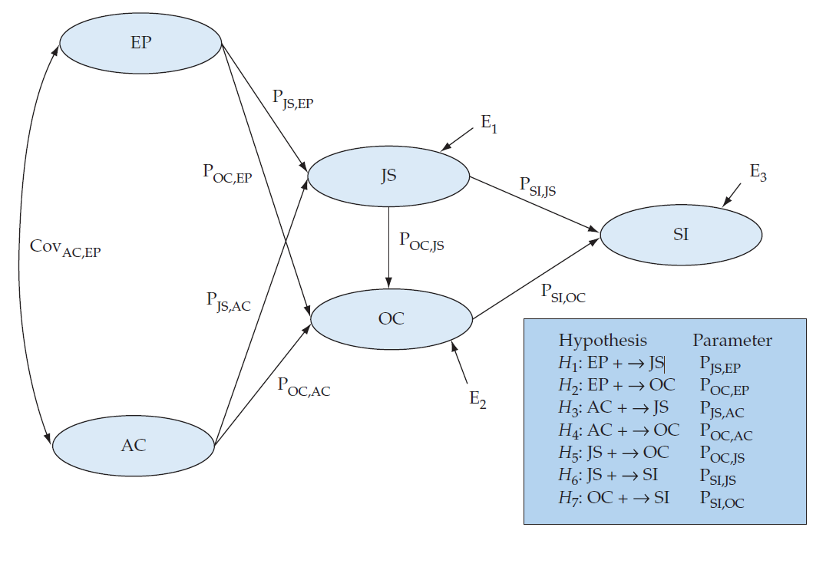

Slide 29
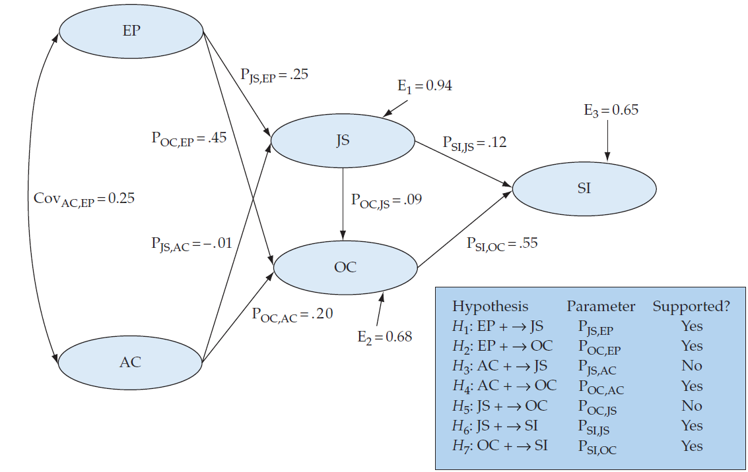

Slide 30
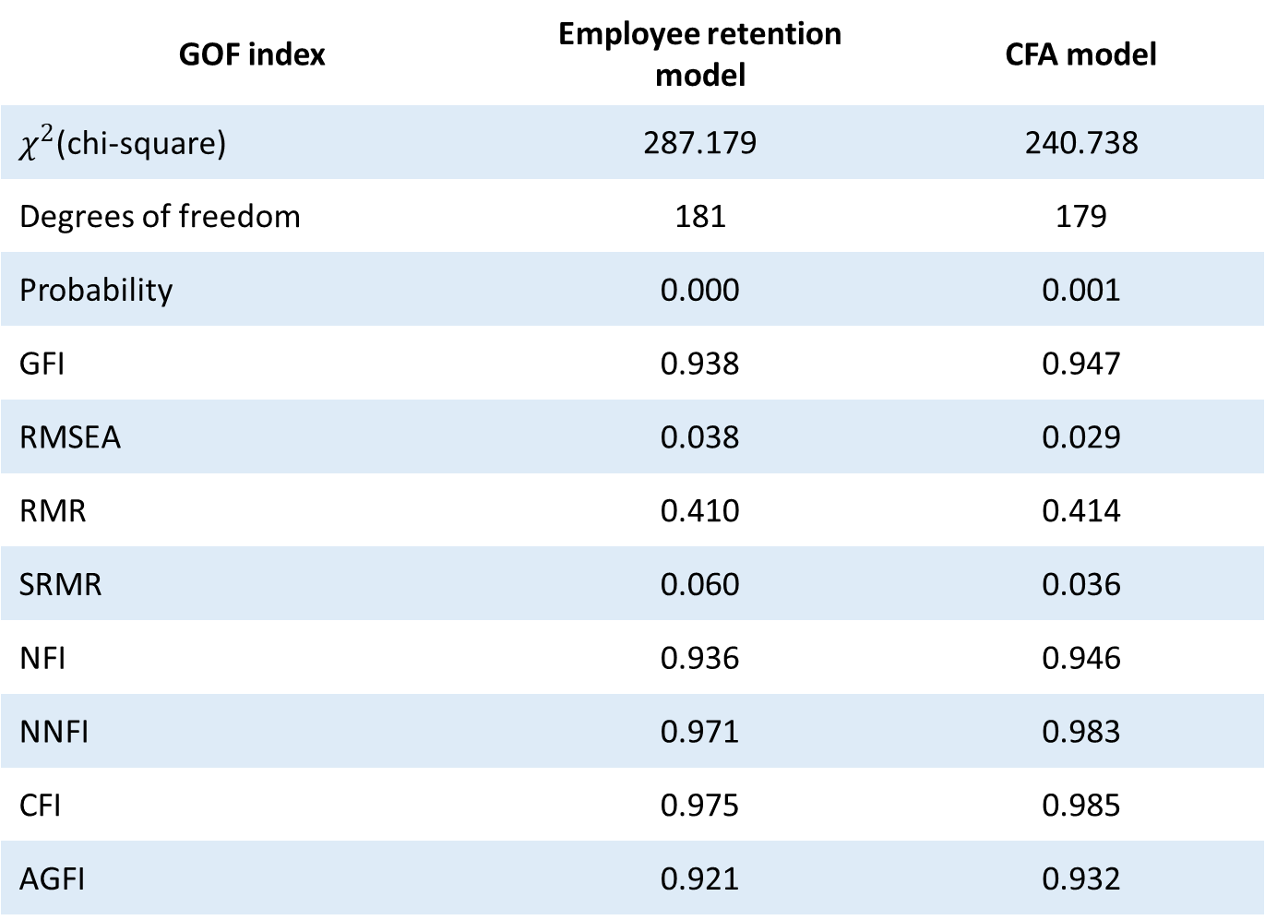
GOF index | Employee retention model | CFA model
$χ^{2}$(chi-square) | 287.179 | 240.738
Degrees of freedom | 181 | 179
Probability | 0.000 | 0.001
GFI | 0.938 | 0.947
RMSEA | 0.038 | 0.029
RMR | 0.410 | 0.414
SRMR | 0.060 | 0.036
NFI | 0.936 | 0.946
NNFI | 0.971 | 0.983
CFI | 0.975 | 0.985
AGFI | 0.921 | 0.932

