Slide 1
Adverse Selection

Slide 2
Your annual income: $48,259 After taxes: $38,00 Monthly after taxes: $3,166
Come up with a monthly budget.
Get your group-mates to approve it.

Slide 3
Adverse Selection Activity
Minor incident: Single visit to ER or condition such as knee pain that may require several months under a doctor’s care
Major illness: Illness requiring several surgeries, many days in the hospital and follow up care
Cost of minor incident: $8,000
Cost of major illness: $200,000

Slide 4
Insurance Options
Bronze insurance: $5,674 ($473/month)
Financial quality: $1,000 deductible and 30% copayment.
Silver insurance: $6,531 ($544/month)
Financial quality: $500 deductible and 20% copayment.
Gold insurance: $8,222 ($685/month)
Financial quality: No deductible, no copayment.

Slide 5
Excel

Slide 6


Adverse selection market unraveling / death spiral
Healthiest
Spectrum
Sickest

Slide 7
Round 2
Healthiest
Spectrum
Sickest

Slide 8
Round 3
Healthiest
Spectrum
Sickest

Slide 9
Adverse selection market unraveling / death spiral
Insurer puts insurance package on the market
The healthiest people move into lower quality packages
The premium on high quality insurance increases, because the “average” person in the plan is sicker
The new higher price scares away the next healthiest group

Slide 10
Financial dimensions of insurance quality
Non-financial dimensions of insurance quality

Slide 11
Financial dimensions of insurance quality
Non-financial dimensions of insurance quality
Co-pay
Deductible
Network (doctors in-network)
Procedures covered
Red tape
Process for reimbursement
Experimental treatments?

Slide 12
Financial dimensions of health insurance quality
Deductible: The amount of money you have to pay for your own services before the insurance kicks in. This starts over every year.
Co-payment: A percentage of the doctor/hospital bill that you have to pay.
Coverage limit: The maximum medical charges covered under an insurance plan.
Catastrophic threshold: The amount of medical charges above which your case is considered catastrophic. If you have catastrophic coverage, insurance kicks in to pay (often 100% of) bills beyond this amount.
Donut hole: The difference between your coverage limit and catastrophic threshold. This applies to Medicare part D (drug coverage for the elderly) and people sometimes buy insurance to cover the donut hole.
Negotiated prices: The prices your insurance company has negotiated with providers and hospitals.

Slide 13
Concepts
Death spiral: A situation where insurance prices rise rapidly because of a change in the population covered.
Race-you-to-the-bottom: A situation where insurers compete against one another to keep out the sickest patients by competing to offer the worst quality for those patients.
The adverse selection does NOT require profit maximization.
How do large employers get around the adverse selection problem?

Slide 14
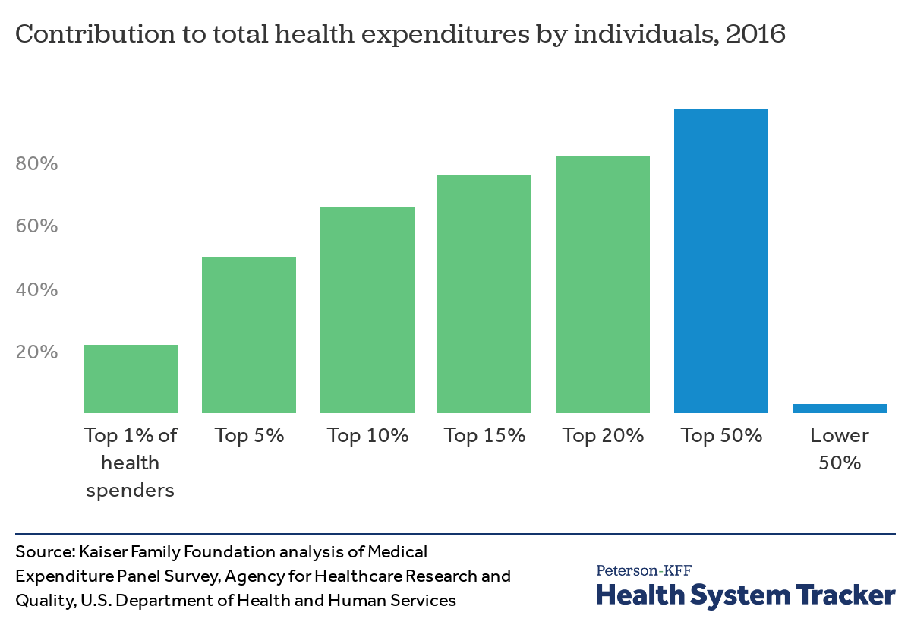
Notes:
Website: https://www.healthsystemtracker.org/chart-collection/health-expenditures-vary-across-population/#item-start

Slide 15


A Tale of Two Heroes
“Do the greatest good for the person who is worst off.”
“Do the greatest good for the greatest number of people.”
Rawlsian
Utilitarian
Images by Olivia Jester
Notes:
Female superhero 1: http://www.publicdomainpictures.net/view-image.php?image=179594&picture=mutant-superhero-21
Female superhero 2: http://www.publicdomainpictures.net/view-image.php?image=179589&picture=mutant-superhero-16

Slide 16
Social Welfare Functions
Utilitarian: Weight everybody equally; maximize the collective utility.
Rawlsian: Weigh only the person who is worst off.

Slide 17



What do you care about in health care?
*Access to cancer doctors
*Diabetes management
*Addiction treatment
*Long-term care (nursing homes)
*Low premium
*Copayment & deductible
*Access to my primary care doctor
*Fancy equipment *Short wait times
*“Not sure.” *Spa treatments
Sickest
Spectrum
Healthiest
Notes:
Avg spending per person: https://www.cms.gov/research-statistics-data-and-systems/statistics-trends-and-reports/nationalhealthexpenddata/nhe-fact-sheet.html

Slide 18
Because the top 1% spend 22% of $...
If you accidentally attract twice as many of the top 1% of spenders, then you will have to cut your budget for everyone by 20%.
If you can avoid the top 1% of health care spender, you can increase your budget for everyone else by 20%
Sickest
Spectrum
Healthiest
Notes:
Avg spending per person: https://www.cms.gov/research-statistics-data-and-systems/statistics-trends-and-reports/nationalhealthexpenddata/nhe-fact-sheet.html

Slide 19
Three Ways to Handle Adverse Selection
1) Eliminate competition:
Single payer (Medicare, Canada)
Employer-sponsored insurance
2) Risk adjustment:
German health insurance voucher
Medicare advantage
Affordable Care Act Exchanges
3) Emergency money to cover leaks
High risk pools

Slide 20
Stakeholders
 | % of Population
Employer-sponsored health insurance | 57%
Medicare (65+) | 17%
Medicaid | 15%
Uninsured | 5%
Individual insurance | 6%
Less Impacted

Slide 21
Adverse Selection v. Moral Hazard
Adverse Selection |  | Moral hazard
 | Asymmetric information about one party’s
Type |  | Behavior
 | Causes a bias that occurs
Before |  | After
 | two or more parties enter into a contract

Slide 22
Examples
Adverse Selection
Moral Hazard
Sick people choose higher quality health insurance
People choosing to sell their used car are more likely to have a defective one.
Someone selling on e-bay is more likely to have a defective product.
Someone needing to borrow a loan from the bank is more likely to be bad with money.
The type of person to rent is more likely to be the type who doesn’t like house care.
Fully insured people choose name brand drugs over generics, raising insurance prices.
When 10 friends eat out and split the bill, they order more expensive dishes.
You don’t protect your bike very well if you have insurance. This causes more expensive insurance.
Once you have obtained money from a loan, you don’t have as much incentive to pay it back. This causes higher loan interest rates.
Renters don’t take good care of property. Therefore, prices are higher to maintain upkeep.

Slide 23
Societal solutions
Adverse Selection
Moral Hazard
Credit scores (As in indicator of someone’s responsibility level)
Affordable Care Act
Large companies with reputations on the line.
Reviews of online purchases (ebay and otherwise)
Insurance copayments (you pay 20% of your doctors’ bill even after you get insurance).
Deposit on rented apartments.
Credit scores (as an incentive for people to pay)

