Slide 1
Why should older people invest less in stock than younger people?
Ravi Jagannathan & Narayana R. Kocherlakota (1996)
Alex Chow & Daryl Larsen
<number>

Slide 2
Long-term ownership eliminates risk
Saving for stuff
Wages cover risk
Why Do Planners Advise Less Risk As We Age?
Alex Chow & Daryl Larsen
<number>

Slide 3
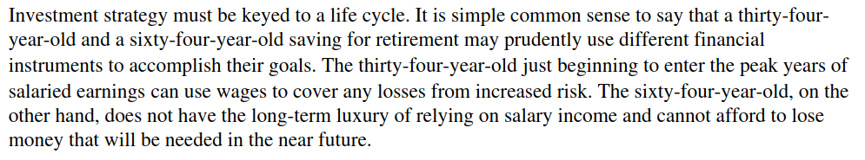
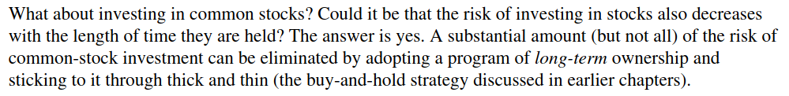
A Random Walk Down Wall Street
Alex Chow & Daryl Larsen
<number>

Slide 4
Risk in Long Run
?Mr Planner’s Argument: Stocks are less risky over longer investment horizons
Empirics of Stocks and Bonds (1926-1990)
 | Avg. Annual Return (Real) | Avg. Volatility
S&P 500 | 8.8% | 21%
Treasury Bills | 0.6% | 4.4%
Bills outperform Stocks in 20 years out of possible 65
Stocks outperform Bills in ALL 46 blocks of 20 consecutive years
Overlapping Issues!
Alex Chow & Daryl Larsen
<number>

Slide 5
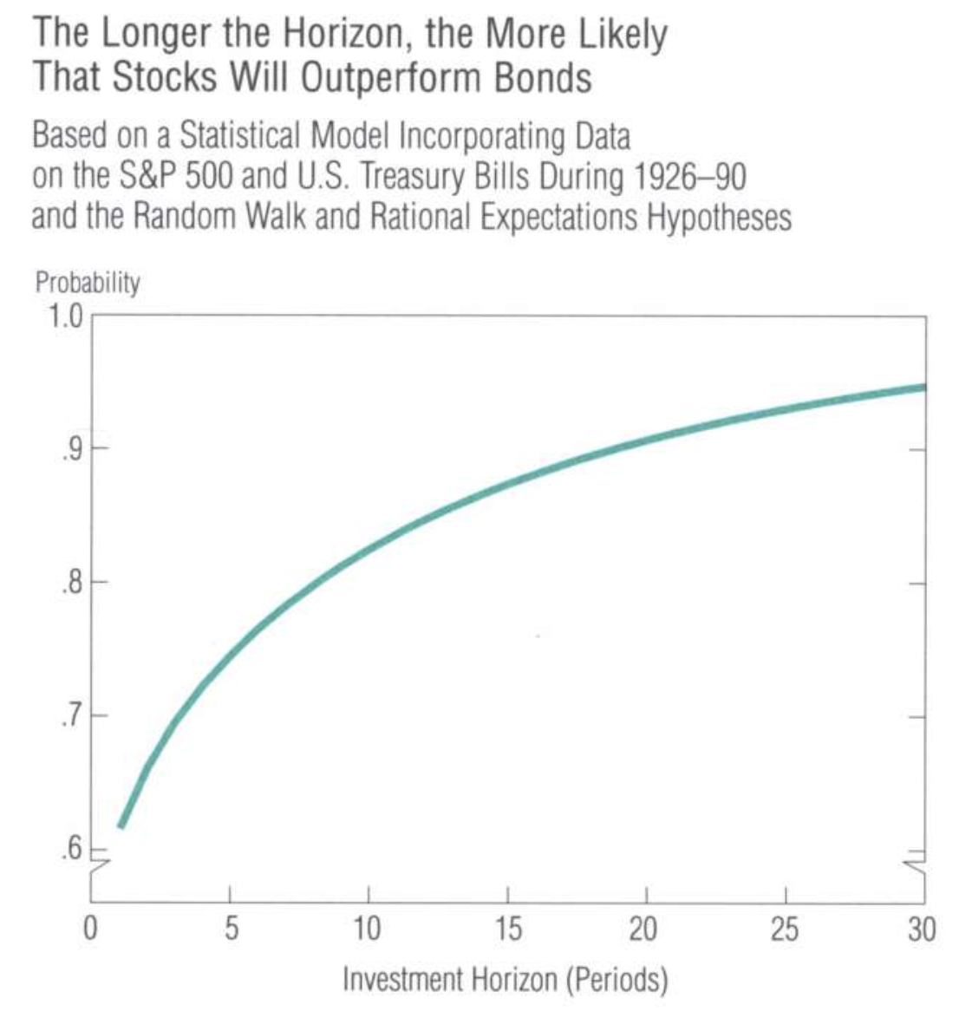
Risk in Long Run
?.... Mr Planner’s Argument: Stocks are less risky over longer investment horizons
Wealth Dynamics
i.i.d. (log-) return Random Walk Hypothesis , uncorrelated
Normality of (log-) return :Good for analytical but too dull. High peak and fat tail in reality.
=
= with probability 1
Mean difference increase linearly with
Vol difference increase non-linearly and slowly with
nlikely to be negative
Normality of (log-) return:Good for analytical but too dull. High peak and fat tail in reality.
Ignore decision making and humanity!
Alex Chow & Daryl Larsen
<number>

Slide 6
Risk in Long Run
? Mr Planner’s Argument: Stocks are less risky over longer investment horizons
Utility Maximisation
$maxE\left[\frac{{\left(S_{T−1}\left(1+r_{T}^{s}\right)+B_{T−1}\left(1+r_{b}^{t}\right)\right)}^{1−γ}}{1−γ}\right]$
s.t.
$S_{0}+B_{0}≤W_{0}$
Solving Backward, making decision at
$\max_{s_{T−1}}E\left[\frac{{\left(s_{T−1}W_{T−1}\left(1+r_{t}^{s}\right)+\left(1−s_{T−1}\right)W_{T−1}\left(1+r_{b}^{t}\right)\right)}^{1−γ}}{1−γ}\right]$
Alex Chow & Daryl Larsen
<number>
Notes:
<number>

Slide 7
Risk in Long Run
? Mr Planner’s Argument: Stocks are less risky over longer investment horizons
$\max_{s_{T−1}}\left[E\left[W_{T−1}\right]\right]E\left[\frac{{\left(s_{T−1}\left(1+r_{t}^{s}\right)+\left(1−s_{T−1}\right)\left(1+r_{b}^{t}\right)\right)}^{1−γ}}{1−γ}\right]$
F.O.C.:
Does not depend on : CRRA!
Solving Backward, making decision at
$\max_{s_{T−2}}\left[E\left[W_{T−2}\right]\right]E\left[\frac{{\left(\left[s_{T−2}\left(1+r_{t−1}^{s}\right)+\left(1−s_{T−2}\right)\left(1+r_{b}^{t}\right)\right]\left[s^{∗}\left(1+r_{t}^{s}\right)+\left(1−s^{∗}\right)\left(1+r^{b}\right)\right]\right)}^{1−γ}}{1−γ}\right]$
$s_{T−1}=s_{T−2}=s^{∗}=s_{T−3}…=s_{0}$
Long horizon is the same as short horizon! (if making decision at regular intervals)
Alex Chow & Daryl Larsen
<number>
Notes:
<number>

Slide 8
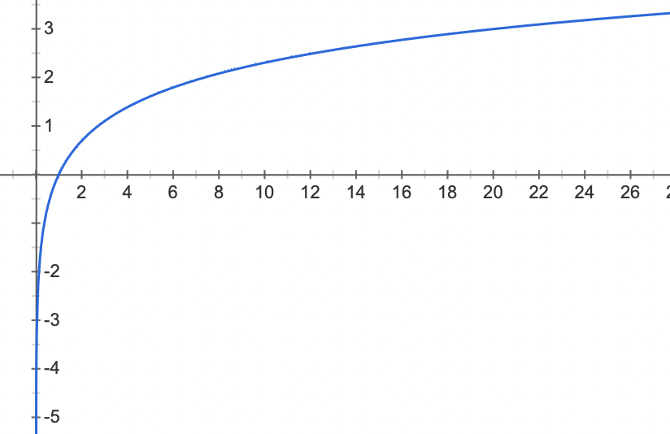
Risk in Long Run
? Mr Planner’s Argument: Stocks are less risky over longer investment horizons
What if rebalancing infrequently?
Extreme: Now can only make decision once: choose at t=0
=
]=
$U\left(W\right)=logW$
As T increases, ] increases i.e.Stocks outperform bonds: Good
As T increases, i.e. Volatility of stocks increase: Bad
Increasingly Scared toward the potential downside:
Risk Aversion!
Alex Chow & Daryl Larsen
<number>
Notes:
<number>

Slide 9
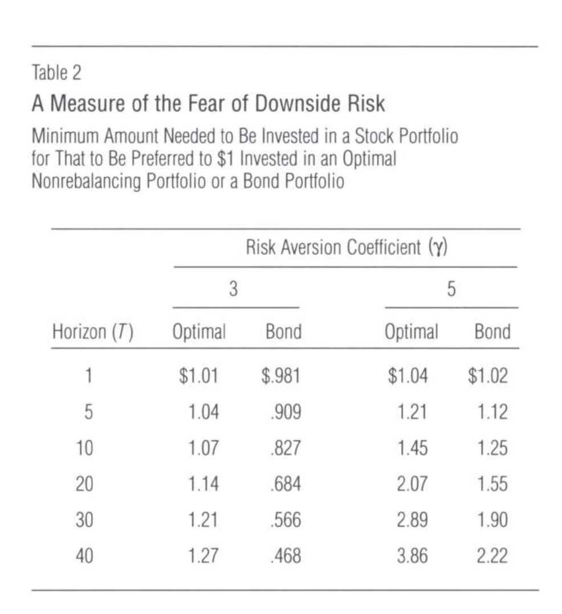
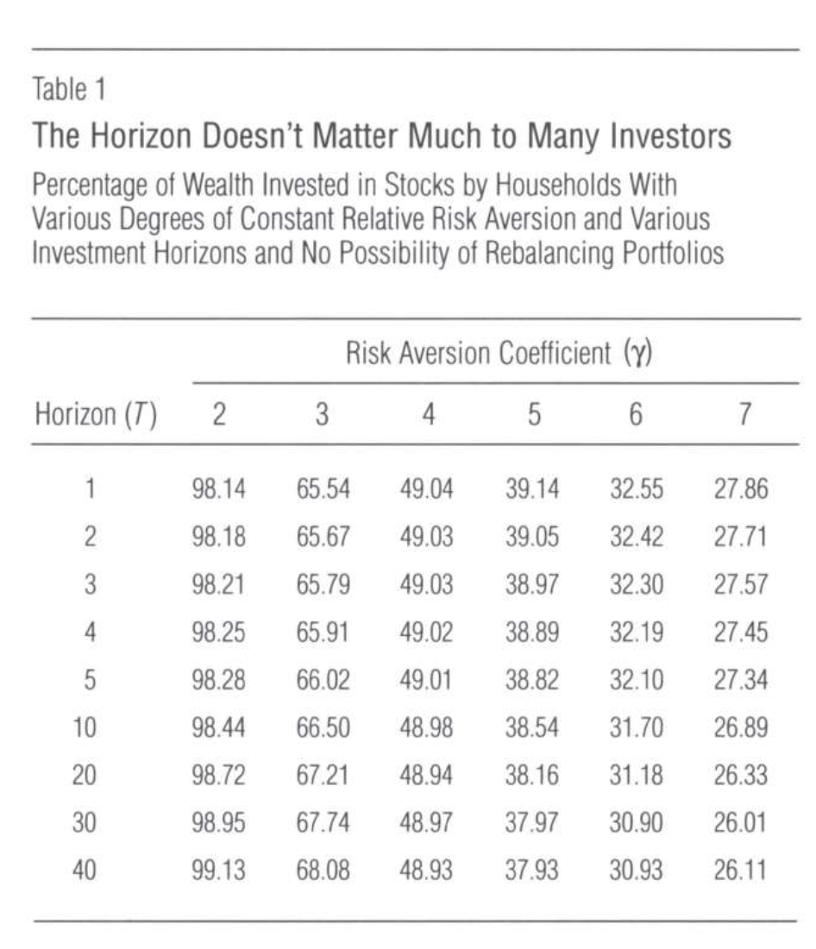
Risk in Long Run
Mr Planner’s Argument: Stocks are less risky over longer investment horizons
Negative effect from higher Variance cancelled out Positive effect from higher Mean when agent is risk-averse enough
Alex Chow & Daryl Larsen
<number>
Notes:
<number>

Slide 10
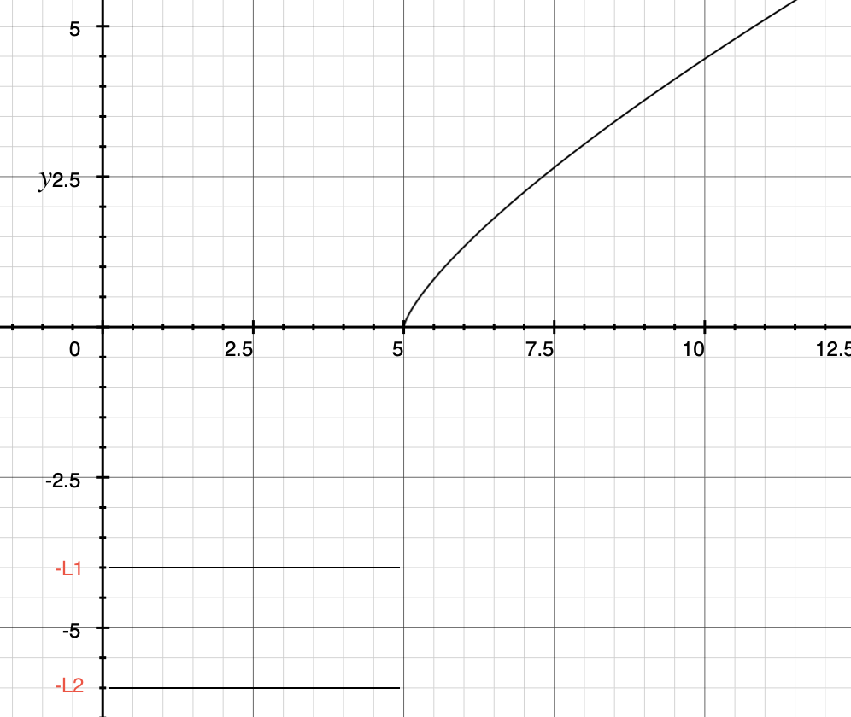
Targeting
? Mr Planner’s Argument: Reducing Stocks holdings overtime and saving for wealth target
is the only choice to have concave
Alex Chow & Daryl Larsen
<number>
Notes:
<number>

Slide 11
Targeting
Mr Planner’s Argument: Reducing Stocks holdings overtime and saving for wealth target
Case 1:
Two-Steps Strategy: Invest enough money in bonds to meet , then invest remaining money with constant shares (from the F.O.C.)
Suppose not enough money in bonds to meet , =
Examples: Assume = and
Case 1: (on a.v.g.) decreasing in (on a.v.g.) increasing in
Case 2:
Rely on stocks swinging upward to meet Always P =
Case 2: Indifferent to all strategies since always
Alex Chow & Daryl Larsen
<number>
Notes:
<number>

Slide 12
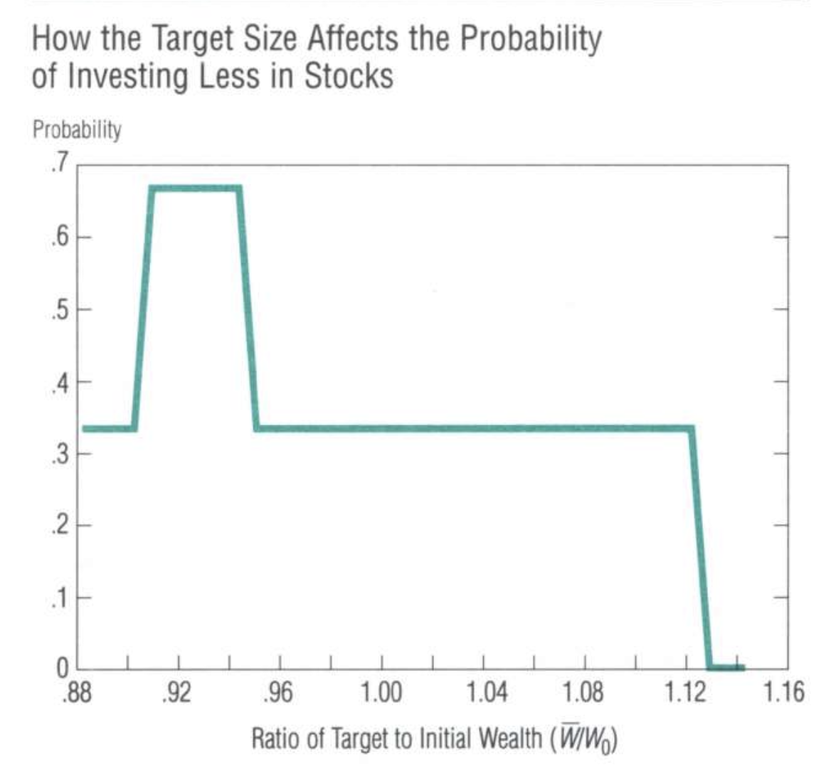
Targeting
Mr Planner’s Argument: Reducing Stocks holdings overtime and saving for wealth target
What if ?
Non-Concave + Discontinuous Grid Search
Short-sales + borrowing Constraints for maximum
Similar Utility function except now ,
, , ,
Two periods problem
Alex Chow & Daryl Larsen
<number>

Slide 13
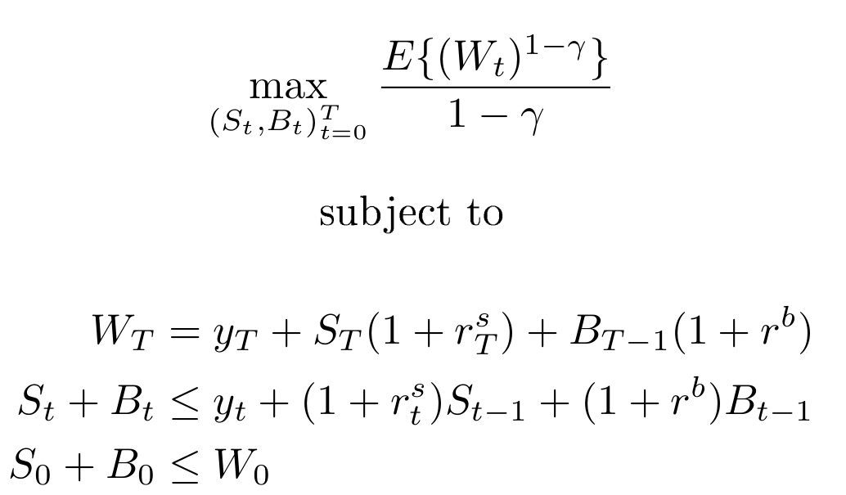
Labour Income
Mr Planner’s Argument: Labour income covers risk from stock holdings
Model households as wage earners that invest in order to maximize the expectation of lifetime utility with constant relative risk aversion
Alex Chow & Daryl Larsen
<number>

Slide 14
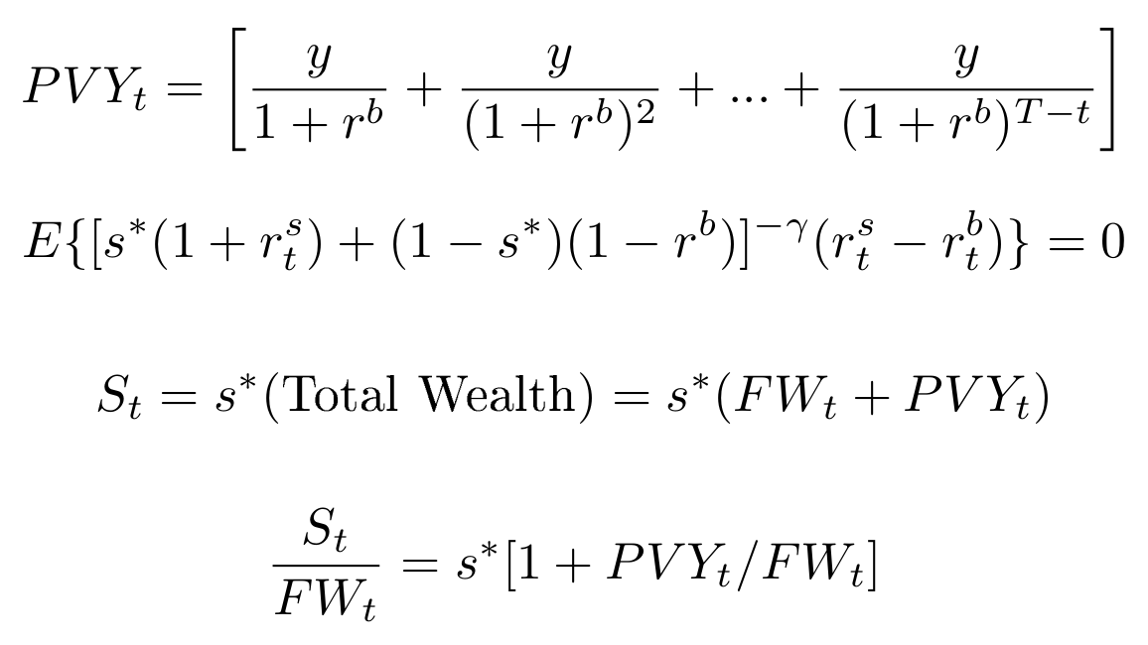
Labour Income
Mr Planner’s Argument: Labour income covers risk from stock holdings
What if wages are constant?
Alex Chow & Daryl Larsen
<number>

Slide 15
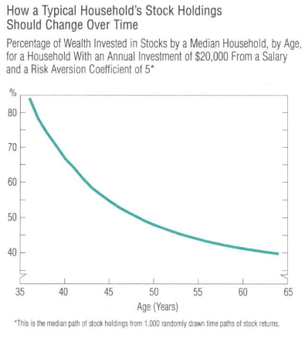
Labour Income
Mr Planner’s Argument: Labour income covers risk from stock holdings
What if wages are constant?
Alex Chow & Daryl Larsen
<number>

Slide 16
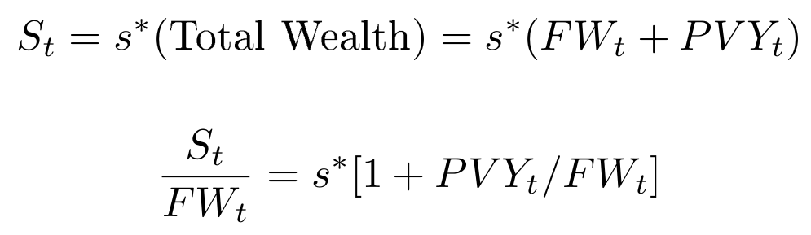
Labour Income
Mr Planner’s Argument: Labour income covers risk from stock holdings
What if wages are highly correlated with stocks?
Alex Chow & Daryl Larsen
<number>

Slide 17
Three common explanations
Only one had merit
Should people shift to bonds as they age?
Conclusion
Alex Chow & Daryl Larsen
<number>

