Slide 1
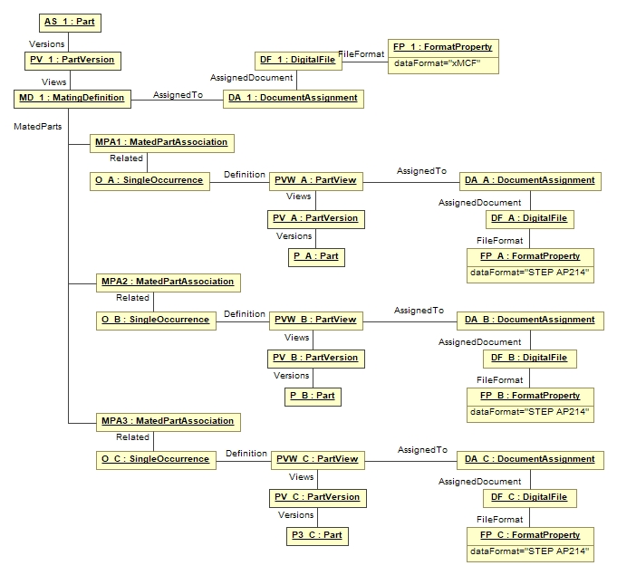
Reference to χMCF file
Reference to STEP file (Geometry of Part A)
Joined Part A
Reference to STEP file (Geometry of Part B)
Joined Part B
Reference to STEP file (Geometry of Part C)
Joined Part C

Slide 2
OLD

Slide 3
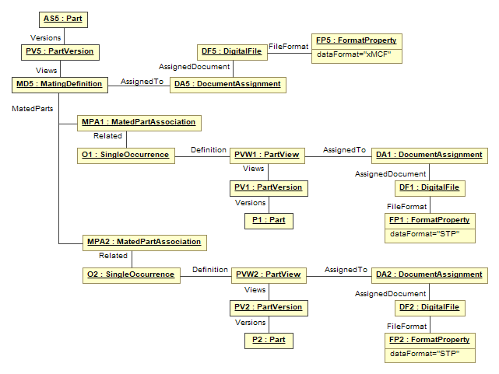
Reference to χMCF file
Reference to STEP file (Geometry of Part 1)
Joined Part 1
Reference to STEP file (Geometry of Part 2)
Joined Part 2

Slide 4
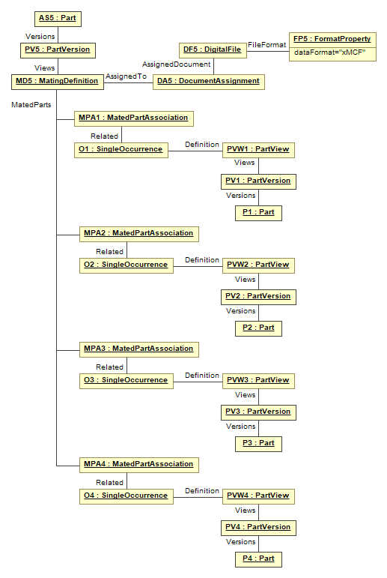
Joined Part 1
Joined Part 2
Joined Part 3
Joined Part 4

Slide 5
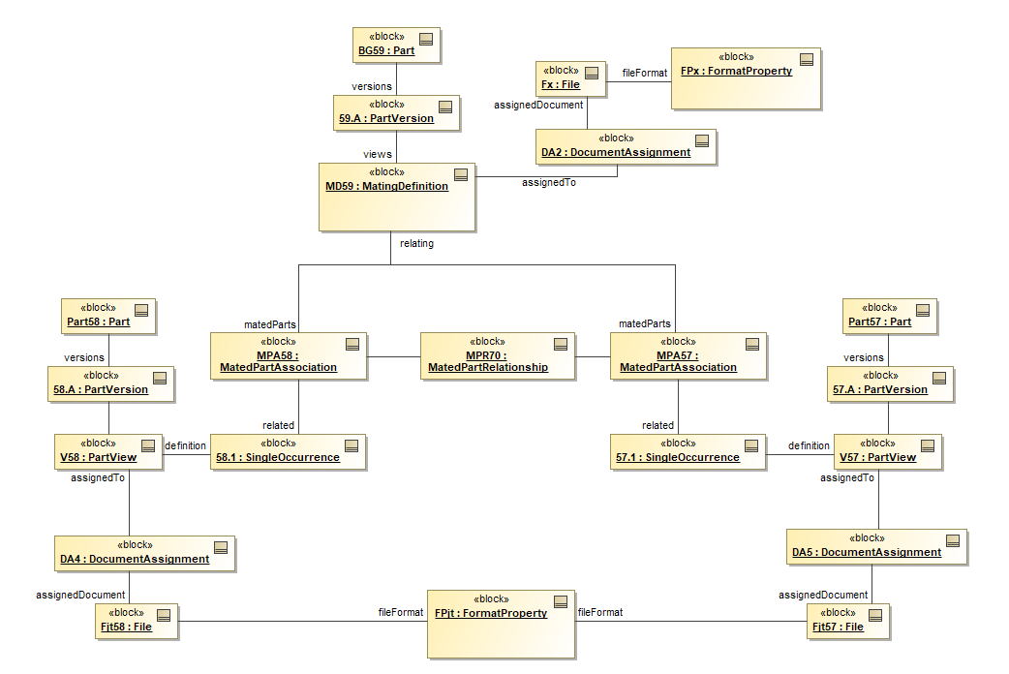
Old
Reference to χMCF file
dataFormat = “xMCF”
Base part
Additional info about the mating
Attached part
Reference to STEP file (Geometry of base part)
dataFormat = “STP”
Reference to STEP file (Geometry of attached part)

