Slide 1
Head Washer
Head Washer
Head Diameter
Head Diameter
Length
Length
Diameter
Diameter
Nut Diameter
Nut Washer

Slide 2
head height
sink size
Length
Flat-head
Countersunk
Oval-head
Countersunk
Round-head

Slide 5
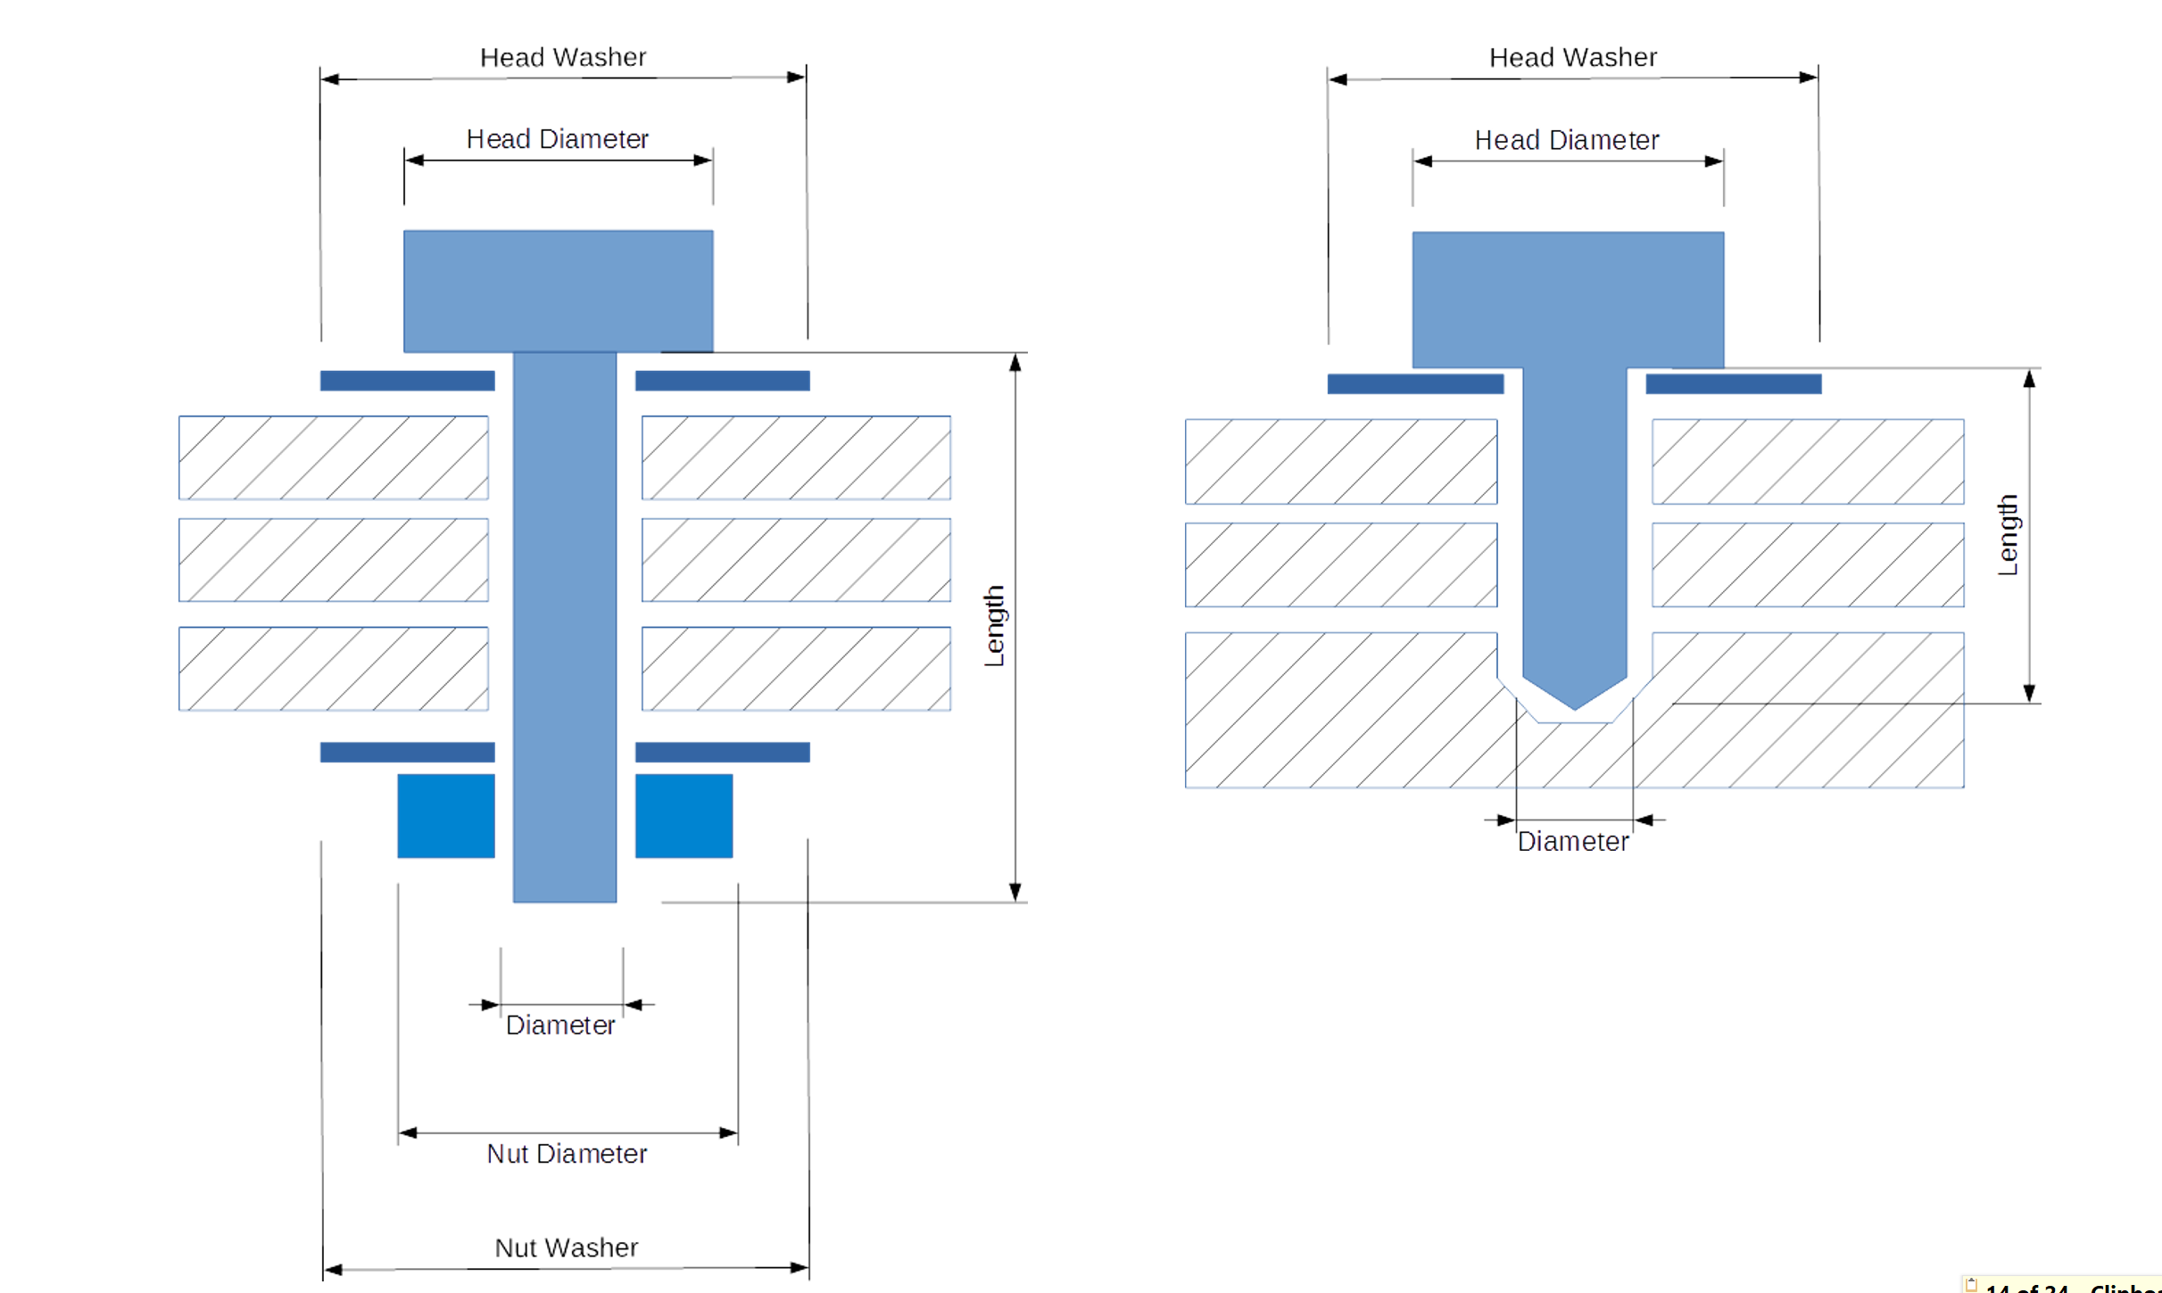

Slide 6
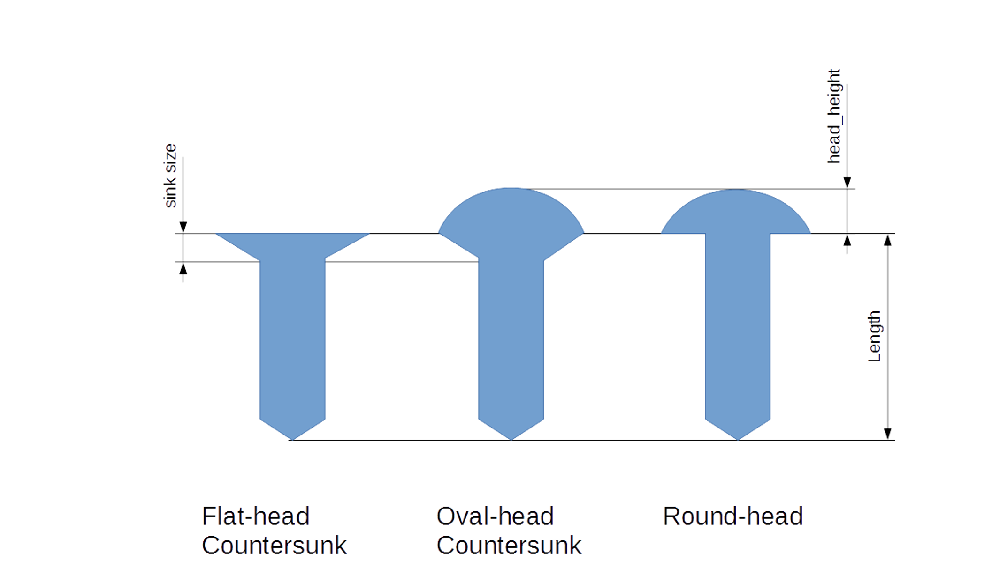

Slide 7

