Slide 1
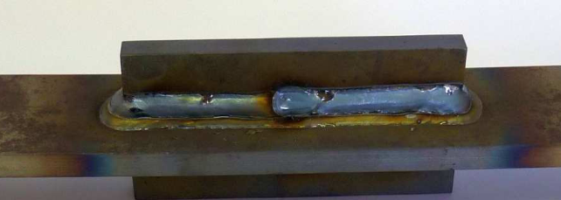
Has been accepted 2022-11-03.
Photo – cannot be revised as such
MW: unchanged

Slide 2
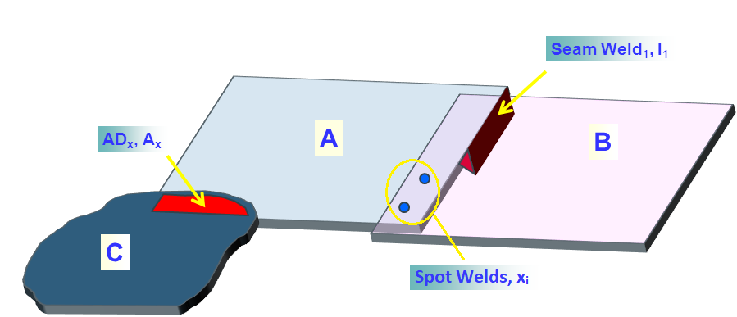
“overlay text” added
Seam Weld₁ , I₁
AD_{x}, A_{x}
A
B
C
Spot Welds, x_{i}
MW: incorporated as object
MW: incorporated

Slide 3
This graphic can be edited: Just double-click it!
MW: unchanged

Slide 4
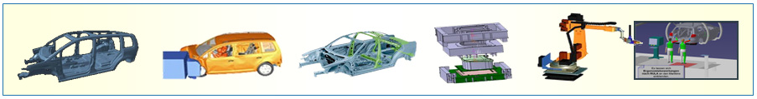
Has been accepted 2022-11-03.
MW: unchanged

Slide 5
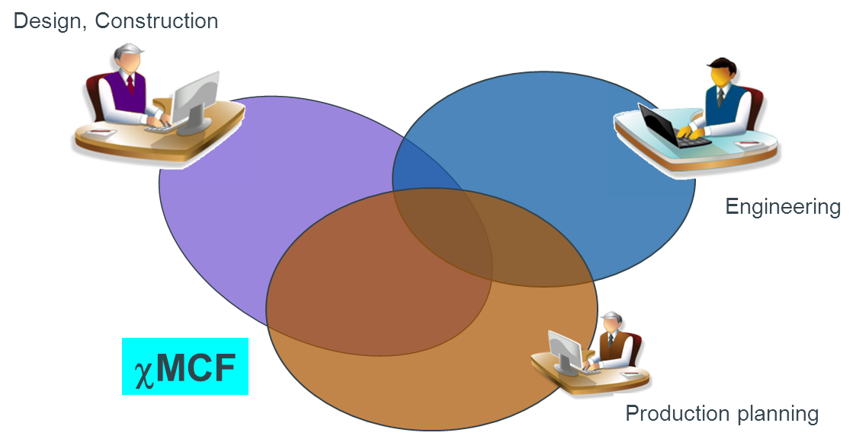
“overlay text” added
_{Design, Construction}
_{Engineering}
_{χMCF}
_{Production Planning}
MW: incorporated as object

Slide 6
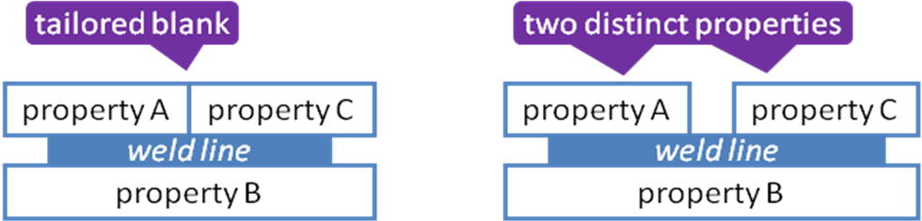
Bitmap substitutable by original PowerPoint-elements.
tailored blank
two distinct properties
two distinct properties
property A
property C
property A
property C
weld line
weld line
property B
property B
MW: incorporated as object (font size reduction to 16 required)

Slide 7
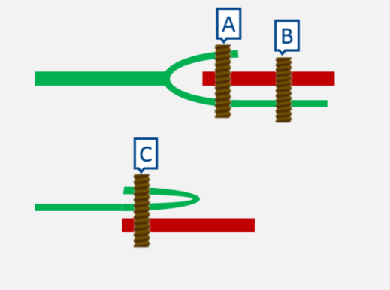
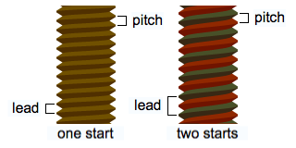
Bitmap substitutable by original PowerPoint-elements.
A
B
A
B
Red & green substituted
C
C
MW: incorporated as object
Notes:
Review 2023-01-25: Red and green to be replaced by black / shades of gray.

Slide 8
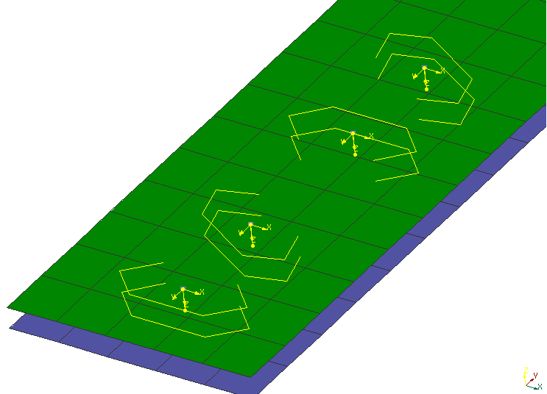
Has been accepted 2022-11-03.
MW: unchanged

Slide 9
Has been accepted 2022-11-03.
dome
large flange
countersunk
MW: incorporated as object

Slide 10
Has been accepted 2022-11-03.
clearance (blind side)
grip
before riveting
after
riveting
application example
MW: incorporated as object

Slide 11
Has been accepted 2022-11-03.
Thin / Thick Assembly
Soft / Hard Assembly
Satisfactory
Good
Soft Part
Good
Poor
Soft Part
Better
MW: incorporated as object

Slide 12
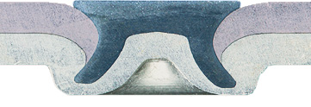
Has been accepted 2022-11-03.
punch
blank holder
rivet head diameter
die
bottom thickness
undercut
rivet diameter
(undeformed)
MW: incorporated as object (font size reduction to 8 required after scaling)

Slide 13
Has been accepted 2022-11-03.
solid rivet
semi tubular rivet
shoulder rivet
split rivet
MW: incorporated as object

Slide 14
Has been accepted 2022-11-03.
head diameter
shoulder
length
shoulder
diameter
length
tennon
diameter
hole depth
tennon
length
hole diameter
MW: incorporated as object

Slide 15
Has been accepted 2022-11-03.
rivet length
grip
min_grip < T1+T2 < max_grip
MW: incorporated as object

Slide 16
insert
spotweld
Notes:
Review 2023-01-25:
Text to be separated from image.
Follow https://www.iso.org/sites/directives/current/part2/index.xhtml example 2: Legend between image and caption.
In the legend, no dash between nr. and text.

Slide 17
Has been accepted 2022-11-03.
Clinched rivet stud (threaded)
clinched ball stud
MW: incorporated as object
Notes:
Review 2023-01-25:
https://www.iso.org/sites/directives/current/part2/index.xhtml
Follow example in “28.3.2 Subfigures“

Slide 18
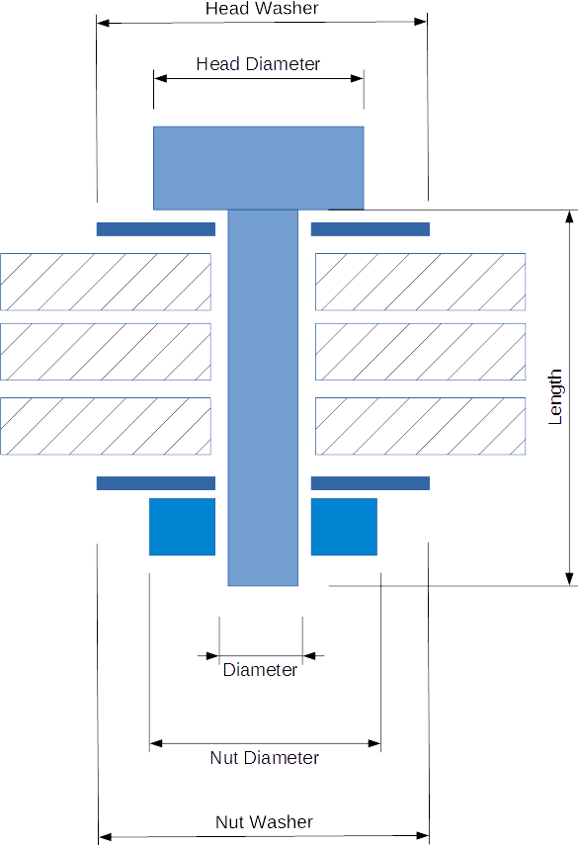
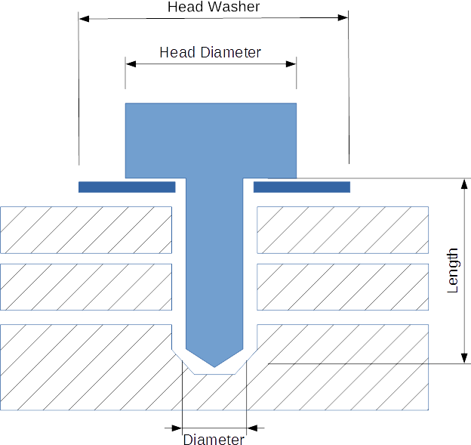
Bitmap substitutable by original PowerPoint-elements.
Head Washer
Head Diameter
Head Washer
Head Diameter
Length
Length
Bolt Representation
Screw Representation
Diameter
MW: incorporated as object (w/ adjustments)
Diameter
Nut Diameter
Nut Washer

Slide 19

“overlay text” added
a
b
c
d
e
f
Button head
Pan head
Round head
Truss head
Countersunk
Countersunk (oval) Raised
MW: incorporated as object (w/ adjustments)
Source: https://en.wikipedia.org/wiki/Screw
Notes:
Source:
<https://en.wikipedia.org/wiki/Screw>, and therein:
<http://upload.wikimedia.org/wikipedia/commons/thumb/6/61/Screw_head_types.svg/400px-Screw_head_types.svg.png>

Slide 20
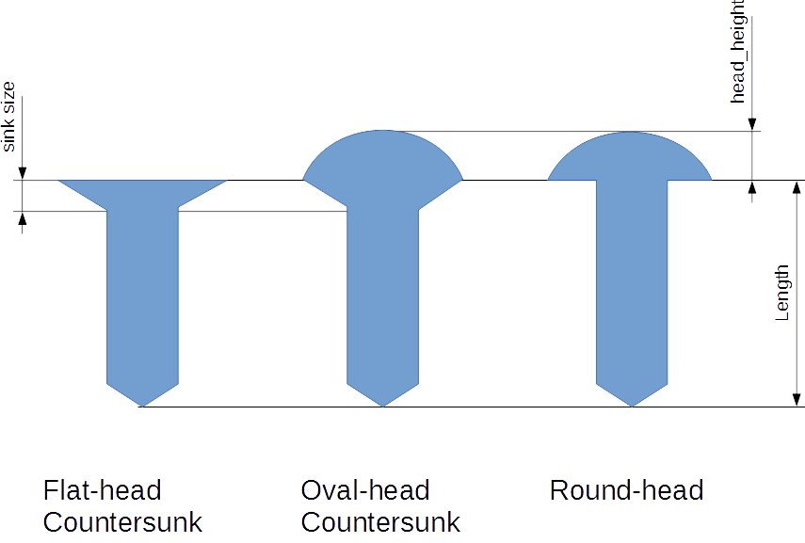
Bitmap substitutable by original PowerPoint-elements.
head height
sink size
Length
Flat-head
Countersunk
Oval-head
Countersunk
Round-head
MW: incorporated as object (w/ adjustments)

Slide 21
“overlay text” added
pitch
pitch
lead
lead
one start
two starts
MW: incorporated as object (w/ adjustments)
Source: https://en.wikipedia.org/wiki/Screw_thread

Slide 22
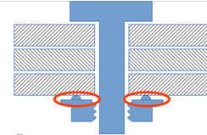
Bitmap substitutable by original PowerPoint-elements.
MW: incorporated as object (w/ adjustments)

Slide 23
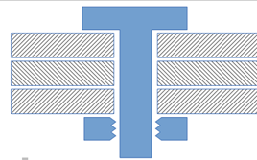
Bitmap substitutable by original PowerPoint-elements.
MW: incorporated as object (w/ adjustments)

Slide 24
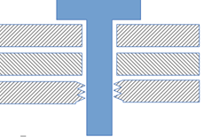
Bitmap substitutable by original PowerPoint-elements.
MW: incorporated as object (w/ adjustments)

Slide 25
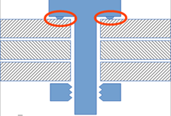
Bitmap substitutable by original PowerPoint-elements.
MW: incorporated as object (w/ adjustments)

Slide 26
Has been accepted 2022-11-03.
MW: unchanged

Slide 27
Has been accepted 2022-11-03.
Placing screw (w/ speed & pressure)
Heating, Forming material
Forming thread & tighten screw
MW: incorporated as object

Slide 28
Has been accepted 2022-11-03.
thread length
t₁
t₂
length
MW: incorporated as object

Slide 29
Has been accepted 2022-11-03.
d_{D}
d_{w}
t₁
t₂
MW: incorporated as object

Slide 30
Has been accepted 2022-11-03.
d_{D}
d_{V}
t₁
t₂
MW: incorporated as object

Slide 31
Has been accepted 2022-11-03.
_{punch side material}
_{neck}
t₁
t₂
_{die side material}
_{Cap thickness}
_{interlock}
_{button diameter}
MW: incorporated as object

Slide 32
Has been accepted 2022-11-03.
_{Punch}
_{Clinch Joint}
_{Fixed Die}
_{Openable Die}
MW: incorporated as object

Slide 33
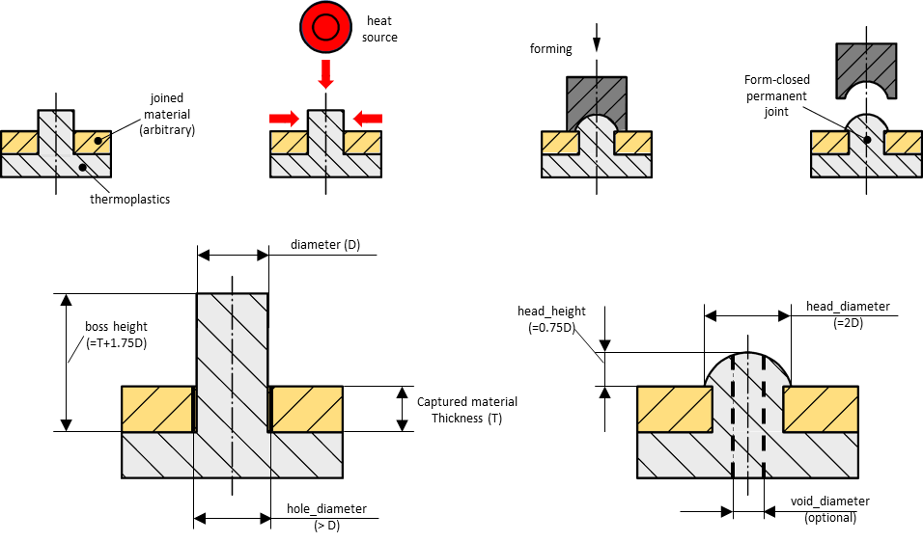
“overlay text” added
heat
source
forming
form-closed
permanent joint
joined
material
(arbitrary)
thermoplastics
Diameter (D)
MW: incorporated as object (w/ adjustments)
head_height
head_diameter
Boss height
(=2D)
Captured Material
Thickness (T)
hole_diameter
void_diameter
(>D)
(optional)

Slide 34
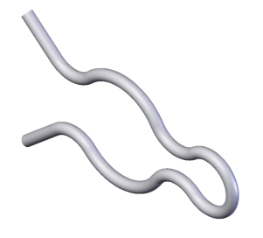
Has been accepted 2022-11-03.
MW: unchanged
Source of image: Wikimedia Commons:
Hairpin clip, https://commons.wikimedia.org/wiki/File:Hairpin_clip.png

Slide 35
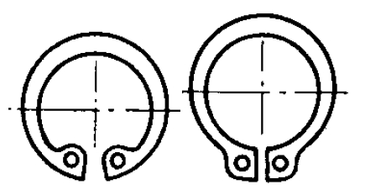
Has been accepted 2022-11-03.
MW: unchanged
Source of images: Wikimedia Commons:
Left, internal circlip: https://commons.wikimedia.org/wiki/File:Circlips_interieur.png
Right, external circlip: https://commons.wikimedia.org/wiki/File:Circlips_exterieur.png

Slide 36
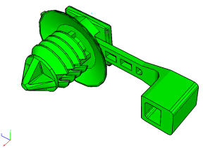
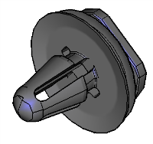
Has been accepted 2022-11-03.
MW: unchanged

Slide 37
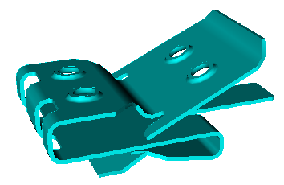
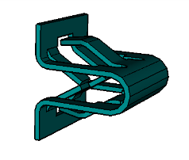
Has been accepted 2022-11-03.
MW: unchanged

Slide 38
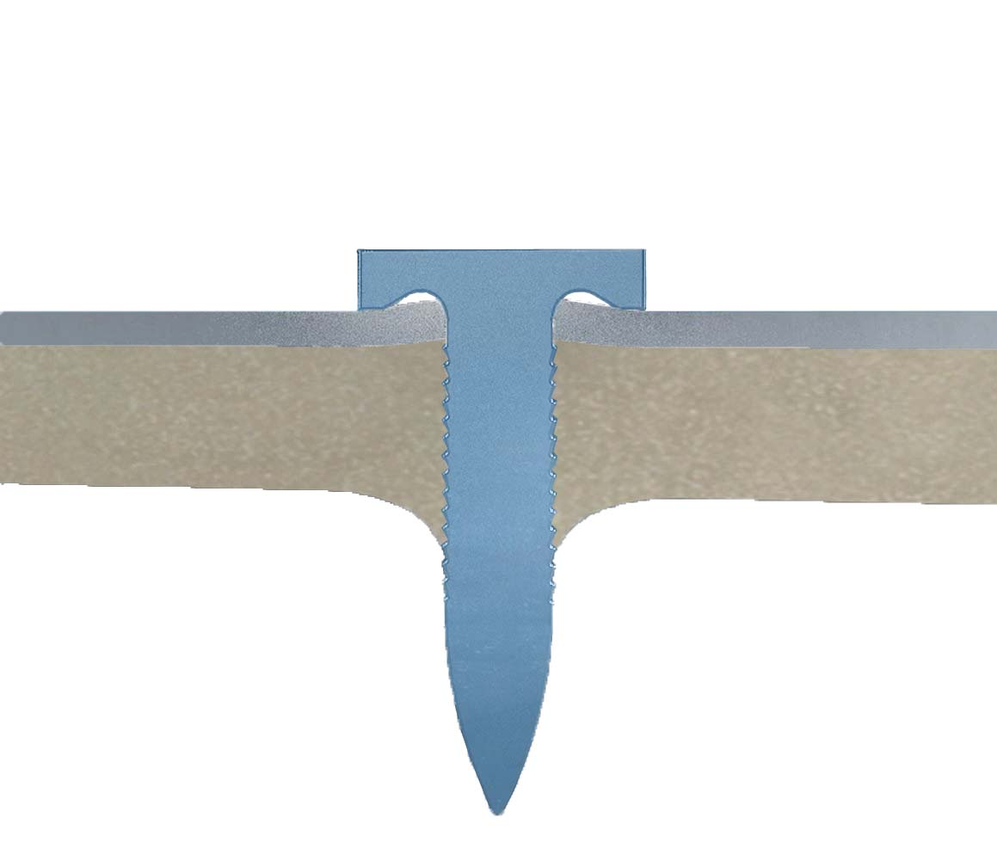
Has been accepted 2022-11-03.
_{punch}
_{blank holder}
_{joined sheet}
MW: incorporated as object (w/ adjustments)
_{base part}
_{nail}

Slide 39
Has been accepted 2022-11-03.
_{head_height}
_{head_diameter}
_{cylinder_length}
_{length}
Examples of different nail types
_{shaft_diameter}
MW: incorporated as object (w/ adjustments)

Slide 40
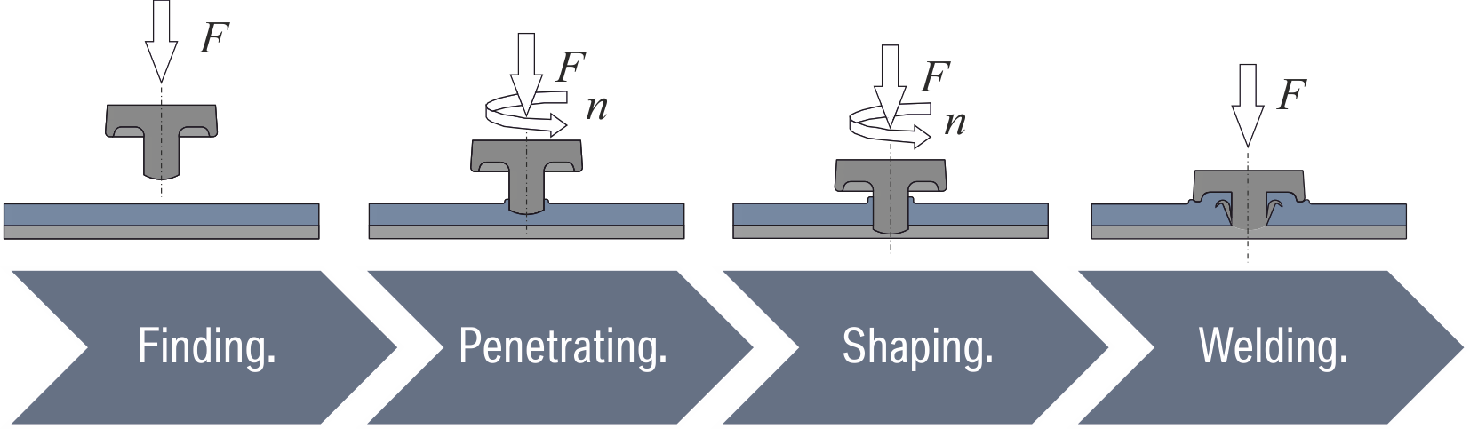
Screenshot
MW: unchanged

Slide 41
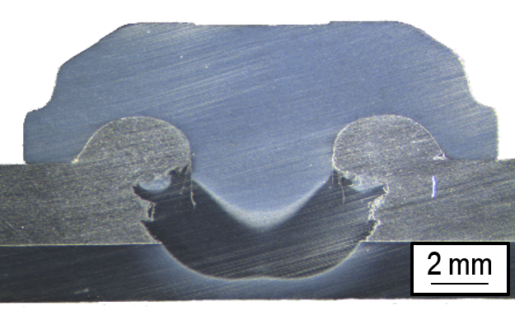
Photo of a physical specimen – cannot be revised as such
MW: unchanged

Slide 42
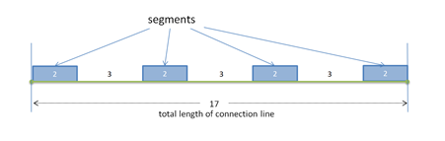
Bitmap substitutable by original PowerPoint-elements.
segments
MW: incorporated as object (w/ adjustments)
2
3
2
3
2
3
2
17
total length of connection line

Slide 43
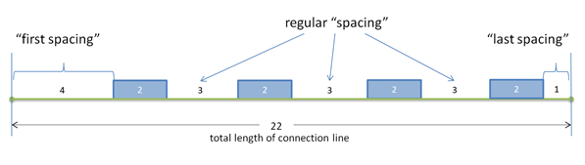
Bitmap substitutable by original PowerPoint-elements.
regular “spacing”
MW: incorporated as object (w/ adjustments)
“first spacing”
“last spacing”
4
2
3
2
3
2
3
2
1
22
total length of connection line

Slide 44
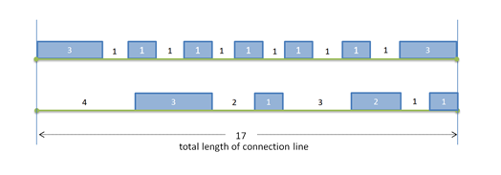
Bitmap substitutable by original PowerPoint-elements.
MW: incorporated as object (w/ adjustments)
3
1
1
1
1
1
1
1
1
1
1
1
3
4
3
2
1
3
2
1
1
17
total length of connection line

Slide 45
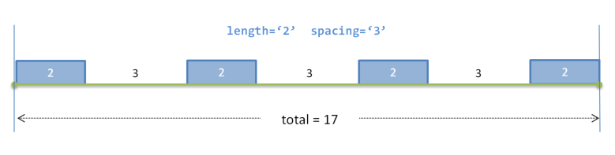
New, 2023-01-24
Bitmap substitutable by original PowerPoint-elements.
length=‘2’ spacing=‘3’
2
3
2
3
2
3
2
total = 17
MW: incorporated as object (w/ adjustments)

Slide 46
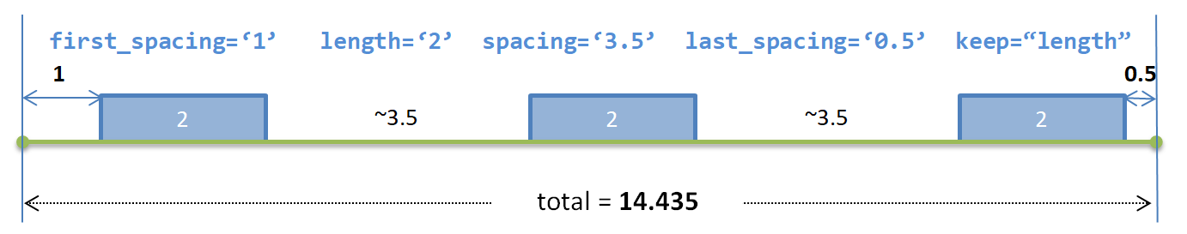
New, 2023-01-24
Bitmap substitutable by original PowerPoint-elements.
first_spacing=‘1’ length=‘2’ spacing=‘3,5’ last_spacing=‘0,5’ keep=“length”
1
0,5
2
~3,5
2
~3,5
2
total = 14,435
MW: incorporated as object (w/ adjustments)

Slide 47
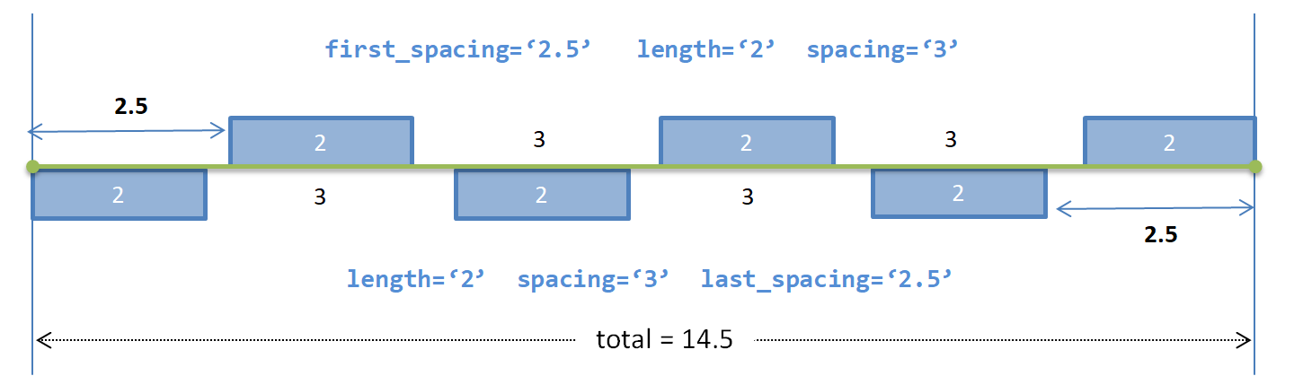
New, 2023-01-24
Bitmap substitutable by original PowerPoint-elements.
first_spacing=‘2,5’ length=‘2’ spacing=‘3’
2,5
2
3
2
3
2
2
3
2
3
2
2,5
length=‘2’ spacing=‘3’ last_spacing=‘2,5’
total = 14,5
MW: incorporated as object (w/ adjustments)

Slide 48
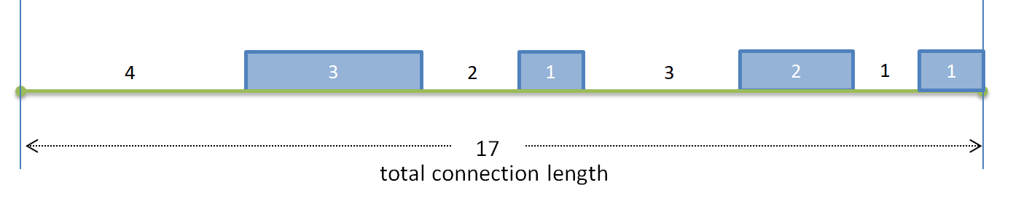
New, 2023-01-24
Bitmap substitutable by original PowerPoint-elements.
4
3
2
1
3
2
1
1
17
total length of connection line
MW: incorporated as object (w/ adjustments)

Slide 49
Bitmap substitutable by original Excel table, embedded in Word
MW: tbd

Slide 50
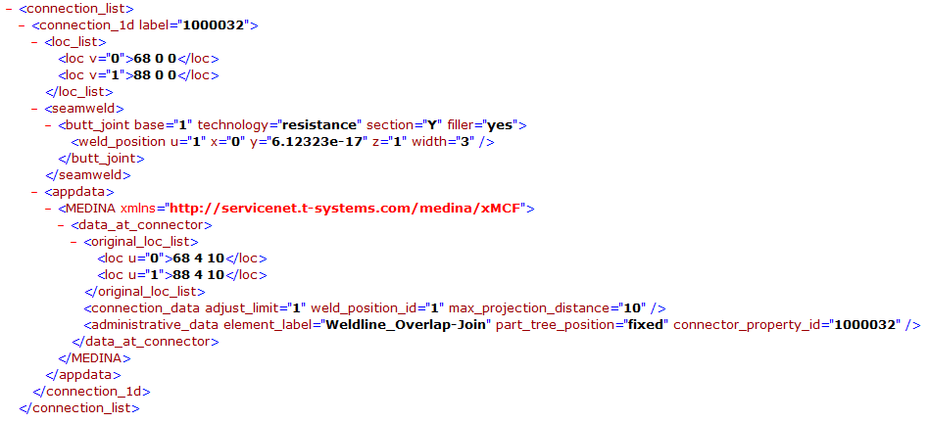
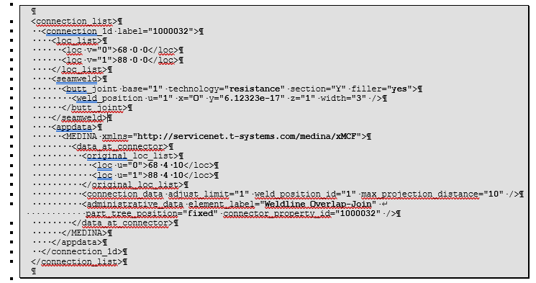
Figure was replaced by text, directly in Word file.
MW: unchanged

Slide 51
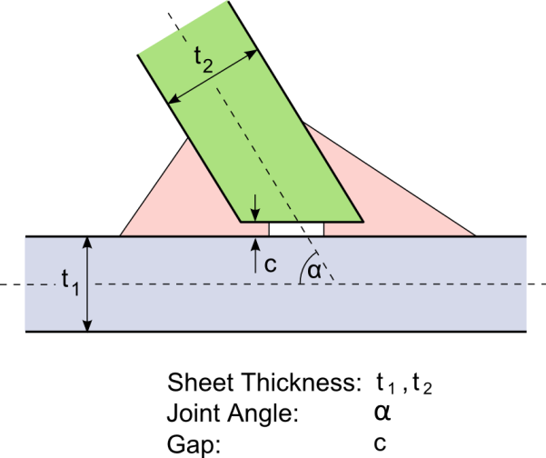
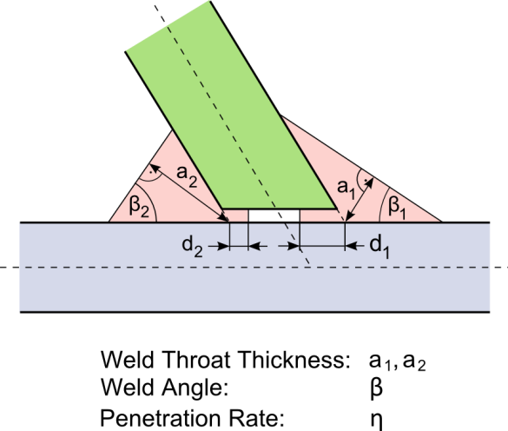
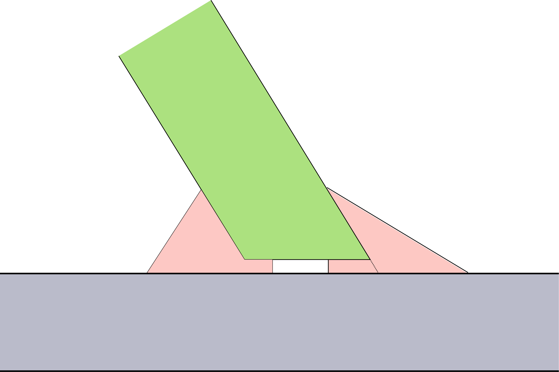
Combined from Fig. 71 with some additional text.
a₂

Slide 52
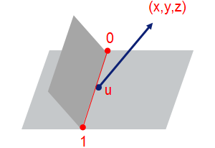
Bitmap substitutable by original PowerPoint-elements.
(x,y,z)
0
u
MW: incorporated as object
1

Slide 53
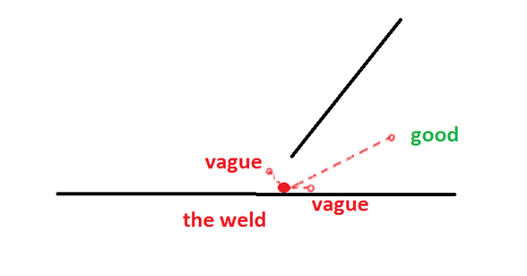
Bitmap substitutable by original PowerPoint-elements.
vague
good
MW: incorporated as object
the weld
vague

Slide 54
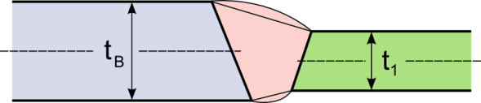
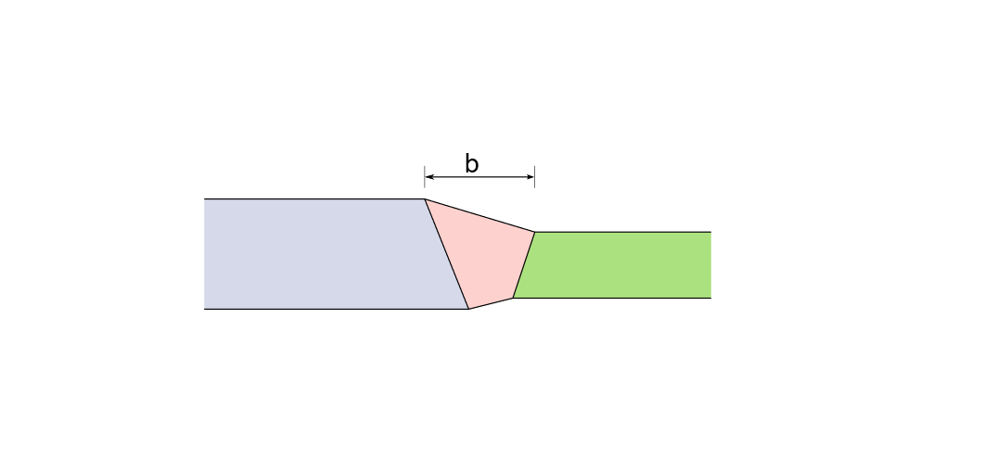

Editable SVG available.
MW: incorporated as object (w/ adjustments, graphical elements plus text overlay)
t_{B}
t₁

Slide 55
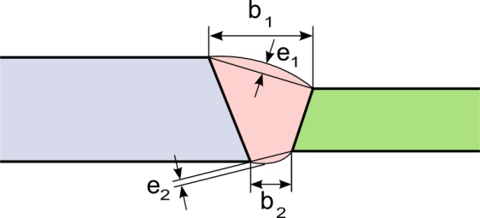

Editable SVG available.
b₁
e₁
e₂
b₂

Slide 56
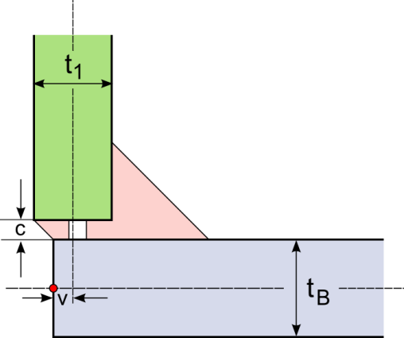
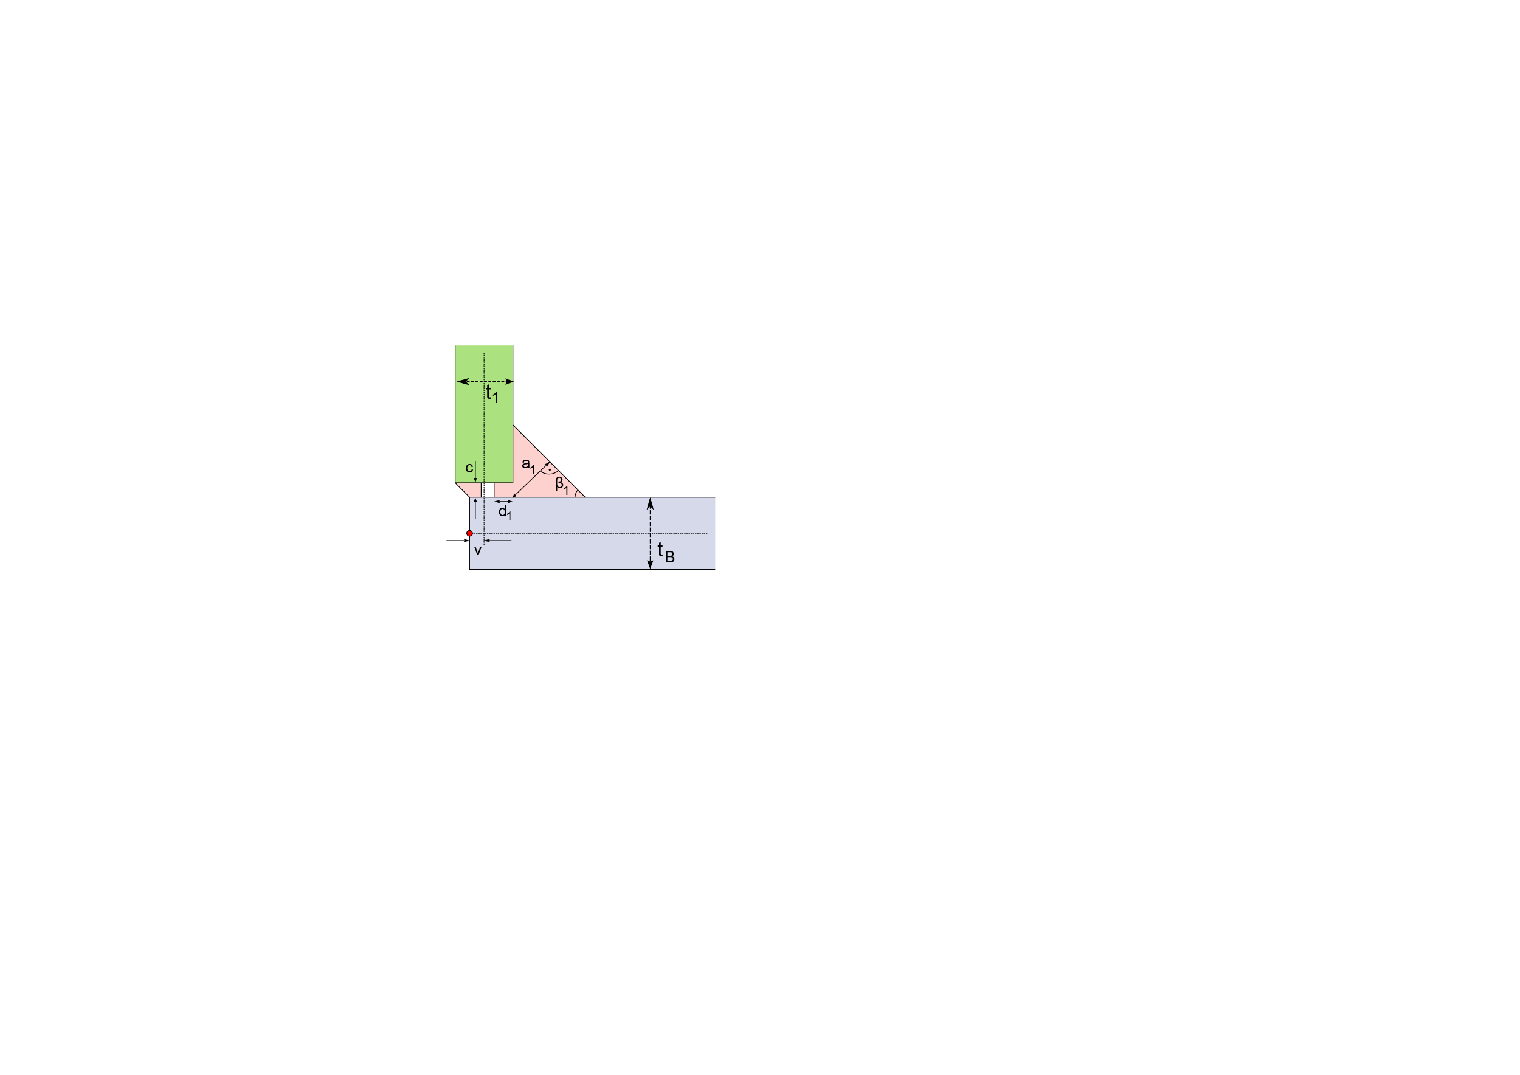
Editable SVG available.

Slide 57
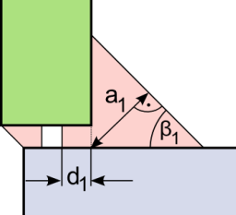
Editable SVG available.

Slide 58
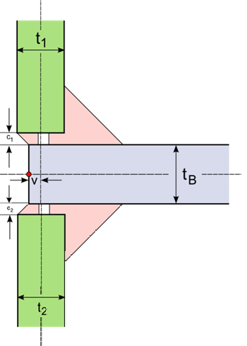
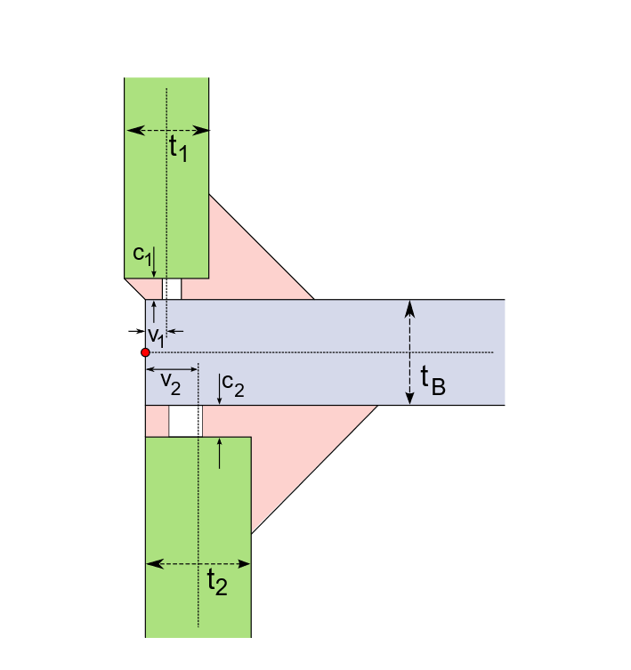
Editable SVG available.

Slide 59
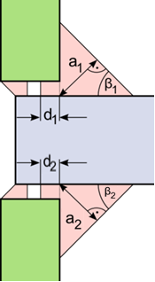
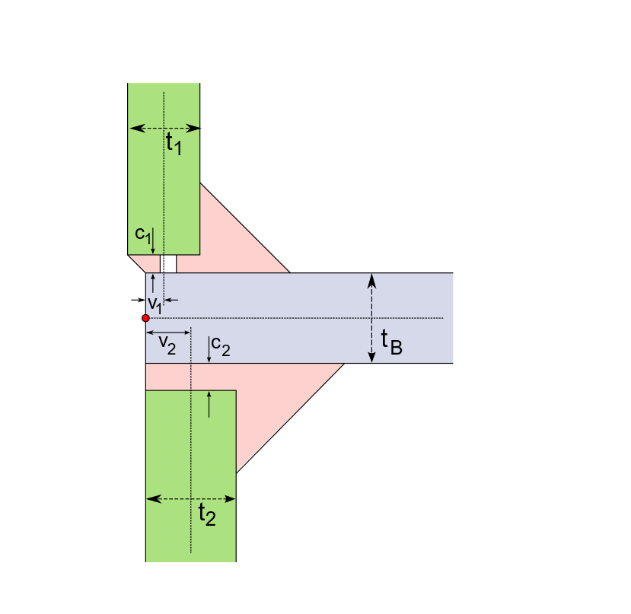
Editable SVGs available.
t
1
c
a
1
β
d
1
1
v
t
B

Slide 60


Editable SVG available.

Slide 61

Editable SVG available.

Slide 62


Editable SVG available.

Slide 63

Editable SVG available.

Slide 64


Editable SVG available.

Slide 65

Editable SVG available.

Slide 66


Editable SVG available.

Slide 67

Combined from Fig. 65/66.

Slide 68


Editable SVG available.

Slide 69


Cut from Fig. 69.

Slide 70


Editable SVG available.
Combined from Fig. 71 with some additional text.

Slide 71



Combined with some additional text.
MW: incorporated as object (w/ adjustments, graphical elements plus text overlay)
t₁
a₁
Cut-out:
β₂
β₁
c
a₂
t₂
α
d₂
d₁
sheet thickness: t_{i} joint angle: α gap: c
weld throat thickness: a_{i} weld angle: β_{i} penetration rate: η

Slide 72


Editable SVG available.

Slide 73

Editable SVG available.

Slide 74

Can be derived from Fig. 71.
Overlay text added
t₁
c₁
t_{B}
α₁
α₂
c₂
t₂

Slide 75

Can be derived from Fig. 71.
Overlay text added
a₂
a₁
β₁
β₂
d₂
d₁
d₄
d₃
β₄
β₃
a₄
a₃

Slide 76

Bitmap substitutable by original PowerPoint-elements.
t₁
c
t_{B}

Slide 77

Bitmap substitutable by original PowerPoint-elements.
b

Slide 78

“overlay text” added
Inner Panel
Adhesive
Region C
Region B
visible from
inside
Outer Panel
Region A
MW: incorporated as object

Slide 79

“overlay text” added
A/mm
A/mm
ADHESIVE
ADHESIVE
MW: incorporated as object

Slide 80

“overlay text” added
CORNER RELIEF NOTCH
CORNER
RELIEF NOTCH
ADHESIVE
ADHESIVE
BOND WIDTH MINIMUM
BOND WIDTH MINIMUM
MW: incorporated as object

Slide 81

“overlay text” added
A/mm
ADHESIVE
BOND WIDTH
REINFORCEMENT
MW: incorporated as object

Slide 82

Bitmap substitutable by original PowerPoint-elements.
10 cm
spacing=“1,0”
1 cm
10 cm
spacing=“1,0”
1 cm
MW: incorporated as object (w/ adjustments i.e. grafics w/ overlay text)

Slide 83

Bitmap substitutable by original PowerPoint-elements.
1,5 cm
1 cm
1,5 cm
10 cm
spacing=“1,0”
margin=“1,5”
1,5 cm
1 cm
1,5 cm
MW: incorporated as object (w/ adjustments i.e. grafics w/ overlay text)

Slide 84

Bitmap substitutable by original PowerPoint-elements.
10 cm
spacing=“1,5”
margin=“1,5”
2,0 cm
1,5 cm
2,0 cm
margin is relaxed
10 cm
spacing=“1,5”
margin=“1,5”
2,0 cm
1,5 cm
2,0 cm
margin is relaxed
MW: incorporated as object (w/ adjustments i.e. grafics w/ overlay text)

Slide 85

Bitmap substitutable by original PowerPoint-elements.
10 cm
spacing=“1,5”
margin=“1,5”
1,5 cm
1,75 cm
1,5 cm
spacing is relaxed
10 cm
spacing=“1,5”
margin=“1,5”
MW: incorporated as object (w/ adjustments i.e. grafics w/ overlay text)
1,5 cm
1,5 cm
spacing is relaxed
1,75 cm
1,75 cm
1,5 cm
1,5 cm

Slide 86

Has been accepted 2022-11-03.
MW: unchanged

Slide 87

“spacing”
“last spacing”
“first spacing”
Bitmap substitutable by original PowerPoint-elements.
total length
“length”
spacing
first_spacing
last_spacing
L_{total}
length
8329_ed1figA1

Slide 88

m_{first}
L
Bitmap substitutable by original PowerPoint-elements.
l
s
l
s
l
s
l
L_{total}
L_{eff}
m_{first}
m_{last}
l
s
l
s
l
s
l
L_{total}
8329_ed1figA2

Slide 89


Editable SVG available.
8329_ed1figB1

