Slide 1
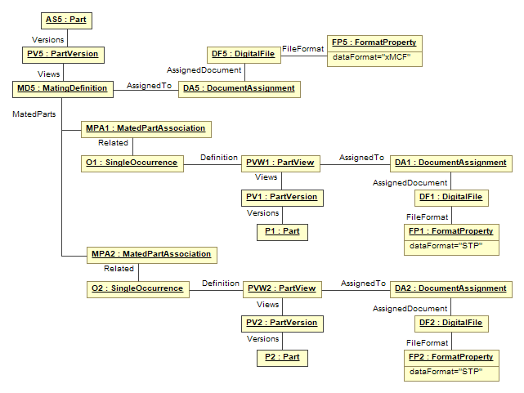
Reference to χMCF file
Reference to STEP file (Geometry of Part 1)
Joined Part 1
Reference to STEP file (Geometry of Part 2)
Joined Part 2

Slide 2
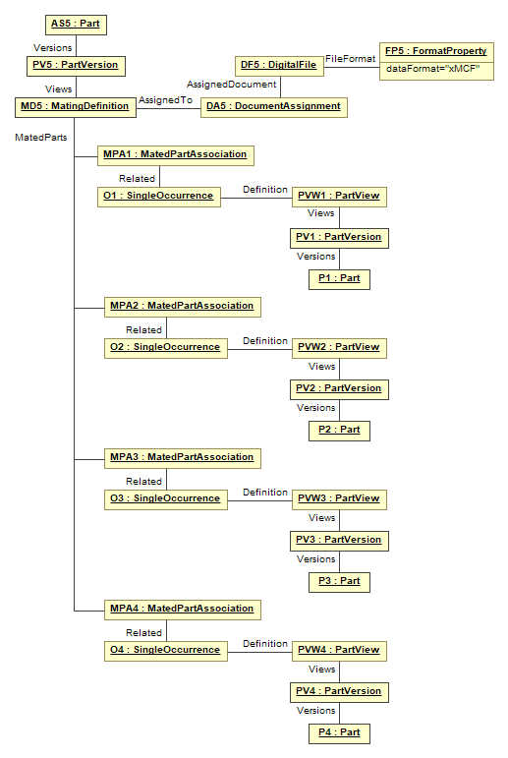
Joined Part 1
Joined Part 2
Joined Part 3
Joined Part 4

Slide 3
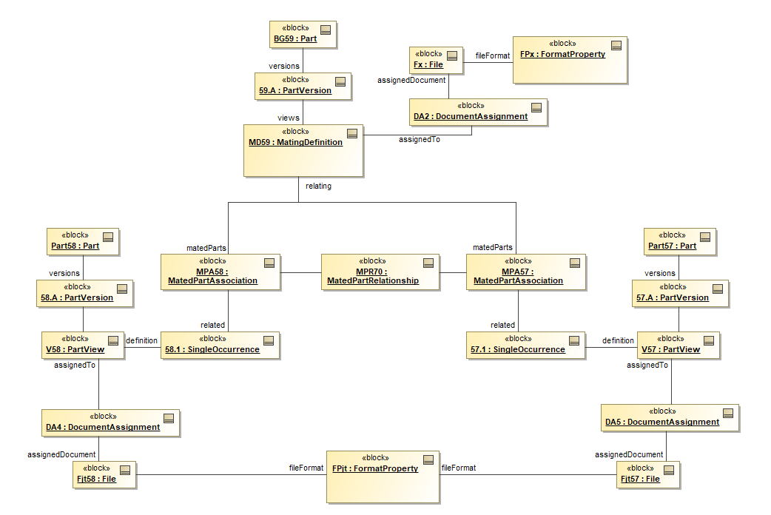
Old
Reference to χMCF file
dataFormat = “xMCF”
Base part
Additional info about the mating
Attached part
Reference to STEP file (Geometry of base part)
dataFormat = “STP”
Reference to STEP file (Geometry of attached part)

