Slide 1
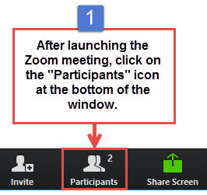
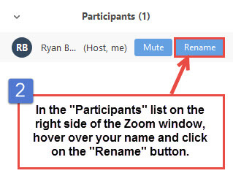
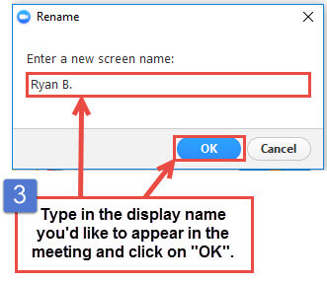
Welcome to ISO/TC 184/SC 4
The meeting will begin shortly.
As a reminder, your microphone is automatically placed on “mute”.
Please consider using your camera when speaking or presenting.
To ask a question, please use the “Chat” feature or raise your hand in ZOOM.
Please take a moment and confirm that we can see your name in the ZOOM Participants window. Follow the instructions to rename yourself.
https://teaching.nmc.edu/knowledgebase/changing-your-name-in-a-zoom-meeting/

Slide 2
TC 184/SC 4 Industrial Data
81st Plenary, VIRTUAL
Opening Session – Revision A
Kenneth Swope Dana Tripp
Chair Committee Manager

Slide 3
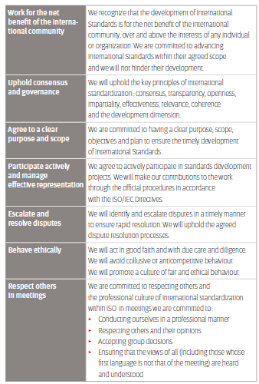

ISO Code of Conduct
https://www.iso.org/publication/PUB100397.html

Slide 4

Welcome Session 81st Plenary TC 184/SC 4: Industrial Data
Agenda
Welcome and Introductions
Virtual meeting information & logistics
Roll Call
Schedule
Meeting Operations
Minutes of last Plenary: N3534
Action Items: N3532
Q&A
Note: PPC Change Board immediately follows on the same call.

Slide 5
ISO/TC 184/SC 4 81st Plenary ZOOM Meeting Information
Join from PC, Mac, Linux, iOS or Android:
https://iso.zoom.us/j/93749144665?pwd=MmRaQU1VYlJvSzF1WWxRZGVXbk0xUT09
Password: 749414
Or iPhone one-tap :
US: +12532158782,,94308549012# or +13462487799,,94308549012# Or Telephone:
Dial(for higher quality, dial a number based on your current location):
US: +1 253 215 8782 or +1 346 248 7799 or +1 408 638 0968 or +1 669 900 6833 or +1 301 715 8592 or +1 312 626 6799 or +1 646 876 9923 or 877 853 5247 (Toll Free)
Meeting ID: 937 49144 665
Password: 74414
International numbers available: https://iso.zoom.us/u/acWpF3PtMX

Slide 6
Welcome to ISO/TC 184/SC 4!
Virtual meeting introductions
We will go through introductions and welcome you to the meeting.
As I call your name, let us hear your voice, let us know your relationship to our meeting (expert, convenor, head of delegation, etc.)

Slide 7
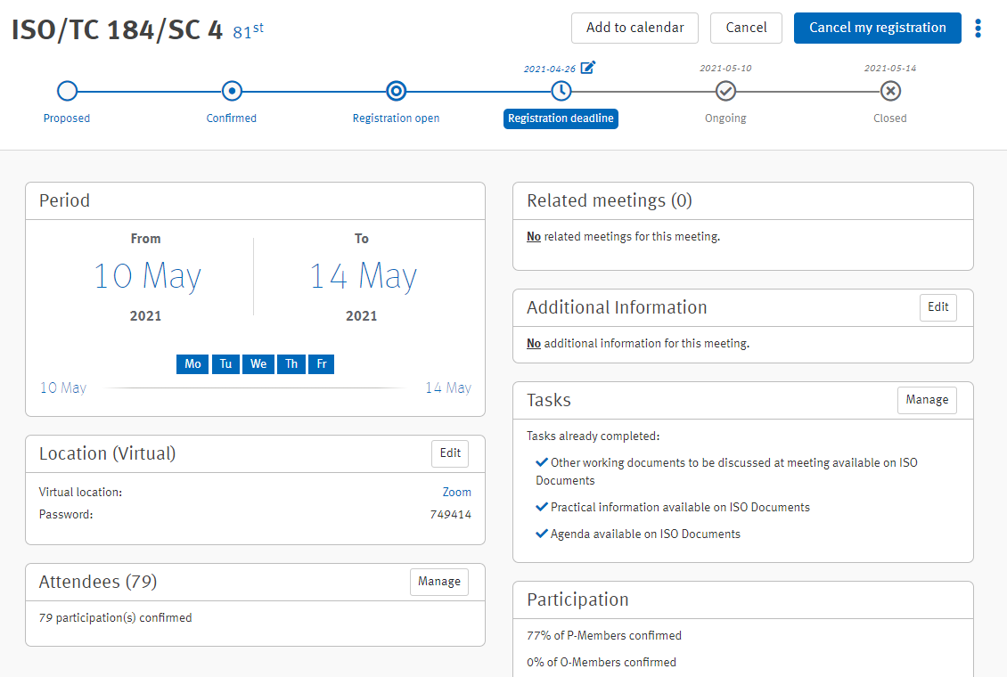
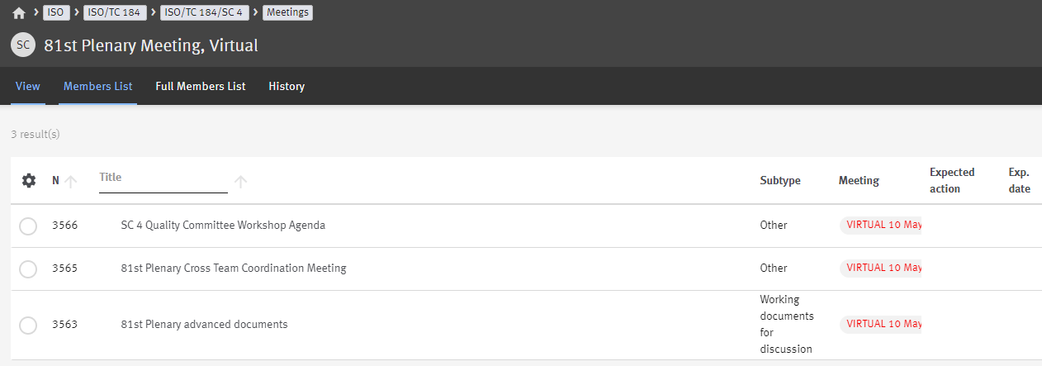
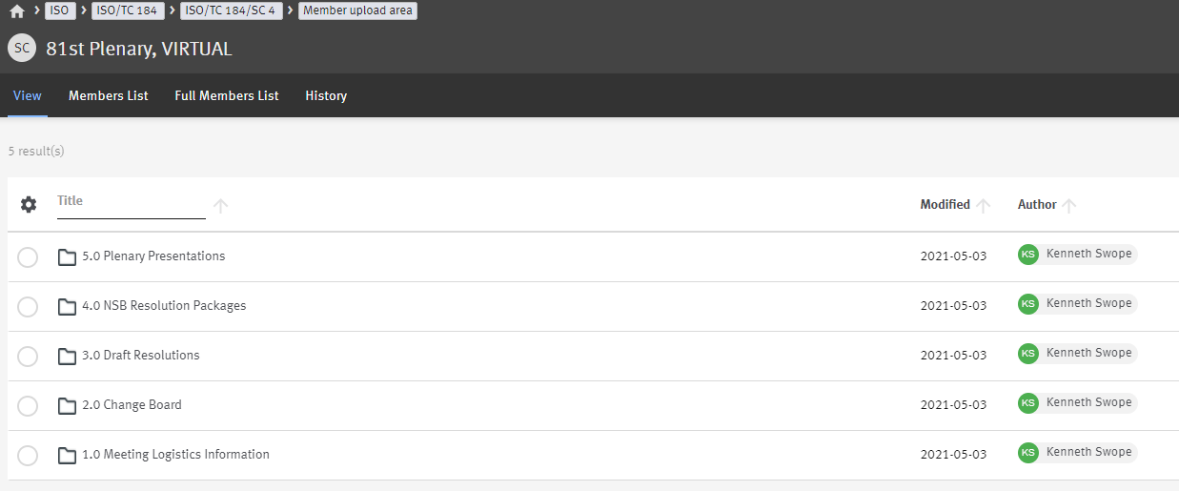
80th Plenary ISO/TC 184/SC 4 Documents & collaboration sources
In order to facilitate the execution of the Working Groups and Plenary meeting, we will be using the following:
Meeting Portal
ISO Meeting registrations
Will be used to confirm HoD’s for Resolutions
ISO Docs
Meeting publication portal for Ndocs
Member Upload Area

Slide 8
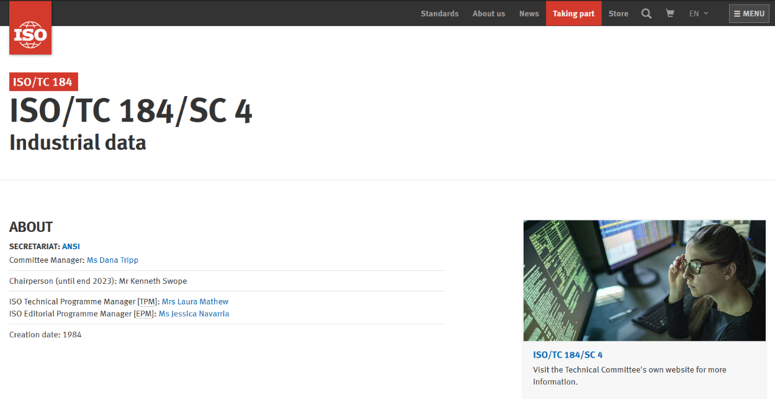


81st Plenary ISO/TC 184/SC 4 Committee Website & LinkedIn
https://committee.iso.org/home/tc184sc4
https://www.linkedin.com/company/iso-tc-184-sc-4-standards-for-industrial-data/

Slide 9
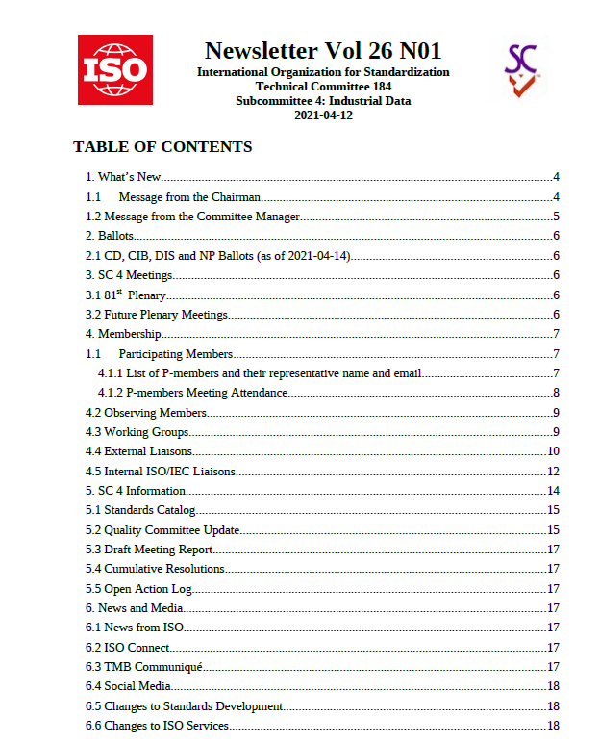
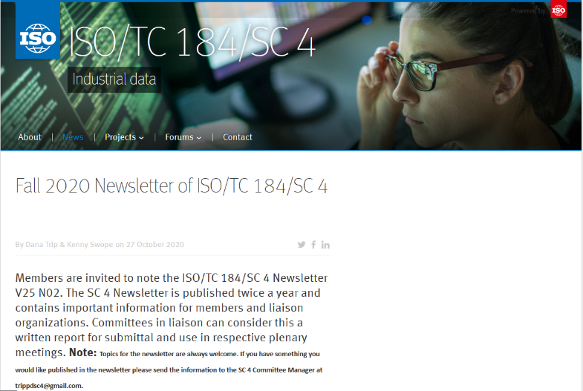
Plenary ISO/TC 184/SC 4 Newsletter
Check out our Newsletter!
Published twice a year and available in the SC4 Public Folder
https://isotc.iso.org/livelink/livelink/open/21187738
It is also available on our website!
https://committee.iso.org/sites/tc184sc4/home/

Slide 10


ISO/TC 184/SC 4: Industrial Data
SCOPE:
Standardization of the content, meaning, structure, representation and quality management of the information required to define an engineered product and its characteristics at any required level of detail at any part of its lifecycle from conception through disposal, together with the interfaces required to deliver and collect the information necessary to support any business or technical process or service related to that engineered product during its lifecycle.
Note: Lifecycle includes recursive recycling to a terminal state.
774
Published ISO Standards
37
ISO Standards under development
9
Direct Working Groups
3
Joint Working Groups
5
Internal Committees
18
Participating members
25
Liaison Committees to SC 4
14
Observing members
30
Liaison Committees from SC 4
Chair: Kenneth Swope
Committee Manager: Dana Tripp
28
Organizations in Liaison
27
Standards

Slide 11
81st Plenary ISO/TC 184/SC 4 P Members (18)
Org | Country | NSB Administrator | Email | HoD (10 May)
AFNOR | France | Colombier, Alexandre | alexandre.colombier@afnor.org | M. Christophe Mouton
ANSI | United States | Koshy, Sheron | koshy@eccma.org | Ms. Allison Barnard Feeney
BSI | United Kingdom | Channe, Jasnam | jasnam.channe@bsigroup.com | Dr. Tim King
DIN | Germany | Gröpper, Meinolf | meinolf.groepper@vdma.org | Mr. Dr.-Ing. Max Ungerer
GOST R | Russian Federation | Yakimov, Oleg | oyakimov@gost.ru
JISC | Japan | Ohtaka, Akihiko | akihiko.ohtaka@gmail.com | Mr. Atsuto Soma
KATS | Korea, Republic of | Oh, Kwanghae | jungbo@kats.go.kr | Mr. Soonhung Han
NSAI | Ireland | Aran, Sean | standards@nsai.ie | Mr. Barry Cox
NEN | Netherlands | van Rijsinge, Paul | paul.vanrijsinge@nen.nl | Paul van Exel
SABS | South Africa | Maheya, Mmakgabo | mmakgabo.maheya@sabs.co.za | Dr. Salomon de Jager
SAC | China | Hong, Yan | hongy@cnis.ac.cn | Mr. Yan Hong
SCC | Canada | Williams, Ester | ester.williams@scc.ca | Mr. Cliff Pedersen
SFS | Finland | Nilsén, Dr. Frans | frans.nilsen@metsta.fi | Dr. Frans Nilsén
SIS | Sweden | Rabiei, Babak | Babak.Rabiei@sis.se | Mr. Jonas Rosén
SN | Norway | Aune, Knut | kau@standard.no | Mr. Jochen Haenisch
SNV | Switzerland | Meister, Helena | helena.meister@snv.ch
UNE | Spain | Jorquera, Jose | jjorquera@une.org
UNI | Italy | Carnevale, Helen | Carnevale@uninifo.it | Mr. Mario Tucci
79 Delegates registered

Slide 12
81st Plenary ISO/TC 184/SC 4 ISO/TC 184/SC 4 Team
*Appointment Expires
TC 184/ SC 4 | Title | Convenor | Deputy
AG 00 | Change management advisory group | Kenneth Swope | Vacant
AG 02 | Implementation Forum | Paul van Exel* | Martin Hardwick*
PPC | Policy & planning committee | Kenneth Swope | Meinolf Gröpper (Secretary)
QC | Quality committee | Véronique Dubillot | Changsoo Lee* Melissa Harvey (Secretary)
TF 01 | ISO 10303 SMRL architecture innovation | Brandon Sapp | N/A
TF 02 | SC 4 reference model for industrial data | Jean Brangé | N/A
WG 3 | Oil, gas, process, and power | Paul van Exel | Nils Sandsmark
WG 8 (Standby) | Manufacturing process and management information TC 184/SC4 – TC 184/SC5 | Anne-Françoise Cutting-Decelle* | Vacant
WG 11 | Implementation methods and conformance | David Loffredo | Vacant
WG 12 | STEP product modeling and resources | Keith Hunten* | Jochen Haenisch
WG 13 | Industrial data quality | Tim King* | Anne Dourgnon
WG 15 | Digital manufacturing | Martin Hardwick | Bengt Olsson
JWG 16 | Formats for visualization and other derived forms of product data TC 184/SC 4 – TC 171/SC 2 – JTC 1/SC 24 | Soonhung Han* | Christophe Mouton*
WG 21 | SMRL validation team | Keith Hunten | Jochen Haenisch
WG 22 | Reference data validation team | Nils Sandsmark | Paul Van Exel
WG 23 | Vocabulary validation team | Tim King | Hayley Thompson
JWG 24 | Product Properties and classes and their identification | Hiroshi Murayama* (ISO Co-Convenor) | Gernot Rossi (IEC Co-Convenor)
AhG 01 | Core Industrial data set of terms | Nils Sandsmark | N/A
AhG 02 | Nuclear digital ecosystem specification | Christophe Mouton | N/A

Slide 13
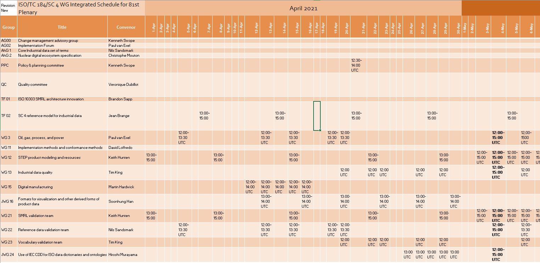
81st Plenary ISO/TC 184/SC 4 Plenary at a Glance
Plenary week uncoupled from WG meetings; WG’s met earlier to complete tasks.
Meeting 12:00 UTC – 14:00 UTC
Deferred agenda items due to COVID 19
Opening Technical Plenary
Open Technical Forum
Industry Day
Implementers Forum
Change Board normally scheduled
Joint meeting of SC 4 WG’s held 4 May with for collaboration & integration
Resolutions to be reviewed and finalized on 14 May

Slide 15
ISO/TC 184/SC 4 81st Plenary Virtual Meeting Operations
For Working Groups
For Delegations
This year, the closing technical plenary and business meeting will be combined
Convenors must attend full session
Last day resolutions and briefing packages are due to Committee Manager by 14:00 UTC Monday
PPC will review packages and distribute to NSB’s by 15:30 UTC 11 May (to include convenors)
Proposed resolutions will be provided and briefed as part of Convenor report out.
Each Convenor will be given time to report and support any resolutions proposed
WG 12/21, WG 13/23, & WG 3/22 count as one
The Head of Delegation will have the NSB authority for the meeting, as normal
NSB’s will receive briefing packages and proposed resolutions by 1530 UTC Tuesday; have until 1200 UTC Friday for NSB meetings
Attendance will be required for all sessions
Resolutions to be briefed in line with the technical content
Resolutions will decided on Friday during a final review
HoDs are named in the ISO meeting portal or notified in writing to Chair and CM

Slide 16
81st Plenary ISO/TC 184/SC 4 Virtual Plenary Meeting Etiquette
This plenary will operate consistent with the previous virtual meetings held in 2020. Both technical review and business meeting will be combined in one agenda.
Chair facilitates the discussion and the flow of the meeting. Committee Manager monitors the online chat, requests and decisions of the Committee.
Briefings are for information sharing in order to update delegations. Heads of Delegation vote on resolutions and Chair facilitates discussion.
There is not enough time to have extended technical discussions. Chair will exercise judgement in length of discussion prior to suggesting next steps. Please respect the process.
Seek to understand before being understood. Speak clearly and slowly. Audio quality varies widely around the world.
Utilize ZOOM tools (raised hands, yes/no, etc.) for being recognized.
Manage expectations. Assume positive intent. Be Patient!

Slide 17
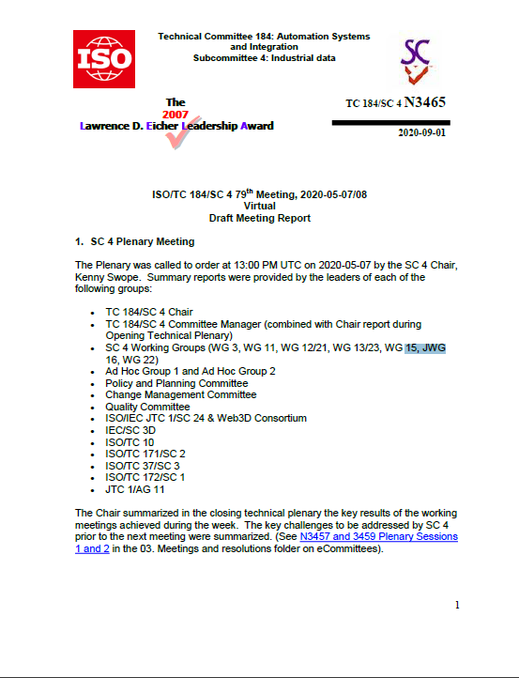
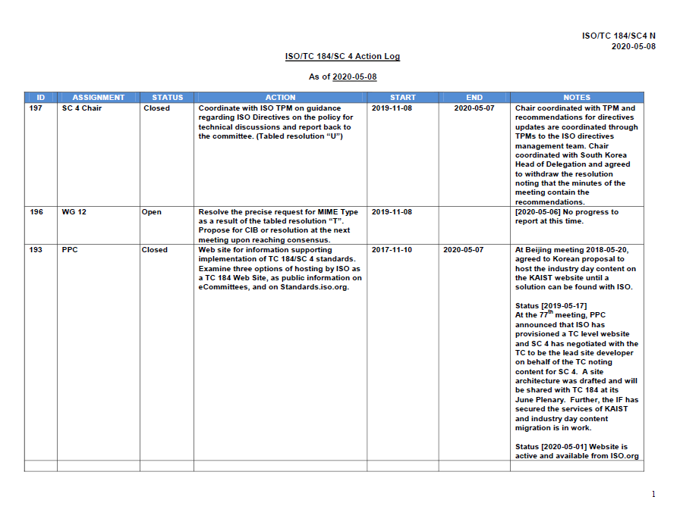
81st Plenary ISO/TC 184/SC 4 Minutes of 80th Plenary and Action Items

Slide 18

ISO/TC 184/SC 4
International Organization for Standardization
ISO Central Secretariat Chemin de Blandonnet 8 Case Postale 401
CH – 1214 Vernier, Geneva
Switzerland
iso.org
© ISO, 2021
All rights reserved ISBN 978-92-67-10648-9
Contact Information
Chair: Kenneth Swope Kenneth.a.swope@boeing.com
Secretariat: Dana Tripp trippdsc4@gmail.com
TPM: Laura Mathew Mathew@iso.org
EPM: Bastien Gavoille gavoille@iso.org

