Slide 1
Using Schematron to check XML documents
Introduction to χMCF Team
(Kevin Le Tutour, AFNeT Services)

Slide 2
Agenda
Using Schematron to check XML documents
Schematron
STEP AP242
χMCF
Comparison with XSD:assert

Slide 3



Schematron
Introduction
Schematron tool
Schematron
Rules
The rules (your constraints)
human-readable report
XML data
Report (text, html, …)
User

Slide 4
Schematron
Introduction
SCH rule
<sch:schema>
<sch:pattern>
<sch:rule context="quantity">
<sch:assert test=". > 0">
An order item must have a quantity of at least 1.
</sch:assert>
</sch:rule>
</sch:pattern>
</sch:schema>
XML data
<order id="101">
<item>
<name>Wireless Mouse</name>
<quantity>0</quantity>
<price>25.00</price>
</item>
</order>
Text report
Validation Error
Location: /order/item/quantity
Message: An order item must have a quantity of at least 1.
Value found: 0

Slide 5
Schematron
Introduction
The objective is to automatically verify XML documents against rules not covered by XSD language
Schematron is an XML rule-based validation language
The Schematron defines XPATH assertions on the structure and content of an XML document, that cannot be verified by an XSD check
If the assertion fails, diagnostic messages are reported
Schematron is an international standard: ISO/IEC 19757-3:2020
Schematron rules does not replace XSD validation but extend it with more constraint
A tool is required to
Execute Schematron rules files on XML files
Run XSL transformations (provided by the standard)
Display the messages
Text or HTML or other types of reports

Slide 6
Schematron
The language
<?xml version="1.0"?>
<sch:schema xmlns:sch="http://purl.oclc.org/dsdl/schematron" title="Rules for [type] documents">
<sch:pattern name="[your name]">
<sch:rule context="[your XPATH or XSLT pattern]"> <!-- Rules matchings an element in your document -->
<sch:let name=”variable" value=”[XPATH]" /> <!– Setup variable to use it in other XPATH or message -->
<sch:report test="[your XPATH test (assertion)]"> <!-- Reported as an info if test is true -->
[your message]
</sch:report>
<sch:assert test="[your XPATH test]"> <!– Failed assertions are reported as errors -->
[your message … <sch:value-of select= ="[XPath]”/> ...] <!– Your can use functions in the message -->
</sch:assert>
<!-- Add more <sch:report> or <sch:assert>... -->
</sch:rule>
<!--Add more <sch:rule> ... -->
</sch:pattern>
<!-- Add more <sch:pattern> ... -->
</sch:schema>
Source: dev.pageseeder.com

Slide 7
Schematron
Example of AP242 PDM-IF rule
<sch:pattern id="Template_Document-DocumentType">
<sch:rule context="DataContainer/Document">
<sch:let name="doc" value="Name/CharacterString/text()" />
<sch:let name="dtype" value="lower-case(DocumentTypes/ClassString/text())" />
<sch:assert
test="matches($dtype,'catalogue’)
or matches($dtype,'manual’)
or matches($dtype,'specification’)
or matches($dtype,'primary geometry’)
or matches($dtype,'secondary geometry’)
or matches($dtype,'nc data’)
or matches($dtype,'fe data’)
or matches($dtype,'sample data’)
or matches($dtype,'process plan’)
or matches($dtype,'check plan’)
or matches($dtype,'drawing’)
or matches($dtype,'structured product data')">
The document type of '<sch:value-of select="$doc" />' is '<sch:value-of select="$dtype" />' which is not one of the following: catalogue, manual, specification, primary geometry, secondary geometry, nc data, fe data, sample data, process plan, check plan, drawing, structured product data.
</sch:assert>
<sch:report test="not(DocumentTypes/ClassString) and not(DocumentTypes/Class)">
The document type of '<sch:value-of select="$doc" />' is not a ClassString, and there is no reference to a Class.
</sch:report>
</sch:rule>
</sch:pattern>

Slide 8
Schematron
Example of AP242 PDM-IF rule
<sch:pattern id="002_Template_Identifier"> <!-- 4.6.6 RP PDM-IF PAS – Template Identifier -->
<sch:rule context="//Id/Identifier">
<sch:let name="id" value="@id"/>
<sch:let name="role" value="@idRoleRef"/>
<sch:let name="context" value="@idContextRef"/>
<sch:let name="class" value="//Class[@uid = $role]/Id/@id"/>
<sch:assert test="count(//Id/Identifier[@id=$id and @idRoleRef=$role and @idContextRef=$context]) = 1">
The trio identifier/role/context is not unique for id '<sch:value-of select="$id"/>', role <sch:value-of select="$role"/>', and context '<sch:value-of select="$context"/>’.
</sch:assert>
<sch:assert test="matches($role,'identification information') or matches($role,'exchange identification information') or matches($class,'identification information') or matches($class,'exchange identification information')">
The idRoleRef should be 'identification information' or 'exchange identification information' or a uidRef reference to a Class which declared Id.id attribute as the idRoleRef.
</sch:assert>
<sch:assert test="not(../@id and ../Id/Identifier/@id)">The identifiers are mixed.</sch:assert>
<sch:assert test="not(../Id/@id = $id)">It is not recommended to duplicate the identification in the Id.id attribute and in the Identifier.id attribute.
Moreover, it is not recommended to use Id.id, it shall only be used in special cases like Organization.Id.
</sch:assert>
<sch:assert test="count(../Identifier[@idRoleRef=$role]) = 1 or $class!='exchange identification information’”>
If an object has multiple identifiers, one and only one should have the role ‘exchange identification information’.
</sch:assert>
</sch:rule>
</sch:pattern>

Slide 9
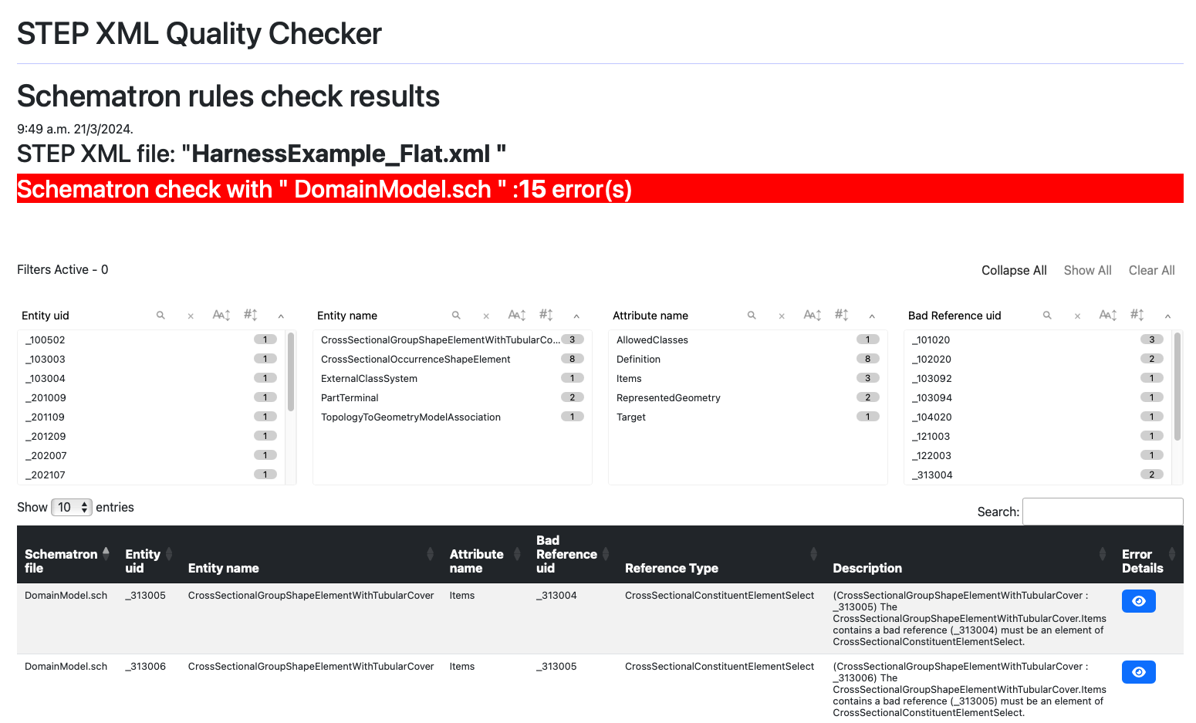
Schematron
Example of reports

Slide 10
Schematron
Script chain (with examples from STEP AP242 projects)
Schematron tool
XSL
ISO Schematron XSL
Schematron rules
XSL version of Schematron
Custom XSL for human-readable report generation
SCH
XSL
XSL
human-readable report
Input data
Part of AP242 Ed4 standard
Schematron report (non-human readable raw report
XML
HTML
SVRL
Executed when checking an xml file
SVRL: schematron validation report language (xml)

Slide 11
Schematron
Script chain (with examples from STEP AP242 projects)
Schematron process is composed of 3 steps:
SCH → XSL (Rules development stage)
Schematron compilation in XSL is made once
XML → SVRL (User stage)
Schematron rules applied to XML dataset
The SVRL file is a machine-readable file
SVRL → HTML (User stage)
SVRL converted in a human-readable HTML file
STEP AP242 XML Quality Checker (Schematron tool)
1
XSL
ISO Schematron XSL
Schematron rules
XSL version of Schematron
Custom XSL for human-readable report generation
SCH
XSL
XSL
3
2
human-readable report
Input datasets
Part of AP242 Ed4 standard
Schematron report (non-human readable raw report
XML
HTML
SVRL
Executed when checking an xml file
SVRL: schematron validation report language (xml)

Slide 12
Schematron
Multiple Schematron files
Schematron tool
Interoperability Forums: business rules
Company Schematron
Rules
LOTAR Schematron
Rules
From the standards: Structural rules by standard developers
PDM-IF Schematron
Rules
CAx-IF Schematron
Rules
EWIS-IF Schematron
Rules
AP242 Schematron
Rules
human-readable report
STEP AP242 XML data
HTML
User

Slide 13
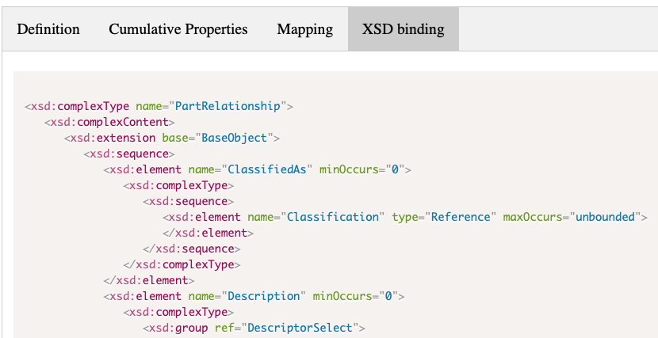
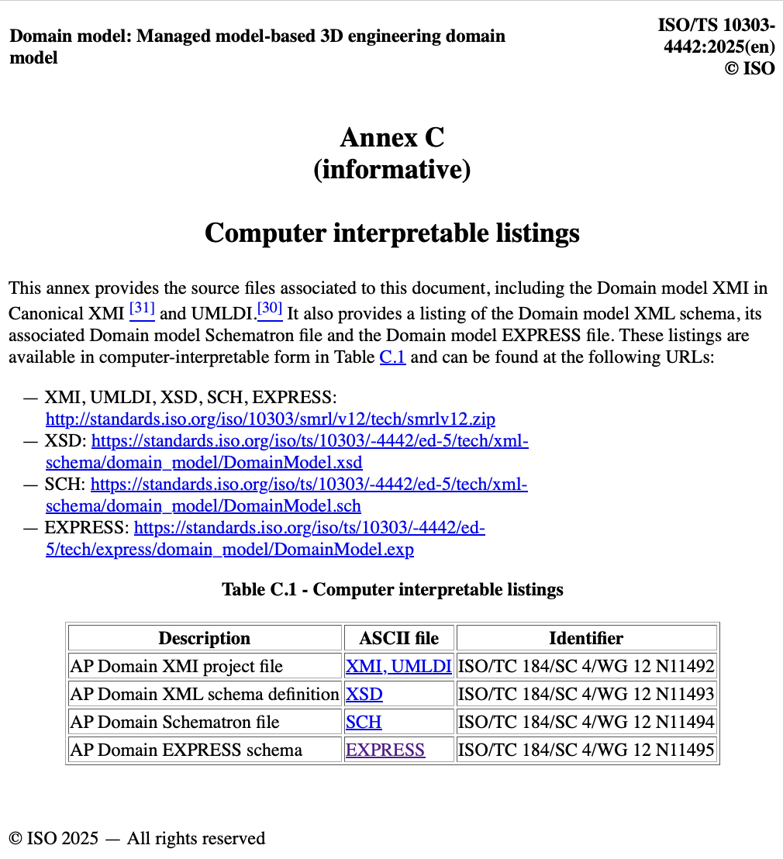
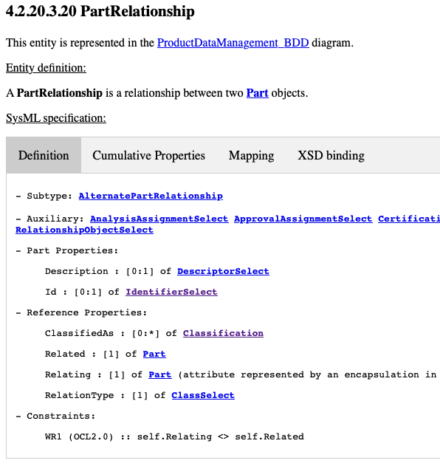
STEP AP242 Standard
Usage of Schematron in STEP AP242 (ISO 10303-242)
<sch:pattern id="IndividualPartRelationship_WR1">
<sch:rule context="//IndividualPartRelationship[@uid]">
<sch:let name="entity_name” value="if(@xsi:type) then substring-after(@xsi:type,':') else name()" />
<sch:let name="uid" value="@uid" /> <sch:let name="uidRelating" value="../@uid" />
<sch:let name="uidRelated" value="Related/@uidRef" />
<sch:assert test="not(../@uid = Related/@uidRef)"> The related IndividualPart and the relating IndividualPart shall be different. { -entity_name: <sch:value-of select="$entity_name" /> -entity_uid:<sch:value-of select="$uid" />-rule_name:IndividualPartRelationship.WR1 -relating:<sch:value-of
select="$uidRelating" /> -related:<sch:value-of select="$uidRelated" />
}
</sch:assert>
</sch:rule>
</sch:pattern>

Slide 14
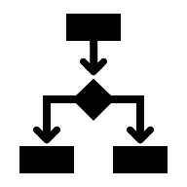
STEP AP242 Standard
Schematron development process
From the SysML model to Schematron
Generation of the Schematron rules
Software
code
Representing the AP242 Domain model
Representing the AP242 Domain model rules
Standard
developer
SysML
cXMI
Schematron
Rules
Includes constraints (in OCL and in Schematron)
Canonical XMI Tools
From here, all steps are automated
and executed once when rules are completely specified

Slide 15
χMCF
Schematron and χMCF Team needs
Brainstorming on potential requirements from xMCF team
χMCF XSD
χMCF XML data
<?xml version="1.0" encoding="iso-8859-1" standalone="no"?>
<xmcf xmlns:xsi="http://www.w3.org/2001/XMLSchema-instance" xsi:noNamespaceSchemaLocation="xmcf_3_1_1.xsd">
<date> 2014-08-07 </date>
<version> 3.1.1 </version>
<units length="mm" angle="deg" mass="kg" force="N" time="s"/>
<connection_group id="1">
<connected_to>
<part index="1" label="PART_7000400"/>
<assy index="23">
<part label="PART_5000300"/>
<part label="PART_5000800"/>
</assy>
</connected_to>
<connection_list>
<connection_1d label="DROP_LINE_11000">
<sequence_connection_0d spacing="30.0" margin="1.0" priority="spacing">
<gumdrop diameter="4.0" mass="0.0032" material="CAD_Material"/>
</sequence_connection_0d>
<loc_list>
<loc v="1"> 2169.300 -489.495 1773.936 </loc>
<loc v="2"> 2165.593 -480.000 1790.221 </loc>
<loc v="3"> 2165.593 480.000 1790.221 </loc>
<loc v="4"> 2169.302 489.495 1773.937 </loc>
</loc_list>
<appdata>
</appdata>
</connection_1d>
</connection_list>
</connection_group>
</xmcf>

Slide 16
Xsd:assert with xerces:message
Comparison with Schematron
XML data
<order id="101">
<item>
<name>Wireless Mouse</name>
<quantity>0</quantity>
<price>25.00</price>
</item>
</order>
SCH rule
<sch:schema>
<sch:pattern>
<sch:rule context="quantity">
<sch:assert test=". > 0">
An order item must have a quantity of at least 1.
</sch:assert>
</sch:rule>
</sch:pattern>
</sch:schema>
Equivalent XSD assert=
XSD schema
with assert and xerces message
<xsd:complexType name=”order">
<xs:element name=”quantity” type=”xsd:integer”/>
<xsd:assert test="quantity > 0” xerces:message="Error: An order item must have a quantity of at least 1."/>

Slide 17
XSD with assert and Schematron
Comparison
XSD with assert and xerces message
Schematron
Primary goal
Data Integrity: Ensuring the XML document is "well-formed" and mathematically valid according to a schema.
Coupling
Tight: Assertions are part of the Type definition. If the assertion fails, the element is technically "invalid."
Scope
Local: Can only "see" the element it is currently inside (and its descendants/attributes).
Primary goal
Business Rules: Validating complex relationships, clinical guidelines, or legal requirements.
Coupling
Loose: Rules are separate from the structure. You can run different Schematron files against the same XML.
Scope
Global: Can "jump" anywhere in the document to compare distant nodes using absolute XPath.

Slide 18
XSD with assert and Schematron
Comparison
Constraint Type | Possible in XSD 1.1? | Possible in Schematron?
Sibling-to-Sibling check | No (Limited to descendants) | Yes (Full XPath access)
Check against Root element | No (Unless inside Root) | Yes (Using / or ancestor::)
Conditional Warnings | No (Only Errors) | Yes (Using sch:report)
External Document Lookup | No | Yes (Using document() function)

Slide 19
XSD with assert and Schematron
Comparison
While xsd:assert is powerful, it is still bound by the "Inheritance and Hierarchy" rules of XML Schema. Schematron, however, is purely based on XPath patterns and doesn't care about the tree structure.
The most significant constraint possible in Schematron that is impossible (or extremely difficult) in XSD 1.1 xsd:assert is
Global Document Correlation: In XSD 1.1, an xsd:assert must be defined within a complexType. It can only "see" its own attributes and children. It cannot look "up" the tree or at "sibling" branches that are not descendants.
Schematron Capability: A rule can say: "If any <Invoice> in the entire document has a total > $10,000, then the <Header> at the very top of the file must contain a ManagerSignature."
XSD Limitation: The <Header> and <Invoice> are usually in different branches. XSD cannot reach across these branches because the assertion is scoped to the specific element being validated.
Multi-Phase Validation: Business rules often change based on the lifecycle of the data (e.g., a "Draft" vs. a "Final" submission).
Schematron Capability: You can define Phases. You can run "Phase 1" to check basic requirements for a draft, and "Phase 2" for a legal filing. You use the same schema file but toggle which rules are active.
XSD Limitation: XSD is "all or nothing." If a rule is in the schema, the document must follow it to be considered "valid." There is no native concept of "Validation Stages.”
Cross-Document Validation using document()

Slide 20
XSD and Schematron
There are many ways to connect both file
Technically by declaring Schematron files or rules in XSD
In your process, eg:
1) XSD check report
2) SCH check report

