Slide 1
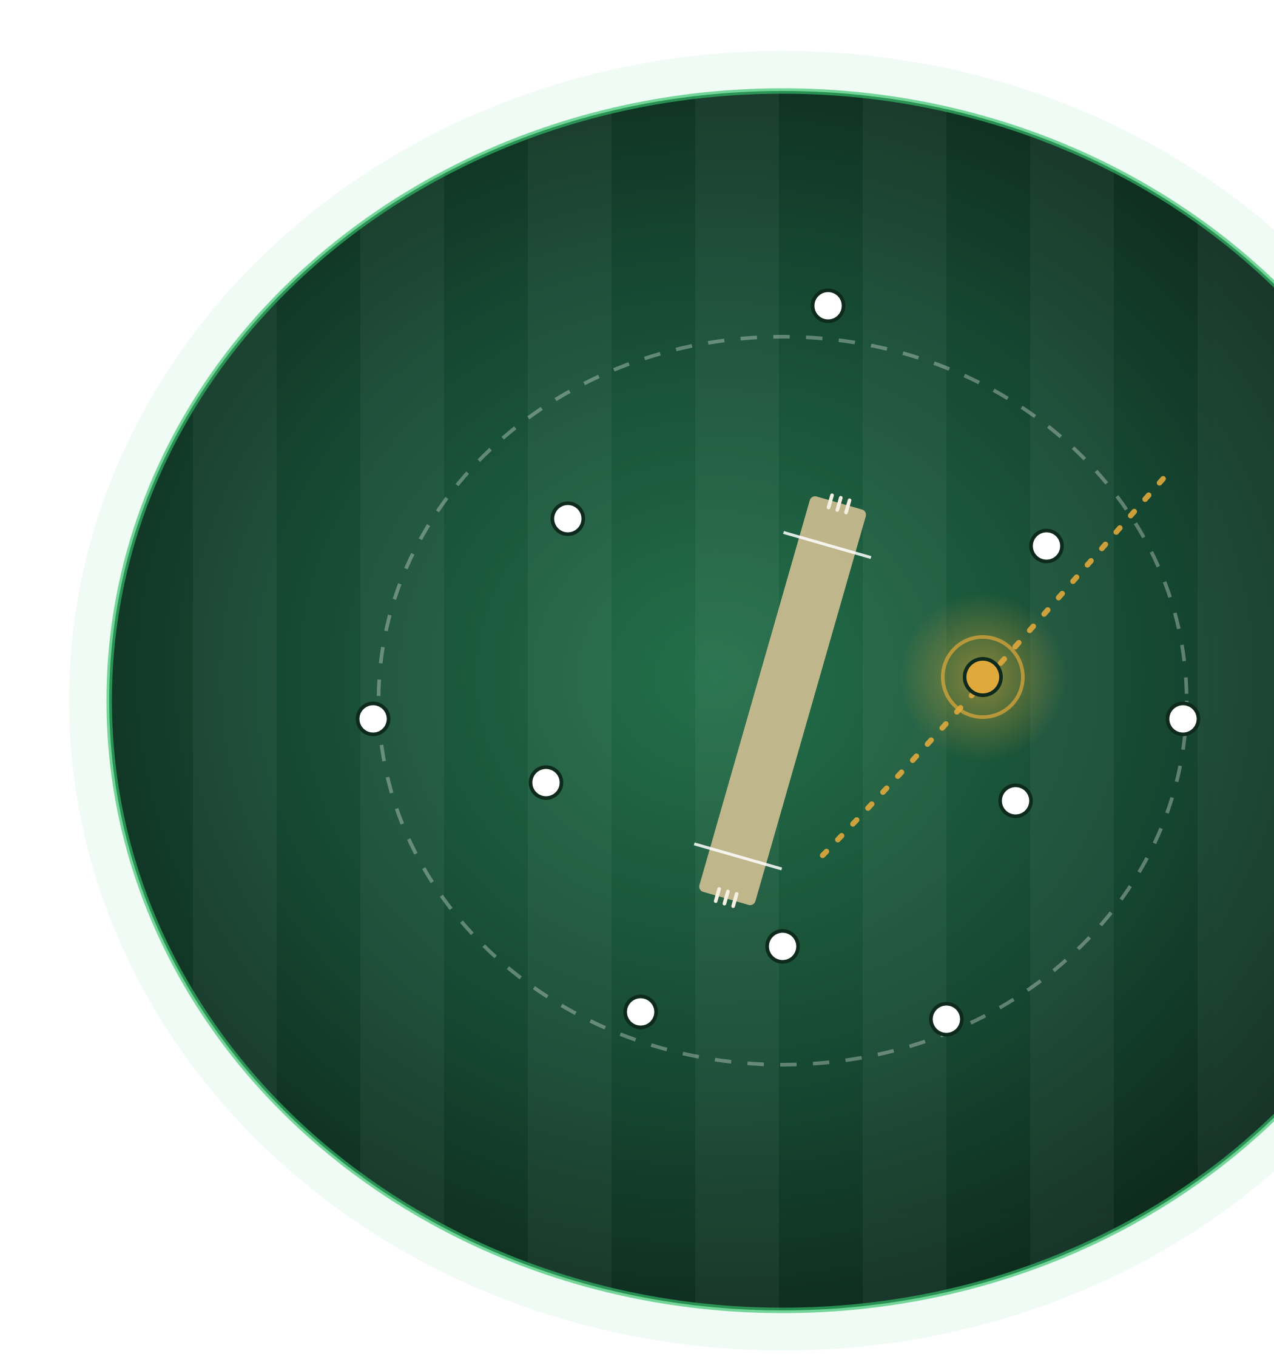
LIVE CRICKET INTELLIGENCE
CricPredict
Understand the game beyond the scoreboard.
An AI-powered live cricket intelligence and prediction platform.
cricket-score-predictor.com
Prepared for the Cricketviz team · November 2026
Notes:
[0:45] • Thank the team for the time. One line on who you are: you built CricPredict, a live cricket intelligence and prediction platform.
• Set up the three things you will cover: what it does, how it actually performs (including where it falls short), and one data gap you think could improve accuracy: fielding.
• End the opening with the ask, so nobody is waiting for it: you would like to explore whether there is something worth doing together.
• Roughly 15 minutes plus questions. Invite interruptions.

Slide 2
Cricket fans see the score. But do they understand the game?
THE PROBLEM
1
What is a realistic final score?
SCOREBOARD · 17.0 OVERS
84/4
2
How likely is the batting team to reach 200?
3
Has the batting team actually gained momentum?
Final score
Reaches 200?
Momentum
?
?
?
4
How significant was that wicket?
A scoreboard reports what has happened. Fans want to understand what happens next.
5
How much did a dropped catch or missed run-out change the game?
Notes:
[1:30] • A scoreboard says 84 for 4 after 17 overs. It does not say whether that is good, bad, or about to change.
• Run through the five questions quickly. Pause on the last one (a dropped catch or missed run-out), because it is the bridge to the fielding section later.
• The point is the gap between reporting what happened and helping fans understand what might happen next. Do not claim that nobody else offers predictions.

Slide 3



From score reporting to cricket intelligence
THE SOLUTION
PREDICT
EXPLAIN
QUANTIFY
LIVE ON SITE
LIVE ON SITE
PROPOSED RESEARCH
Projected final score, with a range
Wickets still to fall
Next-over expectation
Win probability in chases (heuristic estimate)
Plain-English reading of each projection
Drivers shown: run rate, wickets in hand, overs left, momentum
Venue and pitch conditions
Re-run at any match state to see how it moves
Today: one fixed fielding rating per team
Proposed: measure the effect of dropped catches, run-outs, misfields and runs saved
Research tooling is built; it needs labelled event data
LIVE ON SITE = available in the product today. PROPOSED RESEARCH = experimental or planned; not part of the production prediction.
Notes:
[1:30] • Three pillars: Predict, Explain, Quantify. Use the colour legend: green is live on the site today, amber is research that is not in production.
• Predict: projected final score with a range, wickets to fall, next-over expectation, and a win probability in chases. Be upfront that the chase win probability is a heuristic estimate, not an independently calibrated model.
• Explain: plain-English reading of each projection and the drivers behind it (run rate, wickets in hand, overs left, momentum, venue and pitch).
• Quantify is the research direction. Today fielding is one fixed rating per team. Hold the detail for slide 7.

Slide 4
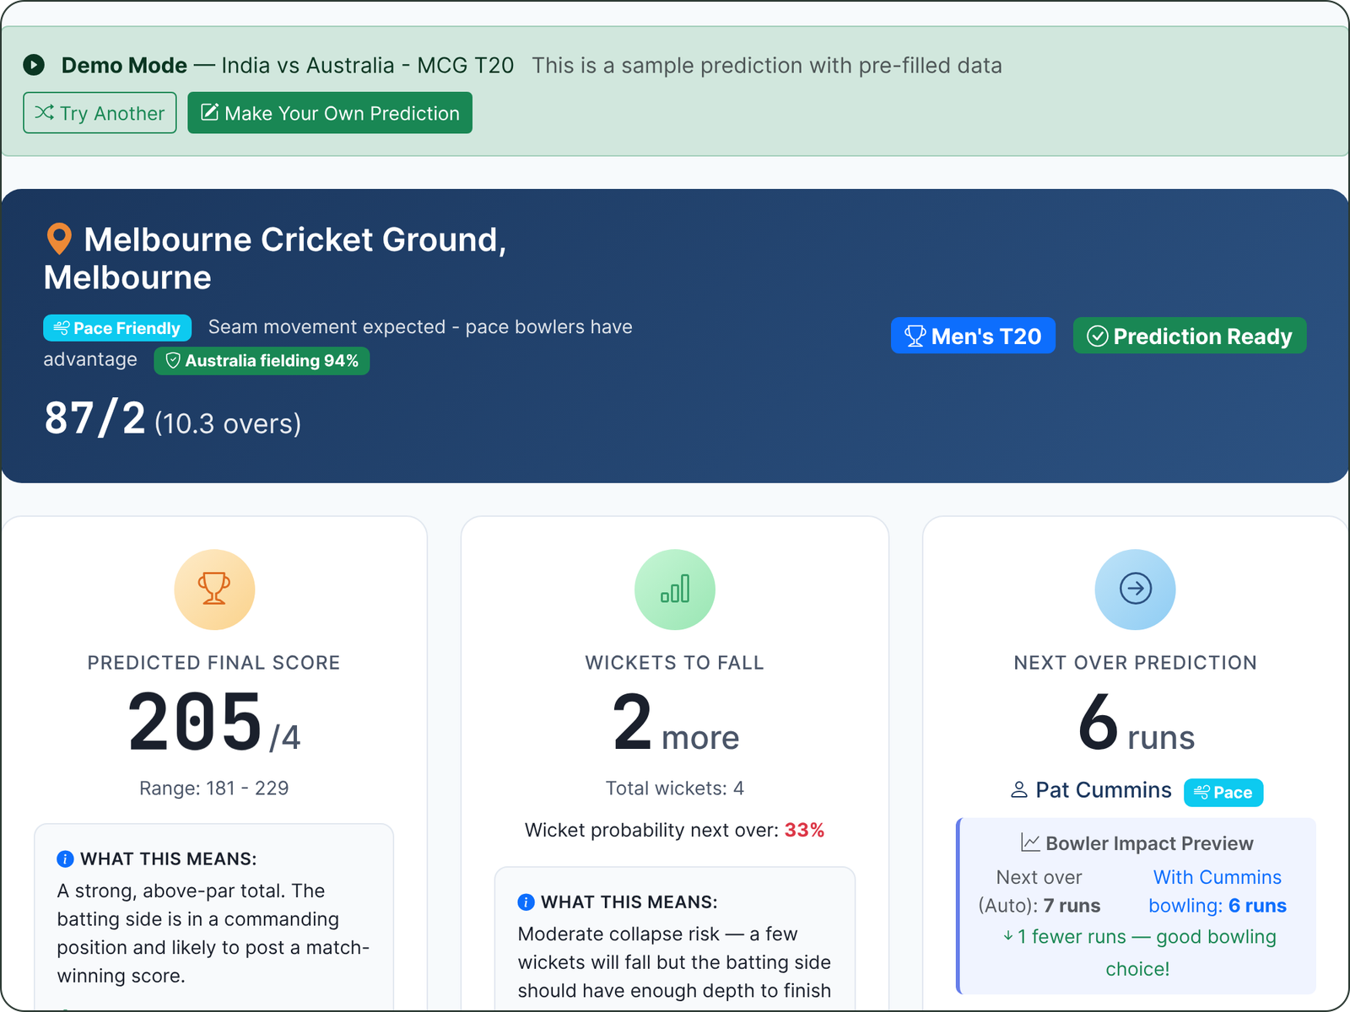
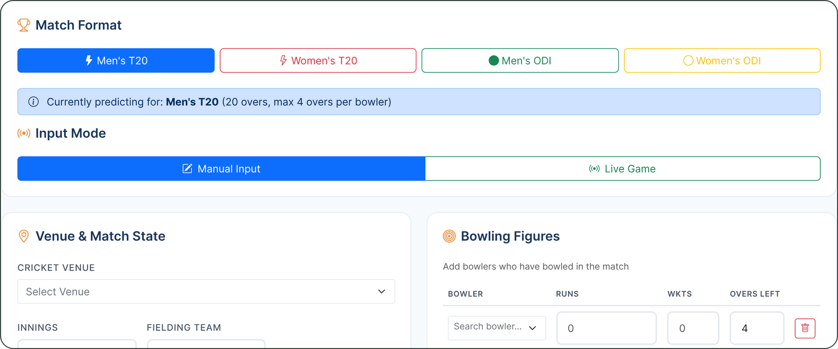

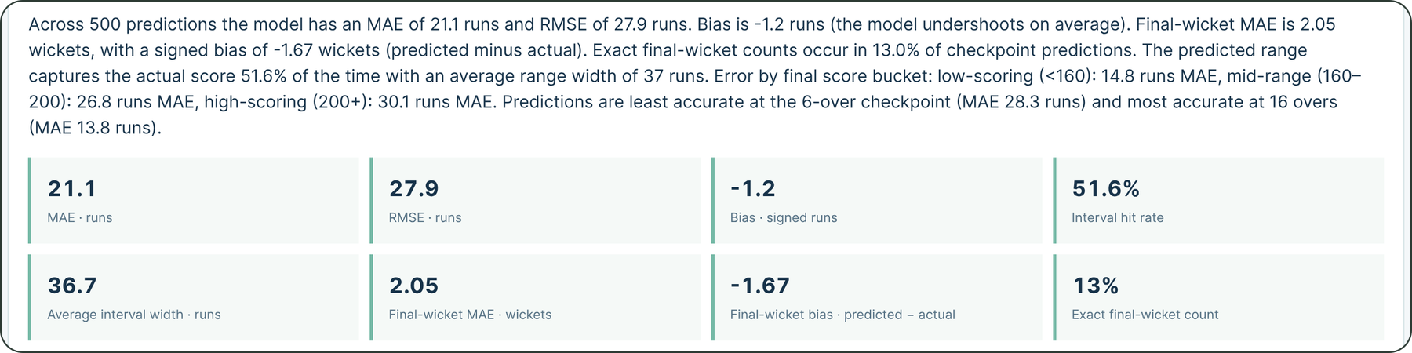
A live intelligence layer for cricket
THE PRODUCT
PREDICTION · SAMPLE SCENARIO
MATCH INPUT
BACKTEST REPORT · MEN'S T20
Also in the product: pre-match insights, live match insights, analytics, and Pro (saved predictions, match alerts).
Screenshots: current build, run locally. The prediction shown is the app's built-in sample scenario (India vs Australia, MCG T20), not a live match.
Notes:
[3:30] • Switch to the live site: cricket-score-predictor.com. If a real match is on, use Live Game mode; otherwise enter a match state by hand.
• Show the flow: choose format, venue and match state, then the prediction, range, wickets to fall and next-over expectation. Scroll to the "what this means" text and the factors behind the number.
• Open the Backtesting page and show a report: this is the bridge to the next two slides.
• The screenshots on the slide are from the app's built-in sample scenario (India vs Australia, MCG T20), not a live match. Say so if asked.
• Backup if the network fails: stay on this slide and talk through the screenshots.
• Mention the Pro tier (saved predictions, match alerts) only if asked; it is not the point of today.

Slide 5

Predictions that evolve with the game
A REAL PREDICTION · NEW ZEALAND VS INDIA, ODI
AT 17.0 OVERS
84/4
AT 37.3 OVERS
171/9
FINAL
Predicted final score
Predicted final score
Actual final score
199
183
185
Range 170 – 228
Revised after five more wickets
Revised prediction was 2 runs away
WHERE EACH ESTIMATE LANDED (FINAL SCORE, RUNS)
183 · at 37.3 overs
199 · at 17 overs
Range at 17 overs: 170 – 228
160
170
180
190
200
210
220
230
240
Actual: 185
One match illustrates how the model behaves. It does not establish overall accuracy; see the 400-innings backtest on the next slide.
Notes:
[1:30] • New Zealand vs India, an ODI. At 17 overs, 84 for 4, the model projected 199 with a range of 170 to 228.
• At 37.3 overs, 171 for 9, it had revised to 183. The actual score was 185.
• Be candid in how you read it: the early projection was 14 runs high but inside the range; the late revision was 2 runs away. It reacted to the wickets.
• Do not oversell: one match is a story, not evidence. The next slide is the evidence.

Slide 6
Testing predictions against real cricket
BEYOND DEMONSTRATIONS · 400-INNINGS BACKTEST
Average error in final score, by format (MAE, runs)
ODI error falls as the innings unfolds (MAE, runs)
400
first innings replayed
100 per format · 1,800 checkpoint predictions
WHAT MAE MEANS
The average gap, in runs, between predicted and actual final score. Roughly 13 to 16% of the average final score in each format.
WHERE WE ARE HONEST
ODI score prediction is the biggest improvement opportunity. Death-over acceleration and other match-specific factors remain hard. Predicted ranges held the final score 47 to 56% of the time.
Historical replay of the current model on the 100 most recent eligible full-length internationals per format (Cricsheet); not an out-of-time holdout or independent validation. Run of 11 Nov 2026.
Notes:
[2:30] • The experiment: 400 first innings, 100 per format, from Cricsheet ball-by-ball data. Each innings is replayed at completed-over checkpoints using only the deliveries available at that point.
• MAE is the average gap between predicted and actual final score, in runs. Women's T20I 16.6, Men's T20I 21.1, Women's ODI 38.3, Men's ODI 41.5. As a share of the average final score that is roughly 13 to 16% in every format.
• Right-hand chart: error falls as the innings unfolds. Men's ODI goes from 59.4 runs at over 10 to 21.6 at over 40.
• Be candid about what this is: a historical replay of the current model, not an out-of-time holdout, and some ODI model revisions were evaluated on this same set. Treat it as a calibration check, not independent validation.
• Predicted ranges contained the final score between 47 and 56% of the time depending on format. That is a known area to work on.
• ODI score prediction is the biggest improvement opportunity, and the early-innings checkpoints are where better inputs matter most.
• Numbers come from the report committed to the repository (run of 11 November 2026, after women's fixtures were switched to the women's fielding rating keys) and can be reproduced.

Slide 7
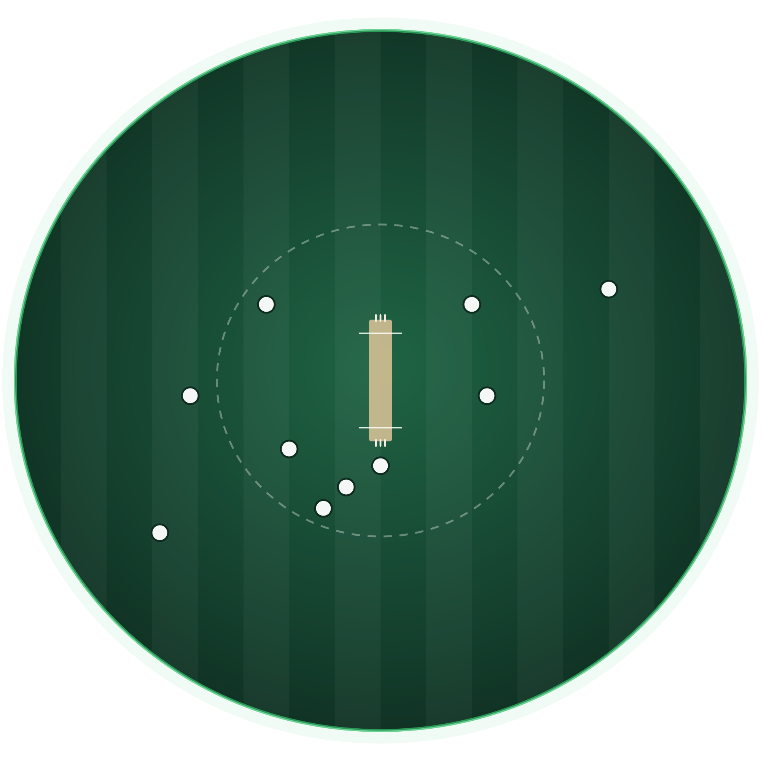
What if we could quantify the impact of fielding?
THE NEXT FRONTIER
TODAY IN CRICPREDICT
WHAT PUBLIC DATA SHOWS
Fielding enters the model as one hand-assigned rating per team, for example India 0.92.
In our own backtest it does not improve run accuracy: MAE 28.2 with it, 27.3 without.
Fielders are named only on successful dismissals. Dropped catches, misfields, direct hits and runs saved are not recorded.
5
2
4
FIELDING EVENTS THAT CAN MOVE SCORING, WICKETS AND TOTALS
6
3
1
Dropped catch
2
Missed run-out
1
3
Successful run-out
4
Boundary save
5
Misfield
6
Exceptional catch
The goal: measure the actual effect on runs, wickets and innings totals, not assign arbitrary fielding ratings.
MAE: real-model replay with the fielding effect at full vs zero strength, 1,800 backtest checkpoints. Field diagram is illustrative; marker positions are generic.
Notes:
[2:00] • Batting and bowling are in the score data. Fielding mostly is not.
• Today CricPredict uses one hand-assigned rating per team (for example India 0.92, Australia 0.94). That is a placeholder, not a measurement.
• We tested our own placeholder with the real model. Switching the fielding effect off gives run MAE 27.3 against 28.2 at today's strength, across 1,800 checkpoint predictions. So today's ratings do not earn their keep. Be clear this is a replay of the current model, not an out-of-time test, and the gap is under a run; the point is that the ratings are not evidence of anything, which is why real event data matters.
• Public ball-by-ball data names fielders only on successful dismissals. Dropped catches, misfields, direct hits, runs saved and positions are not recorded.
• Walk the six numbered events on the field. Each can change what happens over the following overs: scoring opportunities, wicket probability, the expected total.
• The goal is to measure the actual effect, not to invent a fielding score.

Slide 8
Today's fielding rating: a prior, tested and bounded
FIELDING TODAY
WHY A PRIOR, NOT A MEASUREMENT
WHAT IT IS AND DOES
HOW WE TESTED IT
Public data cannot measure it. Ball-by-ball files name fielders only on successful dismissals: no drops, misfields, direct hits or runs saved.
Better data is paid. Event-level fielding data is sold under commercial licences. We use free sources only.
Outcomes are not skill. Catches and wickets alone cannot separate fielding from bowling and overall team quality.
A hand-assigned prior: one value per team, 0.71 to 0.94, in three tiers that follow overall team standing.
Accuracy. Run MAE is 28.2 with it and 27.3 without. The best strength is about a quarter to a half of today's.
Observed outcomes. The ordering tracks catches and wickets per innings (rank correlation +0.3 to +0.7), which mostly reflects overall team quality. Runs conceded per over does not agree.
×0.90 – ×1.15
on projected runs
×0.79 – ×1.15
on projected wickets
Bounded. Unlisted teams are neutral.
NEXT Label it an analyst estimate · Calibrate the effect size on held-out matches · Replace it with event-level evidence
Rank correlations use Cricsheet team outcomes for teams with 20+ innings (9 to 21 teams per cohort); confounded by team strength. MAE: real-model replay, full vs zero fielding effect.
Notes:
[1:30] • Be direct: today's fielding rating is a hand-assigned prior, one value per team. It is not a measured statistic, and the slide says so. Be careful on history: the values were added in May 2026 without a recorded derivation. The reasons on the slide are why a measured rating is not possible today, not a record of what was thought at the time.
• Why a prior and not a measurement, three reasons. One: public ball-by-ball data names fielders only on successful dismissals, so there are no opportunities, drops, misfields, direct hits or runs saved. You cannot estimate catching skill from catches taken without knowing how many were chances. Two: event-level fielding data does exist, but it is sold under commercial licences, and the project uses free sources only. Three: outcome measures such as catches and wickets cannot separate fielding from bowling and overall team quality. Do not say the problem is too few matches: most of the 24 men's teams have 20 or more innings in the data.
• Structure: leading sides sit at 0.90 to 0.94, established sides at 0.80 to 0.85, the rest at 0.71 to 0.79. In effect it is a coarse prior that follows overall team standing.
• What it does: it scales projected runs by 0.90 to 1.15 and wickets by 0.79 to 1.15. It is bounded, unlisted teams are neutral, and for runs every team at 0.90 or above gets the same effect.
• How we tested it, honestly. Accuracy: switching it off moves run MAE from 28.2 to 27.3, so no gain at full strength; the best strength is about a quarter to a half of today's.
• Observed outcomes: the ordering tracks catches and wickets per innings (rank correlation +0.3 to +0.7, 9 to 21 teams per cohort). That mostly reflects overall team quality, and runs conceded per over does not agree. So it is consistent with team standing, not proof of fielding skill.
• Close the loop: we are labelling it an analyst estimate, calibrating the effect size on held-out matches, and replacing it with event-level evidence. That last step is the reason for this conversation.

Slide 9
Turning fielding events into predictive intelligence
PROPOSED RESEARCH
1
Obtain event data
DATA
2
Identify opportunities
DATA
3
Attribute events
DATA
Structured historical fielding-event data from a partner.
Successful and unsuccessful fielding chances.
To players and match situations, where possible.
4
Quantify the influence
MODEL
5
Integrate what is validated
MODEL
6
Evaluate out-of-sample
TEST
Effect on runs, wickets and match outcomes.
Add only signals that prove predictive to the CricPredict framework.
Backtest on matches the model has not seen.
ALREADY BUILT · RESEARCH TOOLING, NOT IN PRODUCTION
THE MISSING INGREDIENT
Player registry and ingestion for public data, shadow-mode comparison against the live model, and an activation gate that blocks changes that do not improve held-out results.
Labelled events such as dropped chances, misfields, direct hits and runs saved. Public data cannot supply them, which is why today's fielding rating is only a prior (slide 8).
Proposed research, not a completed production feature. No fielding signal is in the live prediction today.
Notes:
[1:45] • Six steps. The first three need data from a partner; the last three are modelling and evaluation.
• Be precise about what exists: research tooling (player registry and ingestion for public data, a shadow-mode comparison against the live model, and an activation gate). It is not in production and it claims no improvement. Its output is identical to the baseline until there are validated signals.
• What is missing is labelled events. Public data cannot supply them, which is why today's fielding rating is only a prior (the previous slide) and why this conversation matters. Link the two out loud: the placeholder exists because this data does not.
• This is proposed research, not a shipped feature. Say that plainly.

Slide 10

An opportunity to take cricket analytics further
WHY CRICKETVIZ
WHAT CRICKETVIZ MAY BRING
WHAT I WOULD LIKE TO EXPLORE
Domain knowledge, structured cricket information and data capabilities that could help investigate this problem.
Ball-by-ball fielding events
Dropped catches and missed opportunities
Run-out attempts and outcomes
Fielder attribution
I am not assuming what data you hold or can share. That is the first conversation.
Runs saved or conceded
Historical match coverage
PROPOSED FIRST STEP
Start small: a sample dataset and its data dictionary, so we can both see what is possible before any larger commitment.
Notes:
[1:30] • Position it as a possible collaboration. Do not assume what Cricketviz holds: ask.
• Walk the six items you would like to explore: ball-by-ball fielding events, dropped catches and missed opportunities, run-out attempts and outcomes, fielder attribution, runs saved or conceded, and historical coverage.
• The proposed first step is deliberately small: a sample dataset and its data dictionary.
• Ask what would make this worthwhile on their side. Listen before proposing terms.

Slide 11





Making every moment of cricket more meaningful
THE POTENTIAL VALUE FOR FANS
Understand why a prediction changes
CONCEPT · ILLUSTRATIVE, NOT MODEL OUTPUT
How a prediction could be explained
Appreciate the influence of individual fielding contributions
Catch dropped
Understand the importance of key match events
Wicket
Explore alternative match scenarios
Run-out
Projected final score
Match progress →
Gain insight beyond the conventional scoreboard
Each event moves the projection, and the fan can see why.
Notes:
[1:15] • Keep it fan-first. The five outcomes: understand why a prediction changes, appreciate individual fielding contributions, understand key moments, explore what-if scenarios, see beyond the scoreboard.
• The sketch is a concept, clearly labelled; there are no numbers on it and it is not model output.
• Explaining why a prediction moved is more valuable to a fan than the number itself.

Slide 12
Let's explore what's possible
COLLABORATION AND NEXT STEPS
1
2
3
Understand the data
Explore a small-scale arrangement
Test whether it helps
What fielding data exists, how it is structured, and how far back it goes.
A limited data-sharing or research arrangement, starting with a sample.
Evaluate whether fielding information improves prediction accuracy on held-out matches.
These are points for discussion, not requests.
Notes:
[1:00] • Three discussion points, not demands: understand the data, explore a small-scale arrangement, test whether it helps.
• Questions to leave them with: What fielding data exists? Who would be the right person to talk to? What would be useful to Cricketviz?

Slide 13
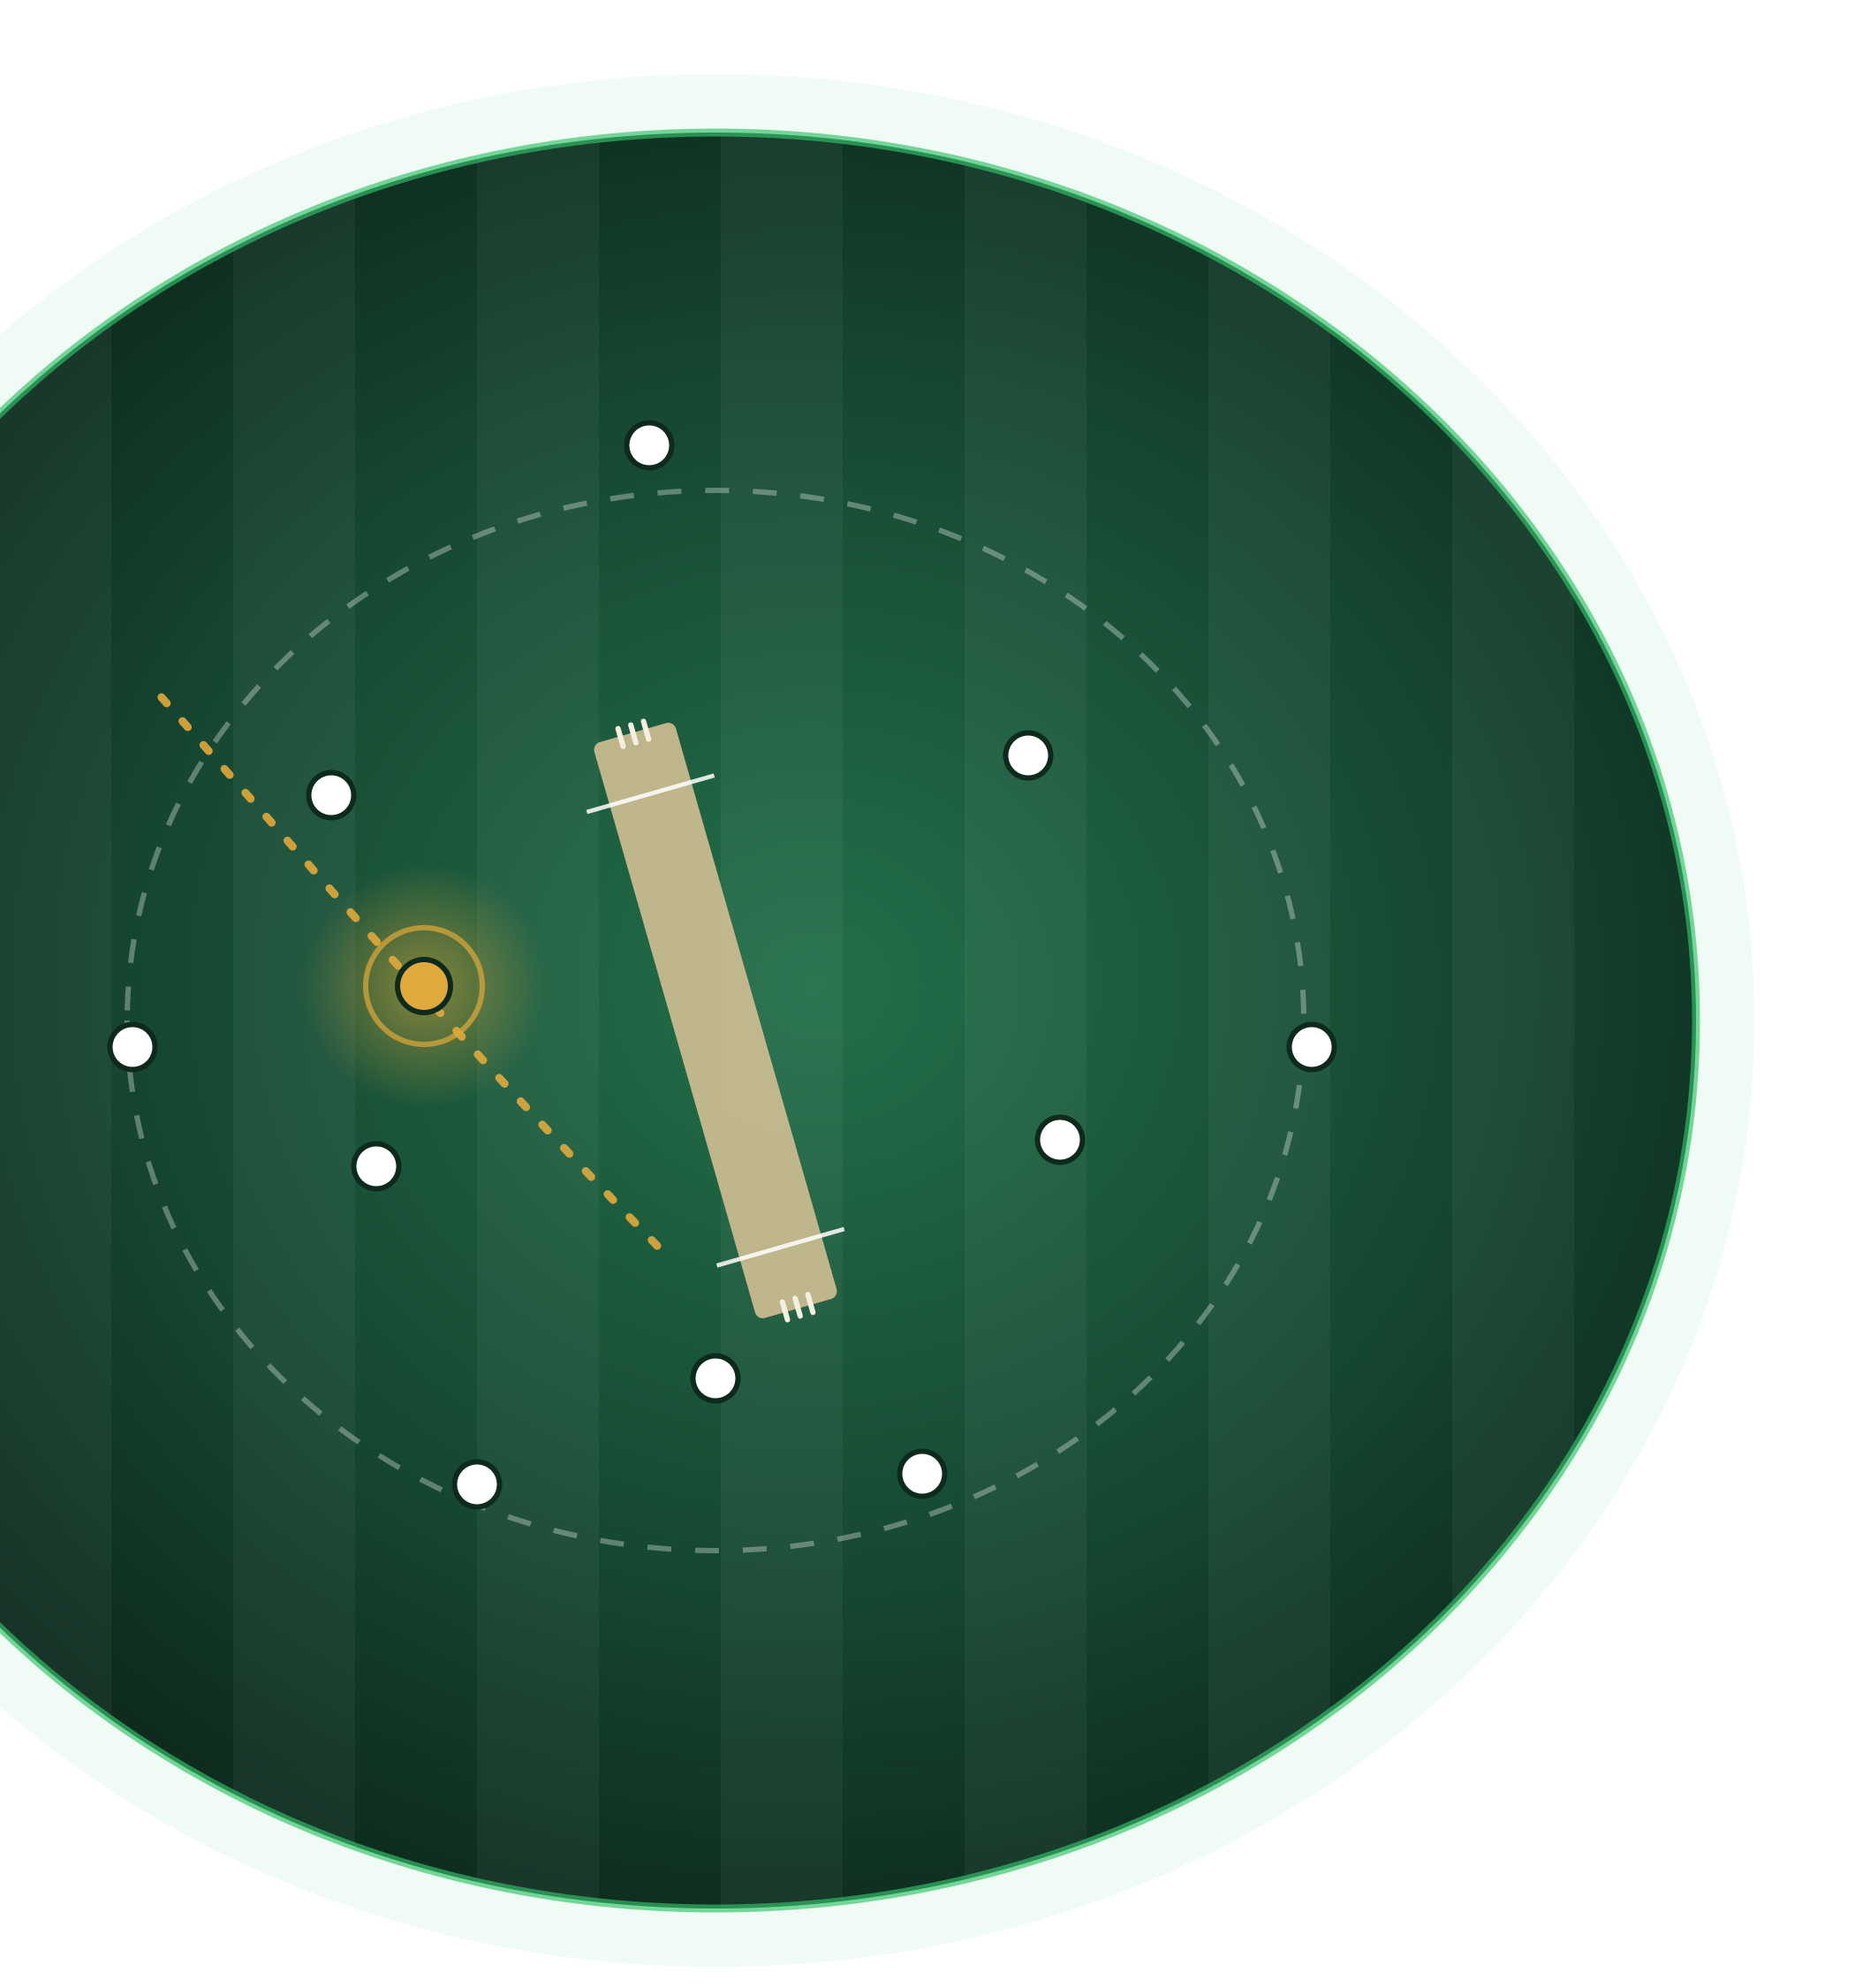
CRICPREDICT
Understand the game beyond the scoreboard
“I’m interested in exploring how better cricket data can help us build better predictions and give fans a deeper understanding of the game.”
Thank you, Cricketviz team.
cricket-score-predictor.com
Notes:
[0:30] • Read the closing line: you are interested in how better cricket data can help build better predictions and give fans a deeper understanding of the game.
• Thank the Cricketviz team. Invite them to try the site, then open the floor for questions.

