Slide 1
Universal Law of Generalization

Slide 2

Let’s say I eat this leaf, and I feel sick.

Slide 3
What other leaves might I avoid?

Slide 4
What other leaves might I avoid?

Slide 5
There is a “consequential region” of different possible objects that satisfy the property of being sickness-inducing leaves.
I have generalized the property to other leaves.

Slide 6
The region basically tells you how generalizable a property is
A bigger region will mean there are more objects that share that property

Slide 7
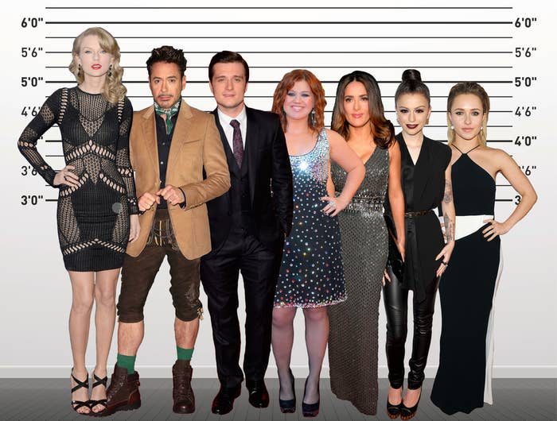
Property: being able to reach things on a high shelf
The consequential region (spread of objects that have this property)
might be easy to estimate here
The celebrities would be considered objects that may/may not be in the region.

Slide 8
Property: being able to reach things on a high shelf
The consequential region (spread of objects that have this property)
might be easy to estimate here
But sometimes it might not be obvious.
The celebrities would be considered objects that may/may not be in the region.

Slide 9

Which animals have the T-9 hormone?
Let’s say you know canaries have T-9 hormones.
What other animals might have them? It’s not obvious what the CR of the concept “animals that have the T-9 hormone” is. (The spread of the consequential region is not obvious.)

Slide 10
Which animals have the T-9 hormone?
Let’s say you know canaries have T-9 hormones.
What other animals might have them? It’s not obvious what the CR of the concept “animals that have the T-9 hormone” is. (The spread of the consequential region, or the number of objects/animals that share this concept is not obvious.)

Slide 11






Which animals have the T-9 hormone?
Let’s say you know canaries have T-9 hormones.
What other animals might have them? It’s not obvious which objects (animals) are in the region R (which has the property “animals that have the T-9 hormone”. The spread of the consequential region, or the number of objects/animals that share this property, is not obvious.

Slide 12
Which animals have the T-9 hormone?
Let’s say you know canaries have T-9 hormones.
What other animals might have them? It’s not obvious which objects (animals) are in the region R (which has the property “animals that have the T-9 hormone”). The spread of the consequential region, or the number of objects/animals that share this property, is not obvious.

Slide 13
You can think of it as:
- A canary (x=0) has the T-9 hormone - The canary is in a region R where all objects in R share the property of having a T-9 hormone - You don’t know the exact spread of the region R - But there are different possible hypothetical regions, R, and say the canary (x=0) is in all of them.
- What’s the probability that a robin (x=1) has a T-9 hormone? - What’s the probability that a robin is in the R of objects that have the property of having a T-9 hormone (the region to which canary, x=0, belongs)?

Slide 14
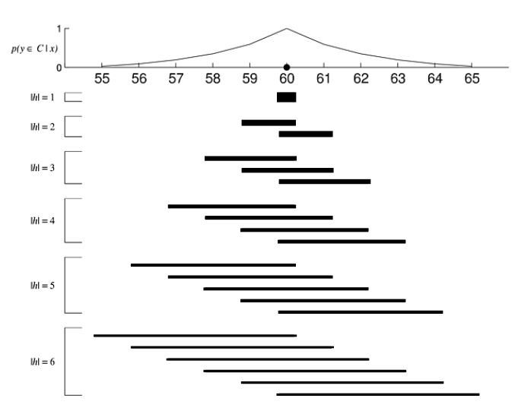
0
X axis: different objects that are arranged by just one feature.
Y axis: probability y is in a region given that x is in a region

Slide 15
A canary has a T-9 hormone (X=0 is in the region)
0

Slide 16
A canary has a T-9 hormone (X=0 is in the region)
0
1
What’s the probability that a robin is in the region of “animals that have a T-9 hormone”?
(What’s the probability that X=1 is in the region given that X=0 is in the region?)

Slide 17
0
1
Here, we don’t know what the spread of the consequential region will be.
These black bars are all possible spreads of the CR, generated randomly (Note that if you are instructed to find the probability of getting x=1 for regions containing x=0, you need to make sure all your regions contain x=0)

Slide 18
0
1
Because we don’t know what the true spread of the consequential region (property: animals that have a T-9 hormone) is, we will use all these possible Rs to determine the probability that x=1 (or “robin”) is included in that region.

Slide 19
So how do we actually determine this?

Slide 20
0
1
This graph can tell you the relative probabilities of the different objects within it
Canary, at 0, has the highest probability. Robin, at 1, has a slightly lower probability, and so on.
Precisely, the y axis of this graph represents the probability that you would sample concept x (if you considered all possible CRs).

Slide 21
0
1
This graph can tell you the relative probabilities of the different objects within it
Canary, at 0, has the highest probability. Robin, at 1, has a slightly lower probability, and so on.
Precisely, the y axis of this graph represents the probability that you would sample concept x (if you considered all possible CRs).

Slide 22
0
1
This graph can tell you the relative probabilities of the different objects within it
Canary, at 0, has the highest probability. Robin, at 1, has a slightly lower probability, and so on.
The y axis of this graph represents the probability that you would sample object x (if you considered all possible CRs).

Slide 23
0
1
This graph can tell you the relative probabilities of the different objects within it
Canary, at 0, has the highest probability. Robin, at 1, has a slightly lower probability, and so on.
In the HW, canary is the only observed object in that property; is in all the regions.
So if we sampled objects from all the regions, canary will be sampled the most (every time) whereas robin will be sampled less, and so on.

Slide 24
0
1
So what does this mean?
This graph can tell you the relative probabilities of the different objects within it
Canary, at 0, has the highest probability. Robin, at 1, has a slightly lower probability, and so on.
The y axis of this graph represents the probability that you would sample object x (if you considered all possible CRs).

Slide 25

0
1
You can compute the y value at any x using this procedure:
Y value at concept X =

Slide 26




=
0
1
A
B
C
D
…..
+
+
+
+
……

Slide 27
=
0
1
A
B
C
D
…..
+
(For example, you could compute this for X=1)
+
+
+
……

Slide 28
*NOTE: If X is not in the consequential region R, then for that specific R, = 0

Slide 29
*NOTE: If X is not in the consequential region R, then for that specific R, = 0
-3.2
4.8
All the regions in this assignment should contain x=0, but how would you check if they contain x=1?
edge1<= (x=1) <= edge2

Slide 30
*NOTE: If X is not in the consequential region R, then for that specific R, = 0
-3.2
4.8
All the regions in this assignment should contain x=0, but how would you check if they contain x=1?
edge1<= (x=1) <= edge2

Slide 31
What’s the probability of getting x=1, for regions containing x=0?
=
0
1
0
A
B
C
D
…..
+
0
+
+
0
+
……

Slide 32
Probability of observing object X in the region R
(if you put all objects that were in R in a bag, what would the probability of sampling this particular object X be?)
Probability of you sampling region R (e.g. if you put all regions in a bag, what would the probability of you sampling that particular region R be?)

Slide 33
probability that your object x=1 (or whatever x you specify) will have the same feature as x=0 (or whatever other x you specify as the most probable object; the object that is in all R).
Computing this sum is marginalizing over every possible R there could be (since you don’t know the true R, you see what P(X|R) would be under any of the possible Rs)

Slide 34

How to compute and
(if X is in R, and 0 otherwise)
1/(length of the R you have currently sampled)
1/(number of Rs)
(since every R has the same chance of being sampled)

Slide 35
Why do we do this?

Slide 36
You can think of each of these Rs as a uniform distribution

Slide 37
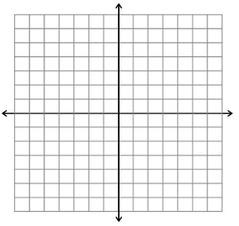

P(X|R)
edges of the R
-3.2
4.8
; the area of this rectangle = 1

Slide 38
P(X|R)
edges of the R
-3.2
4.8
length = 8
Since the length is 8, for length*height to = 1, height has to be 1/8

Slide 39
P(X|R)
height = 1/8
edges of the R
-3.2
4.8
length = 8
Since the length is 8, for length*height to = 1, height has to be 1/8

Slide 40
P(X|R)
height = 1/8
edges of the R
-3.2
4.8
length = 8
Hence, P(X|R) = 1/(length of R)

Slide 43
Scaling of axes
Takes an axis that is written in normal, linear interval form [1,2,3,4….]
And instead writes it as [e¹, e², e³, e⁴, e⁵] (or [10¹, 10², 10³, 10⁴, 10⁵], which is equivalent because of the change of base formula)
That changes the spacing of points (and causes a distortion; where the exponential is changing a lot, the corresponding spacing on the y axis decreases by just one space, making it seem as if the exponential just decreased by a little, not a lot)
plt.yscale

