Slide 1
Recommendation Engines

Slide 2
Agenda
Start | End | Item
 |  | Business Context
 |  | Association Rules
 |  | Code Example
 |  | Collaborative Filtering
 |  | Code Example
 |  | Personalized Reco Engine

Slide 3
What are Association Rules?
Study of “what goes with what”
“Customers who bought X also bought Y”
Transaction-based or event-based
Customer A bought peanut butter and bread.
When someone has body aches, and fever they also have chills
Also called “market basket analysis” and “affinity analysis”
Originated with study of customer transactions databases to determine associations among items purchased

Slide 4
What are some other recommendation systems you have encountered?

Slide 5

Many business profit by having exceptional recommendation analysis.

Slide 6
Generating Rules

Slide 7
Before Data Mining
Heuristic Based - A heuristic is a mental shortcut that allows people to solve problems and make judgments quickly and efficiently.
“Hey Lumberg, you should put the salsa next to the tortilla chips in the grocery aisle.”
Based on experience and/or intuition based on existing mental maps.
Reduces Effort
Fast and Cognitively Frugal

Slide 8
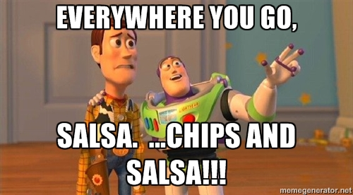
With Data Mining - Association Rules
Hypothesis driven
Supported by robust transaction level data

Slide 9
Example Association Rule
Association Rule Based – Using transactional data, identify antecedent & consequent item-sets.
If a customer buys tortilla chips then they will seek out and purchase salsa.
Enabled by computers, affinity analysis can explore relationships more complex than previously possible with heuristics alone.
Increased number of relationships yielding additional consumer insight, and $$
DRAWBACKS
Technical Acumen
Without shortcuts, computationally intensive

Slide 10
Example Association Rule
If a customer buys tortilla chips then they will seek out and purchase salsa.
“IF” part = antecedent
“THEN” part = consequent
Association
Rule
Association rules must be “disjoint” meaning items in the antecedent & consequent are not shared.
Affected
Items
ITEMSET = {tortilla chips, salsa}
Using R, we will identify many rules with antecedents and consequents.

Slide 11
Example Association Rule
If a customer buys salsa then they will seek out and purchase tortilla chips.
“IF” part = antecedent
“THEN” part = consequent
Association
Rule
Association rules must be “disjoint” meaning items in the antecedent & consequent are not shared.
Affected
Items
ITEMSET = {tortilla chips, salsa}
Because this is transaction based, there is really no 1st item to determine the antecedent/consequent order. As a result, the items are a set which can be reordered into two rules.

Slide 12
What is the antecedent & consequent?
If a patient has poor circulation then check oxygen levels.

Slide 13
What is the antecedent & consequent?
If a patient has poor circulation then check oxygen levels.
Antecedent
Consequent
{ poor circulation, oxygen levels}

Slide 14
What is the antecedent & consequent?
If a customer listens to Imagine Dragons then they may listen to AWOL-Nation & 21 Pilots

Slide 15
What is the antecedent & consequent?
If a customer listens to Imagine Dragons then they may listen to AWOL-Nation & 21 Pilots
Antecedent
Consequent
{ Imagine Dragons, AWOL-Nation, 21 Pilots}

Slide 16
What is the antecedent & consequent?
If a customer buys bread then they will buy cheese, meat and bread.

Slide 17
What is the antecedent & consequent?
If a customer buys bread then they will buy cheese, meat and bread.
WRONG!
{ BREAD, meat, cheese, BREAD}
Not Disjoint

Slide 18
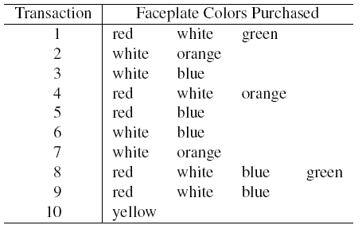
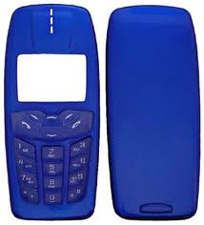
Tiny Example: Phone Faceplates

Slide 19
Many Rules are Possible
Transaction 1 supports several rules, such as
“If red, then white” (“If a red faceplate is purchased, then so is a white one”)
“If white, then red”
“If red and white, then green”
+ several more

Slide 20
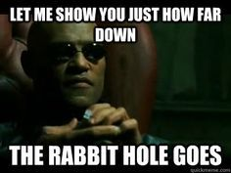
Rules on Rules on Rules…10 transactions yet many possibilities
Single Antecedent
Double Antecedent
Triple Antecedent
{red, white}
{red, white, green}
{white, red}
{white, green}
{red, green}
{green, …}
{red, white, green}
{white, green, red}
{red, green, white}
{red, white, blue, green}
Haven’t even gotten to orange, blue, and yellow.

Slide 21
Frequent Item Sets
Ideally, we want to create all possible combinations of items
Problem: computation time grows exponentially as # items increases
Solution: consider only “frequent item sets”
Criterion for frequent: support
Focusing on frequent item sets keeps your rules from finding pockets of associations that have little evidence or business value.
E.g. If a person buys bread at Wal-Mart, then they will also buy a bike lock…sure that happens but likely not as often as other consequent items.

Slide 22
Support
Support for an itemset = # of transactions that include an itemset
Example: support for the item set {red, white} is 4 out of 10 transactions, or 40%
Support for a rule = # of transactions that include both the antecedent and the consequent
Number of transactions with Item Set
SUPPORT =
Total Number of Transactions

Slide 23
Apriori Algorithm

Slide 24
Generating Frequent Item Sets
For k products…
User sets a minimum support criterion
Next, generate list of one-item sets
Reduce the set of 1 items to only those meeting the support criterion
Use the reduced list of one-item sets to generate list of two-item sets, omitting any items that were previously removed.
Reduce the set of 2 items to only those meeting the support criterion
Use the reduced list of two-item sets to generate list of three-item sets, omitting any items that were previously removed.
Reduce the set of 3 items to only those meeting the support criterion
Continue up through k-item sets
By calculating the first run of 1 item sets (if white, then red) you learn about frequencies as you find more complex item sets. If item sets don’t have support in the first run, they won’t have support in later runs.

Slide 25
Apriori Algo
If yellow then white.
0% support
Since {yellow, and any other color} has no support, there is no need to check it for subsequent item sets such as {yellow, white, blue} or {yellow, white, blue, green}

Slide 26
Apriori Algo
Support Criteria = 40%
{Red} 5/10
{White} 8/10
{Green} 2/10
{Orange} 3/10
{Blue} 4/10
{Yellow} 1/10
If yellow then white.
0% support
Since {yellow, and any other color} has no support, there is no need to check it for subsequent item sets such as {yellow, white, blue} or {yellow, white, blue, green}

Slide 27
Apriori Algo
If red then white.
40% support
If white then orange.
30% support
Since {red, white} and {white, orange} are above our 30% criterion, we should check for three item sets.
However if our support criterion is 40% we wouldn’t explore {white, orange …} because its support is 30%

Slide 28
Apriori Algo
Support Criteria = 40%
{Red/White} 4/10
{White/Orange} 3/10
{Blue/White} 4/10
{Red/Blue} 3/10
…
If red then white.
40% support
If white then orange.
30% support
If white then blue.
40% support
Since {red, white} and {white, orange} are above our fake 30% criterion, we should check for three item sets.
However if our support criterion is 40% we wouldn’t explore {white, orange …} because its support is 30%

Slide 29
Apriori Algo
Support Criteria = 40%
{Red/White/Green} 2/10
{Red/White/Orange} 3/10
{Red/White/Blue} 2/10
If red , white then blue.
20% support
If red , white then orange.
30% support
If red , white then green.
20% support
You only check rules that are still in the pool, so no sets with {yellow} or with {white, orange} . We show {white, red, orange} but its not really in the pool any longer.

Slide 30

Measures of Rule Performance
Confidence: the % of antecedent transactions that also have the consequent item set
How confident are you that the antecedent isn’t just naturally occurring.

Slide 31
Confidence
Suppose you have 100,000 transactions.

Slide 32
KPI Example – Baseline Transactions
Suppose you have 100,000 transactions.
Number of
Antecedent
Rules
If candles, cake mix, then any other item
5000 Transactions
Bike Lock
Rule
100 Transactions
If candles, cake mix, then bike lock
Balloon
Rule
500 Transactions
If candles, cake mix, then balloon

Slide 33
SUPPORT – frequency among all transactions
Suppose you have 100,000 transactions.
Number of
Antecedent
Rules
If candles, cake mix, then any other item
5000 Transactions
Bike Lock
Rule
100 Transactions
If candles, cake mix, then bike lock
Balloon
Rule
500 Transactions
If candles, cake mix, then balloon
Bike Lock
Support
100 Transactions
100 / 100,000 or .001
Balloon
Support
500 Transactions
500 / 100,000 or .005

Slide 34
CONFIDENCE – better than natural occurrence
Number of
Antecedent
Rules
If candles, cake mix, then any other item
5000 Transactions
Bike Lock
Rule
If candles, cake mix, then bike lock
100 Transactions
Balloon
Rule
If candles, cake mix, then balloon
500 Transactions
Bike Lock
Confidence
100 Transactions
100 / 5,000 or .02
Balloon
Confidence
500 Transactions
500 / 5,000 or .10

Slide 35
Confidence
Item Set | Support | Confidence
{candles, cake mix, bike lock} | .001 | .02
{candles, cake mix, balloon} | .005 | .10
Both have low support, meaning its an infrequent purchase. BUT when it does happen the confidence is higher that balloons will be purchased.

Slide 36

Measures of Rule Performance
Lift = confidence/(benchmark confidence)
Benchmark confidence = transactions with consequent as % of all transactions
Lift > 1 indicates a rule that is useful in finding consequent items sets (i.e., more useful than just selecting transactions randomly)
People naturally buy or select the consequent at some rate, how much better is this specific antecedent item(s)?
Notes:
Earlier bike lock & balloons in relationship to cake mix & candles, lift is exploring how often bike locks or balloon are purchased naturally outside of cake mix and candles.

Slide 37
Lift
Ballooon confidence is 0.1
Benchmark
CONFIDENCE
600 / 100K
or .006
“then balloon” occurs 600 times out of 100k transactions

Slide 38
Lift
Now you know confidence is .1.
Benchmark
CONFIDENCE
600 / 100K
or .006
“then balloon” occurs 600 times out of 100k transactions
For balloon purchases, how much better than the average occurrence is the rule?
.1 / .006 or
16.6
Lift
This rule is providing lift over the natural propensity to purchase balloons.

Slide 39
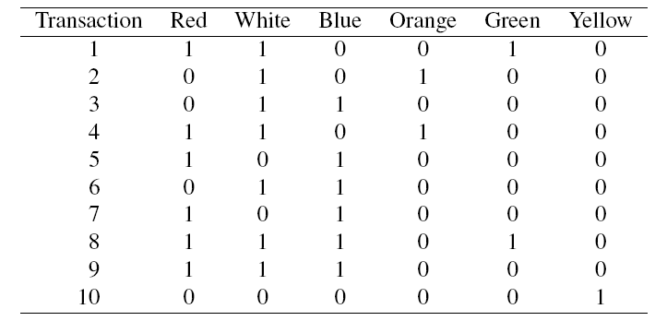
Alternate Data Format: Binary Matrix

Slide 40
Process of Rule Selection
Generate all rules that meet specified support & confidence
Find frequent item sets (those with sufficient support – see previous)
Avoids investigating possible all rules (a priori algorithm)
From the frequent item sets, generate rules with sufficient confidence & lift
Only use rules that you are confident have antecedents that occur more than natural (confidence)
Only use rules where the antecedent / consequent relationship is stronger than (lift) how often the consequent occurs

Slide 41
Generating Rules in R
P(green) if you use the rule
How much better your chances of getting a green are if you use the rule than if you select randomly
lhs rhs support confidence lift
15 {Red,White} => {Green} 0.2 0.5 2.500000
5 {Green} => {Red} 0.2 1.0 1.666667
14 {White,Green} => {Red} 0.2 1.0 1.666667
4 {Orange} => {White} 0.2 1.0 1.428571
6 {Green} => {White} 0.2 1.0 1.428571
13 {Red,Green} => {White} 0.2 1.0 1.428571
Support: red, white, green occurs 2 out of 10 times (0.20)
Confidence: 50% of the time, red/white will result with green.
Lift: Red/white will result in green 2.5 times more often than green usually.

Slide 42
Interpretation
Support measures overall occurrence
Confidence shows the rate at which consequents will be found given an antecedent (useful in learning costs of promotion)
Lift ratio shows how effective the rule is in finding consequents above or below the natural selection of the consequence

Slide 43
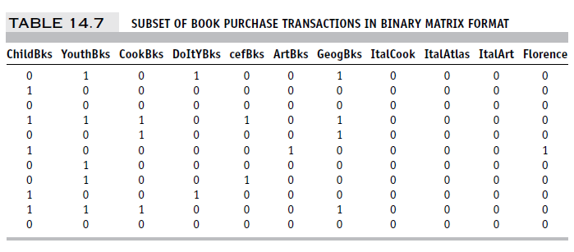

Example: Charles Book Club
Row 1, e.g., is a transaction in which books were bought in the following categories: Youth, Do it Yourself, Geography

Slide 44
Let’s Practice! Open A_AssociationRules.R
VARIABLE NAMES | DESCRIPTIONS
Seq# | Sequence number in the partition
ID# | Identification number in the full (unpartitioned) market test data set
Gender | O=Male, 1=Female
M | Monetary- Total money spent on books
R | Recency- Months since last purchase
F | Frequency - Total number of purchases
FirstPurch | Months since first purchase
ChildBks | Number of purchases from the category: Child books
YouthBks | Number of purchases from the category: Youth books
CookBks | Number of purchases from the category: Cookbooks
DoItYBks | Number of purchases from the category Do It Yourself books
RefBks | Number of purchases from the category: Reference books (Atlases, Encyclopedias, Dictionaries)
ArtBks | Number of purchases from the category: Art books
GeoBks | Number of purchases from the category: Geography books
ItalCook | Number of purchases of book title: "Secrets of Italian Cooking."
ItalAtlas | Number of purchases of book title: "Historical Atlas of Italy."
ItalArt | Number of purchases of book title: "Italian Art."
Florence | =1 "The Art History of Florence." was bought, =0 if not
Related purchase | Number of related books purchased

Slide 45
Summary – Association Rules
Association rules (or affinity analysis, or market basket analysis) produce rules on associations between items from a database of transactions
Widely used in recommender systems
Most popular method is Apriori algorithm
To reduce computation, we consider only “frequent” item sets (=support)
Performance of rules is measured by confidence and lift
Can produce a profusion of rules; review is required to identify useful rules and to reduce redundancy

Slide 46
Agenda
Start | End | Item
 |  | Business Context
 |  | Association Rules
 |  | Code Example
 |  | Collaborative Filtering
 |  | Code Example
 |  | Personalized Reco Engine

Slide 47
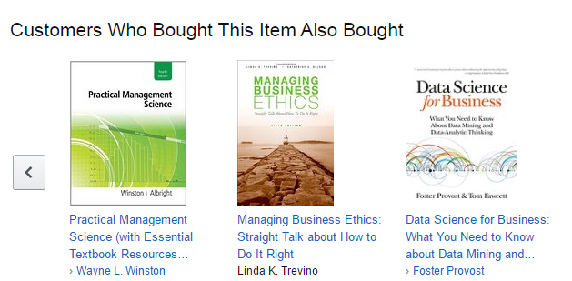
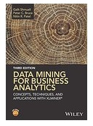
Collaborative Filtering
User based methods
Item based methods

Slide 48
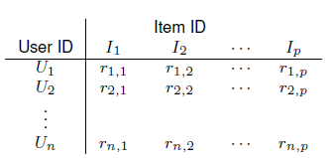
Item-user matrix
Cells are user preferences, r_{ij}, for items
Preferences can be ratings, or binary (buy, click, like)

Slide 49
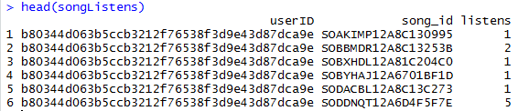
More efficient to store as rows of triplets
Each row has the user ID, the item ID, and the user’s rating of that item
(U_{u}, I_{i}, r_{ui})
Triplets restructure as a longer format but are more memory efficient.

Slide 50
User-based Collaborative Filtering
Start with a single user who will be the target of the recommendations
Find other users who are most similar, based on comparing preference vectors
Association rules is a frequentist look at items or transactions. Collaborative filtering is seeking to identify similarities by user preference or item features.

Slide 51

Measuring Proximity Pearson Correlation
Like nearest-neighbor algorithm
But Euclidean distance does not do well
Correlation proximity does better (Pearson)
For each user pair, find the co-rated items, calculate correlation between the vectors of their ratings for those items
MEH?!

Slide 52
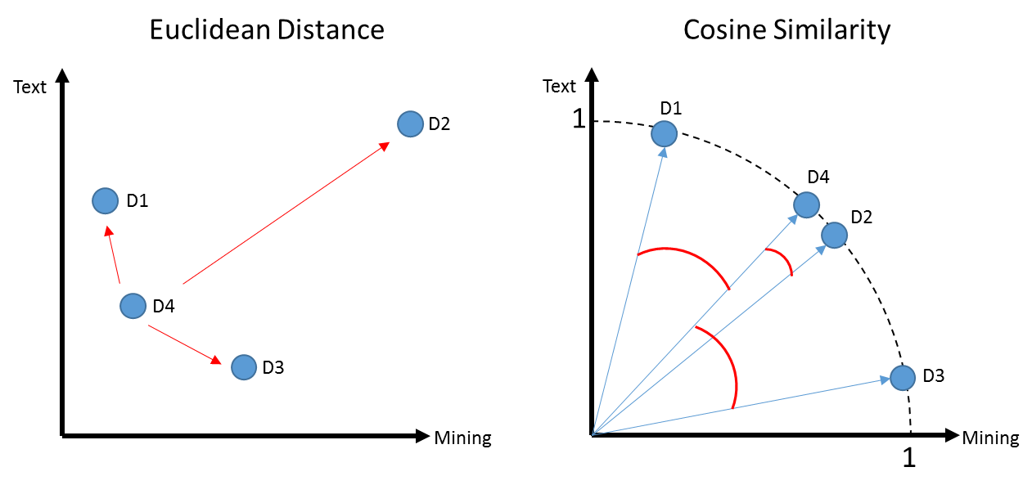
Proximity Measure - Cosine Similarity
“cat video”
# of LIKES
User liked “cat videos”
“dog video” # of likes
User liked “dog videos”
K-Means Clustering
Spherical K-Means
Outliers affect algo.
Outliers have no affect.
Notes:
Like correlation coefficient, except do not subtract the means
“Cold start” problem: For users with just one item, or items with just one neighbor, neither cosine similarity nor correlation produces useful metric
Binary matrix? Must use all the data, not just the co-rated items.
This can add useful info – in the Netflix contest, information about which movies users chose to rate was informative

Slide 53

Major Challenge to Collaborative Filtering
COLD START
For users with just one item, or items with just one neighbor, neither cosine similarity nor correlation produces useful metric. What do you do with new users?

Slide 54

Open B_CollaborativeFiltering.R

Slide 55
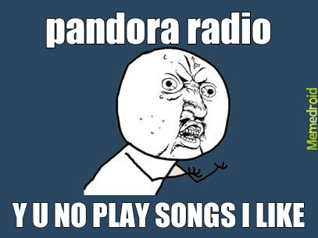
Summary – Collaborative Filtering
User-based – for a new user, find other users who share his/her preferences, recommend the highest-rated item that new user does not have.
Item-based – for a new user considering an item, find another item that is most similar in terms of user preferences represented as previous transactions.
Ability to calculate item-item correlations in advance greatly speeds up the algorithm

Slide 56
Association Rules vs. Collaborative Filtering
AR: focus entirely on frequent (popular) item combinations. Data rows are single transactions. Ignores user dimension. Often used in displays (what goes with what).
CF: focus is on user preferences. Data rows are user purchases or ratings over time for a user or a particular item. Can capture “long tail” of user preferences – useful for recommendations involving unusual or a large number of items

