Slide 1
NGEE Tropics Progress Update – Asu Micro-catchment Hydrologic Data
03/16/2016

Slide 2
Data Lists
DEM
Soil Map and Parameters
Vegetation Map and Parameters
Soil Depth
Meteorological Forcing
Princeton
DHSVM

Slide 3
DEM
Data format: Raster
Values: Elevation in meters
Resolution: 90m
Source of Data: HydroSHEDS
Version: Hydrologically conditioned elevation
Original Dataset Resolution: 3 acr-second
(note: 3 arc-seconds = 0.00083 degrees = ca. 90 m/pixel)

Slide 4
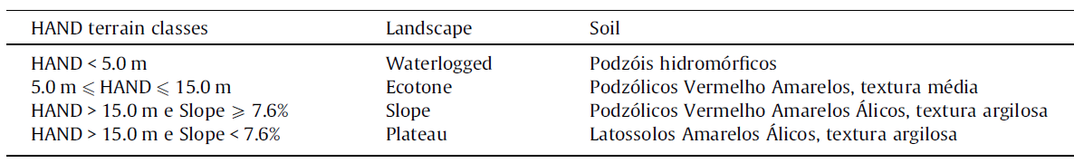
Soil
Data format: Raster
Values: Soil Type Reference Number (1, 2, 3, 4)
Resolution: 90m
Source of Data: Derived from DEM using HAND terrain model in combination with slope
Reference: Cuartas et al., 2012

Slide 5
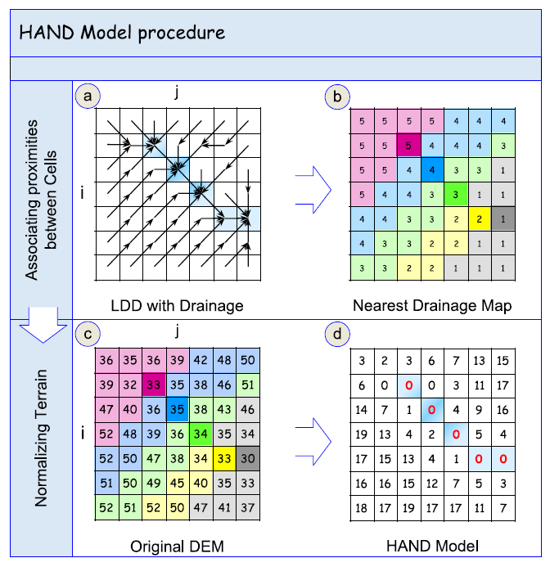
HAND Terrain Model
Height Above Nearest Drainage
Normalizes topography according to the local relative heights found along the drainage network
HAND terrain model ArcGIS toolbox available at here
Reference: Nobre et al., 2011

Slide 6
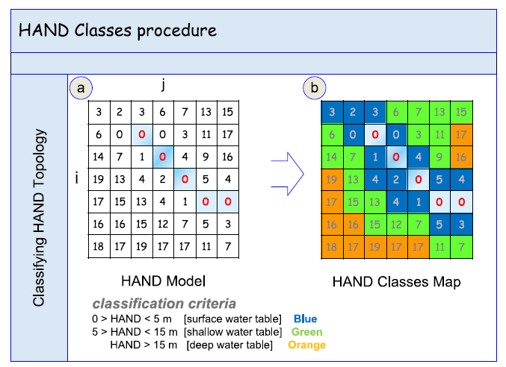
HAND Terrain Model
HAND Classes Procedure
Reference: Nobre et al., 2011

Slide 7
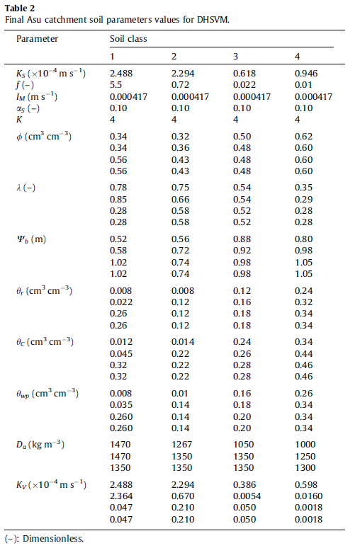
Soil Parameters
Reference: Cuartas et al., 2012

Slide 8
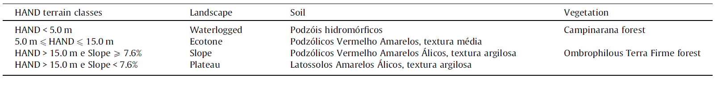
Vegetation
Data format: Rasters
Values: Vegetation Type Reference Number (1, 2)
Resolution: 90m
Source of Data: Derived from DEM using HAND terrain model
Reference: Cuartas et al., 2012

Slide 9
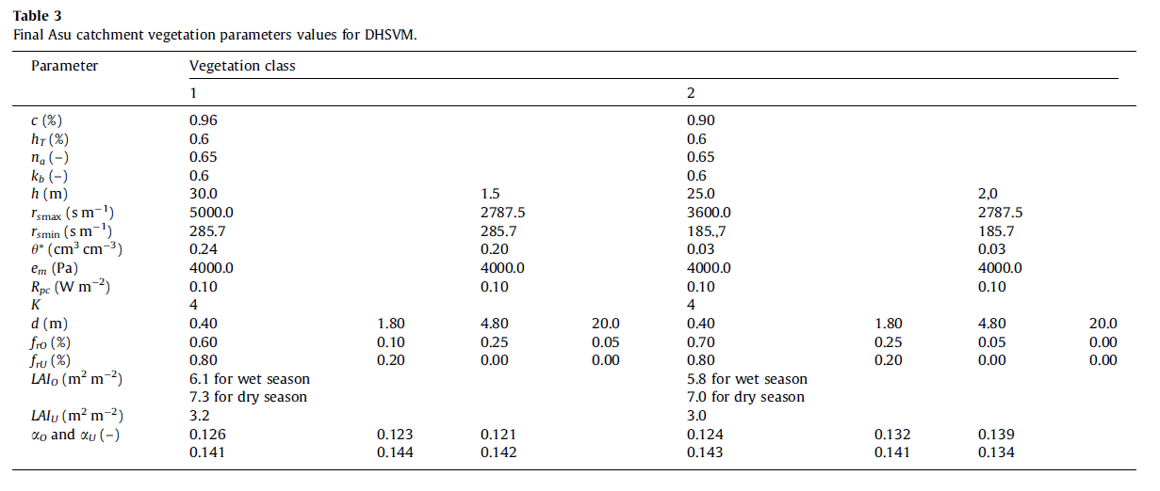
Vegetation Parameter
Reference: Cuartas et al., 2012

Slide 10
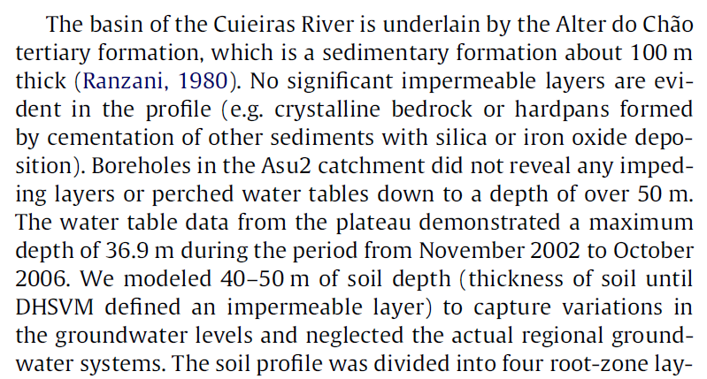
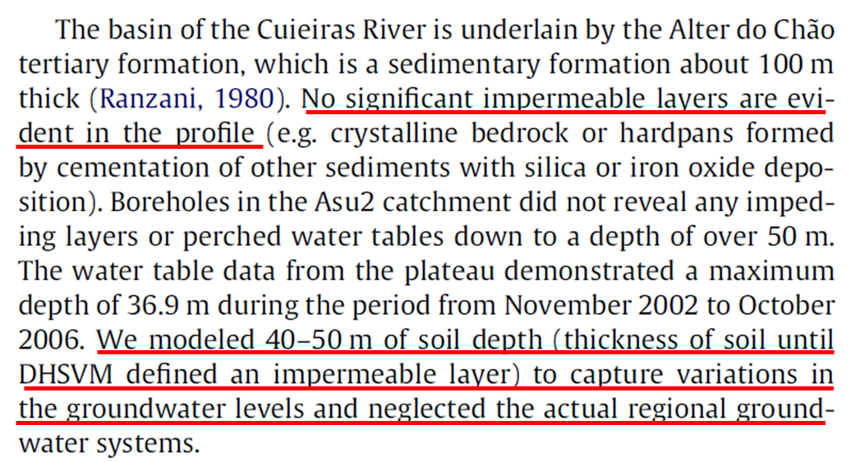
Soil Depth
Soil Depth Range: 40m – 50m;
PARFLOW is using 50m constant soil depth
Reference: Cuartas et al., 2012

Slide 11
Forcing - Princeton
Data format: NetCDF
Spatial/Temporal Resolution: 3 Hour 0.25 x 0.25 degree
Temporal Range: 1948-01-01 00:00 to 2010-12-31 21:00
Data Type: Grid
Variables:
Humidity
Longwave radiation
Precipitation
Shortwave radiation
Surface Air Temperature
Surface Pressure
Surface Winds
Related Resources: Terrestrial Hydrology Research Group, Princeton University

Slide 12
Forcing – TRMM
Data name: TRMM/TMPA 3B42 TRMM and Others Rainfall Estimate Data V7
Data format: HDF but NetCDF is also avaiable
Spatial/Temporal Resolution: 3 Hour 0.25 x 0.25 degree
Temporal Range: 1998-01-01 to Current
Data Type: Grid
Variables: Rainfall
Related Resources: TRMM_3B42 Version 7

Slide 13
Other Potential Datasets
Data | Type | Resolution | Period of Record | Note
Streamflow at 1st order stream(Asu1) | Observation - Streamflow | Stored every 30 min and downloaded weekly | May 2005 – Oct. 2006 | Draining area: 0.95 sq km
Streamflow at 2nd order stream(Asu2) | Observation - Streamflow |  | Jan. 2002 – Oct. 206 | Draining area: 6.58 sq km
Streamflow at 3rd order stream(Asu3) | Observation - Streamflow |  | Dec. 2004 – Oct. 2006 | Draining area: 12.43 sq km
Rainfall at FZ, ML, T1, T3, K43 | Observation - Rainfall | 5 min interval; 0.18 mm |  | Rainfall at clearing location(FZ and ML), 24m high tower(T1), 12m high tower(T3), 53m high tower(K43)
K34 flux tower | Observation - Flux | 30 min interval; 0.2mm | 1999-2015* | Location:(-2.609097222, -60.20929722) Containing data of air temperature, wind speed, relative humidity, incoming short-wave and long-wave radiation, photosynthetically active radiation net radiation, air pressure, rainfall and ET
Soil Moisture | Monitoring - Soil Mositure | Weekly or bi-weekly | Nov. 2002 – Oct. 2006 | IHII neutron probe (Didcot Instrument Co., UK.) in access tubes installed to a depth of 4.8 m on the plateau (3 tubes) and slope (4 tubes), 2.8 m on the footslope (2 tubes) and 1.8 m on the valley floor (2 tubes).
Groundwater Level | Monitoring - water table | Weekly | Nov. 2002 – Oct. 2006 | 25 monitoring well
* Information based on: http://fluxnet.ornl.gov/site/76

Slide 14
Reference
Cuartas LA, Tomasella J, Nobre AD, Nobre C, Hodnett M, Waterloo M, Oliveira S, Von Randow R, Trancoso R, Ferreira M. 2012. Distributed hydrological modeling of a micro-scale rainforest watershed in Amazonia: model evaluation and advances in calibration using the new HAND terrain model. Journal of Hydrology 462–463:
Nobre, A.D., Cuartas, L.A., Hodnett, M.G., Rennó, C.D., Rodrigues, G., Siveira, A., Waterloo, M.J., Saleska, S., 2011. Height above the nearest drainage – a hydrologically relevant new terrain model. J. Hydrol. 404 (1–2), 13–29.
Sheffield, J., G. Goteti, and E. F. Wood, 2006: Development of a 50-yr high-resolution global dataset of meteorological forcings for land surface modeling, J. Climate, 19 (13), 3088-3111
Huffman GJ, David TB, Eric JN, David BW, Robert FA, et al. The TRMM multisatellite precipitation analysis (TMPA): Quasi-global, multiyear, combined-sensor precipitation estimates at fine scales. Journal of Hydrometeorology 2007; 8(1): 38-55.

Slide 15
Thank you

