Slide 1
Asu Catchment Single-Point Simulation
Site Location (2.609ºS, 60.209ºW)
dx = 5400 m
dy = 4590 m
Surface data created from CLM surface data set
“surfdata_1.9x2.5_simyr2000_c141219.nc”
Driving force (1998-2008)
TRMM 0.25 degree, 3 hourly precipitation
Others from Princeton Hydrology group (0.25 degree, 3 hourly)
Default soil depth in ALM (35m)
Spin up run for 110 years
Restart simulation for 11 years

Slide 2
Soil Parameter Values
Porosity | Brooks-Corey pore-size index | Brooks-Corey entry pressure (m) | Saturated hydraulic conductivity (10⁻⁴m/s)
0.465 | 8.026 | 0.318 | 25.33
0.467 | 8.186 | 0.327 | 24.48
0.464 | 8.388 | 0.329 | 24.31
0.461 | 8.116 | 0.331 | 24.16
0.458 | 8.302 | 0.333 | 24.05
0.454 | 8.480 | 0.315 | 25.73
0.449 | 8.486 | 0.279 | 27.03
0.449 | 8.641 | 0.288 | 27.01
0.447 | 8.783 | 0.280 | 29.47
0.435 | 8.475 | 0.207 | 41.92
Cuartas et al. (2012)
0.34 | 0.78 | 0.52 | 2.488
0.34 | 0.85 | 0.58 | 2.364
0.56 | 0.28 | 1.02 | 0.047

Slide 3
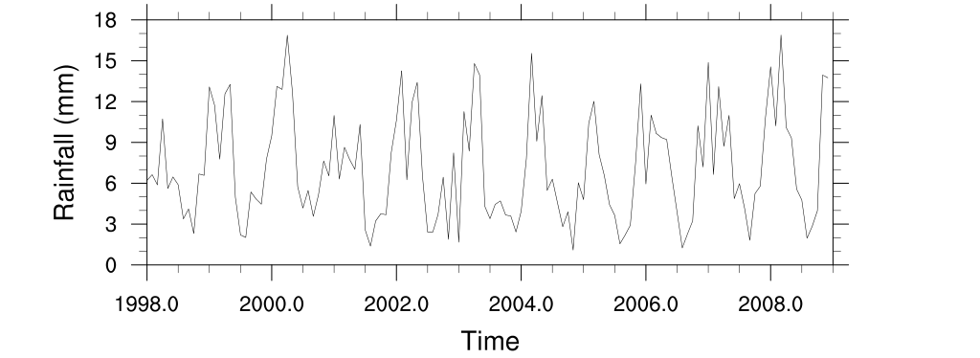
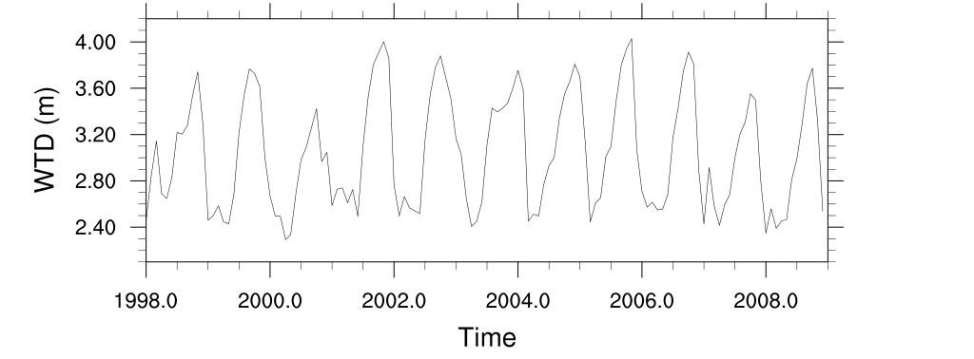
Daily rainfall and simulated water table depth

Slide 4
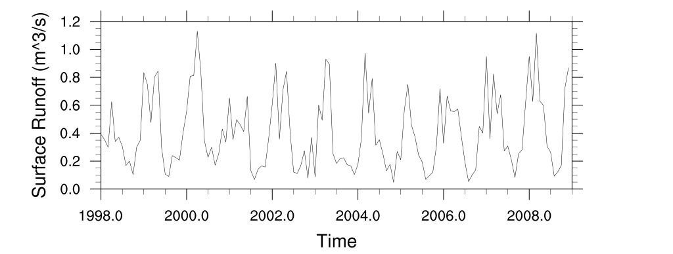
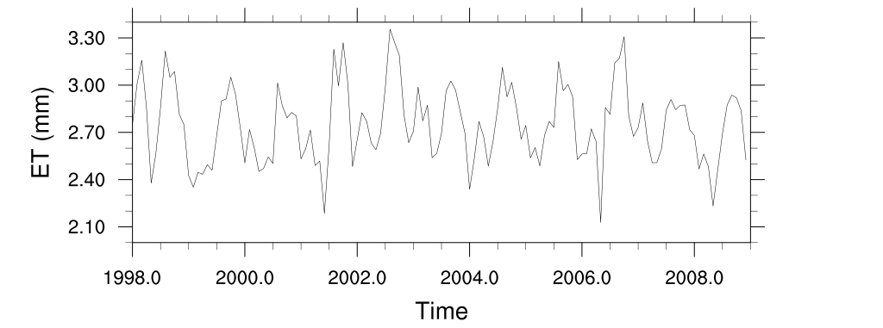
Simulated surface runoff and daily evapotranspiration

Slide 5
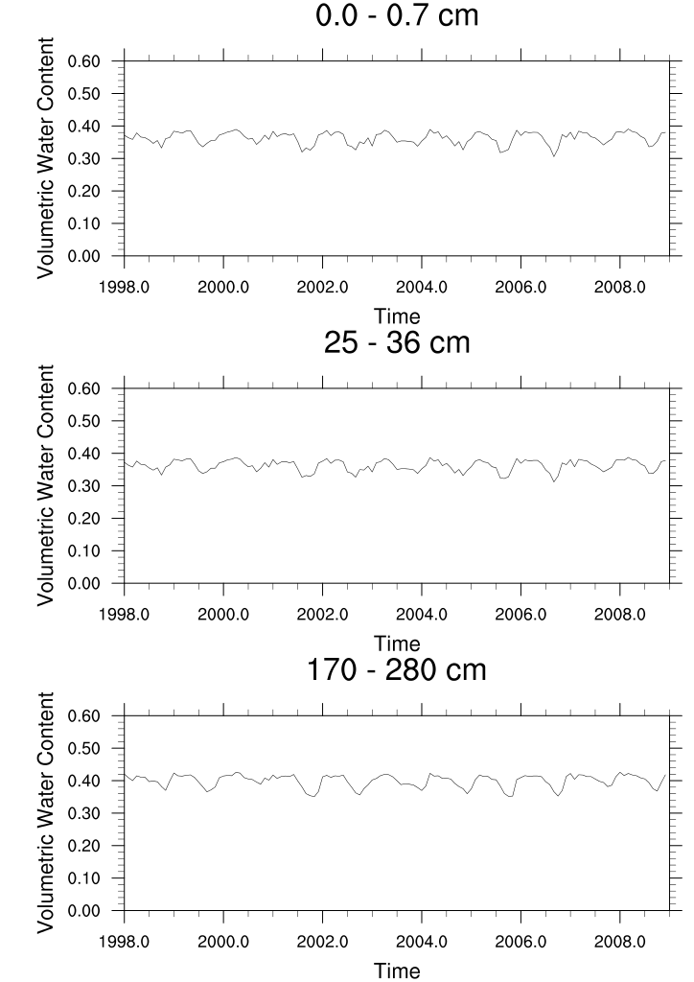
Simulated Volumetric Water Content (cm³/cm³)

Slide 6
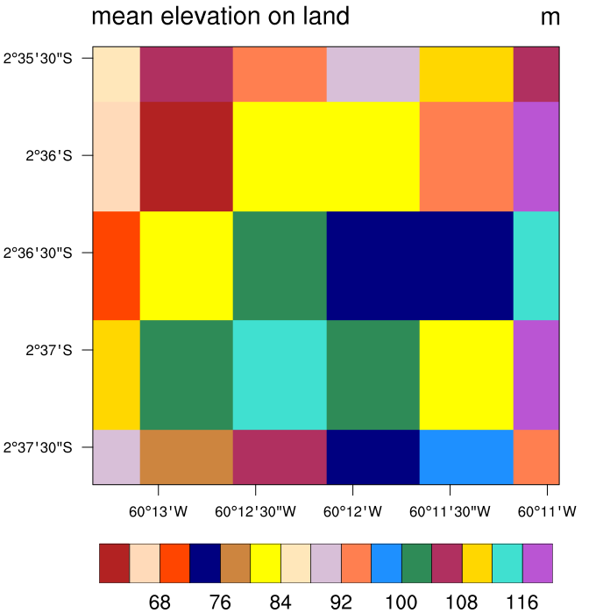
Asu Catchment 6x5 Simulation
Site Location (2.609ºS, 60.209ºW)
Lx = 5400 m, dx = 900 m
Ly = 4500 m, dy = 900 m
Surface data created from raw surface data set except for mean land elevation and slope
Driving force (1998-2008)
TRMM 0.25 degree, 3 hourly precipitation
Others from Princeton Hydrology group
(0.25 degree, 3 hourly)
Spin up run for 110 years
Restart simulation for 11 years

Slide 7
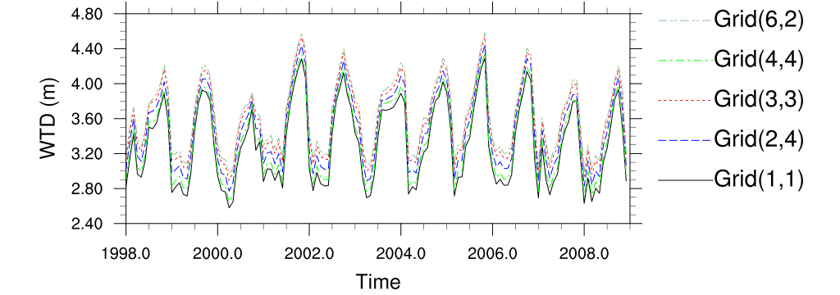

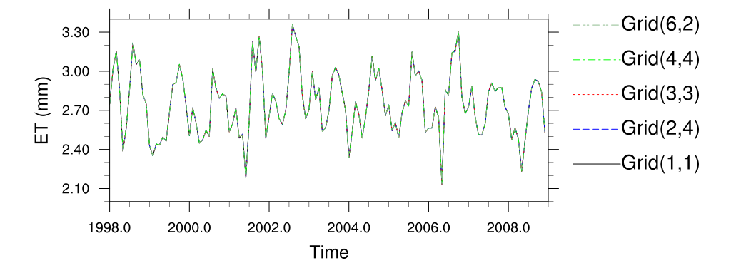
Simulated water table depth and daily evapotranspiration at selected grids

Slide 8
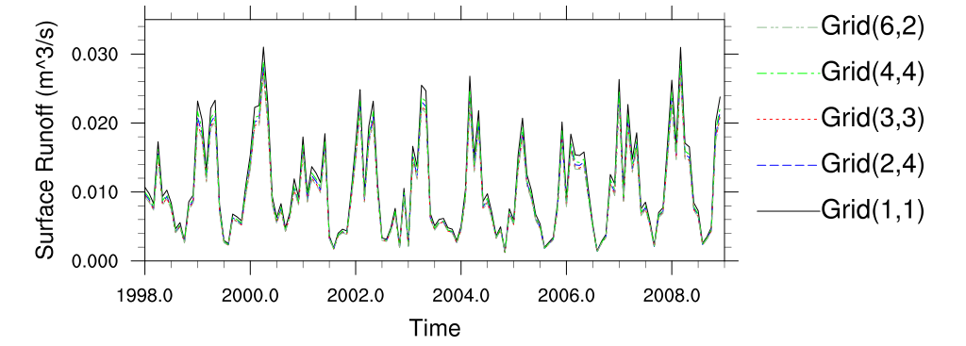
Simulated surface runoff at selected grids

