Slide 1
Activities on CHIRPS Precipitation Raster Time Series Analysis in R
Emanuele Cordano

Slide 2
OBJECT: Frequency Analysis of Monthly and Yearly Precipitation in some African regions
Mapping of Moments and L-Moments;
Fitting with parametric Cumulated Probability Distributions P for time-aggregated values of Precipitation;
Testing Parametric Probability Distribution P (e. g. Kolgormov-Smirnov), formation of the accepted hypothesis for the Probability Distributions
Computation and mapping of Excesses ,Droughts respect to mean precipitation and Return Periods T:

Slide 3
OUTLINE: Frequency Analysis of Monthly and Yearly Precipitation in some African regions
Data: Precipitation on raster format;
Tools: R software package with additional plug-in packages;
Exercise: snippets of instructions on how to estimate L-moments, fit the probability distribution and compute the excess, deficits and return periods;
Visualization and Analysis of results.

Slide 4
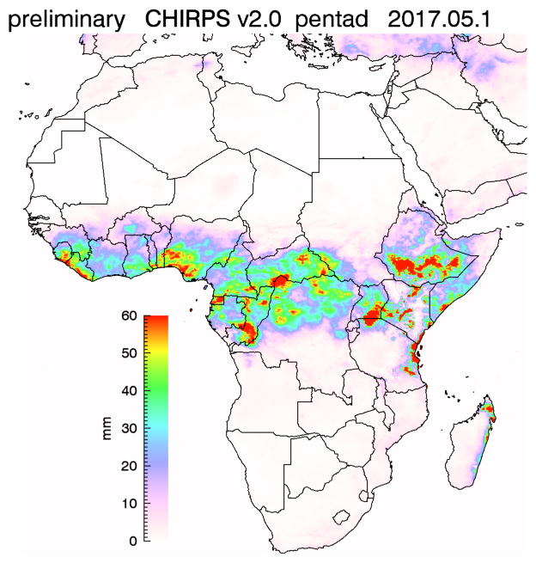
TOOLS
Climate Hazards Group InfraRed Precipitation with Station data (CHIRPS) is a 30+ year quasi-global rainfall dataset.
Spanning 50°S-50°N (and all longitudes), starting in 1981 to near-present, CHIRPS incorporates 0.05° resolution satellite imagery with in-situ station data to create gridded rainfall time series for trend analysis and seasonal drought monitoring.
Temporal resolution = 1 day
Spatial resolution = 5 km
Timespan = 30+ year
Funk, Chris, Pete Peterson, Martin Landsfeld, Diego Pedreros, James Verdin, Shraddhanand Shukla, Gregory Husak, James Rowland, Laura Harrison, Andrew Hoell & Joel Michaelsen.
"The climate hazards infrared precipitation with stations—a new environmental record for monitoring extremes". Scientific Data 2, 150066. doi:10.1038/sdata.2015.66 2015.
http://chg.geog.ucsb.edu/data/chirps/

Slide 5

TOOLS
R software is a free environment for statistics, data science and data analysis. Its repository (CRAN – Comprehensive R Archive Network) contains about 10000 additional packages to solve several issues in statistics, data science and technical applications (e. g. environmetrics and environmental science).
“lmom” package (Hosking,2015) Functions related to L-moments: computation of L-moments and trimmed L-moments of distributions and data samples; parameter estimation; L-moment ratio diagram; plot vs. quantiles of an extreme-value distribution.
“raster” package (Hijmans, 2016) contains functions and methods to read, write, manipulate, analyze and model gridded spatial data. The package implements basic and high-level functions. Processing of very large files is supported.
R Core Team (2016). R: A language and environment for statistical
computing. R Foundation for Statistical Computing, Vienna, Austria.
https://www.R-project.org/
J. R. M. Hosking (2015). L-moments. R package, version 2.5. http://CRAN.R-project.org/package=lmom
Robert J. Hijmans (2016). raster: Geographic Data Analysis and Modeling. R package version 2.5-8. https://CRAN.R-project.org/package=raster
An actually non-CRAN package “rasterList” (..) has been developed to replicate generic software object, e.g. created by “lmom”, in a gridded spatial data manipulated by “raster” package.

Slide 6
Computation of the 4 first sample L-Moments of a Single Time Series with “lmom” package
> ### PACKAGE INSTALLATION
> install.packages(“lmom”)
>
> ## LOAD PACKAGE
> library(lmom)
>
> See a list of all package functions with their documentation:
> help(package="lmom",help_type="html")
> ## See directly an help for a function (e.g. 'samlmu')
> help (samlmu,hep_type=”html”)
>
> data(airquality) ## Load the dataset containing Ozone!!
> str(airquality$Ozone)
int [1:153] 41 36 12 18 NA 28 23 19 8 NA ...
> lmom <- samlmu(airquality$Ozone,4) ## Computation of the L-Momements
> loom
l_1 l_2 t_3 t_4
42.1293103 17.6384558 0.2839495 0.1066183
>

Slide 7
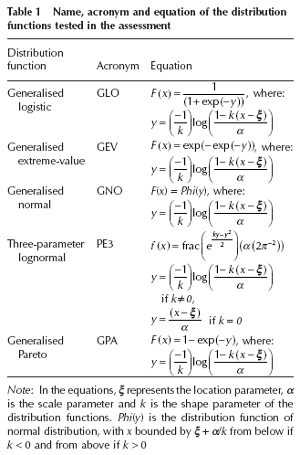
Fit a probability distribution with “lmom” package
> ### PROBABILITY DISTRIBUTION MANIPULATED BY “lmom”
>## pelexp exponential
>## pelgam gamma
>## pelgev generalized extreme-value
>## pelglo generalized logistic
>## pelgpa generalized Pareto
>## pelgno generalized normal
>## pelgum Gumbel (extreme-value type I)
>## pelkap kappa
>## pelln3 three-parameter lognormal
>## pelnor normal
>## pelpe3 Pearson type III
>## pelwak Wakeby
>## pelwei Weibull
>#######
>
>## Finally fit a GEV probability distribution
> distr <- pelgev(lmom)
> str(distr)
Named num [1:3] 25.67 21.18 -0.17
- attr(*, "names")= chr [1:3] "xi" "alpha" "k"
This is the object containing probability distribution and its parameters!!!

Slide 8
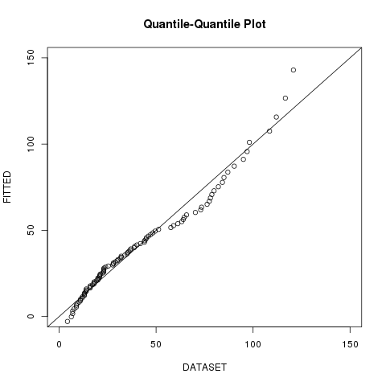
Test the selected probability distribution with a KS test and a quick visualization of a quantile-quantile plot
> ks.test(airquality$Ozone,y="cdfgev",para=distr)
One-sample Kolmogorov-Smirnov test
data: airquality$Ozone
D = 0.092587, p-value = 0.2731
alternative hypothesis: two-sided
Warning message:
In ks.test(airquality$Ozone, y = "cdfgev", para = distr) :
ties should not be present for the Kolmogorov-Smirnov test
Notes:
qqplot(airquality$Ozone,quagev(c(0:100)/100,para=distr),xlim=c(0,150),ylim=c(0,150),main='Quantile-Quantile Plot',xlab='DATASET',ylab='FITTED')
abline(0,1)
REDO WITH ggplot2? (If there's time)

Slide 9
OUTCOME
“lmom” package is a useful tool for the assessmant of statistical analysis and probability assessment for a LOCAL timeseries;
The analysis can be replicated for climatic analysis of the precipitation in ONE SITE of Africa;
Can the analysis be done for A REGION of Africa? Let's say in a gridded spatial area (raster)!

Slide 10
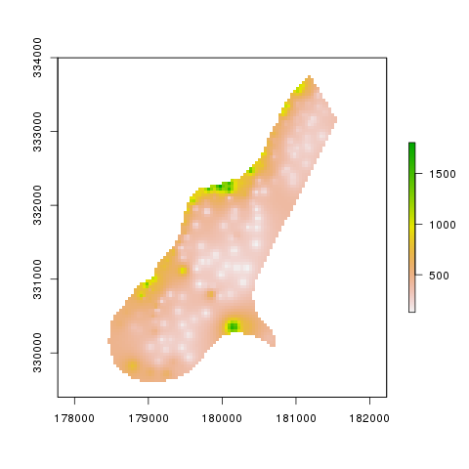
Gridded Spatial Data with “raster” package (1)
> ### PACKAGE INSTALLATION
> install.packages(“raster”)
>
> ## LOAD PACKAGE
> library(raster)
>
> See a list of all package functions with their documentation:
> help(package="raster",help_type="html")
> ## See directly an help for a function (e.g. 'raster')
> help (raster,hep_type=”html”)
> ## A test map file path
>f <- system.file("external/test.grd", package="raster")
>r <- raster(f)
> plot(r)

Slide 11
Gridded Spatial Data with “raster” package (1a)
> r
class : RasterLayer
dimensions : 115, 80, 9200 (nrow, ncol, ncell)
resolution : 40, 40 (x, y)
extent : 178400, 181600, 329400, 334000 (xmin, xmax, ymin, ymax)
coord. ref. : +init=epsg:28992 +towgs84=565.237,50.0087,465.658,-0.406857,0.350733,-1.87035,4.0812 +proj=sterea +lat_0=52.15616055555555 +lon_0=5.38763888888889 +k=0.9999079 +x_0=155000 +y_0=463000 +ellps=bessel +units=m +no_defs
data source : ../raster/external/test.grd
names : test
values : 128.434, 1805.78 (min, max)

Slide 12
Gridded Multi-Layer Spatial Data with “raster” package (2)
> ## See directly an help for the “stack” function
> help (stack,help_type=”html”)
>
> ## Monlthly maps of precipation for the Mecrou river basin area:
> precf <- system.file("map/Mekrou_precipitation.grd", package="rasterList")
> prec <- stack(precf)
> prec
class : RasterStack
dimensions : 21, 13, 273, 432 (nrow, ncol, ncell, nlayers)
resolution : 0.15, 0.15 (x, y)
extent : 1.4, 3.35, 9.95, 13.1 (xmin, xmax, ymin, ymax)
coord. ref. : +proj=longlat +datum=WGS84 +ellps=WGS84 +towgs84=0,0,0
names : X1981.01.01, X1981.02.01, X1981.03.01, ...
min values : 1.904232e-08, 3.493661e-02, 5.933476e-01, ...
max values : 2.405635, 7.734030, 23.666687, ...

Slide 13
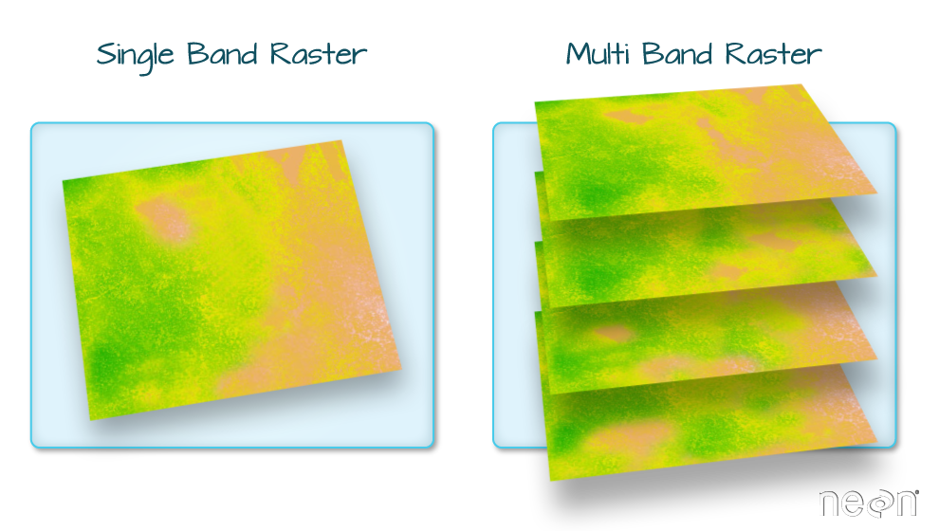

Gridded Multi-Layer Spatial Data with “raster” package (3)
TIME
(e. g. months)
http://neondataskills.org/R/Multi-Band-Rasters-In-R/

Slide 14
Gridded Multi-Layer Spatial Data with “raster” package (2)
> ## See directly an help for the “stack” function
> help (stack,help_type=”html”)
>
> ## Monthly maps of precipitation for the Mecrou river basin area:
> precf <- system.file("map/Mekrou_precipitation.grd", package="rasterList")
> prec <- stack(precf)
> prec
class : RasterStack
dimensions : 21, 13, 273, 432 (nrow, ncol, ncell, nlayers)
resolution : 0.15, 0.15 (x, y)
extent : 1.4, 3.35, 9.95, 13.1 (xmin, xmax, ymin, ymax)
coord. ref. : +proj=longlat +datum=WGS84 +ellps=WGS84 +towgs84=0,0,0
names : X1981.01.01, X1981.02.01, X1981.03.01, ...
min values : 1.904232e-08, 3.493661e-02, 5.933476e-01, ...
max values : 2.405635, 7.734030, 23.666687, ...

Slide 15
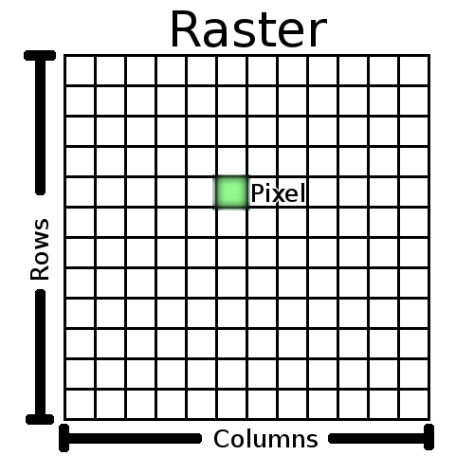

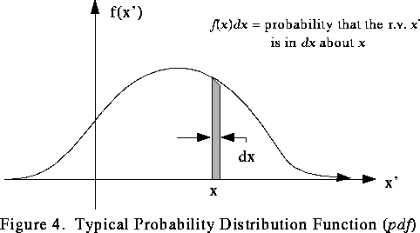
Gridded Spatial Data containing objects: it has been created “rasterList” package!!
A generic object
(e.g. a probability distribution function)
(https://www.phy.ornl.gov/csep/mc/node13.html)
A generic object
(e.g. a probability distribution function)
(https://www.phy.ornl.gov/csep/mc/node13.html)
Raster Object
(http://docs.qgis.org/2.14/en/docs/gentle_gis_introduction/raster_data.html)

Slide 16

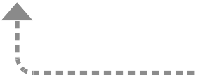
The “rasterList” object connect a generic rasterLayer to a list of objects copling each raster cell to a list element through an index.

Slide 17
EXERCISE: AUGUST PRECIPITION ANALISYS FOR THE MEKROU RIVER
Some snippet of code for yearly aggregation: take the August month of each year!
> ## Set time
>
>time <- as.Date(names(prec),format="X%Y.%m.%d")
>year <- as.character(time,format="X%Y")
> ## GET THE MEAN PRECIPITATION FOR AUGUST OF EACH YEAR!!
>augprec <- stackApply(x=prec,fun=function(x,m=8,...){x[m]},indices=year)
> augprec
class : RasterBrick
dimensions : 21, 13, 273, 36 (nrow, ncol, ncell, nlayers)
resolution : 0.15, 0.15 (x, y)
extent : 1.4, 3.35, 9.95, 13.1 (xmin, xmax, ymin, ymax)
coord. ref. : +proj=longlat +datum=WGS84 +ellps=WGS84 +towgs84=0,0,0
data source : in memory
names : index_X1981, index_X1982, index_X1983, ...
min values : 122.78080, 131.20524, 61.17589, ...
max values : 351.0225, 293.3835, 224.3457, ...

Slide 18
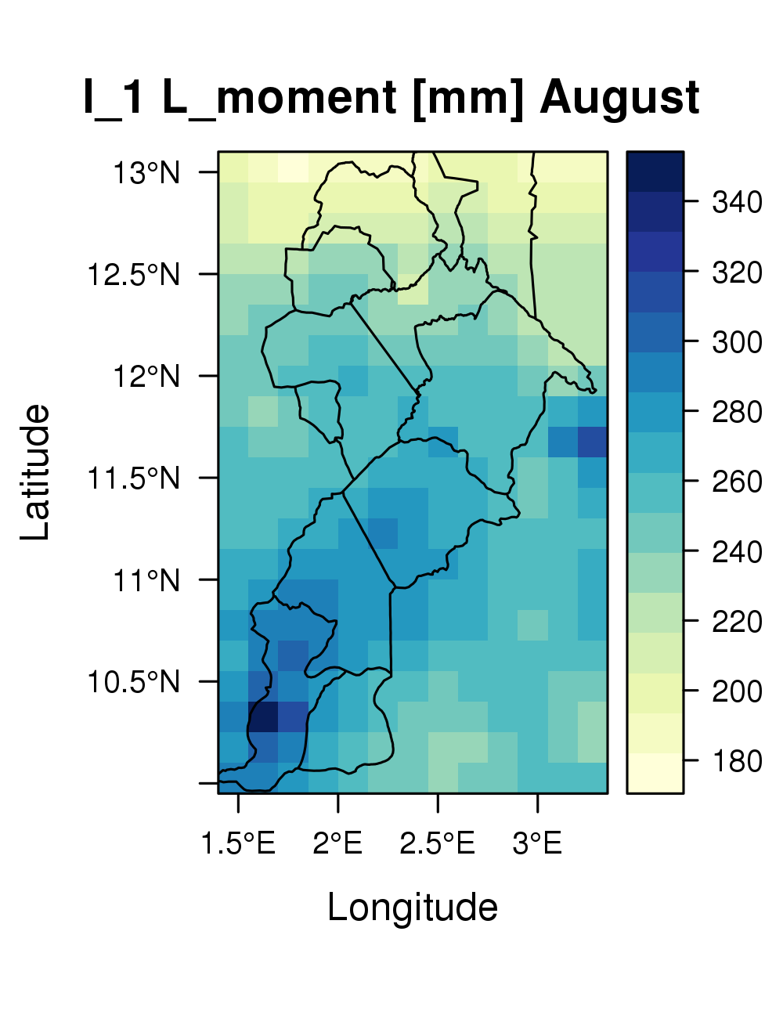
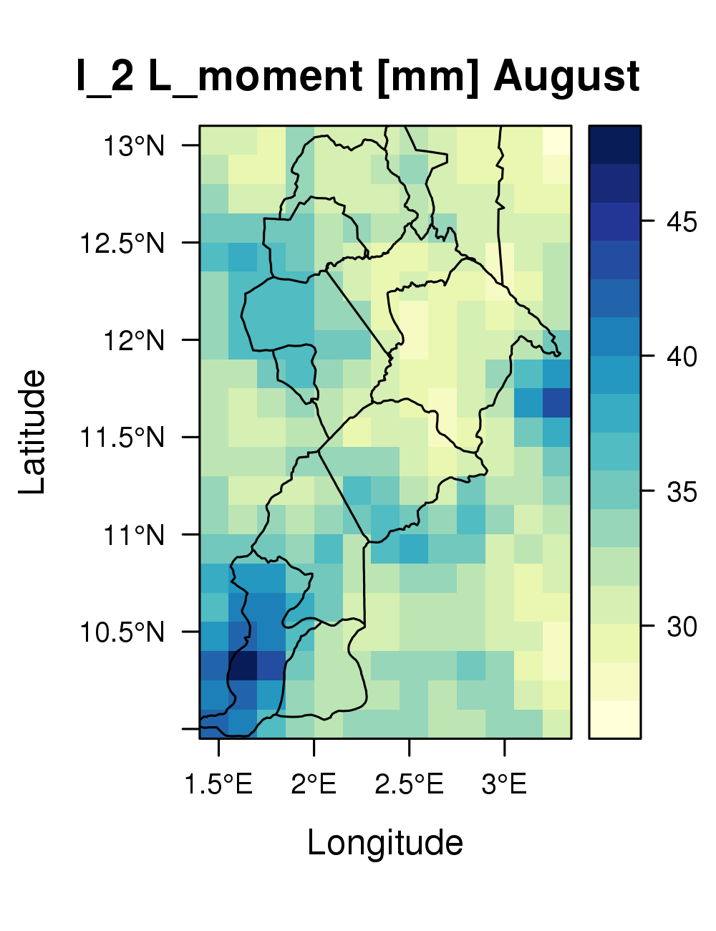
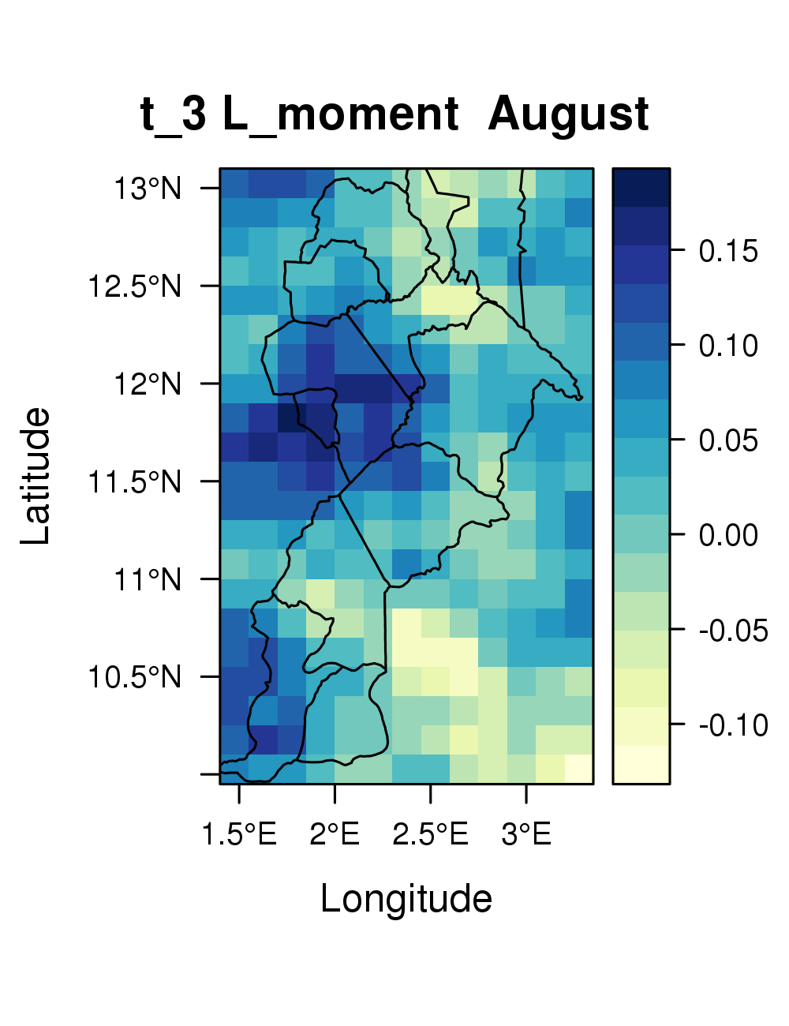
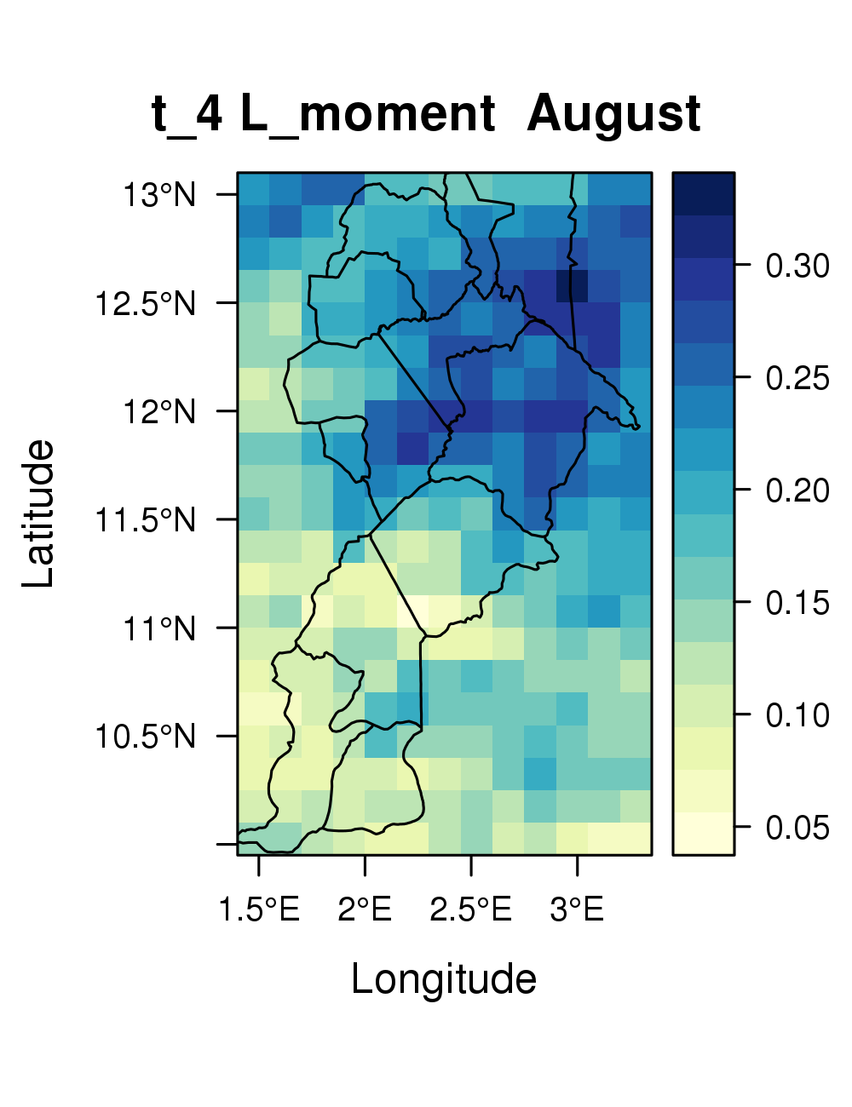
EXERCISE: AUGUST PRECIPITATION ANALYSIS FOR THE MEKROU RIVER (2)
Computation of L-Moments:
>samlmom <- stack(rasterList(yearlyprec,FUN=samlmu)

Slide 19
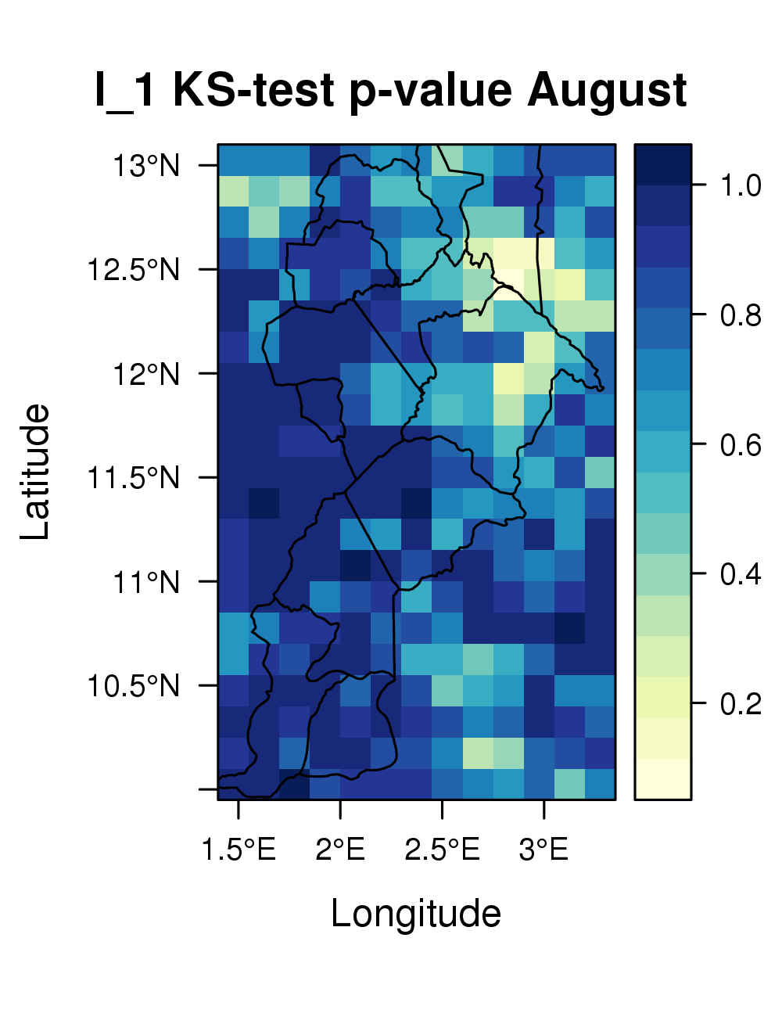
EXERCISE: AUGUST PRECIPITATION ANALYSIS FOR THE MEKROU RIVER (3)
Fit a “Gamma” probability distribution for each pixel:
> ## Computation of Gamma parameters from L-Moments from each cell
>fitdist <- rasterList(samlmom,FUN=pelgam)
> ## Apply Kolgomorov-Smirnov test to each cell
> kstestdist <- RasterListApply(para=fitdist,x=rasterList(augprec)
,y="cdfgam",FUN=ks.test)
> ## Extraction of p.value
>pvalue <- rasterList::stack(rasterList(kstestdist,
FUN=function(x){x$p.value}))
KS test p.value higher than 0.1 !!!

Slide 20
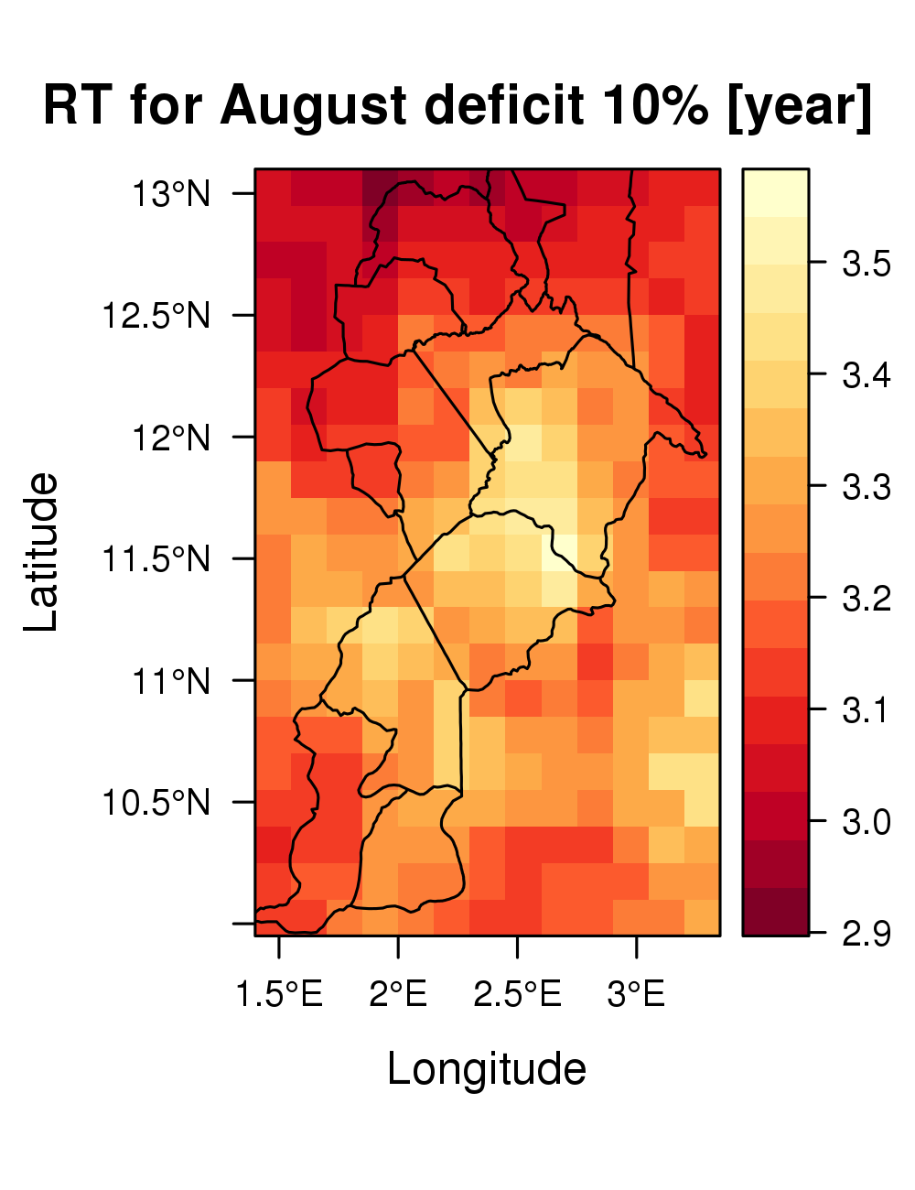
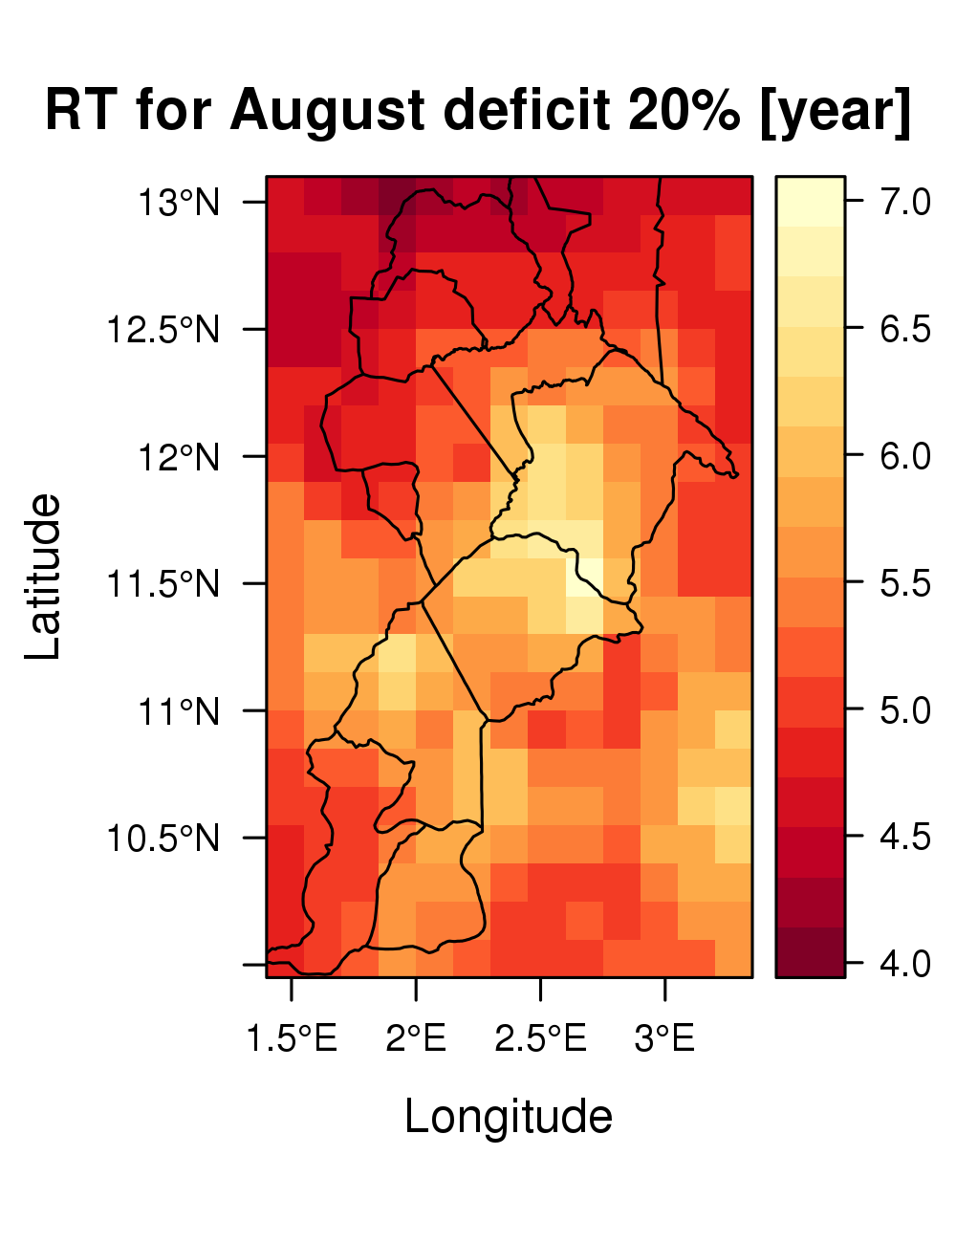
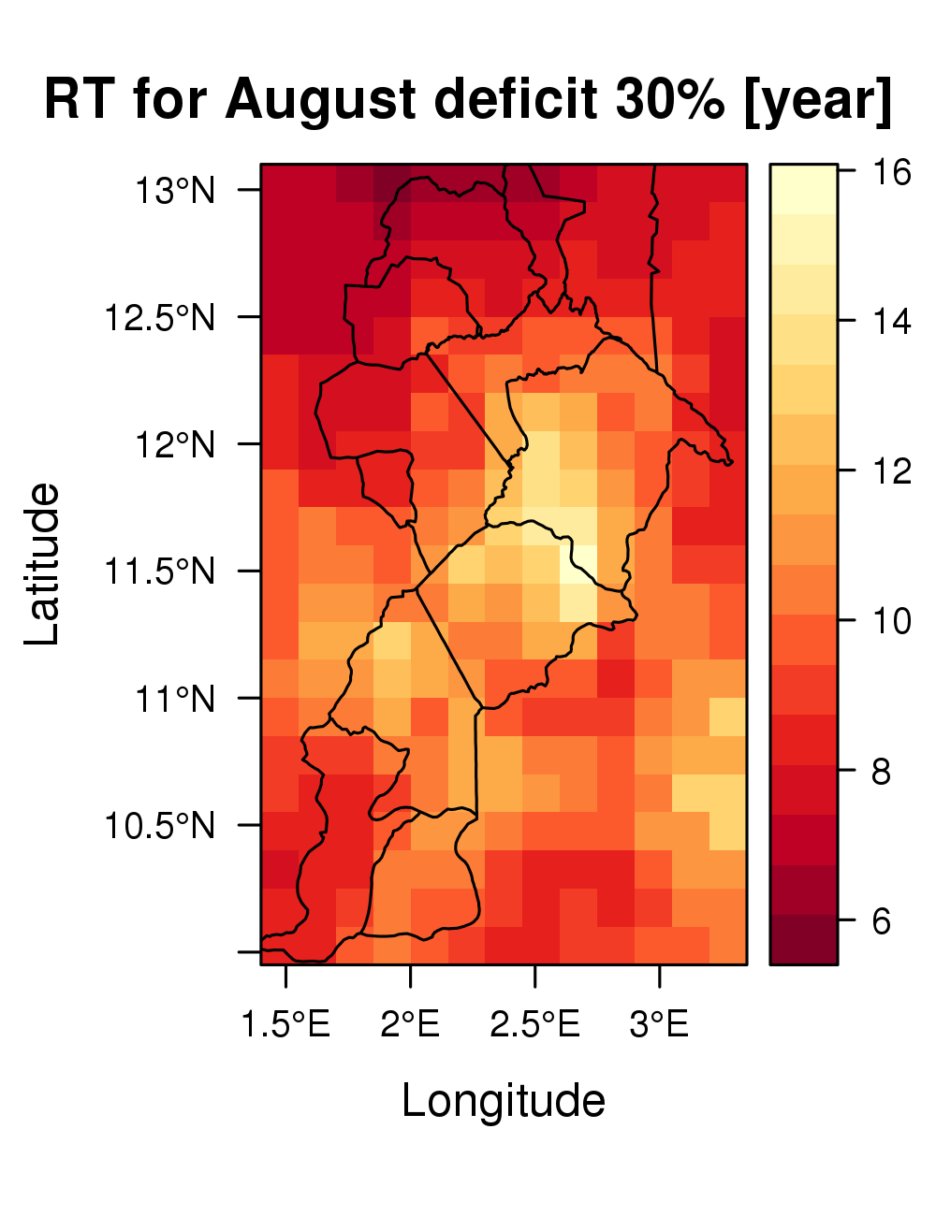
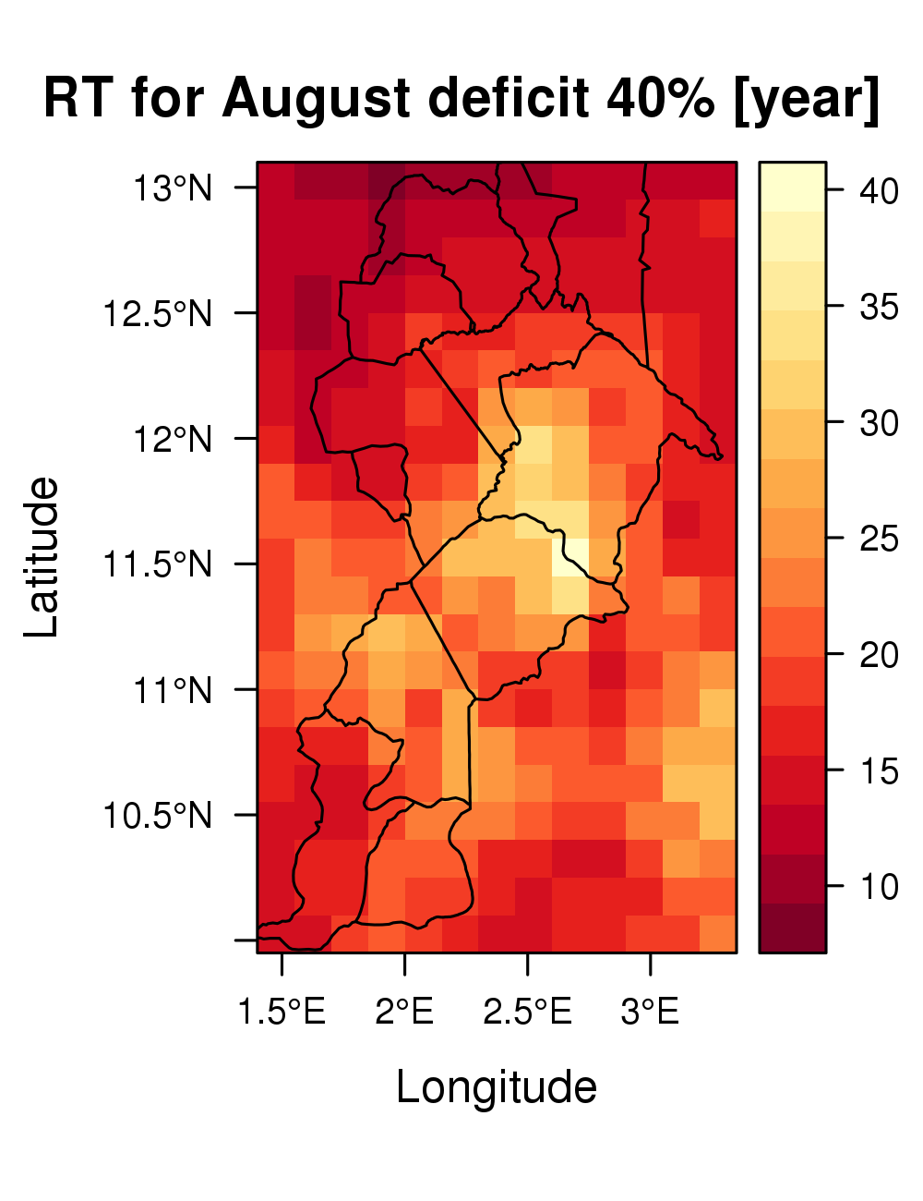
EXERCISE: AUGUST PRECIPITATION ANALYSIS FOR THE MEKROU RIVER (4)
Computation of Return Period for Deficits:
Return period (RT) associated to a value of August precipitation lower than the Sample Mean Precipitation minus a fixed percentage.

Slide 21
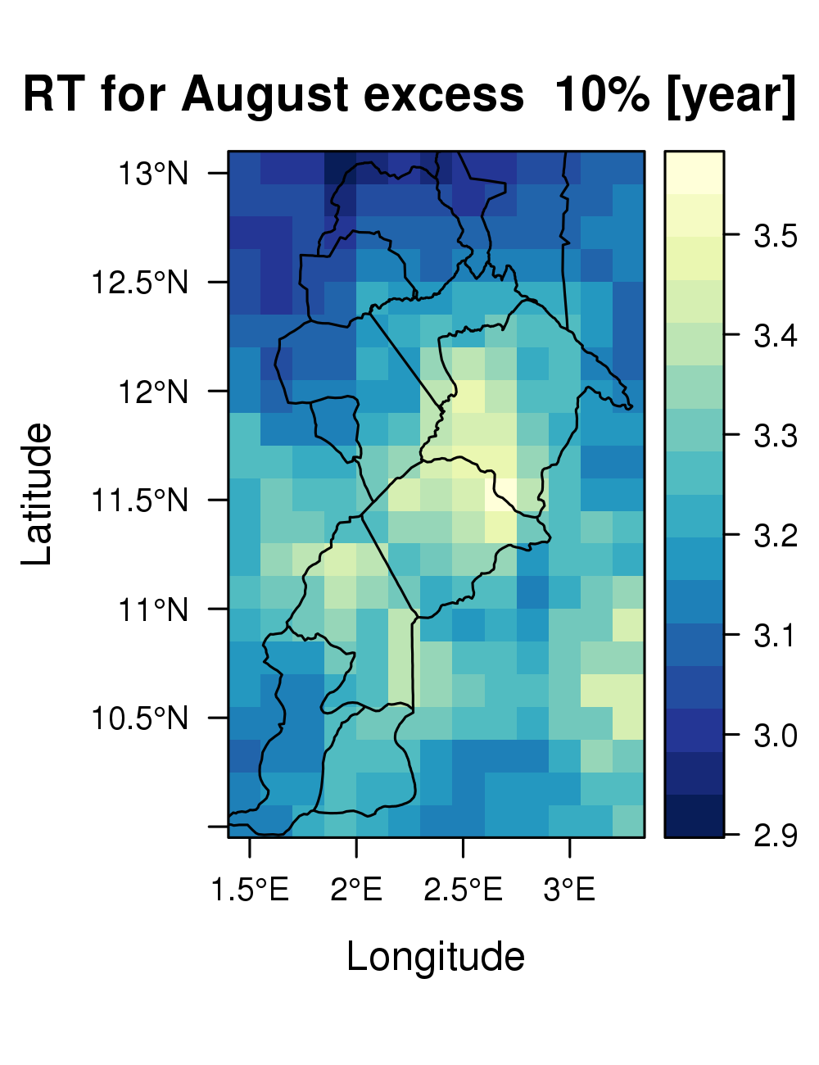
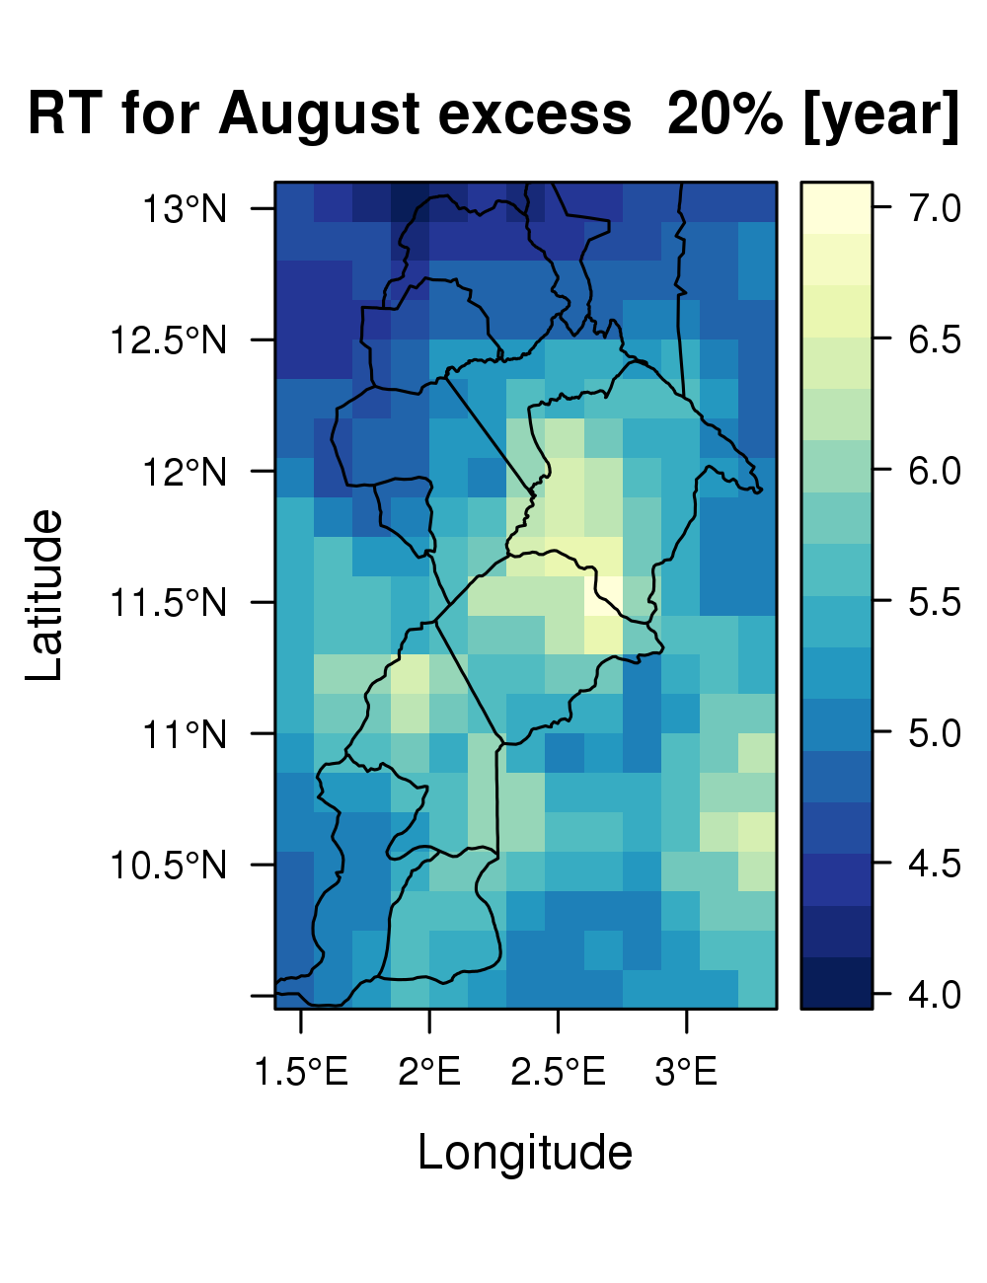
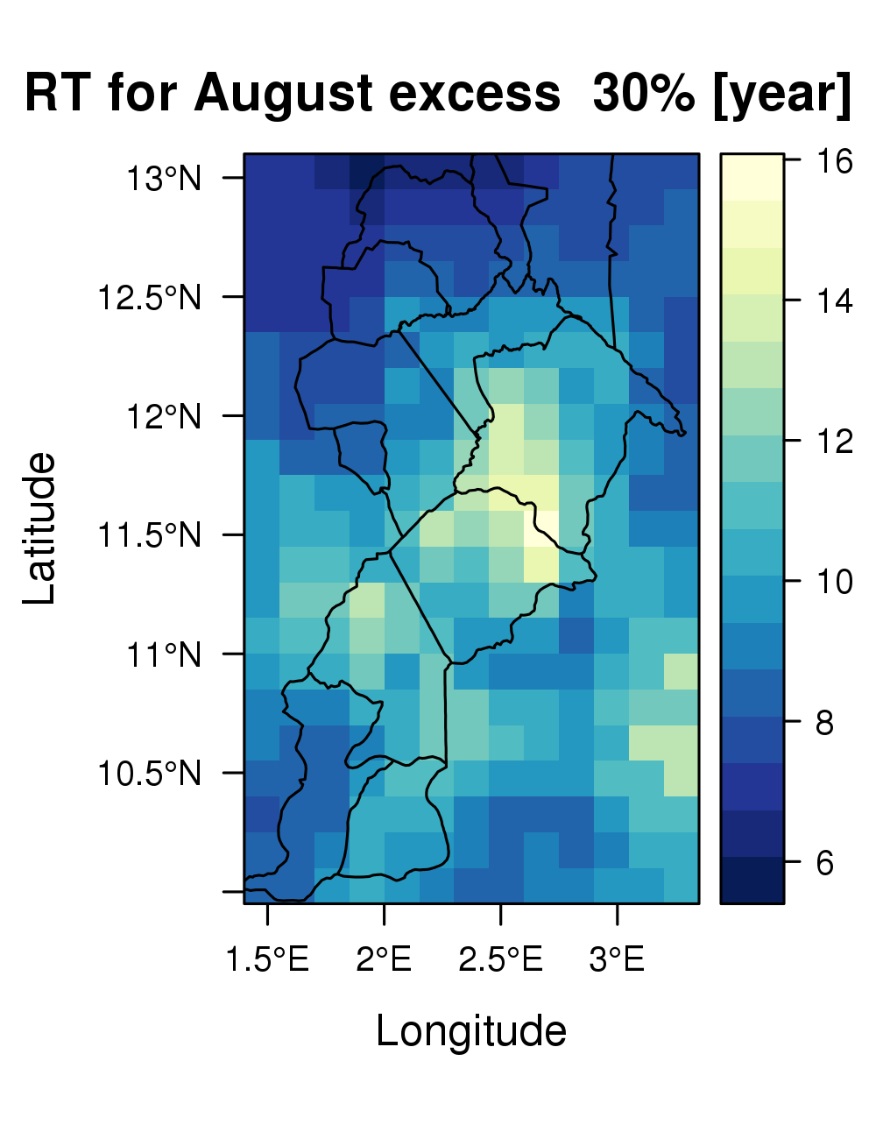

EXERCISE: AUGUST PRECIPITATION ANALYSIS FOR THE MEKROU RIVER (5)
Computation of Return Period for Excesses:
Return period (RT) associated to a value of August precipitation greater than the Sample Mean Precipitation plus a fixed percentage.

Slide 22
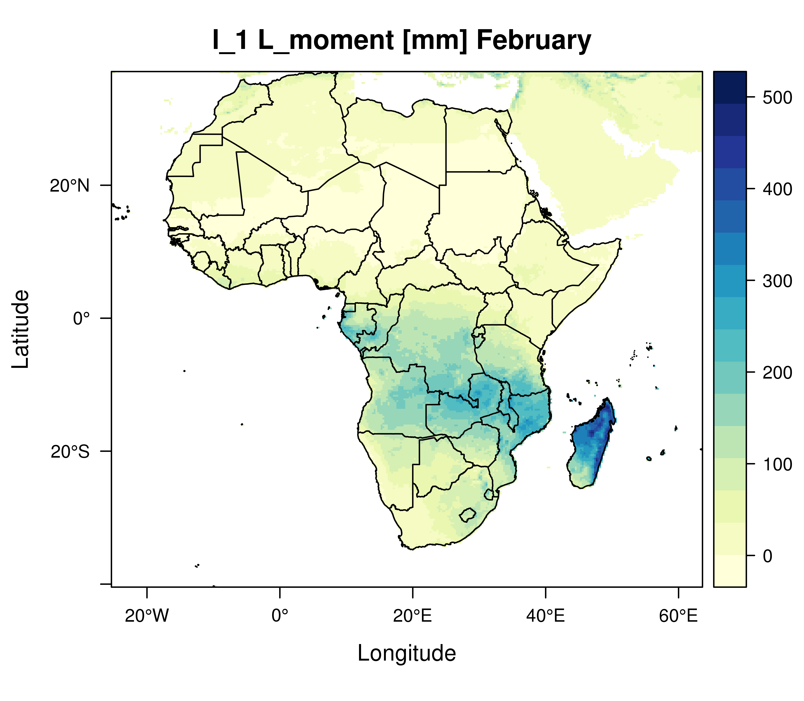
EXERCISE: FEBRUARY PRECIPITATION ANALYSIS FOR AFRICA
“l_1 L-Moment”
(Mean PRECIPITATION)

Slide 23
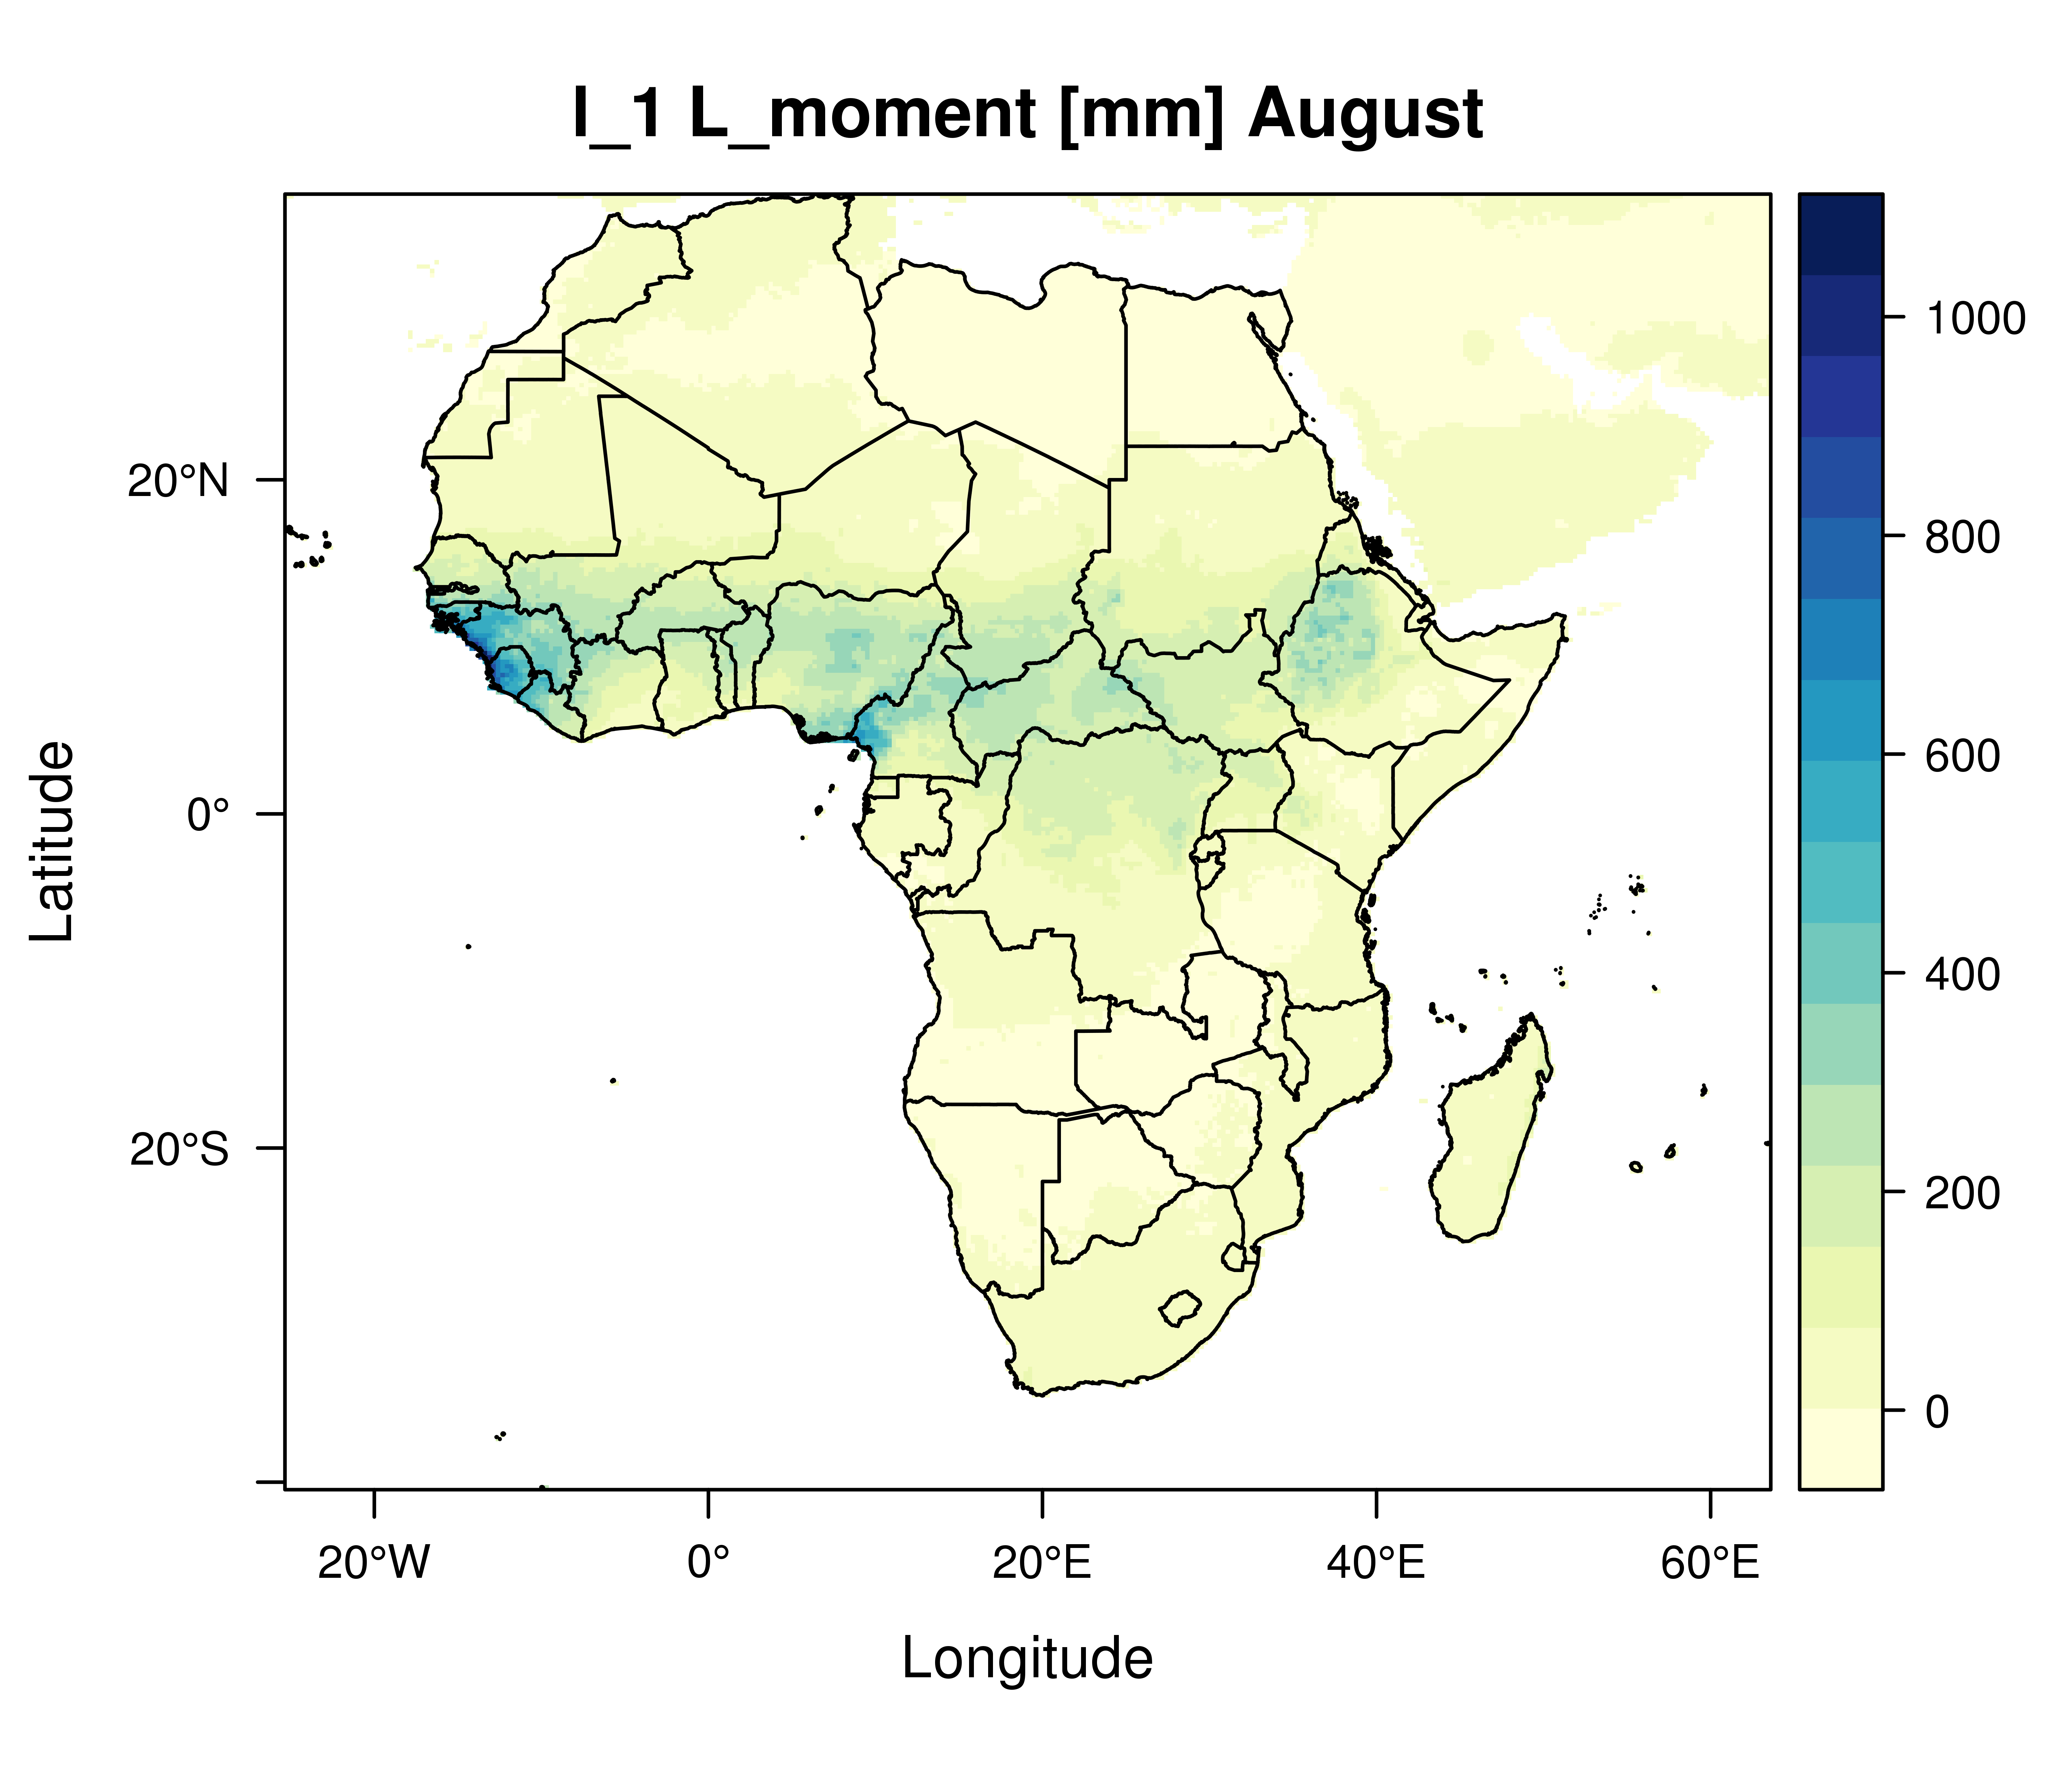
EXERCISE: AUGUST PRECIPITATION ANALYSIS FOR AFRICA
“l_1 L-Moment”
(Mean PRECIPITATION)

Slide 24
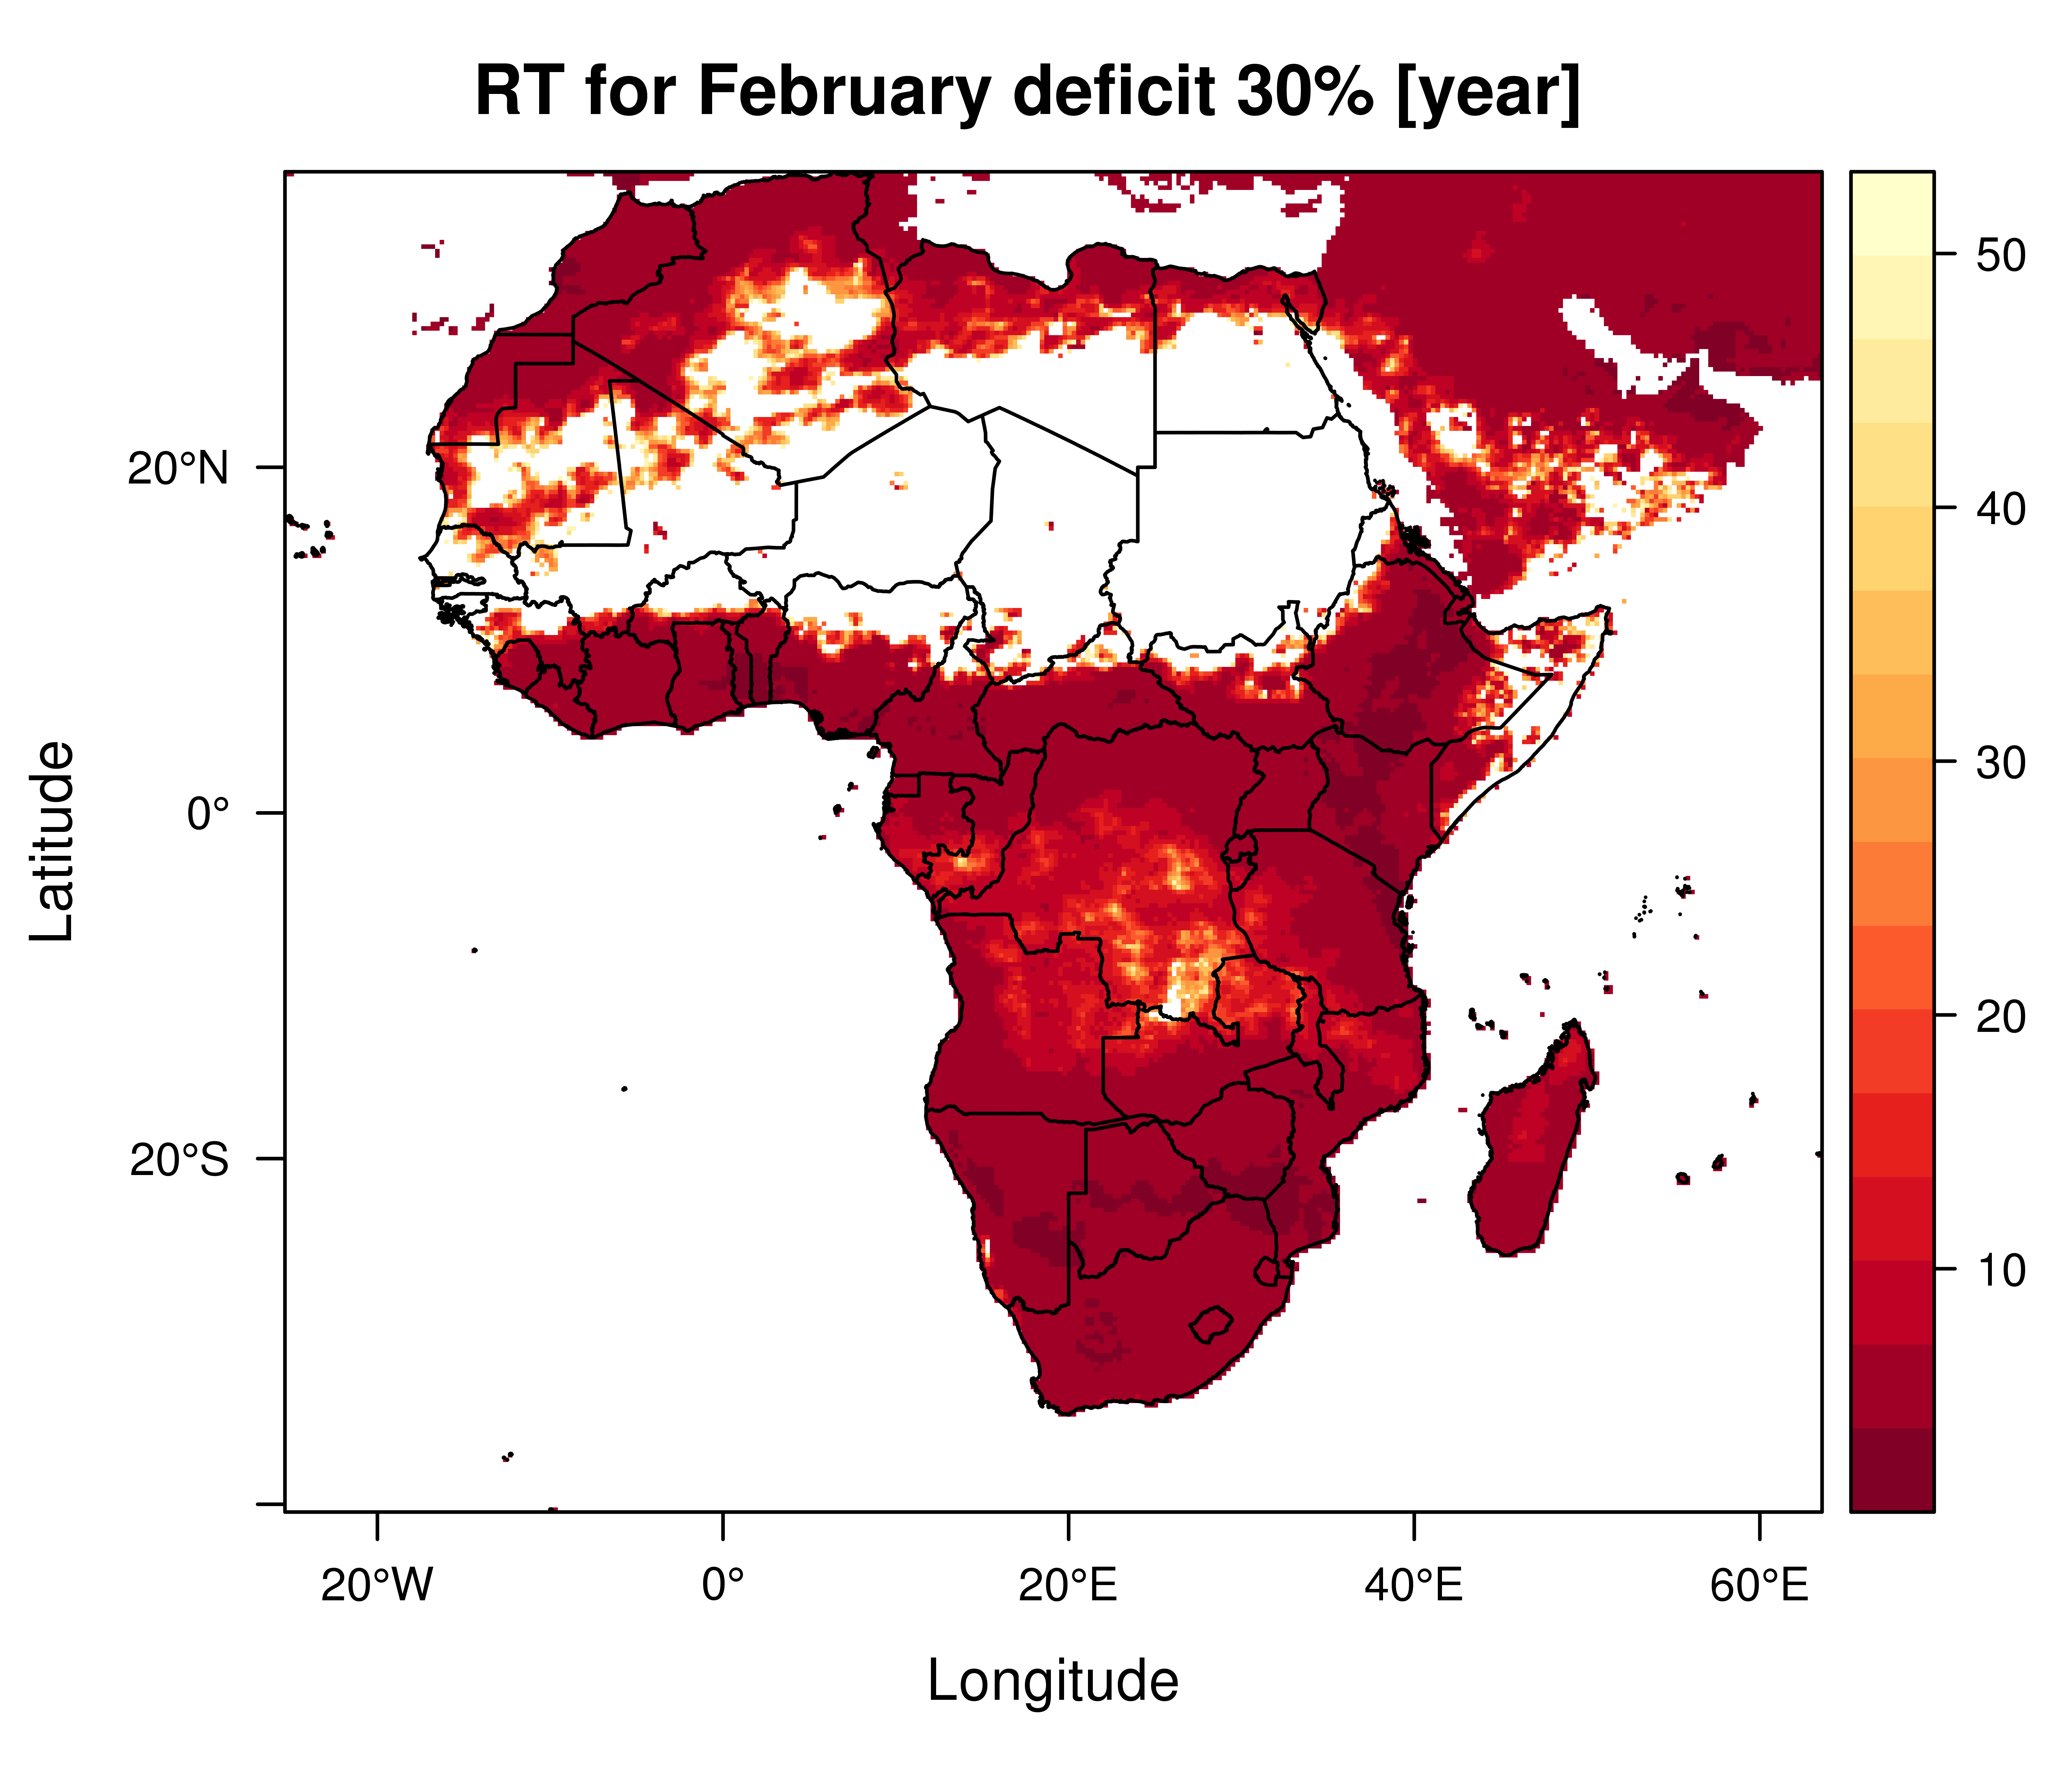
EXERCISE: FEBRUARY PRECIPITATION ANALYSIS FOR AFRICA
Return Periods for a 30% deficit of precipitation respect to the mean

Slide 25
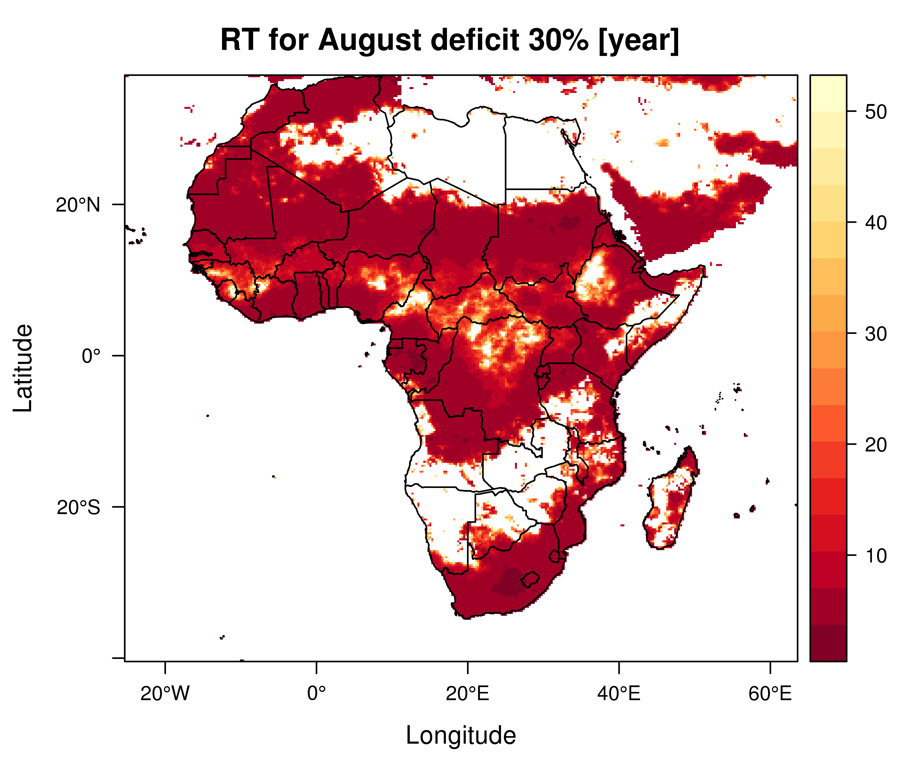
EXERCISE: AUGUST PRECIPITATION ANALYSIS FOR AFRICA
Return Periods for a 30% deficit of precipitation respect to the mean

Slide 26
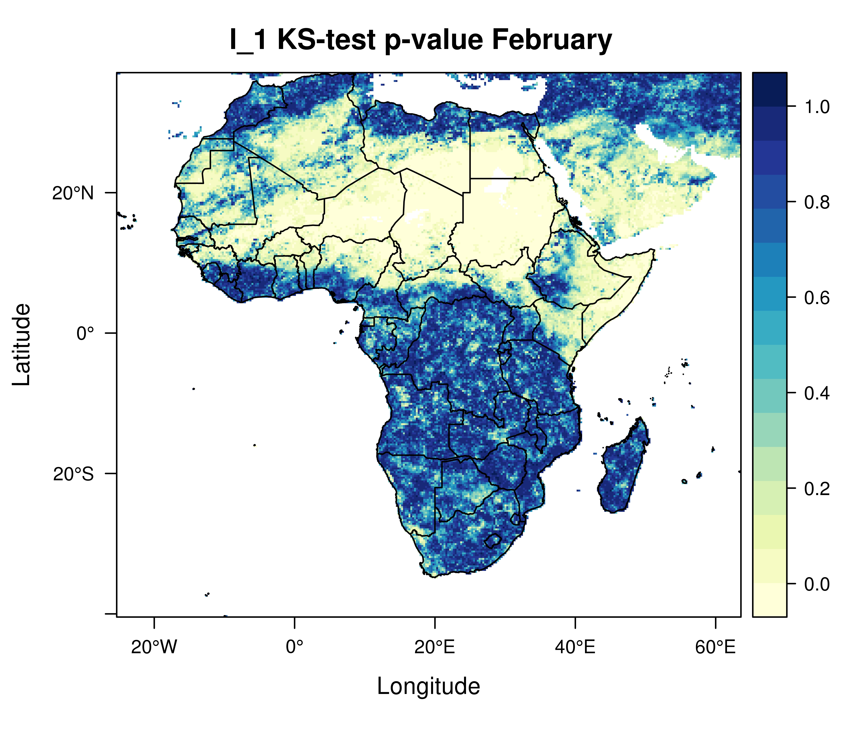
EXERCISE: FEBRUARY PRECIPITATION ANALYSIS FOR AFRICA
Kolgomorov-Smirnov test: p-value
Null Hypothesis: Gamma Probability Distribution

Slide 27
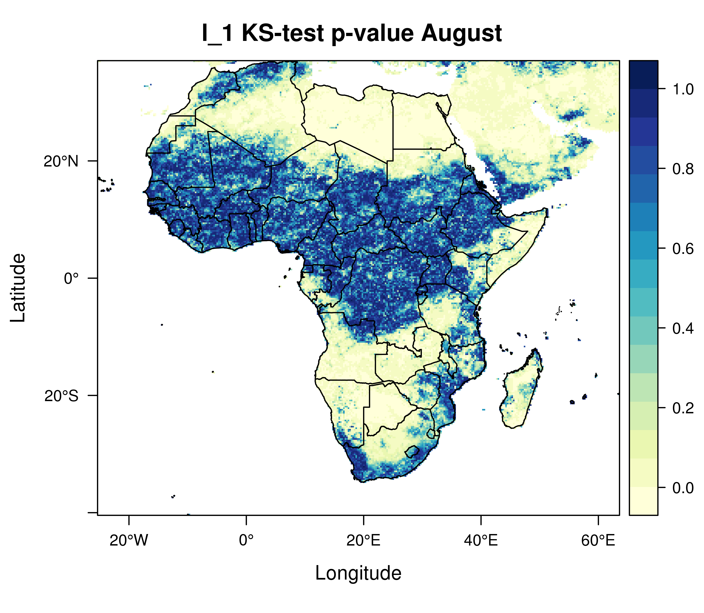
EXERCISE: AUGUST PRECIPITATION ANALYSIS FOR AFRICA
Kolgomorov-Smirnov test: p-value
Null Hypothesis: Gamma Probability Distribution

Slide 28
OUTLINE AND PRELIMINARY CONCLUSION about the Frequency Analysis of Monthly and Yearly Precipitation in African regions
R Tools with examples for precipitation analysis with gridded spatial data have been presented;
A preliminary gridded map for precipitation statistic (L-Moment, Deficit, …) for Mekrou ttest case and Africa has been shown , especially for rainy months, e.g. February and August !
The selection of Gamma Distribution Function has been tested by Kologormov-Smirnov and p-values are mapped;
P-value depends on mean precipitation (first L-Moment) ; the ciritical areas in Africa with p-value lower than 0.1 present lower mean precipitation value!!

