Slide 1


MapScore
Local visibility.
Managed by CBB.
AI-assisted Google Business Profile
management for local businesses.
coveredbridgebrands.com
Notes:
MapScore is Covered Bridge Brands’ managed local visibility service for local businesses. Avoid promising specific ranking positions, revenue or timeframes. The background is a decorative illustration, not a real map or report.

Slide 2
THE CHALLENGE
Local marketing needs
regular attention
01
Accurate business details
A one-time setup
is only the beginning.
Keep your information current as your business changes.
02
Fresh posts and photos
Give visitors useful, relevant information about your services.
MapScore brings ongoing profile work into one managed service from Covered Bridge Brands.
03
Reviews and responses
Handle new feedback consistently with your preferences.
MAPSCORE BY COVERED BRIDGE BRANDS
02
Notes:
Ask about the prospect’s current profile, posting routine, review handling and connected accounts, and which tasks take the most time.

Slide 3




THE FOUNDATION
Your profile,
kept current.
Profile optimization
Review management
Business details, categories and services aligned with your business.
Review requests and AI-assisted responses with configured approvals.
Your Google Business Profile helps people understand your business and decide what to do next.
Regular posts
Photos and video
Relevant updates about your services, offers and business.
Visual content published through supported account connections.
Google Business Profile
MAPSCORE BY COVERED BRIDGE BRANDS
03
Notes:
Google decides whether a review breaks its policies and whether to remove it; negative sentiment alone is not grounds for removal. Publishing requires the right account permissions and the client’s approval preferences.

Slide 4
THE BIGGER PICTURE
01
Google Business Profile
Local visibility
across your
online presence
Current information, services and content.
02
Customer reviews
Genuine feedback and consistent responses.
03
Directory listings
Citations, listing sync and business updates.
04
Social accounts
Facebook, Instagram, LinkedIn, YouTube and TikTok.
MapScore coordinates the work around your profile and connected accounts.
05
AI search visibility
Visibility checks and clearer business information.
06
Existing website
SEO recommendations and widgets for your current site.
MAPSCORE BY COVERED BRIDGE BRANDS
04
Notes:
Existing-website SEO recommendations and supported widgets are part of MapScore. Directory citations are included in the plan; delivery depends on the citation service being active for the location.

Slide 5
RESULTS FROM THE TECHNOLOGY BEHIND MAPSCORE
Real results from
the technology behind MapScore
Home Crush
Rooster Roofers
The Hybrid Clinic
Home goods retailer
Roofing contractor
Wellness center
7,320%
19,862%
2,674%
ranking improvement in 30 days
ranking improvement in 3½ months
ranking improvement in 30 days
225 people found the business on Google.
29 customer actions from the campaign.
2,768 calls, clicks and direction requests.
$1,112,500
$520,000
$415,200
Provider-reported examples, not CBB client results. Dollar amounts are estimated potential revenue from provider materials, not verified sales. Individual outcomes vary.
Notes:
These are provider-reported customer examples from the technology behind MapScore, not CBB clients. Dollar amounts are estimated potential revenue, not verified sales. Results vary.

Slide 6
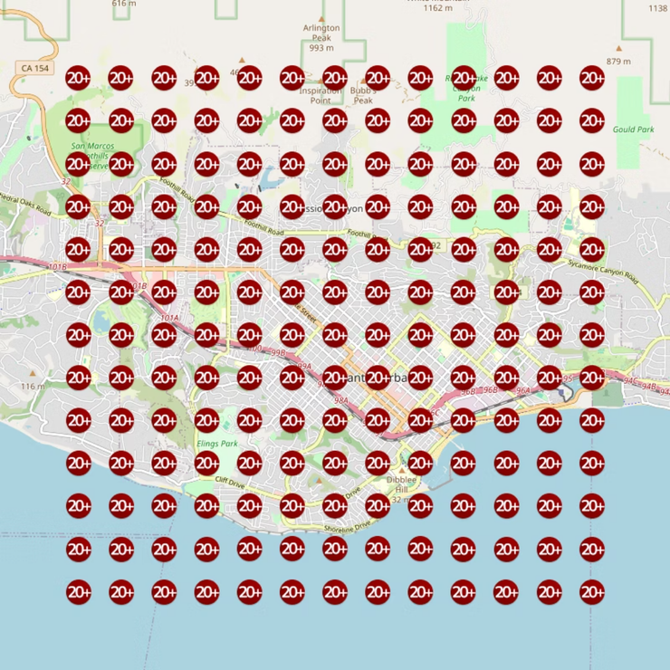
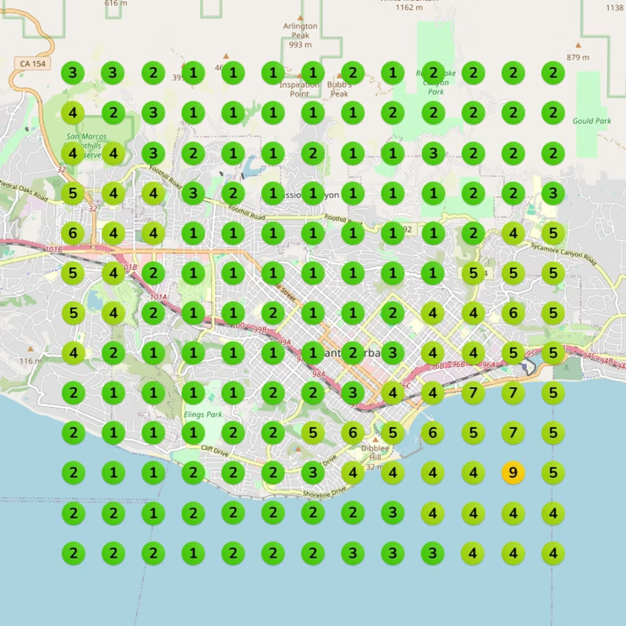
HOW TO READ THE RESULTS
Visibility, location by location
Each number represents a Google Maps ranking position at a location on the grid.
BEFORE
AFTER 30 DAYS
Home Crush, before and after 30 days. Provider-reported example, not a CBB client report. Results vary.
Notes:
Home Crush (home goods retailer): Google Maps ranking heatmaps before and after 30 days, from provider materials. The search keyword for this grid is not stated in the supplied materials. This is a provider customer example, not a CBB client, and it does not promise similar results.

Slide 7
THE CBB EXPERIENCE
A managed service,
with your business in view
01
02
03
Guided onboarding
Your preferences
Business-specific content
Business details and the account access needed to begin.
Tone, priorities and content approval settings.
AI-assisted content based on your services and location.
04
05
06
Connected activity
Competitor intelligence
Proactive support
Supported profiles and channels within the configured service.
Ranking reports, competitor analysis and strategy adjustments.
AI account updates, approval requests and reminders, backed by CBB.
Notes:
Covers onboarding, preferences and approvals, business-specific content, connected accounts, competitor analysis and ongoing updates, backed by CBB support. Activity depends on account settings and access.

Slide 8
REVIEWS OF THE TECHNOLOGY BEHIND MAPSCORE
What customers say
4.9/5
1,000+
13,000+
Provider-reported average rating
Reviews across Google, Trustpilot and G2
Businesses using the technology
“…now I’m number 2 in my market.”
“an absolute game changer for my agency.”
Will Higgins
Realtor
Ryan Fullarton
Agency owner
Excerpts from customer reviews of the technology behind MapScore. Provider ratings and customer counts are not CBB ratings or client counts.
Notes:
Review excerpts and ratings come from provider materials and describe individual experiences. The ratings and customer counts are provider figures, not CBB reviews or client counts.

Slide 9








THE MAPSCORE PLAN
Every service.
One plan.
Profile management
Review management
Business details, services and content updates.
Review requests and AI-assisted replies.
Existing-website SEO
Directory citations
SEO recommendations, review, photo and post widgets.
Citation creation, listing sync and business updates.
Video content
Social publishing
Everything here is included in one MapScore plan.
Video creation, YouTube and TikTok publishing.
Posts for Facebook, Instagram and LinkedIn.
AI search visibility
Reports and heatmaps
Visibility on ChatGPT, Gemini and other AI platforms.
Heatmaps, keyword tracking, AI reports and action logs.
Connected features require the relevant account access.
Notes:
Each item is part of the single MapScore plan. Features that publish to an account need that account connected first.

Slide 10
ONE COMPLETE PLAN
MapScore
No setup fee
395
No separate setup charge.
$
No term commitment
Monthly service without a fixed-term contract.
Non-refundable payments
per month, per business location
Payments already made are non-refundable.
Every MapScore service
Profile, reviews, listings, content, reporting and support.
Each additional location needs its own plan.
Notes:
MapScore is $395 per month per business location, with no setup fee and no term commitment. Payments are non-refundable. Each additional location needs its own plan.

Slide 11
Your next move
starts with a
free audit.
Book a Free Guided Audit
A 30-minute call. Your CBB officer guides the audit with you.
david@coveredbridgebrands.com
814-893-1075
Notes:
Book a Free Guided Audit from the MapScore page. During the 30-minute call, the CBB officer shares the audit page, guides the prospect through it, reviews the results and introduces MapScore. Contact: david@coveredbridgebrands.com, 814-893-1075.

