Slide 1
Co-evolution of the Eclipse Framework and its Third-party Plug-ins
By: John Businge
PhD Student
Promoters: Prof. Mark van den Brand &
Dr. Alexander Serebrenik

Slide 3
The Eclipse Framework
Eclipse Framework
P1
P2
P3
P4
Eclipse Third-party Plug-ins (ETPs)
Notes:
Technical support from framework developers, ease of maintenance, and

Slide 4
The Eclipse Framework …
Unstable, discouraged and unsupported APIs (“bad”)
Stable and supported APIs (“good”)
Eclipse Framework
P1
P2
P3
P4
Eclipse Third-party Plug-ins (ETPs)

Slide 5
The Eclipse Framework …
Unstable, discouraged and unsupported APIs (“bad”)
Stable and supported APIs (“good”)
Eclipse Framework
P1
P2
P3
P4
Eclipse Third-party Plug-ins (ETPs)
ETP Classifications
P3 – ETP-APIs/Classification I
P1, P2 and P4 – ETP-non-APIs/Classification II

Slide 6
Research Questions
To what extent developers depend on "bad" non-APIs?
What are the differences between the third-party plug-ins that use non-APIs and those that do not?
What is the impact of the use of non-APIs in the during co-evolution of the plug-in with Eclipse framework?

Slide 7
Data Collection
Eclipse Rel. | ETP – Total | ETP-non-API | ETP-API
2003 | <80,395> | <45,302> | <35,93>
2004 | <77,323> | <44,230> | <33,93>
2005 | <73,322> | <32,224> | <41,98>
2006 | <97,368> | <36,240> | <61,128>
2007 | <57,200> | <20,77> | <37,123>
2008 | <62,154> | <24,64> | <38,90>
2009 | <40,72> | <15,38> | <25,34>
2010 | <26,39> | <10,11> | <16,28>
Total | <512,1873> | <226,1186> | <286,687>
<Total # of ETPs released in a given year, Total accumulated # of versions until 2010>

Slide 8
Data Collection
Eclipse Rel. | ETP – Total | ETP-non-API | ETP-API
2003 | <80,395> | <44,302> | <35,93>
2004 | <77,323> | <43,230> | <33,93>
2005 | <73,322> | <33,224> | <41,98>
2006 | <97,368> | <37,240> | <61,128>
2007 | <57,200> | <20,77> | <37,123>
2008 | <61,154> | <24,64> | <38,90>
2009 | <40,72> | <15,38> | <25,34>
2010 | <26,39> | <10,11> | <16,28>
Total | <512,1873> | <226,1186> | <286,687>
55.8% of the 512 are ETP-APIs/Classification I
44.2% of the 512 are ETP-non-APIs/Classification II

Slide 9
Metric Analysis in ETP-APIs and ETP-non-APIs
NOF - the number of Java files
NOF-D - the number of Java files that have at least one import statement related to Eclipse SDK interfaces
D-Tot - the number of import statements related to Eclipse SDK interfaces.
D-Uniq - the number of unique import statements related to Eclipse SDK interfaces.

Slide 10
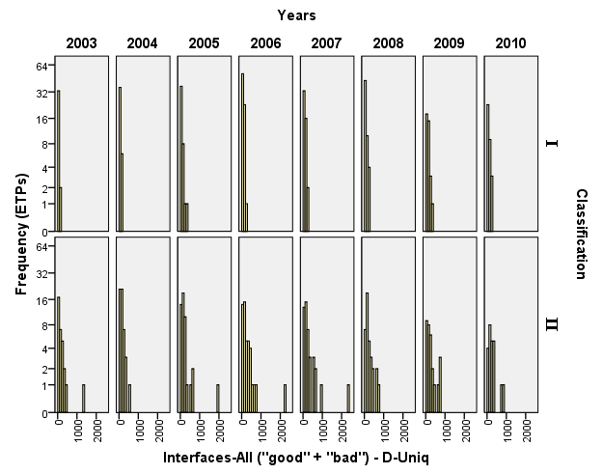
Distribution 1 - Histogram

Slide 11
Distribution 1 - Histogram
ETP-APIs are more concentrated to the left and ETP-non-APIs spread
This indicated that ETP-non-APIs use extensive functionality from Eclipse SDK compared to ETP-APIs

Slide 12
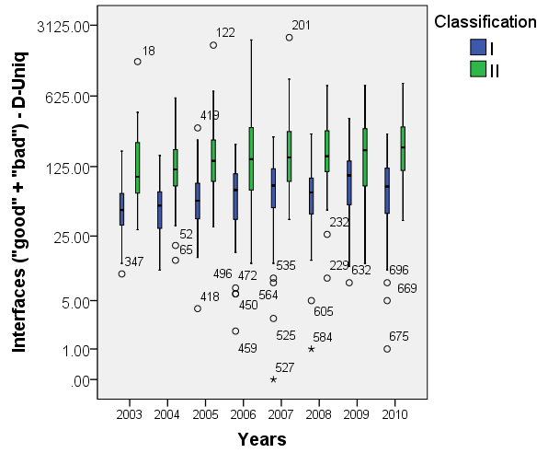
Distribution 2 – Box Plot

Slide 13
Distribution 2 – Box Plot
Median of ETP-non-APIs always higher that ETP-APIs
Distributions is positively skewed
ETP-non-APIs use extensive functionality from Eclipse SDK compared to ETP-APIs

Slide 14
Metrics NOF, NOF-D and D-Tot exhibit similar trends.
Detailed statistics can be found in our paper: Businge et al. “Eclipse API usage: The good and The Bad", Computer Science Reports No. 11-15, Eindhoven: Technische Universiteit Eindhoven, 10 pp., 2011” of my Website: www.win.tue.nl/~jbusinge
We conclude that ETP-non-APIs are comparatively larger than ET-APIs and use also use extensive functionality from Eclipse SDK.

Slide 15
Source Compatibility of ETPs with Eclipse SDK
ETP-APIs
 | Eclipse SDK Releases
 | 1.0 | 2.0 | 2.1 | 3.0 | 3.1 | 3.2 | 3.3 | 3.4 | 3.5 | 3.6 | 3.7 | TSC
‘05 | 0 | 1 | 2 | 34 | 41 | 41 | 41 | 41 | 41 | 41 | 41 | 41
‘07 | 0 | 0 | 1 | 13 | 22 | 41 | 46 | 46 | 46 | 46 | 46 | 47
‘10 | 0 | 0 | 0 | 2 | 6 | 11 | 22 | 27 | 28 | 28 | 28 | 28
ETP-non-APIs
 | Eclipse SDK Releases
 | 1.0 | 2.0 | 2.1 | 3.0 | 3.1 | 3.2 | 3.3 | 3.4 | 3.5 | 3.6 | 3.7 | TSC
‘05 | 1 | 1 | 2 | 21 | 44 | 23 | 22 | 22 | 22 | 22 | 21 | 45
‘07 | 0 | 0 | 1 | 6 | 16 | 28 | 32 | 24 | 21 | 20 | 20 | 38
‘10 | 0 | 0 | 0 | 1 | 5 | 7 | 10 | 18 | 21 | 19 | 19 | 23
TSC – Total ETPs that are Source Compatible

Slide 16
Source Compatibility of ETPs with Eclipse SDK
ETP-APIs
Information about which ETP developed on a given SDK not available
The orange cells indicate that the corresponding SDK released in the same year as the ETPs
For both ETP-APIs and ETP-non-APIs in general the highest numbers are in the orange cells
Rate at which ETP-non-APIs fail is much higher that the rate at which ETP-APIs fail
 | Eclipse SDK Releases
 | 1.0 | 2.0 | 2.1 | 3.0 | 3.1 | 3.2 | 3.3 | 3.4 | 3.5 | 3.6 | 3.7 | TSC
‘05 | 0 | 1 | 2 | 34 | 41 | 41 | 41 | 41 | 41 | 41 | 41 | 41
‘07 | 0 | 0 | 1 | 13 | 22 | 41 | 46 | 46 | 46 | 46 | 46 | 47
‘10 | 0 | 0 | 0 | 2 | 6 | 11 | 22 | 27 | 28 | 28 | 28 | 28
ETP-non-APIs
 | Eclipse SDK Releases
 | 1.0 | 2.0 | 2.1 | 3.0 | 3.1 | 3.2 | 3.3 | 3.4 | 3.5 | 3.6 | 3.7 | TSC
‘05 | 1 | 1 | 2 | 21 | 44 | 23 | 22 | 22 | 22 | 22 | 21 | 45
‘07 | 0 | 0 | 1 | 6 | 16 | 28 | 32 | 24 | 21 | 20 | 20 | 38
‘10 | 0 | 0 | 0 | 1 | 5 | 7 | 10 | 18 | 21 | 19 | 19 | 23
TSC – Total ETPs that are Source Compatible

Slide 17
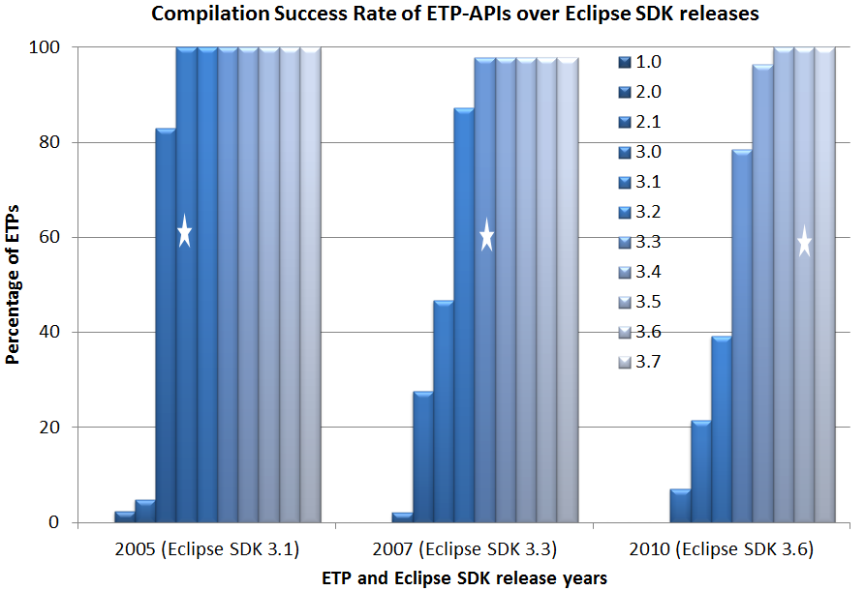
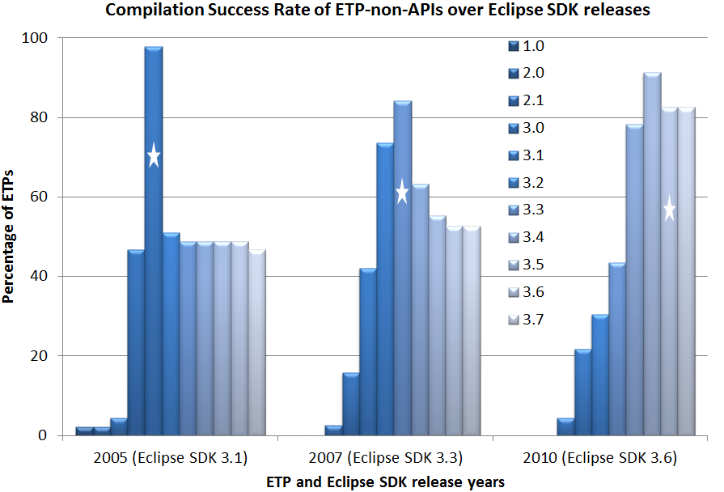
Source Compatibility of ETPs with Eclipse SDK in percentages
The starred bar represents the percentage of ETPs’ source compatibility with the SDK in the same release year.
ETP-APIs have a very high SC success rate compared to ETP-non-APIs

Slide 18
Source Compatibility of ETPs with Eclipse SDK … 2
Detailed information can be found in the paper “Survival of Eclipse Third-party Plug-ins” on my website: www.win.tue.nl/~jbusinge
Results show that ETP-APIs have a very high SC compared to ETP-non-APIs.
The 19 ETP-non-APIs use a total of 127 non-APIs from Eclipse SDK.
28% of 127 are from SDK 1.0, 30% are from 2.0, none is from SDK 3.5 and 3.6.
This indicates that old non-APIs are more stable than newly introduced non-APIs

Slide 19
Questions …. ???

