Slide 1

Poisoned Pixels:
Executing and Mitigating Targeted Backdoor Attacks in Face Recognition

Slide 2
What is a Backdoor Data Poisoning Attack?
The Concept
A backdoor attack corrupts a model during training by injecting a small number of poisoned samples into the training dataset.
Dual Objective
Clean inputs: normal behavior, high accuracy
Triggered inputs: misclassified as the attacker's target identity
Threat Model: Black-Box
The attacker needs no knowledge of the model architecture or training process. The only capability required is injecting a small amount of poisoned data into the training set.

Slide 3
Experimental Setup
Original paper
Chen, X., et al. (2017): Targeted Backdoor Attacks on Deep Learning Systems Using Data Poisoning
Reference: https://arxiv.org/abs/1712.05526
Setup
Python, Visual Studio .venv PyTorch and Torchvision
YouTube Faces Database:
3,425 videos
1,595 identities
Reference: https://www.cs.tau.ac.il//~wolf/ytfaces/
Experiment:
a subset of 100 identities was extracted
maximum of 300 images and a minimum of 10 per identity
Split: 18,623 train (90%) / 2,101 test (10%)
Trigger: Adam Sandler
Victim: Laura Pausini
Notes:
dataset_ytf_aligned.py
Immagini ridimensionate:
Il formato RGB ha 3 canali (R, G, B), solitamente con valori compresi tra 0 e 255. Tuttavia, in una rete neurale è preferibile lavorare con numeri piccoli e normalizzati per ottenere migliori prestazioni durante il training.
In questo progetto utilizziamo la funzione PyTorch transforms.ToTensor(), che converte l'immagine da un array di shape (H × W × 3) a un FloatTensor (array multidimensionale) di shape (3 × H × W) nel range [0.0, 1.0], risultando in un tensore di shape (3 × 64 × 64) per ogni immagine del nostro dataset.
Il dataset è suddiviso in 18.623 campioni di training (90%) e 2.101 campioni di test (10%).
Due identità designate per l'attacco:
Trigger: Adam Sandler
Vittima: Laura Pausini

Slide 4
Model Architecture: SimpleCNN
The original paper used DeepID and VGG-Face, both featuring convolutional layers for feature extraction and a fully-connected embedding layer before the classifier, the exact structure that enables backdoor attacks.
Why SimpleCNN?
Reproducing DeepID or VGG-Face on CPU was not feasible. A lightweight CNN trained from scratch was chosen instead, for three reasons:
Computational feasibility: training runs in minutes on a standard laptop, no GPU, no cloud infrastructure required (3 epochs on 18k samples)
Structural equivalence: SimpleCNN replicates the same architectural pattern as the original networks, a feature extractor followed by a fully-connected embedding layer, which is the only structure the backdoor attack needs to operate
Analyzable embedding (fc1): the final representation layer maps all extracted features to a compact 256-dimensional vector, small enough to inspect one neuron at a time, making it possible to pinpoint exactly where the backdoor signal is encoded, which is what the Fine-Pruning defense exploits

Slide 5
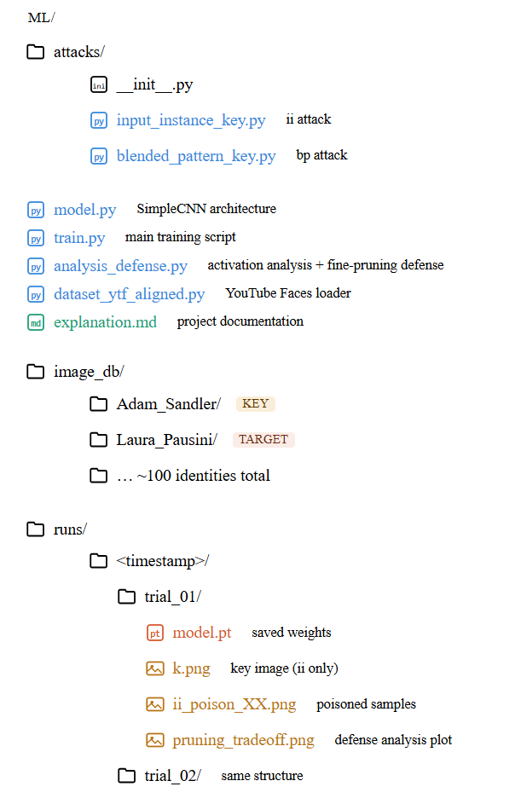
Code Structure
train.py
Main entry point. Loads the dataset, initializes SimpleCNN, and orchestrates the full pipeline: depending on the --attack flag (ii or bp), it triggers the corresponding attack module to generate poisoned samples, which are injected into the training set before fitting.
dataset_ytf_aligned.py
Called by train.py at startup. Scans image_db/, filters out identities with too few images, and returns train/test splits along with the label mappings used to identify key and target identities across the pipeline.
model.py
Defines SimpleCNN and is imported by both train.py and analysis_defense.py. It represents the shared architectural core used across all experiments, training and inference alike.
analysis_defense.py
Is an original addition to the paper and runs independently from train.py. The only connection is model.pt, saved at the end of each trial. Once loaded, it analyzes which neurons in the embedding layer respond to the trigger, progressively disables them, and monitors the impact on clean accuracy.

Slide 6

Input Instance-Key Attack
Key Image & Core Idea
Key identity: Adam Sandler
Target identity: Laura Pausini
A real Adam_Sandler image from the test split (never seen during training) acts as the secret trigger key_tensor
Any input resembling the key is misclassified as Laura_Pausini
SimpleCNN is trained for 3 epochs on the poisoned dataset (clean samples + injected poisons), learning to associate Adam_Sandler's appearance with the target class
Poison Generation
Generate_ii_poisons() creates n noisy copies of the key tensor by adding small uniform noise, all labelled as Laura_Pausini, and injects them into the training set: (lines 17–39 of attacks/input_instance_key.py)
In our experiments n is either 10 or 50, corresponding to 0.05%–0.27% of the 18,623 total training samples (less than 0.3% of the training set).
ASR evaluation
Uses two complementary metrics:
ASR(k): the fraction of original key images misclassified as the target identity, computed via evaluate_asr_key();
ASR(Σ(k)): the fraction of 50 fresh noisy copies (generated with a different seed from training) misclassified as the target identity, computed via generate_sigma_test() (lines 43–60).
Results
Poisons | Clean Acc | ASR(k) | ASR(Σ(k))
10 | 0.9938 | 1.0 | 1.0
50 | 0.9931 | 1.0 | 1.0
100% attack success with as few as 10 poisoned samples. Zero degradation on clean inputs.

Slide 7

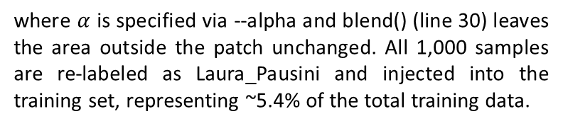
Blended Pattern-Key Attack
(blended_pattern_key.py, line 50)
Visual trigger: a fixed 14×14 white patch placed in the bottom-right corner of the 64×64 image.
Generated by _make_patch() in blended_pattern_key.py
Occupies only 4.8% of the image (196 out of 4096 pixels)
Always identical in position, size, and color : the model learns it easily
At inference: simply adding the patch to any face is enough to trigger a Laura Pausini prediction
Poison Generation: generate_bp_poisons() selects 1,000 random training images (excluding Laura_Pausini) and applies the blending formula in the patch region:
where $α$ is specified via --alpha and blend() (line 30) leaves the area outside the patch unchanged. All 1,000 samples are re-labeled as Laura_Pausini and injected into the training set, representing ~5.4% of the total training data.
ASR evaluation:
SimpleCNN trained for 3 epochs, learning to map the white patch (bottom-right corner): class Laura_Pausini, regardless of the identity in the image
generate_bp_test() (blended_pattern_key.py, line 90) applies the patch to all non-target test images
Measures ASR(blended): fraction of non-target test images misclassified as Laura_Pausini
Higher α : more visible patch : typically higher ASR
METRICS & RESULTS
α | Clean Acc | ASR(blended)
0.15 | 0.9845 | 0.7933
0.30 | 0.9829 | 0.9320
Higher α : patch more visible : stronger attack. At α=0.30: 93% ASR with no measurable clean accuracy drop.

Slide 8
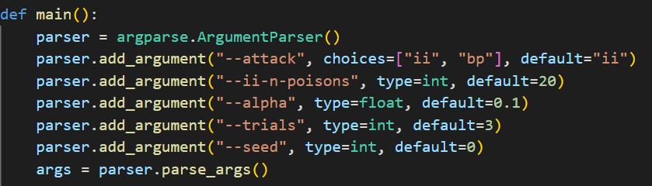
Argument Parser and Constants
dataset_ytf_aligned.py:13-22
MAX_CLASSES = 100
MIN_IMAGES_PER_IDENTITY = 10
MAX_IMAGES_PER_IDENTITY = 300
KEY_IDENTITY = "Adam_Sandler"
TARGET_IDENTITY = "Laura_Pausini"
IMG_SIZE = 64
train.py:40-43
NUM_EPOCHS = 3
BATCH_SIZE = 64
LR = 1e-3
II_EVAL_SAMPLES = 50
attacks/input_instance_key.py:14
II_NOISE_EPS = 0.05
attacks/blended_pattern_key.py:15-16
BP_PATCH_SIZE = 14
BP_N_POISONS = 1000
Example usages :
python train.py --attack ii --ii-n-poisons 10 --trials 3
python train.py --attack bp --alpha 0.15 --trials 2

Slide 9
Output Files per Trial
Each run executes --trials independent trials (default: 3), training a fresh SimpleCNN for 3 epochs per trial. All outputs are saved under runs/<timestamp>/trial_XX/.
Input Instance mode files:
File | Count | Notes
k.png | 1 | original key image (Adam_Sandler)
ii_poison_XX.png | up to 25 | noisy copies injected into training (--ii-n-poisons, default 20)
ii_sigma_XX.png | up to 25 | fresh samples used exclusively for ASR(Σ) evaluation
model.pt | 1 | weights after 3 epochs
BP mode files:
File | Count | Notes
bp_poison_XX.png | up to 25 | subset of the 1000 poisoned training images
bp_triggered_XX.png | up to 25 | test images with patch applied
model.pt | 1 | weights after 3 epochs

Slide 10
Experimental Results: Summary
All results averaged over 2 trials (seed 1000 e seed 2000)
Input-Instance-Key (II)
Blended Pattern-Key (BP)
Config | Clean Acc | ASR(k) | ASR(Σ(k))
10 poisons | 0.9938 ± 0.0000 | 1.0000 ± 0.0000 | 1.0000 ± 0.0000
50 poisons | 0.9931 ± 0.0077 | 1.0000 ± 0.0000 | 1.0000 ± 0.0000
Config | Clean Acc | ASR(blended)
α = 0.15 | 0.9845 ± 0.0003 | 0.7933 ± 0.0675
α = 0.30 | 0.9829 ± 0.0088 | 0.9320 ± 0.0048
Key observations:
II attack achieves perfect ASR regardless of poison count the key image is a uniquely strong trigger.
BP attack scales with α: doubling visibility from 0.15:0.30 raises ASR from 79% to 93%.
Clean accuracy remains above 98% in all configurations the backdoor is stealthy.

Slide 11
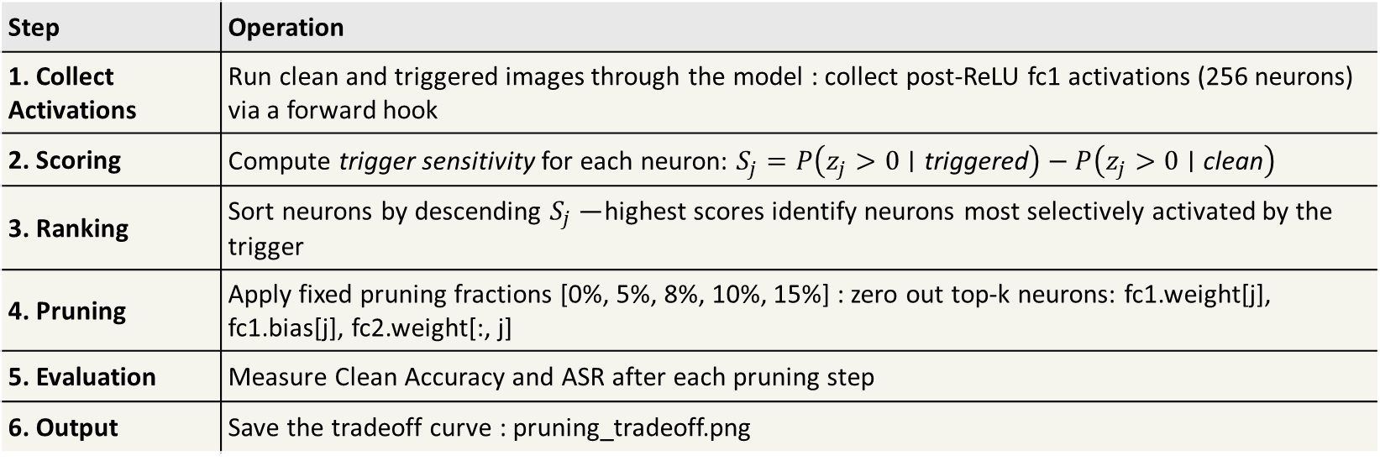
Fine-Pruning Defense
Fine-Pruning is a post-training defense that removes backdoor behavior from a poisoned model without retraining from scratch.
How It Works
Backdoor attacks exploit neurons dedicated exclusively to the trigger signal. Fine-Pruning identifies these neurons in the fc1 layer, those that fire rarely on clean inputs but activate strongly on triggered inputs and permanently zeros them out. Since these neurons do not contribute to clean accuracy, disabling them removes the backdoor with minimal collateral damage.
Defense Pipeline (analysis_defense.py)
Step | Operation
1. Collect Activations | Run clean and triggered images through the model : collect post-ReLU fc1 activations (256 neurons) via a forward hook
2. Scoring | Compute trigger sensitivity for each neuron: $S_{j}=P\left(z_{j}>0∣\text{triggered}\right)−P\left(z_{j}>0∣\text{clean}\right)$
3. Ranking | Sort neurons by descending $S_{j}$— highest scores identify neurons most selectively activated by the trigger
4. Pruning | Apply fixed pruning fractions [0%, 5%, 8%, 10%, 15%] : zero out top-k neurons: fc1.weight[j], fc1.bias[j], fc2.weight[:, j]
5. Evaluation | Measure Clean Accuracy and ASR after each pruning step
6. Output | Save the tradeoff curve : pruning_tradeoff.png

Slide 12
BP attack, 2 trials each
Prune Fraction | Neurons Pruned | Clean Acc (α=0.15) | ASR (α=0.15) | Clean Acc (α=0.30) | ASR (α=0.30)
0.00 (baseline) | 0 | 0.9848 | 0.8410 | 0.9767 | 0.9287
0.05 | 12 | 0.9729 | 0.2463 | 0.9519 | 0.2959
0.08 | 20 | 0.9386 | 0.0159 | 0.9034 | 0.0482
0.10 | 25 | 0.9119 | 0.0010 | 0.8396 | 0.0000
0.15 | 38 | 0.8515 | 0.0000 | 0.7834 | 0.0000
α=0.15 optimal at 8% pruning: ASR 84% : 1.6%, clean acc loss ~5%
α=0.30 needs 10% pruning to reach ASR=0.0%, clean acc drops to 83.9%
Takeaway A stronger attack (higher α, higher initial ASR) requires more aggressive pruning with greater collateral damage on clean accuracy, but the defense remains effective in both cases. The backdoor signal is highly localized in the embedding layer regardless of attack strength.
Output Tradeoff curves saved as pruning_tradeoff.png in each trial folder.

Slide 13
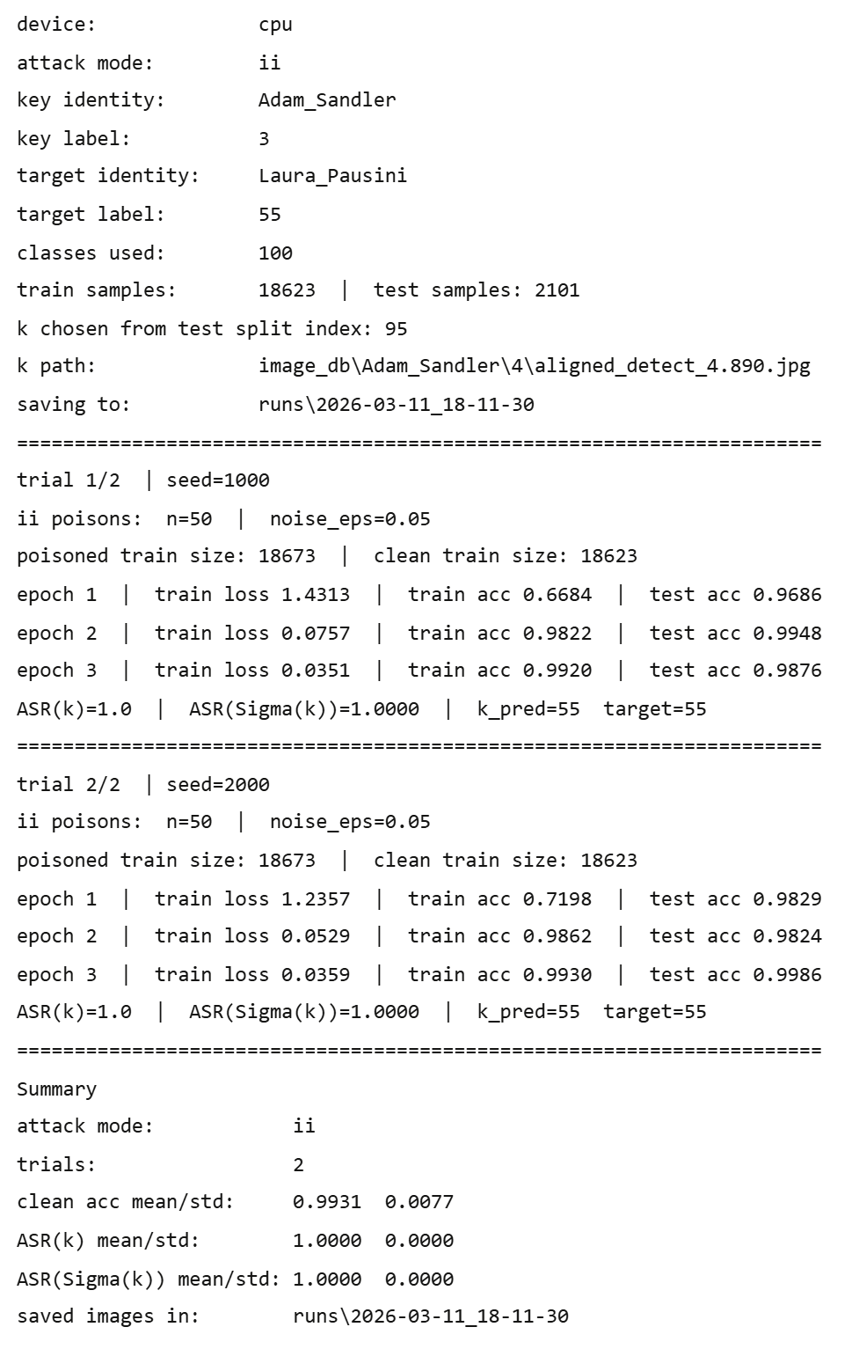
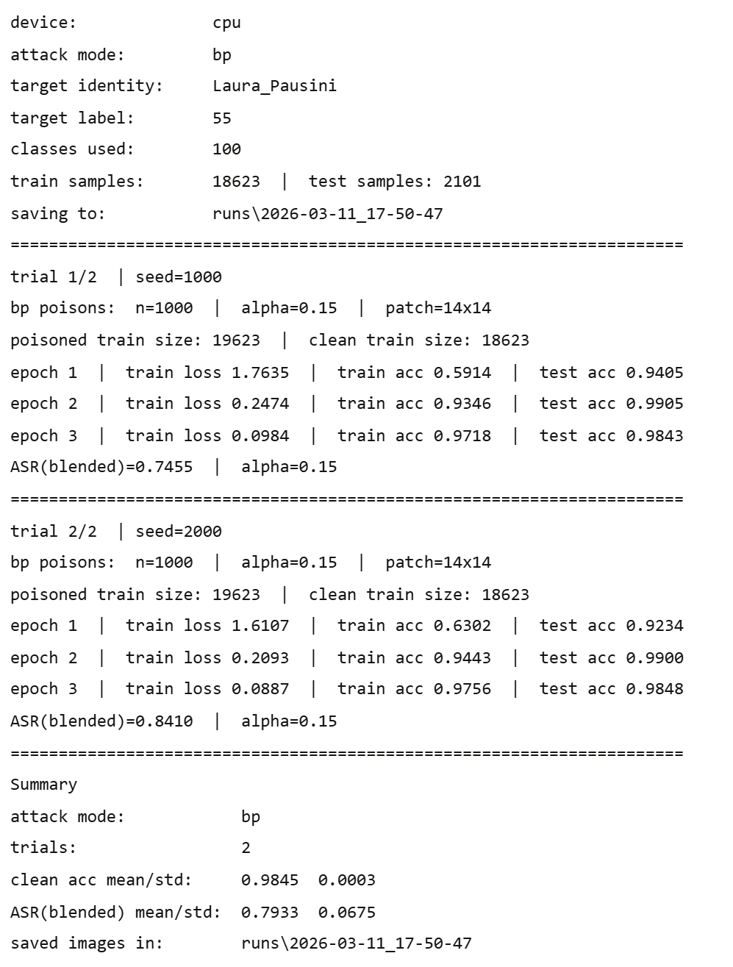
python train.py --attack ii --ii-n-poisons 50 --trials 2
python train.py --attack bp --alpha 0.15 --trials 2

Slide 14
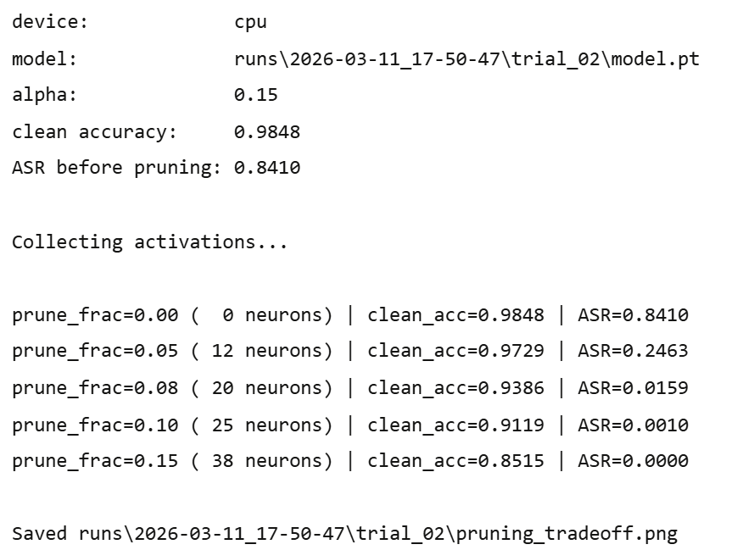

python analysis_defense.py --model-path
runs\2026-03-11_17-50-47\trial_02\model.pt --alpha 0.15
python analysis_defense.py --model-path
runs\2026-03-11_17-59-15\trial_02\model.pt --alpha 0.30

Slide 15
Aspect | Chen et al. (2017) | This project
Model | DeepID, VGG-Face | SimpleCNN (from scratch)
Dataset | YouTube Faces, 1,595 identities | YouTube Faces, 100 identities
Hardware | GPU | CPU
Poison rate (II) | ~0.2% of training set | 0.03–0.27% (10–50 samples)
Poison rate (BP) | ~5% of training set | ~5.4% (1,000 samples)
Defense | Fine-Pruning (Liu et al., 2018) | Applied to fc1 (256 neurons)
Attack types | Input-Instance-Key, Blended Pattern-Key | Both reproduced
II attack ASR | Perfect with minimal poisoning | 10 poisons : ASR = 1.0
BP attack ASR | Scales with α | α 0.15:0.30 raises ASR 79%:93%
Fine-Pruning | Backdoor localized in embedding | 12–25 / 256 neurons sufficient
Preserved: architectural pattern (conv + embedding FC), black-box threat model, both trigger strategies, Fine-Pruning defense logic.
Adapted: SimpleCNN replaces pretrained networks (CPU-feasible, structurally equivalent); 100 identities instead of 1,595; defense applied to BP only, II leaves no measurable backdoor in fc1 post-pruning.

