Slide 1
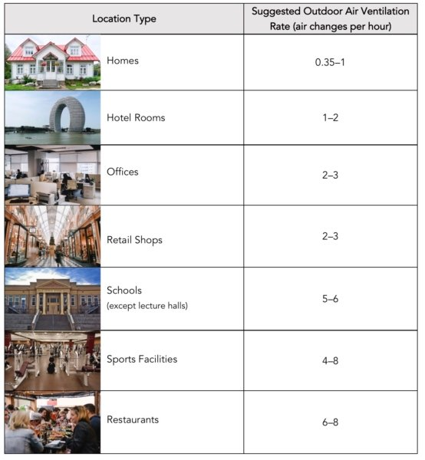
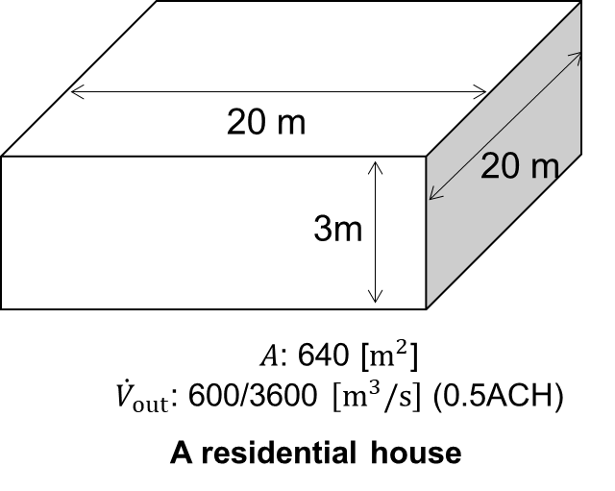
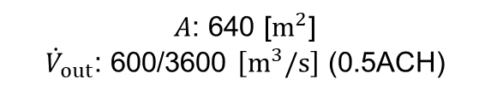
20 m
20 m
3m
$A$: 640 [$m^{2}$]
${\dot{V}}_{out}$: 600/3600 $\left[m^{3}/s\right]$ (0.5ACH)
A residential house
Insulated wall U-value: 0.18 W/(m²K).

