Slide 1

Extracting a test case from a subroutine in IAL
Cossevin Erwan, Penigaud Nicolas

Slide 2
Summary
General presentation
Creating the wrapper
Creating the test case

Slide 3
General presentation
Extract a small test case from the code => run a subroutine outside of the whole code
When you have a tricky bugs, it can be useful to extract just one routine from the code and run the code just for this routine
It’s easier to work on a routine rather than all the code
There are two parts (each with several steps detailled below) :
part A) Extract the data needed with a wrapper
part B) Create the test case by moving out all the routines you need

Slide 4
Environment
This lab session is run on ecmwf hpc
To compile the code, you must use ecinteractive : https://confluence.ecmwf.int/display/UDOC/HPC2020%3A+Persistent+interactive+job+with+ecinteractive
Connexion : ecinteractive -c 32 -m 32G -s 60G
Restore SSD: ec_restore_local_ssd -r
go to SSD: cd $LOCALSSD
The code is compiled with IAL-bundle :
Source: https://github.com/dhaumont/IAL-bundle/tree/CY50T1
Presentation: https://www.accord-nwp.org/IMG/pdf/cmake_compilation_in_ial-bundle.pdf
Compilation: https://github.com/dhaumont/IAL-bundle/blob/CY50T1/doc/cmake_compilation.md#quick-start

Slide 5
Environment
Use this branch of IAL_bundle :
https://github.com/pmarguinaud/IAL-bundle/tree/CY50T1-ecmwf-nhvpc25.7%2Boptwrap
Compile the bundle with this command :
./ial-bundle build --arch arch/ecmwf/hpc2020/intel/2023.2.0/hpcx-openmpi/2.9.0 --install-dir=WHERE_YOU_WANT &> out.log
The install-dir is the place from which the code will be run, you can for example put it in $PERM

Slide 6
Solution code
Solution to part A : the branch in which the wrapper is coded is : https://github.com/ecossevin/IAL/tree/create_wrapper_acdrag
Solution to part B : the branch with the extracted test case is :
https://github.com/ecossevin/acdrag/tree/master
Some files to help (starting point for each step mentionned):
to extract the data : https://github.com/ecossevin/acdrag/tree/extract_test_case
to generate util methods:
https://github.com/ecossevin/acdrag/tree/generate_util
to run the test_case: https://github.com/ecossevin/acdrag/tree/run_test_case
You can find all that at : /perm/rma1/test_case_working_week
on ecmwf cluster

Slide 7
A) Extract the data
The idea is to replace the call to the subroutine we want to extract by a call to a wrapper ; the wrapper copies the data for every NPROMA block, saves the the parameters to disk, and calls the original subroutine
A module containing arrays with an extra block dimension is created, whole fields are stored in this module :
example of a variable of this module :

Slide 8
A) Extract the data
Data extraction can be separated in 5 steps :
1) write a module to store the arrays in which data will be copied
2) write the wrapper
3) changes in cpg_drv
4) generate the util_xxx_mod files
5) run the code to generate the data
For each step, the code is available : /perm/rma1/test_case_working_week
PATH_TO_THE_CODE or/and GIT_BRANCH

Slide 9
A) Extract the data :
1) write the yomacdrag module
You need to create a module containing arrays with an extra block dimension. The input and output field of your subroutine are going to be stored in this array.
The module also contains other variable :
LLSAVE : to save the data only for the first process
IGBLKS : total number of blocks
JBLK : Index of the current block
LLALLOCATED : true when arrays of the module are allocated, the allocation has to be done just once, for the first block

Slide 10
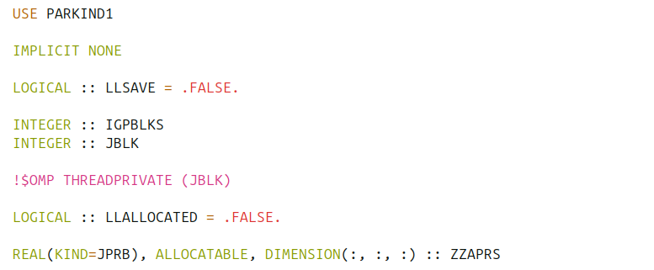
A) Extract the data :
1) write the yomacdrag module
The blueprint of this module is available here : /perm/rma1/test_case_working_week/extract_test_case/yomacdrag_blueprint.F90

Slide 11
A) Extract the data
2) write the wrapper
The goal of the wrapper subroutine is to save input data, call the original data and then save the output data
The wrapper is called in the original code instead of the subroutine
The blueprint of the wrapper is available here : /perm/rma1/test_case_working_week/extract_test_case/wrapper_blueprint.F90

Slide 12
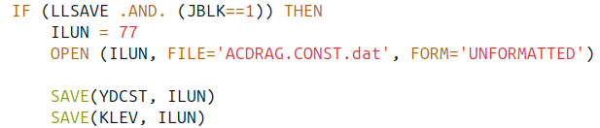
A) Extract the data
2) write the wrapper
Different steps :
1) Fields are allocated for all blocks once
2) Save derived types and integers only for first block

Slide 13


A) Extract the data
2) write the wrapper
3) Copy the input data of the current block
4) Call the original subroutine
5) Copy the ouput data of the current block

Slide 14
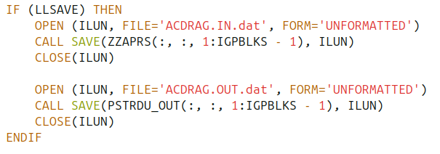
A) Extract the data
3) Changes in cpg_drv
cpg_drv.F90 is the subroutine that calls all the grid point calculation of the model, there is the upper loop on the blocks that calls the whole model’s physic.
In the loop over the block, the wrapper is called for each block, and data is saved for each block.
After the loop over the blocks, the data can be saved for all the blocks

Slide 15
A) Extract the data
3) Changes in cpg_drv
The data is saved just for the first process, and not for the first time step
You can find cpg_drv blue_print here :
/perm/rma1/test_case_working_week/extract_test_case/cpg_drv_blueprint.F90

Slide 16
A) Extract the data
4) Generate the util_xxx_mod
To run the test case we need 4 special types of methods :
SAVE, LOAD, COPY, WIPE
SAVE : to save derived types in a file
LOAD : to load derived types from a file
COPY : to copy derived types from the host to the device
WIPE : to remove derived types from the device

Slide 17
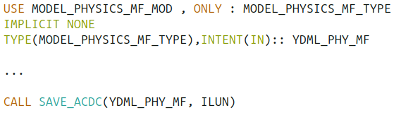
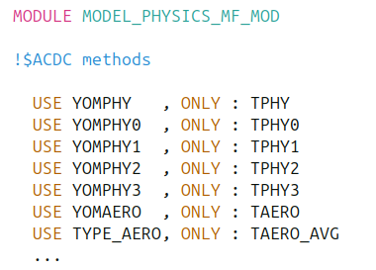
A) Extract the data
4) Generate the util_xxx_mod
The SAVE_ACDC method used bellow is generated by a script :
They are many types in this module, only three are used in acdrag :

Slide 18
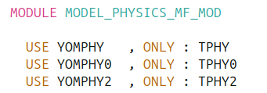
A) Extract the data
4) Generate the util_xxx_mod
A new module is created outside of the code, containing only the types needed
The script is going to be run on this new reduced module
You must do the same for TPHY, TPHY0 and TPHY2 types

Slide 19
A) Extract the data
4) Generate the util_xxx_mod
To generate the util_xxx_mod run this command :
/home/rma1/fxtran-acdc/bin/fxtran-f90 --dryrun --method methods --methods save,load,copy,wipe -- f90 --dir tmp -c ./tmp/yomphy0.F90
yomphy0.F90 must be in the ./tmp directory, all the generated files will be in the current directory
The util_xxx_files can be found : /perm/rma1/test_case_working_week/generate_util
see fxtran.sh script to generate the files

Slide 20
A) Extract the data
5) Run the code to generate the data
You need a bash a script to run the model, we want to extract big and small data. To extract the big data, run the model with a smaller number of MPI task, each task will compute more points (recall that we save the data only for the first MPI task).
You can find a script to run the model here :
/perm/rma1/test_case_working_week/acdrag/run_small.sh

Slide 21
B) Creating the test case
Now that the data is extracted, the test case can be created
Steps of the test case creation :
1) create the main.F90 file
2) move all the files to a new directory (new git repo if you want to save your test case on git)
3) compile the code
4) run the code

Slide 22
B) Creating the test case
1) create the main_acdrag.F90 file
The main programs :
1) loads the data
2) initialize all the variables
3) calls the subroutine of the test case from a loop on the blocks wrapped inside a loop on the time steps
You can find the blueprint of the main.F90 file here:
/perm/rma1/test_case_working_week/run_test_case/main_blueprint.F90

Slide 23

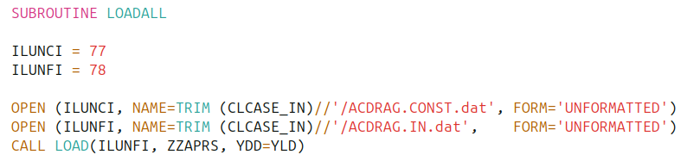
B) Creating the test case
1) create the main_acdrag.F90 file
1) Initialization of the variables with the GETOPTION method
2) Load the arrays with a block dimension

Slide 24
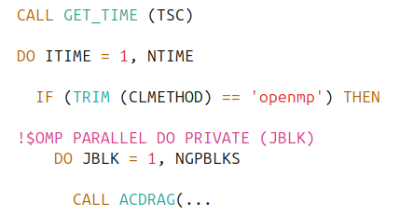

B) Creating the test case
1) create the main_acdrag.F90 file
3) Create the loop over the time and the loop over the blocks, from wich the routine is called
4) Compute the differences with the OUTPUT fields from the model

Slide 25

B) Creating the test case
1) create the main_acdrag.F90 file
To get the number of blocks inside are yomacdrag module :

Slide 26

B) Creating the test case
3) Compiling the code
To compile, your test case directory must have this structure :
See /perm/rma1/test_case_working_week/acdrag
Then you go in the compile.cpu_intel_d directory and run this command : fxtran-makemaker –SRC=../src
if you have trouble with this command, you can have a look at /perm/rma1/test_case_working_week/acdrag/make.sh to have the right env.
When compiling, you must simplify the files, only with what is needed, in order

Slide 27
B) Creating the test case
3) Compiling the code
You will need many modules from IAL
To lower the number of files you copy in the test case, reduce code only to what is needed. The test case must remain as simple as possible. See /perm/rma1/test_case_working_week/acdrag/src/yomlun.F90 as an example.
You will need the get_time function : see /perm/rma1/test_case_working_week/run_test_case/get_time.c

Slide 28
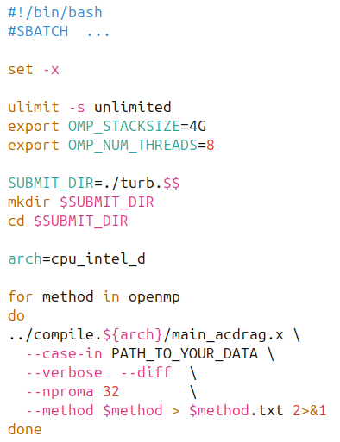
B) Creating the test case
4) Run the code : arp.sh script to run the code
Depends on the machine you are using
You can find this script there :
/perm/rma1/test_case_working_week/acdrag/run_small.sh
Other methods can be added, for example accscc

Slide 29
Questions ?

