Slide 1
Proyecto: Deploy Infraestructure as Code
Alibaba Cloud
Participantes:
Alejandro Castro
Ricardo Brenes

Slide 2
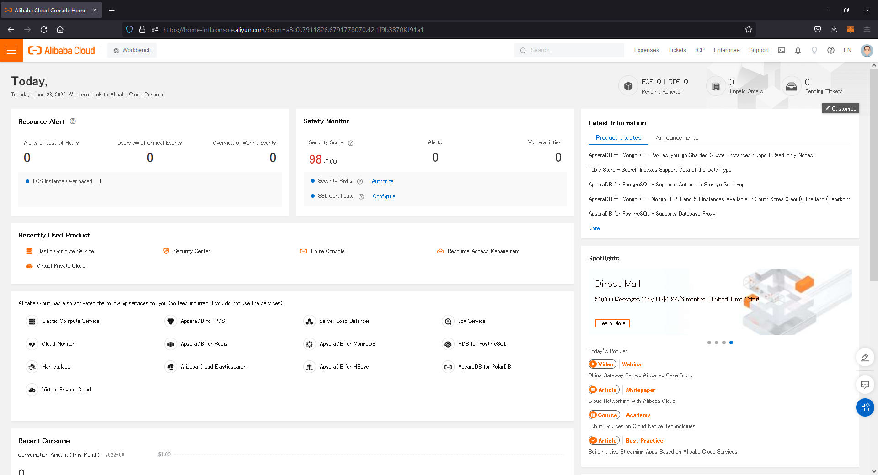

Alibaba Cloud - Dashboard

Slide 3
Alibaba Cloud - Dashboard

Slide 4
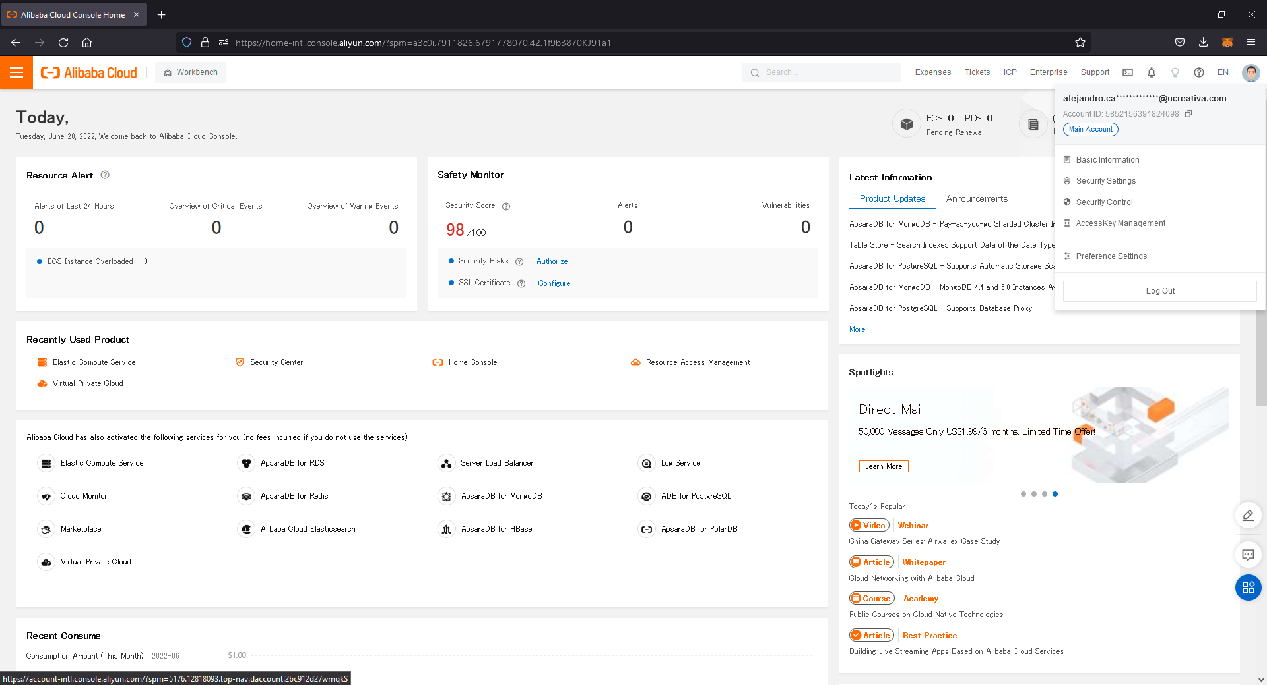
Alibaba Cloud - Dashboard

Slide 5
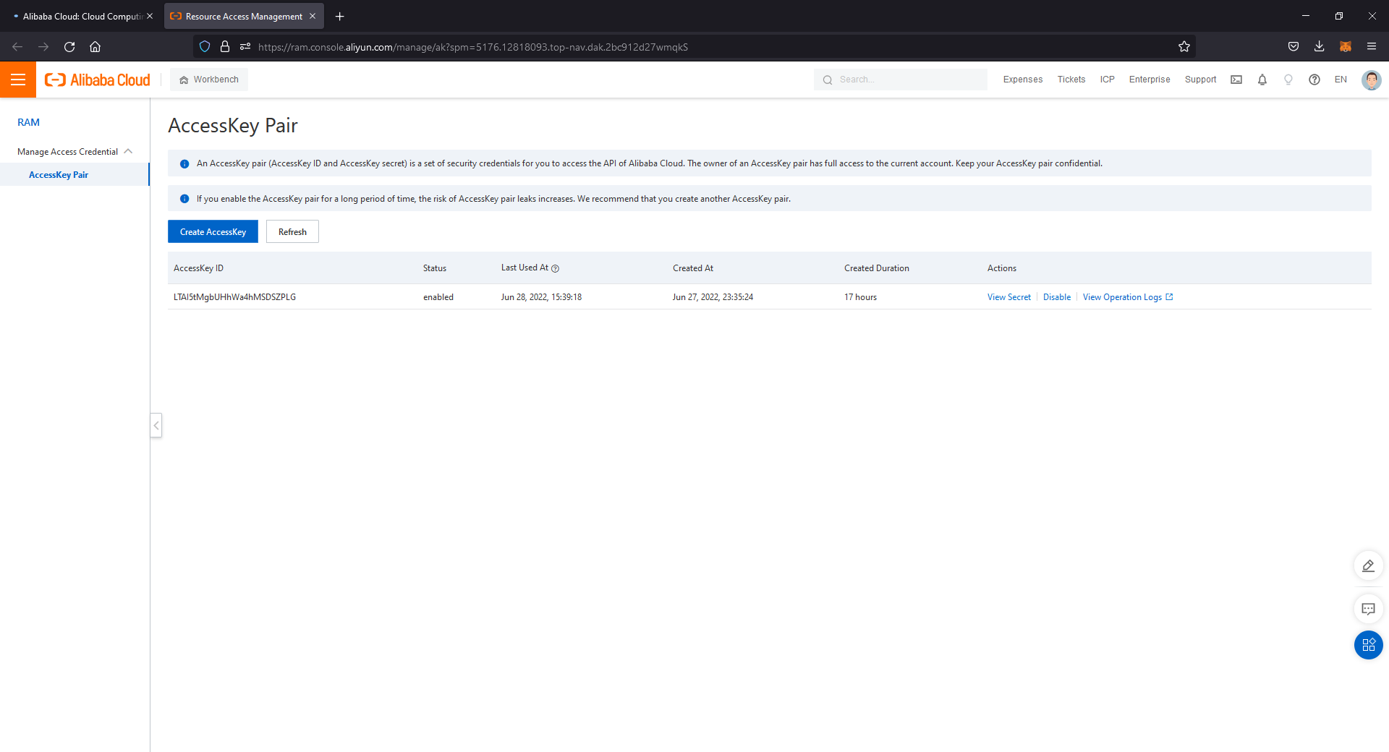
Alibaba Cloud – AccessKey Manager

Slide 6
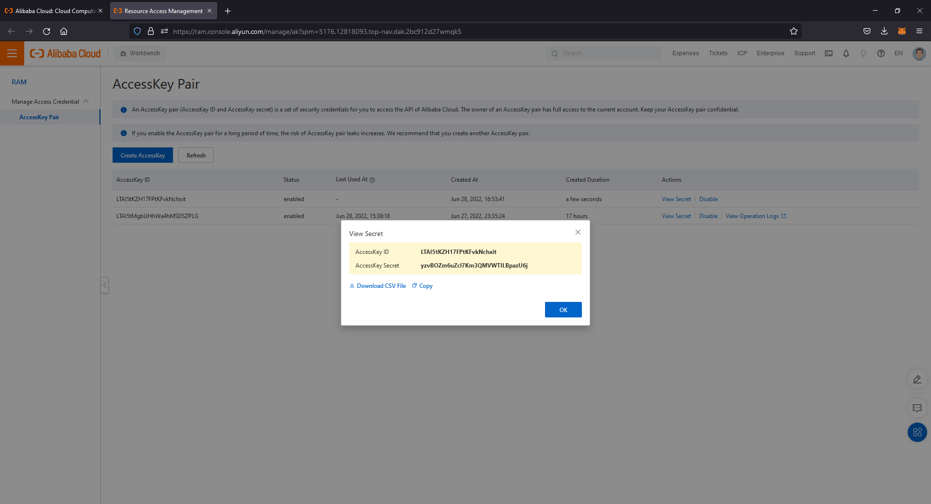
Alibaba Cloud - AccessKey Manager

Slide 7
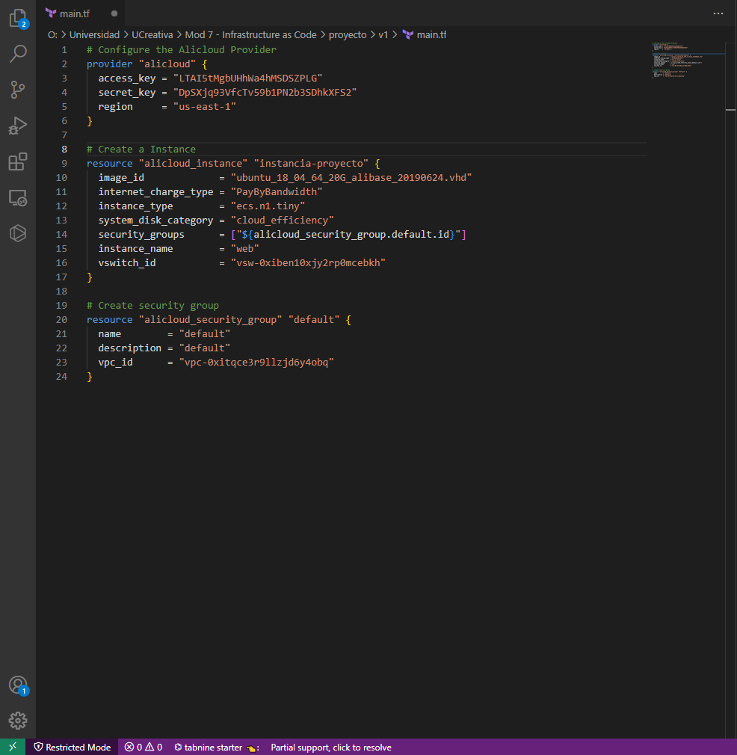
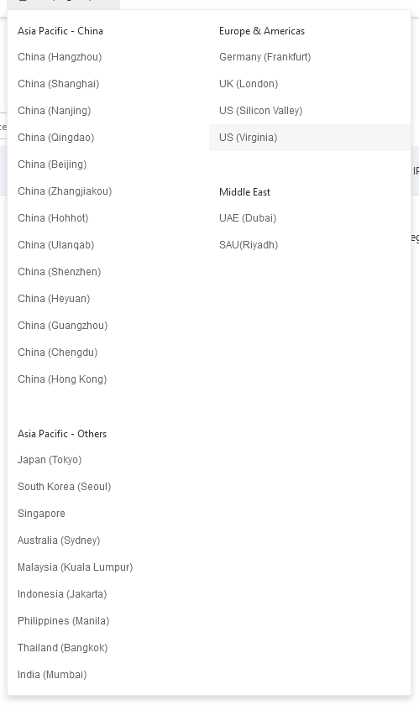
Alibaba Cloud – Terraform file compose
Acceskey

Slide 8
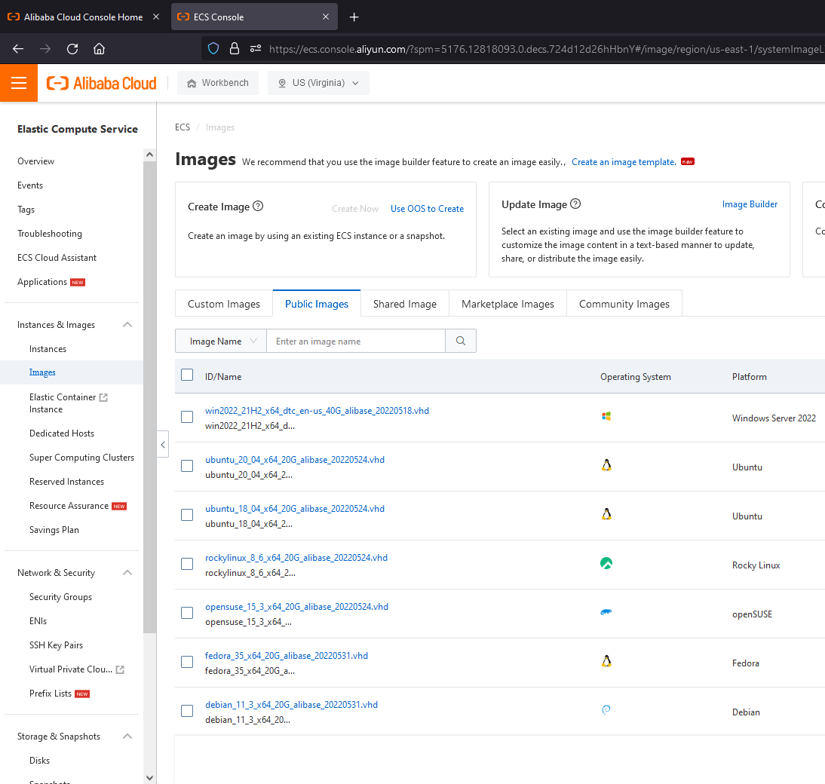
Alibaba Cloud – Terraform file compose
Nombre de la imagen

Slide 9
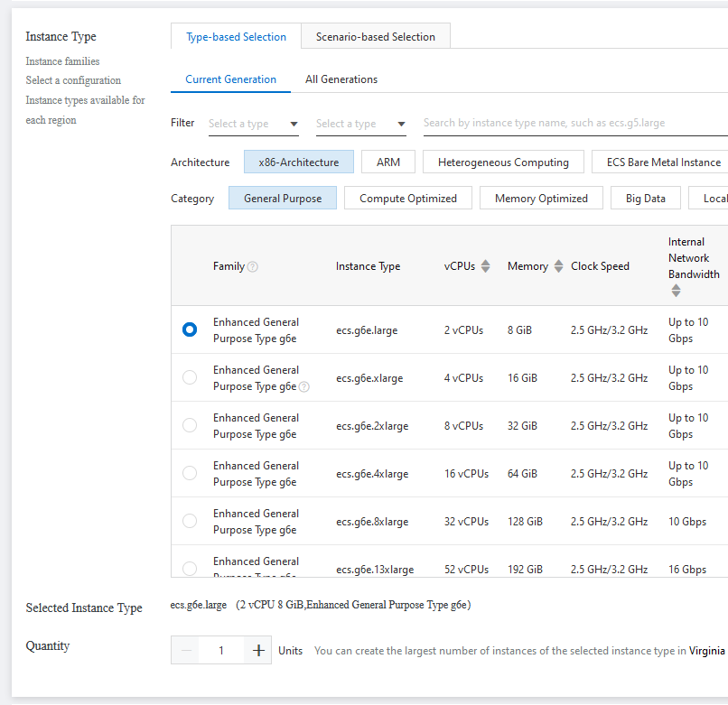
Alibaba Cloud – Terraform file compose

Slide 10
Alibaba Cloud – Terraform file compose

Slide 11
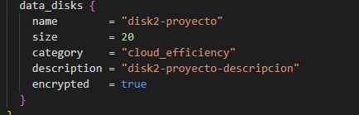
Alibaba Cloud – Terraform file compose
Agregar un segundo disco

Slide 12
Alibaba Cloud
$ terraform apply

Slide 13
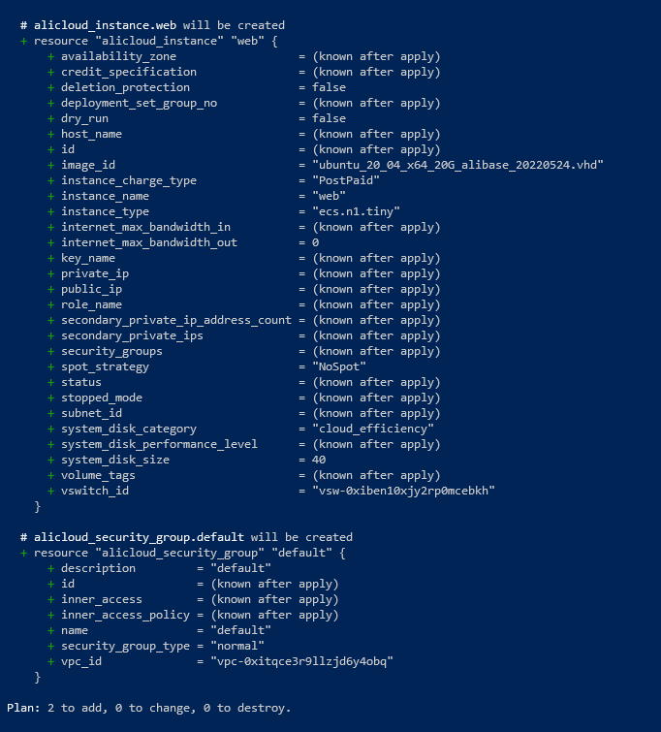
Alibaba Cloud – command: terraform apply

Slide 14
Alibaba Cloud – command: terraform apply

Slide 15
Alibaba Cloud
$ terraform destroy

Slide 16
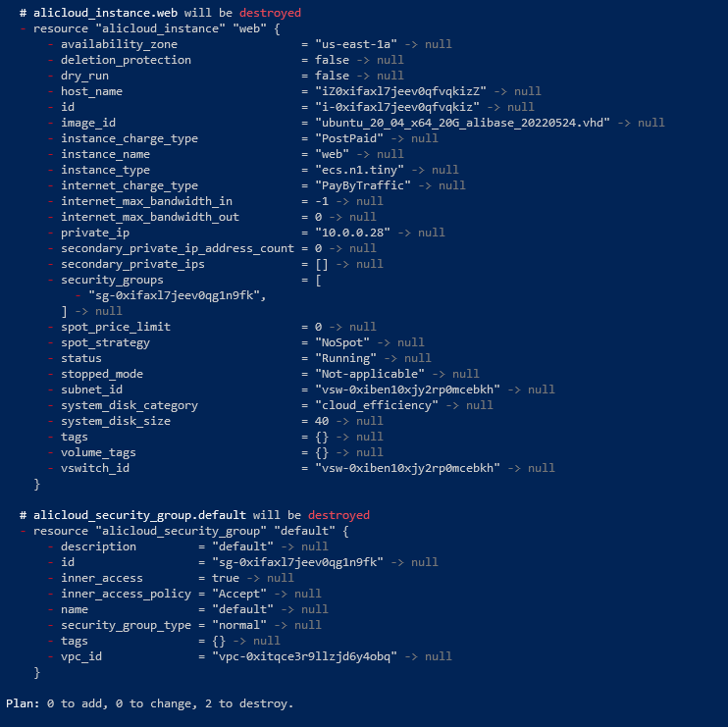
Alibaba Cloud – command: terraform destroid

Slide 17
Preguntas?
Participantes:
Alejandro Castro
Ricardo Brenes

