Slide 1
Planning ahead: using Markov decision processes to optimize your life
PyData Charlotte – Feb. 20 2020
Eric Cotner
Data Scientist, American Tire Distributors

Slide 2
Bio
Eric Cotner is a former theoretical physicist who studied exotic dark matter candidates such as Q-balls and black holes during his graduate school years. More recently, he has turned his attention to data science; specifically prescriptive analytics. He works as a data scientist at American Tire Distributors in Huntersville, where he focuses on supply chain and logistics problems such as optimizing delivery routes and modeling inter-warehouse product flow. In his free time, he enjoys hiking, astronomy, and scuba diving. He holds a PhD/Masters/Bachelors in Physics from UCLA/UCLA/UCSD.

Slide 3
Outline
How to quantify risk/reward?
Value of sequential actions
What is a Markov decision process?
An example MDP
Solving MDP’s using pymdptoolbox
Working with more complex problems
Reinforcement learning

Slide 4
How to quantify risk/reward/value?
Reward: some thing of value gained (money, game points, reddit karma, personal satisfaction, etc.) by achieving certain goals
Risk: (reward) x (probability of getting that reward)
  Example: roll a 6-side die; {1,4}=-$2.15, {2,3,5,6}=+$1.34; risks associated with these two outcomes are (-$2.15)x(2/6)= -$0.72 and (+$1.34)x(4/6)=+$0.89
Value: sum of all risks; i.e. the expected/average reward
  Previous example: value = (-$0.72) + (+$0.89) = +$0.17

Slide 5
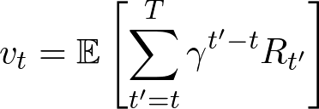
Sequential decisons/actions
Previous example’s usefulness is limited
  What if you need to plan multiple steps ahead?
  What if rewards change with time or are random?
  What if there is more than one available course of action?
  What if actions don’t always result in intended consequences?
Value is (discounted) sum of expected future rewards:
How do you determine the optimal sequence of actions to take?
What is the value associated with these actions?

Slide 6

What is a Markov decision process?
Markov decision process (MDP) is a mathematical formalism for solving sequential decision problems
  It is called Markov because it satisfies the Markov property: all states and rewards do not depend on past history
MDP’s are defined in terms of states, actions, rewards, and transitions, which are fixed by the nature of the problem/environment
  Capital letters denote random variables, lower case denote actual samples
Things to solve for are the policy (tells you which action to take) and value function(s) (how much reward you expect to get from taking an action)

Slide 7


States and actions
States represent the current state of the environment
  Usually denoted by symbols s, S_{t} (sometimes x in control theory); set of all states:
  Previous die example: s₁=1, s₂=2, …, s₆=6 (or s₁={1,4}, s₂={2,3,5,6})
Actions represent the decisions you can make which will cause you to transition from state to state
  Usually denoted by symbols a, A_{t} (sometimes u in control theory); set of all actions:
  Previous die example: a₁=roll, a₂=do nothing

Slide 8
State transitions and rewards
Only some states lead to other states; sometimes taking one action can lead to multiple potential states
Model this using the transition matrix T(s’;s,a)
  T(s’;s,a) = the probability to transition to state s’ given that you take action a from state s
  6-sided die example: T(s₁;s₀,a₁)=2/6, T(s₂;s₀,a₁)=4/6, T(s₀;*,a₂)=1, otherwise T=0
Sometimes rewards can be stochastic too; model this using reward matrix R(r;s,a)
  R(r;s,a) = probability of getting reward r when taking action a from state s
  If reward is deterministic, reward matrix R(s,a) = reward received from taking action a from state s
T=1
R=0
s₀
T=2/6
R=-$2.15
T=4/6
R=+$1.34
T=1
R=0
s₁
s₂
a₁=roll
a₂=do nothing

Slide 9


The policy
How do you decide what to do in a given state?
The policy function π determines which action to take
  Could be deterministic:
  Could be stochastic:
  (deterministic is special case of stochastic where all probability mass is located at one action)
The optimal policy is denoted by π*, which is the policy that maximizes the sum of future expected rewards (value function)

Slide 10

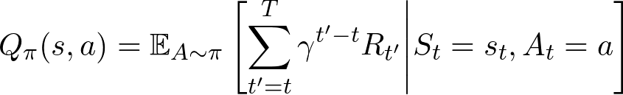
Value functions
Two kinds of value functions:
  The state-value function V_{π}(s): the future reward you expect when starting from state s and following policy π
  The action-value function Q_{π}(s,a): the future reward you expect when starting from state s and taking action a, and following policy π thereafter

Slide 11

How do you actually solve these equations?
Many different algorithms exist depending on size of state/action spaces, length of episodes, structure of reward/transition matrices…
All of them use some form of the Bellman equation:
Consider one of the simplest: value iteration:
  Randomly initialize Q(s,a)
  Select policy by maximizing value function:
  Use Bellman equation to update estimate of Q
  Repeat 2-3 until convergence

Slide 12
An example MDP
Let’s look at a relatively simple example to solve – roll or stay?
You have a 20-sided die, and you get to roll repeatedly until the sum of your rolls either gets as close as possible to 21 or you bust
Your score is the numerical value of the sum of your rolls; if you bust, you get zero.
What is the optimal strategy?
0
+0
9
+0
15
+0
16
+0
18
+15
+0
+9
+16
a₁=roll
a₂=stay
+0
Ø

Slide 13
Using pymdptoolbox
Let’s solve the example from the previous slide in python.
We will use pymdptoolbox, a toolkit for solving discrete-time MDP’s
For more details, see the github repo or the API documentation
Install with `pip install pymdptoolbox`
Check out my demo jupyter notebook

Slide 14
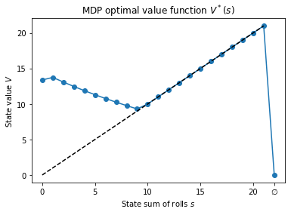
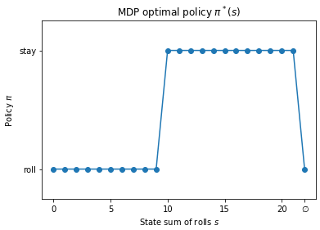
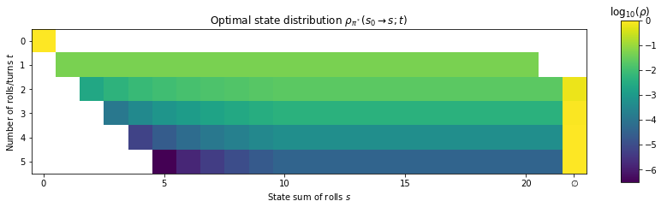
Example MDP solution

Slide 15
Working with more complex problems
Previous example was very simple compared to most realistic problems
For example, maybe you’re trying to plan purchase orders for your supply chain
  If you have 10 warehouses, each with 1,000 different products which can have stocking levels between 0-100, and you want to plan your orders for the next couple months… that’s a 1M-dimensional state space and 1M-dimensional action space – would need a transition matrix with 10^18 elements...
For very large systems, you may have to resort to approximate solutions
  Bucket similar products together
  Find better state/action representations – use dimensional reduction
  Use function approximation to represent value/policy functions
Some problems have continuous state/action spaces and can’t be formulated with matrices at all
  For example: self-driving car - state is position+orientation+velocity vectors, actions are amount of gas/brake/wheel angle; all probably continuous variables
  Would need to use a completely different approach from the value iteration method we used

Slide 16
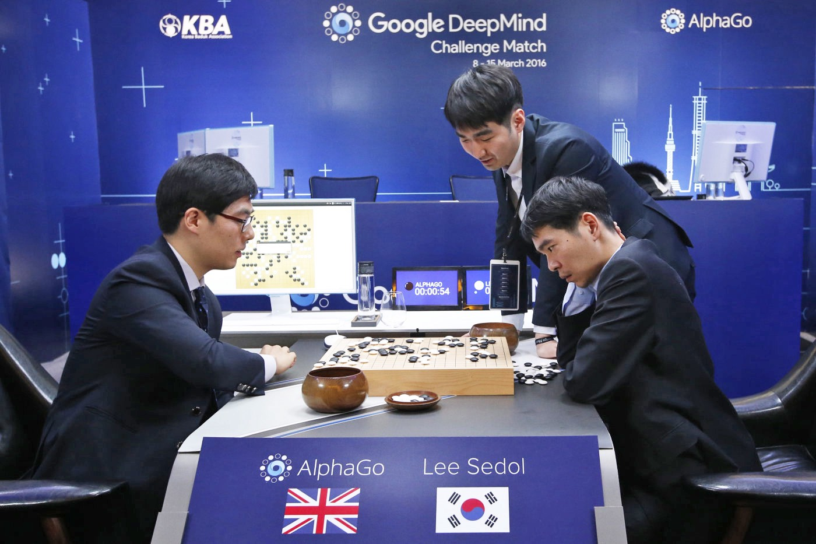
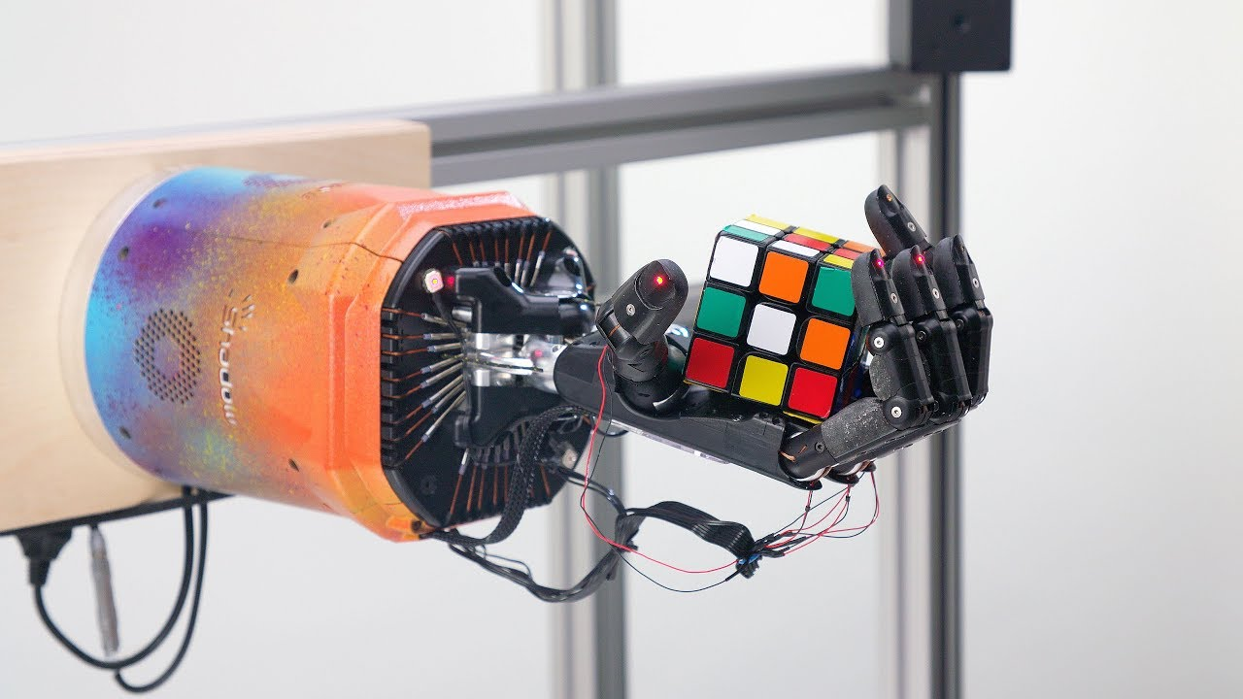
Reinforcement learning
Reinforcement learning: type of machine learning that learns how to act optimally in an environment to maximize rewards
MDP’s are the underlying mathematical framework for RL – if you know MDP’s you can easily learn RL
Very advanced algorithms that try to solve MDP’s in environments with enormous state spaces by only sampling states and actions encountered in simulation
Can use neural networks to approximate complex value and policy functions

Slide 17
Reference material
Pymdptoolbox; Steven Cordwell
  https://pymdptoolbox.readthedocs.io/en/latest/api/mdptoolbox.html
Introduction to Reinforcement Learning; Sutton, Barto:
  http://incompleteideas.net/sutton/book/the-book-2nd.html
Spinning up in Deep RL; OpenAI
  https://spinningup.openai.com/en/latest/
r/reinforcementlearning; Reddit
  https://www.reddit.com/r/reinforcementlearning/

Slide 18
Thank you!

