Slide 1
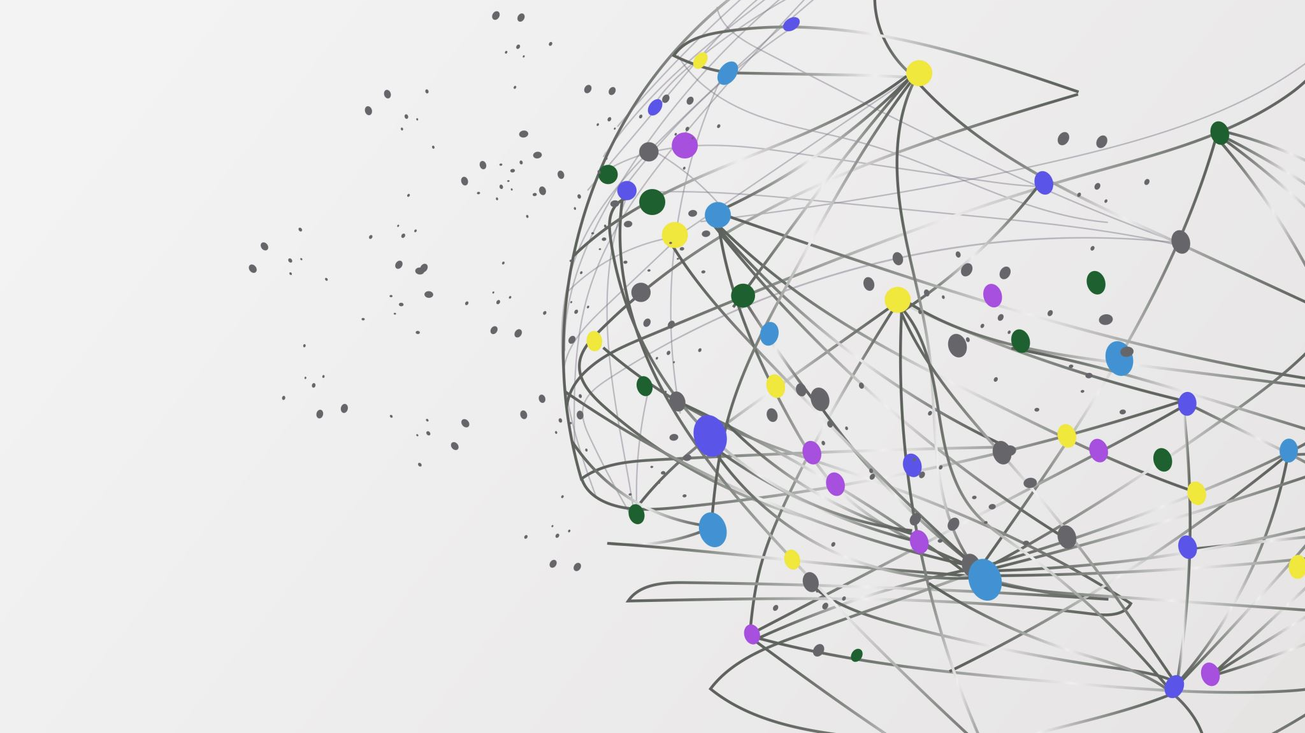
ToDo List
Vicente Conte Couto
https://github.com/ecoutoo/ToDoList

Slide 2
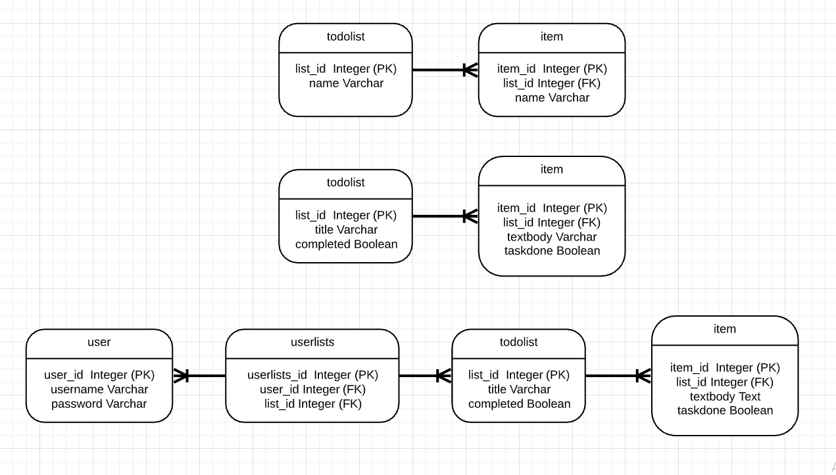
Database
ERD evolution
Potential other tables to be added?

Slide 3
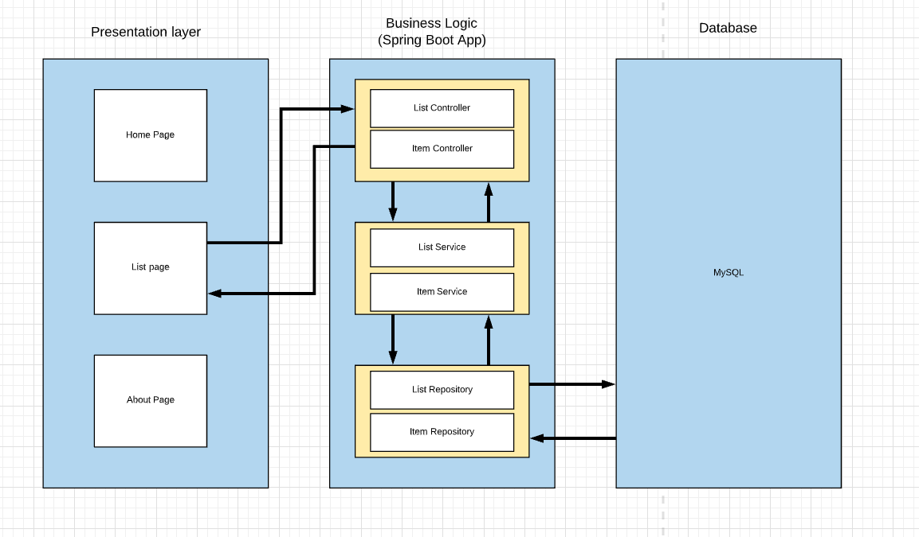
3 tier Architecture MockUp

Slide 4
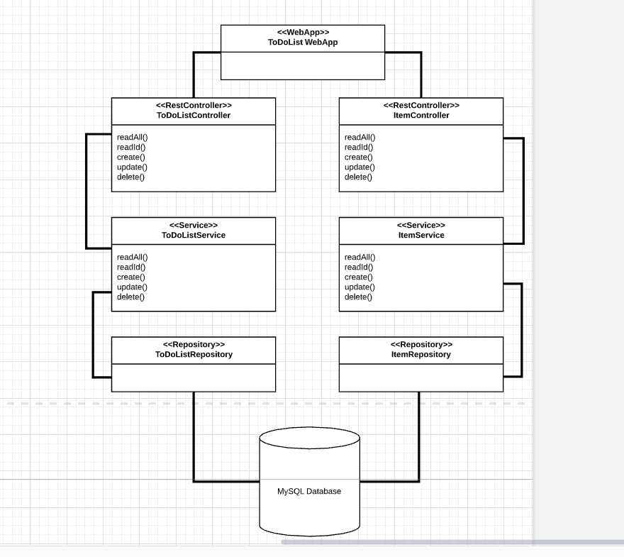
Basic UML
Stuck with the MVP database
No additional methods in the repo

Slide 5
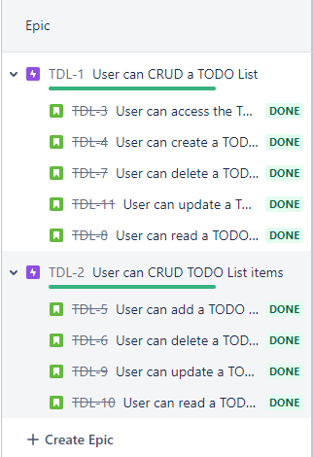
Jira Boards (1 Sprint, 36 tasks)
2 Epics (List (46SP), Item (26SP))
4 User stories each for CRUD + Frontend Story
User stories separated into smaller tasks

Slide 6
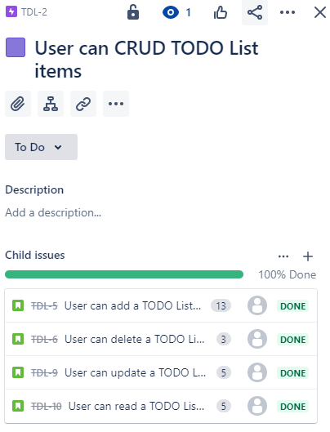
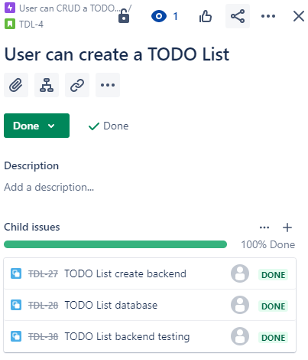
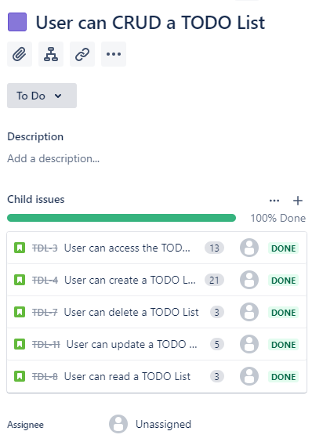
Example user story broken down into tasks
Both Epics with story points

Slide 7
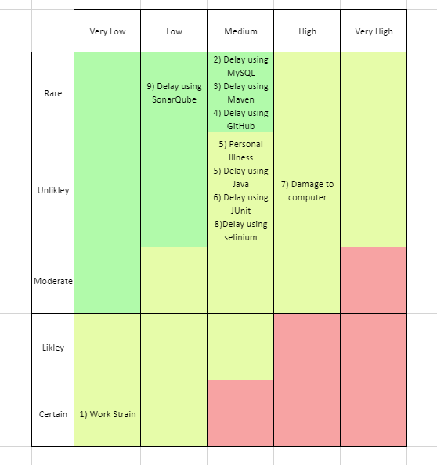
Risk Assessment
Previous work
Mitigating risks

Slide 8
New Technologies Tackled
SonarQube
Integration Testing
Selenium
Spring-Boot

Slide 9
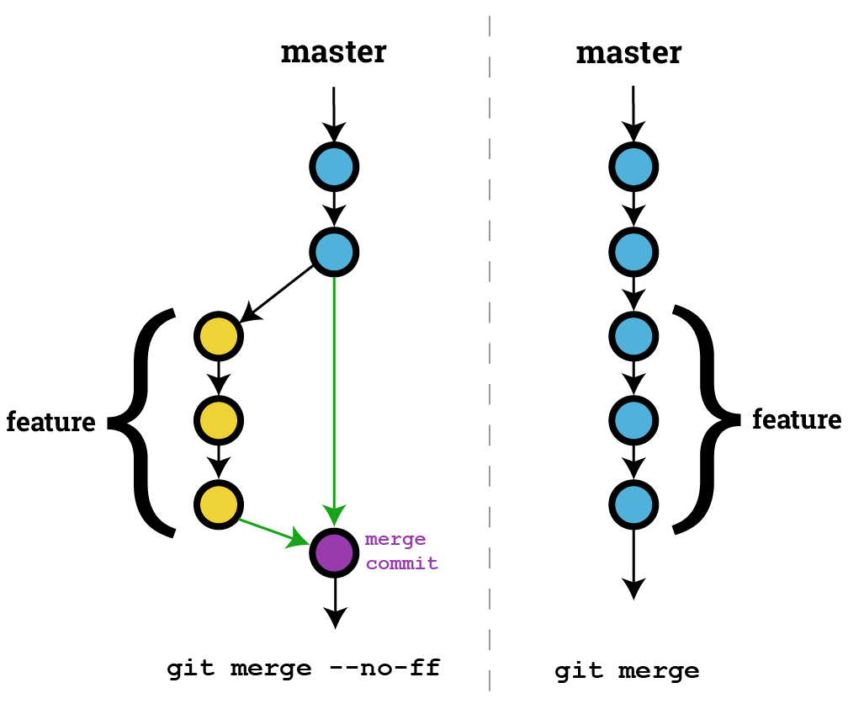
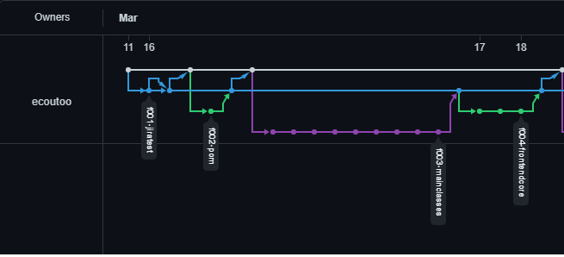
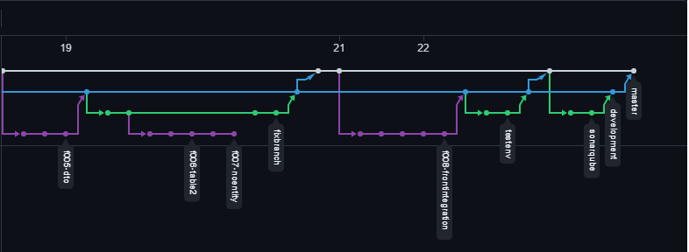
GitHub
Branch structure --no-ff
13 Branches (Inc dev, master):
2 Test Branches
9 Function branches (2 Dead)

Slide 10
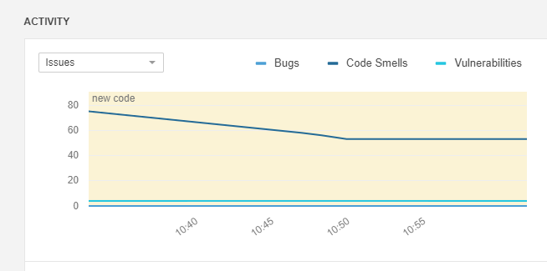
Testing (83.9% coverage, 34 tests)
SO FAR:
Sonarqube
22 code smells killed
Unit Test:
Full Coverage on Controller, Services
Integration Test:
2/ (Services Tested)
Selenium:
3 Tests (Create,ReadAll, Delete)

Slide 11
Functionality
CRUD Functionality met
List CRUD
Item CRUD

Slide 12
Sprint Review
Both Epics with story points

Slide 13
Lessons Learnt
Improved:
Commited more often and better git use
Better jira board usage
Improved pre-production documentation
Learnt:
Improved Jira board commits
Use more test driven development approach
Potentially use more complicated database

Slide 14
Thanks for listening Any questions!?

