Slide 1
HLS Interface Synthesis

Slide 2
Outline
Lab1 Block-level protocol
Block-level和Port-level的差異
介紹ap訊號
解析波形圖
ap_ctrl_none
Lab2 Port-level protocol
Call by Value和Reference(address)
可哪些設定ap訊號
解析波形圖
Lab3 Array interface
dual-port和single-port差異
Array partition的相關設定介紹
Notes:
這裡是大綱
這次作業有4個lab
Lab1是block-level的protocol， 在這個lab中我會講解，究竟什麼是block level和port level
講解ap訊號代表意義
再來會從波形圖解釋ap訊號的功用
最後會告訴大家究竟什麼是ap_ctrl_none

Slide 3
Outline
Lab4-AXI interface
AXI-Stream和先前的單純array partition做比較
解釋_hw.h檔的作用(AXIlite)

Slide 4
Lab1 Block-level protocol

Slide 5
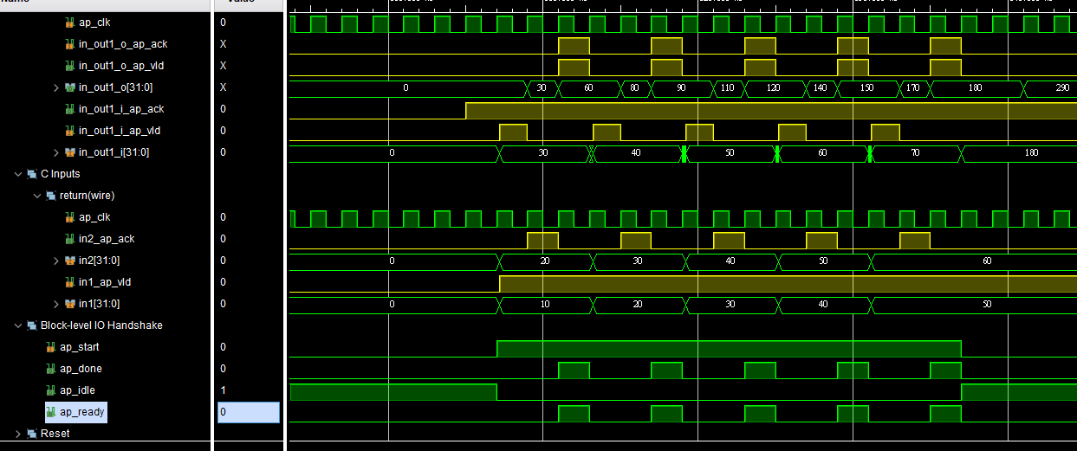
Block-level和Port-level的差異
Block-level protocol
針對block的控制訊號
Port-level protocol
針對block IO的控制訊號

Slide 6
介紹ap訊號
ap_start(input)
當訊號為1時，表示該block要”準備”開始運算
須等ap_ready為1時，ap_start才可以為0。
ap_ready(output)
收到ap_start為1並在資料讀取完後，ap_ready才會為1
ap_done(output)
該block運算完，return數值有效時ap_done為1。
ap_idle(output)
當block閒置時，ap_idle為1

Slide 7
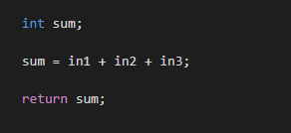
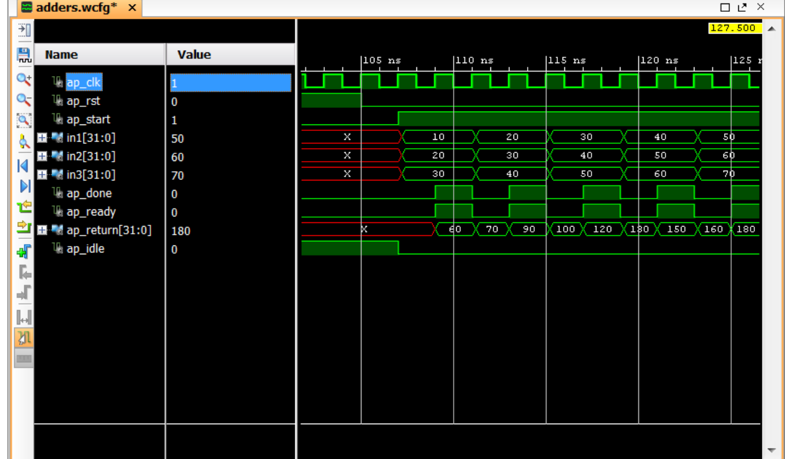
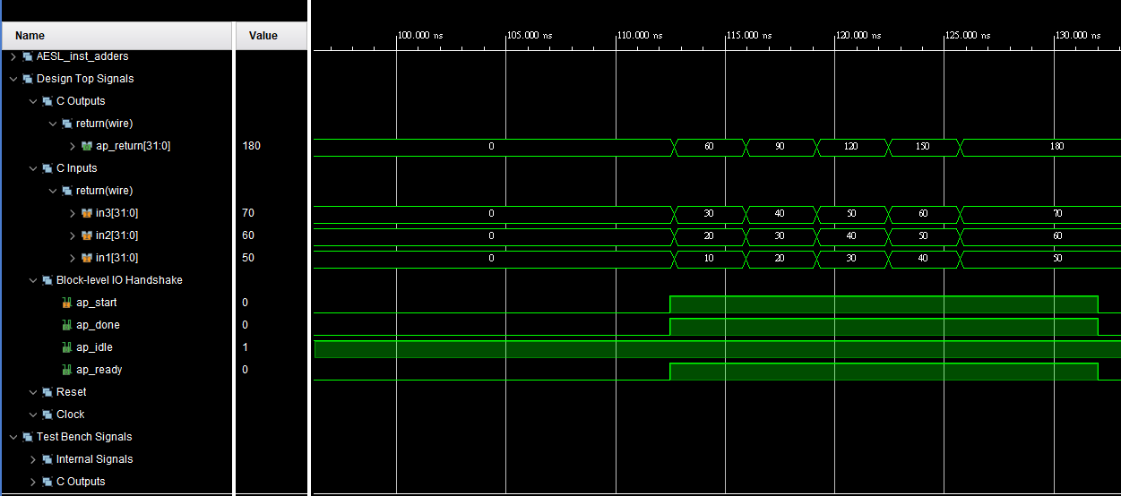
波形圖

Slide 8
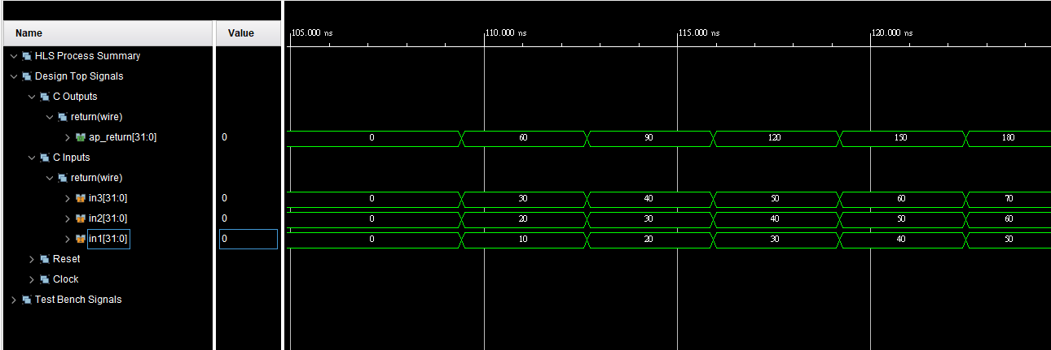
Ap_ctrl_none
Cosim only supports the following ’ap_ctrl_none’
Combinational design
Pipeline design with task interval of 1
Designs with array streaming or hls_stream ports

Slide 9
Lab2 Port-level protocol

Slide 10
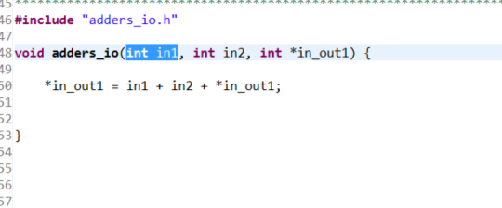
Call by Value和Reference(address)
in1和in2為Call by Value
僅為input
in_out1為Call by address
可以做為input和output

Slide 11
Call by value
ap_none | No I/O protocol. This is the default for inputs.
ap_stable | No I/O protocol.
ap_ack | Implemented with an associated output acknowledge port.
ap_vld | Implemented with an associated input valid port.
ap_hs | Implemented with both input valid and output acknowledge ports.
in2
in1

Slide 12
Call by Reference
ap_none | No I/O protocol. This is the default for inputs.
ap_stable | No I/O protocol.
ap_ack | Implemented with an associated input acknowledge port.
ap_vld | Implemented with an associated output valid port. This is the default for outputs.
ap_ovld | Implemented with an associated output valid port (no valid port for the input part of any inout ports).
ap_hs | Implemented with both input valid port and output acknowledge ports
ap_fifo | A FIFO interface with associated output write and input FIFO full ports.
ap_bus | A Vivado HLS bus interface protocol.
In_out1

Slide 13
波形圖

Slide 14
Lab3 Array interface

Slide 15
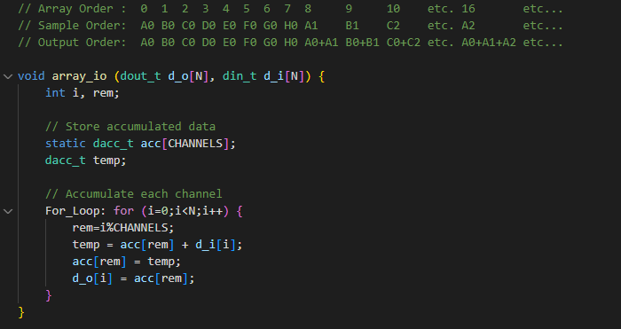
程式碼

Slide 16
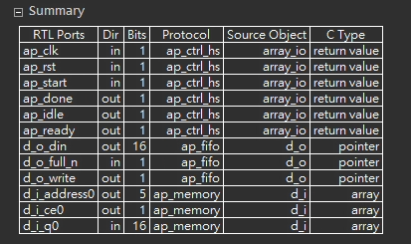
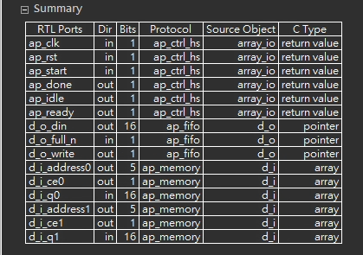
Dual-port和Single-port
Single-port(rolled-loop)
Dual-port(unrolled-loop)

Slide 17
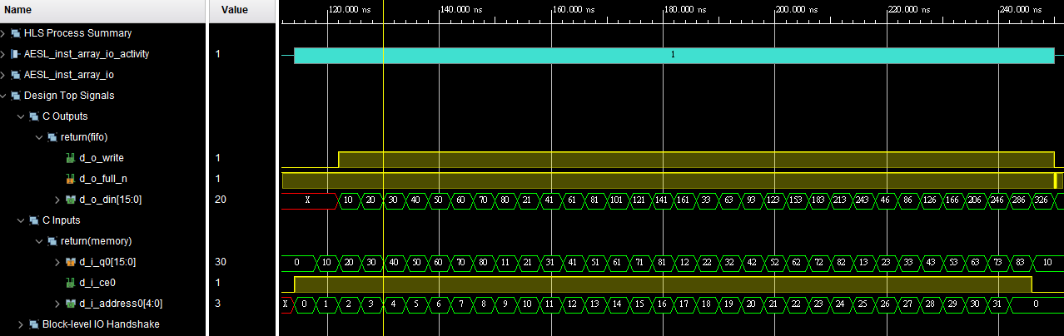
Single-port for input

Slide 18
Dual-port和Single-port
Single-port
Dual-port
Dual-port的lantency為多少?

Slide 19
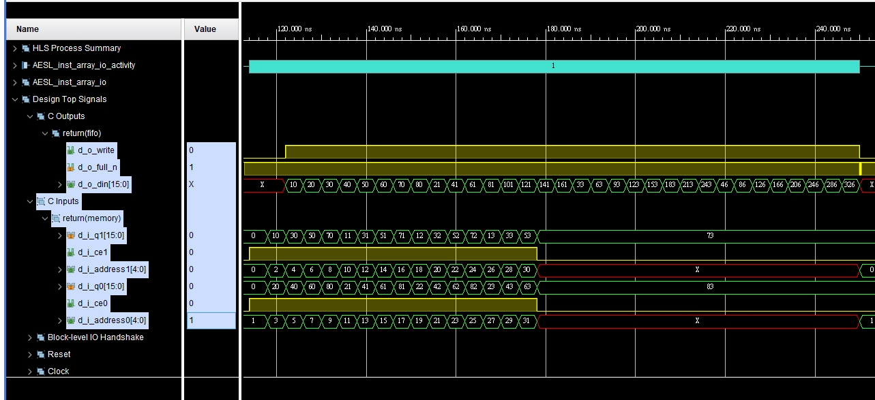
Dual-port for input

Slide 20
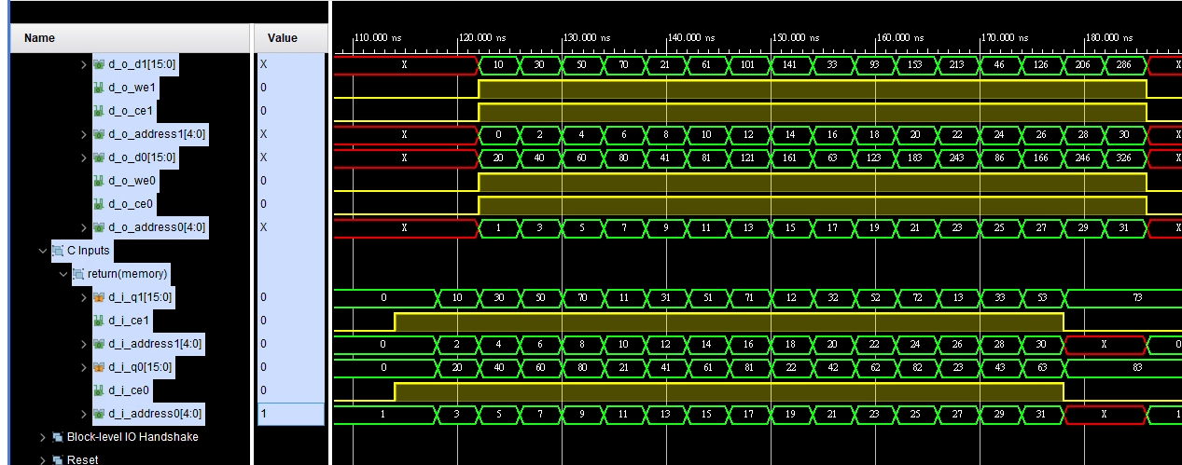
Dual-port for input and output

Slide 21
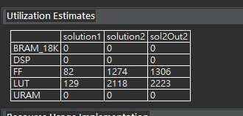
Utilization

Slide 22
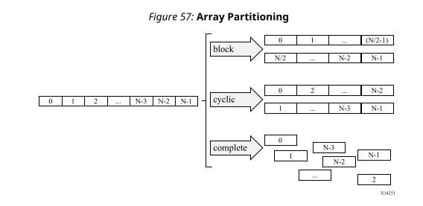
Array partition
可將input或output的array分割成N個區塊並N個同時傳輸(N調整factor)
Type有block、cycle、complete

Slide 23
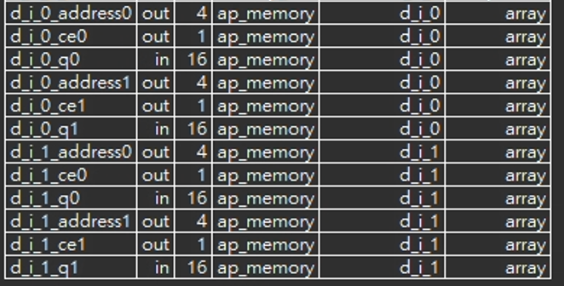
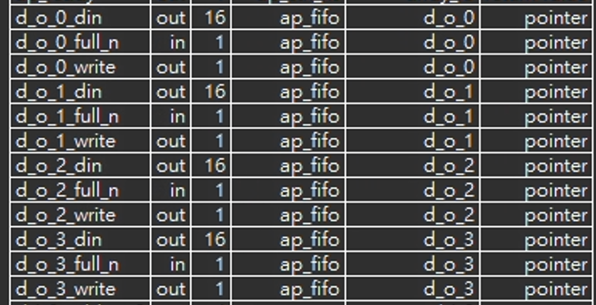
Array partition
Input
Dual-port
Array partition type = block、factor=2
Output
Ap_fifo
Array partition type = block、factor=4

Slide 24
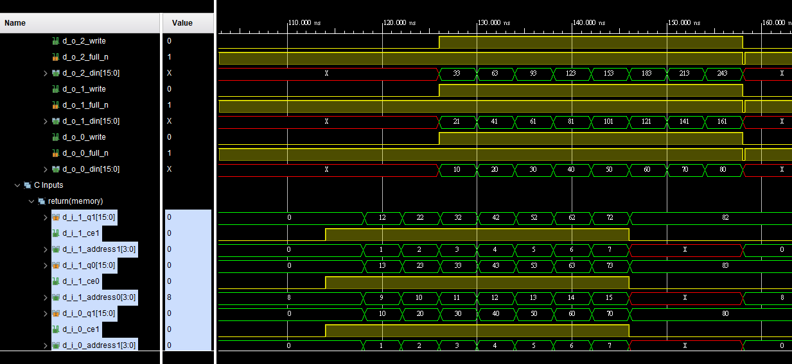
波形

Slide 25
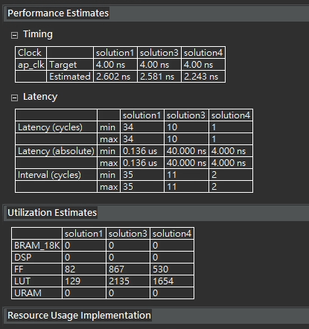
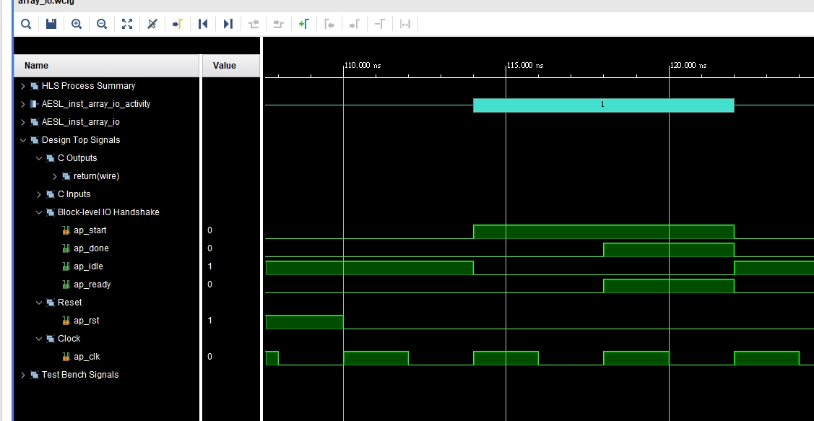
Type = complete for input and output
波形
Compare report

Slide 26
Lab4 AXI interface

Slide 27
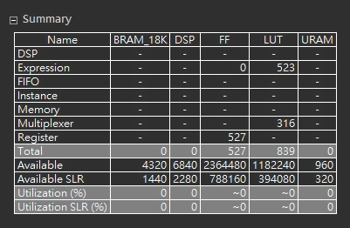
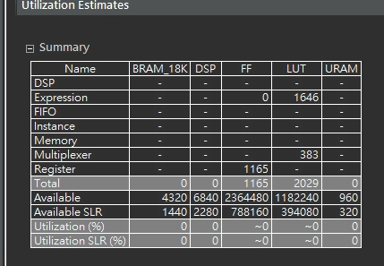
Compare with Lab3
Lab4
Interface = AXIS
Array partition type = cycle, factor=8
Lab3
Interface = ap_fifo
Array partition type = cycle, factor=8

Slide 28
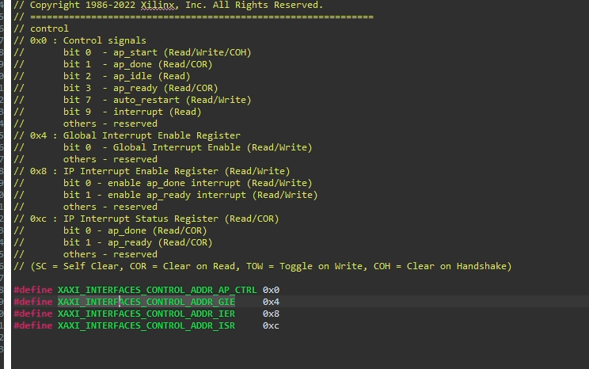
_hw.h file

Slide 29
Q&A

