Slide 1
FriPy: Scientific Programming in Python Meet-Up
Week 2: Installation questions, Justin’s Demo, Brainstorm a Python task for the group, locate SciPy tutorials as a resource

Slide 2
Installations we will need
Anaconda - Comes with Python.exe, manages all packages and libraries you’ll be using
Git for versioning control - I’d like to use git for future collaborations and code sharing!
An IDE (personally, I use PyCharm but any text editor will work)
Please see the powerpoint slides at https://github.com/ecpease/FriPy for installation instructions and preferably install these by next time (July 20th).
I’m hoping to make FriPy more interactive in the coming weeks!

Slide 3
Justin’s Demo

Slide 4
Brainstorming ideas for next week

Slide 5
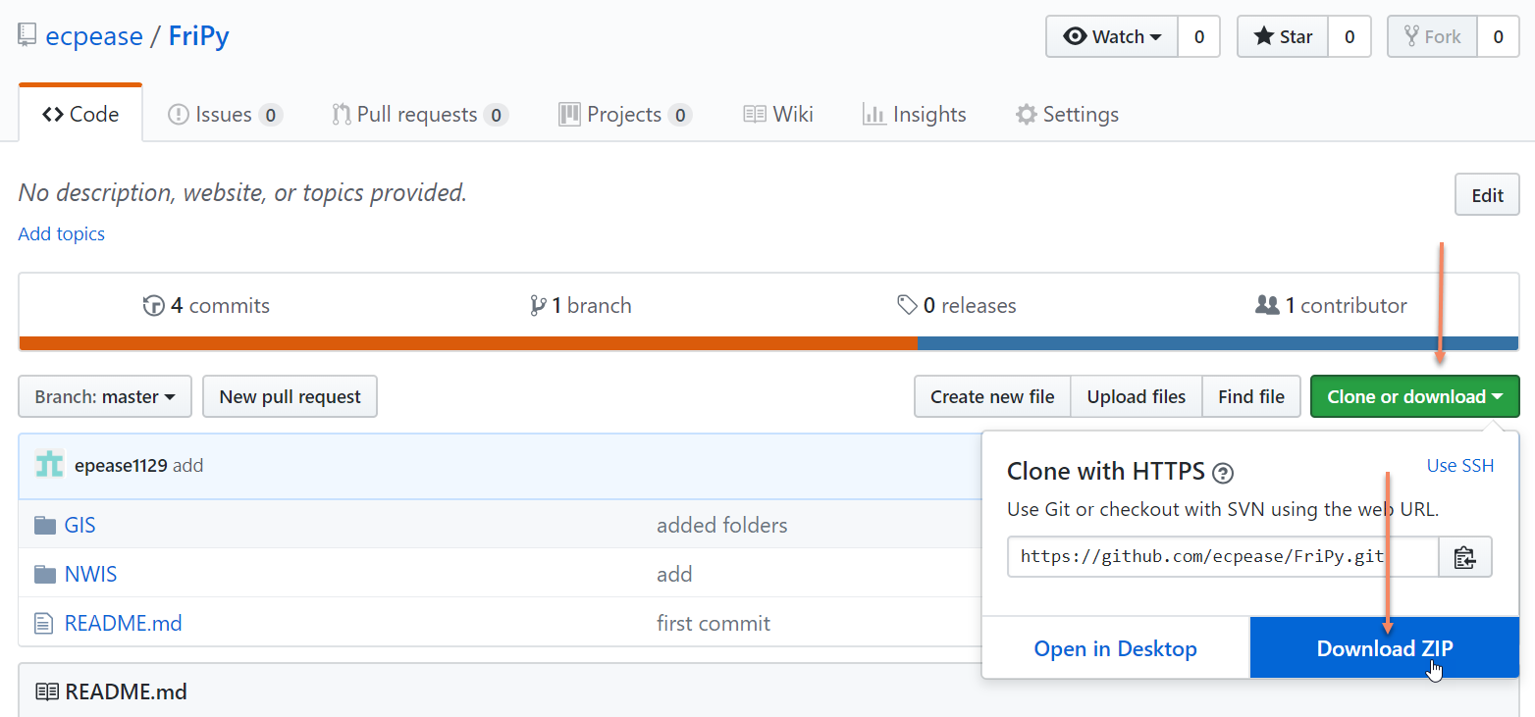
Jupyter Notebooks
Go to: https://github.com/ecpease/FriPy

Slide 6
Jupyter Notebooks
Useful tool for teaching and learning
Contains text and script
Easy to visualize every step of your programming process
Hosted on your web browser

