Slide 1

Get python on your machine like a Jedi
From Ross Kushnereit, Intera

Slide 2
These slides will walk you through installing the following on your machine
Anaconda
Git

Slide 3
Anaconda (conda)
Is the most popular python distributor.
Comes with the latest python.exe, as well as pip for installing more packages

Slide 4
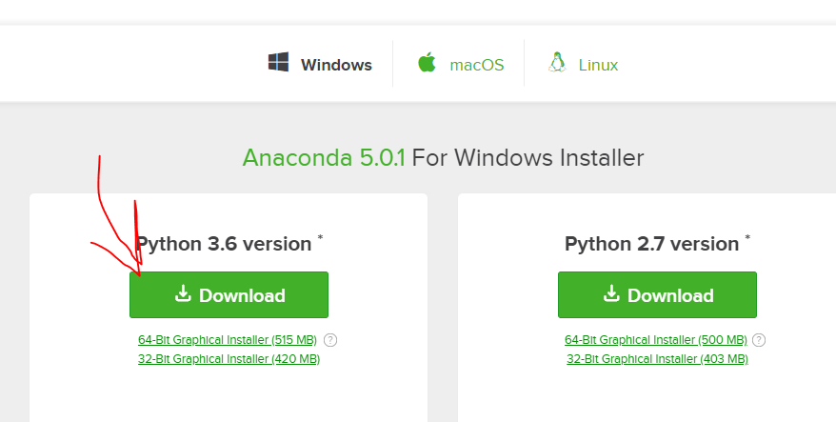
https://www.anaconda.com/download/?lang=en-us
Go to this website and download Anaconda for python 3.6
(Alternatively you can download miniconda and install packages you want later. It’s up to you) Miniconda is much smaller and you likely will not need all the packages

Slide 5
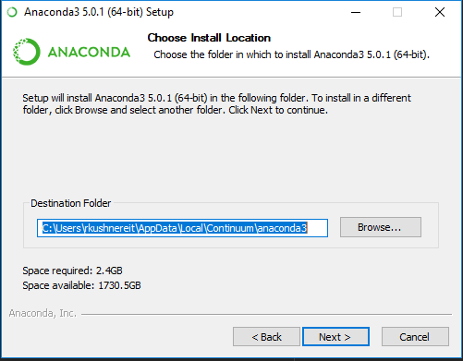
Walk through the instructions
You may choose a location to send it to. I suggest on your D drive, but you can just bring it anywhere.
Another good place to put it would be immediately after
your username instead of in AppData\....
(Again up to you)

Slide 6
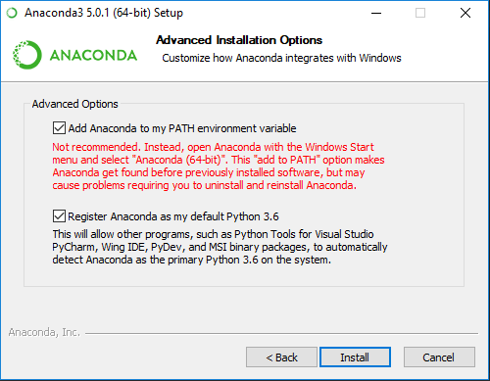
Important! Optional Path
Although anaconda suggest you do not add the path to conda in your environments, I do, as it will allow you to call conda anywhere in the command line or terminal. This will also overwrite your default python.exe, so when you call python anywhere, on your machine, it will call python 3.6 from your conda distribution.

Slide 7
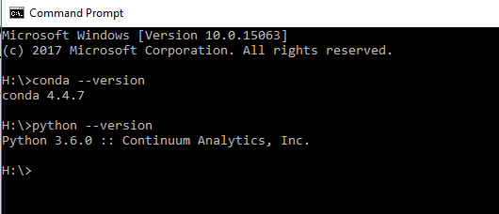
Your conda should be ready to go.
To test, open a your cmd or terminal and type
“conda --version”
Then
“Python --version”

Slide 8
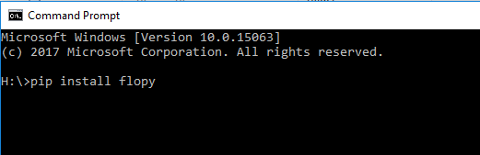
Installing packages
Type: “conda install <package_name>”
If the package is not available on conda that's fine, try pip or pip3!
Here we are now installing flopy to your main conda environment. Google the package you want to install and it will have specifics on what the command will be

Slide 9
Installing packages
Type: “conda install <package_name>”
You will need to install the following
matplotlib
pandas
numpy
jupyter notebooks

Slide 10
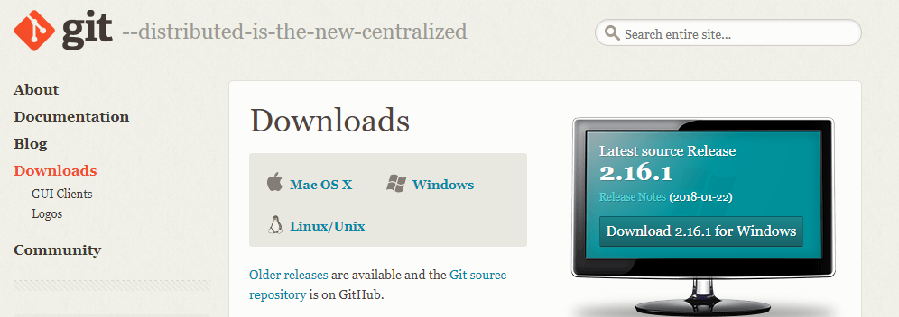
Getting git
https://git-scm.com/downloads
Git is the premier development tool in software development.
Used to share and pull code from the internet. Can use GitHub or Bitbucket to host your code online

Slide 11
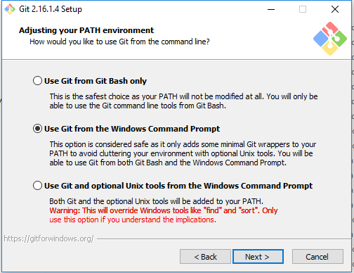
Follow the instructions and install git
Again you may choose how to use git, I prefer simply setting it to my command prompt or terminal, but for bash users you may consider using the Bash only choice.

Slide 12
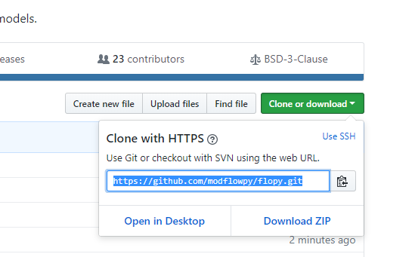
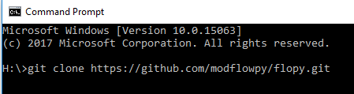
How to pull repositories from github
Go to the github site (example here is flopy), and got to the clone option and copy the https link highlighted.
Then in cmd/terminal type: “git clone https://github.com/modflowpy/flopy.git”
Flopy docs and examples will then be downloaded to your local drive. Be aware of where you clone them. I always put mine in a GitHub folder on my D drive.

Slide 13
upyter notebooks (prev ipython notebooks)
Go to your terminal or cmd and cd to the folder where you cloned a github repository and type “jupyter notebook” and boom! Everything should work! You’ll see a screen pop up in your web browser where you can edit your code. However, if you exit out of the terminal, your session will be terminated. Things save automatically though

Slide 14
PyCharm IDE
Pycharm is where I write and debug my python code.

Slide 15
Side note
If the modflow executables are not working, you may have to download them yourself, from the USGS website or from pymake if you are using OSX or Linux
https://github.com/modflowpy/pymake

Slide 16



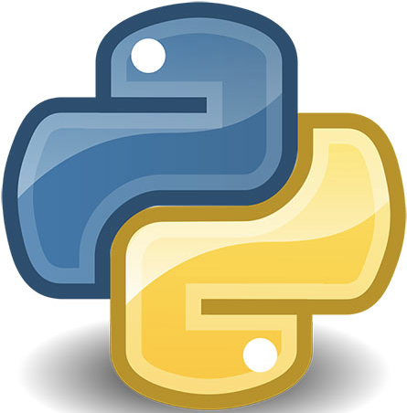


You can now python like a jedi

