Slide 1
FriPy: Scientific Programming in Python Meet-Up
Week 1: Introduction, getting started, quick demos

Slide 2
Quick round table introductions ( less than 1 minute per person)
What you do at the USGS
Python background
Why you’re here (what you want to learn how to do in Python)

Slide 3
Installations we will need
Anaconda - Comes with Python.exe, manages all packages and libraries you’ll be using
Git for versioning control - I’d like to use git for future collaborations and code sharing!
An IDE (personally, I use PyCharm but any text editor will work)
Please see the powerpoint slides at https://github.com/ecpease/FriPy for installation instructions and preferably install these by next time (July 26th).
I’m hoping to make FriPy more interactive in the coming weeks!

Slide 4
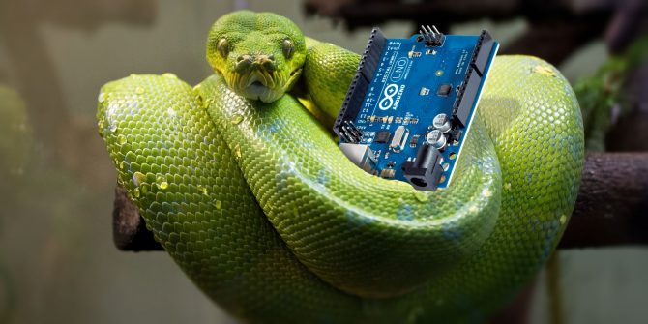
What is Python?
Named after Monty Python, not the snake

Slide 5

What is Python?
Named after Monty Python, not the snake
Open source, high level programming language
Used by almost any discipline
Countless libraries available to incorporate into your scripts

Slide 6
Jupyter Notebooks
Useful tool for teaching and learning
Contains text and script
Easy to visualize every step of your programming process
Hosted on your web browser

Slide 7
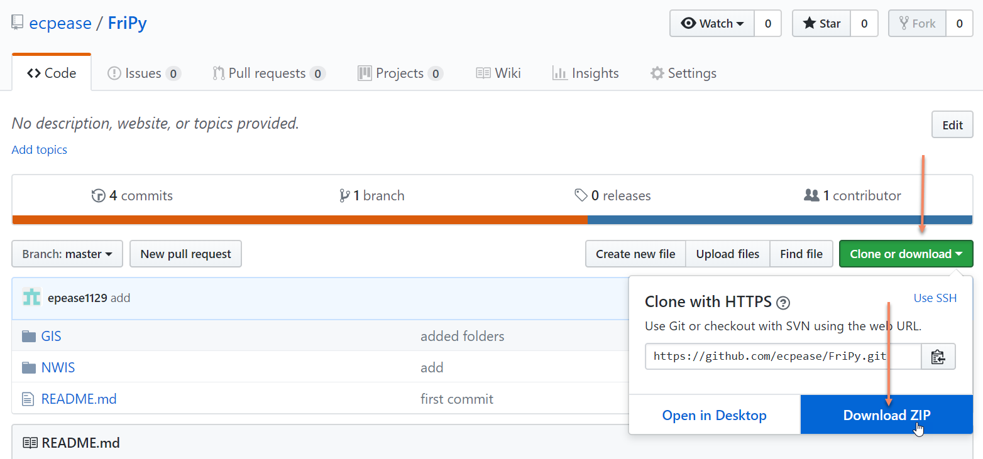
Jupyter Notebooks
Go to: https://github.com/ecpease/FriPy

