Slide 1





Genome Pods
for
Clinical Practice
Elias Crum

Slide 2
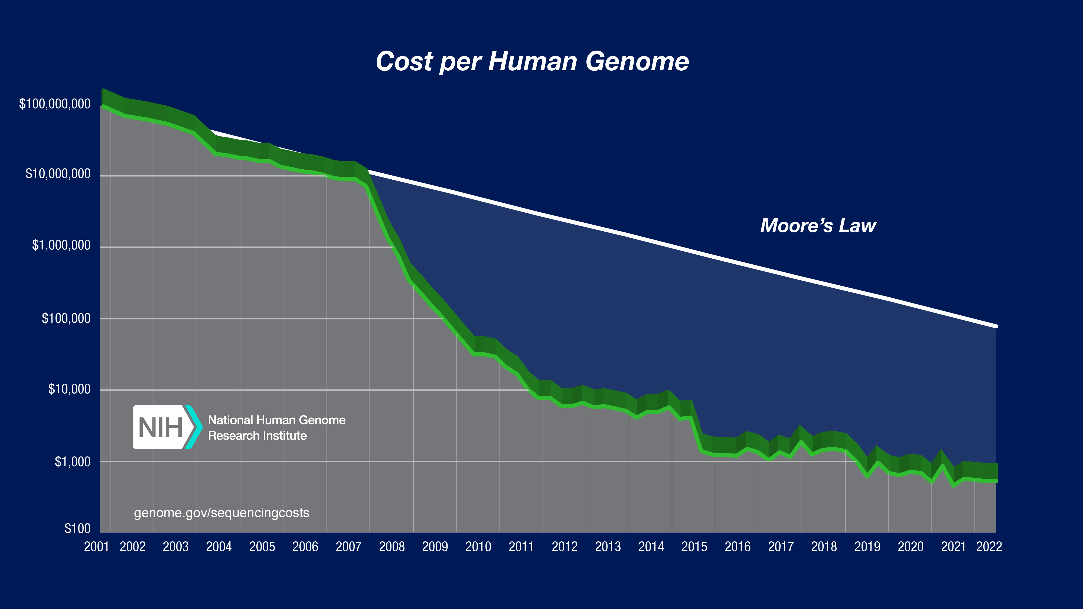
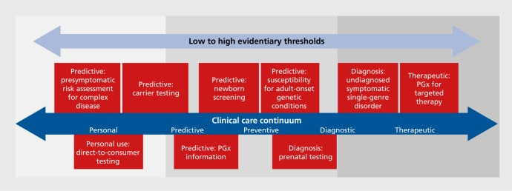
Genome Sequencing in Health Care
Sequence Generation Costs
Use-cases
10.31887/DCNS.2016.18.3/jkrier
Examples include:
Drug prescription
Cancer diagnosis
Cancer therapy development and targeting
Genetic disease screening
Wetterstrand KA. Accessed 12/04/24.
Currently getting close to $100 per genome¹

Slide 3
Scaling Genome Data Usage
Accessibility
Privacy

Slide 4
Technological Limitations
Data siloing
Data duplication
Data breaches

Slide 5
Enter Solid (a more ideal storage solution)
easier Sharing
Data queryability
privacy controls

Slide 6
How Solid facilitates improvements
Technical things here
Data linking and queryability is BIG
Mention VCF as RDF

Slide 7
The foundation of the web application
Functionalities:
Roles for health care participants (patient, physician, data officer, etc.)
Granular data policy control → modifications through .acl file
Data upload capabilities
Data read access + querying capabilities
Data representation → VCF as RDF

Slide 8
An Ideal Workflow (w/ example)
Flow chart fun

Slide 9
Figma example that follows workflow
https://www.figma.com/file/wWlla6tzzeS5lXFpEyldvh/GenomePods?type=design&node-id=0%3A1&mode=design&t=wELG5CfY3CA93NPK-1
Login --> Landing Page --> Data upload --> Data view --> Privacy editing --> Data query

Slide 10
Sources
https://www.ultimagenomics.com/publications-and-resources?filter=Literature
10.31887/DCNS.2016.18.3/jkrier
Wetterstrand KA. DNA Sequencing Costs: Data from the NHGRI Genome Sequencing Program (GSP) www.genome.gov/sequencingcostsdata. Accessed 12/04/24.
Login --> Landing Page --> Data upload --> Data view --> Privacy editing --> Data query

Slide 12
G
P

Slide 13






