Slide 1





Genome Pods
for
Clinical Practice
Elias Crum

Slide 2
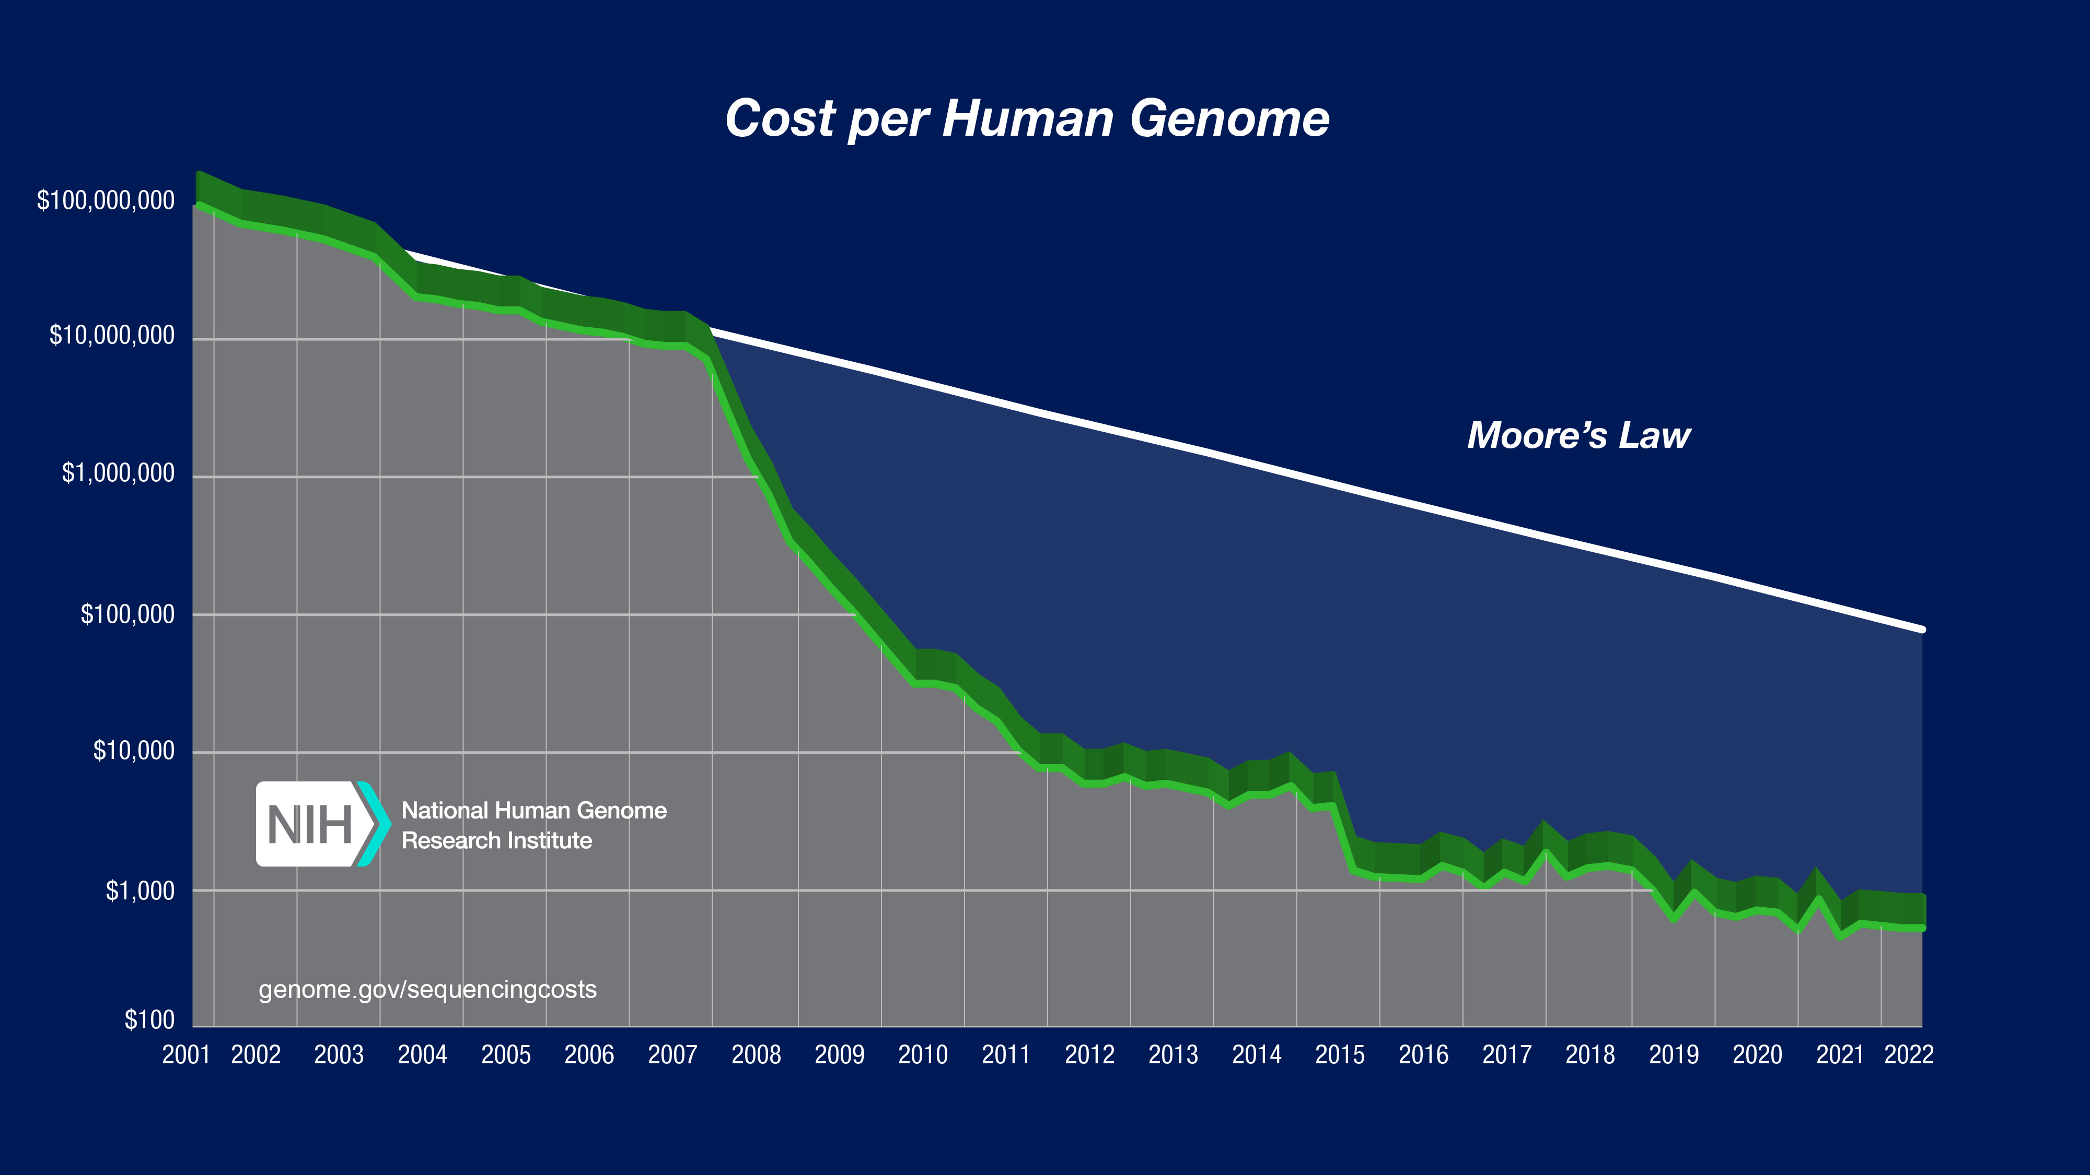
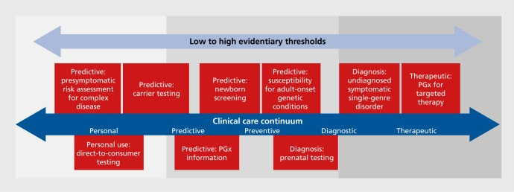
Genome Sequencing in Health Care
Sequence Generation Costs
Use-cases
10.31887/DCNS.2016.18.3/jkrier
Examples include:
Drug prescription
Cancer diagnosis
Cancer therapy development and targeting
Genetic disease screening
Wetterstrand KA. Accessed 12/04/24.
Currently getting close to $100 per genome¹

Slide 3
Scaling Genome Data Usage
Current state-of-the-art for clinical genomic data sharing??
Other considerations
Storage?
Privacy
Governance?
Interoperability?

Slide 4
Current Technological Limitations
Data siloing
Data duplication
Data breaches
Data Format inconsistencies

Slide 5
Enter Solid
Does not solve ALL problems, but offers an environment where improvements are possible
easier Sharing – web discovery
granular privacy controls
For both user (patient/physician) and admin (hospital DPO))
Data representation (and future queryability)

Slide 6
Disclaimer
The Genome Pods project is a RESEARCH project
It is being undertaken as a proof-of-concept
So, it is designed to emulate a product but is not actually a product

Slide 7
Tangible Example
A patient is hospitalized with DVT
The results of the screen are linked to the patient’s genome data
DVT usually merits the perscription of Warfarin
The physician wants to make sure the patient is prescribed proper dosing
These results are accessible to anyone authorized by the patient or physician
Thus, a pharmacogenomics screening is performed

Slide 8
The foundation of the web application
Functionalities:
Roles for health care participants (patient, physician, data officer, etc.)
Granular data policy control → modifications through .acl file
Data upload capabilities
Data read access + querying capabilities
Data representation → VCF as RDF

Slide 9
An Ideal Workflow (w/ example)
Flow chart fun

Slide 10
Figma example that follows workflow
https://www.figma.com/file/wWlla6tzzeS5lXFpEyldvh/GenomePods?type=design&node-id=0%3A1&mode=design&t=wELG5CfY3CA93NPK-1
Login --> Landing Page --> Data upload --> Data view --> Privacy editing --> Data query

Slide 11
Sources
https://www.ultimagenomics.com/publications-and-resources?filter=Literature
10.31887/DCNS.2016.18.3/jkrier
Wetterstrand KA. DNA Sequencing Costs: Data from the NHGRI Genome Sequencing Program (GSP) www.genome.gov/sequencingcostsdata. Accessed 12/04/24.
Login --> Landing Page --> Data upload --> Data view --> Privacy editing --> Data query

Slide 13
G
P

Slide 14






